Slide 1
OBSTRUCTIVE JAUNDICE
BY DR Faryal Azhar
Professor ( SURGICAL UNIT2 HFH)

Slide 2
LEARNING OUTCOMES
Introduction
Pathophysiology
Aetiology
Clinical features
Investigation
Treatment options
Follow up care

Slide 3
JAUNDICE
Jaundice is the yellow discolouration of skin , sclera or mucous membranes of the body usually due to increased serum bilirubin levels.
Normal value is 0.2 to 1 g / dl and is usually detectable clinically when it raises to 3g/dl or above.

Slide 4
ANATOMY

Slide 5
ANATOMY

Slide 8
TYPES OF JAUNDICE
Pre-hepatic (Hemolytic)
Intra-Hepatic ( Hepatocellular)
Post- Hepatic also known as Cholestatic / Obstructive or Surgical Jaundice.

Slide 11
OBSTRUCTIVE JAUNDICE
It is caused by a pathology that blocks the normal flow of bile from liver into the intestine (Cholestasis).
It may be intra-hepatic or extra-hepatic.

Slide 13
EXTRA – HEPATIC JAUNDICE

Slide 14
PATHOLOGICAL CAUSES

Slide 15
CLINICAL FEATURES
Jaundice
Itching
Right upper quadrant pain
Stool becomes white
Urine becomes dark in colour
General weakness and fatigability
Weight loss
Loss of appetite
Anemia

Slide 17
CLINICAL SIGN AND SYMPTOMS
Charcot’s Triad
Reynold’s Pentad
Hepatomegaly
Splenomegaly
Xanthomas
Xanthelasmas
Scratch marks
Finger clubbing

Slide 21
COURVOISIER’S LAW

Slide 22
Stone VS Cancer Classification
PAINFULL JAUNDICE
PAINLESS JAUNDICE
Non-palpable= GB or CBD stone
Non-palpable( on and off jaundice)=CBD stone
Palpable= CBD + Cystic Duct Stone ( Double Impaction)
Non – Palpable= Klatskin Tumor (proximal Cholangiocarcinoma)
Palpable(on and off Jaundice)= Ampullary Cancer ( Distal Cholangiocarcinoma)
Palpable ( Progressive Jaundice)= Carcinoma Head of Pancreas

Slide 23
DIAGNOSIS
Serum bilirubin levels
Serum Gamma glutamyl transpeptidase levels.
Serum Alkaline phosphatase levels
Urinary bilirubin
Urobilinogen (absent)

Slide 24
Radiological Investigations

Slide 25
ULTRASOUND
Sensitive for gall stones and dilated bile ducts
Non- invasive
Cheap
Operator dependant
No radiation
Endoscopic Ultrasound (EUS) can even identify pancreatic focal lesion.

Slide 26
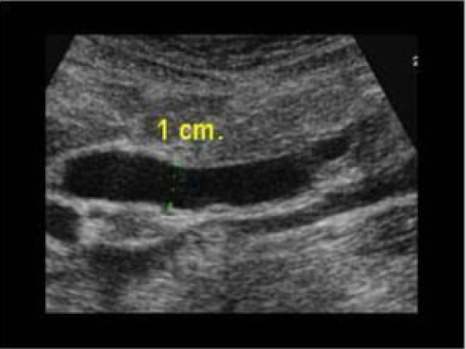
ULTRASOUND
USG showing GB stones
USG showing Gall Bladder Dilatation

Slide 27
X-RAYS

Slide 28
ERCP
Invasive procedure
Diagnostic and therapeutic
Biopsy
Brush Cytology
Stenting
Stone Extraction

Slide 29
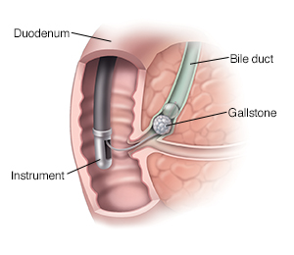
ERCP

Slide 30
CT - SCAN
Modality of choice for staging of cancers of liver gall-bladder, bile-ducts and pancreas.
Identifies level and cause of obstruction
Localization of primary tumors and mets
Non-invasive and diagnostic.

Slide 31
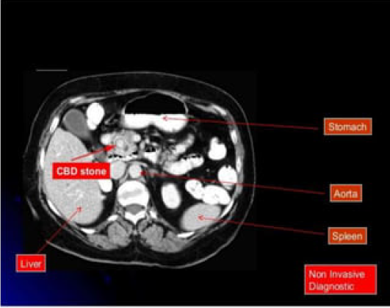
CT- SCAN

Slide 32
MRCP
Non- invasive test to visualize hepato-biliary tree
Entire biliary tree and hepatic duct can be seen
MRCP is better than ERCP to diagnose the extent and type of tumor

Slide 33
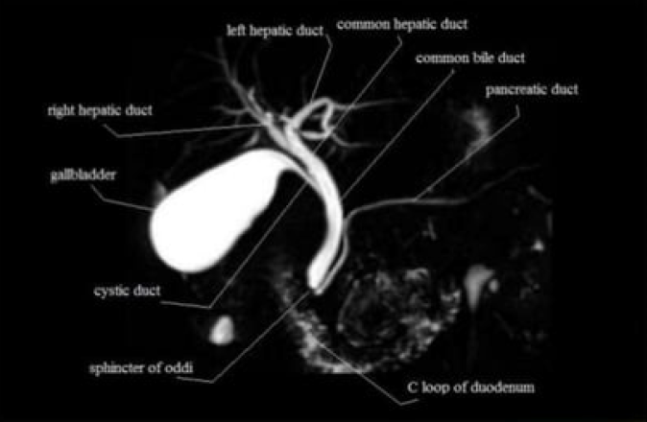
MRCP

Slide 34
TREATMENT
Supportive Management:
Maintaining hydration (preventing Hepato-renal syndrome / Renal failure.
Catheterization to monitor output
Broad spectrum antibiotics
Par-enteral Vit-K / Fresh Frozen Plasma
Correction of hypokalemia and other electrolyte disturbances
Cholestyramine / Anti-histamine for relief from pruritis
Biliary Decompression ( ERCP/ PTC)

Slide 35
TREATMENT
Definitive Treatment:
Depends on treating the cause of obstruction
Gallstones( Cholecystectomy/ ERCP )
Carcinoma (Head of Pancreas/ GB) = Tumor excision / Whipple’s procedure
Choledochal Cyst = Cyst Excision
Stricture= Endoscopic Stenting / sphincterotomy

Slide 39
FOLLOW UP CARE
Follow up care depends upon the cause of obstruction
Usually clinical examination and blood tests are sufficient
In case of Carcinomas, regular follow up care with CT scan and tumor markers is done.

