Slide 3
CLINICAL CASE
A 9 month male child presented in opd with history of lethargy and irritibility for 2 weeks .he is mainly taking cow milk and very little solid food .
On examination he is having Heart rate of 130/min ,with adequate pulses and perfusion, marked pallor with no hepato-splenomegaly.
Qno.1 what is likely diagnosis ?
Qno.2 what is likely cause ?
Qno.3 How will you diagnose ?
Qno.4 How will be Patient managed ?

Slide 4
Case no.1
A 2-year-old child is diagnosed with iron deficiency anemia.
What is the recommended first-line treatment?
Oral iron supplementation with ferrous sulfate
Oral iron supplementation with ferrous gluconate
Parenteral iron therapy
Dietary counseling alone
Blood transfusion

Slide 5
Case no.2
A 2-year-old child presents with pallor, fatigue, and shortness of breath. The child's mother reports that the child has been drinking cow's milk since the age of 1 year. On examination, the child's hemoglobin level is 8 g/dL, and MCV is 60 fL.
What is the most likely cause of anemia in this child?
Inadequate dietary iron intake
Chronic blood loss due to hookworm infestation
Increased iron requirements due to rapid growth
Malabsorption of iron due to celiac disease
Genetic disorder affecting iron metabolism

Slide 6
Case no.3
A 5-year-old child presents with iron deficiency anemia. The child's mother reports that the child has been experiencing recurrent episodes of abdominal pain and diarrhea. On examination, the child's abdomen is tender, and stool examination reveals the presence of hookworm ova.
What is the most likely cause of iron deficiency anemia in this child?
Inadequate dietary iron intake
Chronic blood loss due to hookworm infestation
Increased iron requirements due to rapid growth
Malabsorption of iron due to celiac disease
Genetic disorder affecting iron metabolism

Slide 7
Case no.4
A 3-year-old child presents with pallor, fatigue, and shortness of breath. The child's mother reports that the child has been eating a diet consisting mainly of cow's milk and cereal. On examination, the child's hemoglobin level is 9 g/dL, and MCV is 50 fL.
What is the most likely diagnosis?
Iron deficiency anemia
Vitamin B12 deficiency anemia
Folic acid deficiency anemia
Anemia of chronic disease
Aplastic anemia

Slide 8
Case no.5
A 2-year-old child presents with pallor, fatigue, and shortness of breath. The child's mother reports that the child has been eating a vegan diet only. On examination, the child's hemoglobin level is 8 g/dL, and MCV is 110 fL.
What is the most likely cause of anemia in this child?
Iron deficiency anemia
Vitamin B12 deficiency anemia
Folic acid deficiency anemia
Anemia of chronic disease
Aplastic anemia

Slide 9
Case no.6
A 2-year-old child presents with pallor, fatigue, and shortness of breath. The child's mother reports that the child has been eating a diet consisting mainly of goat's milk and cereal. On examination, the child's hemoglobin level is 8 g/dL, and MCV is 120 fL.
What is the most likely cause of anemia in this child?
Iron deficiency anemia
Vitamin B12 deficiency anemia
Folate deficiency megaloblastic anemia
Anemia of chronic disease
Aplastic anemia

Slide 10
Case no.7
A 5-year-old girl presents with pallor and irritability. CBC shows hemoglobin 8 g/dL, MCV 68 fL, and an elevated red cell distribution width (RDW).
What is the most appropriate initial laboratory investigation to confirm iron deficiency anemia?
A) Serum iron level B) Serum ferritin C) Hemoglobin electrophoresis D) Total iron binding capacity (TIBC) E) Bone marrow aspiration

Slide 11
Case no.8
A 2-year-old girl is diagnosed with iron deficiency anemia. She is otherwise healthy with no ongoing blood loss.
Which of the following is the best initial treatment?
A) Oral ferrous sulfate therapy B) Intravenous iron sucrose C) Blood transfusion D) Vitamin B12 supplementation E) Bone marrow transplantation

Slide 12
Case no.9
A 4-year-old child presents with severe pallor and dyspnea. His hemoglobin is 3.5 g/dL. He is having tachycardia , with shortness of breath , pedal edema
with tender hepatomegaly .
What is the most appropriate management at this stage?
A) Start oral iron therapy and discharge home B) Initiate IV iron infusion immediately C) Begin blood transfusion under monitoring D) Prescribe iron-rich diet only E) No treatment required; reassess later
Notes:
he

Slide 13
Case no.10
A 6-year-old girl is started on oral iron for iron deficiency anemia. After 6 weeks, her hemoglobin has normalized. What is the recommended next step regarding iron therapy?
A) Stop iron immediately B) Continue iron for 2–3 more months C) Switch to folic acid only D) Reduce the iron dose by half E) Start intravenous iron

Slide 14
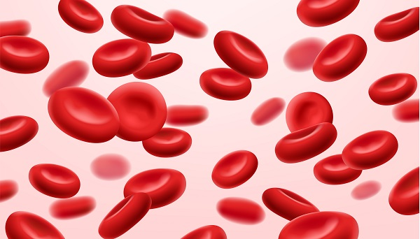
NUTRITIONAL ANEMIA
Dr. Asad Shabbir
Assistant Professor Pediatrics
Rawalpindi medical university

Slide 15
Learning Objective
Introduction of nutritional anemia
Prevalence
Causes of anemia
Clinical manifestations
Diagnosis
Treatment
Preventive strategies

Slide 16
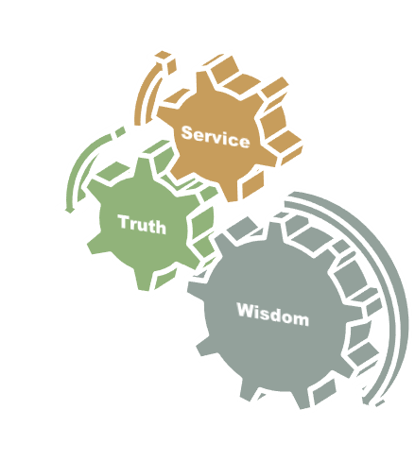
Motto Vision; The Dream / Tomorrow
To impart evidence based research oriented medical education
To provide best possible patient care
To inculcate the values of mutual respect and ethical practice of medicine

Slide 17
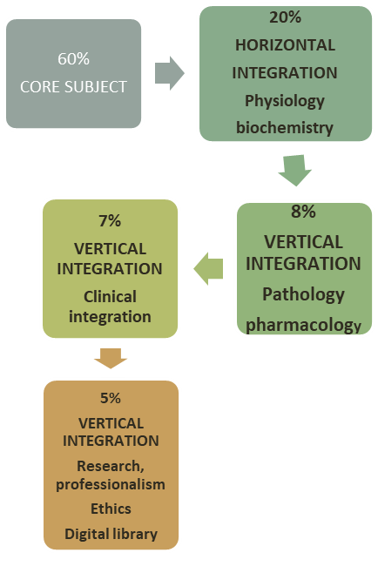
Professor Umar Model of Integrated Lecture
17
Notes:
17

Slide 18
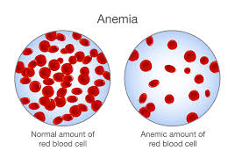
Definition
Anemia :
Anemia is defined as a state in which hemoglobin concenteration or red blood cell volume is 2 standard deviation below the mean for that age and sex
World Health Organization (WHO) Criteria-
Mild anemia: Hb 10-11.9 g/dL
Moderate anemia: Hb 7-9.9 g/dL
Severe anemia: Hb < 7 g/dL
Nutritional anemia :
Nutritional anemia is a condition that occurs when the body doesn't have enough of certain nutrients, like iron, vitamin B12, or folic acid. This can happen when the diet is insufficient, or if an underlying medical condition or treatment prevents the body from absorbing nutrients.

Slide 19
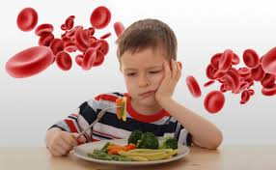
IRON DEFICIENCY ANEMIA
Iron deficiency anemia occurs when your body doesn't have enough iron to produce hemoglobin. Hemoglobin is the part of red blood cells that gives blood its red color and enables the red blood cells to carry oxygenated blood throughout your body.

Slide 20
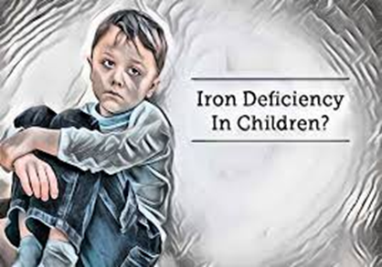
PREVALENCE
VERTICAL INTEGRATION
It is estimated that more than one third of the population in the Region is anaemic.
Pregnant women and young children are most at risk
50% of pregnant women and
63% of children under-5 have iron deficiency anaemia.
75% bound in heme proteins (hemoglobin and myoglobin).
In normal subjects - small amount of iron enters and leaves the body on a daily basis.
Iron balance is achieved primarily by mechanisms affecting intestinal absorption and transport.
In infants and children, 30% of daily iron needs must come from diet.
IRON BALANCE

Slide 21
VERTICAL INTEGRATION
IRON PHYSIOLOGY
FORMS OF IRON
Heme iron
Found in meat, fish, and poultry, heme iron is the most easily absorbed form of iron, with the body absorbing up to 30% of it.
Non-heme iron
Found in plant-based foods like fruits, vegetables, nuts, beans, lentils, whole grains, and some seeds, non-heme iron is less well absorbed, with the body absorbing only 2–10% of it.

Slide 22
PATHOPHYSIOLOGY/ CAUSES
VERTICAL INTEGRATION
NUTRITIONAL CAUSES
BLOOD LOSS
Rapid growth
Insufficient dietary intake
Poor weaning
Limited absorption ( malabsorbtion,celiac)
Less absorption of iron from cow milk/formula fed
Mother anemic
Increase iron demand ( premature/low birth weight)
IN NEONATES
Feto maternal transfusion
Twin twin transfusion
Placental bleeding
Hemorrhagic disease of newborn
Cow milk protein allergy
IN CHILDREN
Worm infestation
Rectal polyps
Inflammatory bowel disease

Slide 23
CLINICAL MANIFESTATIONS
CORE SUBJECT
A symptomatic ( mild)
Lethargy
Pallor
Irritability
Cardiomegaly
Poor feeding
Tachypnea.
signs of congestive heart failure
Esophageal webbing
Koilonychias
Glossitis
Angular stomatitis
Gastric atrophy

Slide 24
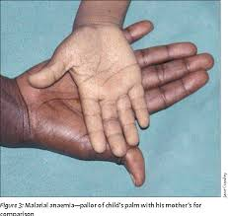

Slide 25
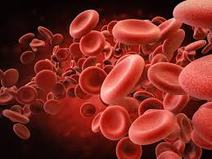
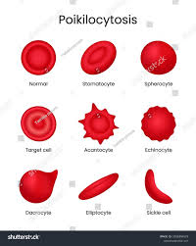
Diagnosis
CORE SUBJECT
COMPLETE BLOOD COUNTS
Hemoglobin level is low
Reticulocyte count normal / elevated
Leucocyte count normal
MCV,MCH,MCHC low
PERIPHERAL FILM
RBC morphology
Microcytic
Hypochromic
Anisocytosis
Poikilocytosis
Serum iron is low
Serum ferritin is low
Iron binding capacity is high
Bone marrow examination low iron

Slide 26
CORE SUBJECT

Slide 27
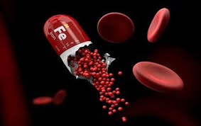
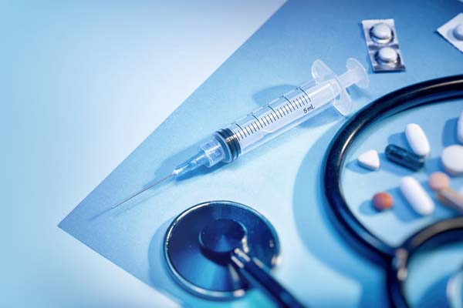
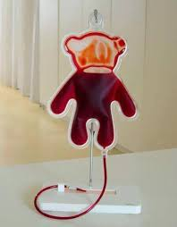
Treatment
CORE SUBJECT
Iron therapy
3-6 mg/kg/day
for 3 months
Dietary counselling
Iron fortified milk
Weaning food
Blood transfusion ( heart failure)
Correct any occult blood loss
Correct underlying disorder

Slide 28
CORE SUBJECT
MEGALOBLASTIC ANEMIA
B12 DEFICIENCY

Slide 29
CORE SUBJECT
MEGALOBLASTIC ANEMIA
When the body doesn't produce enough healthy red blood cells, or the red blood cells are abnormally large.
Deficiency in vitamin B12 or folate, which are essential for the production of healthy red blood cells.
Vitamin B12 deficiency
It is a common cause of megaloblastic anemia, because of insufficient B12 in the body
Folic Acid deficiency
It is a common cause of megaloblastic anemia, because of insufficient folic acid
in the body

Slide 30
CAUSES
CORE SUBJECT
Deficient B12 in breast feeding ,vegetarian diet
Intestinal malabsorbtion
Chrons disease
Chronic pancreatitis
Bacterial over growth
Diphyllobothriumlatum
Surgical resection
Pernicious anemia
Inborn error of metabolism

Slide 31
CLINICAL MANIFESTATIONS
CORE SUBJECT
Fatigue, Weakness
Glossitis
Mouth ulcers
Angular cheilitis
Diarrhea
Constipation
Weight loss
Abdominal pain
Tingling and numbness
Weakness
Gait disturbances
ataxia

Slide 32
Diagnosis
CORE SUBJECT
Complete Blood Count (CBC): -
Anemia (low hemoglobin, hematocrit)
Macrocytosis (high mean corpuscular volume, MCV)
Peripheral Smear:
Megaloblastic red blood cells
Hypersegmented neutrophils
Anisocytosis (variable red blood cell size)
Serum Vitamin B12 Level:
Low serum vitamin B12 level (<150 pg/mL)
Bone Marrow Examination:
Megaloblastic changes in the bone marrow
Hypercellularity
Erythroid hyperplasia

Slide 33
Treatment
CORE SUBJECT
Vitamin B12 Supplementation:
Oral or parenteral vitamin B12 supplementation.
Dietary Counseling:
Encourage dietary sources of vitamin B12,
Animal products.
Addressing Underlying Causes:
Treat underlying conditions, such as
Pernicious anemia or malabsorption.

Slide 34
CORE SUBJECT
MEGALOBLASTIC ANEMIA
FOLIC ACID DEFICIENCY

Slide 35
Causes
CORE SUBJECT
Dietary deficiency:
Inadequate intake of folate-rich foods
Increase intake of goat milk
Leafy greens ,Legumes,Citrus fruits
Malabsorption:
Impaired absorption of folate due to: -
celiac disease, Crohn's disease, ulcerative colitis)
Pancreatic insufficiency
Increased demand:
Rapid growth and development (infancy, adolescence) -

Slide 36
Causes
CORE SUBJECT
Medications:
Decrease folate absorption
Anticonvulsants (phenytoin, carbamazepine) -
Sulfonamides (trimethoprim-sulfamethoxazole) -
Methotrexate
Genetic disorders:
Hereditary folate malabsorption
Chronic diseases:
Inflammatory bowel disease (IBD)
Celiac disease
Chronic kidney disease

Slide 37
CLINICAL MANIFESTATIONS
CORE SUBJECT
Fatigue, Weakness
Glossitis
Mouth ulcers
Angular cheilitis
Diarrhea
Constipation
Weight loss
Abdominal pain
Tingling and numbness
Weakness
Gait disturbances
ataxia

Slide 38
Diagnosis
CORE SUBJECT
Complete Blood Count (CBC):
Anemia
macrocytosis
hypersegmented neutrophils.
Folate Level:
Low serum folate level (<3 ng/mL).
Low RBC folate level (<150 ng/mL). -
Bone Marrow Examination:
Megaloblastic changes,
hypercellularity
erythroid hyperplasia.

Slide 39
Treatment
Folic Acid Supplementation: -
Oral folic acid supplements (1-5 mg/day) for 3-6 months.
Parenteral folic acid (intramuscular or intravenous) for severe deficiency or malabsorption.
Dietary Counseling:
Encourage dietary sources of folate
Leafy greens
Legumes (lentils, chickpeas, black beans)
Citrus fruits (oranges, grapefruits, lemons)
Whole grains (brown rice, quinoa, whole-wheat bread)
Treat underlying gastrointestinal disorders
celiac disease, Crohn's disease)
Manage medications that interfere with folate absorption or increase folate requirements.

Slide 40
Treatment
Folic Acid Fortification
consumption of folic acid-fortified foods
Dietary Counseling:
Educate parents about of folate-rich foods.
Screening:
Screen high-risk populations, such as pregnant women and children with malabsorption disorders, for folate deficiency.

