Slide 2
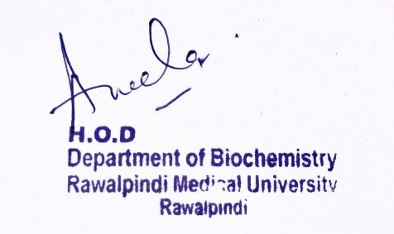
2nd Year MBBS Gastrointestinal Tract Module Large Group Interactive Session (LGIS) Nutrition-III
dDdD
31-01-2025
Dr. Rahat Afzal
Biochemistry Department
Date: 00-00-2023
Date: 00-00-2024

Slide 3
Motto Vision; The Dream/Tomorrow
To impart evidence based research oriented medical education
To provide best possible patient care
To inculcate the values of mutual respect and ethical practice of medicine
Wisdom
Truth
Service

Slide 4
equence of LGIS

Slide 5
Learning Objectives
At the end of the lecture, students will be able to:
Explain
Calculation of caloric requirement of a person.
Starvation.
Dietary fiber.
.

Slide 6
CALORIE:
Core Knowledge
A calorie is a unit of energy that measures how much energy food provides to the body.
The body needs calories to work as it should.

Slide 7
CALCULATION OF CALORIC REQUIREMENT OF A PERSON
Core Knowledge
There are six needs which must be met by food:
Basal metabolism/Basal energy expenditure:
These are calories used by an individual at complete physical or mental rest and have not taken food at least 14 hours before the measurement of BMR.
These are needed for working of internal body organs and maintaining muscle tone.

Slide 8
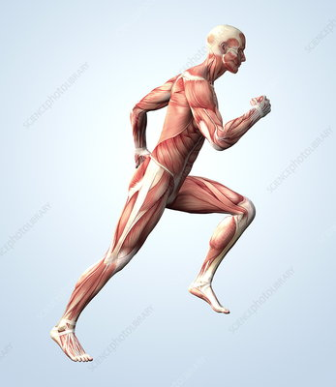
Core Knowledge
It is directly proportional to body weight and body surface area.
Any individual normally utilizes 1300-2000 kcal/day by BMR.
2) Muscular activity:
The calories which are used for muscular activity differs in every individual depending upon severity of work.
Laborers and athletes need 4000-8000 or more kcal/day

Slide 9
Core Knowledge
3) Shivering thermogenesis:
A person in cold loses calories by shivering (muscular activity) that is directly proportional to the rate of shivering.
4) Dietary thermogenesis:
Ingestion of food followed by its digestion and assimilation stimulates metabolism and thus increases the metabolic activity.
Diet thermogenesis is more marked with protein food.
30% of food intake (pure protein) is used by the body for heat (regulation of body temperature.)

Slide 10
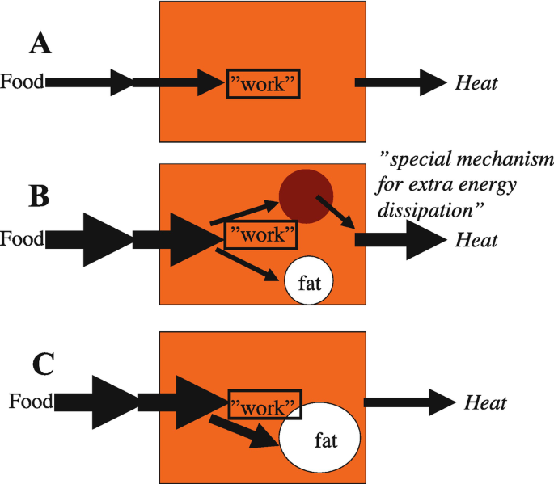
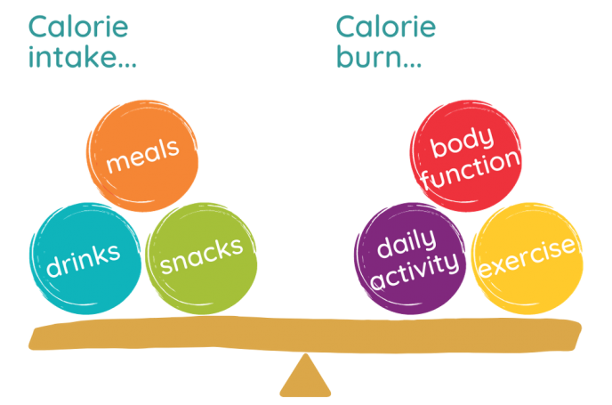
Core Knowledge
This action of carbohydrates and fatty acids is very low.
Dietary thermogenesis of mixed food (carbohydrates, fats, and proteins) is 6-10%.
So, mixed food is more beneficial to our body as relatively more food is utilized in a useful way.

Slide 11
Core Knowledge
5) Non-Exercise Activity Thermogenesis (NEAT):
Small amount of thermogenesis occurs in individuals due to some physical activity (other than exercise) like spontaneous muscular contractions, maintaining posture, fidgeting (restless movements in nervous individual), chewing gum for long time.

Slide 12
Core Knowledge
6) Growth and pregnancy:
These two conditions require more calories.
Total number of calories per day till 7-14 years is more than those required in 19-22 years.
After these requirements falls are seen in later life due to fall in BMR and lowered physical activity.
Calories required in male and female is same till 10 years of age. After this rises in male.
Children need more calories than adults due to increase in BMR is considerably high in children than adults as they expend more energy.
A major proportion of food is utilized for growth.

Slide 13
STARVATION
Core Knowledge
It is characterized by complete deprivation of food, and only water is supplied.
Death occurs in two months in previously well person.
Thin persons will die early than fat.
Women tolerate it better than men (greater percentage of fat in women.)

Slide 14
Core Knowledge
CAUSES OF STARVATION
Lesions of esophagus, stomach etc.
Chronic diseases, malignancy, CRF, hepatitis, AIDS.
Social causes.
Political protests.
Depression.
Personal low socio-economic status.

Slide 15
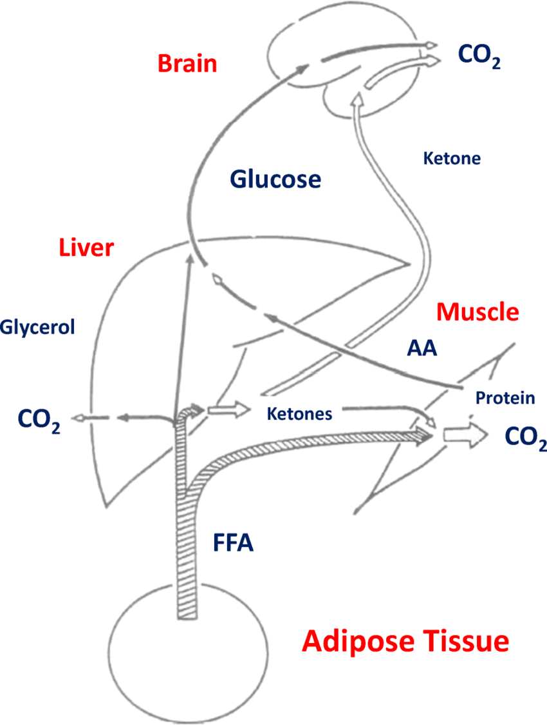
METABOLIC CHANGES DURING STARVATION
Core Knowledge
In starvation many metabolic and adaptive changes takes place.
In first 24 hours, circulating glucose, fatty acids, triglycerides, and liver and muscle glycogen are used as fuel.
The sum of this fuel is 1200kcal in 70kg man and is not sufficient for BMR of an adult for a single day.

Slide 16
CARBOHYDRATE METABOLISM
Core Knowledge
Liver glycogen falls (5% of liver mass) falls rapidly. Later this liver glycogen level might be raised due to synthesis from Cori's cycle and proteins (gluconeogenesis.) Muscle glycogen also fall but to a lesser level than liver glycogen.
Blood glucose remains normal for first 2 days. But then falls as low as 50mg/dl. Then it may rise due to increased gluconeogenesis.
Glucose is first provided to critical tissues like brain. Heart, kidneys and skeletal muscle change fuel from glucose to fatty acids and ketone bodies (sparing glucose.)

Slide 17
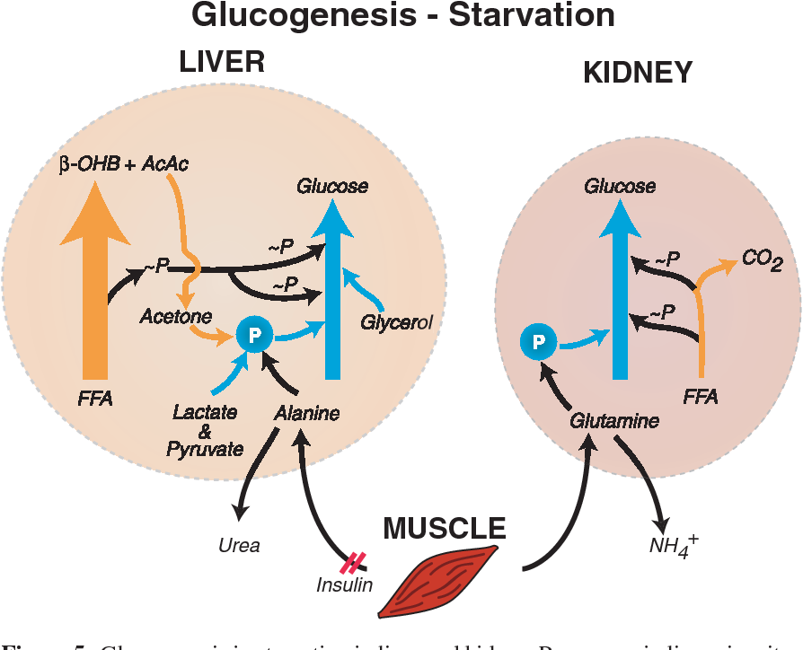
Core Knowledge
Other tissues like bone marrow, renal medulla and peripheral nerves starts anaerobic glycolysis (formation of lactate and pyruvate)
These undergo Cori’s cycle in liver and changed to glucose and enters circulation and supply glucose to brain.

Slide 18
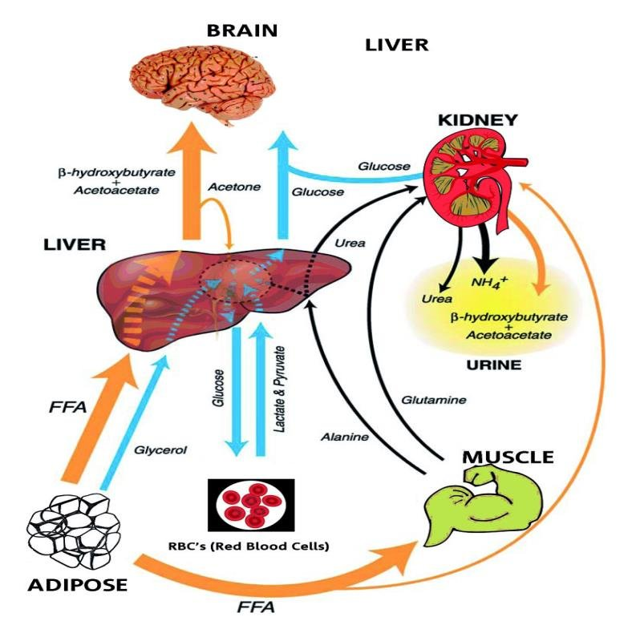
FAT METABOLISM
Core Knowledge
When stored carbohydrate reserves are utilized, fatty acids are mobilized from fat stores. There is excessive production of ketone bodies in liver causing ketoacidosis.
Fat deposited in liver results in causing fatty liver.
The brain now start utilizing ketone bodies as an energy source thus conceiving tissue protein

Slide 19
PROTEIN METABOLISM
Core Knowledge
There is continuous catabolism of protein with no intake, so there is negative nitrogen metabolism.
Skeletal muscles are a major source of proteins for catabolism.
Deamination of amino acids and resulting in formation of ammonia and urea.
Non-nitrogenous residues are converted to glucose and to acetyl-coA.

Slide 20
WEIGHT CHANGES
Core Knowledge
No calorie intake decrease great expenditure so negative energy balance so weight decrease.
The adipose tissue completely disappeared.
Liver, GIT and muscles lose one-third of their mass.
Heat size decreased markedly.
CNS loses 5% of its mass.
Urinary excretion of non-protein nitrogenous products.
Urea: Initially increased later falls (renal failure)
Ammonia: Excretion rises due to ketoacidosis.
Creatinine and creatine: Remains unchanged.

Slide 21
TYPES OF DIETARY FIBER
Core Knowledge
There are two types of fiber depending upon:
Chemical Composition.
Action in GIT.
The two types are:
Insoluble fiber.
Soluble fiber.

Slide 22
INSOLUBLE FIBER
Core Knowledge
It comprises of cellulose, hemicellulose and lignin in wheat bran.
Cellulose and hemicellulose are complex polysaccharides.
Lignin is a polymer of phenylalanine and tyrosine.
ACTION:
Retain water in GIT.
Makes feces soft and increase their bulk.
Prevents constipation and its sequelae such as hemorrhoids and anal fissure.

Slide 23
SOLUBLE FIBER
Core Knowledge
It contains gums, pectins (in legumes),oats and fruits.
ACTION:
Slows gastric emptying.
Delays absorption of glucose from GIT.
Decreases insulin secretion.
If insulin is excreted in excess causes reactive hypoglycemia.
Stimulates appetite.

Slide 24
GOOD EFFECTS OF FIBER
Core Knowledge
Presence of fiber in diet decreases incidence of diseases such as appendicitis, diverticulitis, benign and malignant diseases of colon and rectum, MI and DM.
If taken in excess, they decrease the absorption of certain trace elements like zinc.
Play a role in absorption of fat soluble vitamins.
Fiber intake should not be exceeded beyond
20-35g/day.

Slide 25
DIETARY FIBER

Slide 26
ROLE OF DIETARY FIBER IN CONSTIPATION

Slide 27
Family Medicine
Spiral Integration
Family Medicine plays important role in preventing and treating diseases in following manner:
Preventive care and education.
Early detection and screening.
Diagnostic evaluation.
Treatment planning and management.
Monitoring and follow-up.
Community out-reach and advocacy.

Slide 28
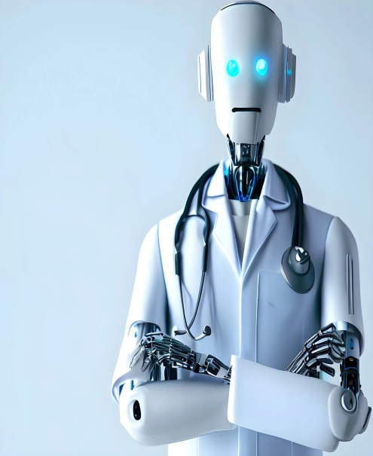
Artificial Intelligence
Spiral Integration
Artificial Intelligence plays role in following aspects to address the nutrition related issues:
Data analysis and prediction.
Early detection and diagnosis.
Personalized treatment planning.
Remote monitoring and support.
Decision support tools.
Public health surveillance and intervention.
Research and innovation.
Community engagement and education.

Slide 29
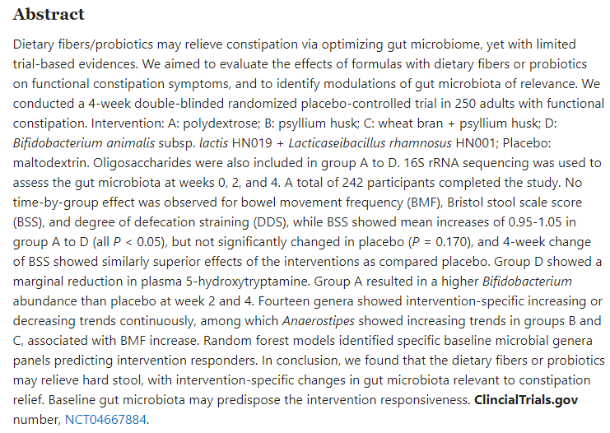
Suggested Research Article
Link: https://pubmed.ncbi.nlm.nih.gov/37078654/

Slide 30
How To Access Digital Library
Steps to Access HEC Digital Library
Go to the website of HEC National Digital Library
On Home Page, click on the INSTITUTES
A page will appear showing the universities from Public and Private Sector and other Institutes which have access to HEC National Digital Library HNDL
Select your desired Institute
A page will appear showing the resources of the institution
Journals and Researches will appear
You can find a Journal by clicking on JOURNALS AND DATABASE and enter a keyword to search for your desired journal

Slide 31
Learning Resources
Textbook of Biochemistry, Lippincott 8th edition, chapter no.27, page no. 717-753.
Google scholar
Google images

