Slide 2
MSK-1 Module SGD/Dissection Neurovascular Organization of Forearm
Date: 22/04/24
Dr Ali Raza
Senior Demonstrator

Slide 3
Mission- Vision- Values
Wisdom
Truth
Service
To impart evidence based research oriented medical education
To provide best possible patient care
To inculcate the values of mutual respect and ethical practice of medicine

Slide 4
Learning Objectives At the end of the Demonstration Student should be able to
Describe nerves and vessels of forearm (formation, commencement, course, branches and relations)
Describe associated clinical conditions (Median nerve injury, pronator syndrome, cubital tunnel syndrome)
Understand the curative and preventive health care measures
Practice principles of bioethics
Apply strategic use of artificial intelligence in healthcare
Read a relevant research article

Slide 5
Core Concept
Slide No 6-22

Slide 6
Nerves of Forearm
The nerves of the forearm are the Median, Ulnar, and Radial.
The median nerve is the principal nerve of the
anterior (flexor–pronator) compartment of the forearm.
Although the radial nerve appears in the cubital
region, it soon enters the posterior (extensor–supinator) compartment of the forearm.

Slide 7
Median nerve
After originating from the brachial plexus , the median nerve descends down the arm, initially lateral to the brachial artery. Halfway down the arm, the nerve crosses over the brachial artery, and becomes situated medially. The median nerve enters the anterior compartment of the forearm via the cubital fossa.

Slide 8
Median nerve
Vascular branch to the brachial artery in arm
Muscular branches - to the superficial and intermediate group of forearm flexors (except the FCU and deep muscles (except tendons to 4th and 5th fingers) via its branch, the Anterior interosseous nerve (major branch)
Articular branches to the elbow joint
Muscular branches. The nerve to the pronator teres. A broad bundle of nerves pierces the superficial flexor group of muscles and innervates the FCR, the palmaris longus, and the FDS.
Anterior interosseous nerve - runs on the interosseous membrane with the anterior interosseous branch of the ulnar artery. After supplying flexors (except tendons to 4th and 5th fingers), it passes deep to and supplies the pronator quadratus, then ends by sending articular branches to the wrist joint.
Palmar cutaneous branch of the median nerve - Arises just proximal to the flexor retinaculum, but is distributed to skin of the central part of the palm

Slide 9
Ulnar nerve
No branches in the arm
In the forearm it supplies only one and a half muscles, the FCU and the ulnar part of the FDP-tendons to the 4th and 5th digit
After supplying FCU tendon, become superficial just proximal to the wrist, passes above to the flexor retinaculum and enter the hand by passing through a groove between the pisiform and the hook of the hamate. A band of fibrous tissue from the flexor retinaculum bridges the groove to form the small ulnar canal (Guyon canal)

Slide 10
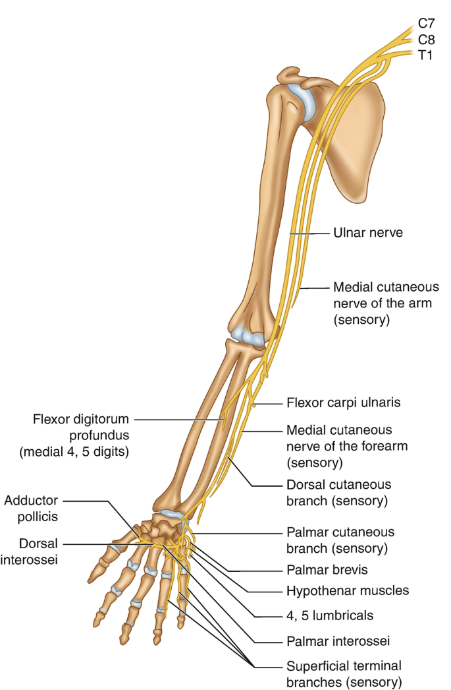
• Articular branches pass to the elbow joint while the nerve is between the olecranon and the medial epicondyle.
Muscular branches supply the FCU and the medial half of the FDP
Palmar cutaneous branch – innervates the medial half of the palm.
Dorsal cutaneous branch – innervates the dorsal surface of the medial one and a half fingers, and the associated dorsal hand area.
Superficial branch – innervates the palmar surface of the medial one and a half fingers.

Slide 11
KLM 6th Edition Pg. No. 762-63

Slide 15
Vessels of Forearm-Arteries
The main arteries of the forearm are the Ulnar
and Radial arteries, which usually arise opposite
the neck of the radius in the inferior part of the
cubital fossa as terminal branches of the brachial
artery.
The blood supply to the forearm is mainly derived from
the anterior and posterior interosseous arteries, the
terminal branches of the common interosseous artery, a
branch of the ulnar artery.

Slide 16
KLM 6th Edition Pg. No. 758

Slide 17
KLM 6th Edition Pg. No. 759-60

Slide 19
Vessels of Forearm-Veins
The superficial veins ascend in the subcutaneous tissue. (Cephalic & Basilic veins)
The deep veins accompany the deep arteries of
the forearm. (Radial, Ulnar & Interosseous
veins)

Slide 20
KLM 6th Edition Pg. No. 761

Slide 23
Vertical Integration

Slide 24
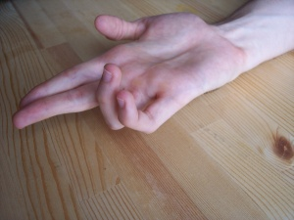
Median Nerve Injury KLM pg #768
flexion of the proximal interphalangeal joints of the 1st–3rd digits is lost
flexion of the 4th and 5th digits is weakened.
Flexion of the distal interphalangeal joints of the 2nd and 3rd digits weakens.
The ability to flex the metacarpophalangeal joints of the 2nd and 3rd digits is affected because the digital branches of the median nerve supply the 1st and 2nd lumbricals. Thus, when the person attempts to make a fist, the 2nd and 3rd fingers remain partially extended “hand of benediction”

Slide 25
Median claw: Distal median nerve injury causes palsy of the lumbricals I and II with preserved function of extrinsic flexors. This imbalance leads to permanent flexion of the index finger and the middle finger (aggravated when trying to extend the fingers). Ape hand: inability to oppose and abduct the thumb due to injury of the proximal or distal median nerves impairing the thenar muscles' functions
The hand of the benediction occurs only in proximal median nerve lesions

Slide 26
Anterior interosseous Syndrome
When the person attempts to make the “okay” sign, opposing the tip of the thumb and index finger in a circle, a “pinch” posture of the hand results instead owing to the absence of flexion of the interphalangeal joint of the thumb and distal interphalangeal joint of the index finger (anterior interosseous syndrome)
KLM page #768

Slide 27
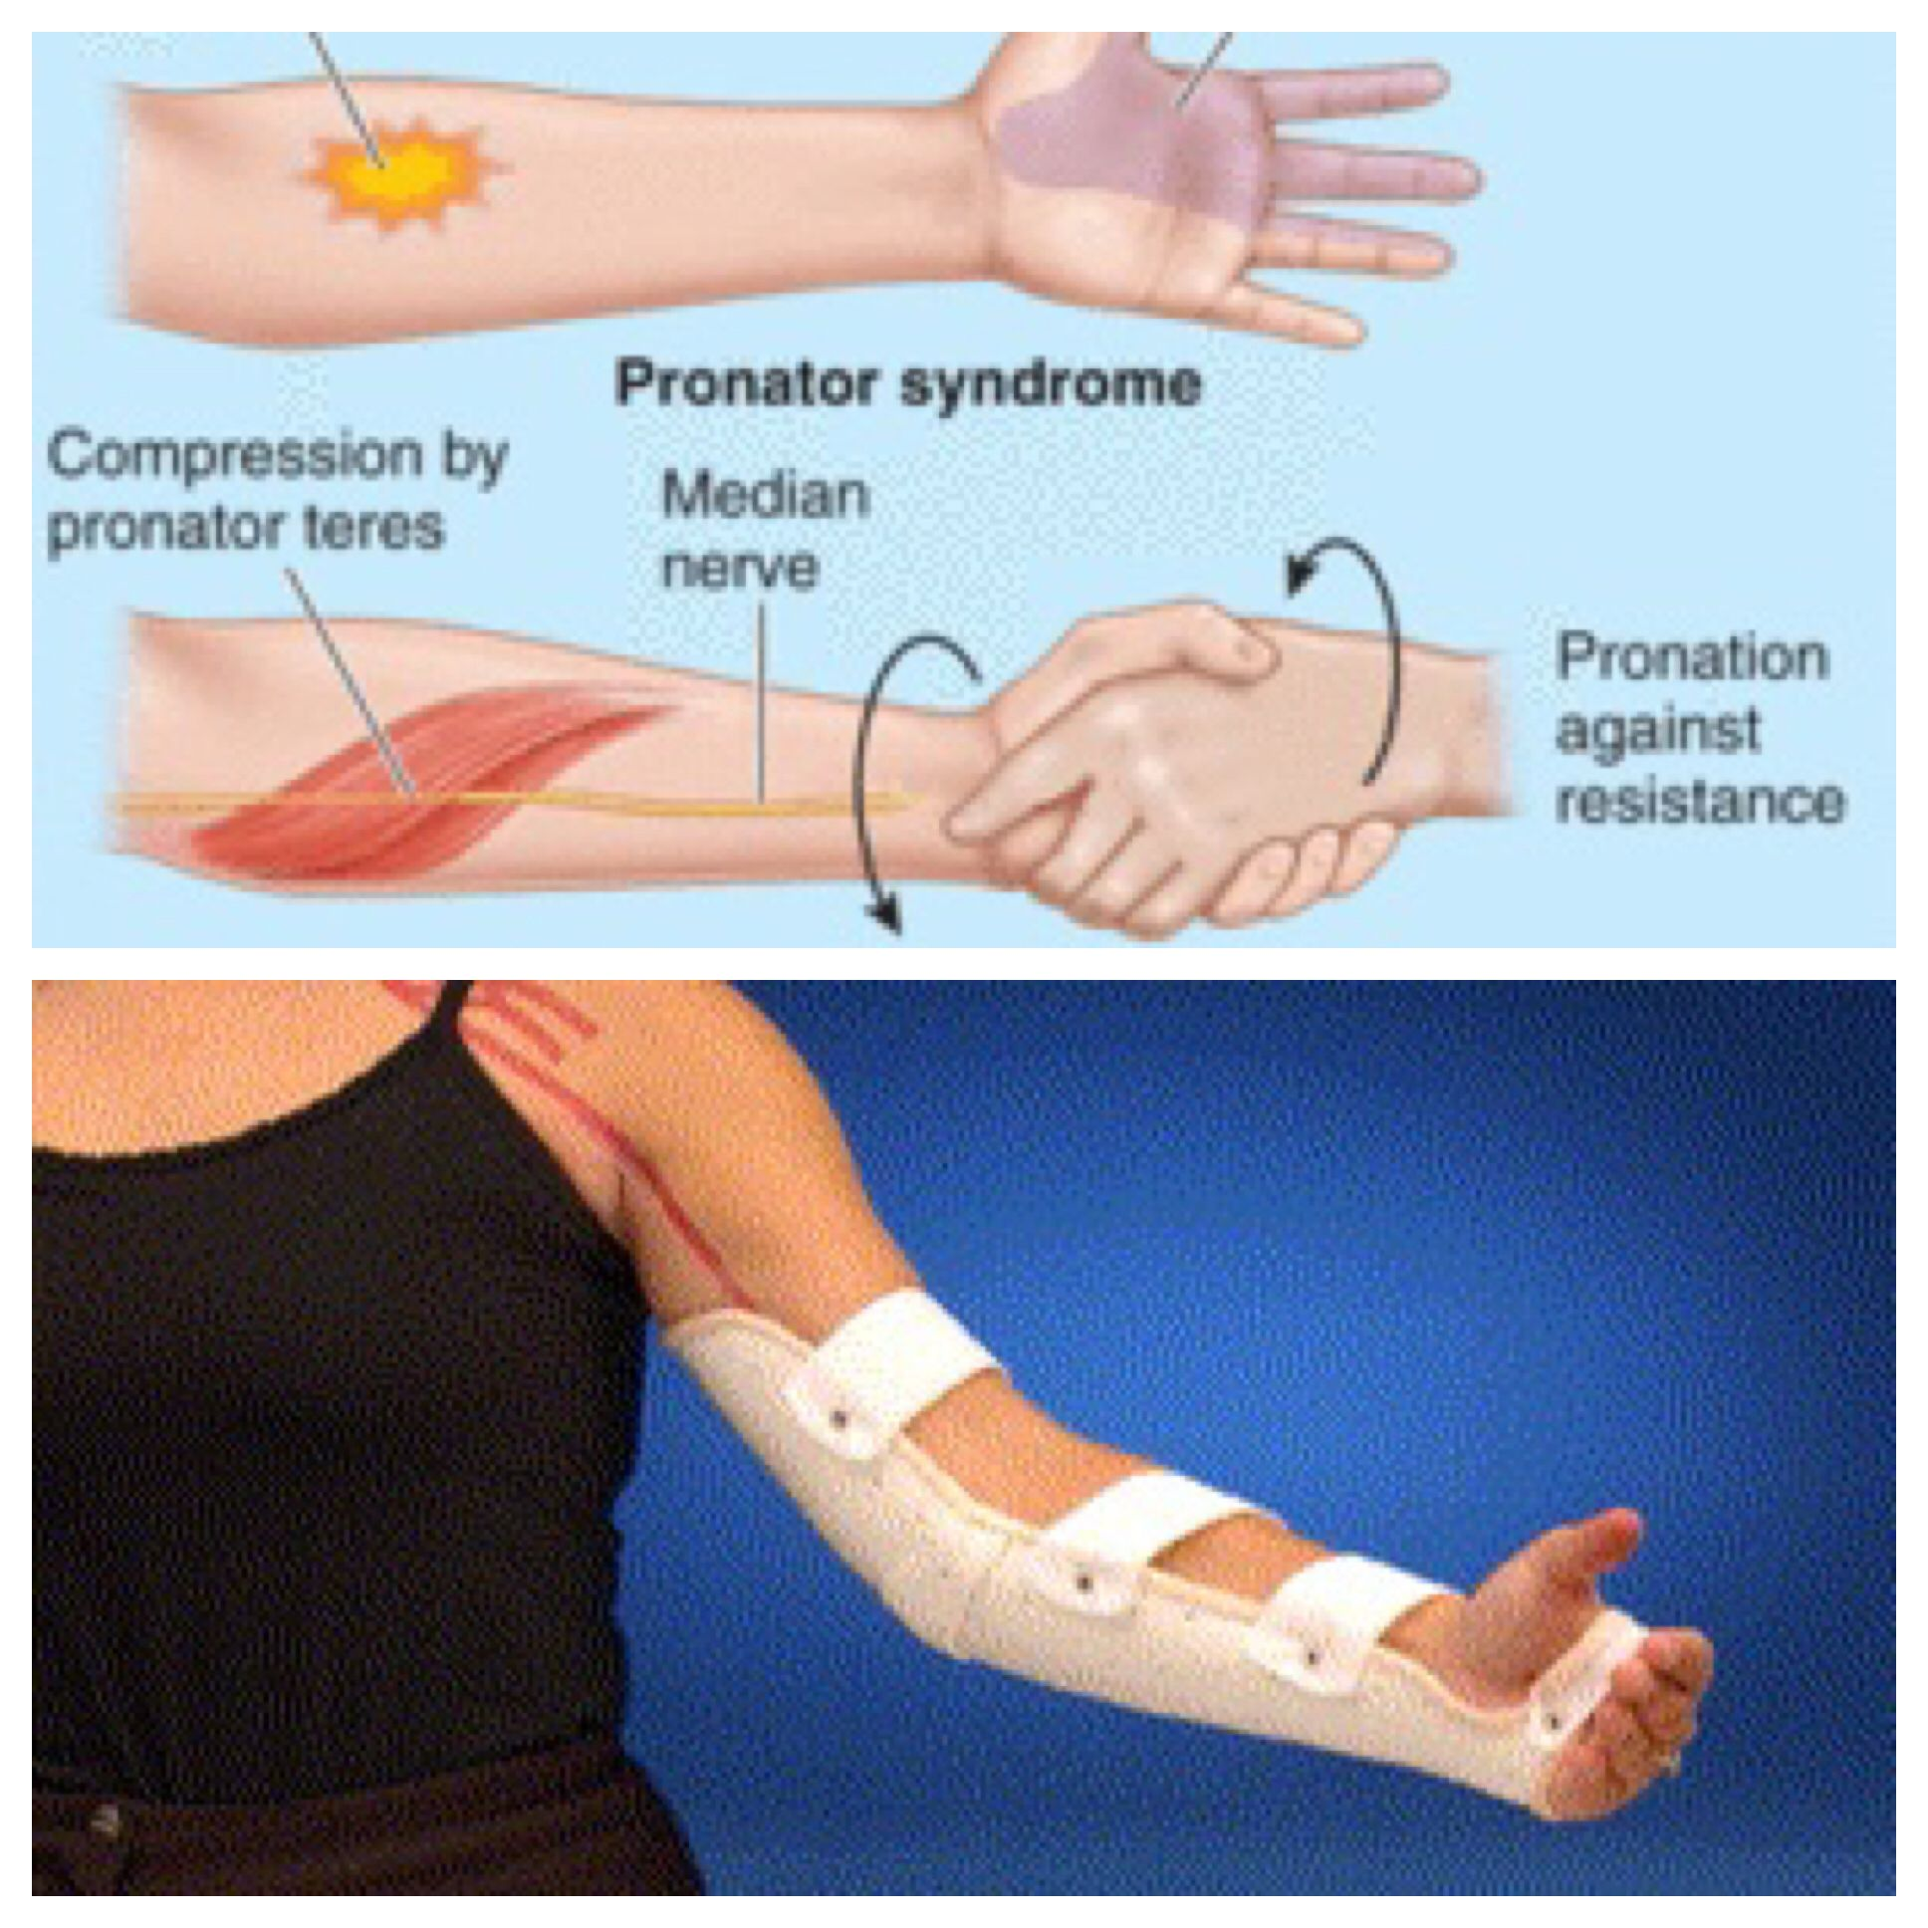
Pronator Syndrome
Pronator syndrome, a nerve entrapment syndrome, is caused by compression of the median nerve near the elbow. The nerve may be compressed between the heads of the pronator teres as a result of trauma, muscular hypertrophy, or fibrous bands. Individuals with this syndrome are first seen clinically with pain and tenderness in the proximal aspect of the anterior forearm and hypesthesia of palmar aspects of the radial three and half digits and adjacent palm

Slide 34
Surface Anatomy

Slide 41
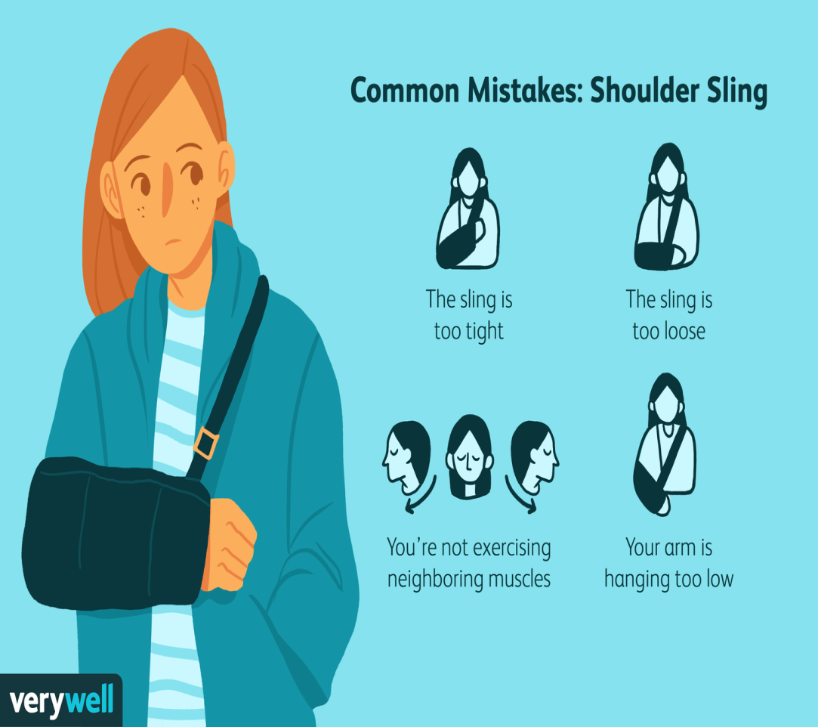
Family Medicine
Initial Assessment: Family physicians play a crucial role in the initial assessment of any neurovascular compromise, providing immediate medical attention, diagnosing the severity of the injury, and initiating appropriate treatment plans.
Referral and Coordination: They facilitate referrals to Surgeons (General/Vascular/
Neuro) if necessary, ensuring patients receive specialized care for complex injuries.
Follow-up Care: Family physicians provide ongoing monitoring and management of injuries, overseeing the healing process, adjusting treatment as needed, and addressing any complications or concerns that may arise during recovery.

Slide 42
Biomedical Ethics
Biomedical ethics in the context of radius and ulna fractures involve ensuring patient autonomy in treatment decisions, such as choosing between surgical intervention and conservative management.
Physicians must uphold beneficence by prioritizing patient well-being, opting for treatments that optimize long-term function and quality of life.
Additionally, ethical considerations include maintaining patient confidentiality regarding sensitive medical information related to the injury and treatment process.

Slide 43
Artificial Intelligence
AI aids in detection of any compromise in NVS through Doppler Ultrasound and Nerve conduction studies (NCS), assisting surgeons in accurately identifying and categorizing neurovascular compromise.
Furthermore, AI algorithms contribute to the development of personalized rehabilitation plans, enhancing post-op care by tailoring interventions to individual patient needs and progress.

Slide 44
Assessment

Slide 45
1. Select the most appropriate ending for the following
sentence. The median nerve:
a. Arises from both the posterior and medial cords
of the brachial plexus.
b. Passes from the medial to the lateral side of the
brachial artery in the arm.
c. Gives no muscular branches in the arm.
d. Enters the forearm by passing between the two
heads of flexor carpi ulnaris.
e. Supplies all of flexor digitorum profundus.
2. Which of these statements best completes the following
sentence? The ulnar nerve:
a. Has the ulnar artery as a medial relation at the
wrist.
b. Passes deep to the flexor retinaculum at the wrist.
c. Usually innervates the lateral two lumbricals.
d. Innervates adductor pollicis.
e. Innervates the skin of the lateral (radial) 1½ digits.

Slide 46
3. Which of the following accurately describes
the anterior compartment of the forearm?
a. The median nerve enters the forearm between
the two heads of flexor carpi ulnaris.
b. Palmaris longus is present in approximately
15% of arms.
c. Flexor digitorum profundus originates from
the common flexor origin.
d. Flexor pollicis longus is characteristically
unipennate.
e. The superficial flexor muscles are all
innervated by the median nerve.
4. Which of the following best describes the forearm?
a. The median nerve is related anteriorly to
flexor digitorum superficialis.
b. Pronator quadratus lies deep to the long flexor
tendons just proximal to the wrist.
c. The ulnar nerve lies superficial to flexor carpi
ulnaris.
d. Flexor digitorum profundus is partially
supplied by the posterior interosseous nerve.
e. The radial nerve carries motor fibres in the
anterior compartment of the forearm.
5. Which of the following statements best
describes the structures in the posterior
compartment of the forearm?
a. Brachioradialis is innervated by the posterior
interosseous nerve.
b. The common extensor origin is the medial
epicondyle of the humerus.
c. The posterior interosseous nerve pierces
supinator.
d. The extensor retinaculum is attached to the radius
and the ulna.
e. The extensor tendons pass through the extensor
retinaculum in the same fascial compartment.

Slide 47
Key
C
D
D
B
C

Slide 48
Learning Resources
Clinically Oriented Anatomy by KLM 7th Edition
Guyton and Hall Textbook of Medical Physiology (Guyton Physiology)
www.google.com

