Slide 1



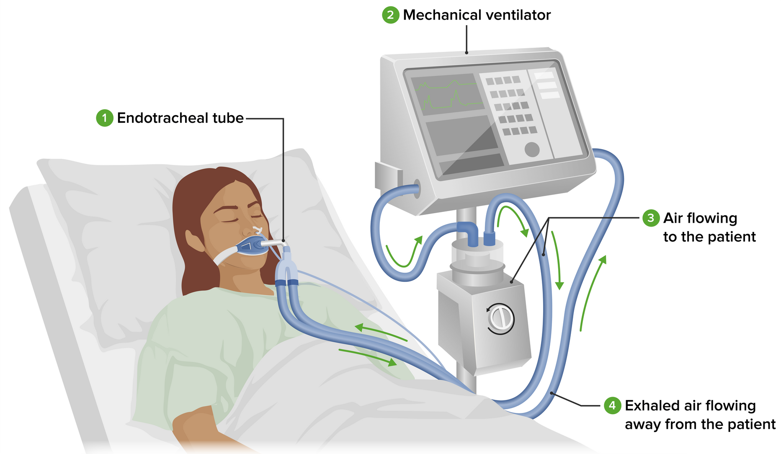
MECHANICAL VENTILATION
Dr Abeera Zareen
MBBS, FCPS, MSc (Pain Med CHPE)
Head of Anesthesia & Intensive Care
BBH, Rawalpindi

Slide 2

INTRODUCTION
  A machine used to move air in and out of the lungs
  Serves as substitute for the manual squeezing of reservoir bag of circle system, the bain circuit, or another breathing system
  Classification
  Power source
  Driving mechanism
  Cycling mechanism
  Bellow type
01

Slide 3

UNIVERSITY MOTO, VISION, VALUES & GOALS
Mission Statement
To impart evidence-based research-oriented health professional education in order to provide best possible patient care and inculcate the values of mutual respect, ethical practice of healthcare and social accountability.
Vision and Values
Highly recognized and accredited centre of excellence in Medical Education, using evidence based training techniques for development of highly competent health professionals.
Goals of the Undergraduate Integrated Modular Curriculum
The Undergraduate Integrated Learning Program is geared to provide you with quality medical education in an environment designed to:
  Provide thorough grounding in the basic theoretical concepts underpinning the practice of medicine.
  Develop and polish the skills required for providing medical services at all levels of the Health care delivery system.
02

Slide 4
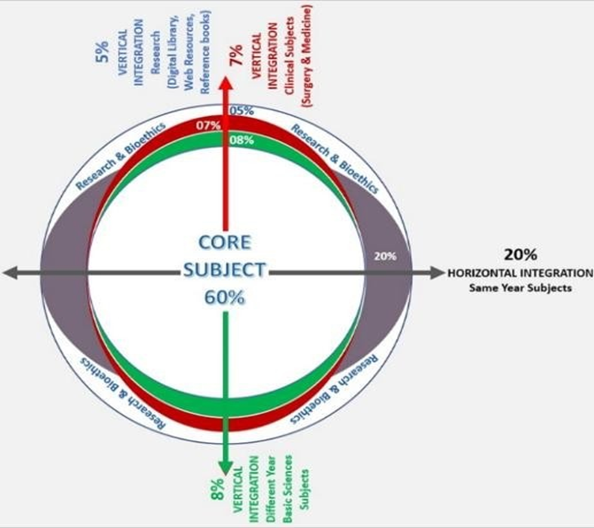
PROF’S UMAR MODEL OF INTEGRATED LECTURE
03

Slide 5
LEARNING OBJECTIVES
AT THE END OF THIS LECTURE STUDENTS SHALL BE ABLE TO LEARN:
🠶 Introduction to Mechanical Ventilation
🠶 Power Source
🠶 Drive Mechanism and Circuit Design
🠶 Cycling Mechanism
🠶 Bellows Classification
🠶 Modes of Ventilation
04

Slide 6
SEQUENCE OF LGIS
LEARNING OBJECTIVES
  Mechanical Ventilation
(core concept = 70%)
  MODES OF VENTILATION
(horizontal integration 15%)
  Related implication of different mode of Ventilation
(vertical integration – 10%)
  Research article related to topic (3%)
  Ethics (2%)
05

Slide 7
POWER SOURCE
  Compressed gas
  Electricity
  Both
  Older – only a pneumatic power source
  Electronic ventilators require either electric only or both an electrical and pneumatic power source
06

Slide 8
DRIVE MECHANISM AND CIRCUIT
Double-circuit ventilators
  Patient gas and drive gas (mostly 100% oxygen)
  Pneumatically driven
  Driving force is pressurized gas that compresses analogous component to reservoir bag known as ventilator bellows and bellow then delivers ventilation
Piston – type ventilators
  Computer controlled stepper motor
  Single patient gas circuit
  Also called piston driven single circuit ventillators
  Piston operates like syringe
  Consume less compressed gas
07

Slide 9
CYCLING MECHANISM
Time cycled
  Ventilator support in control mode
  Inspiratory phase initiated by timing device
  Older ones use fluidic timing device
  Electronic ventilators use solid-state timing device and classified as time cycled and electronically controlled
Pressure support
  Adjustable threshold pressure trigger
  Pressure sensors provide feedback and help in controlling initiation and termination of respiratory cycle
08

Slide 10

BELLOWS CLASSIFICATION
  Direction of bellows movement during expiratory phase determines classification
  Ascending (standing)
  Descending (hanging)
  Ascending – ascend during expiratory phase
  Descending – descend during expiratory phase
  Older ones and some new ones use weighed descending bellows
  Most contemporary electronic ones use ascending bellows
  Ascending one generally more safer
09

Slide 11
CONT...
  Ascending bellow will not fill in total disconnection
  Descending bellow will continue movement due to driving gas and atmospheric air in inspiratory and expiratory phase respectively
10

Slide 12
MODES OF VENTILATORS
The most common modes of mechanical ventilation include:
  CMV- Continuous mandatory Ventilation
  AC- Assist Control Ventilation
  SIMV- Spontaneous Intermittent Mandatory Ventilation
  PSV- pressure support ventilation
11

Slide 13
CMV MODE
  Machine delivers preset tidal volume at set time triggered frequency.
  Patient cannot increase respiratory rate or breathe spontaneously
  Patient must be appropriately sedated and paralyzed
12

Slide 14
CMV
INDICTIONS:
Patient needs complete respiratory rest such as in
Flail chest
crushed chest trauma
major surgery, tetanus
DISADVANTAGES:
Asynchrony, barotrauma , hemodynamic disturbances, V/Q mismatch
13

Slide 15
TYPES OF MODE IN CMV
The most common types are
  VCV- volume controlled ventilation
  PCV- pressure controlled ventilation
14

Slide 16
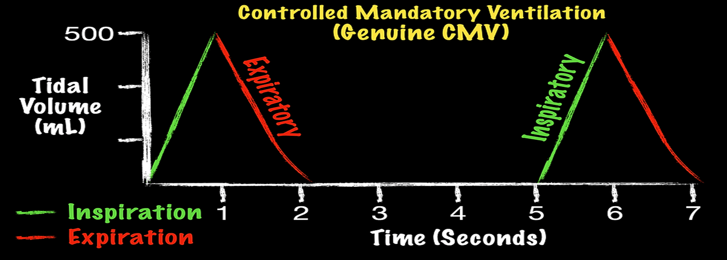
CMV
15

Slide 17
ASSIST CONTROL VENTILATION
  A set tidal volume (volume controlled) or a set pressure and time (pressure controlled) is delivered at a minimum rate
  Additional ventilator breaths are given if triggered by patient
  Mandatory breaths : Ventilator delivers preset volume at preset flow rate at a set backup rate
  Spontaneous breaths: additional cycles can be triggered by the patient but otherwise identical to mandatory breaths
16

Slide 18
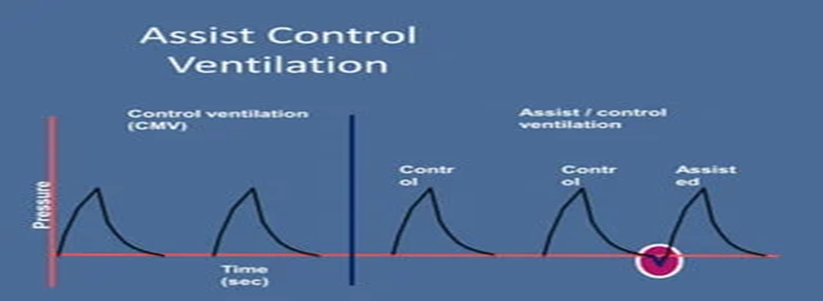
ASSIST CONTROL VENTILATION
17

Slide 19
SIMV MODE
Three types of breathing
  Patient initiated assisted ventilation
  Ventilator generated controlled ventilation
  Unassisted synchronized breaths
  If patient makes an inspiratory effort ventilator will deliver a time triggered ventilatory breath
  If patient makes spontaneous inspiratory effort then ventilator delivers an assisted breath
18

Slide 20
IMV AND SIMV
Indications- facilitates transition
Advantages:
  Maintains respiratory muscle strength by avoiding muscle atrophy
  Decreases mean airway pressure
  Facilitates weaning
19

Slide 21
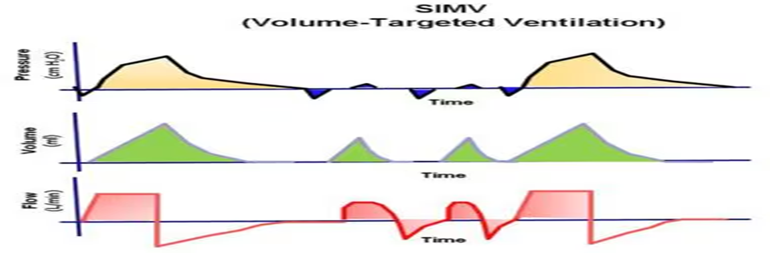
SIMV
20

Slide 22
PRESSURE SUPPORT VENTILATION
•No mandatory breaths
•Pressure is the setting variable
•Applicable on spontaneous ventilation
•Patient effort determines size of breath and flow rate
•Helps in weaning
21

Slide 23
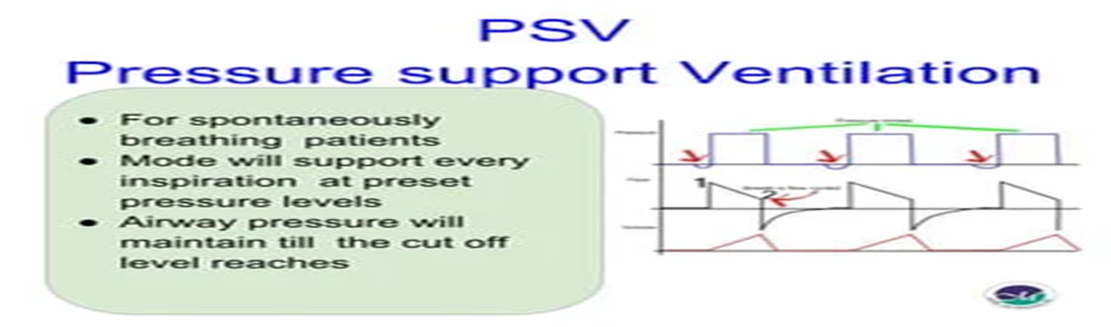
PSV
22

Slide 24
PSV
ADVANTAGES:
  Allows complete patient control
  Decreases patient work of breathing
  Decreases patient spontaneous RR
23

Slide 25
REFRENCES
  Morgan and Mikhail_s Clinical Anesthesiology
  Miller_s Basics of Anesthesia
24

Slide 26
RESEARCH
Walter JM, Corbridge TC, Singer BD. Invasive Mechanical Ventilation. South Med J. 2018 Dec;111(12):746-753. doi: 10.14423/SMJ.0000000000000905. PMID: 30512128; PMCID: PMC6284234.
25

Slide 27
THANK YOU

