Slide 3
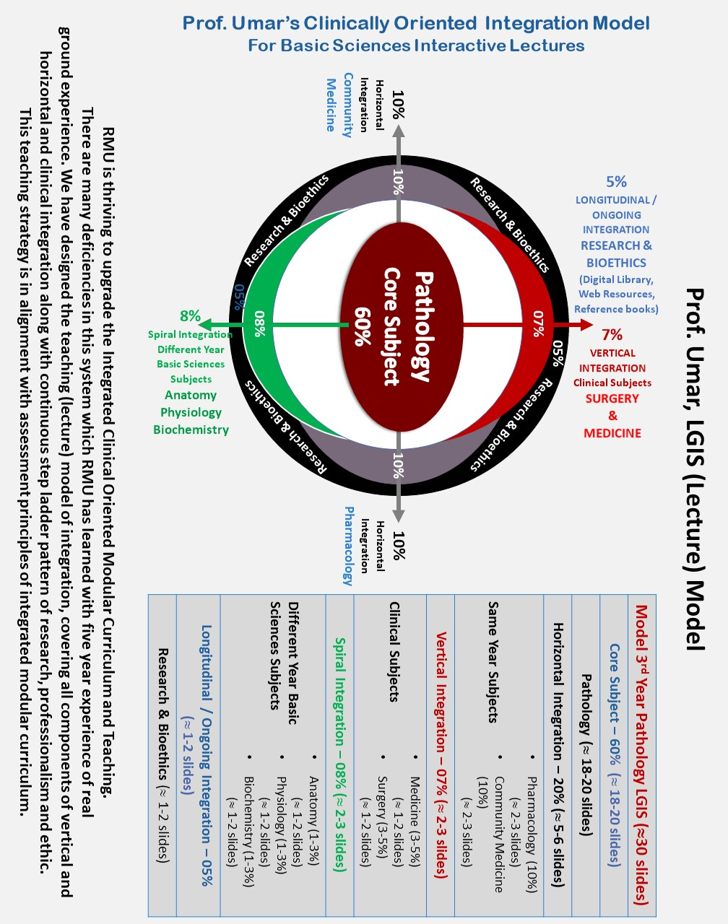

Slide 4
MEDICINE AND ALLIED INTRODUCTION
Dr. SAIMA AMBREEN
MBBS,FCPS (MED)
ASSOCIATE PROF. HOD mu1
Holy family hospital Rawalpindi

Slide 5
DEFINITION
CORE CONCEPT
Internal medicine or general internal medicine is the medical specialty dealing with the prevention, diagnosis, and treatment of diseases.

Slide 6
CORE CONCEPT
Internal medicine physicians are specialists who apply scientific knowledge and clinical expertise to the diagnosis, treatment, and compassionate care of adults across the spectrum from health to complex illness.

Slide 7
CORE CONCEPT
Internists receive significant training in many of the recognized sub-specialties of the profession and are trained in both inpatient and outpatient settings.
Family medicine physicians recEIVe education on a broad range of conditions and typically train in an outpatient setting with minimal experience in a hospital setting.

Slide 8
Internal Medicine Subspecialties
CORE CONCEPT
Some Internal Medicine physicians choose to take additional training to "subspecialize" in a more focused area of internal medicine.

Slide 9
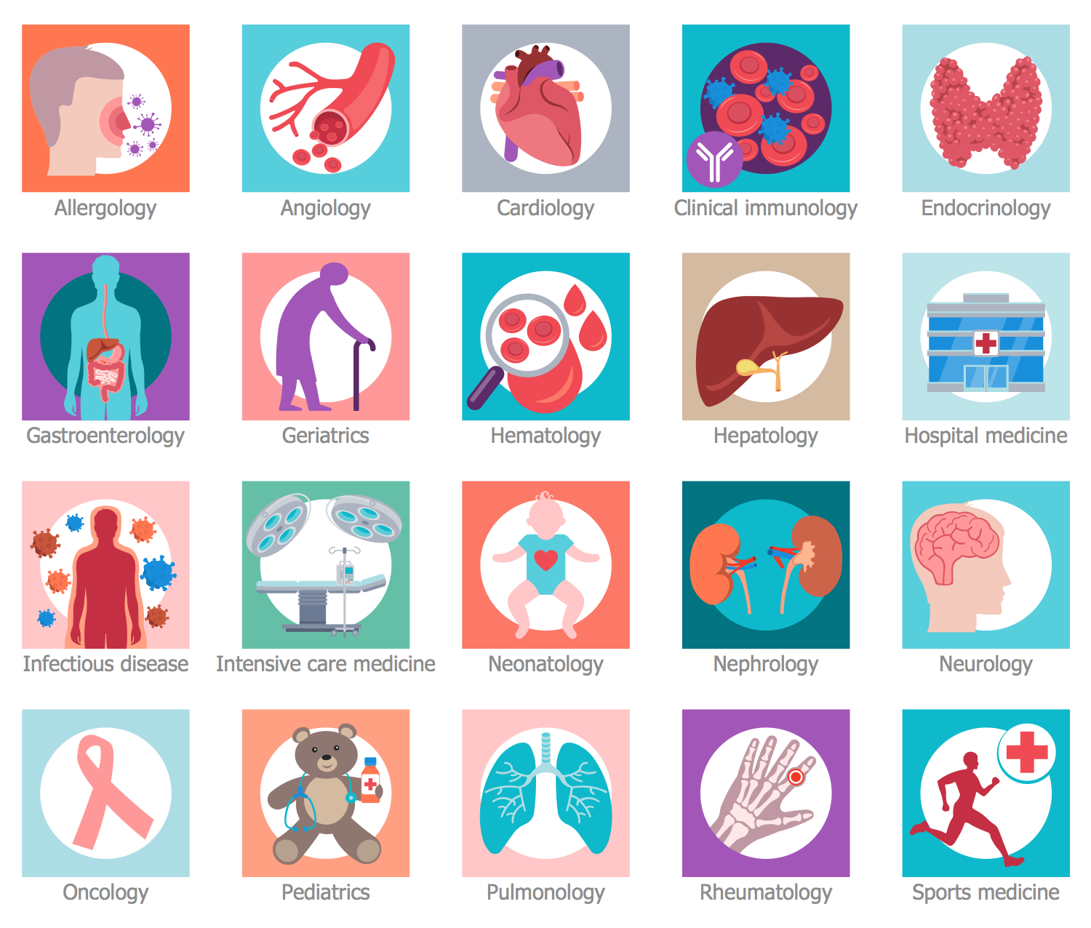

Slide 10
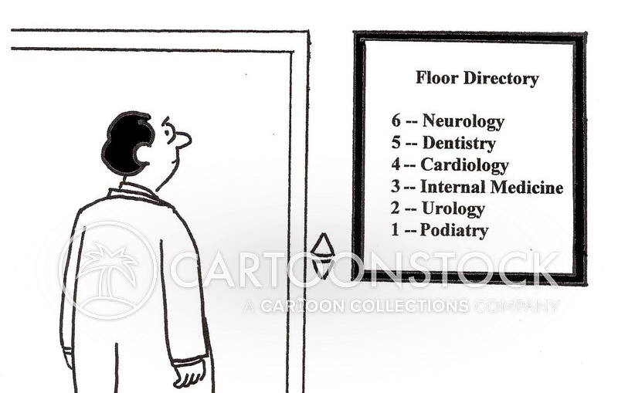

Slide 11
CORE CONCEPT
Physicians who have completed additional training in a particular area of internal medicine are frequently referred to by their area of subspecialty focus (heart -“cardiologists”)
The training also qualifies them to manage very complex medical issues and, in many cases, perform advanced clinical procedures.

Slide 12
CORE CONCEPT
Allergy and Immunology (immune system)
Critical Care Medicine (care of patients in intensive care settings)
Geriatric Medicine (care of older patients)
Hospice and Palliative Medicine (care of patients with serious illness)
Sleep Medicine (sleep disturbances and disorders)
Sports Medicine (sports and exercise)

Slide 13
CORE CONCEPT
Medical Oncology (cancer)
Pulmonology (lungs and respiratory system)
Rheumatology (joints and musculoskeletal system)
Hematology (blood)
Infectious Disease (bacterial, viral, fungal, and parasitic infections)
Nephrology (kidneys)
Neurology (with possible subspecialty in stroke medicine)
Dermatology ( SKIN)

Slide 14
CORE CONCEPT
Nuclear medicine
Rehabilitation medicine (with possible subspecialty in stroke medicine)
Tropical medicine
Acute medicine / hospital medicine

Slide 15
CORE CONCEPT
Sub-specialties have additional diagnostic tools, including those listed below.
Cardiology: angioplasty, cardioversion, cardiac ablation, intra-aortic balloon pump
Critical care medicine: mechanical ventilation
Gastroenterology: endoscopy and ERCP
Nephrology: dialysis
Pulmonology: bronchoscopy
The effectiveness and efficiency of the specialist referral process is an area of potential improvement.

Slide 16
Subspecialties
CORE CONCEPT
Cardiovascular Disease (heart and vascular system)
Cardiac Electrophysiology
Heart Failure and Transplant Cardiology
Interventional Cardiology
Endocrinology, Diabetes, and Metabolism (diabetes and other glandular and metabolic disorders)
Gastroenterology (gastrointestinal system, liver, and gall bladder)
Transplant Hepatology

Slide 17
GENERAL OBJECTIVES
VERTICAL INTEGRATION
Internal Medicine rotation should enable a student in:
1. History and Physical Examination – The effective acquisition of a medical history and the performance of a comprehensive physical examination.
2. Case Presentations - Students are expected to effectively record an initial history and physical examination and follow-up notes as well as deliver comprehensive oral presentations to their team members based on these written documents.

Slide 18
VERTICAL INTEGRATION
3. Test Interpretation – Basic understanding of routine laboratory and ancillary tests including complete blood count, chemistry panels, ECG, chest x-rays, pulmonary function tests, and body fluid cell counts.
4. Diagnostic Decision Making – The formulation of a differential diagnosis with up-to-date scientific evidence and clinical judgment .

Slide 19
VERTICAL INTEGRATION
5. Therapeutic Decision Making – This objective includes assessing the risks, benefits, and costs of varying, effective treatment options; involving the patient in decision-making via open discussion.
6. Core Internal Medicine Concepts – The development of a basic understanding of core Internal Medicine concepts.

Slide 20
VERTICAL INTEGRATION
7. Communication and Relationships with Patients and Colleagues The establishment of rapport with patients by identifying important psychosocial issues and providing patient-centered care through specific medical treatment as well as education
8. Bioethics of Patient Care – The development of a functional understanding of informed consent, advanced directives, and the physician-patient relationship.

Slide 21
VERTICAL INTEGRATION
9. Self-directed Learning – The identification of key information resources and the utilization of the medical literature to expand one’s knowledge base and to search for answers to medical problems.
10. Preventive Medicine –The promotion of health via adult immunizations, periodic health screening, and risk factor assessment and modification.
11. Research and Scientific Knowledge - Practice evidence-based learning with reference to research and scientific knowledge pertaining to their discipline through comprehensive training in Research Methodology

Slide 22
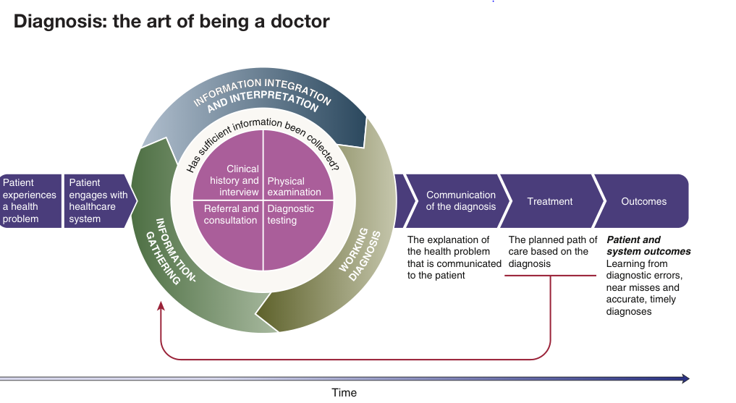

Slide 23
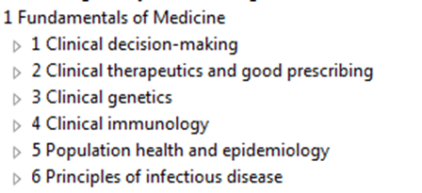

Slide 26
CORE CONCEPT
Under/Post-graduate medical education is provided by physicians as part of accredited education programs that are usually affiliated with teaching hospitals.
Medical research is an important part of most education programs.
Many licensed physicians continue to be involved in research activities.

Slide 27
VERTICAL INTEGRATION
In Pakistan, Medical Universities and the College of Physicians and Surgeons of Pakistan are responsible for setting curricula and training programs, although the process is monitored and accredited by the independent Pakistan Medical Council (which also maintains the specialist register).

Slide 28
FIVE STAR DOCTOR

Slide 29
VERTICAL INTEGRATION
Career Paths
Internal Medicine is a Launchpad for many different career pathways and a gateway to health care leadership and impact.

Slide 30
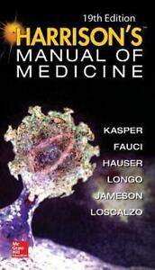
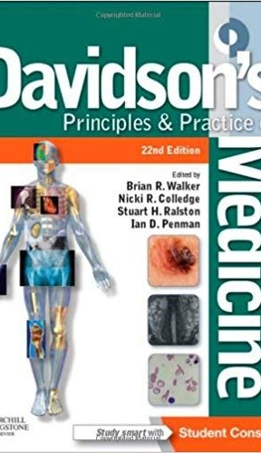
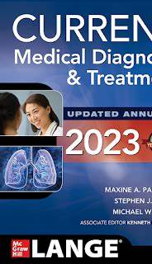
STUDY RESOURCES
VERTICAL INTEGRATION

Slide 31
SELF DIRECTED LEARNING

Slide 32
MEDICAL RESEARCH
MEDICAL RESEARCH

Slide 33
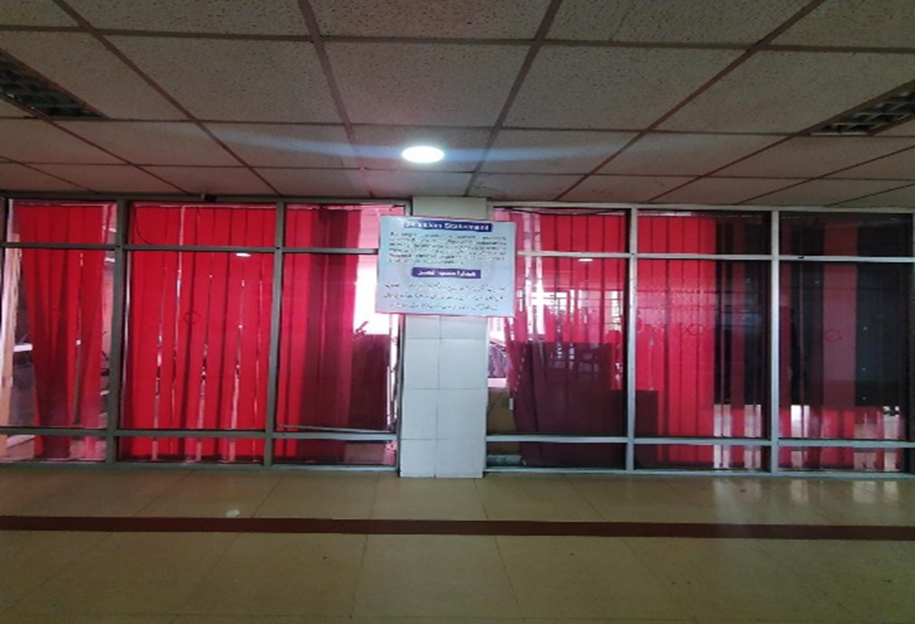
MEDICAL UNIT 1 HOLY FAMILY HOSPITAL

Slide 40
MCQS
Which of the following field of medicine is related to ventilator dependent patients.
a) dermatology
B) ENDOCRINOLOGY
C) GASTROENTEROLOGY
D) CRITICAL CARE
E) RHEUMATOLOGY
REFERENCE; DAVIDSON’s principles and practice of internal med, ed# 23

Slide 41
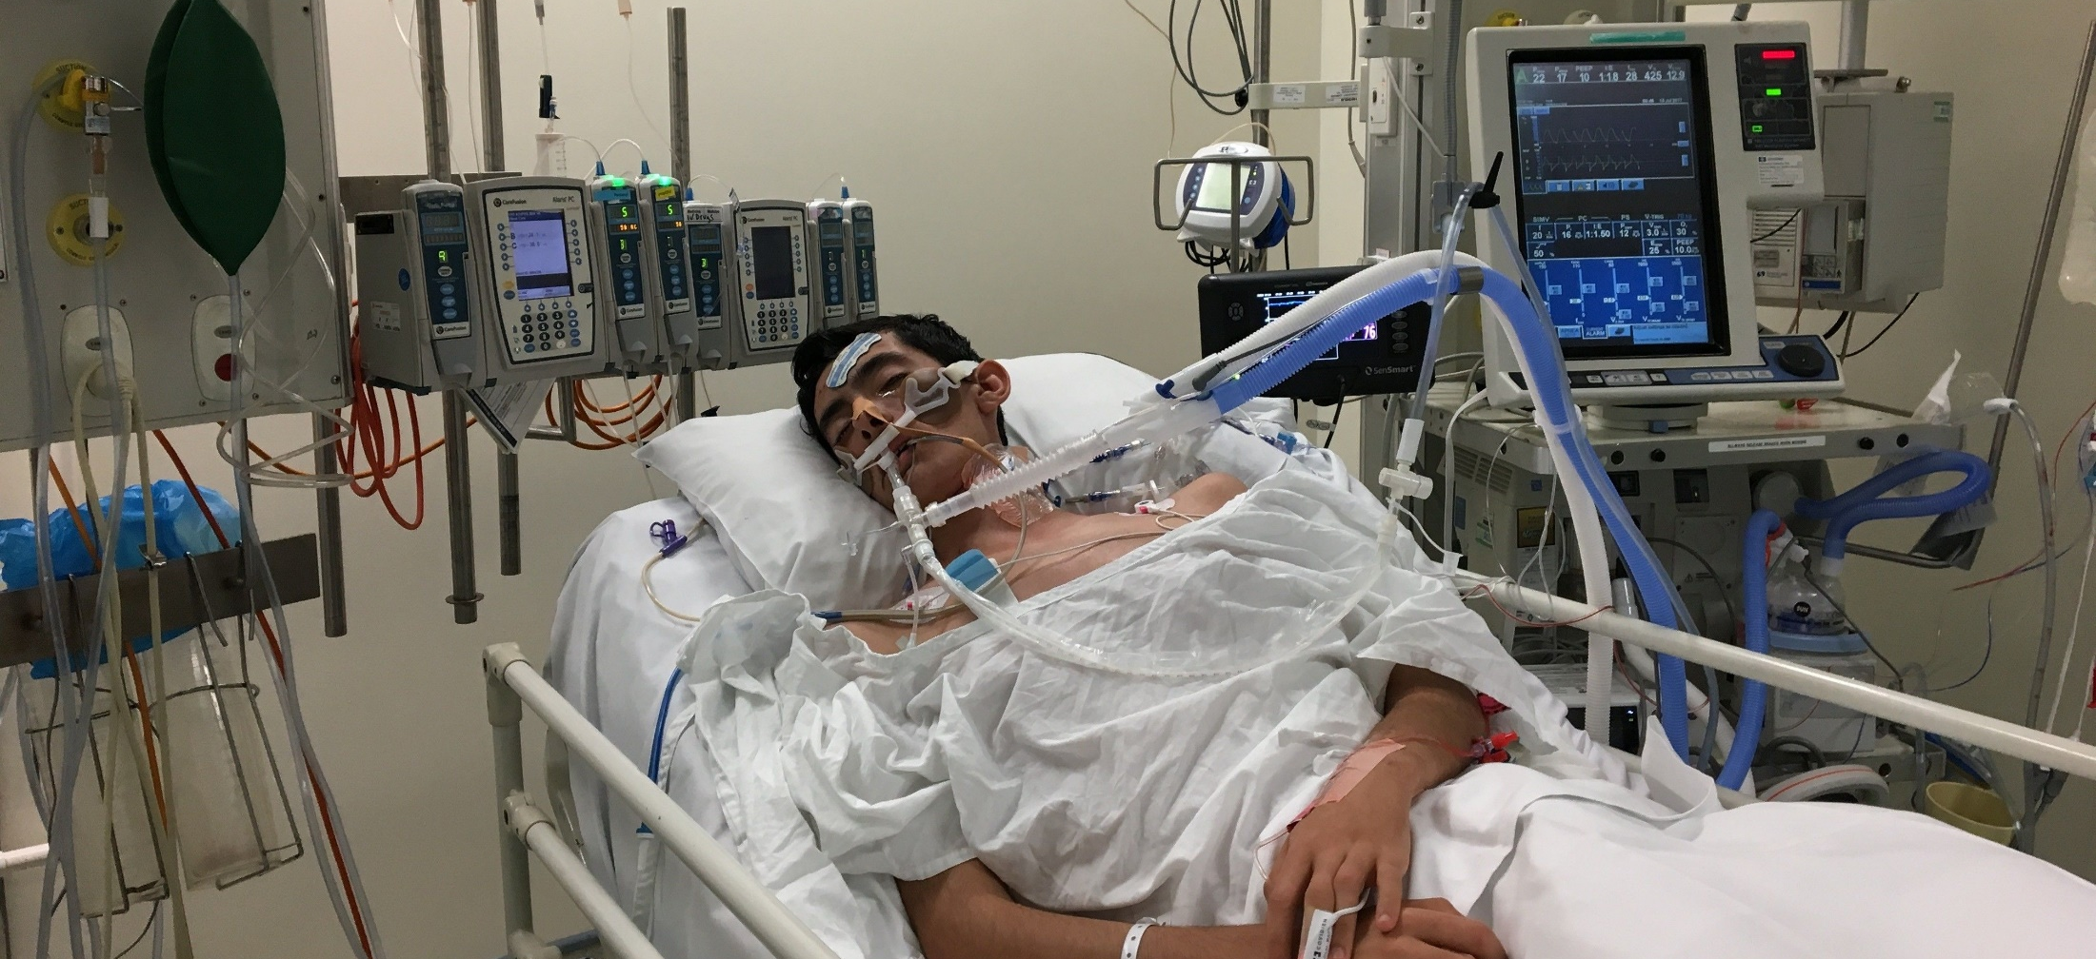
Answer d

Slide 42
2. A 15-year-old male presents to medical opd with vomiting, abdominal pain and fever for 1 week. On examination he was dyspneic with respiratory rate of 30/min. blood sugar was 500mg/dl. He will be managed by which team of doctors.
Cardiology
General surgery
Gastroenterology
Internal medicine
dermatology
REFERENCE; DAVIDSON’s principles and practice of internal med, ed# 23

Slide 43
Answer = internal med ( DX diabetic ketoacidosis)

Slide 44
3. Which of the following is the first step in patient assessment.
examination
History taking
Send BLOOD tests
Decision making
SEND PATIENT FOR IMAGING
REFERENCE; DAVIDSON’s principles and practice of internal med, ed# 23

Slide 45
ANSWER B

Slide 46
3. A 100-year-old male who was bed bound due to multiple co morbids, now presented to medical emergency with a large middle cerebral artery infarct. His Glasgow coma scale is 3/15 and is not improving despite treatment.
What is the best possible decision for this patient.
Surgery ( decompressive caraniotomy)
Increase aspirin dose
Give antibiotics
Palliative and comfort care
Put him on ventilator
REFERENCE; DAVIDSON’s principles and practice of internal med, ed# 23

Slide 47
ANSWER D

Slide 48
5. Which of the following is a component of a 5-star doctor.
punctual
Intelligent
Care provider
Irresponsible
Short tempered
REFERENCE; DAVIDSON’s principles and practice of internal med, ed# 23

Slide 49
ANSWER C

Slide 50
