Slide 1
MALARIA
Dr. Muhammad Mujeeb Khan
FCPS (Medicine)
Dip. DM (UK), Dip. Nutrition (Pak),
MSc. Infectious Diseases (UK)
Associate Professor
Rawalpindi Medical University, Rawalpindi

Slide 2
University Motto, Vision, Values & Goals
Mission Statement
To impart evidence-based research-oriented health professional education
Best possible patient care
Mutual respect, ethical practice of healthcare and social accountability.
Vision and Values
Highly recognized and accredited centre of excellence in medical education, using evidence-based training techniques for development of highly competent health professionals, who are lifelong experiential learner and are socially accountable.
Goals
The Undergraduate Integrated Learning Program is geared to provide you with quality medical education in an environment designed.

Slide 3
PROF UMER MODEL OF INTEGRATED LECTURE

Slide 4
SEQUENCE OF LGIS
Learning objectives
What is Malaria and how to diagnose it?(core concept = 70%)
Related pathology and pharmacology (horizontal integration 15%)
Recent advances and developments. (vertical integration – 10%)
Research article related to topic (3%) Ethics (2%)

Slide 5
LEARNING OBJECTIVES
At the end of the lecture, students will have learnt about
What is malaria?
Transmission and risk factors of malaria
Pathophysiology of malaria
Approach and management of malaria
Complications and prevention
Recent advances

Slide 6
CLINICAL SCENARIO
A 43-year-old woman from Rawalpindi with hypertension presented with a 12 days history of fever, chills, rigors, and sweating, along with headache, muscle aches, fatigue, loose stools, and dark urine. Physical exam showed jaundice and ultrasound revealed splenomegaly
WBC:: 9000,
Hb: 9.6 g/dL,
HCT: 27.6%,
Platelets: 680000
Biochemistry:
Total Bilirubin 4.6 mg/dL,
Urea 24 mg/dL,
Creatinine: 1.1 mg/dL
What is Diagnosis?

Slide 7
MALARIA: THE SILENT KILLER
It is life threatening disease caused by plasmodium parasites
Transmission: By the bite of infected female anopheles mosquito
It causes RBCs destruction and may result in organ damage
It is fatal disease if untreated
263 million cases reported in 2023 and deaths remaining high at around 597000

Slide 8
INTRODUCTION
There are five species of Plasmodium known to cause malaria in humans:
P. falciparum: Most prevalent and associated with severe disease.
P. vivax: Common and capable of causing relapses due to dormant liver stages.
P. ovale: Less common; can also cause relapses.
P. malariae: Less common; associated with chronic infections.
P. knowlesi: Zoonotic species primarily infecting macaques but can infect humans, leading to malaria.

Slide 9
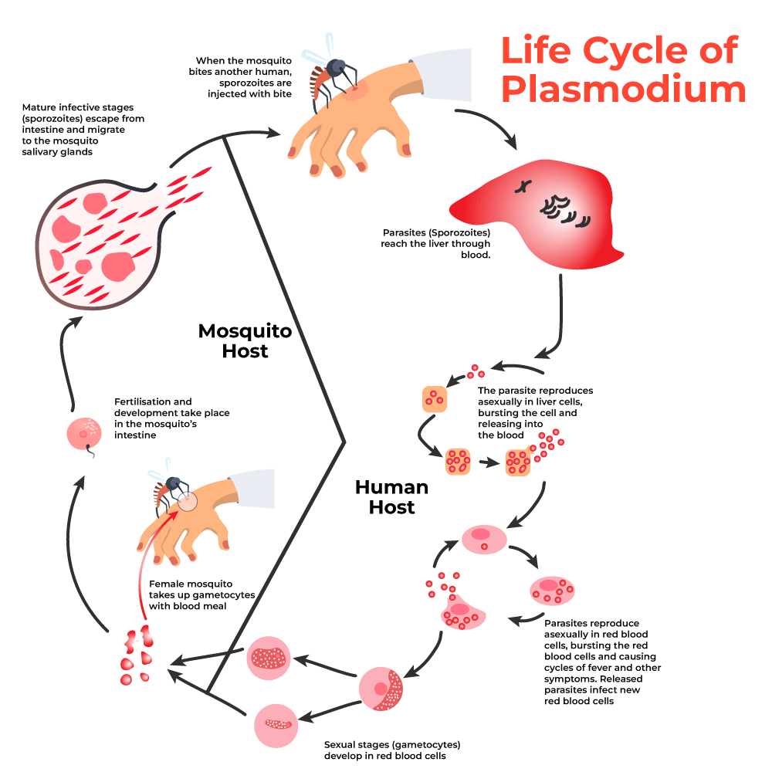

Slide 10
Risk Factors
Geographical Exposure:
Living in or traveling to regions where malaria is endemic, particularly tropical and subtropical areas.
Time Spent Outdoors:
Engaging in outdoor activities, especially in rural areas, increases exposure to mosquito bites.
Lack of Preventive Measures:
Not using protective measures such as insect repellent, bed nets, or appropriate clothing to prevent mosquito bites.

Slide 11
Risk Factors
Vulnerable Populations:
Pregnant women
Children under 5 years of age
Individuals with HIV/AIDS
These groups are at higher risk of severe infection and complications.

Slide 12
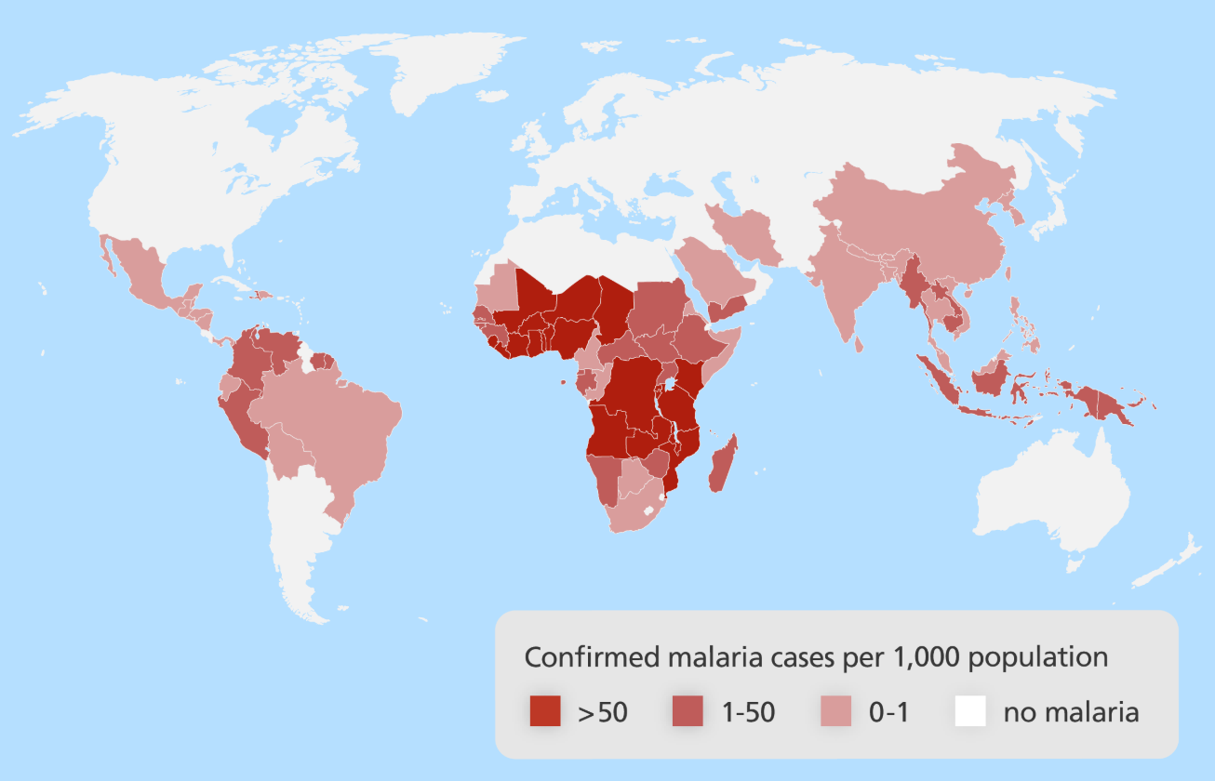
This map shows areas where Plasmodium falciparum is endemic around the world.
Malaria is a disease of the developing world affecting people in some of the poorest countries, especially in sub‐Saharan Africa. It is considered a disease of poverty but is also a major cause of poverty .

Slide 13
INCUBATION PERIOD OF THE PARASITE
Plasmodium Species | Typical Incubation Period
P. falciparum | 9–14 days
P. vivax | 12–17 days
P. ovale | 12–18 days
P. malariae | 18–40 days
P. knowlesi | 9–12 days
These incubation periods can vary based on factors such as the strain of the parasite, host immunity, and environmental conditions.

Slide 14
PATHOPHYSIOLOGY OF MALARIA
Female Anopheles mosquito bite injects sporozoites into blood stream
Sporozoites travel to liver, invade hepatocytes and mature into schizonts
P.Vivax & ovale
enters dormant phase (hypnozoites)
Schizonts undergo replication produces
thousands of merozoites inside hepatocytes
Merozoites enters into circulation and infects RBCs
Infected RBCs rupture, releasing more merozoites
RBCs destruction leads to Anemia, Jaundice, Splenomegaly

Slide 15
PATHOPHYSIOLOGY OF MALARIA:
INFLAMMATORY AND IMMUNE RESPONE:
Immune system responds with cytokine release (TNF-α, IL-1, IL-6
Fever, chills, rigors and systemic inflammation
Severe cases: Shock, Lactic acidosis, multiorgan failure

Slide 16
P. FALCIFARUM CAUSES SEVERE MALARIA
P. facliparum infected RBCs manifest specific protein on membrane
This protein binds to endothelial receptors causing sequestration of infected RBC
Into small blood vessles
Microvascular obstruction & cerebral malaria, organ dysfunction

Slide 17
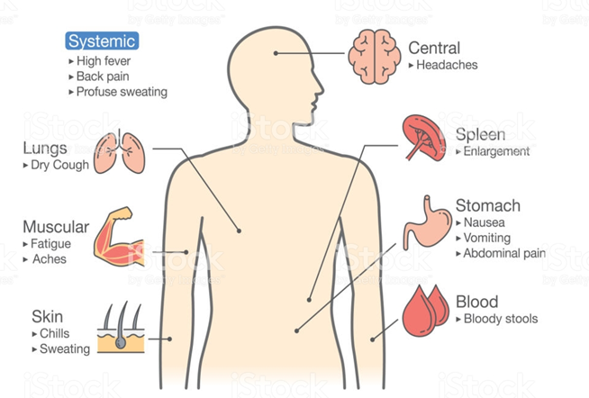
SYMPTOMS OF MALARIA

Slide 18
DIAGNOSIS OF MALARIA
Medical History
Physical Examination
Laboratory Diagnosis
Microscopy | Immunological | Molecular
Films of blood (Thick & Thin blood smear) | Antibody based techniques (serological test) ELISA Indirect Fluorescent antibody test (IFAT) | Polymerase chain reaction (PCR)
Quantitative Buffy coat (QBC) Test | Antigen based techniques Rapid diagnostic tests (RDTs)

Slide 19
Contt…
TREATMENT OF MALARIA
Uncomplicated Malaria:
P. falciparum:
Artemisinin based therapy (ACTs) is first line
Artemether-lumefantrine
Artesunate-amodiaquine
Artesunate-mefloquine
Chloroquine if sensitive
P. vivax & Plasmodium Ovale:
Artemisinin based therapy (ACT) + primaquine
Chloroquine (if sensitive) + Primaquine
P. Malariae and knowlesi:
Chloroquine or Artemisinin based therapy (ACTs)

Slide 20
PRIMAQUINE
Treatment of P. Vivax & ovale with out primaquine is like locking te door but leaving the window open
P. Vivax and ovale forms hypnozoites, which remains dormant in liver for months to years
Primaquine kills hypnozoites: 15 mg Once a day for 14 days
Newer drug: Tafenoquine: 300 mg single dose
Unchecked G6PD + primaquine may be recipe for severe hemolysis
Always check G6PD levels before prescribing primaquine or tafenoquine
G6PD deficient can not handle oxidative stress caused by primaquine

Slide 21
SEVERE MALARIA
Definition: Acute malaria with major signs of organ dysfunction and/or high level of parasitemia
Manifestations:
Impaired Consciousness: GCS < 11 in adults or Blantyre score < 3 in cildren
Prostration: Severe generalized weakness (unable to sit, stand or walk with out support)
Shock:
Systolic blood pressure < 80 mmHg in adults with evidence of poor perfusion
Systolic blood pressure < 70 mmHg in children with evidence of poor perfusion
Significant bleeding
Pulmonary edema

Slide 22
SEVERE MALARIA
Severe anemia: Hb < 7 g/dl. Or hematocrit < 20%
Jaundice: Serum bilirubin > 3 mg/dl
Renal Impairment: Creatinine > 3 mg/dl or blood urea > 20 mmol/l
Hyperparacitemia: Paracitemia >10%
Acidosis: Plasma HCO3 < 15 or plasma lactate > 5
Hypoglycaemia:
Plasma glucose < 40 mg/dl in adults
Plasma glucose < 54 mg/dl in < 5 years old child

Slide 23
TREATMENT OF SEVERE MALRIA
IV artesunate: 2.4 mg/kg IV at 0, 12, 24 hours hen daily
Alternate
IV quinine (If artesunate not available)
Loading dose: 20mg/kg IV over 4 hours
Maintenance: 10 mg/kg IV every 8 hours
Switch to oral therapy after 48 hours or when patient improves

Slide 24
COMPLICATIONS OF MALARIA
Species | Major Complications
P.Falciparum | Cerebral Malaria, Hemolytic anemia (Black Water Fever), Jaundice, Hypoglycemia
P. Vivax | Relapse due to liver hypnozoites
P. Ovale | Relapse due to liver hypnozoites
P. Malaria | Nephrotic Syndrome

Slide 25
COMPLICATIONS OF MALARIA
CNS
Cerebral Malaria
(Coma)
Renal
Haemoglobinuria
(black water fever), Acute Renal Failure, Oliguria
Blood
DIC
Severe Hemolytic anemia, ARDS
Metabolic
Hypoglycemia, Metabolic acidosis
GIT
Diarrhea, Jaundice, Splenic Rupture
Others
Shock, Hypotension, Hyperpyrexia

Slide 26
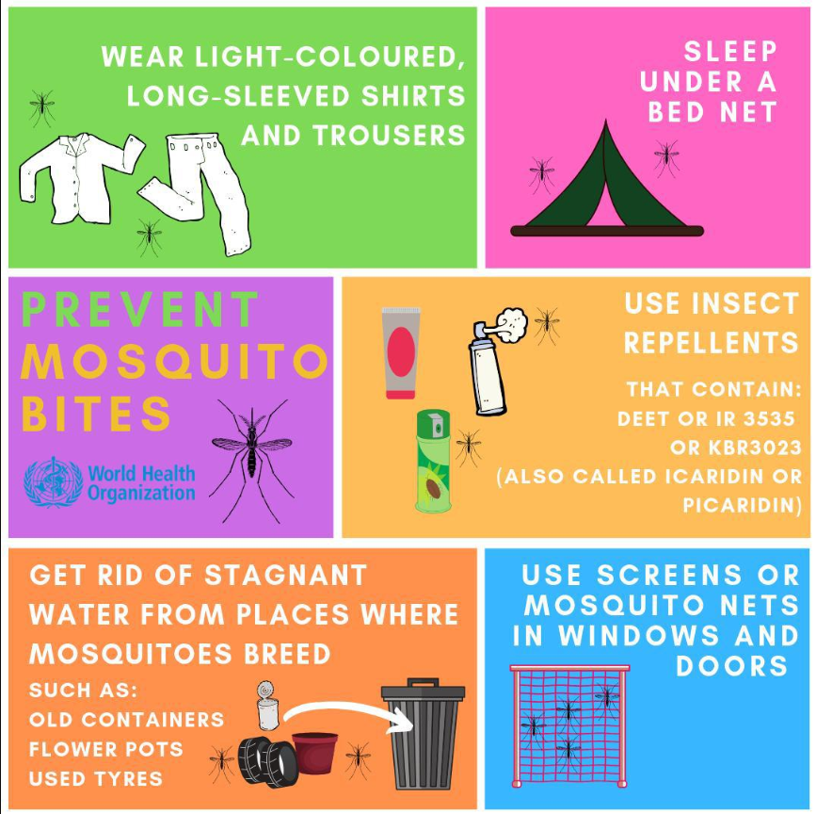
PREVENTION
Prevent Mosquito Bites:
Cover Exposed Skin
Use Insect Repellent
Sleep Under Mosquito Nets
Eliminate standing water where mosquitoes breed.
Chemoprophylaxis:
In malaria-endemic areas, take prescribed antimalarial drugs as recommended.

Slide 27
RECENT ADVANCES IN MALARIA
Vaccines:
R21/Matrix-M Vaccine: (approved in 2021)
It has 75% efficacy in preventing severe malaria in children and is available in some African countries
Mosquirix: RTS,S/AS01 (approved in 2023)
Targets plasmodium falciparum
Prevents severe malaria by approximately 30%

Slide 28
RECENT ADVANCES IN MALARIA
Drug Development
Tafenoquine (Krintafel): A newer drug related to primaquine
Nanotechnology-Based Therapies:
Nanoparticles help deliver antimalarial drugs directly to infected cells

Slide 29
REFERENCES
World Health Organization. Guidelines for the treatment of malaria. 3rd ed. Geneva: World Health Organization; 2015.
White NJ, Pukrittayakamee S, Hien TT, Faiz MA, Mokuolu OA, Dondorp AM. Malaria. Lancet. 2014;383(9918):723-35.
Ashley EA, Phyo AP, Woodrow CJ. Malaria. Lancet. 2018;391(10130):1608-21.
Centres for Disease Control and Prevention. Malaria: diagnosis and treatment. CDC. 2023.
Dondorp AM, Fanello CI, Hendriksen IC, Gomes E, Seni A, Chhaganlal KD, et al. Artesunate versus quinine in the treatment of severe falciparum malaria in African children (AQUAMAT): an open-label, randomised trial. Lancet. 2010;376(9753):1647-57.
Baird JK. Evidence and implications of mortality associated with acute Plasmodium vivax malaria. Clin Microbiol Rev. 2013;26(1):36-57.
Greenwood BM, Fidock DA, Kyle DE, Kappe SH, Alonso PL, Collins FH, et al. Malaria: progress, perils, and prospects for eradication. J Clin Invest. 2008;118(4):1266-76.

Slide 30
Thank You

