Slide 2
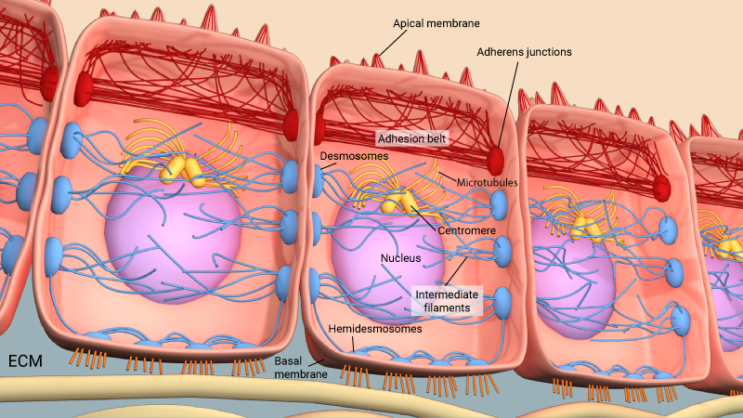
Foundation Module 1st Year MBBS(LGIS) Intercellular Junctions And Adhesions
Presenter: Dr. Mohtasham Hina Date: 11-03-25
(Associate Professor)

Slide 3
Prof. Umar’s Model of Teaching Strategy
First Ten Minutes
Self Directed Learning Assessment Program
Objectives :To cultivate critical thinking, analytical reasoning, and problem-
solving competencies.
To instill a culture of self-directed learning, fostering lifelong learning habits and autonomy.
How to Assess?
Ten randomly selected students will be evaluated within the first 10 minutes of the lecture through 10 multiple-choice questions (MCQs) based on the PowerPoint presentation shared on Students Official WhatsApp group, one day before the teaching session.
The number of MCQs from the components of the lecture will follow the guidelines outlined in the Prof. Umar model of Integrated Lecture.
Component of LGIS | Core Knowledge | Horizontal Integration | Vertical Integration | Spiral Integration
No of MCQs | 6-7 | 1-2 | 1 | 1

Slide 4
Professor Umar Model of Integrated Lecture

Slide 5
Learning Objectives
What are cell junctions
Types of cell junctions
Ultrastructure of different cell junctions
Location and function of cell junctions

Slide 6
interactive Session
While hanging out, a group of friends ate at an unhygienic countryside hotel. The next morning, one of them developed severe abdominal pain, diarrhea and vomiting for which he was admitted to hospital. Diagnosis of food poisoning by Clostridium perfringens was made. Patient was treated and started to get better after 24 hours.

Slide 7
Cell Junctions
Core Knowledge
Occluding junctions (zona occludens)
Anchoring junctions
Zonula adherens
Macula adherens
Gap junctions

Slide 8
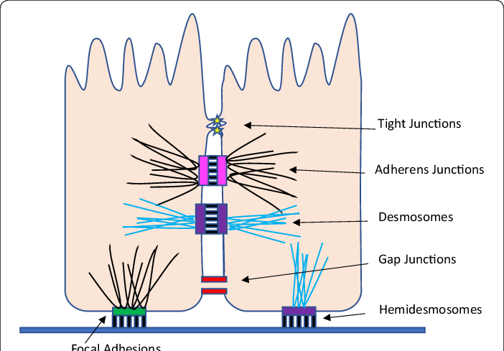
Types of Junctions
Core Knowledge

Slide 9
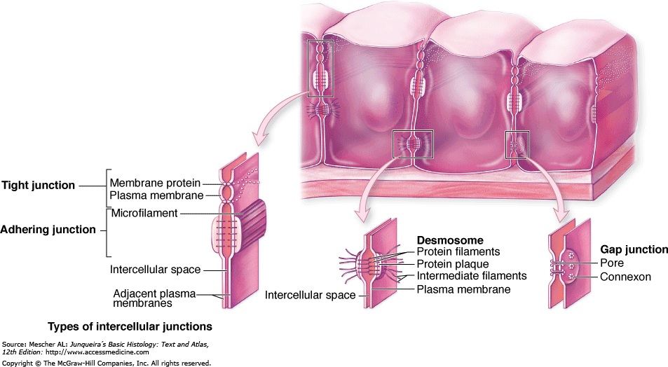
Occluding Junctions
Core Knowledge

Slide 10
Occluding Junctions
Core Knowledge

Slide 11
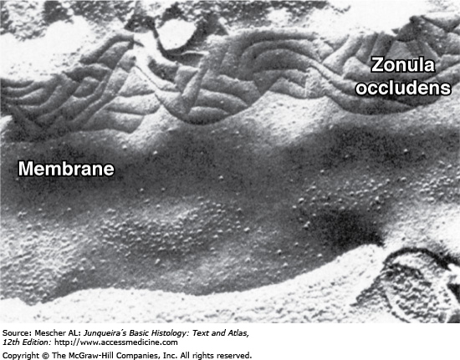
Occluding Junctions
Core Knowledge

Slide 12
Occluding Junctions
Core Knowledge

Slide 13
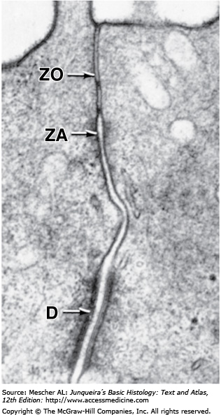
Occluding Junctions
Core Knowledge

Slide 14
Anchoring Junctions (Zonula Adherens)
Core Knowledge

Slide 15
Macula Adherens
Core Knowledge
Plakophilin
Plakoglobin
desmoplakin

Slide 16
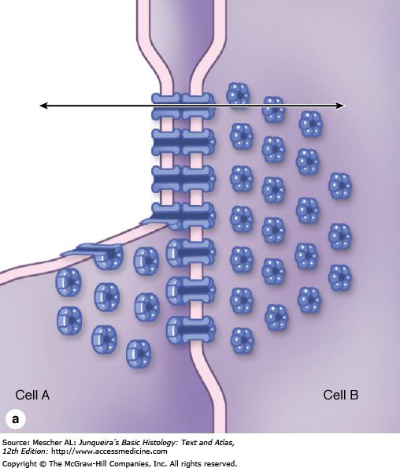
Gap Junctions
Core Knowledge

Slide 17
Gap Junctions
Core Knowledge

Slide 18
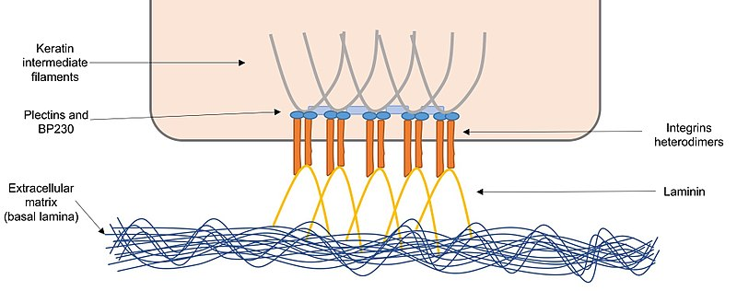
Hemidesmosomes
Core Knowledge

Slide 19
Core Knowledge

Slide 20
Core Knowledge

Slide 21
Bio-Physiological Aspects
Horizontal Integration
Epithelia form a physical barrier that allows the body to maintain internal homeostasis while protecting the organism from harmful pathogenic agents from the external environment.
Adhesion
Channels for communication

Slide 22
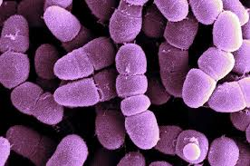
Interactive Session
Vertical Integration
Bacteria. A common bacterium that causes food poisoning, Clostridium perfringens, attacks the zonula occludens junction.
Helicobacter pylori, another bacterium, resides within the stomach and binds to the extracellular domains of zonula occludens proteins
The common house dust mite, destroys zonula occludens junctions. When its fecal pellets are inhaled with dust particles, serine and cysteine peptidases present in the pellets cleave occluding and ZO1 protein, resulting in the breakdown of zonula occludens junctions in the respiratory epithelium. The loss of the protective epithelial barrier in the lung exposes the lung to inhaled allergens and initiates an immune response that can lead to severe asthma attacks.

Slide 23
Spiral Integration
Family Medicine
1. Initial Assessment:
History:
Ask about recent food intake (e.g., improperly cooked or stored meat, poultry).
Identify symptoms like diarrhea, abdominal cramps, nausea, or fever.
Note the duration and onset of symptoms, typically within 6-24 hours of ingestion.
Physical Examination:
Check for signs of dehydration (e.g., dry mucous membranes, tachycardia, reduced urine output).
Assess abdominal tenderness or distension
Symptomatic Management:
Hydration:
Encourage oral rehydration with fluids containing electrolytes.
For severe dehydration, consider intravenous fluids.
Symptom Control:
Antispasmodics for abdominal cramps (e.g., hyoscine).
Avoid anti-diarrheal agents like loperamide if infection is suspected, as they can prolong bacterial toxin effects.

Slide 24
Intercellular adhesion: Mechanisms for Growth and Metastasis of Epithelial Cancers
Spiral Integration
Research
Eric M. Balzer^{1,2,3} and Konstantinos Konstantopoulos
https://pubmed.ncbi.nlm.nih.gov/?term=Konstantopoulos%20K%5BAuthor%5D
Intercellular adhesion molecules are also involved in each subsequent phase of metastasis, including transendothelial migration, transit through the bloodstream or lymphatics, and renewed proliferation in secondary sites

Slide 25
Spiral Integration
Bioethics
Informed Consent: Patients with food poisoning caused by Clostridium perfringens should be informed about the bacteria's effects on tight junctions (e.g., zonula occludens) and the potential consequences on intestinal integrity.
Justice: Equal access to proper diagnosis, treatment, and preventive measures, such as safe food storage and preparation techniques, should be ensured for all populations, especially vulnerable groups.
Non-Maleficence: Healthcare providers must prioritize early diagnosis and appropriate treatment to prevent complications like intestinal barrier dysfunction due to bacterial toxins.
Research Ethics: Studies on Clostridium perfringens and its effects on cellular junctions must comply with ethical standards, ensuring transparency, informed consent for human participation, and responsible use of data.

Slide 26
Spiral Integration
Artificial Intelligence
Role of AI in Diagnosis of Clostridium perfringens
AI can potentially aid in enhancing diagnostic accuracy and efficiency.
AI-powered decision support systems can also help clinicians in selecting appropriate treatment modalities

Slide 27
How To Access Digital Library
Go to the website of HEC National Digital Library.
On Home Page, click on the INSTITUTES.
A page will appear showing the universities from Public and Private Sector and other Institutes which have access to HEC National Digital Library HNDL.
Select your desired Institute.
5. A page will appear showing the resources of the institution
6. Journals and Researches will appear
7. You can find a Journal by clicking on JOURNALS AND DATABASE and enter a keyword to search for your desired journal.

Slide 28
Learning Resources
Junqueira’s Basic Histology 12th Edition, Chapter 4
Histology , A text and Atlas by Michael H.Ross 7th Edition, Chapter 5
DiFiore's Atlas of Histology with Functional Correlations 11th Edition, Chapter 2
Google scholar

