Slide 1
LOWER GIT BLEEDING
Dr Faryal Azhar

Slide 2
Mission Statement
To impart evidence-based research-oriented health professional education
Best possible patient care
Mutual respect, ethical practice of healthcare and social accountability.
Vision and Values
Highly recognized and accredited centre of excellence in
Medical Education, using evidence-based training techniques for development of highly competent health
professionals, who are lifelong experiential learner and are socially accountable.
Goals
The Undergraduate Integrated Learning Program is geared to provide you with quality medical education in an environment designed to:

Slide 4
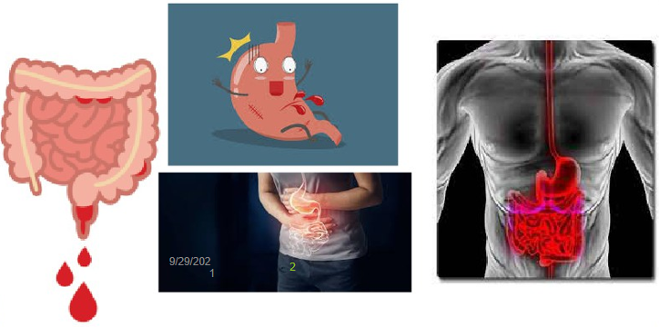

Slide 5
Learning Objectives:
At the end of this lecture you must know:
difference between upper and lower GI bleeding
causes of lower GI bleeding
Clinical presentation
how to investigate patient with LGI bleed
differential diagnosis
Risk factors
complications
Management

Slide 6
Introduction
Lower gastrointestinal bleeding occurs distal to the ligament of Treitz and may involve the small bowel, colon, and rectum.
Lower gastrointestinal bleeding is less common than upper and accounts for approximately 30% of all gastrointestinal bleeding and the rates here are affected by the H Pylori prevalence .

Slide 7
The H Pylori prevalence is affected by the socioeconomic factors.
Lower gastrointestinal bleeding tends to affect the elderly patients and is more
likely to occur in an 80 years old than in a 20 years old patient.

Slide 8
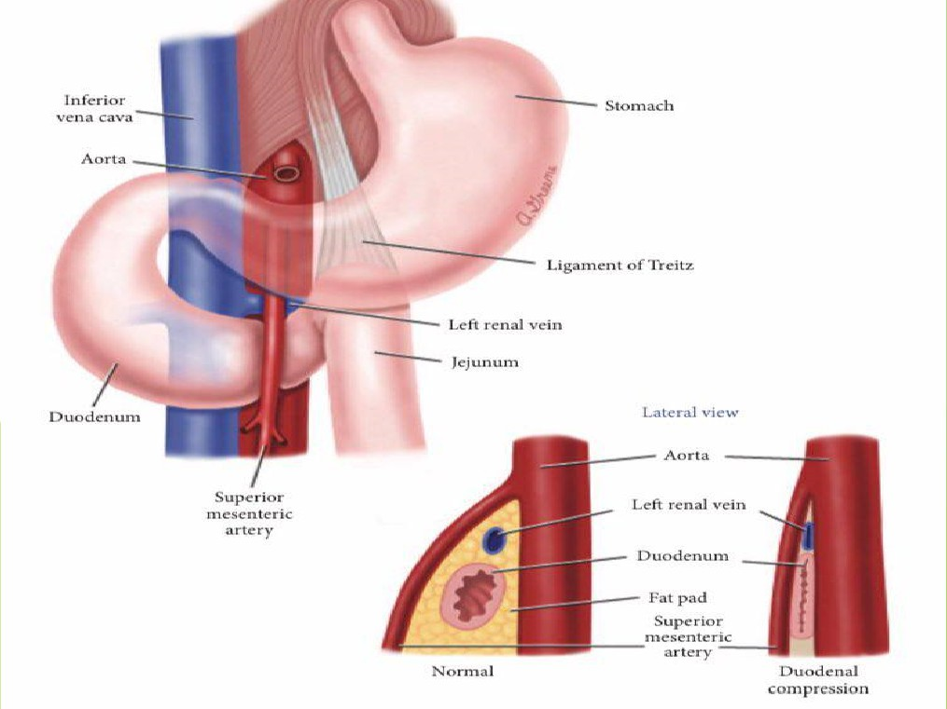
9

Slide 9
Incidence:
Lower GI bleeds are fairly common and account for 20% to 30% of all patients with major GI bleeding.
The incidence is higher in older patients and patients taking multiple medications.
Approximately 80% to 85% of lower GI bleeds originate distal to the iliocaecal valve , with only 0.7% to 9% originating from the small intestine .

Slide 10
9

Slide 11
Clinical presentation:
Hematochezia: is the passage of fresh blood per anus. Which can range from bright red to old clots.
Melena: is the passage of black, tarry stools. If the bleeding is slower or from a more proximal source.

Slide 12
Bleeding per rectum
Bright red stool :Piles/polyps/fissure
Altered blood: cancer/ ulcer/ IBD/ dysentery
Maroon color: Meckle's diverticulum
Streaks of blood: Anal fissure
Splash in pain: Piles
Red currant jelly: Intussusception
Blood with mucus: Colitis/ Cancer / Dysentery

Slide 13
Bleeding in Stool
Relationship to defecation:
1- Initial / before defecation: external-anal fissures, trauma,
abscess.
2- Terminal / after defecation: hemorrhoids
3-mixed/total: higher up tumors,vascular,polyps
Associated symptoms:
1-pain
2-mucus-inflammation/infection/tumors
3-abdominal symptoms- cramping pain
4-symptoms related to primary cause- cancer

Slide 14
Categorization of (LGI) bleeding by intensity:
Massive Bleeding: Presents as a large volume of bright red blood PR bleeding > 1.5 L /day, hemodynamic instability and shock
decrease in hematocrit level of 6g /dl
Common causes: Diverticula / Angiodysplasia/ Ischemic colitis
transfusion of at least 2 units of blood bleeding that continues for 3 days.
Moderate Bleeding:
present with any age, presents as hematochezia or melena, hemodinamically stable.
cause: anorectal,congenital,inflammatory, and neoplastic diseases.
initial decrease in hematocrit level of 8g /dl or less.

Slide 15
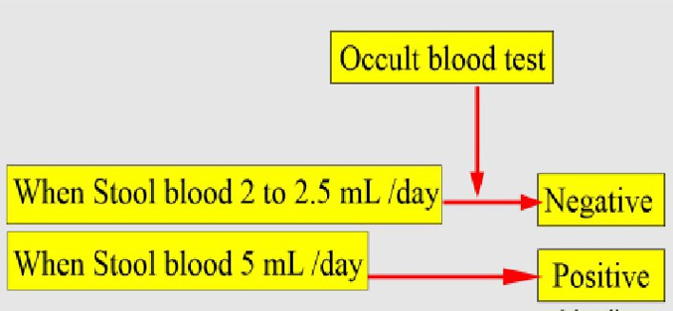
Occult Bleeding
Detected by routine chemical tests of the stool, with or without systemic evidence of chronic blood loss.
5ml of blood loss/day is necessary to have stool occult positive
cause: carcinoma/colitis/large adenoma

Slide 16
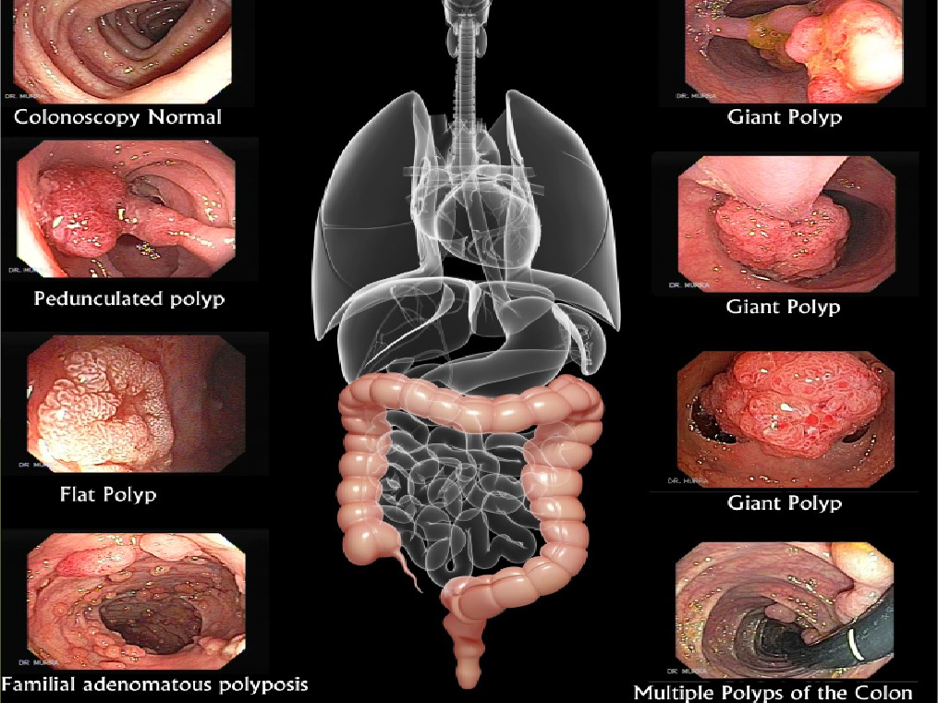
9

Slide 17
9

Slide 18
Acute lower GI bleeding:
Bleeding of recent duration< 3days, that may result in
hemodynamic instability, anemia, and/ or the need for blood
transfusion.
Chronic lower GI bleeding:
Bleeding over several days or longer, and usually intermittent
or slow loss of blood.
Patients present with occult fecal blood intermittent melena
or maroon stools, or scant amounts of bright red blood /rectum.

Slide 19
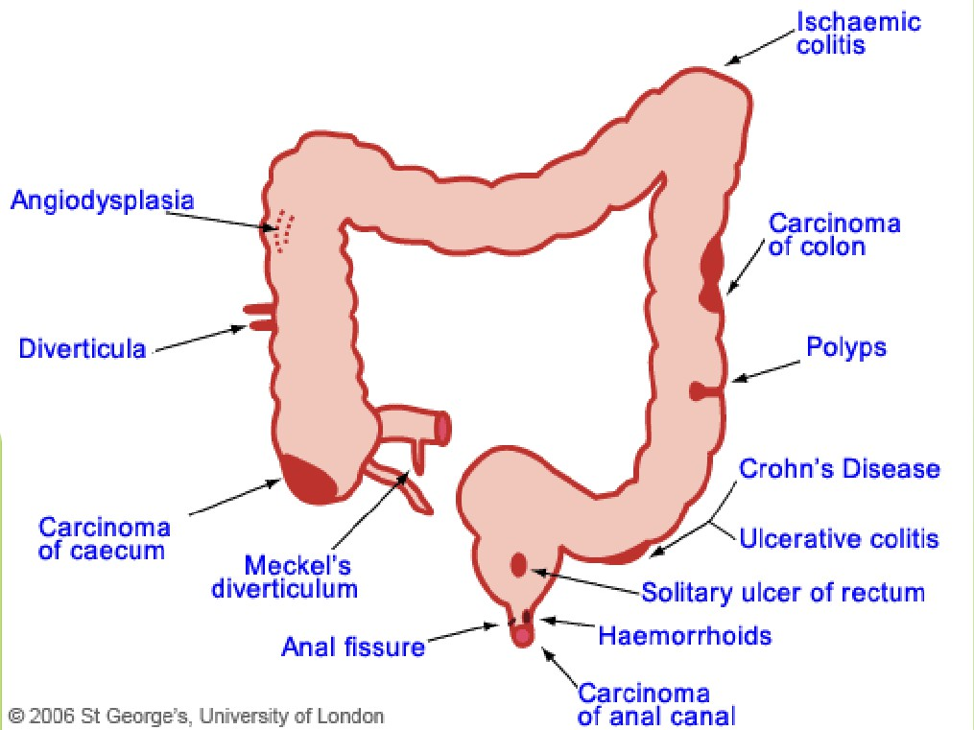
9

Slide 20
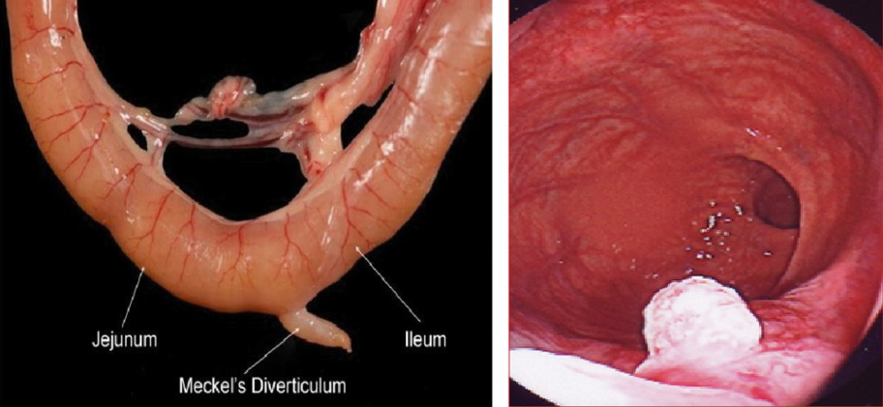
Meckel’s Diverticulum
Solitary ulcer of rectum

Slide 21
causes of sub acute /Chronic
Anal diseases
Inflamatory bowel disease
Large polyp
Carcinoma
solitary rectal ulcers
radiation enteritis

Slide 22
Local causes : site
1- small intestine:
Polyp/Meckel’s diverticulum/ulcers/ tumors/ intussuception
2-large intestine: Angiodysplasia/ carcinoma/ colitis/ diverticulitis
3-perianal: Injury/ rupture (anorectal abscess)/ candyloma/carcinoma
4-Anal: Piles/ anal fissure/ carcinoma/ fistula in ano
9/29/202
21
1

Slide 23
History and Examination:

Slide 24
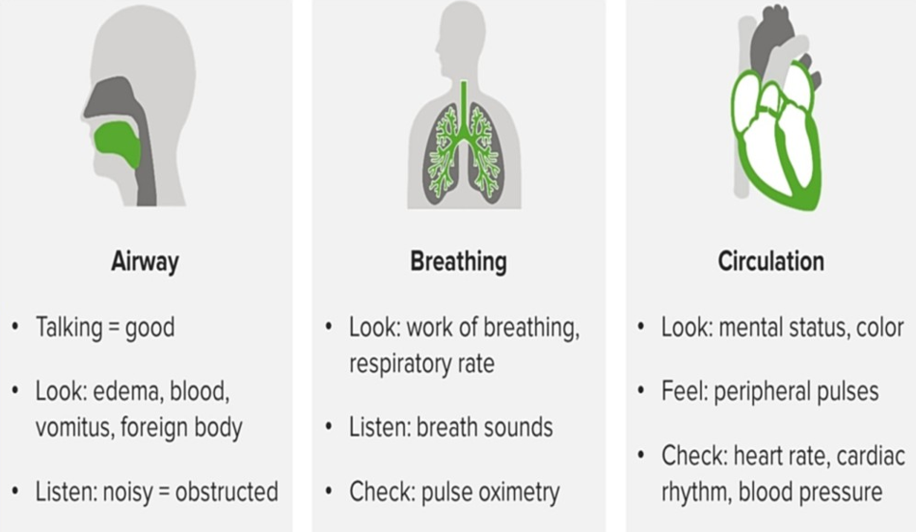
Start the physical examination with
the ABCs:

Slide 25
Important Physical Findings

Slide 26
Investigations:

Slide 27
9

Slide 28
9

Slide 29
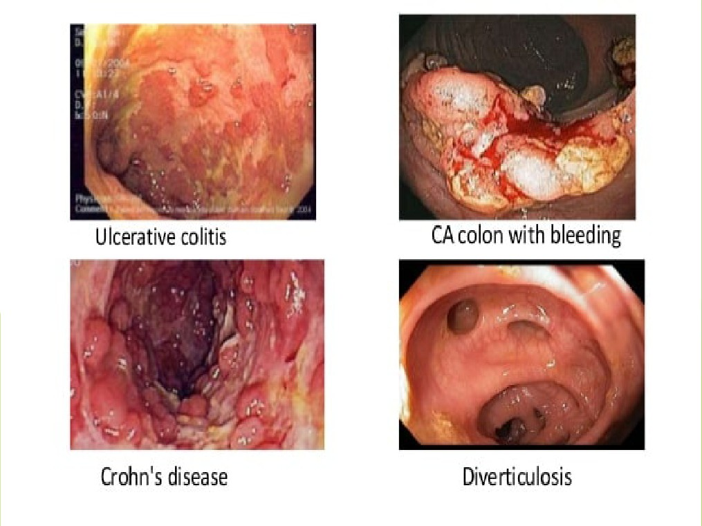
9

Slide 30
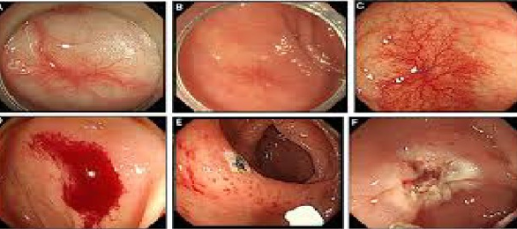
colonic angiodysplasia & colonic varices

Slide 31
Rectal CA

Slide 32
Ischemic colitis

Slide 33
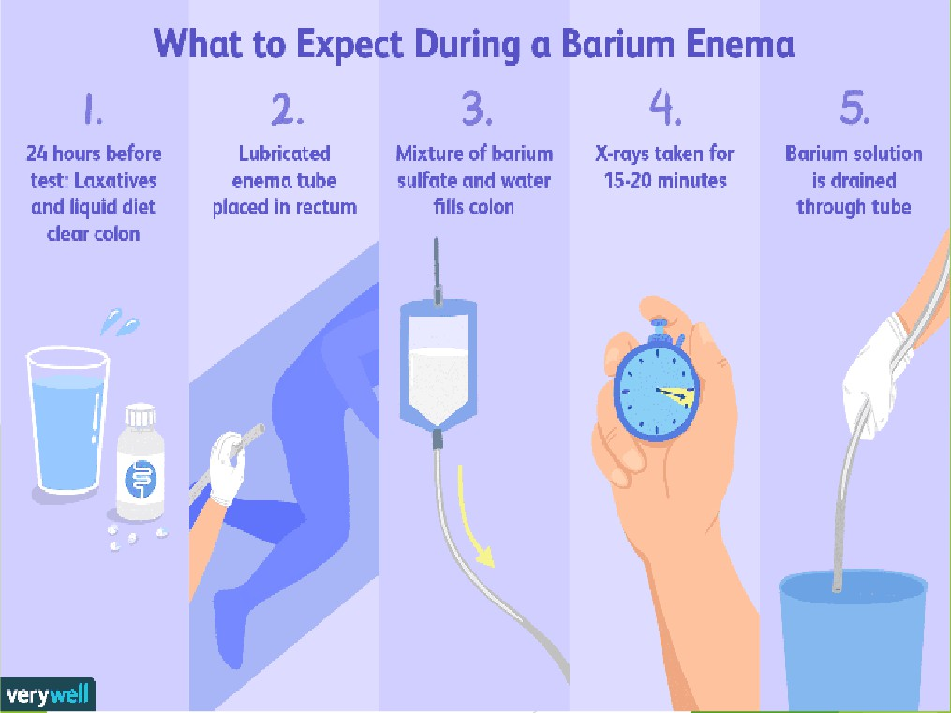
9

Slide 35
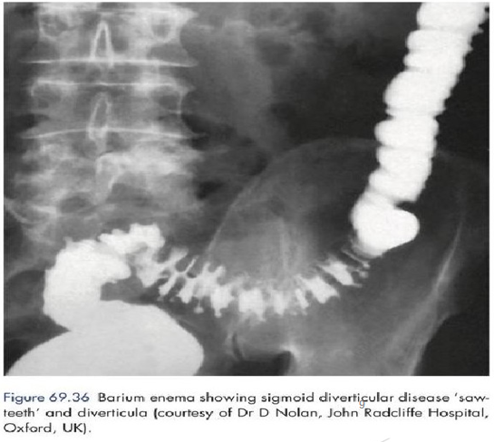
9

Slide 37
Differntial Diagnosis:
1- Anorectal abscess. 2- Colitis.
3- Colon cancer. 4- Crohn disease. 5- Diverticulitis. 6- Endometriosis.
7- Inflammatory bowel disease (IBD). 8- Intussusception
9- Meckel diverticulitis
9/29/202
38
1

Slide 38
Risk Factors of lower GI bleeding:
1-age(> 60 years old)
2-overuse of nonsteroidal anti-inflammatory drugs, which can irritate the lining of the GI tract.
3-chronic constipation, which may lead to straining and hemorrhoids.
4- family history of conditions that damage the lower GI tract, such as IBD.
5-blood or bleeding disorders, or a family history of these disorders
6-activities that could potentially cause rectal tears.
9/29/202
39
1

Slide 39
Complications :
lower GI bleeding may cause complications if left untreated due to blood loss and the complications include:
1- anemia
2-respiratory distress 3-heart attack
4-infection 5-shock
6-death
9/29/202
40
1

Slide 40
Management and Treatment
:
Resuscitation: IV fluids
Nasal O2
NG tube
urine Catheterization
HDU monitoring
Vitamin K
CVP monitoring
9/29/202
41
1

Slide 41
Treatment :
1- proton pump inhibitors (to reduce acid secretion in the stomach to slow the rate of bleeding).
2-reversal agents for anticoagulants.
9/29/202
42
1

Slide 42
Golden Standard for a therapeutic control
Endoscopy: ligation/clipping/cautery/ injection
Angiogram: embolism
Surgery: open exploration/ segmental resection/ total colectomy
Hartmann procedure/ colostomy
9/29/202
43
1

Slide 43
Case study : 1
An elderly woman is found anemic. As part of her examination, she had a barium enema which reveals a mass lesion in the ascending colon. What is the single most appropriate diagnosis?
1- Sigmoid volvulus 2- Anal fissure
3- Sigmoid carcinoma 4- Cecal carcinoma 5- Diverticular disease
9/29/202
44
1

Slide 44
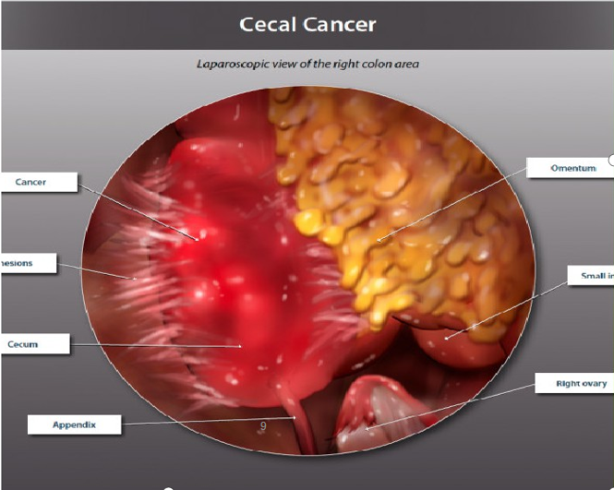
Answer : (D) cecal carcinoma. (Mass in assending colon and anemia makes cecal carcinoma the likely diagnosis )
9

Slide 45
Case study : 2
A 57 years old male presents with sudden onset severe abdominal pain and rigidity against a 4 days background of LIF ( left iliac fossa) pain and pyrexia. He has no past medical or surgical history of note and isn’t on any medicine. What is the most likely diagnosis?
1- Intussusception 2- Ischemic colon 3- Sigmoid volvulus
4- Perforated diverticulum
5- Perforated Mackle's diverticulum
9/29/202
46
1

Slide 46
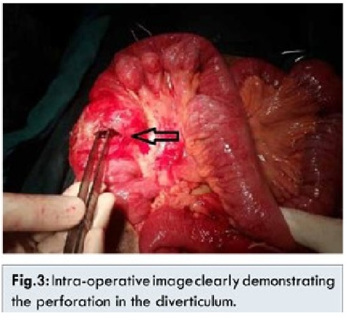
Answer: (D), perforated diverticulum. { sudden onset, severe
abdominal pain, rigidity, left iliac fossa pain and fever are in favor of perforated diverticulum }

Slide 47
Case study:3
A 29 years old young man presents with
continuous of recurrent attacks of diarrhea. He says his stools contain blood and mucus. Sometimes he has low grade fever. What is the most appropriate investigation for his condition?
1- stool culture
2- plain abdominal X-RAY 3- per rectal exam
4- barium enema
9/29/202
48
1

Slide 48
Answer: (D). Barium enema. { feature are suggestive of IBD, so barium enema is the most relevant investigation among the given options. Barium contrast dyes allows an evaluation of the intestines. This is more commonly used in severe
IBD to rule out serious complications like a perforated colon}
9/29/202
49
1

Slide 49
Prevention of recurrent lower GI bleeding:
• *Avoid non-aspirin NSAID use in the patients with a history of acute LGIB .
*Don't discontinue aspirin for secondary prevention in patients with high-risk cardiovascular disease and a history of LGIB.
9/29/202
50
1

Slide 50
References:
• Bailey and love short practice of surgery 27th
edition.
• European Society Of Gastrointestinal Endoscopy.
•
9/29/202
51
1

Slide 51
9

