Slide 1
Joints Of Thoracic Wall
Respiratory System Module
1st Year MBBS SGD
August 2025
Dr Zeneara Saqib

Slide 2
Mission- Vision- Values
To impart evidence based research oriented medical education
To provide best possible patient care
To inculcate the values of mutual respect and ethical practice of medicine
Wisdom
Truth
Service

Slide 3
Professor Umar Model of Integrated Lecture

Slide 4
How To Access Digital Library
Go to the website of HEC National Digital Library.
On Home Page, click on the INSTITUTES.
A page will appear showing the universities from Public and Private Sector and other Institutes which have access to HEC National Digital Library HNDL.
Select your desired Institute.
A page will appear showing the resources of the institution
Journals and Researches will appear
You can find a Journal by clicking on JOURNALS AND DATABASE and enter a keyword to search for your desired journal.

Slide 5
Learning Objectives
Discuss the type, ligaments and relations of the joints of the thorax (Manubriosternal, xiphisternal, costoverterbal, costotransverse, costochondral, chondrosternal, interchondral
and intervertebral joints).
Discuss the components & functions of the intervertebral disc.
Related clinical abnormalities (Vertical integration)
Research article related to topic

Slide 6
Clinical Case
A 35-year-old female teacher presents in your clinic with sharp chest pain which increases on inspiration and expiration
She gave history of carrying sofa chair during shifting her furniture. On examination there are tender sites along the lateral border of sternum

Slide 8
Costovertebral Joints
1. Joints of Head of Rib
Articulation:
The head of the rib articulates with
the superior costal facet of the
corresponding(same-numbered)
vertebra, the inferior costal facet
of the vertebra superior to it, and
the adjacent intervertebral (IV)
disc uniting the two vertebrae

Slide 9
Costovertebral Joint

Slide 10
Costovertebral Joints
Joints of Head of Rib
Type:
Synovial Plane joint
Ligaments:
Radiate and intra-articular ligaments
Heads of 1st, 11th and 12th ribs (sometimes 10th) articulate only with vertebral body of same number.

Slide 11
Costovertebral Joints
2. Costotransverse Joints
Articulation:
Tubercle of rib with transverse
process of same vertebrae
Type:
Synovial Plane joint

Slide 12
Costovertebral Joints
2. Costotransverse Joints
Ligaments:
Superior costotransverse ligament
Lateral costotransverse ligament
Superior CT ligament is divided into strong anterior and weak posterior CT ligaments

Slide 13
Intervertebral Joints
Articulation:
Adjacent vertebral bodies bound
together by IV discs
Type:
Symphysis (secondary
cartilaginous)

Slide 14
Intervertebral Joints
Ligaments:
Anterior and posterior Longitudinal
Ligaments
Movements mostly limited to small degrees of rotation

Slide 15
Costochondral Joints
Articulation:
Lateral end of costal cartilage
with sternal end of rib
Type:
Primary (hyaline) cartilaginous joint

Slide 16
Costochondral Joints
Ligaments:
Cartilage and bone bound together by
periosteum
No movement occurs at this joint, costal cartilage provides flexibility

Slide 17
Interchondral Joints
Articulation:
Between costal cartilages of 6th
and 7th , 7th and 8th, 8th and 9th
ribs
Type:
Synovial plane joint

Slide 18
Interchondral Joints
Ligaments:
Interchondral ligaments
Articulation between costal cartilages of 9th and 10th ribs is fibrous

Slide 19
Sternocostal Joints
Articulation:
1st costal cartilages with
manubrium of sternum, 2nd to 7th
pairs of costal cartilages with
sternum
Type:
Saddle type of Synovial joint

Slide 20
Sternocostal Joints
Ligaments:
Anterior and posterior radiate
sternocostal, Intra-articular
Articular cavities often absent,
fibrocartilage covers the joint
cavity

Slide 21
Manubriosternal Joint
Type: secondary cartilaginous joint, also known as a symphysis.
Function:
It allows a small amount of movement, which helps increase the anteroposterior diameter of the thoracic cage during inspiration

Slide 22
Angle Of Louis
The manubriosternal joint, also known as the angle of Louis, is an important anatomical landmark used by clinicians to locate the second rib and start counting ribs.

Slide 23
Xiphisternal Joint
Type: It is a primary cartilaginous joint, also known as a synchondrosis.
Function: It typically ossifies with age, meaning it turns into bone, and provides structural support to the lower part of the sternum

Slide 24
Vertical Integration

Slide 25
Displacement Of Interchondral Joints
Vertical Integration
usually occurs unilaterally and involves ribs 8, 9, and 10.
The injury produces a lump-like deformity at the displacement site.

Slide 26
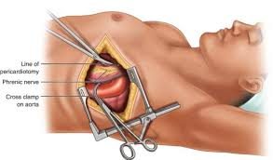
Thoracotomy
Vertical Integration

Slide 27
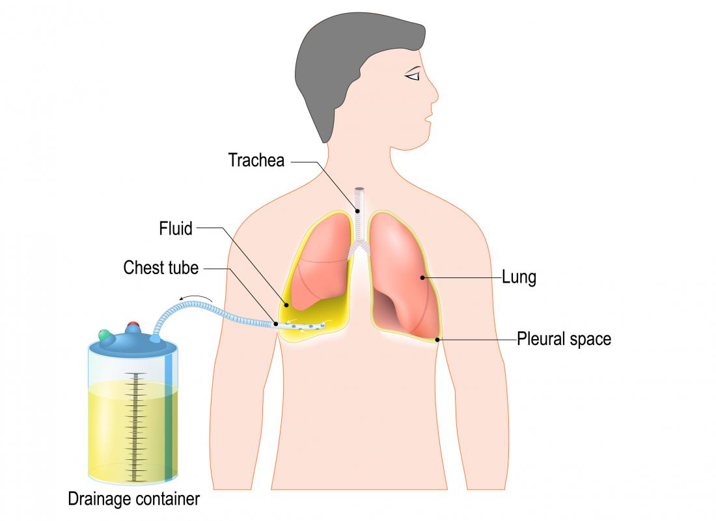
Chest Tube Insertion
Vertical Integration

Slide 28
Family Medicine
Vertical Integration

Slide 29
Relevant Research Article
Vertical Integration
Research Article
Thoracic costotransverse joint pain patterns: a study in normal volunteers
Pain referral patterns of asymptomatic costotransverse joints have not been established. The objective of this study was to determine the pain referral patterns of asymptomatic costotransverse joints via provocative intra-articular injection
https://bmcmusculoskeletdisord.biomedcentral.com/articles/10.1186/1471-2474-9-140

Slide 30
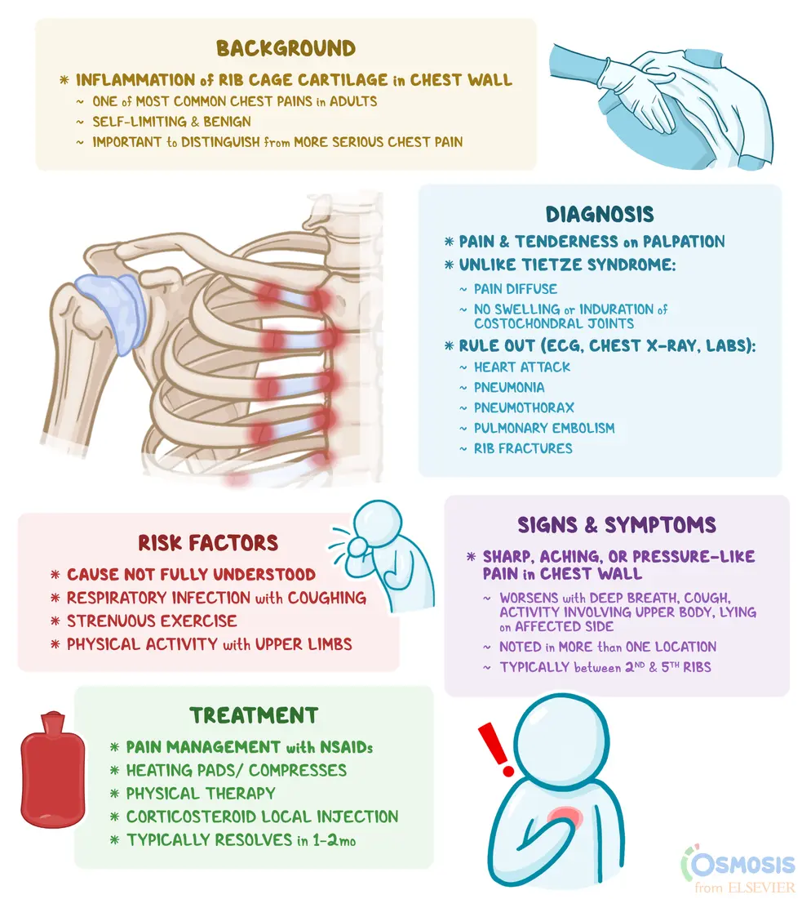
Take Home Message(Costochondritis)
Vertical Integration

Slide 31
Learning Resources
Clinically Oriented Anatomy 8th Edition
by Keith L. Moore (Author), Anne M. R. Agur (Author), Arthur F. Dalley (Author)
Richard S. Snell
Google images

