Slide 2
APPROACH TO A PATIENT WITH JAUNDICE
DR.MUHAMMAD UMER
SENIOR REGISTRAR MEDICAL UNIT-1
HFH RWP

Slide 4
DEFINITION
CORE CONCEPT
Yellow discolouration of skin, sclera and mucous membranes as a result of hyperbilirubinaemia.
It arises from the abnormal accumulation of bilirubin in body tissues, which occurs when the serum bilirubin level exceeds 3 mg/dL or 51.3 umol/L .
Sclera first place to become jaundiced.
Its not a disease rather it’s a clinical sign of many diseases.

Slide 5
Differential diagnosis for yellowing of skin
CORE CONCEPT
Carotenemia : Ingestion of excessive amounts of carotene.
Absence of yellow color in mucous membranes and sclerae, the normal urine color.
The accentuation of yellow-brown carotenoid pigment in the palms, soles, and nasolabial folds.
Serum bilirubin levels are normal.
Drugs – quinacrine, phenols

Slide 6
Production and Metabolism of Bilirubin
CORE CONCEPT
Bilirubin, a tetrapyrrole pigment.
250-300mg of bilirubin is produced daily
Bilirubin
70-80%-senescent RBC
Hemoproteins- Myoglobin,cytochromes

Slide 7
Bilirubin Metabolism
CORE CONCEPT
Pre-hepatic
Hepatic
Post-hepatic

Slide 8
Bilirubin Metabolism: Pre-Hepatic
CORE CONCEPT
Formed in reticuloendothelial system as breakdown product of hemoglobin.
Heme group → biliverdin → bilirubin
Bilirubin is insoluble in water, bound to albumin.
Circulates in the blood before uptake by the liver.
Pre-hepatic jaundice = if not taken up by the liver/produced in excess.

Slide 9
Bilirubin Metabolism: Hepatic
CORE CONCEPT
Bilirubin is taken up into hepatocytes and conjugated to glucuronic acid
(bilirubin diglucuronide > bilirubin monoglucuronide )
The glucuronide conjugated form of bilirubin is water soluble and is excreted into bile.
Hepatic jaundice = disorders of bilirubin uptake or conjugation

Slide 10
Bilirubin Metabolism: Post-Hepatic
CORE CONCEPT
Glucuronide-conjugated bilirubin degraded to urobilinogen.
Urobilinogen pathway:
May be reabsorbed by the gut and returned to the liver.
Converted to urobilin -> reabsorbed into plasma for excretion by kidneys.
May be acted upon by bacterial enzymes within the gut to form the bile pigment stercobilinogen. (stercobilin=brown color of feces)
Notes:
Hence, failure of bilirubin to reach the gut e.g. due to obstructive jaundice, results in a reduction in pigment within the stool; pale stools are witnessed clinically.

Slide 12
Classification of Jaundice
CORE CONCEPT
Pre-hepatic:
(Any cause of increased break down of red cells)
Hereditary hemolytic anemia :
Defects of red blood cell membrane
( hereditary spherocytosis and hereditary elliptocytosis)
Defects in hemoglobin production
(thalassemia, sickle-cell disease )
Defective red cell metabolism
( G6PD and pyruvate kinase deficiency).

Slide 13
CORE CONCEPT
Acquired hemolytic anemias
Autoimmune hemolytic anemia (Association with SLE, RA, Hodgkin's lymphoma, and CLL).
Cold agglutinin disease (as in Mycoplasma pneumonia infection
Spur cell hemolytic anemia
Paroxysmal nocturnal haemoglobinuria is a rare, acquired, disorder characterized by complement-induced intravascular hemolytic anemia.

Slide 14
CORE CONCEPT
Drugs
Penicillin's
Sulfasalazine
Infections
Malaria
Mechanical
Metallic valve prostheses, DIC
Transfusion reactions

Slide 15
HEPATIC
CORE CONCEPT
Can result from hepatocyte destruction and therefore unconjugated hyperbilirubinaemia
Bile cannaliculi destruction and therefore conjugated hyperbilirubinaemia or both
Note/ neonatal jaundice: occurs in most new-borns as hepatic machinery for conjugation and excretion of bilirubin not fully matured until 2 weeks of age

Slide 16
HEPATOCELLULAR CAUSES OF JAUNDICE
Viral hepatitis – Viral serology, ALT>=AST
Hepatitis A, B, C, D, and E
Epstein-Barr virus
Cytomegalovirus
Herpes simplex
Alcohol – AST/ALT -2:1,AST rarely > 300
Drug toxicity
Predictable, dose-dependent, e.g., acetaminophen
Unpredictable, idiosyncratic, e.g., isoniazid
Environmental toxins
Vinyl chloride
Jamaica bush tea—pyrrolizidine alkaloids
Kava Kava
Wild mushrooms—Amanita phalloides or A. verna
Wilson's disease –
Hemochromatosis
Autoimmune hepatitis – middle aged females,
CORE CONCEPT

Slide 17
CORE CONCEPT
Post-hepatic:
Pathology occurring after conjugation of bilirubin within the liver (aka obstructive jaundice)

Slide 18
POST HEPATIC JAUNDICE
CORE CONCEPT
Intrahepatic Cholestasis (impaired excretion)
Functional, obstructive
Hepatitis (viral, alcoholic, and non-alcoholic)
Primary biliary cirrhosis or end-stage liver disease
Sepsis and hypo-perfusion states
TPN
Pregnancy
Infiltrative disease: TB, amyloid, sarcoid, lymphoma
Drugs/toxins i.e. chlorpromazine,cyclosporine, azathioprine, erythromycin,
Post-op patient or post-organ transplantation

Slide 19
Obstructive Jaundice
CORE CONCEPT
Extrahepatic Cholestasis (obstructive jaundice)
Choledocholithiasis.
Cancer/Neoplasm:
(Pancreatic CA, Cholangiocarcinoma ,Gallbladder CA, Ampullary adenoma/adenocarcinoma. adenopathy of porta hepatis)
Strictures after invasive procedures.
Acute and chronic pancreatitis.
Primary sclerosing cholangitis (PSC).
Parasitic infections.
Notes:
PSC: chronic progressive disorder of unknown etiology that is characterized by inflammation, fibrosis, and stricturing of medium size and large ducts in the intrahepatic and extrahepatic biliary tree. The majority of cases have underlying UC.

Slide 20
Inherited syndromes
CORE CONCEPT
Gilbert’s syndrome – reduced activity of glucuronyl transferase UGT-1.Benign and common (5%).elevated unconjugated bilirubin
Criggler-Najjar – reduction in amount of glucoronyl transferase therefore elevated unconjugated bilirubin
Rotor’s/Dubin-Johnson syndrome – defective excretion of conjugated bilirubin into the biliary cannaliculi therefore elevated conjugated bilirubin

Slide 21
DIFFERENTIAL DIAGNOSIS
↑production | ↓transport or ↓conjugation | Impaired excretion | Biliary obstruction
↑ Unconjugated | ↑ Unconjugated | ↑ Conjugated | ↑ Conjugated
Hemolysis | Gilbert’s | Rotor’s | CH/CBD stone
Transfusions | Crigler-Najarr | DubinJohnson | Stricture
Txfusion rxn | Neonatal | Cancer | Tumor/Cancer
Sepsis | Cirrhosis | Cirrhosis | Pancreatitis
Burns | Hepatitis | Hepatitis | PSC
Hgb-opathies | Drug inhibition | Amyloidosis
 |  | Pregnancy

Slide 22
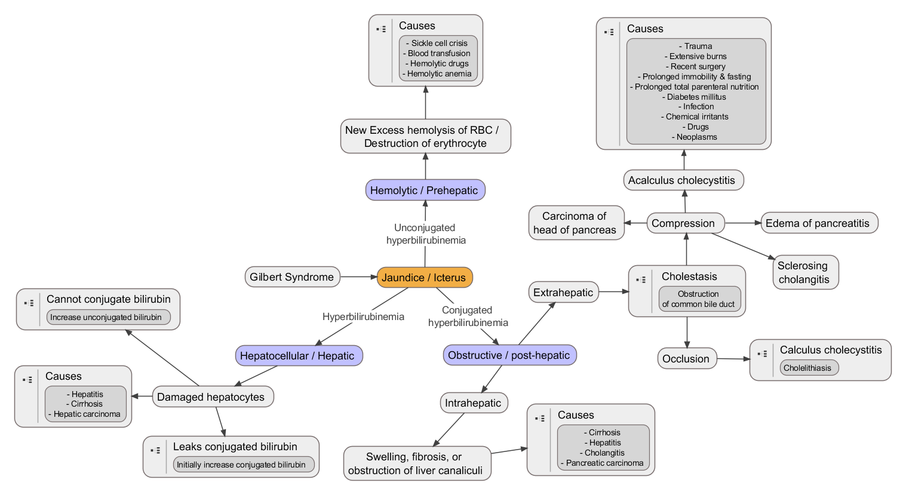

Slide 23
Several questions must be answered initially
CORE CONCEPT
1. Is the elevated bilirubin conjugated or unconjugated?
2. If the hyperbilirubinemia is unconjugated, is it caused by
increased production
decreased uptake
impaired conjugation
3. If the hyperbilirubinemia is conjugated, is the problem
intrahepatic or
extrahepatic?
4. Is the process acute or chronic?

Slide 24
HISTORY TAKING
VERTICAL INTEGRATION
How long been jaundiced?
Ever been jaundiced before?
Any associated fevers or abdominal pain or weight loss?
Pale stool and dark urine (suggests obstructive/post-hepatic jaundice)?
Any recent foreign travel (hepatitis, malaria)?
Any risk factors for hepatitis (tattoos, IVDU, high risk professions, blood transfusions, multiple sexual partners)?

Slide 25
VERTICAL INTEGRATION
Past Medical History of blood disorders (e.g. SCD, thalassemia)?
Drug History any new medications that can cause jaundice?
Social History excess alcohol intake
Family History of jaundice (inherited disorders of bilirubin metabolism)

Slide 26
Associated symptoms
VERTICAL INTEGRATION
Abdominal pain
Fever
fatigue
Fat intolerance
Change in urine and stool color
Pruritus
Bleeding tendency
Abdominal distention
Pedal edema
Dry mouth
Weight loss

Slide 27
Determining aetiology of Jaundice
HORIZONTAL INTEGRATION
Jaundice appearing over a few days to a week implies hepatitis, whether drug or toxin induced, viral or bacterial.
Jaundice of fluctuating intensity implicates gallstones, ampullary carcinoma, or possible drug hepatitis.

Slide 28
HORIZONTAL INTEGRATION
If jaundice associated with background of intermittent RUQ pains think gallstones and choledocholithiasis.
If jaundice associated with long history of upper abdominal pain and weight loss and patient elderly think pancreatic cancer.
If jaundice is painless and family history of blood disorder think pre-hepatic jaundice.

Slide 29
PHYSICAL EXAMINATION
VERTICAL INTEGRATION
Look for jaundice: under tongue, conjunctiva, skin
Examination of the liver
Examination of spleen
Examination for evidence of stigmata of chronic liver disease
Palmar erythema
Dupuytren contracture
Abnormal nails
Parotid enlargement
Xanthelasmas
Gynecomastia
Spider nevi
Dilated veins
Signs of DCLD: ascites
Hyperpigmentation (hemochromatosis)
Kayser-Fleischer ring (Wilson’s disease)

Slide 30
VERTICAL INTEGRATION
Palpation of the liver , single most crucial step.
An appreciation of its size, surface characteristics, and tenderness are central to understanding the cause of the patient's illness.
Liver size should always be expressed in terms of centimeters of total span.

Slide 31
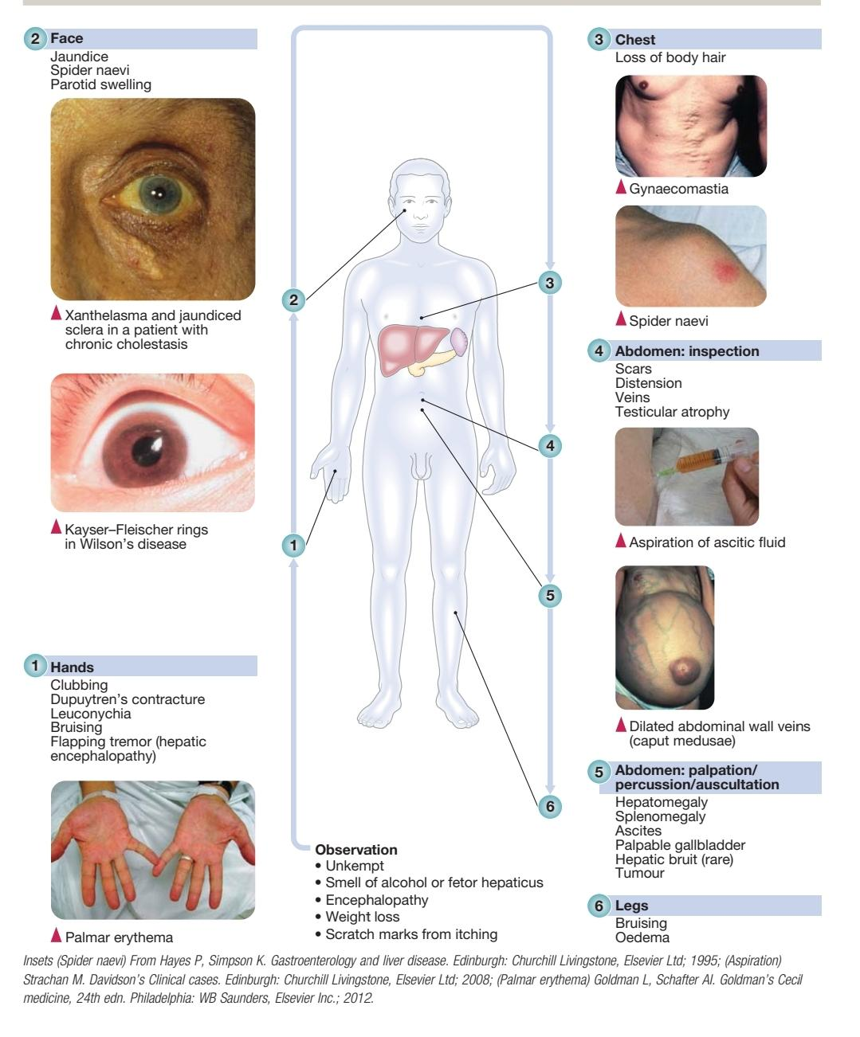

Slide 32
Evaluation: LABS
VERTICAL INTEGRATION
CBC – infection, anemia
(low HB suggesting haemolysis)
LFTs
Bilirubin (total/direct/indirect)
AST, ALT (AST/ALT)
Predominant increase in AST/ALT implies intrinsic hepatocellular disease
Alkaline Phosphatase , GGT
↑Alkaline Phosphatase also seen in sarcoid, TB, bone
In this case, GGT is specific for biliary origin
INR/albumin
Urine bilirubin and urobilinogen levels

Slide 33
VERTICAL INTEGRATION
Normal serum bilirubin concentration is usually no greater than 1.2 mg/dl.
Jaundice due primarily to hemolysis or a bilirubin conjugation disorder results in a serum bilirubin whose unconjugated component is at least 85% of the total.
In the presence of a normal liver, hemolysis alone does not produce a serum bilirubin greater than 4 mg/dl.

Slide 34
Determining aetiology of Jaundice
HORIZONTAL INTEGRATION
Total bilirubin and its conjugated and unconjugated levels help to determine nature of jaundice
Test | Pre-hepatic | Hepatic | Post-hepatic
Total bilirubin | + | ++ | +++
Conjugated bilirubin | Normal | Increased | Increased
Unconjugated bilirubin | Increased | Increased | Normal

Slide 35
Determining Aetiology of jaundice
HORIZONTAL INTEGRATION
Liver Enzymes
ALT/AST mainly present in hepatocytes
ALP/GGT mainly present in bile cannaliculi biliary tree
Derangement of particular liver enzymes in association with jaundice can determine nature of the jaundice
Test | Pre-hepatic | Hepatic | Post-hepatic
ALT/AST | Normal | +++ | +
ALP/GGT | Normal | + | +++

Slide 36
INVESTIGATIONS
VERTICAL INTEGRATION
Pre-hepatic
A blood film—or peripheral blood smear
Coombs test
Sickle cell test
Hb electrophoresis
Hepatic
Hepatitis screen
serum iron, ferritin, copper, alpha-1 antitrypsin levels
auto-antibody screen
Liver USG
Post-hepatic
USG,MRCP,ERCP,CT

Slide 37
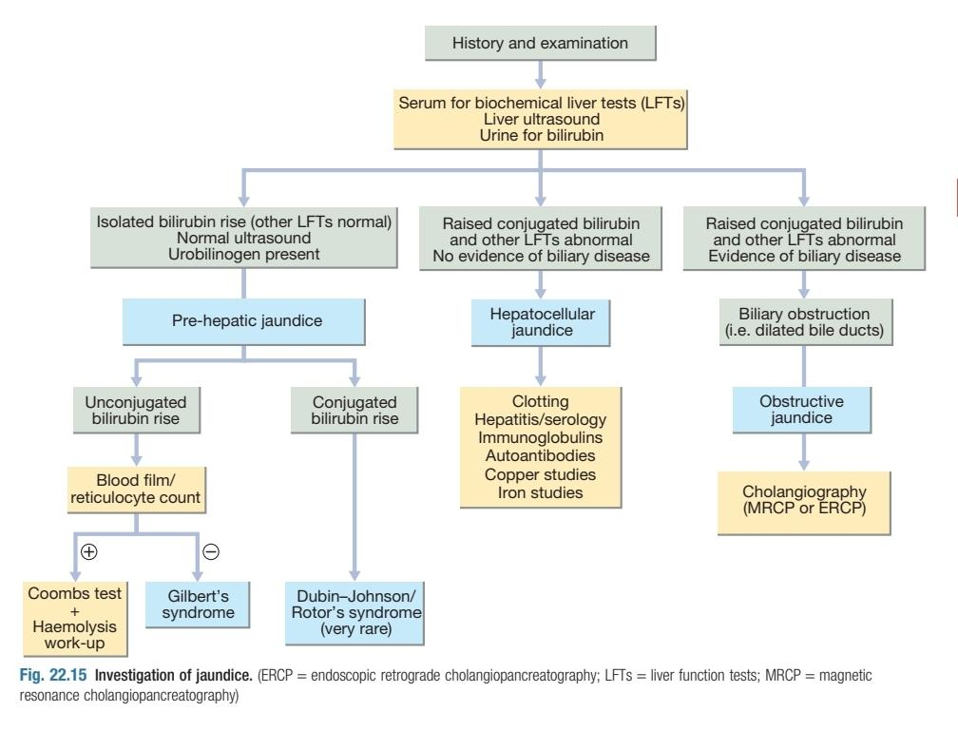

Slide 38
LONGITUDINAL INTEGRATION

Slide 39
LONGITUDINAL INTEGRATION

Slide 40
LONGITUDINAL INTEGRATION

Slide 41
TAKE HOME MESSAGE
Jaundice DDX is extensive
DDX starting point: pre-hepatic, hepatic, post-hepatic
Management depends upon the cause

