Slide 1
APPROACH TO A PATIENT WITH JAUNDICE
DR. SADIA AHMED
ASSISTANT PROFESSOR GASTROENETEROLOGY
RAWALPINDI MEDICAL UNIVERSITY

Slide 2
Learning Objectives
Define jaundice.
Describe the metabolism of bilirubin.
Explain the pathophysiology of jaundice
Differentiate between the different types.
Identify key laboratory investigations and imaging modalities for diagnosing jaundice.
Outline a structured diagnostic approach for a patient presenting with jaundice.

Slide 4
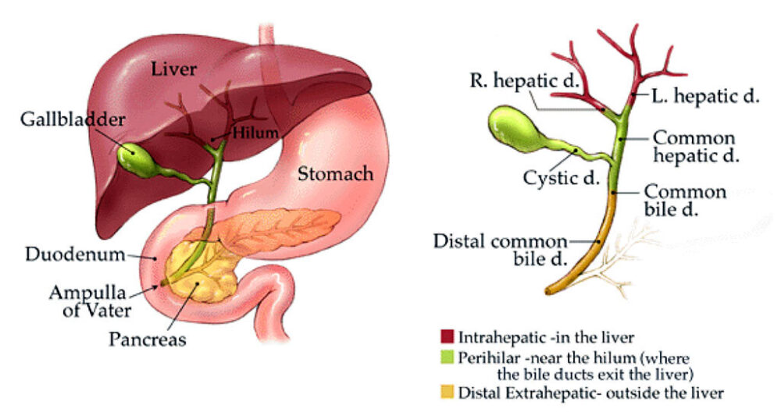
ANATOMY OF LIVER AND BILIARY TRACT

Slide 6
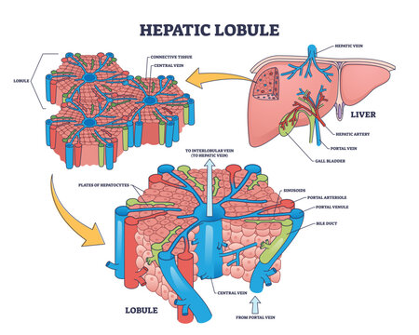
LIVER HISTOLOGY

Slide 7
LIVER HISTOLOGY

Slide 8
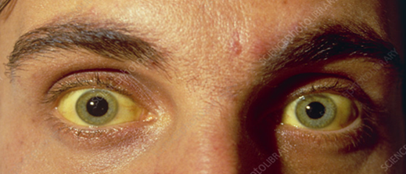
Definition of Jaundice
Jaundice: Yellow discoloration of skin, sclera, and mucous membranes due to hyperbilirubinemia (>2.5 mg/dL)
Causes: Increased bilirubin production, impaired metabolism, or obstruction to excretion

Slide 9
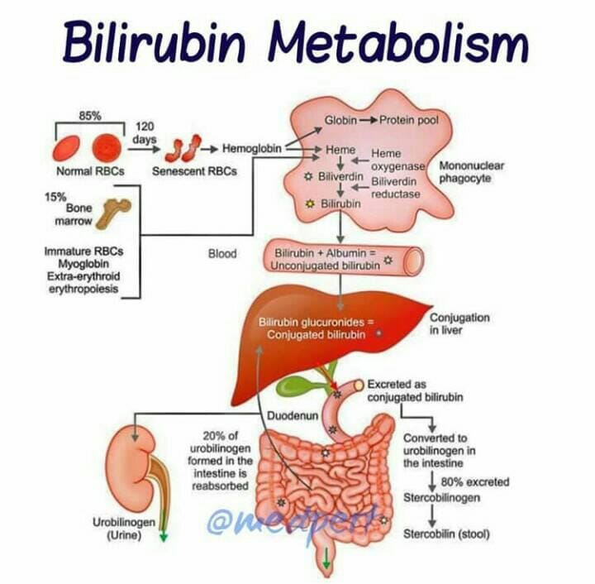

Slide 10
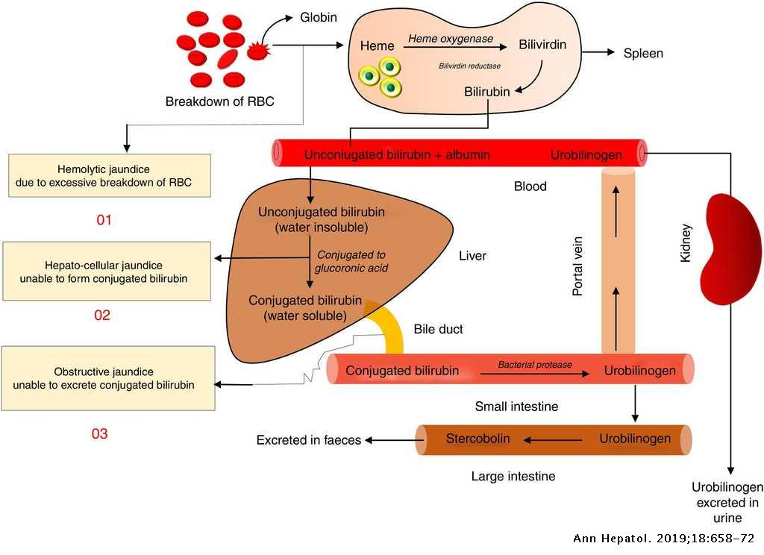
Pathophysiology of Jaundice
Causes: Overproduction, defective uptake, conjugation failure, excretion defect, or biliary obstruction
Flowchart linking causes to types of jaundice
SPIRAL INTEGRATION

Slide 11
CLASSIFICATION OF JAUNDICE

Slide 12
CORE SUBJECT

Slide 13
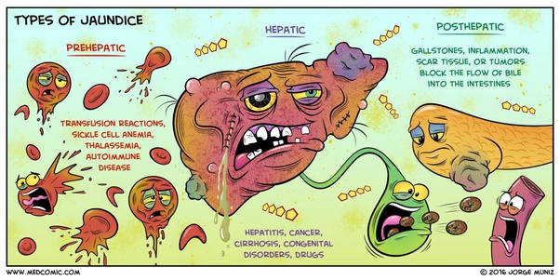
CORE SUBJECT
Prehepatic (Hemolytic): Excess bilirubin production
Hepatic (Hepatocellular): Impaired metabolism
Posthepatic (Obstructive): Impaired bile flow

Slide 14
CAUSES OF JAUNDICE
CORE SUBJECT
PRE HEPATIC | HEPATIC | POST HEPATIC
Hemolysis (e.g., G6PD deficiency, sickle cell disease) Ineffective erythropoiesis Transfusion reactions | Viral hepatitis (HAV, HBV, HCV, etc.) Alcoholic liver disease Drug-induced liver injury Cirrhosis Gilbert’s & Crigler-Najjar syndromes | Gallstones Cholangiocarcinoma Pancreatic carcinoma Primary sclerosing cholangitis Biliary atresia (in neonates)

Slide 16
HAPPY &FRESH
OR
TIRED ????

Slide 17
History in the patient with jaundice
The following factors should be assessed when obtaining a history in a patient with jaundice.
Pruritus, dark urine, and pale stools.
Duration of illness.
Abdominal pain.
Fevers or rigors.
Drug history.

Slide 18
Alcohol consumption.
Infectious contacts.
Recent surgery.
Intravenous drug abuse, tattoos.
Occupation.
Family history of recurrent jaundice.
History of blood transfusions.

Slide 19
Clinical Features
CORE SUBJECT
PRE HEPATIC | HEPATIC | POST HEPATIC
Mild jaundice, Unconjugated hyperbilirubinemia. Dark stool and normal/dark urine. Splenomegaly (in hemolytic anemia). | Mixed hyperbilirubine-mia. Fatigue, malaise, anorexia. Hepatomegaly. Dark urine & pale stools. | Conjugated hyperbilirubinemia Dark urine, pale/clay-colored stools. Pruritus due to bile salt accumulation. Steatorrhea (fat malabsorption.)

Slide 20
INVESTIGATIONS
Blood tests: CBC, reticulocyte count, LFTs: bilirubin {unconjugated/ conjugated}, AST, ALT, ALP, GGT
Imaging: USG, MRCP, ERCP
Special tests: Viral markers, autoimmune markers, liver biopsy

Slide 21
Laboratory Diagnosis
VERTICAL INTEGRATION
PRE HEPATIC | HEPATIC | POST HEPATIC
Unconjugated bilirubin ↑ Reticulocyte count ↑ (hemolysis) Normal ALP, AST, ALT | Mixed bilirubin increase AST & ALT markedly ↑ Albumin ↓ in chronic cases | Conjugated bilirubin ↑ ALP & GGT markedly ↑ AST & ALT mild ↑

Slide 22
IMAGING
VERTICAL INTEGRATION
Ultrasound: First-line for biliary obstruction
Magnetic Resonance Cholangiopancreatography: Biliary and pancreatic pathology
CT scan: Malignancy detection
Liver biopsy: Hepatic causes

Slide 23
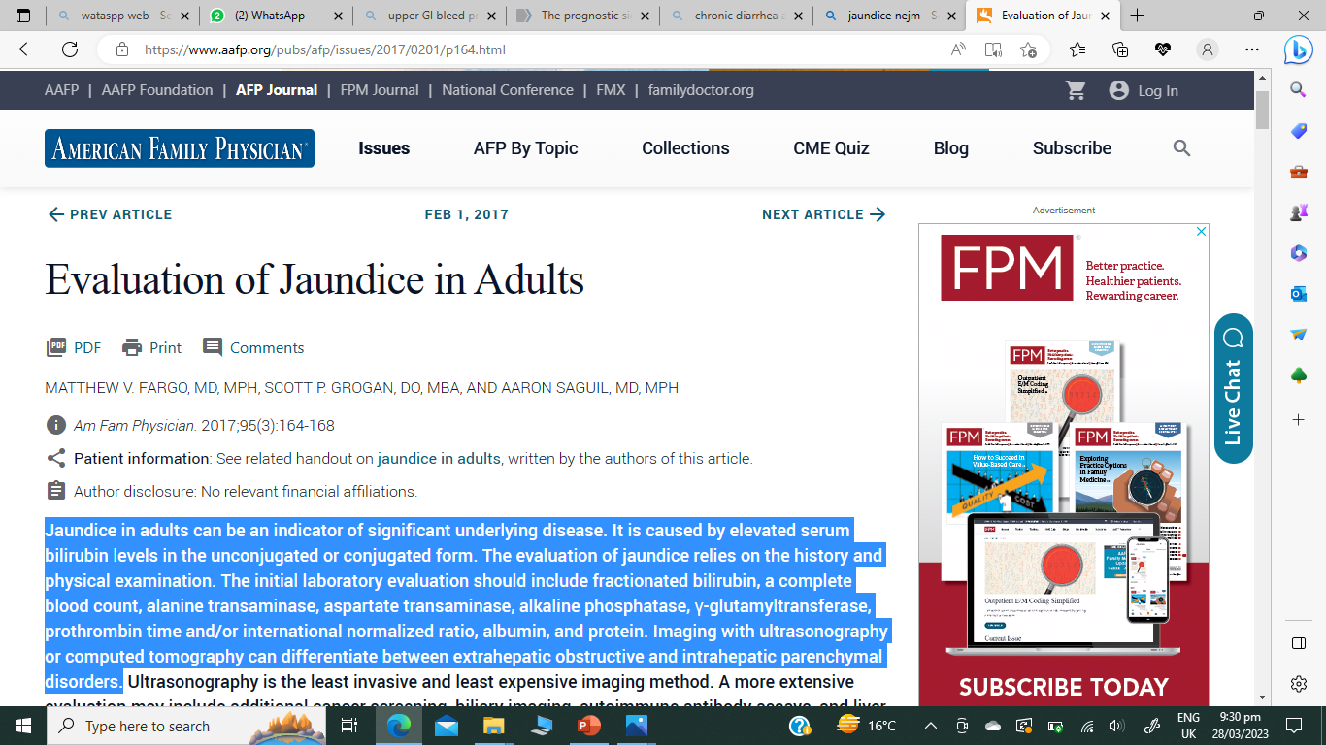
RESEARCH

Slide 24
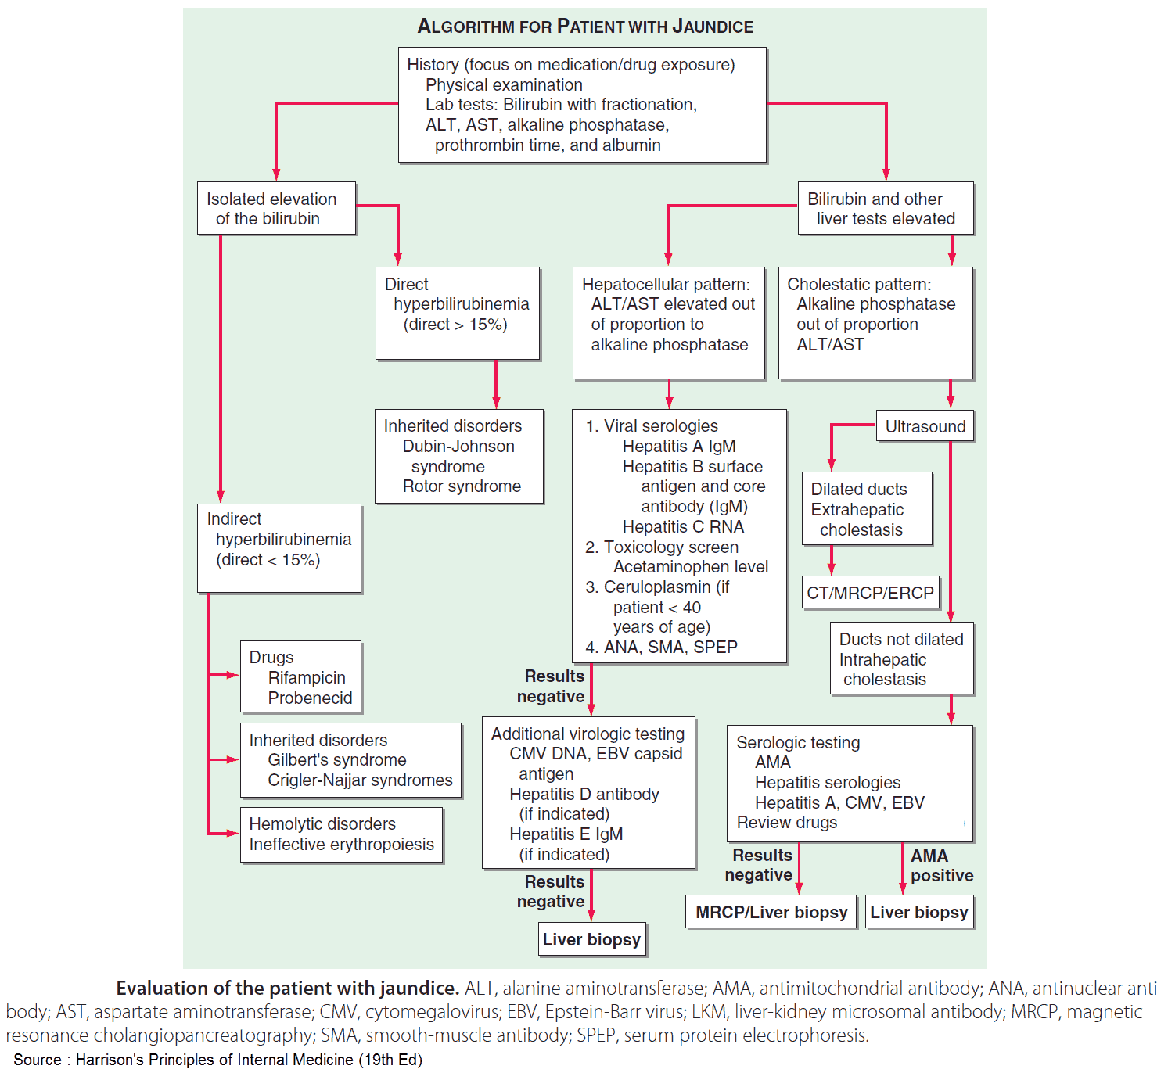
Approach to a Patient with Jaundice

Slide 25
Management
TREAT THE UNDERLYING CAUSE
Supportive care (nutrition, hydration).
Antiviral therapy for hepatitis.
Liver transplant for end-stage liver disease.
ERCP for bile duct stones removal, stenting for obstructed bile ducts.
Surgery for tumors.

Slide 26
Biomedical Ethics
Informed Consent & Autonomy: Assess decision-making capacity, especially in hepatic encephalopathy, before procedures like ERCP, liver biopsy, or paracentesis.
Beneficence & Non-Maleficence: Weigh risks when prescribing hepatotoxic drugs (e.g., acetaminophen) or performing invasive procedures in coagulopathic patients.
Confidentiality: Maintain privacy in hepatitis B or C cases while fulfilling public health reporting responsibilities.
Justice & Resource Allocation: Ethical prioritization for liver transplantation using severity scores (e.g., MELD score).

Slide 28
THANKYOU

