Slide 2
INTERPRETATION OF UPPER LIMB RADIOGRAPHS AND USE OF AI
BY DR ZEENAT SAULAT DR FIZZA BATOOL
CONSULTANT RADIOLOGIST SENIOR REGISTRAR
BENAZIR BHUTTO HOSPITAL RAWALPINDI TEACHING HOSPITAL

Slide 3
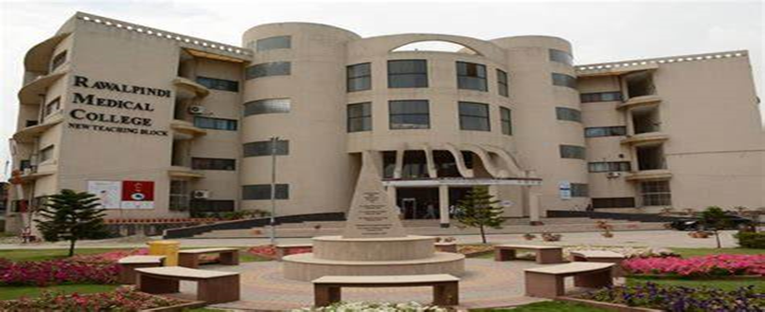
MISSION STATEMENT
VISION AND VALUES
To impart evidence-based research-oriented health professional education in order to provide best possible patient care and inculcate the values of mutual respect, ethical practice of healthcare and social accountability.

Slide 5
SEQUENCE OF LECTURE Introduction Learning objectives Core concept Horizontal Integration Vertical Integration Recent Articles Assessment Recommended Books Take home message

Slide 6
LEARNING OBJECTIVES LEARNING OBJECTIVES

Slide 9
RADIOLOGICAL MODALITIES Xrays CT MRI

Slide 15
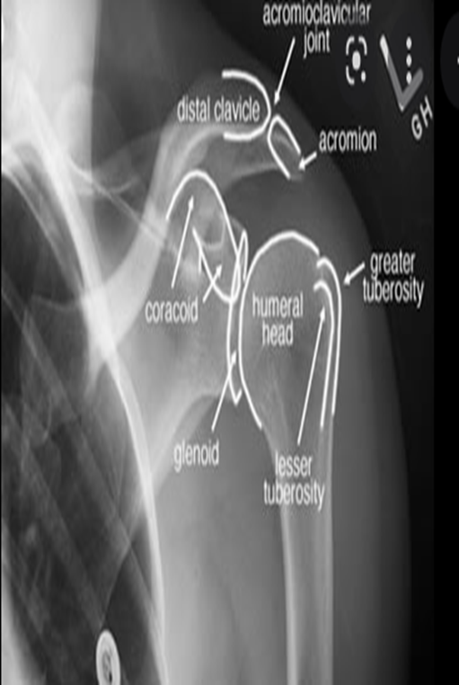
NORMAL MEASUREMENTS AT AT SHOULDER JOINT
Acromioclavicular distance : 2-4mm
Coracoclavicular distance : 11-13mm
Acromiohumeral distance: 7-11mm
Glenohumeral distance: 3-6mm

Slide 16
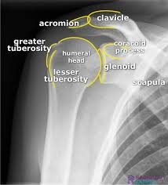

Slide 25
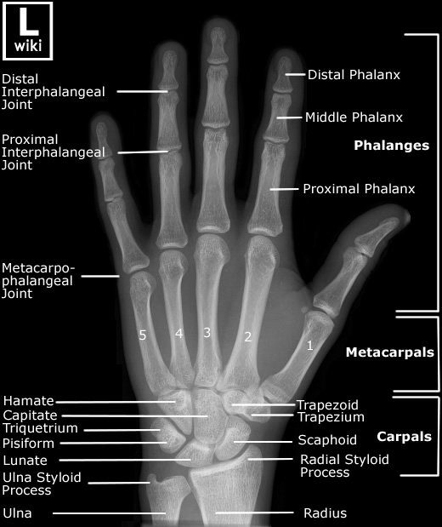

Slide 27
Fractures can also occur, however, in a variety of other settings.
Firstly, the entire skeleton may be weak due to metabolic (e.g. osteoporosis) or less frequently genetic abnormalities (e.g. osteogenesis imperfecta) and thus prone to fractures from forces that would be insufficient to cause fractures in normal bones. These are known as insufficiency fractures.
Secondly, the protracted chronic application of abnormal stresses (e.g. running) can result in the accumulation of microfractures faster than the body can heal, eventually resulting in macroscopic failure. These are termed fatigue fractures.
Together, insufficiency and fatigue fractures are often grouped together as stress fractures.
Thirdly, the bone may have a lesion that focally weakens a bone (e.g. metastasis, or bone cyst). These are known as pathological fractures.

Slide 28
DESCRIBING A FRACTURE
LOCATION
TYPE
Complete Fracture: extends all the way across the bone (most common)
Transverse Fracture
Oblique fracture
Spiral fracture
Comminuted fracture
Incomplete Fracture: does not cross the bone completely (usually encountered in children)
Bowing fracture
Buckle fracture
Greenstick fracture
DISPLACEMENT
Fracture translation
Fracture rotation
Fracture angulation
Fracture length

Slide 35
Chondroblastoma

Slide 48
Bennett’s fracture

Slide 49
Important fractures in children

Slide 54
In 1959, Arthur Samuel defined artificial intelligence (AI) as a field of study that gives a computer the ability to learn without needing to be reprogrammed.
In layman’s terms, AI algorithms are developed to derive rules and patterns from large amounts of data to calculate the probabilities of various outcomes with new sets of similar data.
For instance, Netflix uses AI algorithms to analyze the viewing preferences of millions of people and determine what a viewer is likely to enjoy based on prior viewing behavior. Computers are programmed to continuously update probabilities of a person liking a given television show based on a combination of new all-user data and individual viewing choices.

Slide 55
AI can process images faster than you can say "X-ray," potentially taking over routine tasks
Faster than a speeding bullet (or a radiologist) - AI can analyze thousands of images in seconds.
Always awake and alert - AI doesn't need coffee breaks or vacations.
Consistency is key - AI offers consistent, objective results, reducing human error.

Slide 56
Role Of AI In Diagnostic Imaging
The use of artificial intelligence (AI) in the interpretation of orthopedic X-rays has shown great potential to improve the accuracy and efficiency of fracture diagnosis. AI algorithms rely on large datasets of annotated images to learn how to accurately classify and diagnose abnormalities.

Slide 58
Examples of class activation maps (CAMs) for localizing fractures

Slide 61
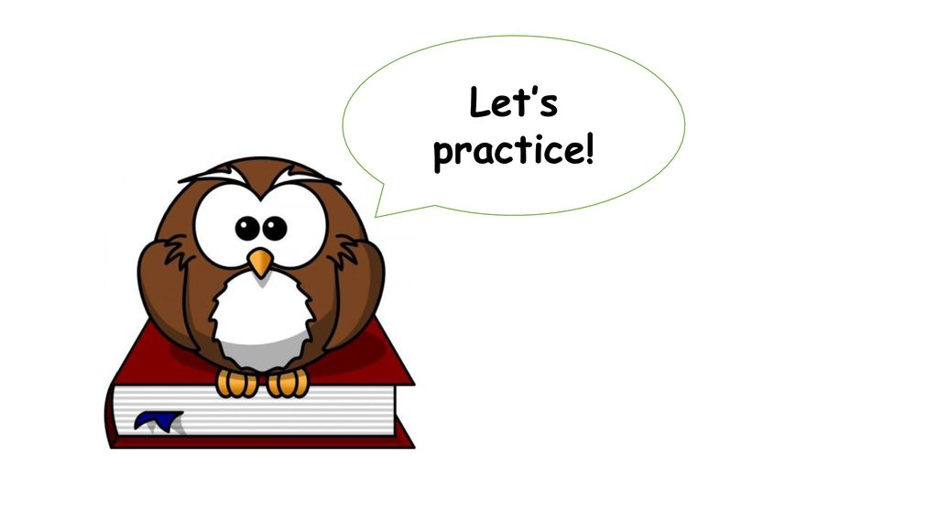

Slide 62
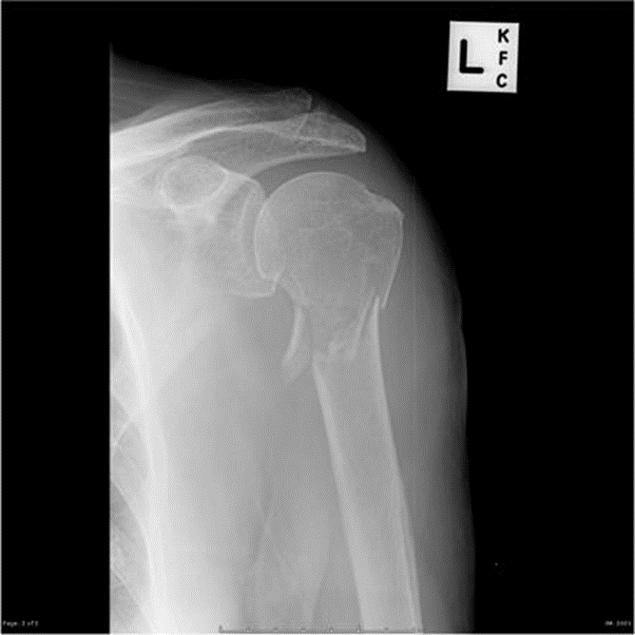

Slide 63
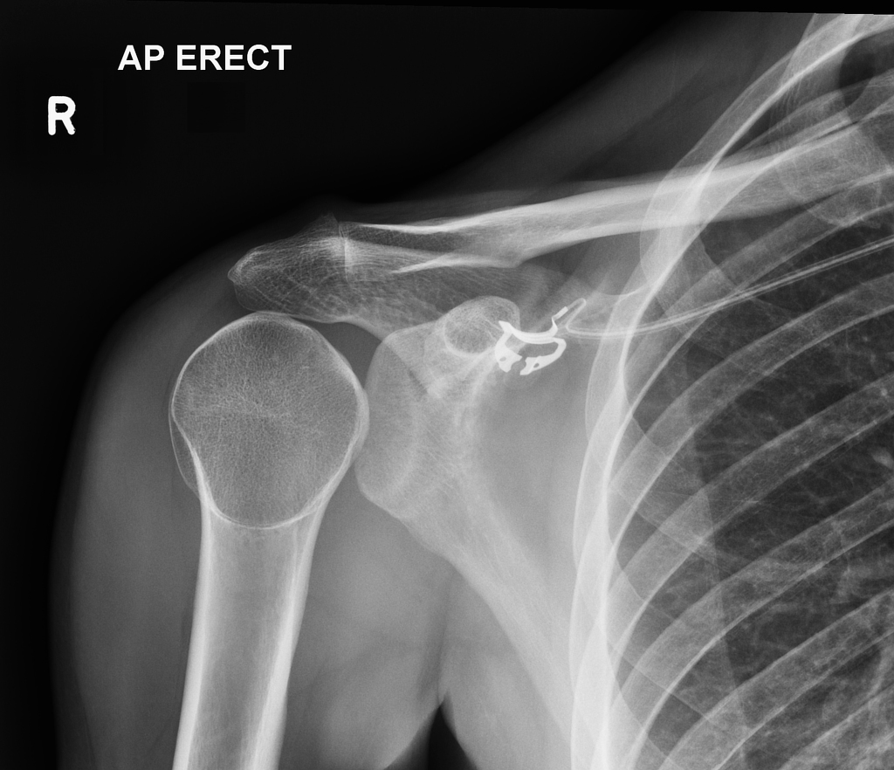

Slide 64
CLINICAL SCENARIO

Slide 66
IDENTIFY THE VIEWS?
AP AND LATERAL VIEW OF WRIST
DESCRIBE THE FINDINGS?
THERE IS A DISPLACED FRACTURE THROUGH THE DISTAL RADIAL METAPHYSEAL REGION WITH DORSAL ANGULATION OF THE DISTAL FRACTURE COMPONENT, GIVING A DINNER FORK DEFORMITY. NO INTRAARTICULAR EXTENSION SEEN. FINDINGS ARE IN KEEPING WITH A COLLES FRACTURE.
FURTHER IMAGING IF REQUIRED?
NONE

Slide 67
REFERENCES

Slide 68
THANKYOU

