Slide 1
GIT Module Inflammatory Bowel Disease(IBD)
Dr. AQSA NASEER
B.Sc. MBBS. FCPS. ESEGH. CHPE. ICMT
Department of Gastroenterology,
Holy Family Hospital, Rawalpindi

Slide 2
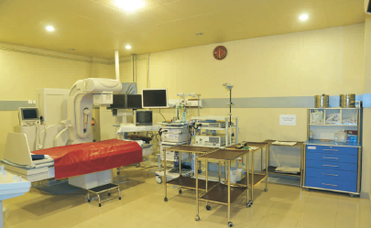
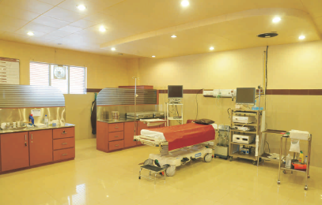
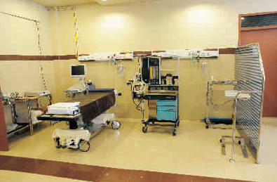
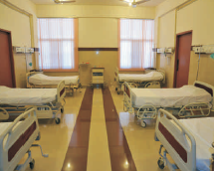
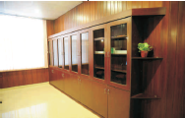
Center for liver and digestive diseases
32 beds in department (14 bedded ward)
Average Daily Admission via OPD: 0.23
Average Daily Admission via Emergency: 2.11
24/7 ward services and on call ER services
Inpatient Services
ERCP Room EUS Room
Liver Clinic
GI clinic
HCC Clinic
IBD Clinic
Pancreatitis Clinic
RFA/ Fibroscan Room Recovery Bay
EUS
ERCP
Manometry
Endoscopy
Procedures
Diagnostic + Therapeutic
OPD Services
Conference Room Library

Slide 3
Professor Umar’s Model of Integrated Lecture
60%
CORE SUBJECT
20%
HORIZONTAL
INTEGRATION
Physiology
biochemistry
8%
VERTICAL INTEGRATION
Pathology
pharmacology
7%
VERTICAL INTEGRATION
Clinical integration
5%
VERTICAL INTEGRATION
Research, professionalism
Ethics
Digital library

Slide 4
Learning Objectives
At the end of one- hour lecture session by using the power point presentation, 2nd year medical students should be able to
Define IBD
Discuss the national and international epidemiology of IBD
Discuss the pathophysiology of IBD
Discuss clinical presentation of UC & CD
Illustrate an approach towards diagnosing IBD patients
Discuss the therapeutic options for IBD patients

Slide 5
A 22-year-old presents with recurrent diarrhea, abdominal pain, and weight loss.
What are your thoughts?
Why is understanding anatomy and physiology essential to diagnosing IBD?

Slide 6
Which layer of the intestinal wall provides a barrier against harmful substances?
Which immune cells are responsible for causing inflammation in the intestine?

Slide 7
Anatomy Of The Gastrointestinal Tract
Horizontal Integration

Slide 8
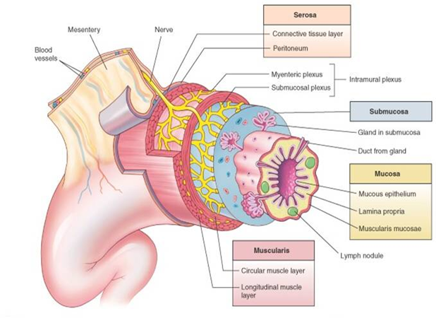
Histology Of The Gastrointestinal Tract
Horizontal Integration

Slide 9
Normal vs Diseased Intestine
Horizontal Integration

Slide 10
Inflammatory Bowel Disease (IBD)
Core Subject
Inflammatory bowel disease, also called IBD, is an umbrella term for a group of conditions that cause swelling and inflammation of the tissues in the digestive tract.
Ulcerative Colitis
Crohn’s Disease

Slide 11
Pathogenesis
ENVIRONMENTAL FACTORS
Smoking, Diet, Exercise, medications, Geography, Socioeconomic Factors
Vertical Integration
IMMUNE DYSREGULATION
Cytokines, Aberrant immune response, Impaired intestinal barrier function
GUT MICROBIOTA
Dysbiosis, Microbe-immune interaction
IBD
GENETIC PREDISPOSITION
240 genetic variants recognized.
immunity (IL-23R, IL-10, ITGAL, and ICAM1 variants)
epithelial barrier (e.g., ECM1),
bacteria recognition (e.g., NOD2)
autophagy (e.g., ATG16L1 and IRGM)

Slide 12
Vertical Integration

Slide 13
Epidemiology of IBD
Core Subject
 | Ulcerative colitis | Crohn’s disease
Incidence (US) | 11/100 000 | 7/100 000
Age of onset | 15-30 & 60-80 | 15-30 & 60-80
Male:female ratio | 1:1 | 1.1-1.8:1
Smoking | May prevent disease | May cause disease
Oral contraceptive | No increased risk | Relative risk 1.9
Appendectomy | Not protective | Protective
Monozygotic twins | 8% concordance | 67% concordance

Slide 14
Global Burden of Inflammatory bowel disease
Core Subject
Globally, IBD accounts for 3.32million cases in 1990 and 4.90million cases in 2019, corresponding to an increase of 47.45% between 1990 and 2019

Slide 15
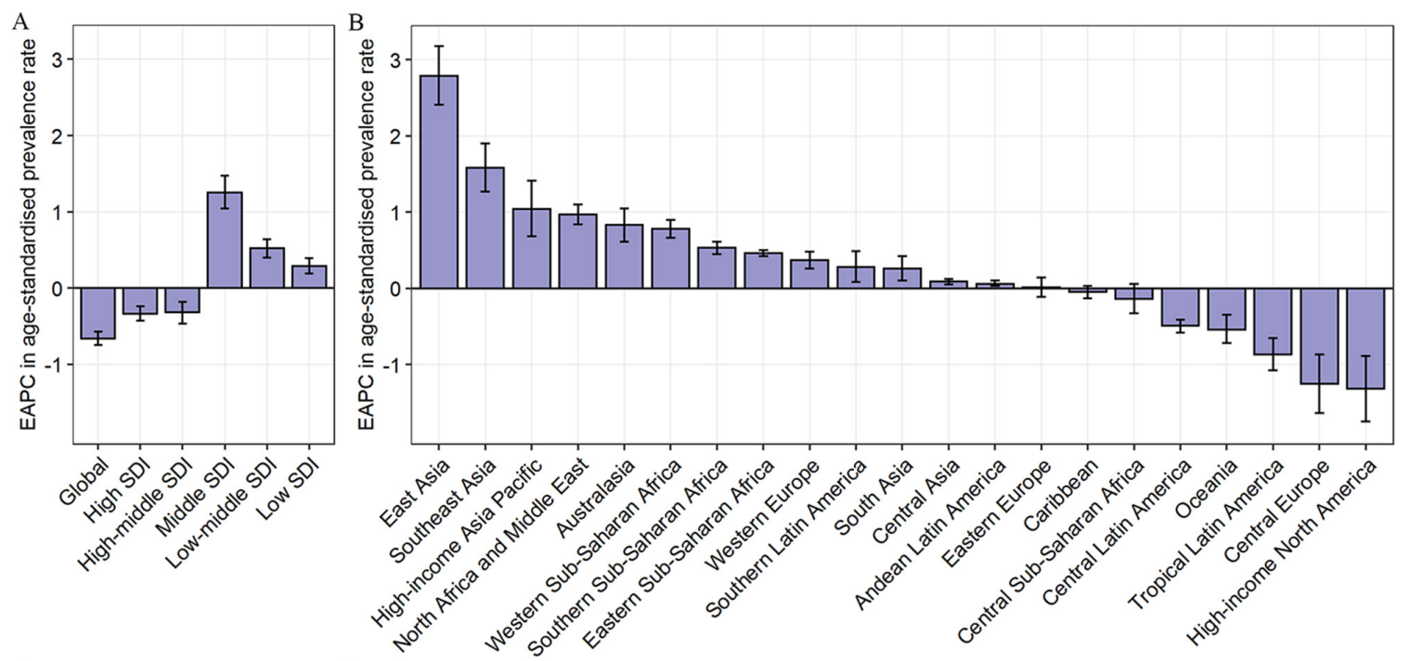
Global Burden of Inflammatory bowel disease
Core Subject
The estimated annual percentage change in age-standardised rates of prevalence

Slide 16
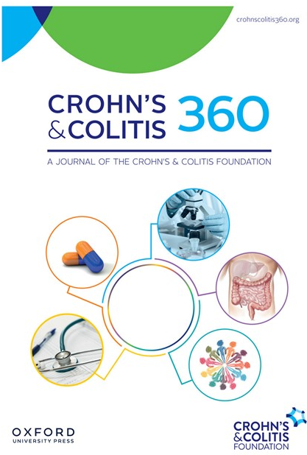
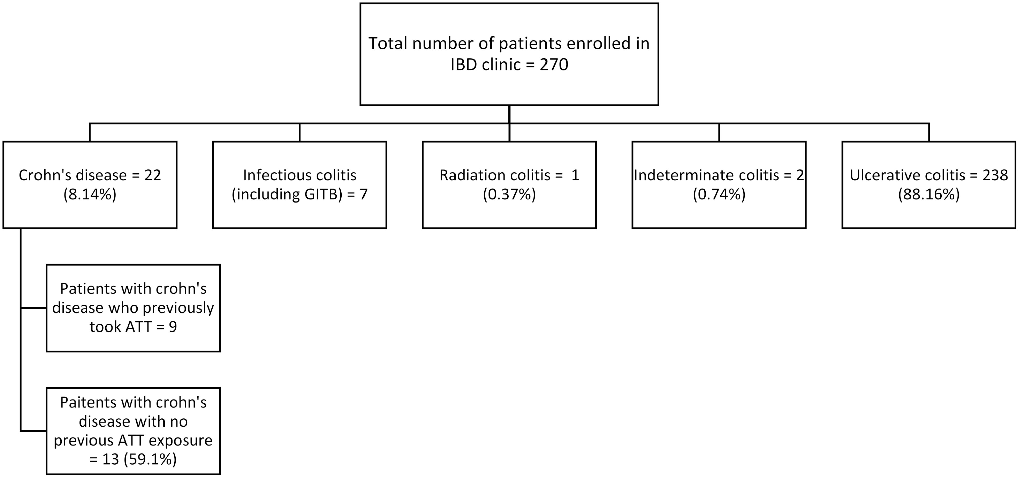
IBD in Pakistan
Core Subject/Vertical Integration Research
Figure 1. Consort chart showing the prevalence of cases at IBD clinic of Holy Family Hospital, Rawalpindi, Pakistan.
Tayyab Saeed Akhtar, Bilal Ashraf, Kanza Zahid, Sameen Abbas, Anosh Sana, Abdul Rauf Khan, Faiqa Ijaz, Faisal Riaz, Evaluation of Factors Contributing to Diagnosis of Crohn’s Disease in the Face of Increasing Trend in Pakistan, Crohn's & Colitis 360, Volume 6, Issue 1, January 2024, otae015, https://doi.org/10.1093/crocol/otae015

Slide 17
IBD in Pakistan: Center for Liver and Digestive Diseases, Holy family Hospital, Rawalpindi.
Vertical Integration: Professionalism
IBD Clinic
IBD clinic established since 2016

Slide 18
Vertical Integration: Professionalism
Total IBD Patients = 342
IBD Clinic
314
24
4

Slide 19
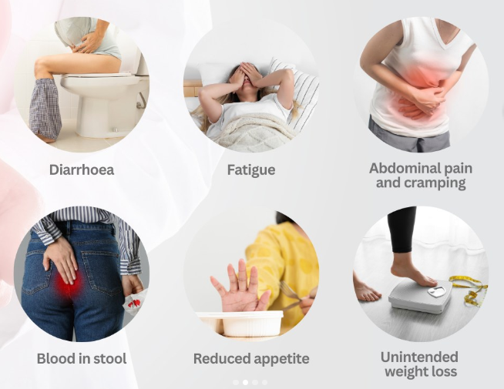
Clinical Presentation of IBD
Vertical Integration/Clinical Integration
Ulcerative Colitis
Crohn’s Disease
The predominant presenting symptoms are
mucus diarrhea in 49 (90.7%)
gross blood in stools in 42 (77.8%)
abdominal pain or cramps in 40 (74.1%)
weight loss in 15 (27.7%)
Tayyab Saeed Akhtar, Bilal Ashraf, Kanza Zahid, Sameen Abbas, Anosh Sana, Abdul Rauf Khan, Faiqa Ijaz, Faisal Riaz, Evaluation of Factors Contributing to Diagnosis of Crohn’s Disease in the Face of Increasing Trend in Pakistan, Crohn's & Colitis 360, Volume 6, Issue 1, January 2024, otae015, https://doi.org/10.1093/crocol/otae015
Qureshi M, Abbas Z. Clinical Presentation of Ulcerative Colitis in Pakistani Adults. Euroasian J Hepatogastroenterol. 2015 Jul-Dec;5(2):127-130. doi: 10.5005/jp-journals-10018-1151. Epub 2016 Jul 9. PMID: 29201709; PMCID: PMC5578543.

Slide 20
Extraintestinal Manifestations and Complications of IBD
Vertical Integration/Clinical Integration

Slide 21
Ulcerative Colitis
Core Subject
Crohn’s Disease
VS
Any Where in GI
(From Gum to Bum)
Limited to Colon
Location of Inflammation
Continuous (without skip areas)
Patchy
(Having skip lesions in between)
Pattern of Inflammation
Superficial Ulcers
Transmural (Ulcer penetrating the entire bowel thickness)
Appearance of Inflammation
Typically in Lower Left Abdomen
Typically in Lower Right Abdomen
Location of Pain
Common (during Bowel movements)
Uncommon
Bleeding

Slide 22
Utility of fecal calprotectin in the management of inflammatory bowel disease
Core Subject/Vertical Integration Pathology
Using cut-off values of 50 µg/g and 100 µg/g, the estimated demand for colonoscopies was reduced by 50% and 67%, respectively
(Burri & Beglinger, 2012)

Slide 23
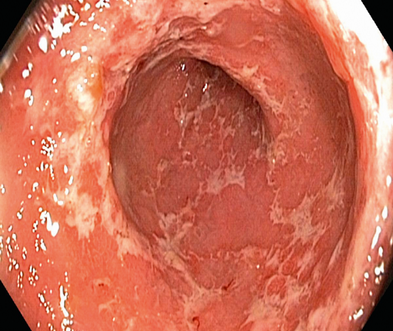
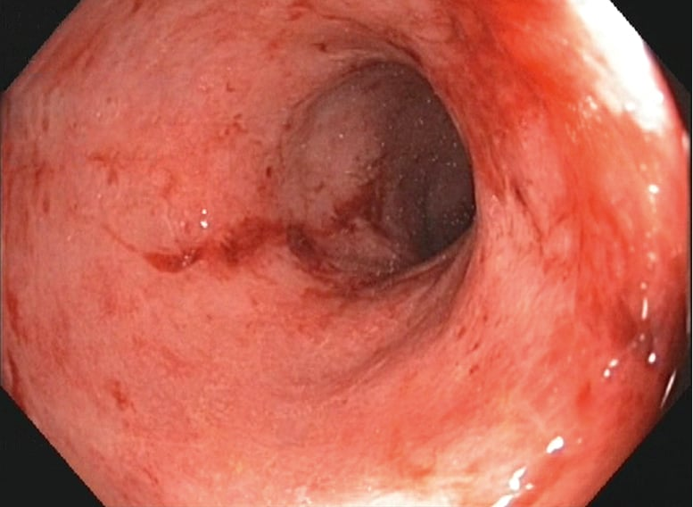
Colonoscopy
Core Subject
Ulcerative Colitis
VS
Crohn’s Disease
Continuous Inflammation
Lacks healthy tissue in the involved segment
Superficial Ulcers
Patchy Inflammation
Interspersed healthy tissue
Cobble Stone Appearance
Deep Ulcers

Slide 24
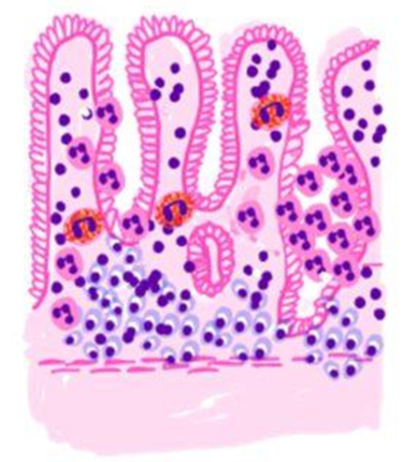
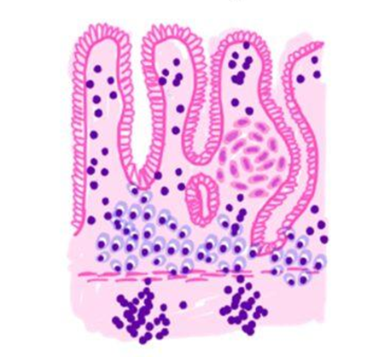
Histopathology
Core Subject/Vertical Integration Pathology
Ulcerative Colitis
VS
Crohn’s Disease

Slide 25
Disease Extent
Core Subject

Slide 26
The Step-up Approach
Vertical Integration: Pharmacology
Mild
Moderate
Severe
Management of IBD

Slide 27
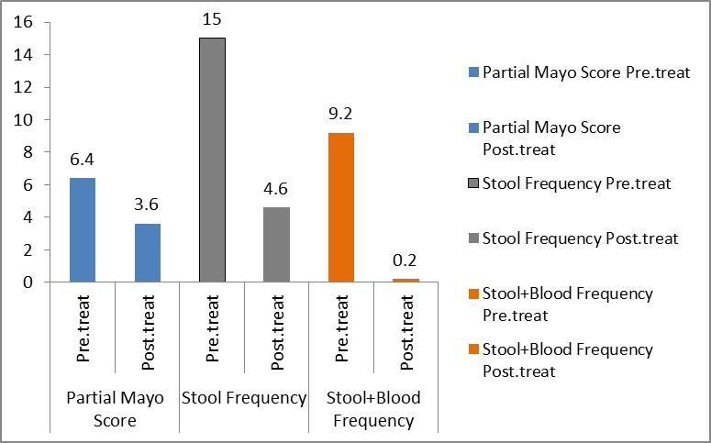
Efficacy & safety of low dose Tofacitinib as induction therapy in moderate to severe UC: A Pilot Project
Vertical Integration Research
Side Effects
Body aches.
Flatulence.
Abdominal pain.
Black outs.
Edema.
Ahmed S, Umar M, Kamran M, Noureen M, Ashraf I, Khan J. Efficacy And Safety Of Low Dose Tofacitinib As Induction Therapy In Moderate To Severe Ulcerative Colitis: A Pilot Study. JRMC [Internet]. 2024 Dec. 31 [cited 2025 Mar. 21];28(4). Available from: https://www.journalrmc.com/index.php/JRMC/article/view/2421

Slide 28
Summary
Core Subject
IBD includes Crohn's disease and ulcerative colitis, both involving chronic inflammation of the GI tract.
Crohn's disease can affect any part of the GI tract with skip lesions and transmural inflammation.
Ulcerative colitis is limited to the colon with continuous mucosal inflammation.
Symptoms include diarrhea, abdominal pain, weight loss, and rectal bleeding.
Treatment involves medications like anti-inflammatory drugs, immunosuppressants, and sometimes surgery.

Slide 29
Mcq#1
A 22-year-old female presents with abdominal pain and bloody diarrhea for 4 weeks. She also complains of tenesmus. Colonoscopy shows continuous inflammation starting from the rectum. What is the most likely diagnosis?
A) Crohn’s disease
B) Ulcerative colitis
C) Irritable bowel syndrome
D) Celiac disease
E) Gastroenteritis
Key: B

Slide 30
Mcq#2
A 30-year-old male presents with right lower quadrant pain, diarrhea, and weight loss. On colonoscopy, skip lesions and cobblestone appearance are observed. Which of the following is the most likely diagnosis?
Ulcerative colitis
Crohn’s disease
Appendicitis
Diverticulitis
Gastroenteritis
(Key: B)

Slide 31
Mcq#3
A patient presents with diarrhea, abdominal pain, and extraintestinal symptoms like joint pain and skin rashes. Which of the following investigations is most useful to confirm inflammatory bowel disease?
A) Colonoscopy with biopsy
B) Abdominal ultrasound
C) Liver function tests
D) Stool culture
E)Serum amylase levels
(Key: A)

Slide 32
Mcq#4
A 22-year-old male presents with chronic diarrhea and weight loss. Colonoscopy reveals skip lesions and a cobblestone appearance.
Which histological finding would confirm the diagnosis?
A) Crypt abscesses
B) Non-caseating granulomas
C) Villous atrophy
D) Dysplasia
E) Pseudopolyps
Key: B

Slide 33
Mcq#5
A 26-year-old male presents with chronic diarrhea and weight loss. His colonoscopy shows granulomas. Which disease is most likely?
A) Crohn’s disease
B) Ulcerative colitis
C) Gastroenteritis
D) Irritable bowel syndrome
E) Diverticulitis
Key: A

Slide 34
THANKS
Department of Gastroenterology
Holyfamily Hospital Rawalpindi
For Correspondence:
anaseer@rmur.edu.pk
+923004064369
https://www.facebook.com/p/Dr-Aqsa-Naseer-100063769844823/
https://www.instagram.com/dr_aqsanaseer/?hl=en

