Slide 2
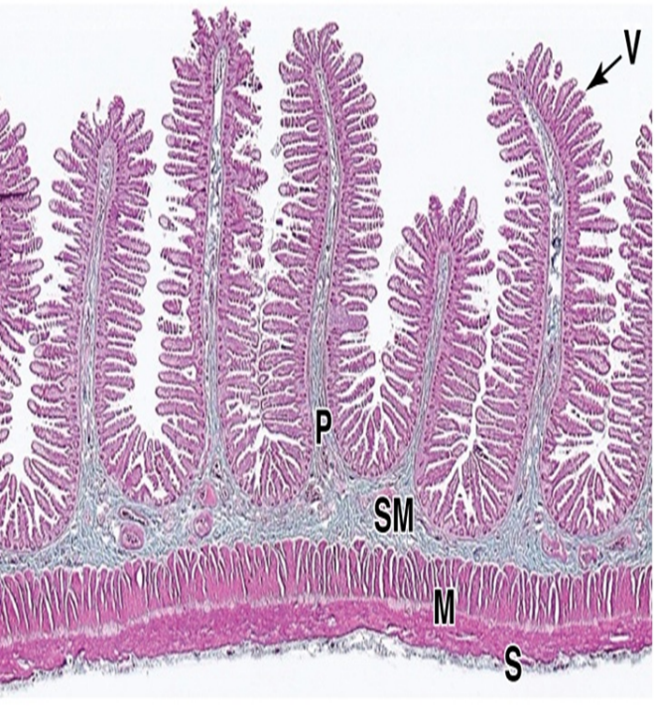
Gastrointestinal Tract (GIT) Module 2nd Year MBBS(LGIS) Histology of Small Intestine
Presenter: Dr. Maria Tasleem Date: 15-03-25
(Assistant Professor)

Slide 3
Prof. Umar’s Model of Teaching Strategy Self Directed Learning Assessment Program
Objectives :To cultivate critical thinking, analytical reasoning, and problem-solving competencies.
To instill a culture of self-directed learning, fostering lifelong learning habits and autonomy.
How to Assess?
➢Ten randomly selected students will be evaluated within the first 10
minutes of the lecture through 10 multiple-choice questions (MCQs)
based on the PowerPoint presentation shared on Students Official
WhatsApp group, one day before the teaching session.
➢The number of MCQs from the components of the lecture will follow
the guidelines outlined in the Prof. Umar model of Integrated Lecture.
Component of LGIS | Core Knowledge | Horizontal Integration | Vertical Integration | Spiral Integration
No. of MCQs | 6-7 | 1-2 | 1 | 1

Slide 4
Professor Umar Model of Integrated Lecture

Slide 5
Learning Objectives
At the end of this session students should be able to
Differentiate the histological features of duodenum, jejunum and ileum
Discuss the location and function of villi, crypts of lieberkuhn and microvilli in different parts of small intestine
Discuss different cells lining the epithelium of small intestine
Discuss histological aspects of celiac disease and crohn’s disease
Understand curative and preventive heath care measures.

Slide 6
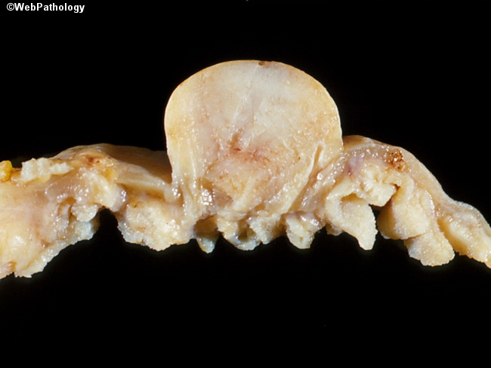
Interactive Session
A 40 years male patient came to OPD with complain of abdominal pain and weight loss since 1 month. On abdominal examination there was mild tenderness. MRI showed intestinal mass and a diagnosis of small intestine leiomyoma was made. Explain the origin of this tumor.

Slide 7
Small Intestine Anatomy
Core Knowledge
connects stomach to large intestine;
held together in abdominal cavity by “mesentery proper”
site for completion of chemical digestion & absorption of nutrients
comprised of three regions

Slide 8
General Structure
Core Knowledge
Mucosa
Folds of mucosa & submucosa- plicae circulares (valves of Kerckring)
Mucosal outgrowth (epithellium + lamina propria)- villi
Crypts of Lieberkuhn- are intestinal glands between villi
Microvilli
Submucosa
Muscularis externa
Serosa

Slide 9
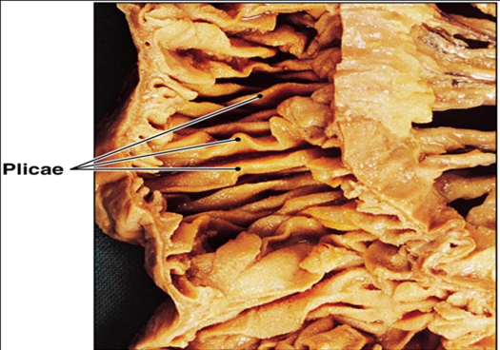
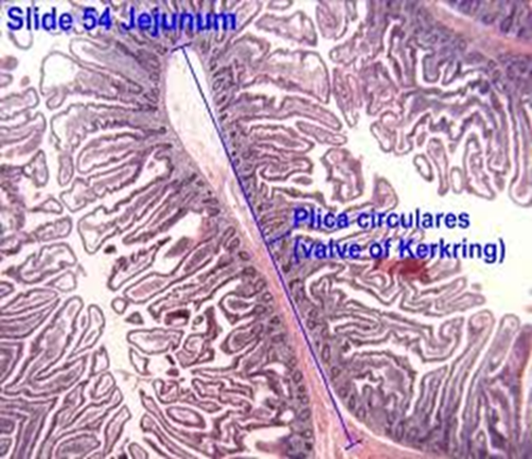
Plicae Circulares
Core Knowledge
These are permanent folds of mucosa with a submucosal core that extend into intestinal lumen

Slide 10
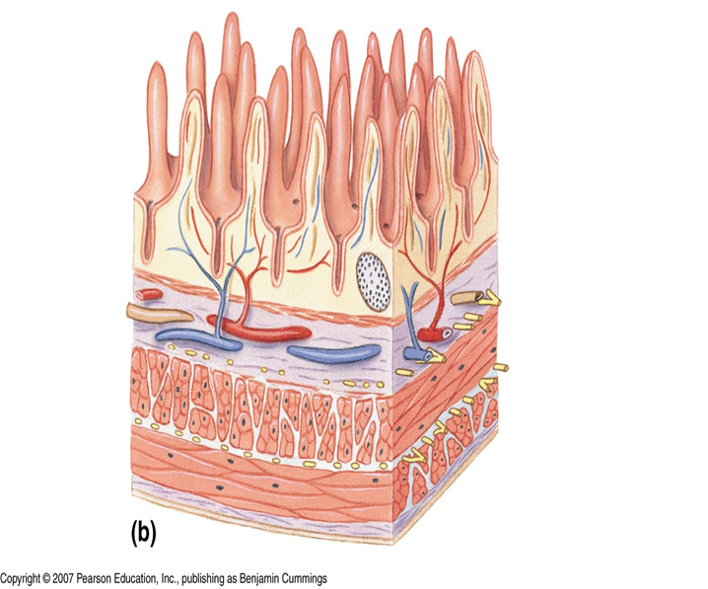
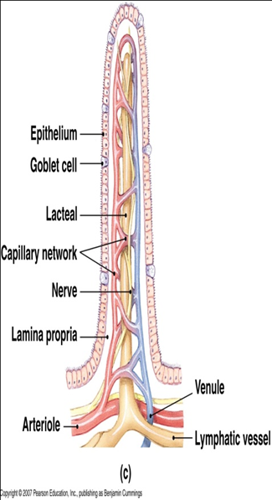
Villi
Core Knowledge
small finger-like or leaf like projections of mucosa across surface of intestine.
Gives the small intestine a velvety appearance

Slide 11
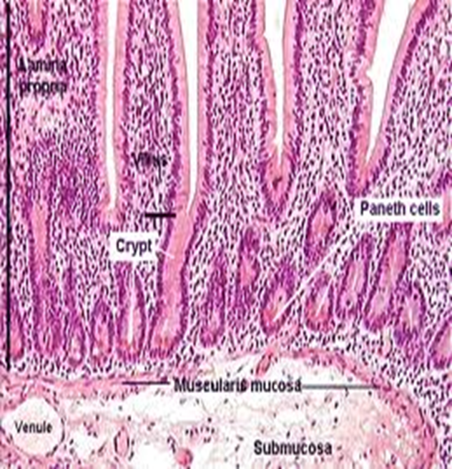
Crypts of Lieberkuhn/ Intestinal Glands
Core Knowledge
Further increase in mucosal surface area.
Deep invaginations b/w bases of the villi.
These glands are present in L.P & extend to muscularis mucosae
Microvilli
cytoplasmic extensions, covers apices of intestinal absorptive cells. Under LM, visible as striated brush border

Slide 12
Cells of small intestine
Core Knowledge
Enterocytes
Goblet cells
Paneth cells
Enteroendocrine cells
M (Microfold) cells

Slide 13
Enterocytes
Core Knowledge
Tall columnar cells
Tight junctions
Striated brush border – microvilli,
3000 microvilli/cell
Secrete
Disaccharidases
Peptidases

Slide 14
Absorption of Food
Horizontal Integration
Product of lipid digestion diffuse across cell
Re-esterified as triglyceride
Surrounded by a layer of apoprotien – chylomicron
Transferred to lateral cell membrane- lamina propria - lacteal

Slide 15
Goblet Cells
Core Knowledge
Lie between enterocytes
Unicellular glands
Shape
Nucleus
Produce glycoprotein mucin
Functions
Protection
Lubrication

Slide 16
Paneth Cells
Core Knowledge
Found in bases of crypts
Pyramidal cells
Features of protein secreting cells
Large eosinophilic granules
Granules contain:
Lysozymes
Phospholipase A 2
Defensins
Functions:
Breakdown bacterial cell wall
Innate immunity

Slide 17
Enteroendocrine cells
Core Knowledge
Are part of diffuse neuroendocrine system
Found in crypts
Contain granules which release hormones that exerts
Endocrine effect –gastrin, secretin, CCK
Paracrine effect- somatostatin
Two classes:
Granules released into lamina propria & enter BV

Slide 18
M (Microfold) cells
Core Knowledge
In ileum overlying the lymphoid follicles of payer’s patches
Basal membrane invagination contain lymphocytes & APC
M cells endocytose bacteria & transport them to underlying macrophages & lymphocytes – lymph nodes
BM under M cells is porous

Slide 19
Immunity by M Cells
Horizontal Integration

Slide 20
Undifferentiated (stem) cells
Core Knowledge
Lie in bases of intestinal glands
Are source of all other type of cells
Columnar, immature cells
Apical microvilli are shorter & less numerous
Frequent mitosis
Cell takes 4-5 days to move from base to villous tip
Maturing Paneth cell move downwards

Slide 21
Cells in intestinal crypts
Core Knowledge

Slide 22
Comparison
Core Knowledge
Villi
Gland

Slide 23
General Structure
Core Knowledge
Lamina propria
Reticular fibers, cells, muscle fibers, lacteals
Peyer’s patches – are aggregation of lymphocytes into nodules. Villi over them absent. They extend into submucosa. Present in ILEUM
Muscularis mucosae
Inner circular
Outer longitudinal

Slide 24
General Structure
Core Knowledge
Submucosa
Blood vessels (large plexus), lymphatics, plexus of nerves (Meissner’s)
Brunner’s gland in DUODENUM. They are branched tubular mucous glands. Ducts open in intestinal crypts.
Muscularis externa
Inner circular
Outer longitudInal
Myenteric plexus of nerves between them
Serosa

Slide 25
Duodenum
Core Knowledge
Villi leaf like
Mucosa
Epithelium
Lamina propria
Muscularis mucosae- disrupted
Submucosa – Brunner’s glands whose ducts open into intestinal glands-alkaline mucous
Muscularis externa
Serosa / Adventitia

Slide 26
Jejunum
Core Knowledge
Villi finger like
Mucosa
Epithelium
Lamina propria
Muscularis mucosa
Submucosa
Muscularis externa
Serosa

Slide 27
Ileum
Core Knowledge
Villi are club shaped
Mucosa:
Epithelium
Lamina propria- Peyer’s patches
Muscularis mucosae-disrupted
Submucosa – Peyer’s patches
Muscularis externa
Serosa

Slide 28
Leiomyomas
Vertical Integration
Benign tumors of smooth muscle cells
Most common type in stomach & small intestine

Slide 29
Celiac Disease
Vertical Integration
Damage or destruction of villi
Gluten sensitivity
Enterocytes affected that lead to reduced nutrient absorption

Slide 30
Crohn’s Disease
Vertical Integration
Chronic inflammatory bowel disease
Most commonly in ileum or colon
Immune, environmental or genetic factors
Excessive lymphocytic activity & inflammation
Pain, malabsorption, diarrhea

Slide 31
Spiral Integration
Family Medicine
Management of Leiomyoma
Medical History and Physical Examination
Diagnostic Tests
Symptom Management
Monitoring
Referral to Specialist Patient Education and Support

Slide 32
Spiral Integration
Bioethics
Ethical Considerations
From an ethical standpoint, the scenario raises considerations regarding patient autonomy, informed consent, and confidentiality
The physician must ensure that patient fully understands the diagnosis, treatment options, and potential implications
Additionally, the physician must respect patient’s privacy and confidentiality throughout the diagnostic and treatment process

Slide 33
Spiral Integration
Artificial Intelligence
Role of AI in Leiomyoma Management
AI can potentially aid in enhancing diagnostic accuracy and efficiency.
AI-powered decision support systems can also help clinicians in selecting appropriate treatment modalities
AI-driven predictive models may help anticipate the risk of disease occurrence in susceptible populations

Slide 34
Histological Evidence for the Enteric Nervous System and the Choroid Plexus as Alternative Routes of Neuroinvasion by SARS-CoV2
Spiral Integration
Research Article
F Deffner, M Scharr, S Klingenstein, M Klingenstein, A Milazzo, S Scherer, A Wagner, B Hirt…
https://doi.org/10.3389/fnana.2020.596439
Carried out immunostainings for ACE2 and TMPRSS2, two proteinases crucial for the entry of SARS-CoV2 into host cells, in the human enteric nervous system (ENS)
Found that ACE2 and TMPRSS2 are expressed by enteric neurons and glial cells of the small and large intestine
Results are fundamental histological evidence substantiating current theories of neuroinvasion by SARS-CoV2.

Slide 35
Learning Resources
Junqueira’s Basic Histology 14th Edition, Chapter 16, pages 309-316
Histology , A text and Atlas by Michael H.Ross 7th Edition, Chapter 18, pages 584-594
DiFiore's Atlas of Histology with Functional Correlations 11th Edition, Chapter 14, pages 291-301

Slide 36
THANK YOU

