Slide 1
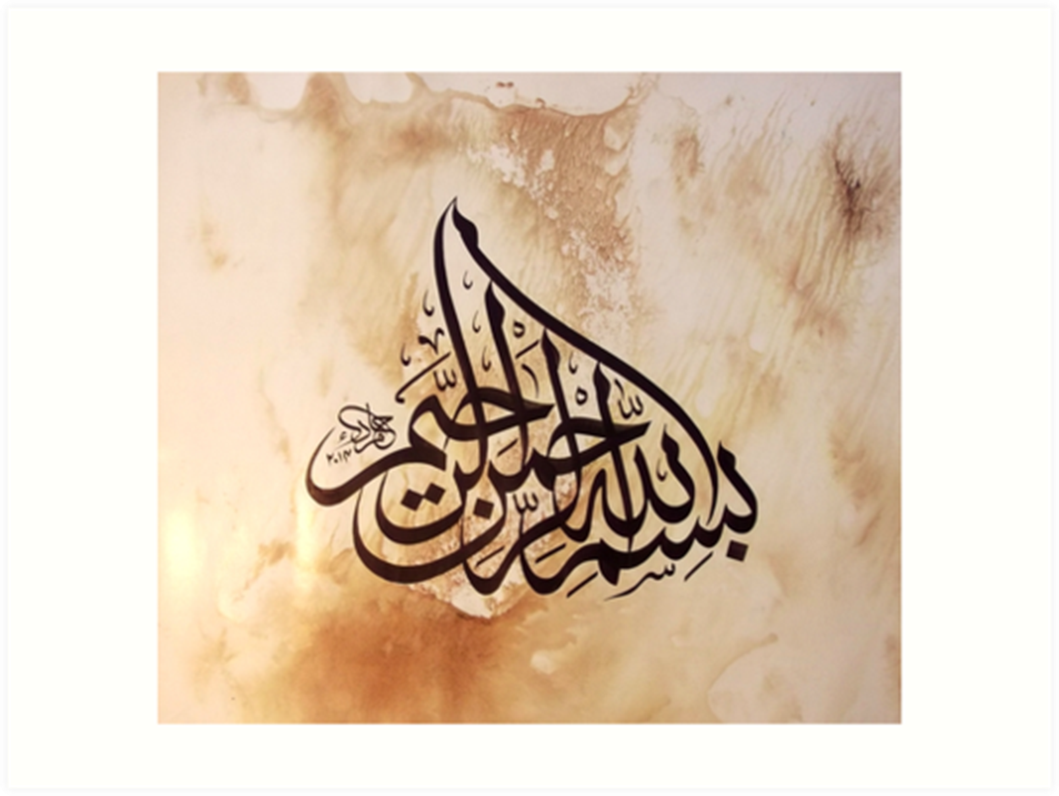

Slide 2
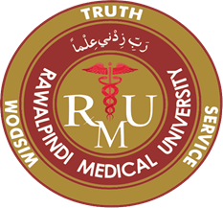
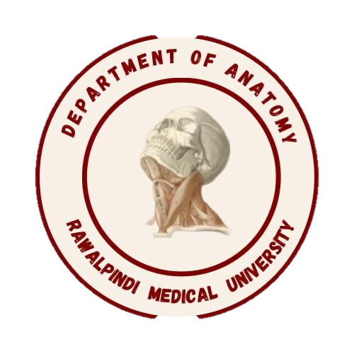
Gastrointestinal Tract (GIT) Module 2nd Year MBBS(LGIS) Histology of Liver
Presenter: Dr. Maria Tasleem Date: 11-03-25
(Assistant Professor)

Slide 3
Prof. Umar’s Model of Teaching Strategy Self Directed Learning Assessment Program
Objectives :To cultivate critical thinking, analytical reasoning, and problem-solving competencies.
To instill a culture of self-directed learning, fostering lifelong learning habits and autonomy.
How to Assess?
➢Ten randomly selected students will be evaluated within the first 10
minutes of the lecture through 10 multiple-choice questions (MCQs)
based on the PowerPoint presentation shared on Students Official
WhatsApp group, one day before the teaching session.
➢The number of MCQs from the components of the lecture will follow
the guidelines outlined in the Prof. Umar model of Integrated Lecture.
Component of LGIS | Core Knowledge | Horizontal Integration | Vertical Integration | Spiral Integration
No. of MCQs | 6-7 | 1-2 | 1 | 1

Slide 4
Professor Umar Model of Integrated Lecture

Slide 5
Learning Objectives
At the end of this session students should be able to
Discuss in detail the histological organization of liver
Explain the structure of liver lobule, portal triads & hepatic acinus and its functional importance
Discuss histological features and bio-physiological aspects of hepatocytes.
Explain Hepatic cords, central vein, portal triad, hepatic venules, hepatic arterioles, bile duct & liver sinusoids
Discuss the blood supply of the liver.
Describe clinical aspects of liver on histological grounds e.g jaundice, cirrhosis & fatty liver

Slide 6
Interactive Session
A known case of Liver Cirrhosis due to chronic alcoholism went for few laboratory tests. The tests revealed deranged PTT (prothrombin time) and hypoalbuminemia. With your knowledge of Liver histology explain the cause of these deranged lab tests.

Slide 7
Liver-Gross Anatomy
Core Knowledge
Largest organ of the body
Largest gland
Location
Receives blood from:
Portal vein
Hepatic artery
Drains to IVC

Slide 8
Bio-physiological Aspects of Liver
Horizontal Integration
Liver produces most of the body’s circulating plasma proteins e.g
Albumin- involved in regulating plasma volume and tissue fluid balance
Lipoproteins- VLDL, HDL and LDL that are involved in transport of triglycerides from the liver to other organs
glycoproteins, which include proteins involved in iron transport such as haptoglobin, transferrin
Prothrombin and fibrinogen, important components of the blood-clotting cascade

Slide 9
Bio-physiological Aspects of Liver
Horizontal Integration
Liver stores and converts several vitamins
vitamin A (retinol), an important vitamin in vision. Night blindness and multiple skin disorders are related to vitamin A deficiency
vitamin D, converted into its active metabolite. Deficiency could lead to rickets and other disorders of bone mineralization.
vitamin K, deficiency is associated with hypoprothrombinemia and bleeding disorders.

Slide 10
Bio-physiological Aspects of Liver
Horizontal Integration
Liver degrades drugs and toxins
Involved in many other metabolic pathways
Bile production is an exocrine function of the liver
The endocrine-like functions of the liver are represented by its ability to modify the structure and function of many hormones like vitamin D, growth hormone, thyroxine

Slide 11
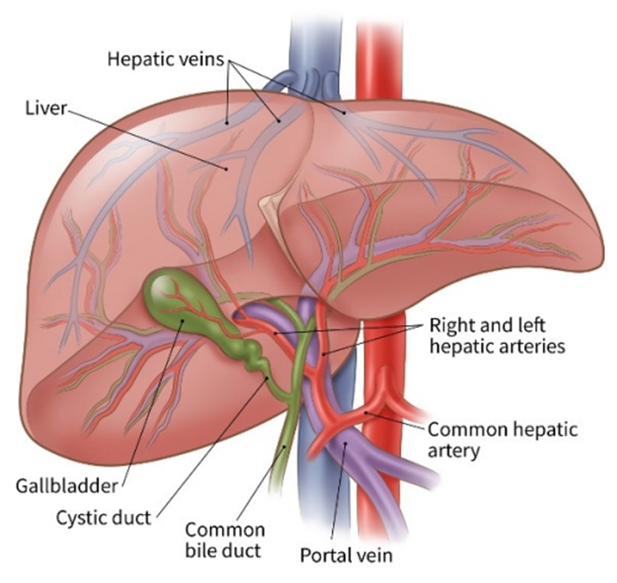
Blood Supply of Liver
Core Knowledge
Portal vein 75% (nutrient rich)
Hepatic artery 25% (oxygen rich)

Slide 12
Blood Supply of Liver
Core Knowledge

Slide 13
Blood Supply of Liver
Core Knowledge

Slide 14
Histology of liver
Core Knowledge
Histologically, structural components of liver include
Stroma
Parenchyma
Sinusoids
Perisinusoidal spaces

Slide 15
Lobulation
Core Knowledge
Three ways to describe the histological structure of liver
Classic hepatic lobule
Portal lobule
Liver acinus

Slide 16
Classic Hepatic Lobule
Core Knowledge
Based on the distribution of portal vein & hepatic artery
Emphasizes the endocrine function of hepatocytes
Central vein at center
Portal triads at periphery
Area near portal triad well supplied by oxygen & nutrients
Area near central vein not well supplied

Slide 17
Portal Lobule
Core Knowledge
Triangular area
Three central veins
Portal triad at center
Consists of tissues draining bile into bile duct
Emphasizes the hepatocytes exocrine function

Slide 18
Liver Acinus
Core Knowledge
Diamond shaped area
Two portal triads
Two closest central veins
Based on nature of blood supply & O₂ gradient
ZONE 1- nearest arteriole- most O₂ & nutrients, oxidative metabolism
ZONE III –near central vein – least O₂ & nutrients, glycolysis, lipid formation,ischemic necrosis
ZONE II – intermediate range

Slide 19
Identify the Hepatic Lobules
Core Knowledge

Slide 20
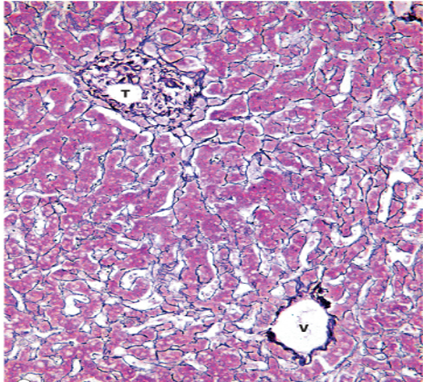
Stroma
Core Knowledge
Connective tissue (Glisson’s) capsule
Thick at hilum
Blood vessels & ducts surrounded by CT
Reticular fibers surround & supports liver cells & sinusoids

Slide 21
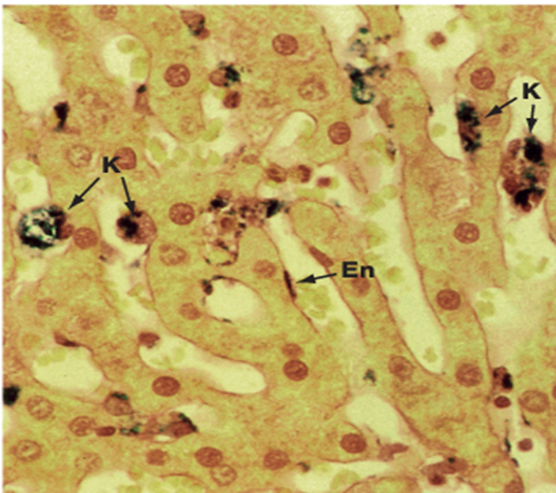
Sinusoids
Core Knowledge
Dilated veins with incomplete basement membrane
Supported by reticular fibers
Cells:
Endothelial cells- fenestrated without diaphragm
Kupffer cells (macrophages) present within sinosuoids
Metabolize aged erythrocytes,
Digest bacteria

Slide 22
Perisinusoidal spaces
Core Knowledge
A subendothelial space
Present between hepatocytes & sinosuoids
Microvilli of hepatocytes project into the space
Fat storing (Ito) cells that stores Vit. A present here
Space continuous with sinusoids

Slide 23
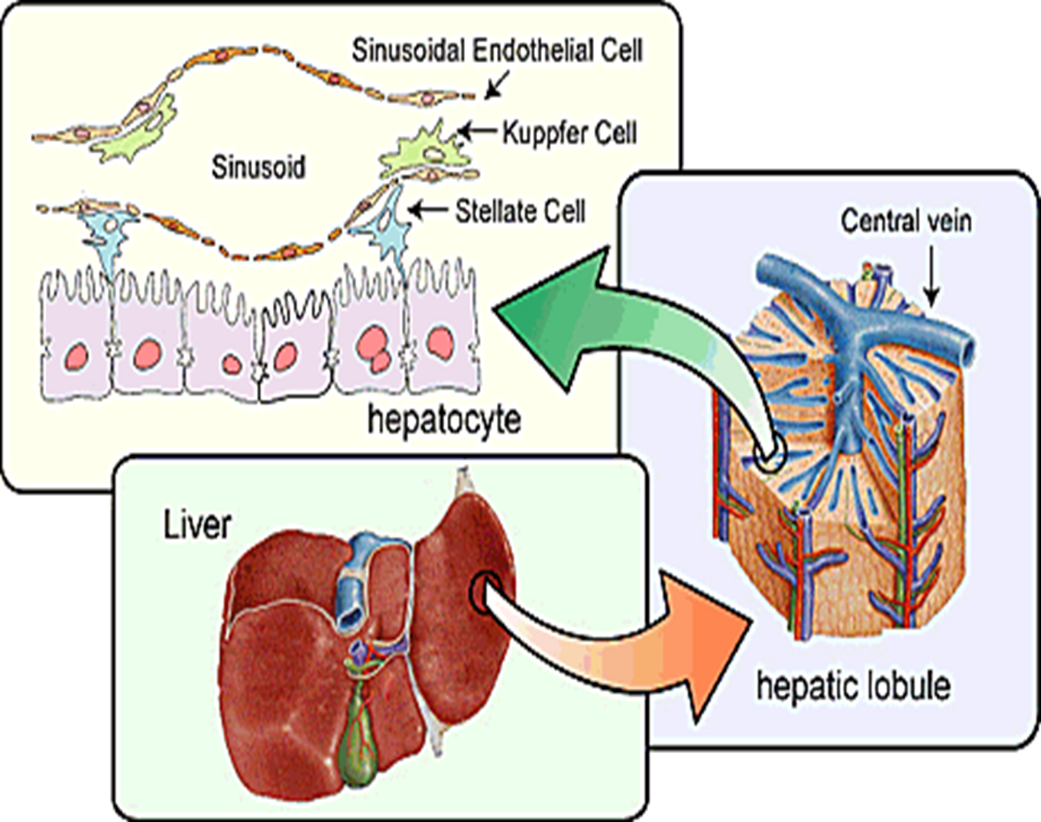
Core Knowledge

Slide 24
Parenchyma
Core Knowledge
Parenchyma includes hepatocytes
Hepatocytes
Polyhedral cells 20-30µm
Eosinophilic
Large nucleus /binucleate
Bile canaliculi
Hepatocyte surfaces related to:
Perisinosoidal space
Adjacent hepatocyte
Bile canaliculi

Slide 25
Parenchyma
Core Knowledge
Nucleus
Prominent nucleolus
Disperse chromatin
Polyploidy
Cytoplasm
Glycogen-lacey appearance
Fat-spherical vacuoles
Ribosomes & RER- basophilia
SER
Mitochondria-eosinophilic
Lysosomes
Golgi complex
Peroxisomes

Slide 26
Parenchyma
Core Knowledge
Fine structure of hepatocytes
Rough endoplasmic reticulum – protein synthesis
Smooth endoplasmic reticulum – oxidation, methylation
Conjugation of bilirubin to gluronate – bilirubin glucoronide
Synthesis of bile acids
Golgi apparatus – near nucleus
Formation of lysomes
Secretion of proteins, glycoproteins, lipoproteins into plasma
Lysosomes –turnover & degradation of organelles
Mitochondria
Peroxisomes –
Important for oxidation of excess fatty acid
Breakdown of hydrogen peroxide
Breakdown of purines to uric acid
Synthesis of cholestrol, bile acids & some lipids for myelin
Drug inactivation –by enzyme glucuronyle transferase

Slide 27
Core Knowledge

Slide 28
Biliary Tree
Core Knowledge

Slide 29
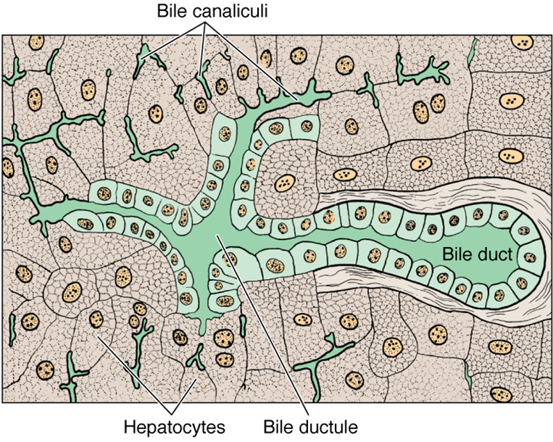
Core Knowledge

Slide 30
Liver Cirrhosis
Vertical Integration
Occurs late in chronic liver disease
Histological findings include excessive connective tissue, fibrosis in perisinusoidal spaces due to proliferation of fibroblasts and Ito cells
Metabolic exchange between hepatocytes and sinusoids is interfered
Can result in clotting disorders, hypoalbuminemia and other medical problems

Slide 31
Fatty Liver Disease
Vertical Integration
Reversible condition
Large lipid droplets accumulate abnormally in hepatocytes called steatosis
Alcoholism, obesity
Progressive inflammation of liver called steatohepatitis

Slide 32
Jaundice
Vertical Integration
When bilirubin glucuronide is not formed or not excreted properly various diseases characterized by Jaundice occur
Neonatal hyperbilirubinemia – jaundice in newborn
Underdeveloped smooth ER
Treatment – blue light exposure
Unconjugated bilirubin transformed into water soluble photoisomer that can be excreted by kidneys

Slide 33
Malignant Tumors
Vertical Integration
Mostly derived from hepatocytes or cholangiocytes of hepatic ducts
Pathogenesis associated with viral hepatitis B,C and cirrhosis

Slide 34
Spiral Integration
Family Medicine
Management of Liver Cirrhosis
Review the patient's clinical presentation, medical history, and diagnostic test results
The most crucial step in managing liver cirrhosis due to alcoholism is complete abstinence from alcohol.
Management of Complications
Nutritional Support, Malnutrition is common in patients with liver cirrhosis. Encourage the patient to follow a well-balanced diet
Schedule regular follow-up visits to monitor the progression of liver disease
Offer counseling and support services to address the emotional and psychological challenges
Medication Management

Slide 35
Spiral Integration
Bioethics
Ethical Considerations
From an ethical standpoint, the scenario raises considerations regarding patient autonomy, informed consent, and confidentiality
The physician must ensure that patient fully understands her diagnosis, treatment options, and potential implications
Additionally, the physician must respect patient’s privacy and confidentiality throughout the diagnostic and treatment process

Slide 36
Spiral Integration
Artificial Intelligence
Role of AI in Liver Cirrhosis Management
AI can potentially aid in enhancing diagnostic accuracy and efficiency.
AI-powered decision support systems can also help clinicians in selecting appropriate treatment modalities
AI-driven predictive models may help anticipate the risk of disease occurrence in susceptible populations

Slide 37
Natural history of histologically proven alcohol-related liver disease: A systematic review
Spiral Integration
Research Article
Parker R, Aithal GP, Becker U, Gleeson D, Masson S, Wyatt JI, Rowe IA, https://doi.org/10.1016/j.jhep.2019.05.020
Alcohol-related hepatic steatohepatitis requiring admission to hospital is the most dangerous subtype of ALD. Alcohol-related steatosis is not a benign condition as it is associated with significant risk of mortality.

Slide 38
Learning Resources
Junqueira’s Basic Histology 14th Edition, Chapter 15, pages 301-309
Histology , A text and Atlas by Michael H.Ross 7th Edition, Chapter 17, pages 572-584
DiFiore's Atlas of Histology with Functional Correlations 11th Edition, Chapter 11, pages 240-245
Google images

Slide 39
THANK YOU

