Slide 2
Gastrointestinal Tract (GIT) Module 2nd Year MBBS(LGIS) Histology of Large Intestine
Presenter: Dr. Maria Tasleem Date: 15-03-25
(Assistant Professor)

Slide 3
Prof. Umar’s Model of Teaching Strategy Self Directed Learning Assessment Program
Objectives :To cultivate critical thinking, analytical reasoning, and problem-solving competencies.
To instill a culture of self-directed learning, fostering lifelong learning habits and autonomy.
How to Assess?
➢Ten randomly selected students will be evaluated within the first 10
minutes of the lecture through 10 multiple-choice questions (MCQs)
based on the PowerPoint presentation shared on Students Official
WhatsApp group, one day before the teaching session.
➢The number of MCQs from the components of the lecture will follow
the guidelines outlined in the Prof. Umar model of Integrated Lecture.
Component of LGIS | Core Knowledge | Horizontal Integration | Vertical Integration | Spiral Integration
No. of MCQs | 6-7 | 1-2 | 1 | 1

Slide 4
Professor Umar Model of Integrated Lecture

Slide 5
Learning Objectives
At the end of this session students should be able to
Describe histological features of large intestine.
Discuss cells lining the epithelium
Explain concept of teniae coli
Differentiate histological structure of the large intestine from the small intestine.
Describe histological features of appendix,cecum, rectum and anal canal
Discuss clinical conditions
Understand curative and preventive heath care measures.

Slide 6
Interactive Session
A 62-year-old male presents to his primary care physician with complaints of changes in bowel habits, including alternating diarrhea and constipation, abdominal pain, and blood in his stool.

Slide 7
Interactive Session
Upon further examination, the physician detects a palpable mass in the patient's abdomen and orders a colonoscopy, which reveals a polyp in the descending colon. Biopsy confirms polyp as an adenomatous polyp. What is the significance of this finding?

Slide 8
Large Intestine
Core Knowledge
Has caecum, appendix, colon, rectum and anal canal.
Absorption of water
Formation of fecal mass
Production of mucus

Slide 9
Histological Layers
Core Knowledge
Mucosa
Sub mucosa
Muscularis externa
Serosa/adventitia
But
No villi
No plicae circulares
Special features include
Teniae coli
Haustrations
Appendices epiploicae

Slide 10
Large Intestine-Gross Features
Core Knowledge

Slide 11
Large Intestine-Histological Layers
Core Knowledge

Slide 12
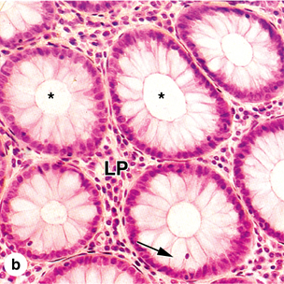
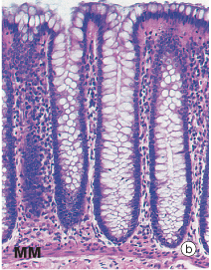
Colon
Core Knowledge
NO villi / plica circulares
Mucosa
Epithelium –coloncytes
Intestinal gland- 0.5mm deep, lined by columnar cells, goblet cells, enteroendocrine & stem cells

Slide 13
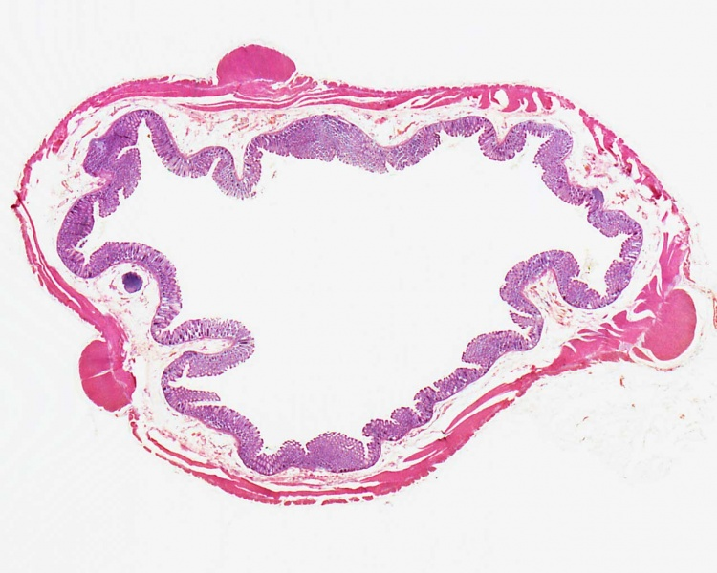
Colon
Core Knowledge
Lamina propria- rich in lymphatic tissue, BV, lymphocytes, plasma cells, collagen
Muscularis mucosae- prominent
Submucosa
Muscularis externa
Inner circular
Outer longitudinal – teniae coli
Serosa / Adventitia

Slide 14
Colon
Core Knowledge

Slide 15
Colon
Core Knowledge

Slide 16
Appendix
Core Knowledge
Irregular lumen
Few short intestinal glands
Epithelium
Columnar cells
Goblet cells- few
Enteroendocrine cells-few
Lamina propria
Diffuse lymphocytic infiltration
Lymphatic nodules

Slide 17
Appendix
Core Knowledge
Muscularis mucosae- disrupted
Submucosa- lymphatic tissue
Muscularis externa- two layers
Serosa

Slide 18
Rectum
Core Knowledge

Slide 19
Rectum
Core Knowledge

Slide 20
Comparison
Core Knowledge
Colon
Rectum

Slide 21
Anal Canal
Core Knowledge

Slide 22
Anal canal (Upper 1/3)
Core Knowledge
Epithelium:
Simple columnar with goblet cells
Lamina propria:
Intestinal glands -short
Muscularis mucosa:
Inner circular
Outer longitudnal

Slide 23
Anal canal (Upper 1/3)
Core Knowledge
Submusoa:
Loose CT
Branched tubular glands lined with mucous cells
Numerous thin walled veins- Internal hemorrhoidal veins (Piles)
Muscularis externa
Inner circular – internal anal sphincter
Outer longitudinal
Outermost – skeletal muscle – external anal sphincter
Adventitia

Slide 24
Anal Canal (Middle 1/3)
Core Knowledge
Epithelium:
Stratified squamous non-keratinized
Lamina propria:
Crypts absentt
Muscularis mucosae:
Broken –gradually indistinct
Submucosa

Slide 25
Anal Canal (Lower 1/3)
Core Knowledge
Epithelium:
Stratified squamous keratinized
Sweat glands
Sebaceous glands
Lamina propria & Submucosa:
No distinction
Muscularis mucosa:
Absent

Slide 26
Core Knowledge

Slide 27
Bio-physiological aspects of Large Intestine
Horizontal Integration
Principal functions are
Reabsorption of water and electrolytes
Elimination of undigested food and waste

Slide 28
Colorectal Cancer
Vertical Integration
Adenocarcinoma of colon
Very common in old age
Causes
Low fiber intake
Ulcerative colitis/ other diseases of gut
Family history

Slide 29
Diverticulosis
Vertical Integration
Herniation or outpocketing of mucosa and submucosa
Structural defects in the colon wall or constipation
Can lead to diverticulitis

Slide 30
Appendicitis
Vertical Integration
Infection & inflammation of appendix
Lymphoid follicle enlarges
Wall rupture

Slide 31
Anal Fissure
Vertical Integration
A tear in the lining of anus or anal canal
Causes
Hard stools
Long lasting diarrhea
Constipation and straining during bowel movements

Slide 32
Anal Abscess
Vertical Integration
Mostly due to infection of small anal glands
Surgical incision and drainage
Can lead to anal fistulas

Slide 33
Hemorrhoids
Vertical Integration

Slide 34
Spiral Integration
Family Medicine
Management of Colorectal Cancer
Detailed medical history and physical examination
Refer the patient to specialists such as oncologists, colorectal surgeons
Provide supportive care and help manage symptoms associated with colonic cancer and its treatment.
Schedule regular follow-up visits to monitor the progression of disease
Offer counseling and support services to address the emotional and psychological challenges

Slide 35
Spiral Integration
Bioethics
Ethical Considerations
From an ethical standpoint, the scenario raises considerations regarding patient autonomy, informed consent, and confidentiality
The physician must ensure that patient fully understands the diagnosis, treatment options, and potential implications
Additionally, the physician must respect patient’s privacy and confidentiality throughout the diagnostic and treatment process

Slide 36
Spiral Integration
Artificial Intelligence
Role of AI in Coloractal Management
AI can potentially aid in enhancing diagnostic accuracy and efficiency.
AI-powered decision support systems can also help clinicians in selecting appropriate treatment modalities
AI-driven predictive models may help anticipate the risk of disease occurrence in susceptible populations

Slide 37
Herniation of crypts in hyperplastic polyp and sessile serrated adenoma: a prospective study
Spiral Integration
Research Article
K Hu, S Shen, L Zhang
PMID: 29416927
Presence of colonic crypts in submucosa is termed as herniation of crypts. The histological presence of this herniation is strongly suggestive of adenomatous polyp and hence is a means to differentiate adenomatous polyp from hyperplastic polyp.

Slide 38
Learning Resources
Junqueira’s Basic Histology 14th Edition, Chapter 16, pages 316-319
Histology , A text and Atlas by Michael H.Ross 7th Edition, Chapter 18, pages 594-599
DiFiore's Atlas of Histology with Functional Correlations 11th Edition, Chapter 14, pages 302-309
Google images

Slide 39
THANK YOU

