Slide 2
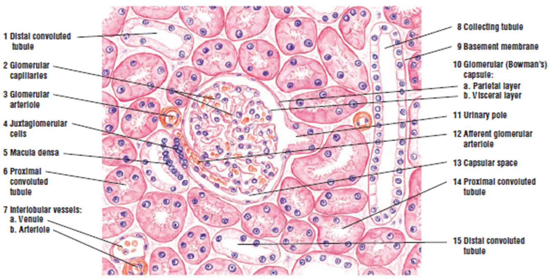
Renal Module 2nd Year MBBS(LGIS) Histology of Kidney
Presenter: Dr. Maria Tasleem Date: 21-04-25
(Assistant Professor)

Slide 3
Prof. Umar’s Model of Teaching Strategy Self Directed Learning Assessment Program
Objectives :To cultivate critical thinking, analytical reasoning, and problem-solving competencies.
To instill a culture of self-directed learning, fostering lifelong learning habits and autonomy.
How to Assess?
➢Ten randomly selected students will be evaluated within the first 10
minutes of the lecture through 10 multiple-choice questions (MCQs)
based on the PowerPoint presentation shared on Students Official
WhatsApp group, one day before the teaching session.
➢The number of MCQs from the components of the lecture will follow
the guidelines outlined in the Prof. Umar model of Integrated Lecture.
Component of LGIS | Core Knowledge | Horizontal Integration | Vertical Integration | Spiral Integration
No. of MCQs | 6-7 | 1-2 | 1 | 1

Slide 4
Professor Umar Model of Integrated Lecture

Slide 5
Learning Objectives
At the end of this session students should be able to
Discuss the structural components of the nephron..
Discuss the histology of filtration barrier.
Understand the bio-physiological aspects of filtration
Distinguish the key microscopic components of the renal cortex and medulla.
Differentiate the histological appearance of proximal tubule, loop of Henley, distal convulated tubule and collecting duct.
Enumerate the component cells of the juxta glomerular apparatus.

Slide 6
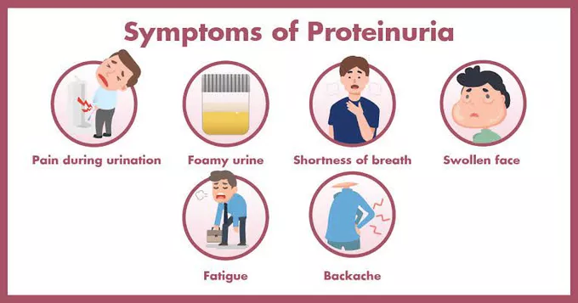
Interactive Session
40 years old patient with history of hypertension noticed that his urine has become frothy and dark yellow in color. He has also been feeling tired and weak lately. He went to the doctor who advised a urine detailed report.

Slide 7
Interactive Session
The report showed Proteinuria, indicating the presence of excess protein in the urine. With your knowledge of kidney histology explain the structure that has been affected.

Slide 8
Kidney- Gross Anatomy
Core Knowledge

Slide 9
General Organization of Kidney
Core Knowledge
Capsule (Stroma)
Cortex
Cortical Labyrinth
Medullary rays
Medulla
Renal pyramid
Renal columns
Major & minor calyces
Pelvis

Slide 10
Core Knowledge

Slide 11
General Organization of Kidney
Core Knowledge
Stroma
Capsule
Outer Layer: Fibroblast & Collagen Fibers
Inner Layer: Myofibroblasts
Parenchyma
Nephrons
Collecting ducts
Vascular components
Organized into cortex and medulla

Slide 12
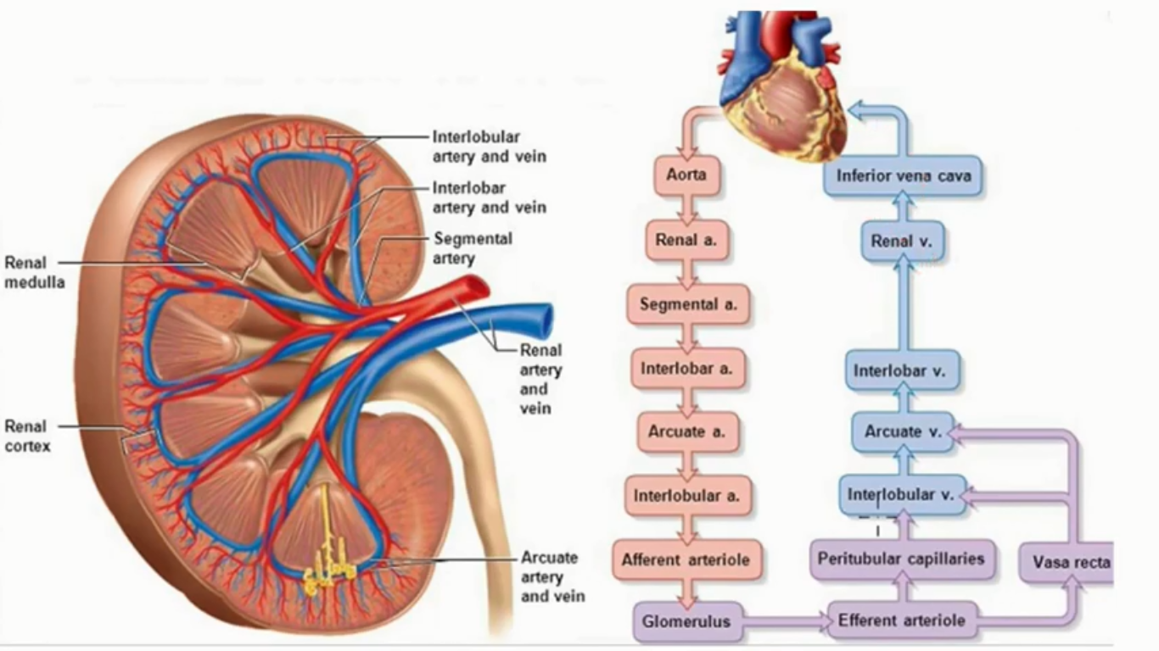
Vasculature of Kidney
Core Knowledge

Slide 13
Vasculature of Kidney
Core Knowledge

Slide 14
Microscopic structure
Core Knowledge
Uriniferous Tubules
Nephron-secretory part
Collecting tubule-collecting part

Slide 15
Nephron-Parts
Core Knowledge
Structural & functional unit
Renal Corpuscle/
Malpighian Corpuscle
(for filtration)
Glomerulus
Bowman’s Capsule
Renal Tubules(for selective reabsorption)
Proximal tubule
Convulated & Straight portions
Loop of Henle
Thin & thick portions
Distal tubule
Straight & convulated portions

Slide 16
Nephron-Types
Core Knowledge
Cortical nephrons
~85% of all nephrons
Located in the cortex
Relatively short loops that dip only slightly in the medulla
Juxtamedullary nephrons
Closer to renal medulla
Loops of Henle very long and extend deep into renal pyramids
Intermediate/
midcortical nephrons

Slide 17
Renal Corpuscle
Core Knowledge
Bowman’s capsule + glomerulus
Filtration apparatus of kidney

Slide 18
Renal Corpuscle
Core Knowledge

Slide 19
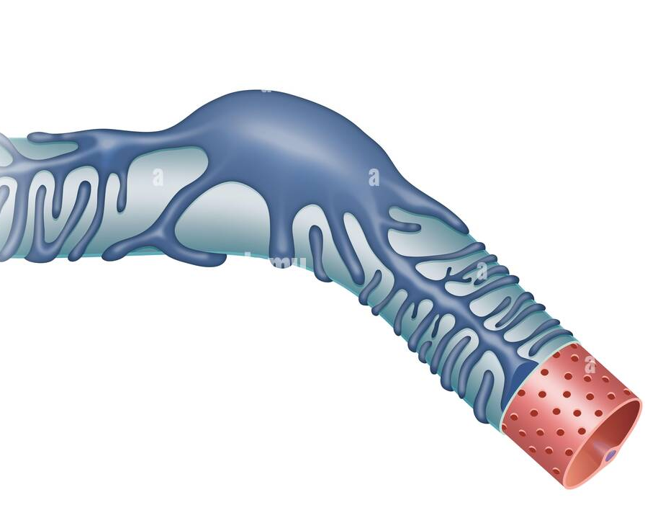
Podocyte
Core Knowledge

Slide 20
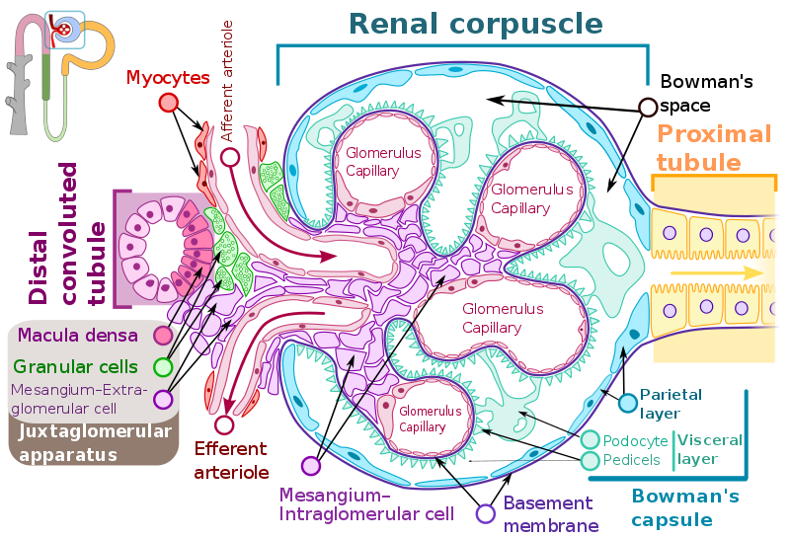
Core Knowledge

Slide 21
Glomerular Basement Membrane
Core Knowledge

Slide 22
Glomerular Filtration Membrane-The Filtration Barrier
Core Knowledge

Slide 23
Core Knowledge

Slide 24
Renal Tubules
Core Knowledge
Proximal Convulated Tubule-PCT
Long therefore found more than DCT in cross sections
Simple cuboidal epithelium
Apical brush border
Basal striations
Lateral interdigitations
Active absorption of sodium

Slide 25
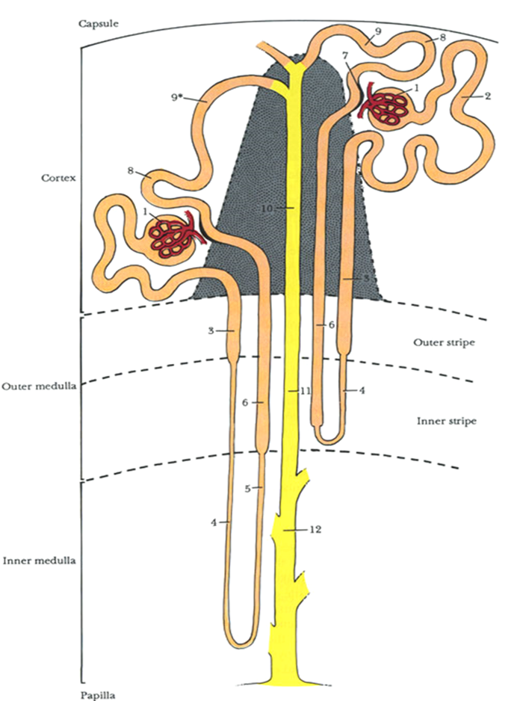
Core Knowledge
Loop of Henle
Simple squamous & cuboidal epithelium
Descending thin limb freely permeable to water-aqua porin channels
Ascending thin segment reabsorbs sodium, chloride & potassium by membrane cotransporters
Creates a hypertonic environment in the interstitium of medulla

Slide 26
Core Knowledge
Distal Convulated Tubule-DCT
Smaller diameter than PCT
Wider lumen
Cuboidal epithelium
Faintly acidophilic cytoplasm
Basal striations
No brush border
Active reabsorption of sodium, passive reabsorption of chloride
Secrete H-ions in lumen maintaining the acidity of urine

Slide 27
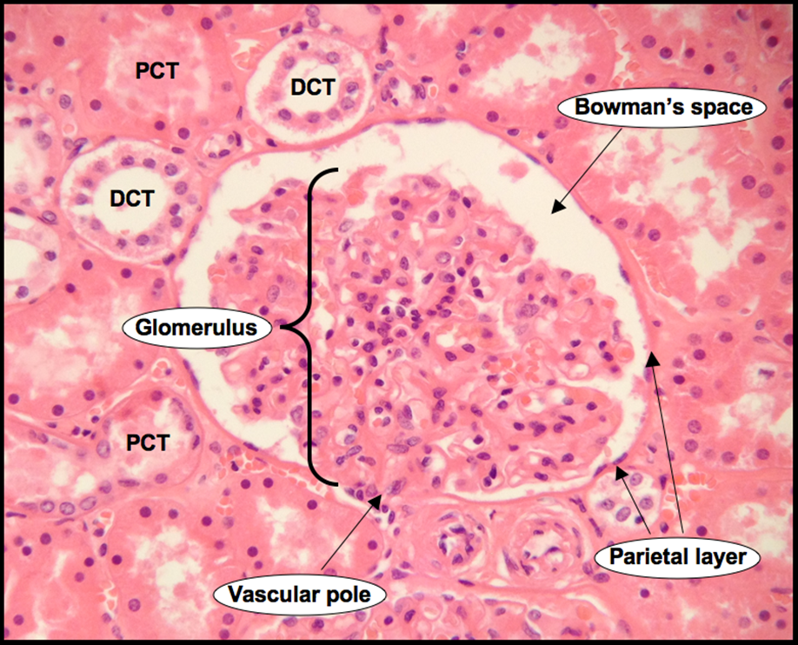
Core Knowledge

Slide 28
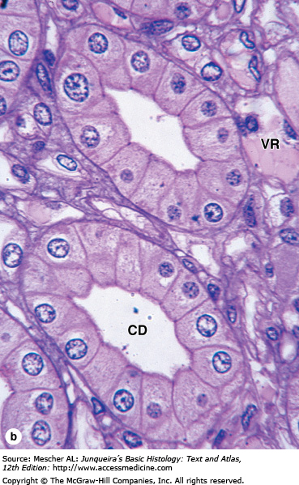
Collecting Duct
Core Knowledge
Principal cells or Light cells
Permeable to water
Rich in aquaporins
ADH hormone increases the permeability
Aldosterone receptors for sodium reabsorption and potassium secretion
Intercalated cells or Dark cells
α intercalated secrete H-ions
Β Intercalated secrete HCO3 ions

Slide 29
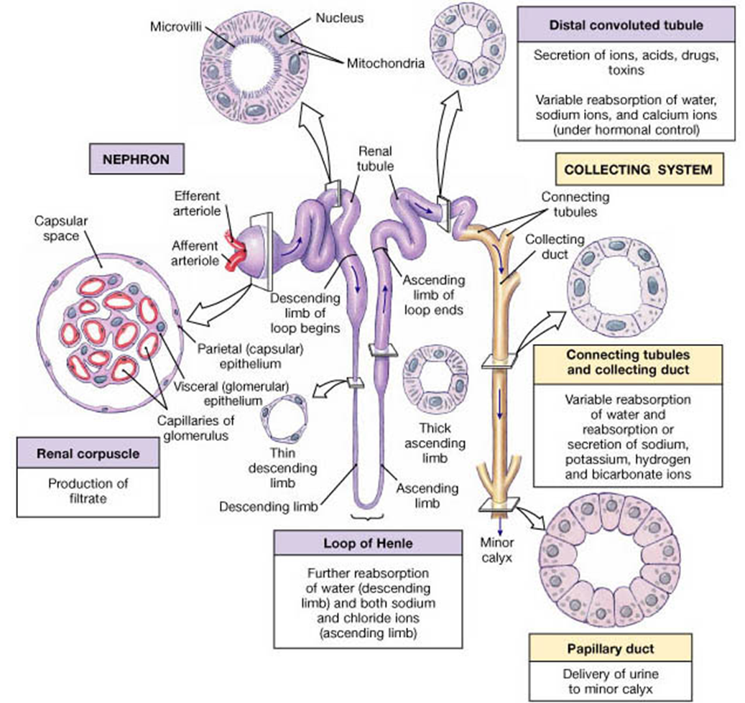
Core Knowledge

Slide 30
Juxtaglomerular Apparatus
Core Knowledge
Macula Densa
Juxtaglomerular cells
Lacis cells/ Extramesangial cells

Slide 31
Core Knowledge

Slide 32
Renal Interstitium
Core Knowledge
The connective tissue of kidney parenchyma that surrounds the nephrons, ducts and blood and lymphatic vessels

Slide 33
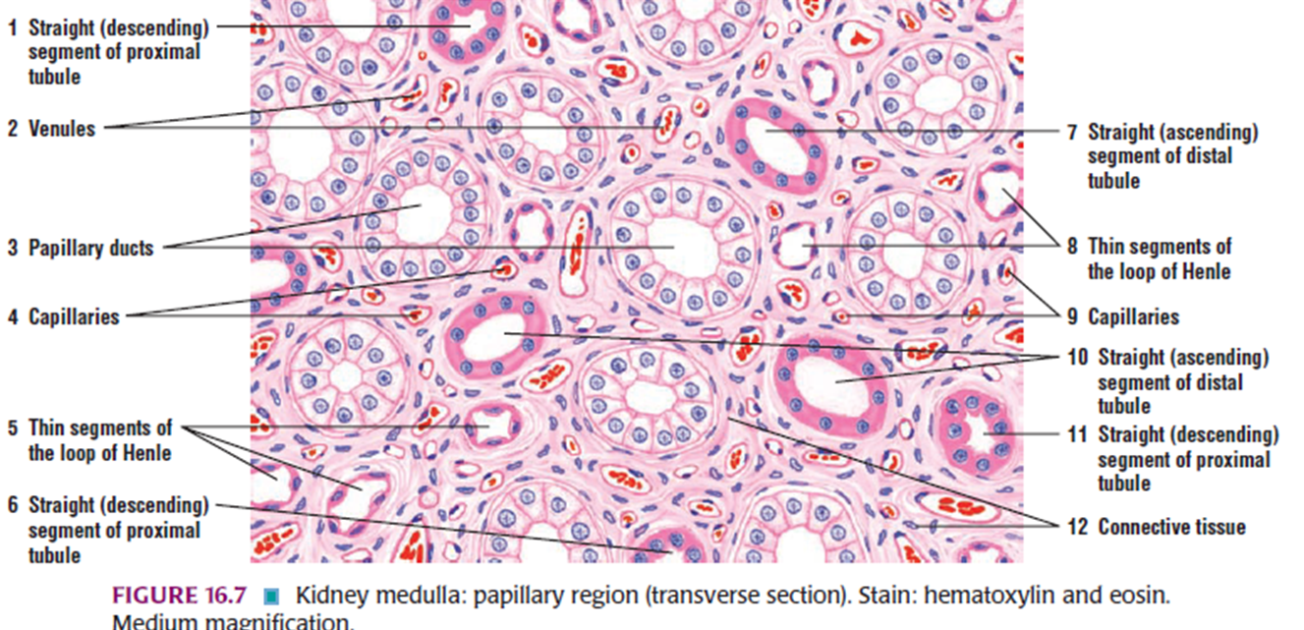
Core Knowledge

Slide 34
Bio-Physiological Aspects of Kidney
Horizontal Integration

Slide 35
Horizontal Integration

Slide 36
Polycystic Kidney Disease
Vertical Integration
Inherited disorder
Normal cortical organization is lost
Loss of renal function

Slide 37
Glomerulonephritis
Vertical Integration
Inflammation within the glomeruli
Deposition of circulating antigen antibody complexes
Elicit local inflammatory response

Slide 38
Proteinuria
Vertical Integration

Slide 39
Diabetic Glomeruloscelrosis
Vertical Integration
Thickening and loss of function in GBM
End stage kidney disease
Kidney transplant or artificial hemodialysis

Slide 40
Spiral Integration
Family Medicine
Management of Proteinuria
Medical History and Physical Examination
Diagnostic Tests
Identify the underlying cause
Treatment of cause
Patient Education and Support
Referral to Specialist

Slide 41
Spiral Integration
Bioethics
Ethical Considerations
From an ethical standpoint, the scenario raises considerations regarding patient autonomy, informed consent, and confidentiality
The physician must ensure that patient fully understands her diagnosis, treatment options, and potential implications
Additionally, the physician must respect patient’s privacy and confidentiality throughout the diagnostic and treatment process

Slide 42
Spiral Integration
Artificial Intelligence
Role of AI in Liver Proteinuria
AI can potentially aid in enhancing diagnostic accuracy and efficiency.
AI-powered decision support systems can also help clinicians in selecting appropriate treatment modalities
AI-driven predictive models may help anticipate the risk of disease occurrence in susceptible populations

Slide 43
Impact of Pregnancy on GFR Decline and Kidney Histology in Kidney Transplant Recipients
Spiral Integration
Research Article
Andrea G. Kattah , Sam Albadri, Mariam P. Alexander , Byron Smith https://www.ncbi.nlm.nih.gov/pmc/articles/pmid/29416927/
Pregnancy did not affect the risk of graft failure, death-censored graft failure, or 50% reduction in GFR.

Slide 44
Learning Resources
Junqueira’s Basic Histology 14th Edition, Chapter 19, pages 385-397
Histology , A text and Atlas by Michael H.Ross 7th Edition, Chapter 20, pages 724-727
DiFiore's Atlas of Histology with Functional Correlations 11th Edition, Chapter 14, pages 372-379
Google images

Slide 45
THANK YOU

