Slide 1
HEART FAILURE
Dr. Ifrah Tahir
Senior Registrar Cardiology
Benazir Bhutto Hospital

Slide 2
LEARNING OBJECTIVES
At the end of this lecture, the student will learn:
Definition and classification of HF
Causes and mechanisms involved in HF
Clinical manifestations of HF
Management of HF

Slide 3
DEFINITION (Core subject)
Heart failure is a complex clinical syndrome characterized by the heart's inability to pump blood effectively due to structural or functional impairments.

Slide 4
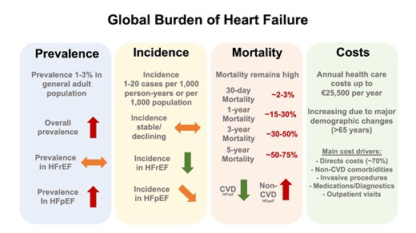
Vertical Integration with Community Medicine

Slide 5
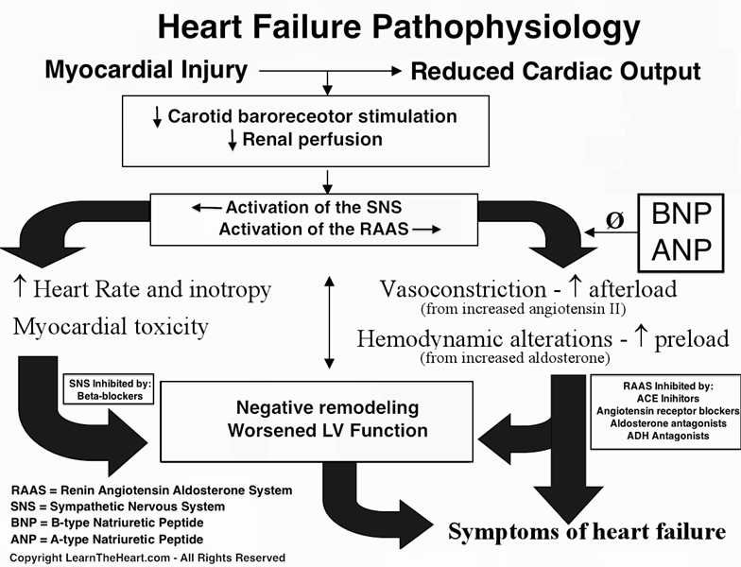
Vertical Integration with Pathophysiology

Slide 6
CLASSIFICATION (Core subject)
Left Heart Failure
Right Heart Failure
Biventricular Failure

Slide 7
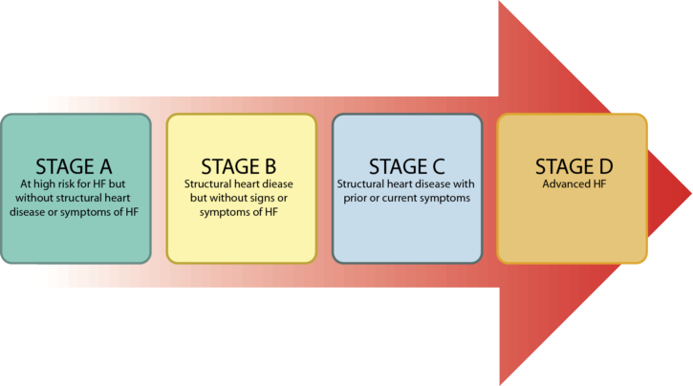
STAGES (Core subject)

Slide 8
MECHANISMS (Core subject)
Reduced Ventricular Contractility
Ventricular Outflow Obstruction
Ventricular Inflow Obstruction
Ventricular Volume Overload
Diastolic Dysfunction

Slide 9
CLINICAL FEATURES
(Core subject)

Slide 10
ACUTE HF
Sudden onset of severe dyspnea, orthopnea and cough (Dry or frothy)
Apprehension and sweating
Pallor and clammy skin
Rapid pulse (Inappropriate Bradycardia in some)
Normal Blood Pressure (low in shock or high due to SNS activation)

Slide 11
Raised Jugular Venous pulse (incase of Right heart involvement)
Gallop Rhythm
New systolic murmur (Acute MR/VSR)
Crepitations at lung bases (Expiratory wheeze in some)

Slide 12
CHRONIC HF
Chronic, worsening dyspnea, orthopnea, Paroxysmal nocturnal dyspnea and dry cough (periods of stability and instability)
Fatigue, effort intolerance, anorexia and weight loss (Cardiac Cachexia)
Cold peripheries
Low Blood Pressure
Oliguria

Slide 13
Raised Jugular Venous pulse (incase of Right heart involvement)
Pedal edema (Sacral edema in bed bound patients)
Ascites
Tender Hepatomegaly
Inspiratory Crepitations at lung bases

Slide 14
COMPLICATIONS (Core subject)
Renal Failure
Hypokalemia
Hyperkalemia
Hyponatremia
Impaired Liver Function
Thromboembolism
Arrhythmias
Sudden Death

Slide 15
INVESTIGATIONS
(Core subject)

Slide 16
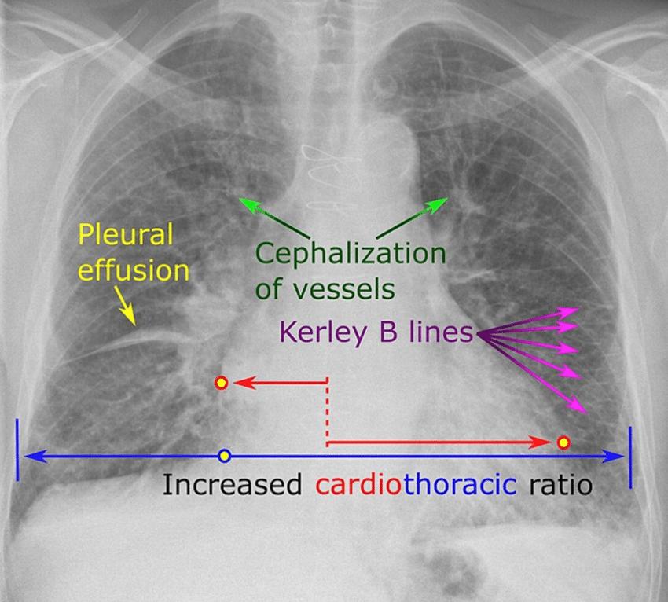
CHEST X-RAY

Slide 17
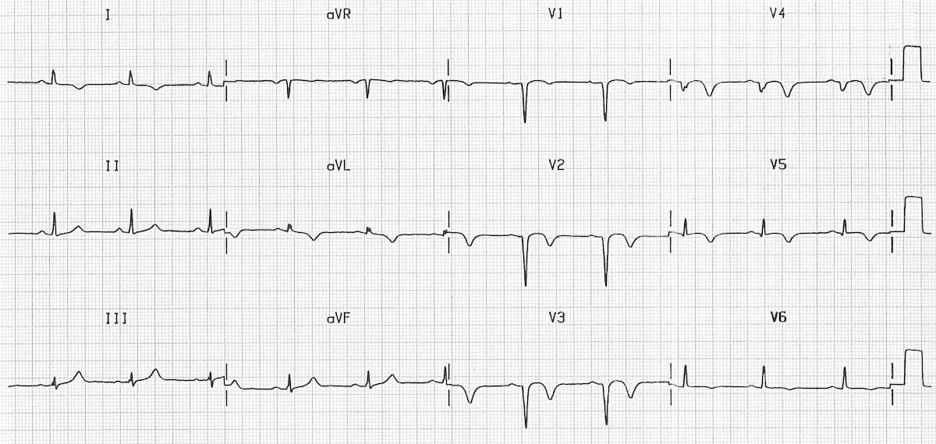
ELECTROCARDIOGRAM

Slide 18
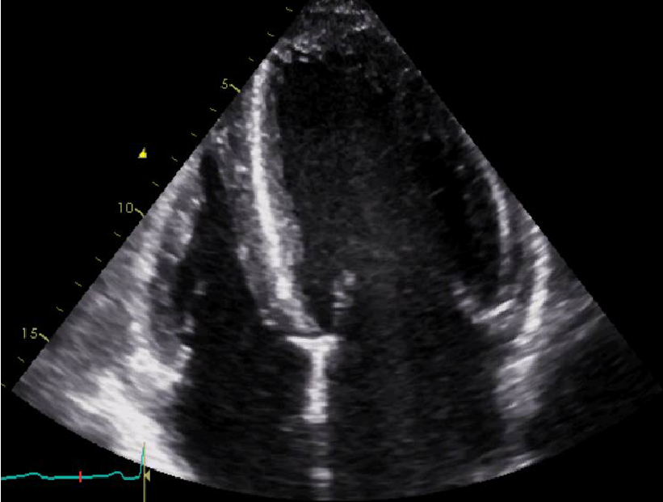
ECHOCARDIOGRAM

Slide 19
BLOOD TESTS
Complete Blood Count
Renal Function Tests
Liver Function Tests
Serum Electrolyte
Blood Glucose
Thyroid Function Tests
Natriuretic Peptides

Slide 20
MANAGEMENT
(Core subject)

Slide 21
ACUTE HEART FAILURE
Prop Up
Supplementary Oxygen inhalation
Administration of Loop Diuretics
Administration of Nitrates
Inotropic support or Percutaneous cardiac support devices (In case of shock)
Continuous monitoring of vitals, Cardiac rhythm, fluid intake and output.

Slide 22
CHRONIC HEART FAILURE
Education
Salt and Fluid Restriction
Smoking Cessation
Exercise
Vaccination

Slide 23
PHARMACOLOGICAL THERAPY
Diuretics
Beta Blockers
ACE inhibitors, Angiotensin receptor blockers and Neprilysin inhibitors
Mineralocorticoid receptor blockers
Sodium Glucose Co-transport 2 inhibitors
Ivabradine
Digoxin

Slide 24
NONPHARMACOLOGICAL THERAPY

Slide 25
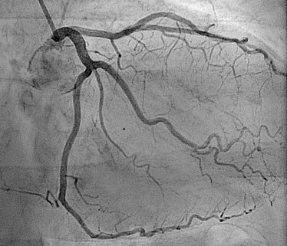
Coronary Revascularization

Slide 26
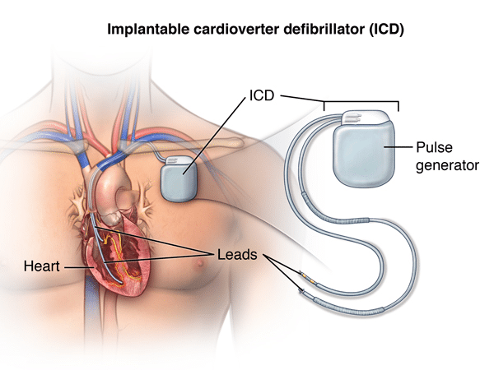
Implantable Cardiac Defibrillators

Slide 27
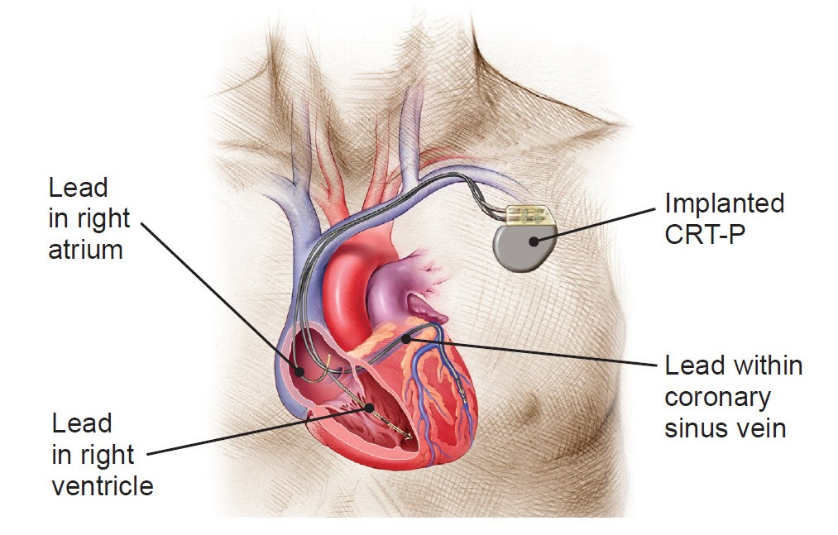
Cardiac Resynchronization Therapy

Slide 28
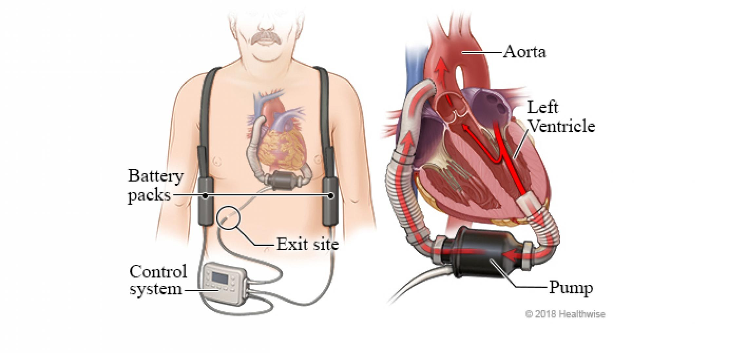
Ventricular Assist Devices

Slide 29
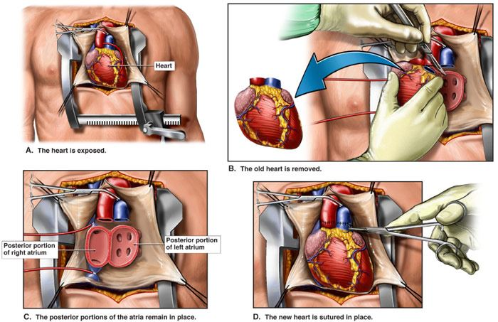
Cardiac Transplant

Slide 30
Biomedical Ethics
Before doing any medical and surgical treatment, informed consent must be taken.
Prognosis should be explained to patients and attendants.

Slide 31
REFERENCES
Davidson’s Principles and Practice of Medicine 2rd Edition
American Heart Association Guidelines for HF 2022

