Slide 1
Gastric outlet obstruction
By Dr faryal azhar

Slide 2
This Photo by Unknown Author is licensed under CC BY-SA

Slide 3
Prophet Muhammad (PBUH) said: “Nothing is worse than a person who fills his stomach. It should be enough for the son of Adam to have a few bites to satisfy his hunger. If he wishes more, it should be: One-third for his food, one-third for his liquids, and one-third for his breath.”
– Tirmidhi & Ibn Majah

Slide 4
Anatomy of stomach

Slide 5
Blood supply

Slide 6
Anatomical relations of stomach

Slide 7
Scenarios
A 25 years female came with projectile vomiting and cannot eat solids. She is looking pale and weak. She is complaining of pain abdomen off and on. She had past history of some psychiatric issue.
A 45 years old male came with pain epigastrium off and on aggravated on eating. He presented with history of projectile vomiting and weight loss. He had few episodes of hematemesis.
A middle-aged male presented with projectile vomiting . He had a past history of pain epigastrium off and on and history of too much use of nsaids.

Slide 8
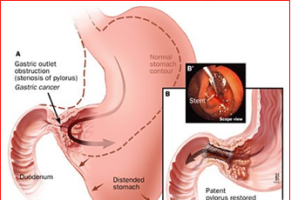
Defination

Slide 9
Causes of gastric outlet obstruction

Slide 13
Pathophysiology

Slide 14
Clinical features

Slide 16
Investigations
Baseline : Blood Cp ,rft , lft, Abgs
Specific: Contrast studies, Abdominal x-rays, endoscopy, ct with contrast.

Slide 17
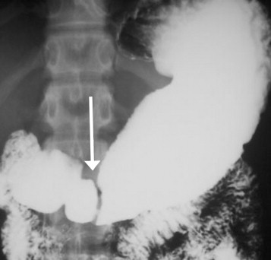

Slide 20
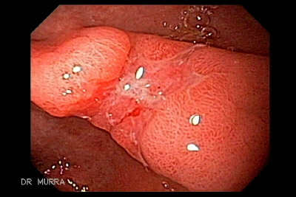
Corrosive and Ca

Slide 21
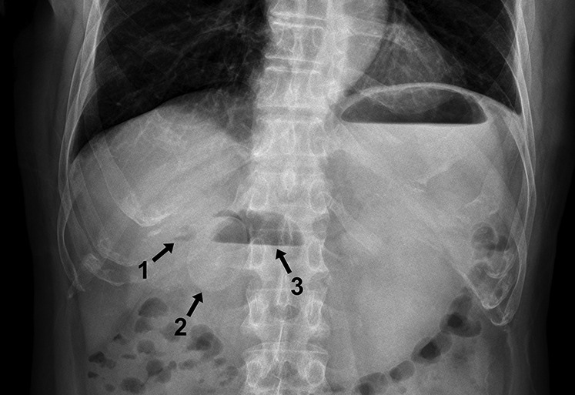
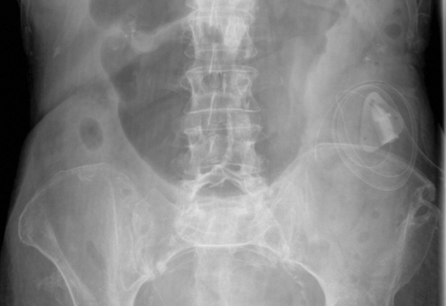
diagnosis
Abdominal x-rays

Slide 22
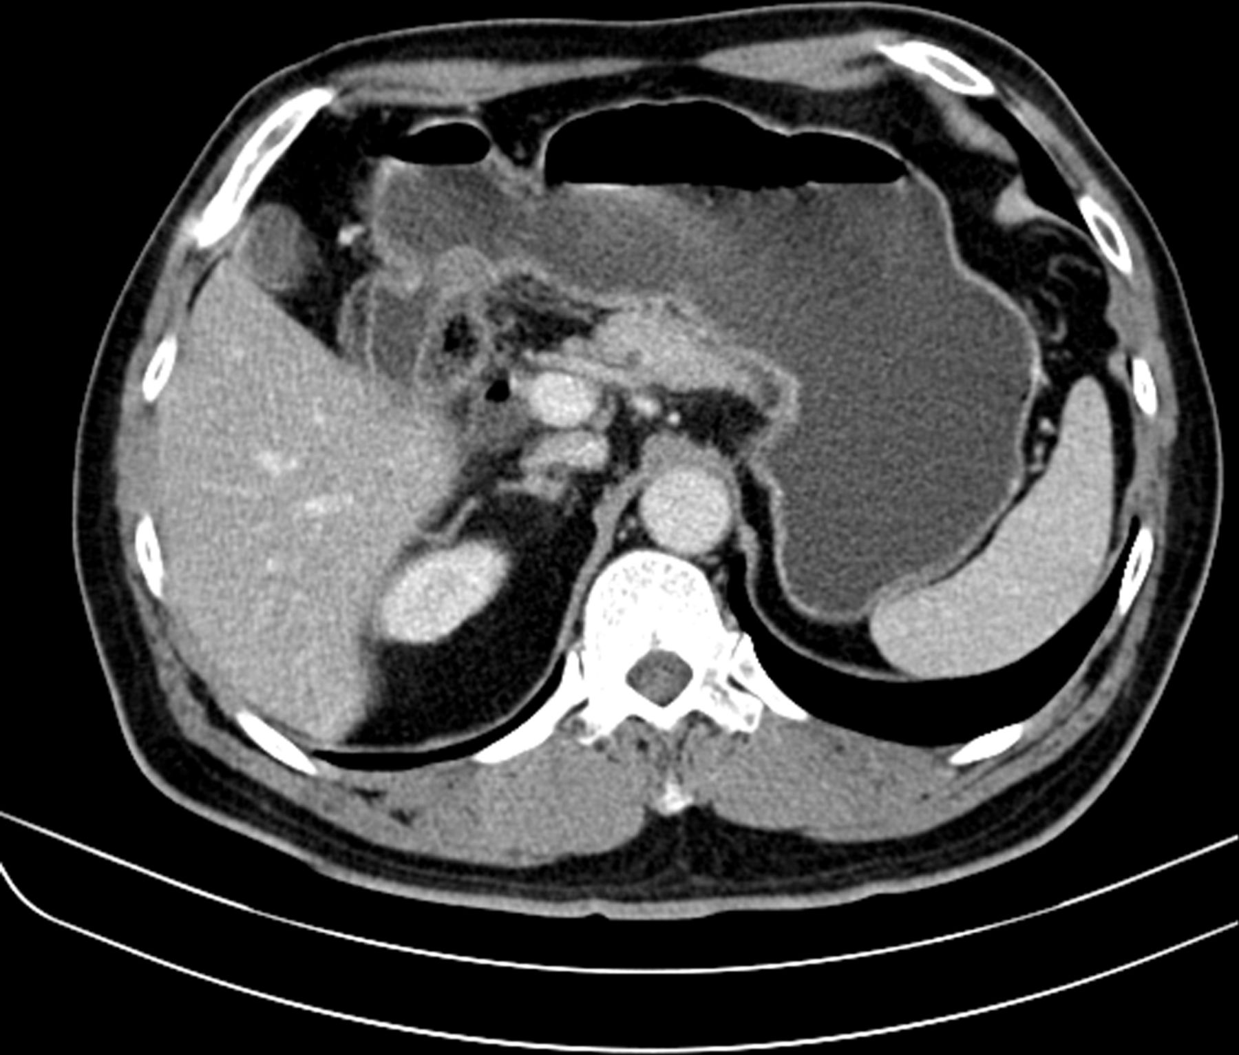
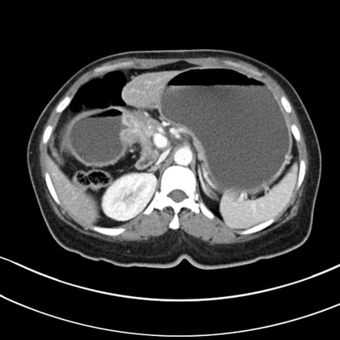
Ct scan with contrast

Slide 23
treatment

Slide 25
Endoscopic gastric dilatations

Slide 26
Surgical options

