Slide 2
2nd Year MBBS Gastrointestinal Tract Module Large Group Interactive Session (LGIS) GIT Hormones
Presenter: Dr. Almas Ajaz

Slide 3
Motto, Vision, Dream
To impart evidence based research oriented medical education
To provide best possible patient care
To inculcate the values of mutual respect and ethical practice of medicine
Wisdom
Truth
Service

Slide 4
Professor Umar Model of Integrated Lecture

Slide 5
Learning Objectives
At the end of this session students should be able to
Explain the general anatomy and physiological functioning of gastrointestinal tract.
Explain the different gastrointestinal hormones and their actions along with their regulation.
Co relate the hormones with associated disease in case of excess or diminished secretions.

Slide 6
Interactive Session
Patient: John Smith, a 55-year-old male
Chief Complaint: Severe abdominal pain and bloating for the past 3 months
Medical History: John has a history of peptic ulcers and has been on proton pump inhibitors (PPIs) for the past year. He also reports occasional diarrhea and unexplained weight loss.
Clinical Findings: Upon examination, John's abdomen is distended and tender to palpation. Laboratory tests reveal elevated serum gastrin levels.

Slide 7
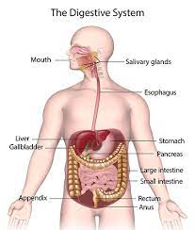

Slide 8
Ingestion: Taking in food
❑ Digestion: Chemical and Mechanical
❑ Absorption: moving nutrients from the lumen of the GI tract into the cells of the body
❑ Excretion: getting rid of undigested and unabsorbed material
❑ Movement: movement of ingested food throughout the GI

Slide 9
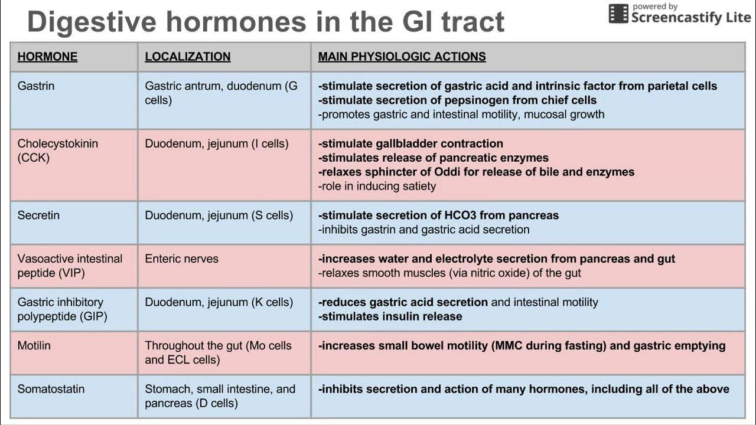
Core Concept
Salivary Glands
There are 3 main pair of Salivary glands
Parotid Gland (Serous section)
Submandibular Gland (Serous and mucus secretion)
Sublingual Gland (mostly mucus secretion)
There are also minor buccal glands which secrete mucus.
These minor glands are located at tip of tongue or in oral mucosa

Slide 17
Core Knowledge

Slide 22
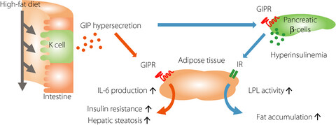

Slide 23
Vertical Integration

Slide 24
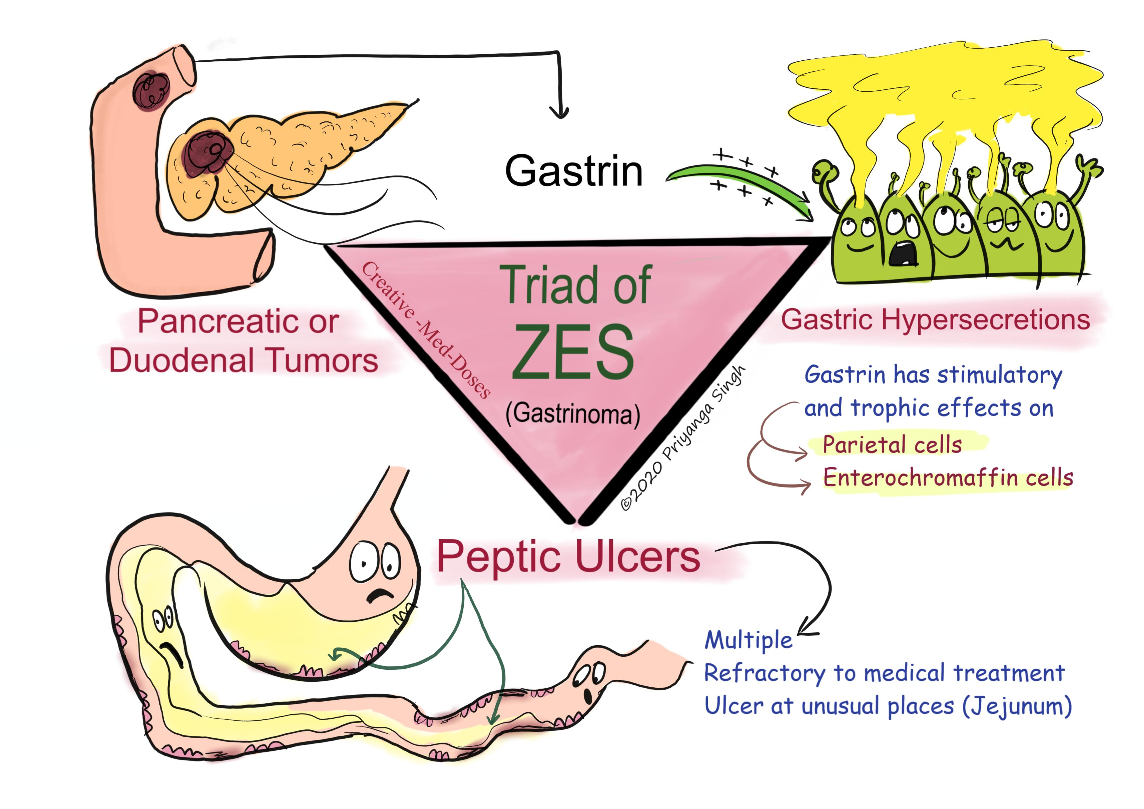

Slide 26
Family Medicine
Gastric Acid Disorders: such as gastritis, peptic ulcers, or gastroesophageal reflux disease (GERD), which can be influenced by imbalances in gastric hormones like gastrin.
Pancreatic Disorders: such as pancreatitis or pancreatic insufficiency, can impact the secretion of hormones like CCK and secretin, leading to digestive complications.
Obesity and Metabolic Disorders: family medicine practitioners play a crucial role in addressing obesity-related issues.

Slide 27
Artificial Intelligence
By leveraging AI techniques such as machine learning and data analysis,
researchers can analyze large datasets related to git hormone levels and behavioral outcomes.
researchers can use AI to analyze complex biological data related to git hormone signaling pathways, gene expression patterns, and hormone-receptor interactions.

Slide 28
Bioethics
Informed Consent and Autonomy: In the context of GIT hormones, this means ensuring that all individuals have access to accurate information and that they are able to make their own decisions about whether to pursue this treatment.
Medical Necessity and Evidence-Based Med
Privacy and Confidentiality: This is particularly relevant to GIT hormones, as some individuals may be concerned about the potential social or legal consequences of seeking hormone therapy

Slide 29
Suggested Research Article
Link:
https://link.springer.com/article/10.1007/s11894-021-00801-6
Journal Name:
“Gut Hormones: The Future of Obesity Treatment?”
Author Name:
Caroline Small, Rachel L. Batterham, and Stephen R. Bloom.
Abstract:
The researchers highlight the complex interplay between gut hormones, the central nervous system, and peripheral tissues in controlling metabolic homeostasis. Furthermore, the article discusses emerging pharmacological strategies that aim to harness the potential of gut hormone-based therapies for obesity and metabolic syndrome.

Slide 30
Learning Resources
Textbook of Biochemistry, Lippincott 8th edition, chapter no. 15 AND 19
Google scholar
Google images

Slide 31
How to access Digital Library
Open PC.
Open Internet.
Search HEC library.
Access public universities
Click on RMU
Read your desired article.

