Slide 1


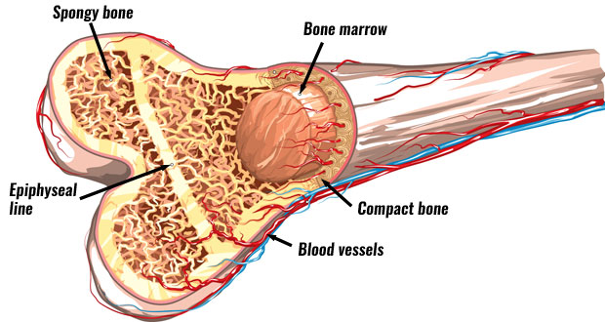
MSK-I Module
1st Year MBBS(LGIS)
General Anatomy of Bones
Presented by:
Dr. Sumyyia Bashir
Assistant Professor
Date:17-04-2025

Slide 2
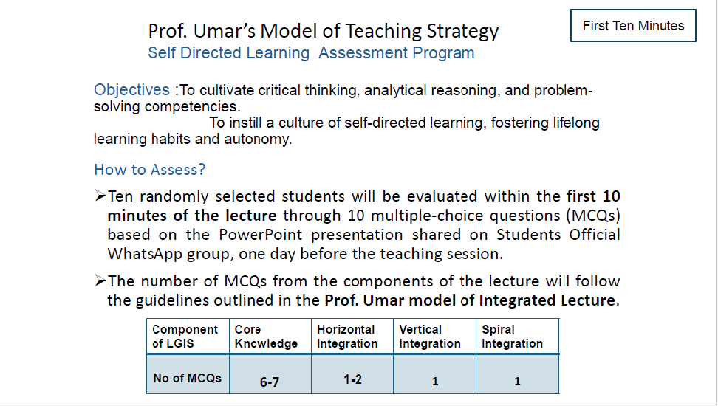

Slide 3
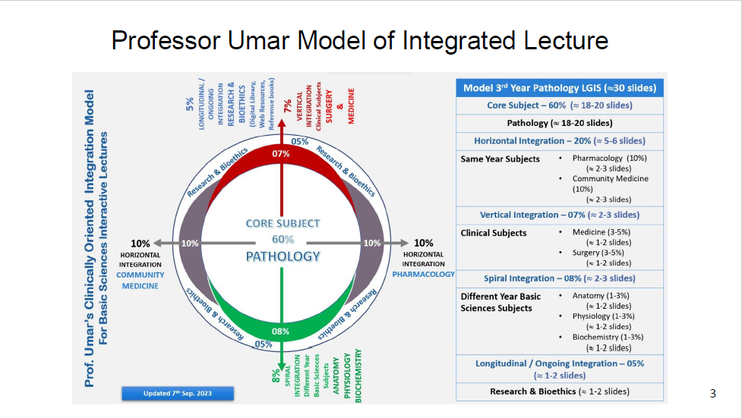

Slide 4
Learning Objectives
Describe the functions of bone and skeleton.
Classify bones based on different criteria.
Identify general features of bone.
Describe the growing end hypothesis.
Correlate with clinical conditions of bone.

Slide 5
Bones (Os)
Core Knowledge
Tough & resilient
Highly vascular
Highly regenerative
Show remodeling
A highly vascular, mineralized, constantly changing specialized type of connective tissue.

Slide 6
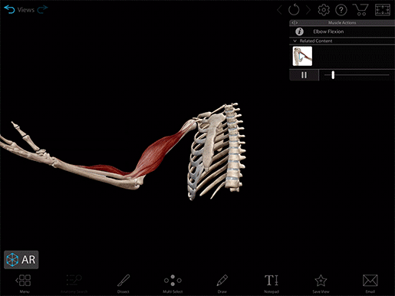
Functions
Core Knowledge
Provision of the framework of the body
Give attachment to muscles and tendons
Allow movement of the body
Forms the boundaries of the cranial, thoracic and pelvic cavities
Protect the organs, help it perform its function.
Haemopoiesis
Mineral storage

Slide 7
Types of Classification
Core Knowledge
Classification based on gross appearance and structure.
Classification based on region
Classification based on development
Classification based on shape and size
Classification based on ossification centres.

Slide 8
Based upon gross appearance
Core Knowledge
COMPACT/CORTICAL
Densely packed solid matter
Little intertrabecular spaces
CANCELLOUS/SPONGY
Loosely packed trabeculae
More intertrabecular spaces

Slide 9
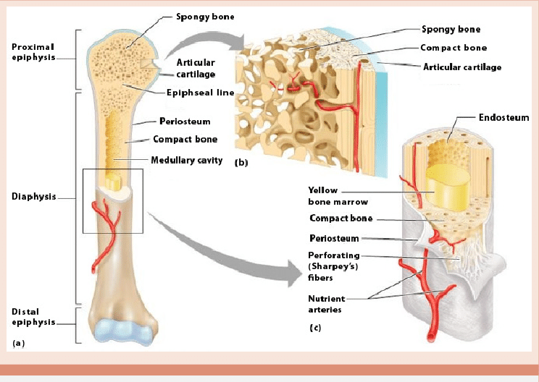

Slide 10
Regional
Core Knowledge
Regional
Axial
Appendicular
Upper limb
Lower limb
Skull
Vertebral column
Rib cage

Slide 11
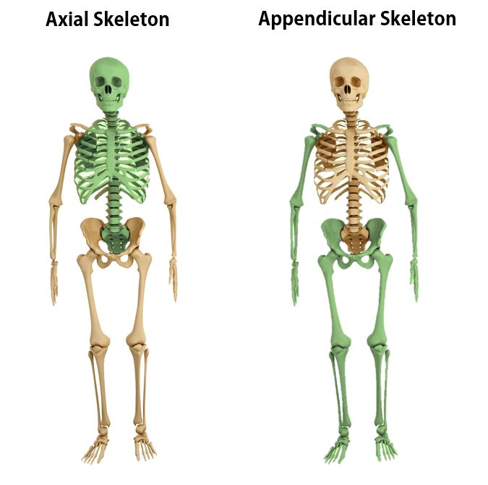
Core Knowledge

Slide 12
Developmental
Core Knowledge
Ossification
Membranous
Limbs, Ribs, Vertebrae
Vault, Face
Membranocartilaginous
Sphenoid, Temporal, Mandible, Clavicle
Cartilaginous

Slide 13
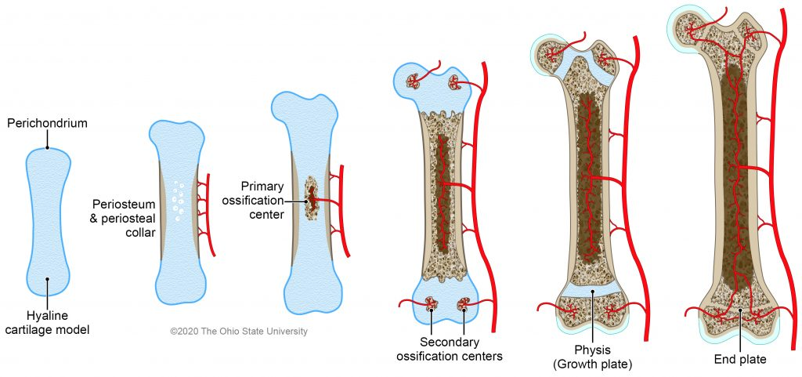
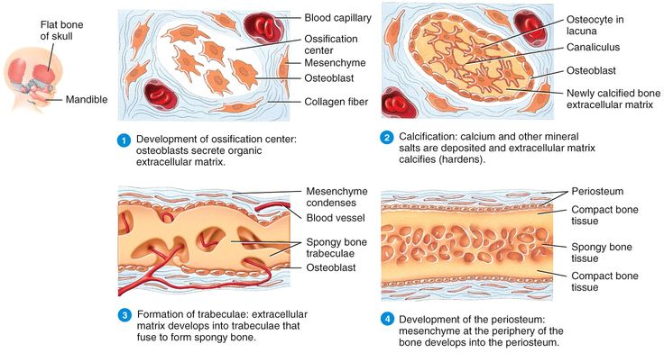
Core Knowledge

Slide 14
Morphological
Core Knowledge
Morphology
Long bone
Miniature long bone
Flat bone
Short bone
Irregular bone
Sesamoid
Typical
Accessory
Supernumary
Heterotropic

Slide 15
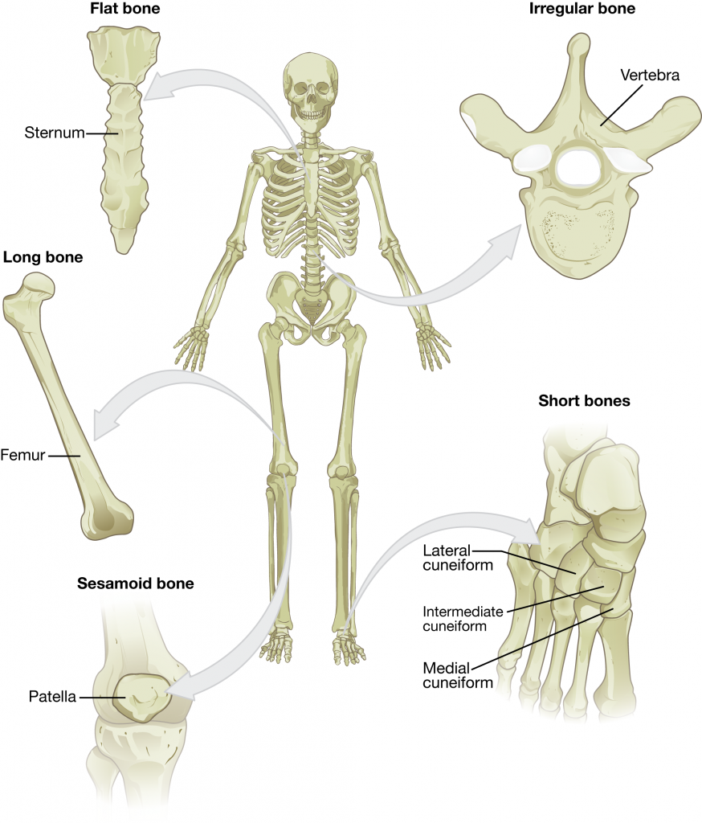

Slide 16
Based on the Number of Ossification Centers
Core Knowledge
No. of centers
Single
Multiple
Primary centres
Typical
Atavistic
Secondary centres
Pressure
Traction
Atavistic
Aberrant
Composite
Composite Atavistic

Slide 17
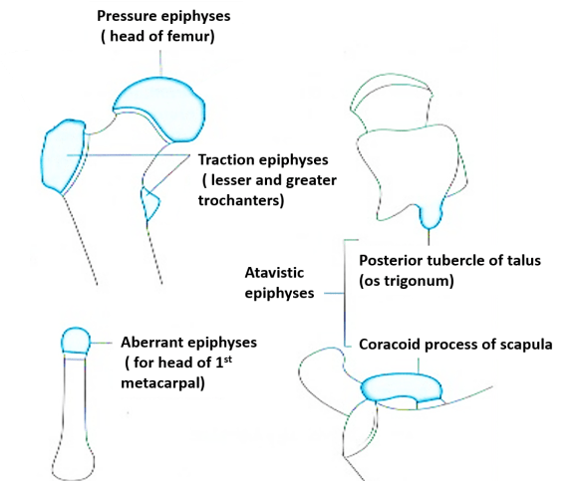
Core Knowledge

Slide 18
Bone Markings
Core Knowledge
C . Non articular surfaces
Process, Tubercle
Trochanter, Tuberosity
Malleolus
Epicondyle
Spine, Styloid process
Hamulus
Line
Crest
Fovea
Notch
Articular surfaces
Head
Capitulum
Trochlea
Condyle
Facet
Fossa
B. Grooves & holes
Fissure, Foramen
Meatus, Sulcus
Hiatus

Slide 19
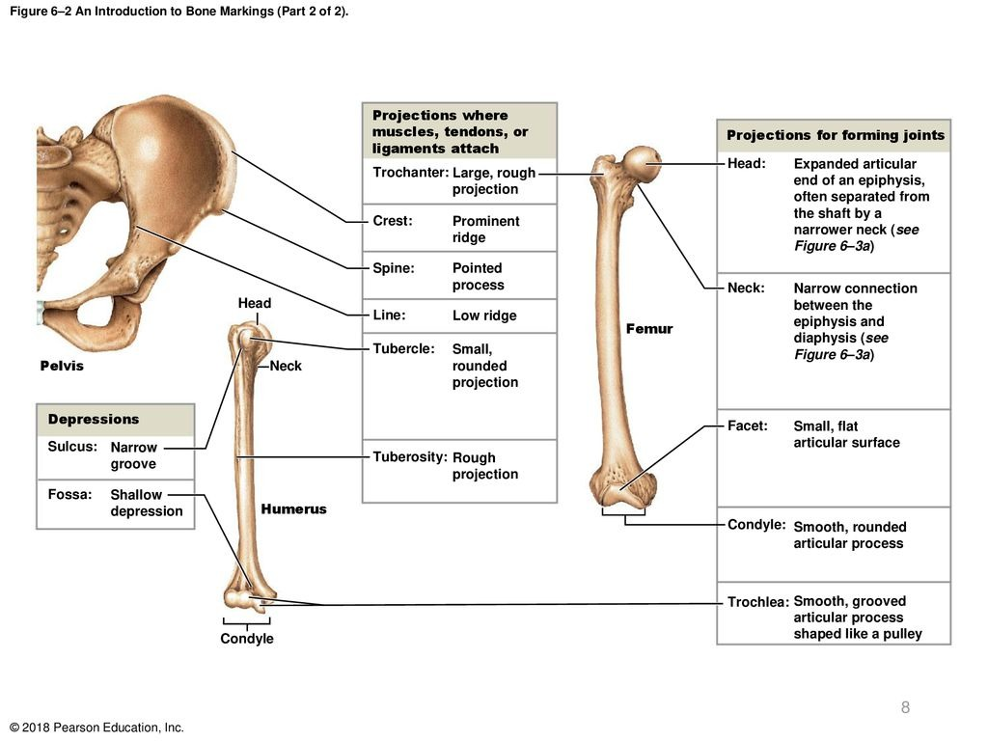
Core Knowledge

Slide 20
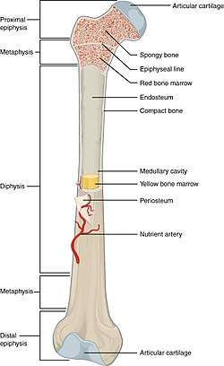
Gross Structure of A Long Bone
Core Knowledge

Slide 21
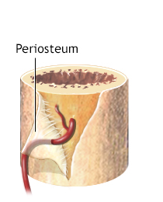
Periosteum
Core Knowledge
Vascular membrane
Outer layer is tough and fibrous
Inner layer contains osteoblasts and osteoclasts
Continuous with the joint capsule

Slide 22
Growing End Hypothesis
Core Knowledge
1: Epiphysis first to appear is the last to fuse.
2: Nutrient canal is always directed away from the growing end.

Slide 23
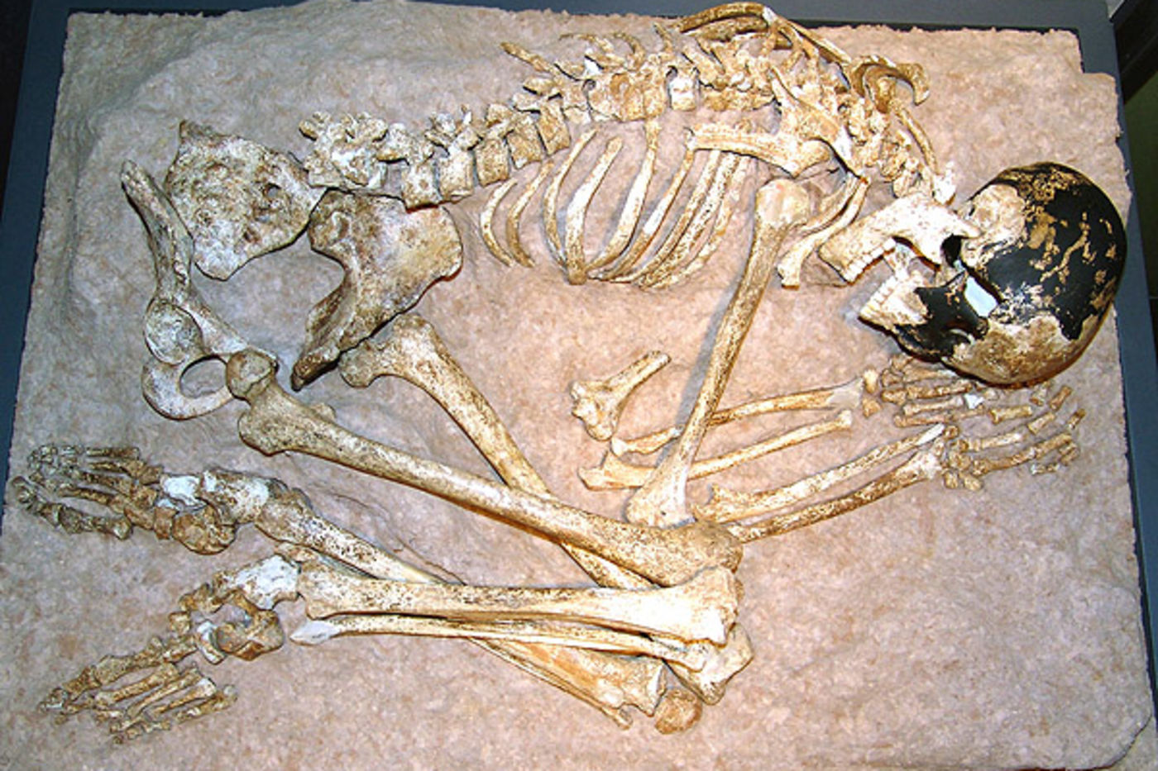
Anthropological Aspects
Vertical Integration
Age
Gender
Race
Stature
Time& cause of death

Slide 24
ESTIMATION OF SKELETAL AGE
Vertical Integration
Upto 25yrs of age
Dentition
25yrs onwards
Ossification
Cranial sutures
Pubic symphysis

Slide 25
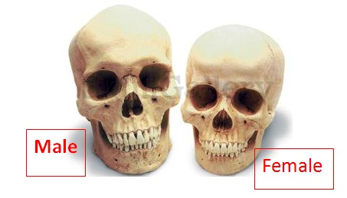
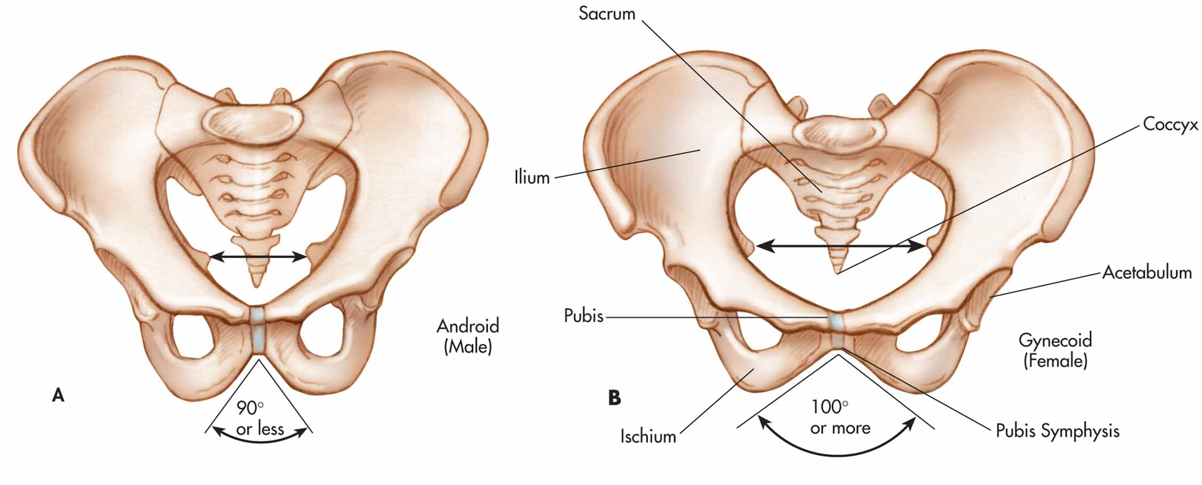
ESTIMATION OF GENDER
Vertical Integration
After the age of puberty
Pelvis & skull 90% accuracy

Slide 26
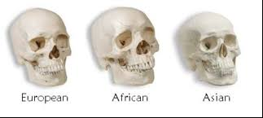
ESTIMATION OF RACE
Vertical Integration
Cranial indices
Facial indices

Slide 27
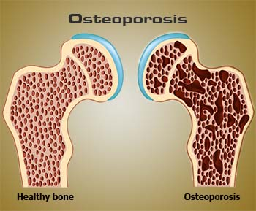
OSTEOPOROSIS
Vertical Integration
Low bone mass
Structural deterioration of bone tissue leading to bone fragility
Increased risk of fractures of the hip, spine, and wrist.

Slide 28
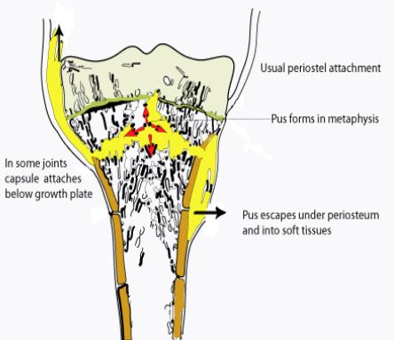
OSTEOMYELITIS
Vertical Integration
Infection of bone
Metaphysis of bones in children
Bacteria or emboli are trapped in the hair-pin bends of metaphyseal arteries
Leading to infarction

Slide 29
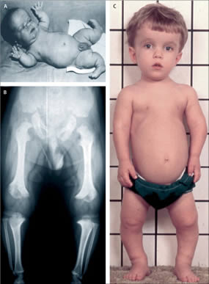
ACHONDROPLASIA
Vertical Integration
Defect in endochondral ossification
Causes dwarfism
Limbs are short
Trunk is normal

Slide 30
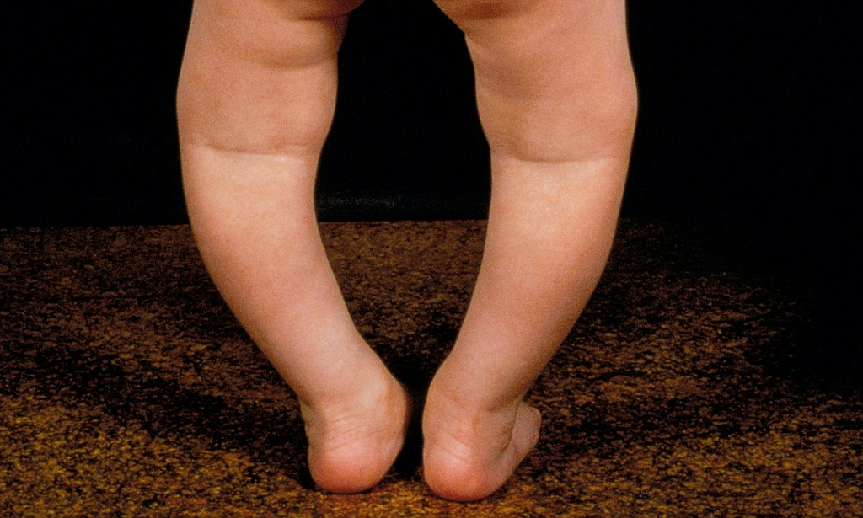
RICKETS
Vertical Integration
Deficiency of vit D
Ossification of growth zone is disturbed

Slide 31
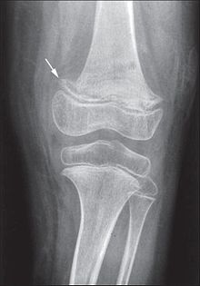
SCURVY
Vertical Integration
Deficiency of vit C
Lack of collagen
Sub periosteal hematomas
Spurring of bones

Slide 32
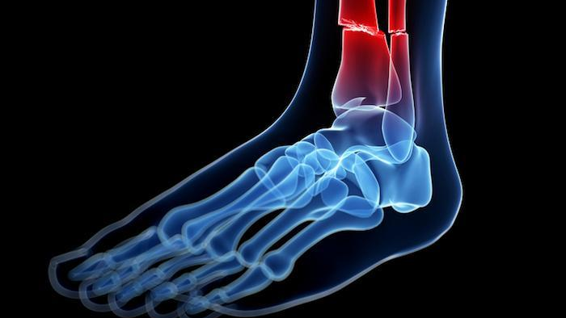
FRACTURE
Break in continuity of a bone

Slide 33
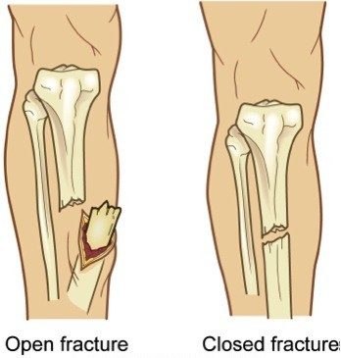
Vertical Integration

Slide 34
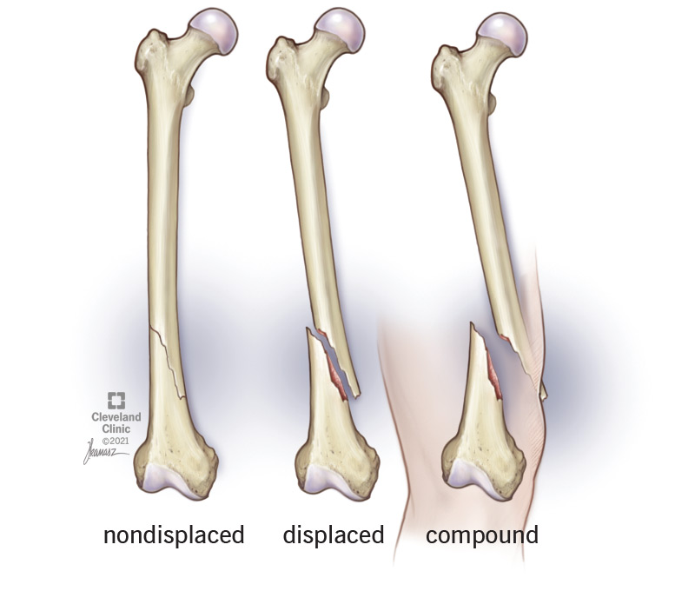
Vertical Integration

Slide 35
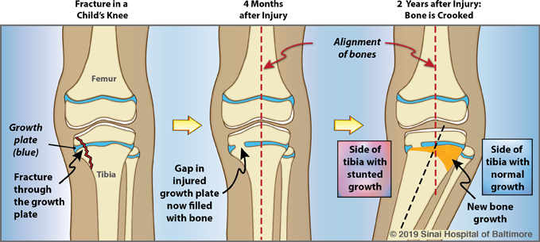
FRACTURE INVOLVING GROWTH PLATE
Vertical Integration
Can result in stunted growth

Slide 36
AI application in bone fracture detection
Spiral Integration
Artificial Intelligence
Several AI models demonstrated certain performance at the expert level.
Although the comprehensive interpretation of the image has not been achieved yet, it is too early to consider AI operating independently in a clinical setting.
However, with the current technology, AI has the potential to be considered to augment the efficiency of clinical workflow.
https://journalmsr.com/artificial-intelligence-application-in-bone-fracture-detection/

Slide 37
Bone Tissue Types: A Brief Account of Currently Used Categories
ByVivian de Buffrénil, Alexandra Quilhac
Spiral Integration
Research Article
https://www.taylorfrancis.com/chapters/edit/10.1201/9781351189590-8/bone-tissue-types-brief-account-currently-used-categories-vivian-de-buffr%C3%A9nil-alexandra-quilhac
The present review treats this topic at several levels that correspond to the main structural characteristics of osseous formations, and to the usual practical path followed by descriptions in comparative skeletal histology. Information is thus given about (1) relevant microanatomical features including the characteristics and diversity of compact and cancellous formations, vascular density and patterns; (2) topographical and chronological dimensions of osseous deposits (e.g., cortical vs. medullary, primary vs. secondary); and (3) histological features proper, such as matrix fibrillar structuration and cell characteristics (morphology, density, distribution)

Slide 38
Learning resources
https://quizlet.com/379428558/bone-markings-flash-cards/
Gray’s Anatomy, edition 42nd
KLM, Anatomy Clinically Oriented Anatomy, 8th Edition
Liaq hussain, General Anatomy, 3rd edition
Tassaduq hussian, Understanding General Anatomy, 16th edition

Slide 39
Thankyou

