Slide 1
*Epilepsy Surgical Approaches

Slide 2
Learning Objectives:
Understand the principles and history of epilepsy surgery
Identify appropriate candidates for surgical intervention
Describe comprehensive pre-surgical evaluation protocols
Compare and contrast different surgical approaches
Evaluate outcomes and prognostic factors
Appreciate emerging techniques and future directions

Slide 3
Introduction to Epilepsy:
Affects ~50 million people worldwide
* ~30% develop drug-resistant epilepsy (DRE)
* ILAE definition: Failure of adequate trials of two tolerated, appropriately chosen AEDs
* Significant impact on quality of life, mortality, psychosocial function
* Surgical treatment increasingly important for DRE patients

Slide 4
Historical Perspective
1886: First modern epilepsy surgery by Victor Horsley
1934: Wilder Penfield's cortical mapping techniques
1950s: Development of stereotactic techniques
1970s: Advent of microsurgery
1990s: Improved neuroimaging revolutionized surgical planning
2000s: Development of minimally invasive approaches

Slide 5
Primary Goal
Seizure freedom
Secondary Goals
Reduce seizure frequency/severity
Reduce medication burden
Improve quality of life
Reduce mortality risk
Prevent developmental delays (in children)
Achieve these with minimal neurological deficit

Slide 6
Classification of Epilepsy Surgery
By Intent:*
Curative: Complete seizure freedom (resection, disconnection)
Palliative: Reduction in seizure frequency/severity (neuromodulation)
By Approach
Resective: Removal of epileptogenic zone
Disconnective: Interruption of seizure pathways
Neuromodulatory: Alteration of neural activity
Stereotactic: Targeted ablation of epileptogenic foci

Slide 7
Patient Selection
Patient Selection Criteria:
Drug-resistant epilepsy
Disabling seizures
Identifiable epileptogenic zone
Resectable epileptogenic zone
Acceptable risk-benefit ratio
Patient/family motivation and expectations
Absence of progressive neurological disorder
Failure of appropriate medical therapy

Slide 8
Pre-surgical Evaluation Goals
Confirm diagnosis of epilepsy
Localize the epileptogenic zone
Define relationship to eloquent cortex
Determine cognitive/psychological status
Establish baseline for outcome assessment
Predict likelihood of surgical success
Anticipate potential deficits

Slide 9
Non-invasive Evaluation Methods:
Detailed history and examination
Routine EEG and video-EEG monitoring
Structural neuroimaging (MRI)
Functional neuroimaging (PET, SPECT, fMRI)
Neuropsychological assessment
Psychiatric evaluation
Sodium amobarbital procedure (Wada test)
Magnetoencephalography (MEG)
EEG-fMRI

Slide 10
Invasive Monitoring:
Indicated when non-invasive evaluation is inconclusive
Subdural electrodes:
Grid and strip electrodes
Better cortical coverage
Direct cortical stimulation possible
Depth electrodes:
Stereotactic placement
Access to deep structures
SEEG approach increasingly used
Other approaches:
- Foramen ovale electrodes
- Combined approaches

Slide 11
Structural MRI in Epilepsy Surgery
High-resolution protocols essential
Common findings:
Mesial temporal sclerosis
Focal cortical dysplasia
Tumors (DNET, ganglioglioma)
Vascular malformations
Tuberous sclerosis
Post-traumatic lesions
Encephaloceles
Important note: Negative MRI ≠ inoperable epilepsy

Slide 12
Advanced Neuroimaging Techniques
PET: Hypometabolism in epileptogenic zone
Ictal SPECT: Hyperperfusion during seizures
SISCOM: Subtraction ictal-interictal SPECT
fMRI: Mapping of eloquent cortex
DTI: White matter tract visualization
Arterial spin labeling
7T MRI: Higher resolution structural imaging
PET-MRI: Combined structural-functional information

Slide 13
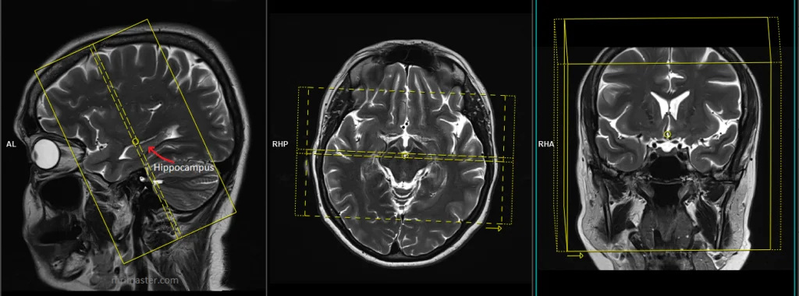

Slide 14
Resective Procedures: Temporal Lobe
Anterior temporal lobectomy (ATL)
- Standard procedure with amygdalohippocampectomy
- ~60-80% seizure freedom
Selective amygdalohippocampectomy
- Transsylvian, transcortical, subtemporal approaches
- Spares lateral temporal neocortex
Temporal pole resection
Note: Consideration of language dominance critical

Slide 15
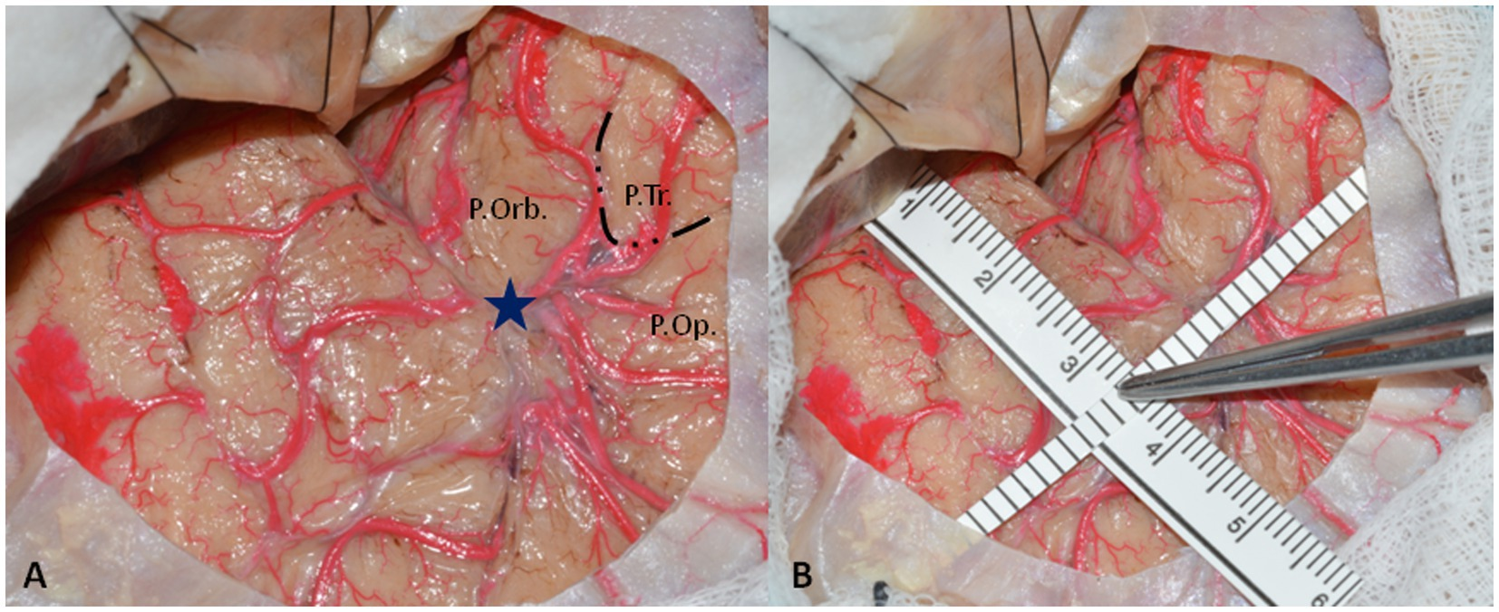

Slide 16
Temporal Lobe Epilepsy Surgery
Dominant hemisphere considerations:
- Language mapping essential
- Smaller resections typically
- Higher risk of verbal memory decline
Non-dominant hemisphere:
- Lower risk of cognitive deficits
- Visual field defects still possible
- Non-verbal memory effects

Slide 17
Extratemporal Resections
Frontal lobe: Wide variability in outcomes (45-70% seizure-free)
Parietal lobe: Challenging due to eloquent cortex
Occipital lobe: Visual field defects common
Insular cortex: Deep location, vascular challenges
Multilobar resections: Higher morbidity, lower seizure-free rates

Slide 18
Lesionectomy
Removal of epileptogenic structural lesion
Best outcomes when:
- Complete resection achieved
- Concordant EEG findings
- Clear margins around lesion included
Common pathologies:
- Low-grade tumors (DNET, ganglioglioma)
- Cavernous malformations
- Focal cortical dysplasia
- Tuberous sclerosis lesions

Slide 19
Hemispherectomy & Hemispherotomy
For unilateral hemisphere pathology
Anatomical hemispherectomy: Complete removal (rarely performed)
Functional hemispherectomy: Partial removal with disconnection
Hemispherotomy: Disconnection techniques (peri-insular, vertical, lateral)
Indications:
Rasmussen's encephalitis
Sturge-Weber syndrome
Hemimegalencephaly
Extensive unilateral MCA infarcts
Hemispheric cortical dysplasia

Slide 20
Hemispherotomy Techniques
Advantages of disconnection vs. resection:
- Reduced blood loss
- Reduced operation time
- Lower risk of hydrocephalus
- Lower risk of superficial cerebral hemosiderosis
Expected deficits: Contralateral hemiparesis, hemianopia

Slide 21
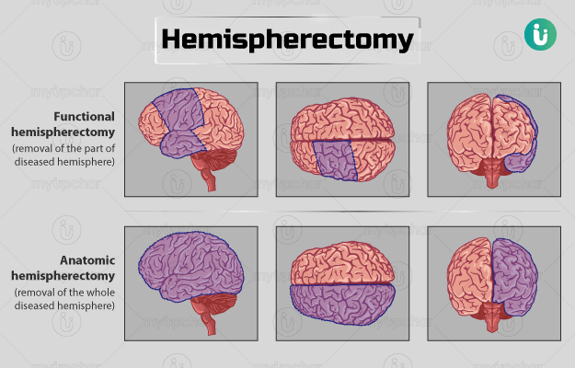

Slide 22
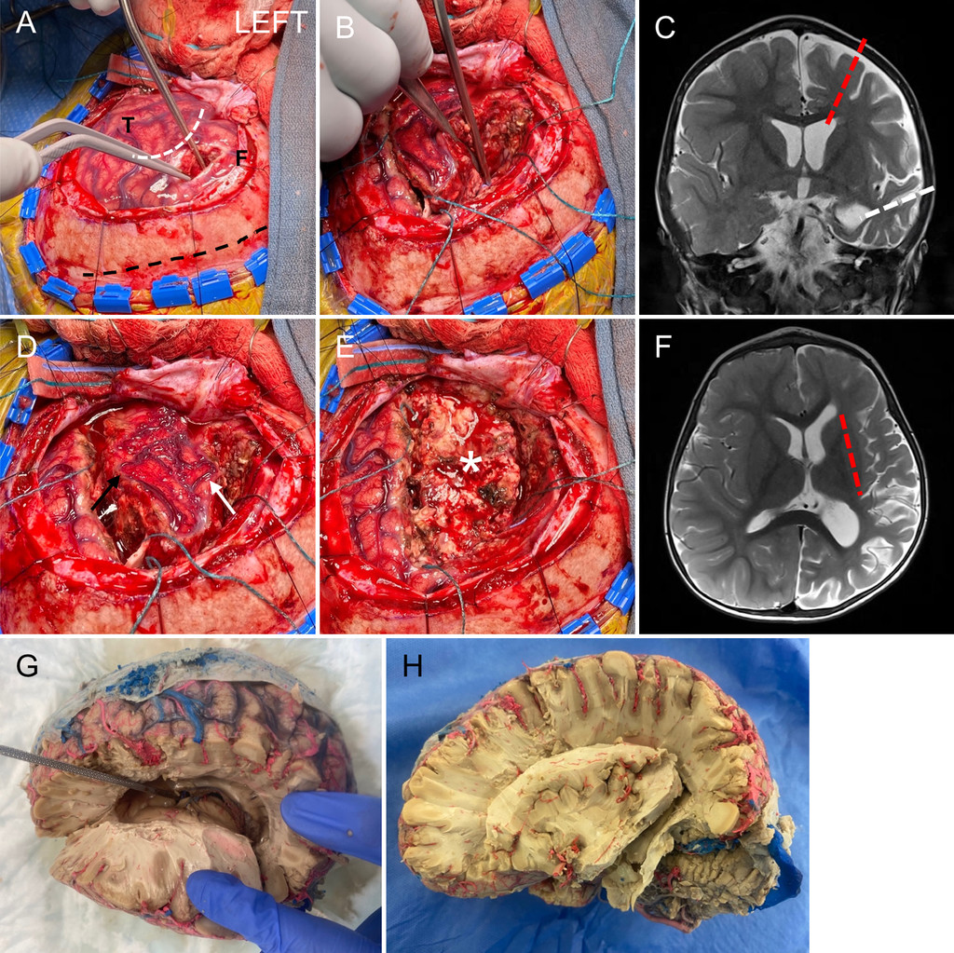

Slide 23
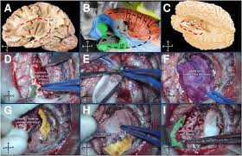

Slide 24
Corpus Callosotomy
Palliative disconnection procedure
Prevents interhemispheric spread of seizures
Most effective for:
- Drop attacks (atonic seizures)
- Generalized tonic-clonic seizures
- Lennox-Gastaut syndrome
Approaches:
- Complete vs. partial (anterior 2/3)
- One-stage vs. two-stage procedure
Complications: Disconnection syndrome, SMA syndrome

Slide 25
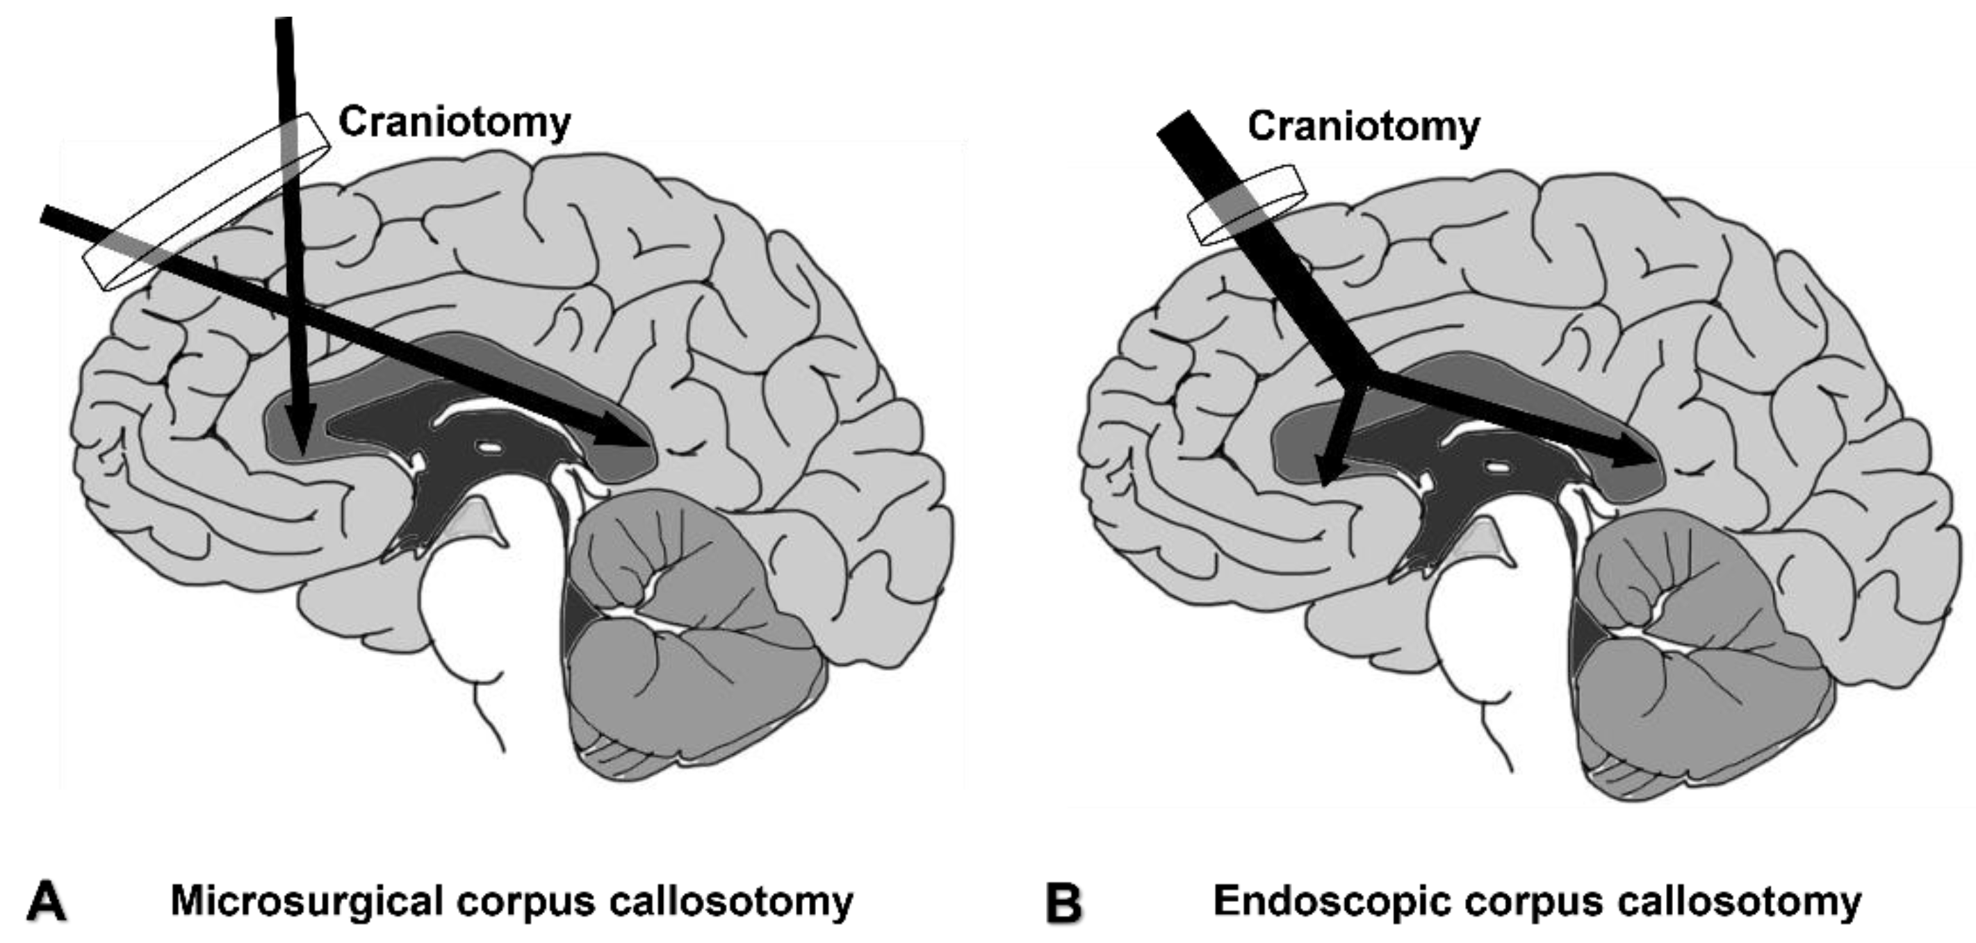

Slide 26
Multiple Subpial Transections (MST
Creates shallow cuts perpendicular to cortical surface
Interrupts horizontal cortical connections while preserving vertical columns
Used for epileptogenic tissue in eloquent cortex
Often combined with resection of adjacent non-eloquent cortex
Lower seizure-free rates than resection alone
Less commonly performed today

Slide 27
Vagus Nerve Stimulation (VNS)
FDA-approved neuromodulation therapy
Components:
- Programmable pulse generator (chest wall)
- Bipolar helical electrodes (left vagus nerve)
Mechanism: Afferent vagal projections to NTS, thalamus, limbic structures
Outcomes:
- 50% seizure reduction in ~50% of patients
- 5-10% become seizure-free
- Progressive improvement over time
Advantages: Low morbidity, adjustable, reversible

Slide 28
Deep Brain Stimulation (DBS)
Open-loop scheduled stimulation
Targets:
- Anterior nucleus of thalamus (ANT)
- Centromedian nucleus of thalamus
- Hippocampus
- Others under investigation
Outcomes:
- 40-50% seizure reduction
- 14-17% seizure-free
- Improvements continue over years
FDA approved for ANT stimulation

Slide 29
Responsive Neurostimulation (RNS)
Closed-loop, responsive cortical stimulation
Components:
- Implantable neurostimulator in skull
- Depth and/or cortical strip leads
- External programmer and data upload
* Function: Detects abnormal EEG patterns and delivers stimulation
Indications:
- Focal epilepsy with 1-2 foci
- Eloquent cortex involvement
- Bilateral temporal lobe epilepsy
Outcomes: ~75% seizure reduction at 3+ years

Slide 30
Stereotactic Radiosurgery
Gamma Knife most commonly used
Applications:
- Mesial temporal lobe epilepsy
- Cavernous malformations
- Hypothalamic hamartomas
Limitations:
- Delayed effect (6-18 months)
- Radiation effects on surrounding tissue
- Transient increase in seizures possible
Outcomes: Variable, 60-70% significant improvement

Slide 31
Outcomes After Epilepsy Surgery
Engel Classification:
- Class I: Seizure-free or auras only
- Class II: Rare disabling seizures
- Class III: Worthwhile improvement
- Class IV: No worthwhile improvement
Best outcomes:
- Temporal lobe epilepsy with MTS (60-80% seizure-free)
- Lesional epilepsy with complete resection
- Concordant non-invasive data

Slide 32
Outcome Predictors
Favorable factors:
- Presence of lesion on MRI
- Complete resection of lesion
- Concordant EEG, MRI, semiology
- Temporal lobe onset
- Unilateral ictal onset
- History of febrile seizures (for MTLE)
- Absence of generalized seizures
- Shorter epilepsy duration

Slide 33
Surgical Complications:
General surgical risks:
- Infection (1-2%)
- Hemorrhage (1-2%)
- DVT/PE (<1%)
Neurological deficits:
- Visual field defects (temporal: 15-20%)
- Motor/sensory deficits (variable)
- Language deficits (1-4% permanent)
- Memory impairment (10-60% depending on baseline, laterality)
Mortality: 0.1-0.5%

Slide 34
Surgical Approach to Specific Epilepsy Syndromes
Mesial temporal lobe epilepsy: ATL, SAH, LITT
Tuberous sclerosis: Tuberectomy, lobectomy
Rasmussen encephalitis: Hemispherotomy
Lennox-Gastaut syndrome: Corpus callosotomy, VNS
Hypothalamic hamartoma: Disconnection, LITT, SRS
Sturge-Weber syndrome: Functional hemispherotomy
Landau-Kleffner: MST of language cortex

Slide 35
Current Challenges
Low referral rates to epilepsy centers
Long delay from DRE diagnosis to surgery (15-20 years)
Limited resources in developing countries
Persistence of neuropsychological effects
Non-lesional epilepsy outcomes
Better biomarkers for epileptogenicity
Optimizing neuromodulation parameters

Slide 36
EOLA( END OF LECTURE ASSESSMENT)
32-year-old female with drug-resistant seizures since age 14
History of complex febrile seizures
Semiology: Aura of fear, automated behaviors, postictal confusion
MRI: Right hippocampal atrophy, increased T2 signal
Video-EEG: Right anterior temporal spikes, seizures from right temporal region
PET: Right temporal hypometabolism
Neuropsychological testing: Preserved verbal memory, mild visual memory deficits

Slide 37
Continue..
Surgical approach: Right anterior temporal lobectomy
Outcome: Seizure-free (Engel I) at 5-year follow-up

Slide 38
Role Of AI
AI plays a growing role in epilepsy surgery by aiding in diagnosis, surgical planning, and predicting outcomes. AI algorithms can analyze neuroimaging data, like MRI scans, to detect epileptogenic lesions and predict seizure freedom after surgery

Slide 39
Key Messages
Epilepsy surgery is highly effective for appropriately selected patients
Comprehensive pre-surgical evaluation essential for optimal outcomes
Multiple surgical approaches available based on epilepsy characteristics
Earlier referral for surgical evaluation improves outcomes
Technological advances continue to improve surgical planning and outcomes
Neuromodulation expanding options for non-resective candidates
Minimally invasive approaches reducing surgical morbidity

Slide 40
References and Resources
Greenberg Handbook of Surgery 10th Edition
Principles of Neurological Surgery 4th Edition
ILAE Guidelines on Epilepsy Surgery
* AAN Practice Parameters for Temporal Lobe and Neocortical Resections
* National Association of Epilepsy Centers (NAEC)

