Slide 1
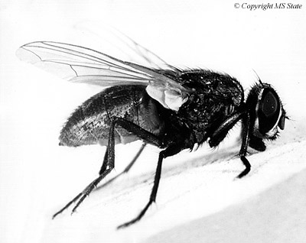
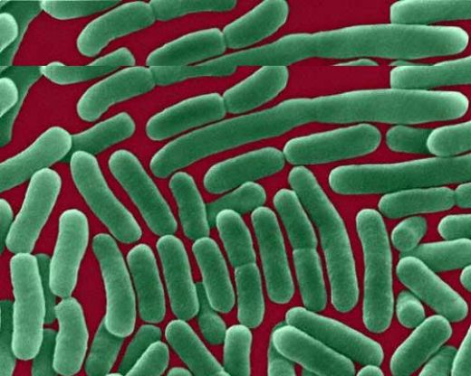
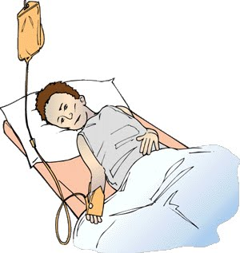
Enteric FEVER
Dr. Muhammad Mujeeb Khan
FCPS (Medicine)
Dip. DM (UK), Dip. Nutrition (Pak),
MSc. Infectious Diseases (UK)
Associate Professor
Rawalpindi Medical University, Rawalpindi

Slide 2
University Motto, Vision, Values & Goals
Mission Statement
To impart evidence-based research-oriented health professional education
Best possible patient care
Mutual respect, ethical practice of healthcare and social accountability.
Vision and Values
Highly recognized and accredited centre of excellence in medical education, using evidence-based training techniques for development of highly competent health professionals, who are lifelong experiential learner and are socially accountable.
Goals
The Undergraduate Integrated Learning Program is geared to provide you with quality medical education in an environment designed.

Slide 3
SEQUENCE OF LGIS
Learning objectives
What is enteric Fever and how to diagnose it?(core concept = 70%)
Related pathology and pharmacology (horizontal integration 15%)
Recent advances and developments. (vertical integration – 10%)
Research article related to topic (3%) Ethics (2%)

Slide 4
Learning objectives
By the end of this session, students will be able to:
Define enteric fever and identify its causative agent.
Describe the modes of transmission and key epidemiological factors of enteric fever.
Understand the pathophysiological mechanisms leading to systemic symptoms.
Recognize the clinical features and complications associated with enteric fever.
Outline the diagnostic approaches, including laboratory and imaging investigations.
Discuss the pharmacological management and strategies to address antimicrobial resistance.
Explain preventive measures, including vaccination and hygiene practices.

Slide 5
PROF UMER MODEL OF INTEGRATED LECTURE

Slide 6
DEFINITION
Enteric fever is a life-threatening infection caused by the bacterium Salmonella Enterica serotype Typhi.
Enteric fever is a potentially fatal multisystem illness characterized by prolonged fever, abdominal pain, and systemic symptoms.
The disease primarily spreads through ingestion of food or water contaminated with feces from an infected person.

Slide 7
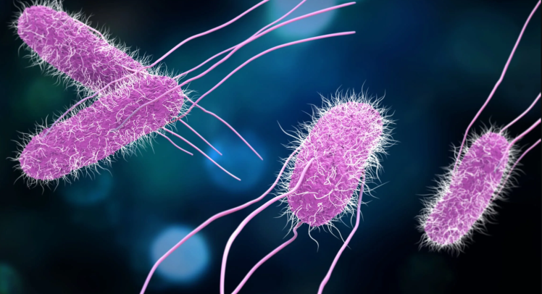
SALMONELLA ENTERICA
Classification:
Member of the genus Salmonella, family Enterobacteriaceae.
Morphology:
Rod-shaped, flagellated, aerobic, Gram-negative bacterium.
Adhesion Factors:
Possesses numerous fimbrial and non-fimbrial adhesins that facilitate biofilm formation and adherence to host cells.

Slide 8
SALMONELLA ENTERICA
Hosts:
Infects a wide range of hosts, including cattle, poultry, domestic cats, hamsters, and humans.
Environmental Resilience:
Refrigeration and freezing significantly slow or halt bacterial growth.
Pasteurization and food irradiation effectively kill Salmonella.

Slide 9
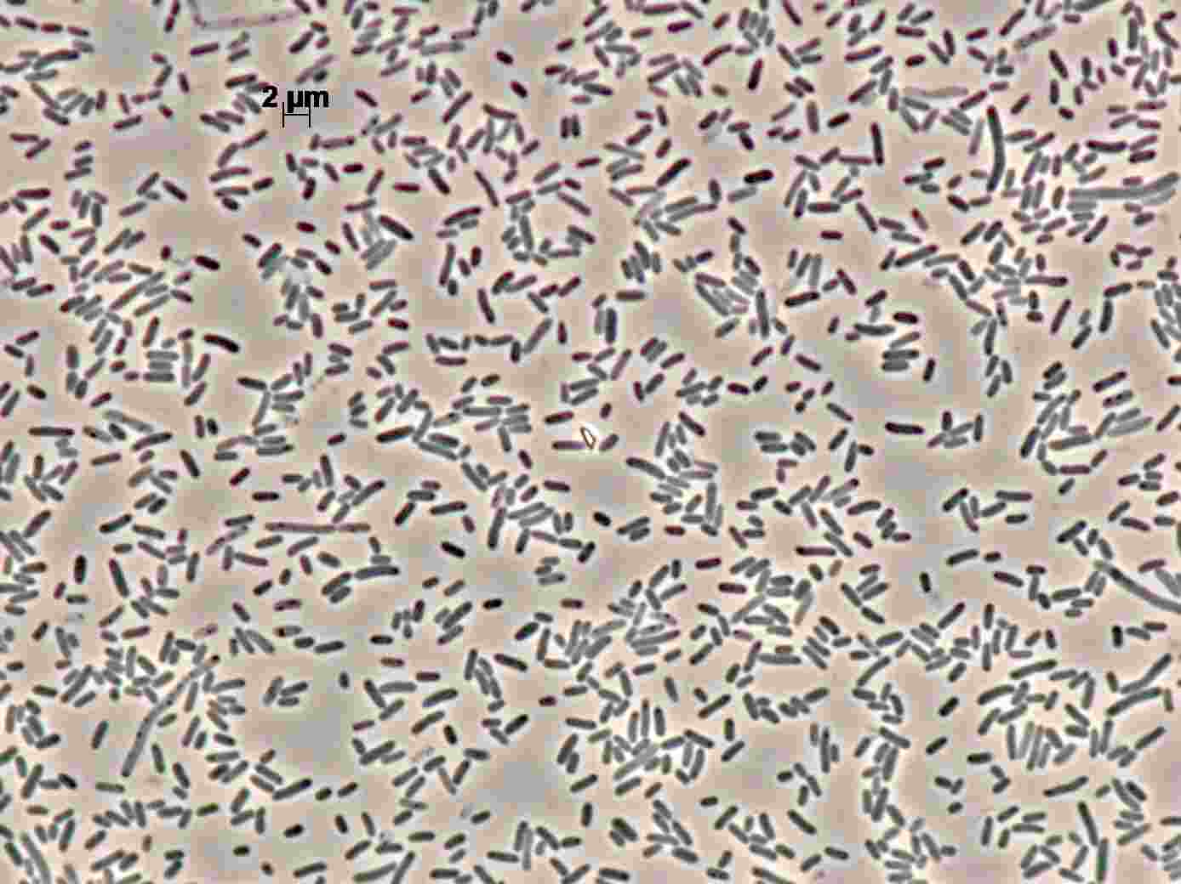
SALMONELLA ENTERICA

Slide 10
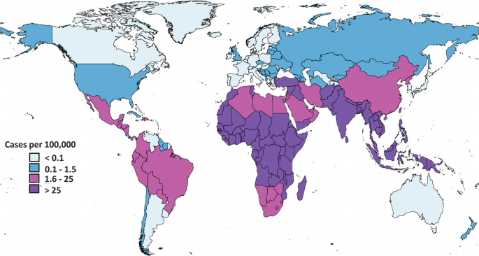
EPIDEMIOLOGY

Slide 11
TRANSMISSION TO HUMANS
Fecal-Oral Route:
Salmonella Typhi is primarily transmitted through ingestion of food or water contaminated with feces from an infected person.
Contaminated Food and Water:
Consumption of contaminated food or water introduces the bacteria into the gastrointestinal tract.
The bacteria invade the small intestine and enter the bloodstream.
Person-to-Person Contact:
Close contact with individuals infected with enteric fever can facilitate transmission.

Slide 12
TRANSMISSION TO HUMANS
Environmental Factors:
Areas with inadequate sewage systems and poor sanitation.
Chronic Carriers:
Individuals who have recovered but continue to harbor S. Typhi can asymptomatically shed bacteria, posing a risk to others.
Other Salmonella Species:
Salmonella Enteritidis and Salmonella Typhimurium are other serotypes that can cause illness in humans,
It usually leads to gastroenteritis rather than enteric fever.

Slide 13
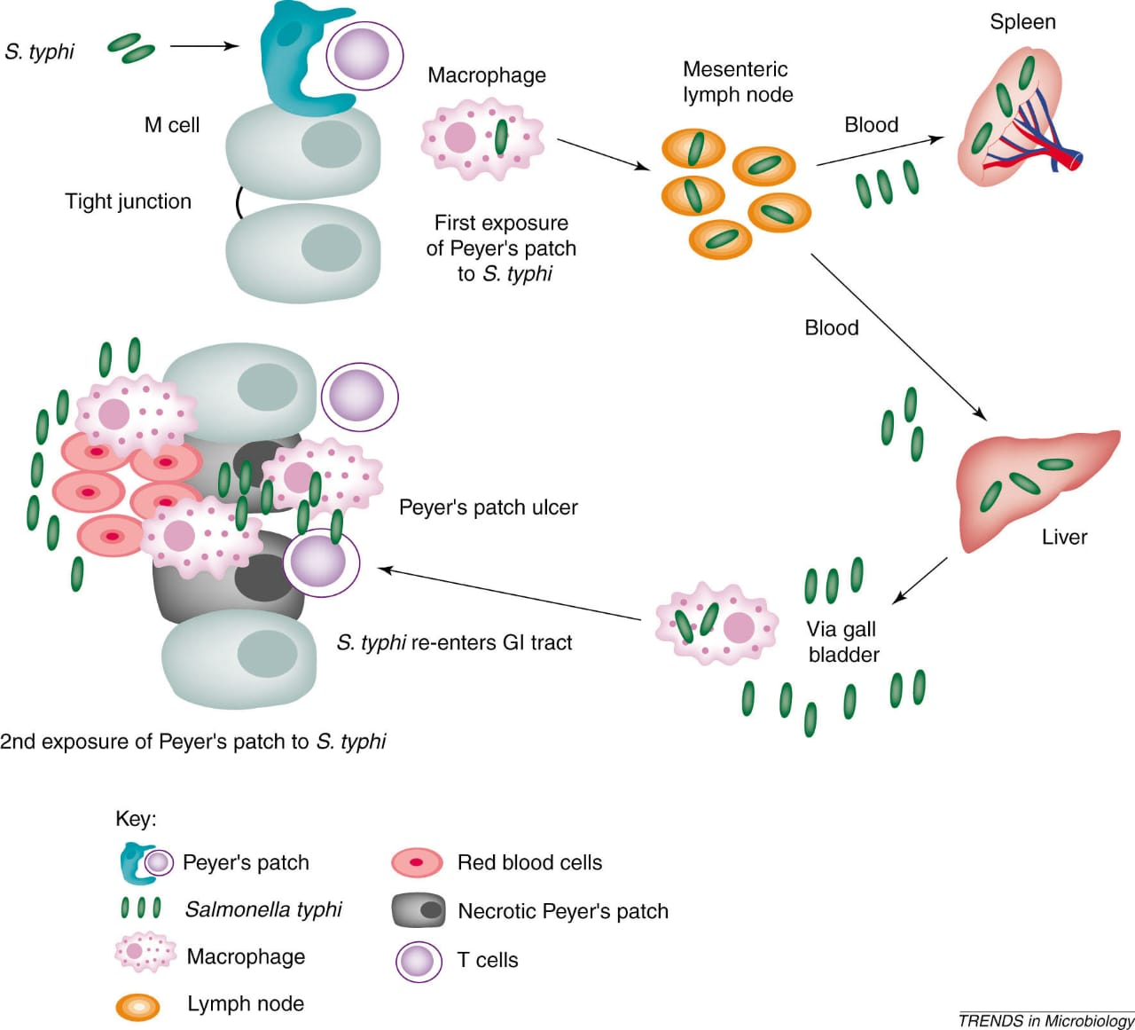
PATHOPHYSIOLOGY

Slide 14
Pathophysiology
Contaminated food or water introduces S. Typhi into the gastrointestinal tract.
Bacteria invade the small intestine's mucosal lining.
They enter the bloodstream and are transported by white blood cells to organs such as the liver, spleen,
and bone marrow.
Within these organs, bacteria multiply and reenter the bloodstream, leading to systemic symptoms.
Bacteria may localize in the gallbladder and biliary system, further shedding into the intestinal tract.
High numbers of bacteria are excreted in feces, which can be cultured for diagnostic purposes.

Slide 15
CLINICAL FEATURES
First week
Fever Headache Myalgia Bradycardia | Constipation Diarrrhea Vomiting
End of First Week
Rose spot on trunk Splenomegaly Cough | Abdominal distension Diarrhea
End of second weak
Delerium, Complication, Coma and death

Slide 16
COMPLICATIONS
Bowel
Perforation | Haemorrhage
Septic foci
Bone and joint infection | Cholcytitis, Meningitis
Toxic phenomena
Myocarditis | Nephritis
Chronic Carraige
Perristent gallbladder carraige

Slide 17
COURSE OF THE DISEASE
Incubation Period:
Typically, 6–30 days post-exposure.
Onset:
Gradual development of symptoms over several weeks; however, children may
exhibit a more sudden onset.
Duration Without Treatment:
Symptoms can persist for weeks or complications develop.

Slide 18
DIAGNOSIS
Clinical Evaluation: Initial assessment based on presenting symptoms and patient history.
Laboratory Investigations:
Culture Tests:
Blood Culture: highly Specific.
Stool Culture: Useful for detecting bacteria; sensitivity varies.
Bone Marrow Culture: Gold standard with approximately 90% sensitivity, even after antibiotic initiation.

Slide 19
DIAGNOSIS
Serological Tests:
Widal and Typhi dot are not recommended due to poor sensitivity and specificity
Molecular Tests:
Polymerase Chain Reaction (PCR): Detects bacterial DNA; offers rapid results but may have variable sensitivity.
Antimicrobial Susceptibility Testing: Determines effective antibiotic therapy; essential due to rising drug resistance.

Slide 20
COMMON LABORATORY INVESTIGATION FINDINGS
Hematological:
Moderate Anemia:
Thrombocytopenia
Relative Lymphopenia
Absolute Eosinopenia
Inflammatory Markers:
Elevated Erythrocyte Sedimentation Rate (ESR):
C-Reactive Protein (CRP) >40 mg/L: Coagulation Profile Elevated PT and aPTT
Decreased Fibrinogen Levels
Increased Fibrin Degradation Products

Slide 21
COMMON LABORATORY INVESTIGATION FINDINGS
Liver Function Tests:
Elevated Bilirubin
Increased Liver Transaminases (ALT, AST)
Electrolyte Imbalance:
Mild Hyponatremia
Hypokalemia

Slide 22
ANTIBIOTIC RESISTANCE
Classification | Case definition
Non-resistant enteric fever | Sensitive to first line drugs (Chloramphenicol, trimethoprim-sulphamethoxazole, ampicillin) Fluoroquinolones 3rd generation cephalosporin
Multidrug resistant enteric fever (MDR) | Resistant to first line drugs (Chloramphenicol, trimethoprim-sulphamethoxazole, ampicillin) Sensitive to Fluoroquinolones 3rd generation cephalosporin
Extensive drug resistant enteric fever (XDR) | Resistant to first line drugs (Chloramphenicol, trimethoprim-sulphamethoxazole, ampicillin) Fluoroquinolones 3rd generation cephalosporin Sensitive to Azithromycin Carbapenems

Slide 23
BLOOD CULTURE SENSITIVITY
Culture
Culture has yielded growth of Salmonella spp. after 48 Hour(s) incubation at 37C
Antibiotic Susceptibility
Antibiotics | Salmonella spp.
Amoxicillin | R
Azithromycin | S
Cefixime | R
Ceftriaxone | R
Ciprofloxacin | R
Imipenam | S
Meropenam | S
Nalidixic Acid | R

Slide 24
ANTIBIOTIC RESISTANCE
Mechanisms:
Plasmid-Mediated Resistance: Genes acquired via plasmids contribute to resistance against multiple antibiotics.
Quinolone Resistance: Often due to mutations in the quinolone resistance determining region of the gyrA gene, leading to decreased fluoroquinolone susceptibility.

Slide 25
TREATMENT RECOMMENDATIONS FOR PAKISTAN
Pakistan is the first country to report the cases of extensively resistant enteric fever in Hyderabad, Sindh in 2016.
The most cases of enteric fever are multidrug resistant. So, the empirical therapy is 3rd generation cephalosporin
Non Resistant enteric countries of world may prefer 1st line agent as empirical therapy

Slide 26
TREATMENT
Supportive Treatment
Antipyretics
Adequate rest, hydration,
Adequate nutrition: Soft and easily digestible diet
Empiric treatment:
Start antibiotic as soon as possible after Blood cultures
Cephalosporin (3rd generation)
IV ceftriaxone: 1gm – 2 gm BD
Oral cefixime: 15-20 mg/kg

Slide 27
EXTENSIVE DRUG RESISTANT ENTERIC FEVER
Resistant to all recommended antibiotics for enteric fever
Sensitive to carbapenems and azithromycin
Azithromycin: If the patient is clinically stable, Dose according to Body weight
Weight > 60 kg: 1gm P/O q 24 hours for 7-10 days
Weight < 60 kg: 1gm loading dose followed by 500 mg q 24 hours for 7-10 days
Carbapenems: For sick patients
Imipenem: 500mg q6h for 10 or 14 days
Meropenem: 1gm q8hr for 10 - 14 days
Ertapenem: 1gm q24hr for 10 - 14 days

Slide 28
DRUG SENSITIVE ENTERIC
For Drug-sensitive Typhoid fever (if susceptibility result is available)
Antibiotic | Route | Adult dosage/day | Dosage: mg/kg/day | Duration in days
Ceftriaxone | IM, IV | 1gm q12hr or 2gm q24hr | 50-75 mg/kg | 10-14
Cefixime | Oral | 400 mg q12hr | 50-20 mg/kg: in 1-2 doses | 10-14
Ciprofloxacin | Oral/IV | 500-750 mg q12hr PO/400 mg q12hr IV | - | 10-14
Chloramphenicol | Oral, IV | 500 mg q6hr | 50 mg/kg in 4 doses | 14
Thrimethoprim-Sulfamethoxazole | Oral, IV | 160/800 mg q12hr | 4-20 mg/kg: in 2 dose | 14
Ampicillin /Amoxicillin | Oral, IV, IM | 1000-2000 mg q6hr | 75-100 mg/kg: in 4 doses | 14

Slide 29
THE STORY OF TYPHE MARRY
Marry Mallon, an irish immigrant worked as cook in Newyork
Being asymptomatic carrier of enteric fever, unknowingly infected the 51 people, causing 3 deaths
Investigation of outbreak showed Mary was shedding bacteria in her stool and was forcibly quarantined from 1907-1910
Released in 1910 on the condition that she will never work as a cook again
She changed her name and resumed working as a cook. She was again quarantined from 1915 until her death (1938)

Slide 30
ENTERIC CARRIER TREATMENT
Definition: Individual who continue to shed salmonella typhi in their stool or urin for > 12months
Risk factors
Gall bladder abnormalities (Stools)
Chronic liver disease
Treatment:
Ciprofloxacin
Cholecystectomy

Slide 31
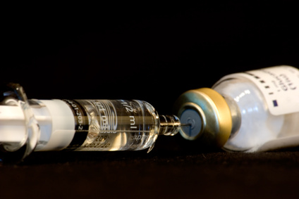
PREVENTION
Three main enteric fever prevention strategies:
Vaccination
1) Injectable vaccine
Contains killed Salmonella typhi bacteria.
Recommended for age over 2 years.

Slide 32
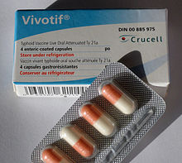
2) Oral vaccine
Contains a live but weakened strain of the Salmonella bacteria., Recommended for age over 5 years.
Enteric conjugate vaccine … for age 6 months or grater

Slide 33
TRAVEL ADVICE
Wash hands thoroughly and frequently using soap.
Use boiled or bottled drinking water
Ask for drinks without ice, unless the ice is made from bottled or boiled water.
Avoid Popsicles and flavored ices.
Be vaccinated against enteric at least one week before travel

Slide 34
REFERENCES
World Health Organization (WHO). Typhoid fever. [Internet]. Geneva: WHO; [updated 2023]. Available from: https://www.who.int/news-room/fact-sheets/detail/typhoid
Centers for Disease Control and Prevention (CDC). Typhoid fever and paratyphoid fever. [Internet]. Atlanta: CDC; [updated 2023]. Available from: https://www.cdc.gov/typhoid-fever/index.html
Crump JA, Mintz ED. Global trends in typhoid and paratyphoid fever. Clin Infect Dis. 2010;50(2):241-6. doi:10.1086/649541.
Parry CM, Hien TT, Dougan G, White NJ, Farrar JJ. Typhoid fever. N Engl J Med. 2002;347(22):1770-82. doi:10.1056/NEJMra020201.
Wain J, Hendriksen RS, Mikoleit ML, Keddy KH, Ochiai RL. Typhoid fever. Lancet. 2015;385(9973):1136-45. doi:10.1016/S0140-6736(13)62708-7.
Bhutta ZA. Current concepts in the diagnosis and treatment of typhoid fever. BMJ. 2006;333(7558):78-82. doi:10.1136/bmj.333.7558.78.
Khan MI, Soofi SB, Ochiai RL, Habib MA, Sahito SM, Nizami SQ, et al. Effectiveness of Vi capsular polysaccharide typhoid vaccine among children: a cluster randomized trial in Karachi, Pakistan. Vaccine. 2012;30(36):5389-95. doi:10.1016/j.vaccine.2012.06.015.
Andrews JR, Ryan ET. Diagnostics for invasive Salmonella infections: current challenges and future directions. Vaccine. 2015;33 Suppl 3:C8-15. doi:10.1016/j.vaccine.2015.02.030.
Crump JA, Sjölund-Karlsson M, Gordon MA, Parry CM. Epidemiology, clinical presentation, laboratory diagnosis, antimicrobial resistance, and antimicrobial management of invasive Salmonella infections. Clin Microbiol Rev. 2015;28(4):901-37. doi:10.1128/CMR.00002-15.

Slide 35
Thankyou

