Slide 1
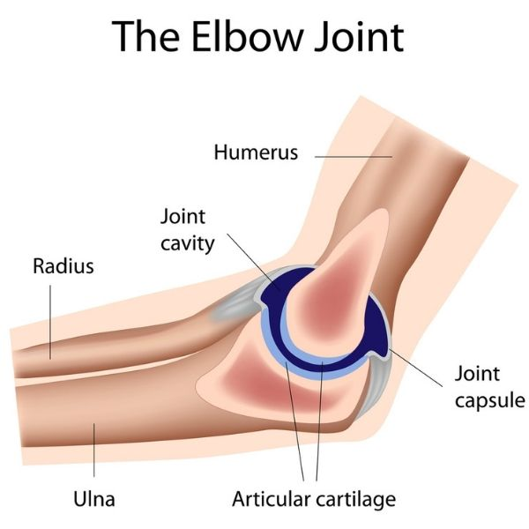
1st Year MBBS Elbow Joint
MSK-1 Module SGD/Dissection
24th April 2025
Dr. Sumyyia Bashir Assistant Professor

Slide 2
Mission- Vision- Values
Wisdom
Truth
Service
To impart evidence based research oriented medical education
To provide best possible patient care
To inculcate the values of mutual respect and ethical practice of medicine

Slide 3
Prof. Umar’s Model of Teaching Strategy Self Directed Learning Assessment Program
Objectives :To cultivate critical thinking, analytical reasoning, and problem-solving competencies.
To instill a culture of self-directed learning, fostering lifelong learning habits and autonomy.
How to Assess?
➢Ten randomly selected students will be evaluated within the first 10
minutes of the lecture through 10 multiple-choice questions (MCQs)
based on the PowerPoint presentation shared on Students Official
WhatsApp group, one day before the teaching session.
➢The number of MCQs from the components of the lecture will follow
the guidelines outlined in the Prof. Umar model of Integrated Lecture.
Component of LGIS | Core Knowledge | Horizontal Integration | Vertical Integration | Spiral Integration
No. of MCQs | 6-7 | 1-2 | 1 | 1

Slide 4
Professor Umar Model of Integrated Lecture

Slide 5
Learning Objectives At the end of the Demonstration Student should be able to
Describe the type of joint with its articular surfaces.
Discuss the capsule, synovial membrane and ligaments of the joints.
Enumerate the related bursae.
Describe axis and plane of movements
Enumerate muscles producing movements at elbow joint.
Describe the associated clinical conditions (Elbow joint dislocation and student’s elbow)
Understand the curative and preventive health care measures.

Slide 6
Hinge type of synovial joint, is located 2–3 cm inferior to the epicondyles of the humerus Articular Surfaces Trochlear notch of the ulna and the spool shaped trochlea of the humerus head of the radius and the spheroidal capitulum of the humerus
Core Knowledge
Elbow Joint
Type

Slide 7
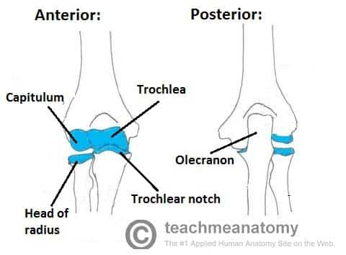
Core Knowledge
Joint Capsule A fibrous capsule encloses the joint, and is lined internally by a synovial membrane
Attached to the humerus at the margins of the articular surfaces of the capitulum and trochlea.
Anteriorly and posteriorly it is carried superiorly, proximal to the coronoid and olecranon fossae.

Slide 8
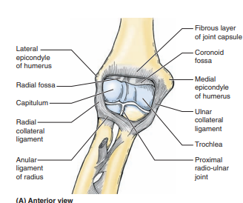
The lateral, fan-like radial collateral ligament connects the humerus to radius. Blends with the annular ligament of the radius, which holds the head of the radius in the radial notch of the ulna. The medial, triangular ulnar collateral ligament - from the medial epicondyle of the humerus to olecranon of the ulna. 3 bands : (1) the anterior cord-like band is the strongest (2) the posterior fan-like band is the weakest (3) the slender oblique band The quadrate ligament connects radius to ulna maintains constant tension during pronation and supination,
Core Knowledge
Ligaments

Slide 9
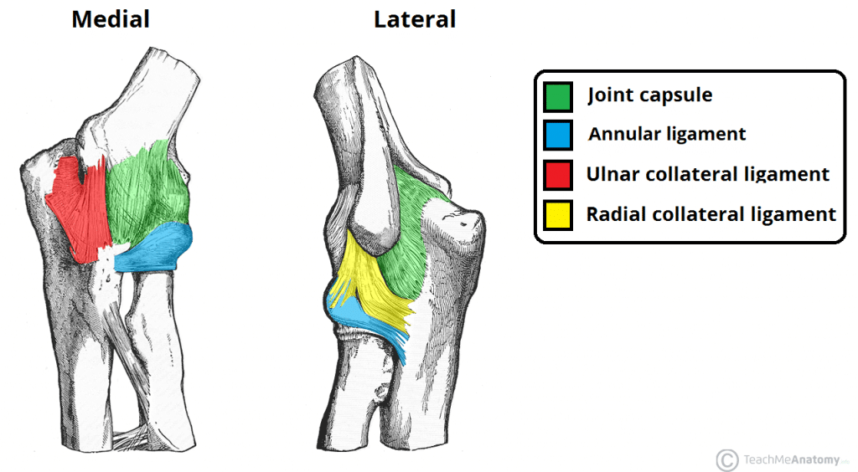
Core Knowledge

Slide 10
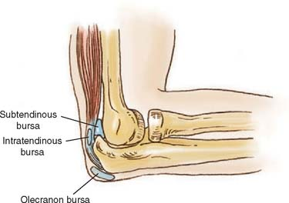
Bursae 3 olecranon bursae are 1. Intratendinous Olecranon Bursa, Which is sometimes present in the tendon of triceps brachii. 2. Subtendinous Olecranon Bursa, Which is located between the olecranon and the triceps tendon, just proximal to its attachment to the olecranon. 3. Subcutaneous Olecranon Bursa, Which is located in the subcut tissue over the olecranon. The bicipitoradial bursa (biceps bursa) separates the biceps tendon from, and reduces abrasion against, the anterior part of the radial tuberosity
Core Knowledge

Slide 11
Branches of the median, musculocutaneous, radial and ulnar nerves. Movements Flexion by Biceps Brachialis Brachioradialis
Core Knowledge
Innervation
Carrying Angle
The long axis of the fully extended ulna makes an angle of approximately 170° with the long axis of the humerus. This angle is called the carrying angle.
Extension by Triceps Brachii

Slide 12
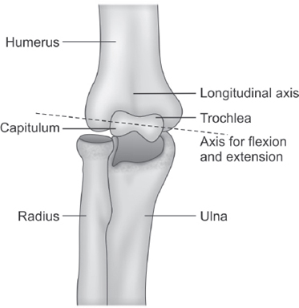
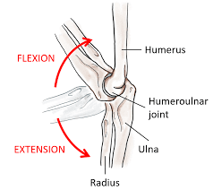
Core Knowledge
Planes & Axis of Movements

Slide 13
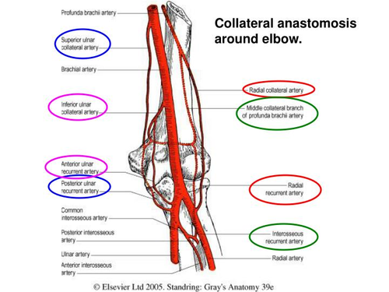
From the brachial artery superior ulnar collateral artery inferior ulnar collateral artery From the deep brachial artery middle collateral artery radial collateral artery From the radial artery radial recurrent artery
Core Knowledge
Blood Supply
Via Elbow Anastomosis

Slide 14
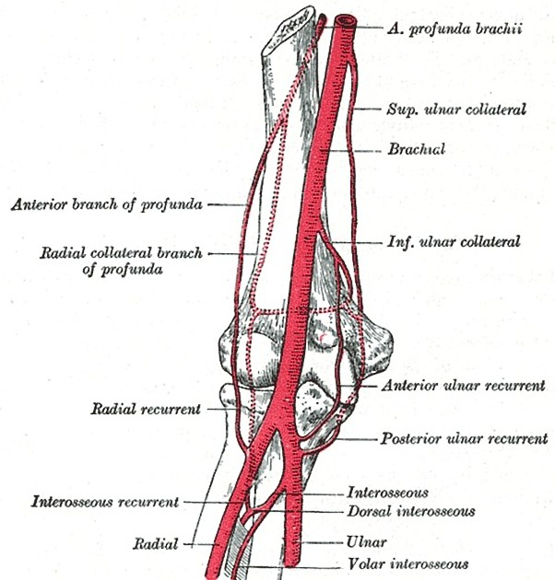
Core Knowledge
from the ulnar artery
common interosseous artery
anterior interosseous artery
posterior interosseous artery
interosseous recurrent artery
posterior ulnar recurrent artery
anterior ulnar recurrent artery
Accompanying veins also form a rich venous plexus.

Slide 15
The subcutaneous olecranon bursa is exposed to injury during falls on the elbow or infection of the skin over olecranon, repeated excessive pressure and friction as in wrestling, may cause this bursa to become inflamed, producing a friction subcutaneous olecranon bursitis (e.g., “Student’s elbow”) also known as “dart thrower’s elbow” and “miner’s elbow”.
Vertical Integration
Student’s Elbow Or Dart Thrower’s Elbow

Slide 16
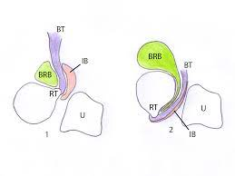
Bicipitoradial bursitis (biceps bursitis) results in pain when the forearm is pronated because this action compresses the bicipitoradial bursa against the anterior half of the tuberosity of the radius
Vertical Integration
Bicipitoradial Bursitis

Slide 17
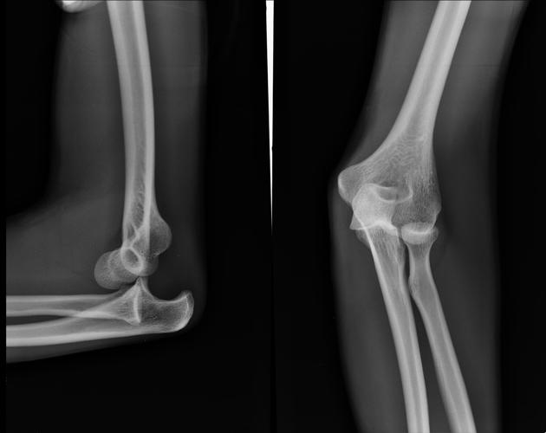
Elbow Joint Dislocation
Vertical Integration
Radiograph

Slide 18
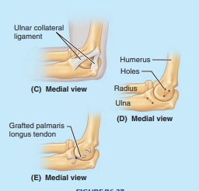
Rupture, tearing, or stretching of the ulnar collateral ligament (UCL) are increasingly common injuries related to athletic throwing football passing, javelin throwing, and playing water polo. Reconstruction of the UCL, commonly known as a “tommy john procedure”
Vertical Integration
Ulnar Collateral Ligament Reconstruction

Slide 19
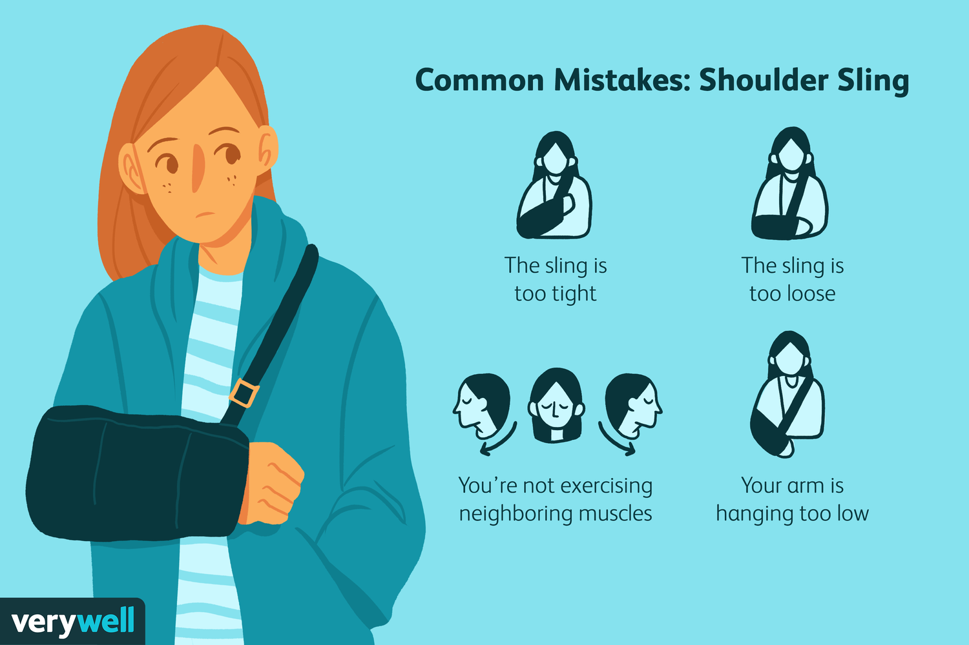
Management of Elbow Dislocation
Spiral Integration
Family Medicine
Initial Assessment: Family physicians play a crucial role in the initial assessment of fractures/dislocation of elbow joint , providing immediate medical attention, diagnosing the severity of the injury, and initiating appropriate treatment plans.
Referral and Coordination: They facilitate referrals to orthopedic specialists if necessary, ensuring patients receive specialized care for complex fractures/dislocations. Additionally, they coordinate with radiologists for timely imaging, aiding in accurate diagnosis and treatment planning.
Follow-up Care: Family physicians provide ongoing monitoring and management of fractures, overseeing the healing process, adjusting treatment as needed, and addressing any complications or concerns that may arise during recovery.

Slide 20
Ethical Considerations
Spiral Integration
Bioethics
Biomedical ethics in the context of Elbow joint fractures/dislocations involve ensuring patient autonomy in treatment decisions, such as choosing between surgical intervention and conservative management.
Physicians must uphold beneficence by prioritizing patient well-being, opting for treatments that optimize long-term function and quality of life.
Additionally, ethical considerations include maintaining patient confidentiality regarding sensitive medical information related to the injury and treatment process.

Slide 21
Role of AI in Elbow Dislocation Management
Spiral Integration
Artificial Intelligence
AI aids in fracture detection through advanced imaging analysis, assisting radiologists in accurately identifying and categorizing elbow joint fractures/dislocations from X-rays or scans.
Additionally, AI-powered systems can help predict fracture healing times and outcomes based on patient-specific factors, guiding treatment decisions for optimal recovery.
Furthermore, AI algorithms contribute to the development of personalized rehabilitation plans, enhancing post-fracture care by tailoring interventions to individual patient needs and progress.

Slide 22
https://www.Ncbi.Nlm.Nih.Gov/pmc/articles/PMC3553418/ Lateral epicondylitis of the elbow, is defined as a microscopic tear of extensor carpi radialis brevis tendon, and microscopic findings show immature reparative tissue (angiofibroblastic hyperplasia). The patient needs coordinated rehabilitation, range-of motion-exercise, stretching, and bracing in the second phase. Ninety-five percent of patients with lateral epicondylitis heal spontaneously or conservatively. The medial collateral ligament injury of the elbow is most common in the overhead-throwing athlete. Jobe’s procedure, the original reconstruction technique, and its modifications in bone-tunnel creation, allow a tendon graft to be wound in a figure-eight configuration through the tunnels.
Spiral Integration
Research Article
Current concepts of elbow-joint disorders and their treatment

Slide 23
Learning Resources Clinically oriented anatomy 7th edition region upper limb page no. 800-807 blue boxes 814 -817

