Slide 2
ENDOCRINOLOGY & BASIC RADIOLOGY
BY
DR. ZEENAT SAULAT
CONSULTANT RADIOLOGIST,BBH
DR .FIZZA BATOOL
SENIOR REGISTRAR, RTH

Slide 3
 | Mission Statement To impart evidence-based research-oriented health professional education in order to provide best possible patient care and inculcate the values of mutual respect, ethical practice of healthcare and social accountability. Vision and Values Highly recognized and accredited center of excellence in Medical Education, using evidence-based training techniques for development of highly competent health professionals, who are lifelong experiential learner and are socially accountable. Goals of the Undergraduate Integrated Modular Curriculum To provide you with quality medical education in environment designed to: Provide thorough grounding in the basic theoretical concepts underpinning the practice of medicine. Develop and polish the skills required for providing medical services at all levels of the Health care delivery system. Help you attain and maintain the highest possible levels of ethical and professional conduct in your future life.
TRUTH,
WISDOM & SERVICE
“OUT MOTTO”

Slide 5
LEARNING OBJECTIVES
At the end of the LGIS. Students should be able to:
Describe …. Radiological techniques i.e USG, CT MRI, and Radionuclear study.
Identify…Radiological anatomy and pathology like thyroid nodules, pituitary adenoma, parathyroid adenoma.
Classify…Endocrinological pathologies
Explain…Endocrinology… radiological implications and management.

Slide 6
SEQUENCE TO LGIS
INTRODUCTION TO RADIOLOGICAL ANATOMY OF THYROID GLAND, PARATHYROID GLAND, ADRENAL GLAND, PITUATARY GLAND
INTRODUCTION TO RADIOLOGICAL PATHOLOGY OF THYROID GLAND, PARATHYROID GLAND, ADRENAL GLAND, PITUATARY GLAND
ON RADIOLOGICAL MODALITIES LIKE
THYROID USG
THYROID SCAN /UPTAKE
PARATHYROID USG
ADRENAL GLAND MRI
PITUATARY MRI
CLINICAL SCENERIO AND MANAGEMENT
RESEARCH ARTICLE
BIOMEDICAL ETHICS

Slide 7
HORIZONTAL INTEGRATION
ANATOMY

Slide 8
Thyroid ultrasound, transverse image
The thyroid is easily imaged
with the patient in a supine
position with the neck extended by
1. Thyroid gland lobe
2. Thyroid gland isthmus
3. Trachea
4. Common carotid artery
6. Infrahyoid strap muscle
7. Sternocleidomastoid muscle
8. Prevertebral muscle

Slide 9
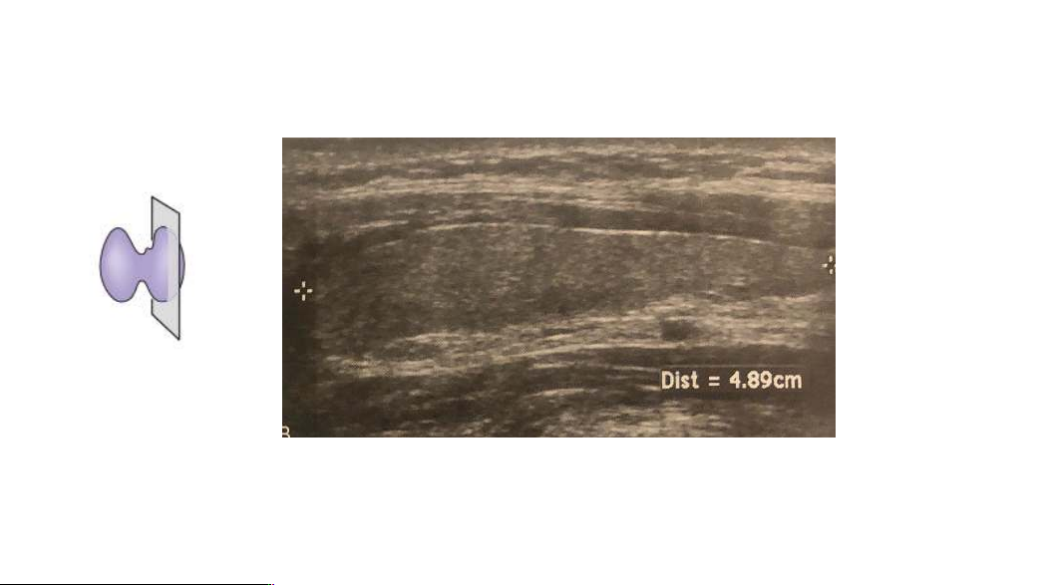
Thyroid ultrasound, longitudinal image

Slide 10
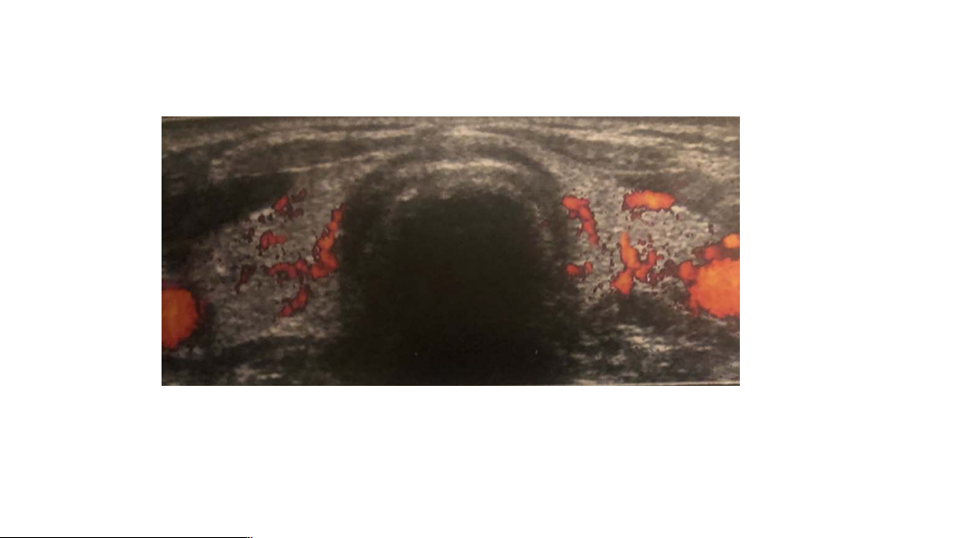
Normal thyroid vascularity on power Doppler ultrasound
With currently available high-sensitivity Doppler instruments, the rich vascularity of the gland can be seen homogeneously distributed throughout the entire parenchyma.

Slide 11
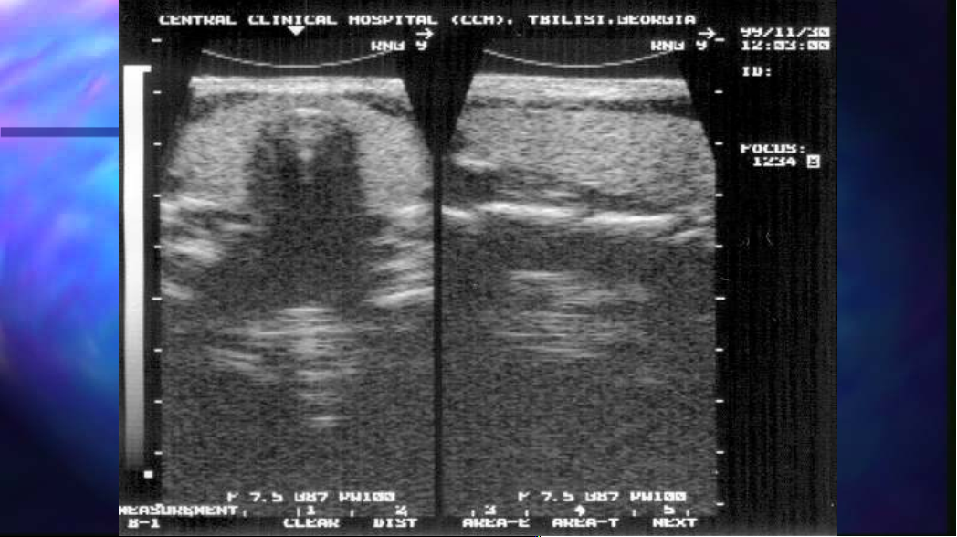

Slide 12
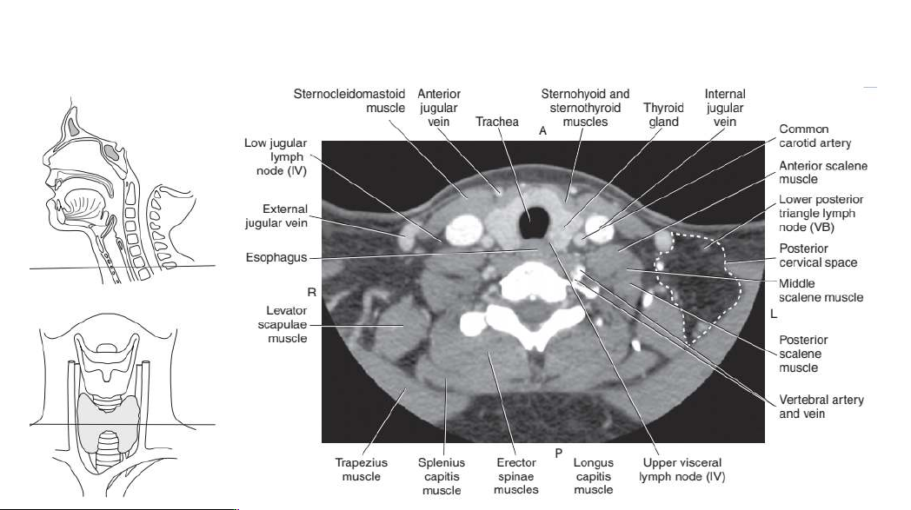

Slide 13
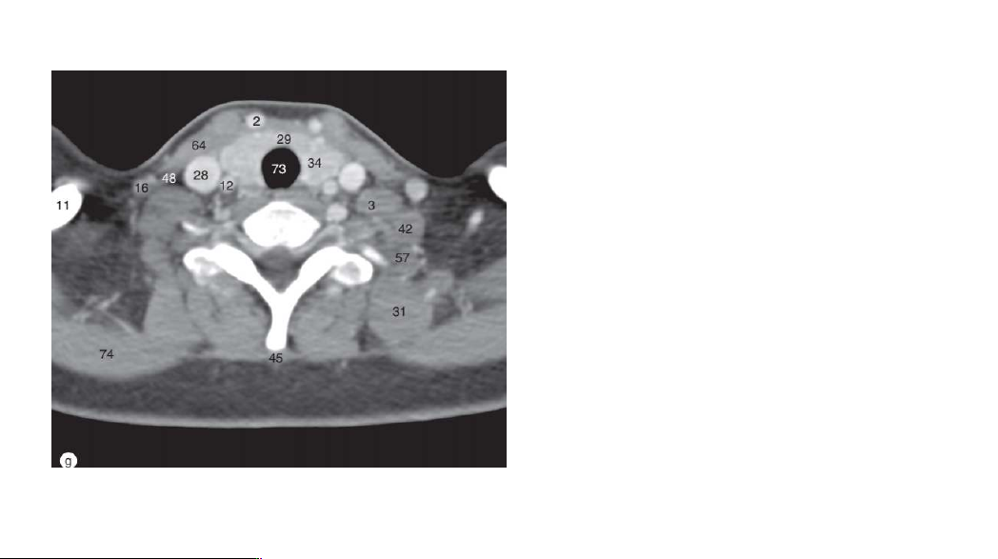
CONTRAST ENHANCED CT NECK
2. Anterior jugular vein
3. Anterior scalene muscle
11. Clavicle
12. Common carotid artery
16. External jugular vein
28. Internal jugular vein
29. Isthmus of thyroid gland
31. Levator scapulae muscle
34. Lobe of thyroid gland
42. Middle scalene muscle
45. Nuchal ligament
48. Omohyoid muscle
57. Posterior scalene muscle
64. Sternocleidomastoid muscle

Slide 16
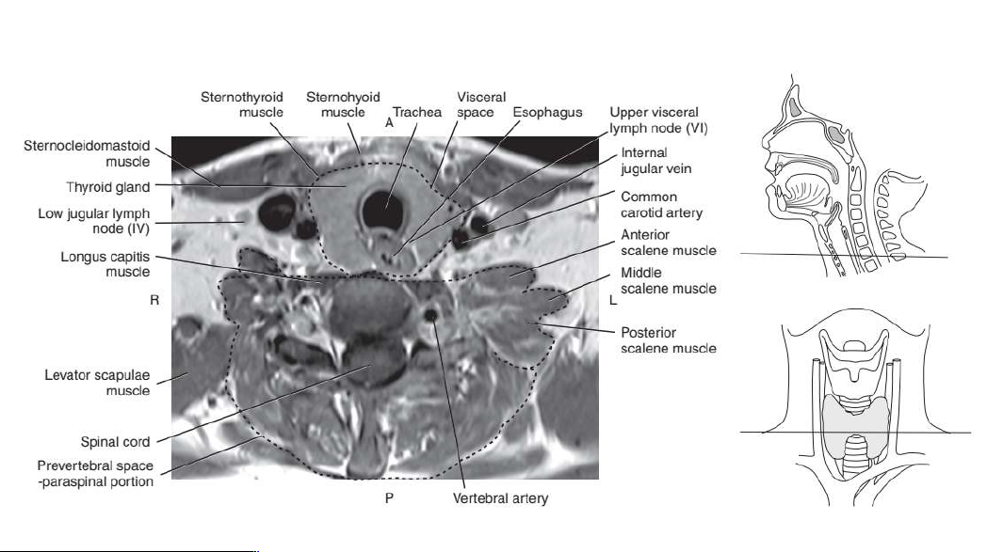

Slide 17
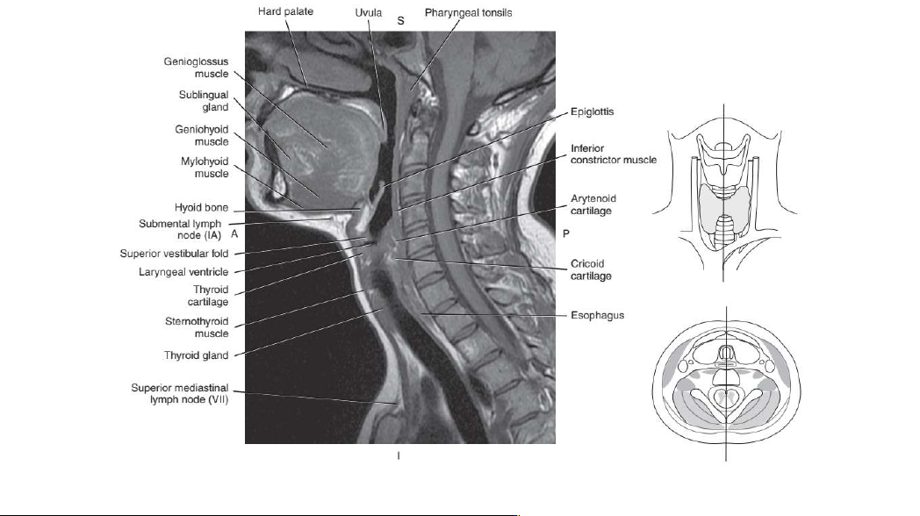

Slide 18
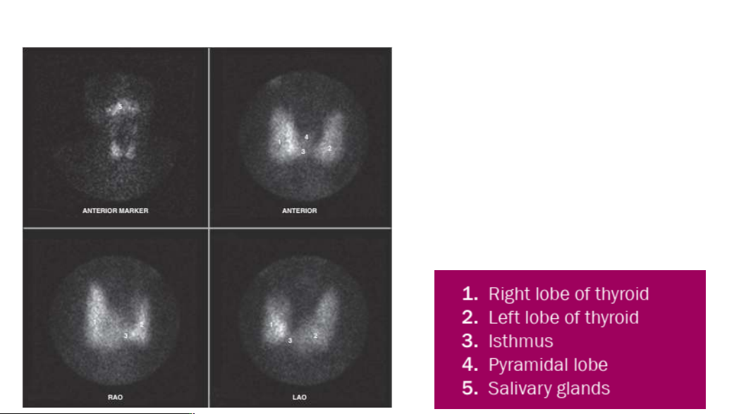
Normal thyroid scan (imaging agent is Tc-99m pertechnetate)

Slide 19
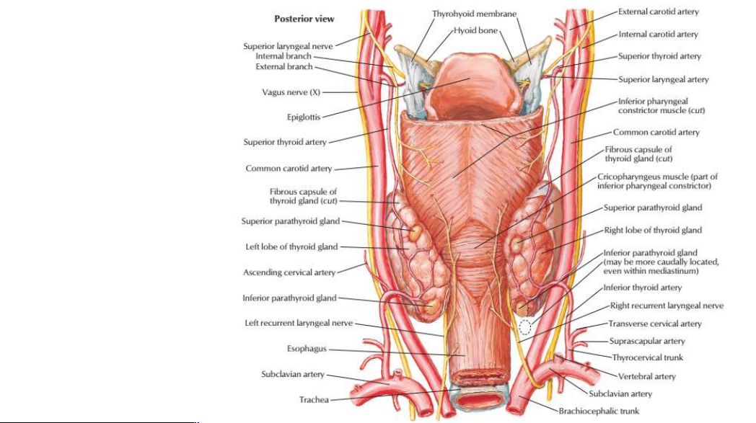

Slide 20
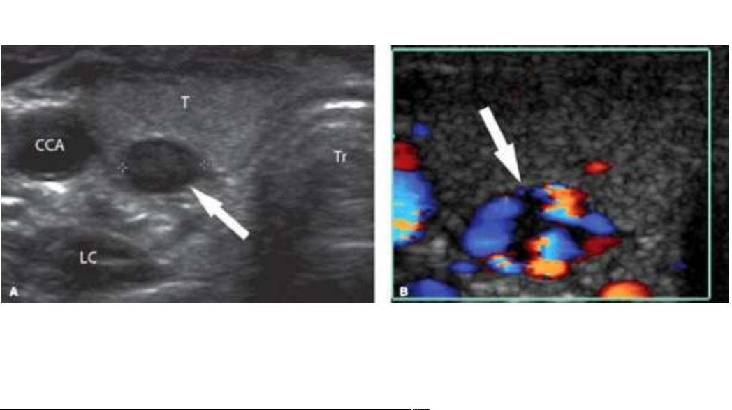
A. Transverse US image shows the characteristic markedly low echogenicity of a parathyroid
adenoma (arrow) in typical location, deep to the thyroid lobe (T), superficial to the longus
colli muscle (LC), medial to the common carotid artery (CCA), and lateral to the acoustic
shadow of the trachea (Tr).
B. Color Doppler US shows the marked hypervascularity within the nodule (arrow)

Slide 21
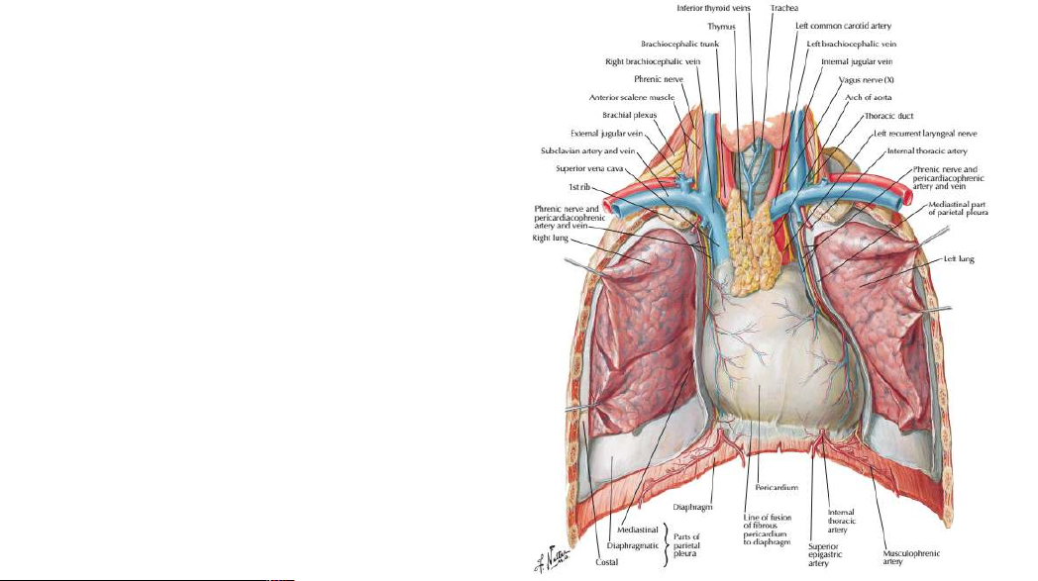
THYMUS GLAND

Slide 22
Normal Thymus Configurations. A. In a young infant, the thymus is often quite
prominent, causing bilateral superior mediastinal widening (arrowheads). Note the
rightward buckling of the trachea, which is a normal finding during expiration in
infants and should not be mistaken for mass effect. B. In older infants and young
children, the lobes of the thymus gland become less prominent (arrows). Note the
subtle notch at the junction of the thymic and cardiac shadows (red arrowheads).

Slide 23
Normal Thymus Configurations. C. The right thymic lobe (arrowheads) is prominent in
this patient, with a configuration that has been likened to a sail. D. CT coronal
reconstruction of a child with a prominent right thymic lobe (arrowheads) and thymus
extending to the thoracic inlet. This is the CT equivalent of the sail sign.

Slide 24
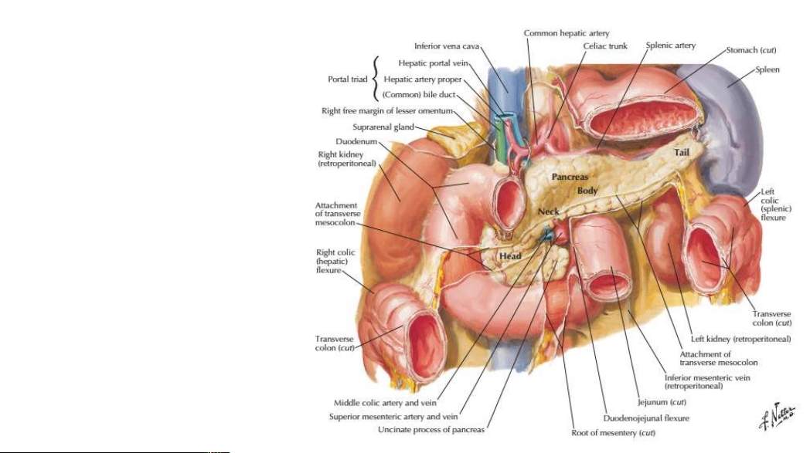
PANCREAS

Slide 25
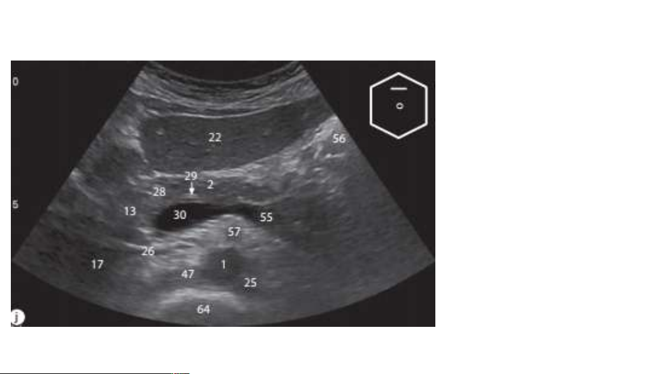
USG PANCREAS
1Abdominal aorta
2. Body of pancreas
13. Head of pancreas
17. Inferior vena cava
22. Left lobe of liver
25. Left renal artery
26. Left renal vein
28. Neck of pancreas
29. Pancreatic duct
30. Portal vein
47. Right renal artery
55. Splenic vein
56. Stomach
57. Superior mesenteric artery
64. Vertebral body

Slide 26
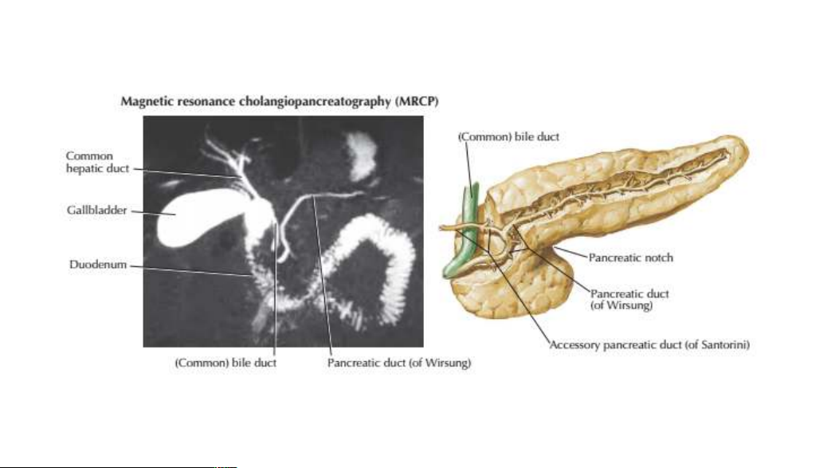

Slide 27
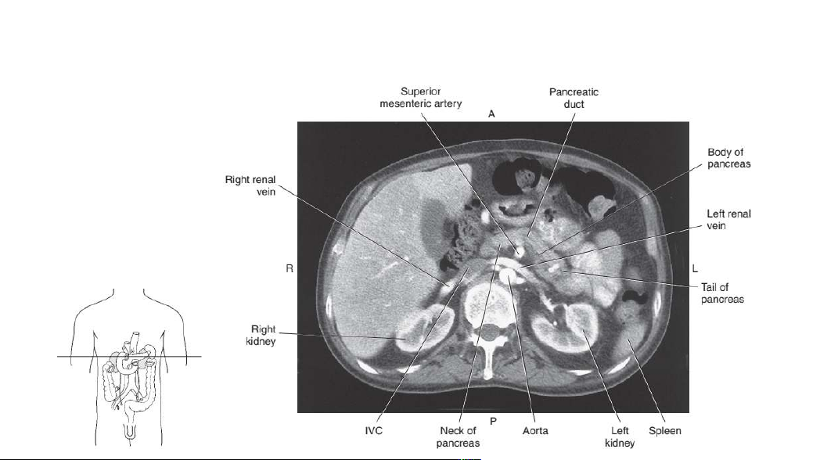
AXIAL CT AT PANCREAS

Slide 28
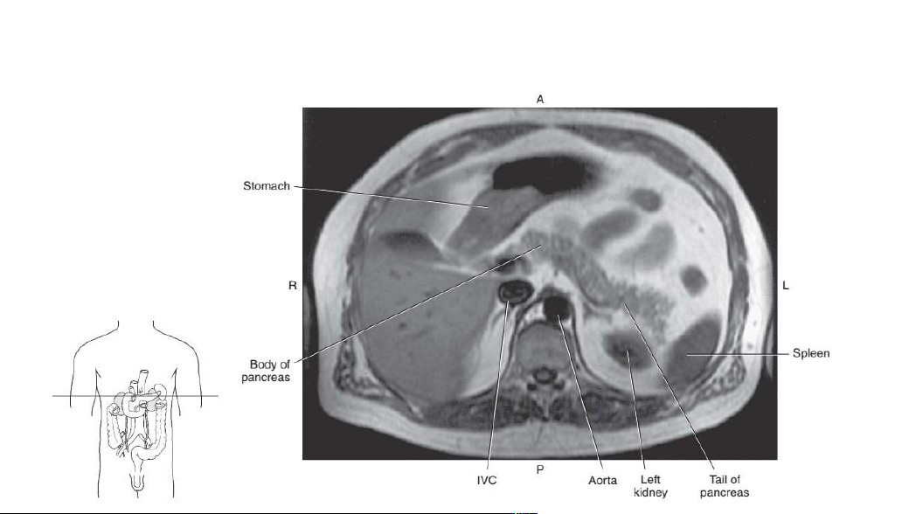
Axial TIWT MRI PANCREAS

Slide 29
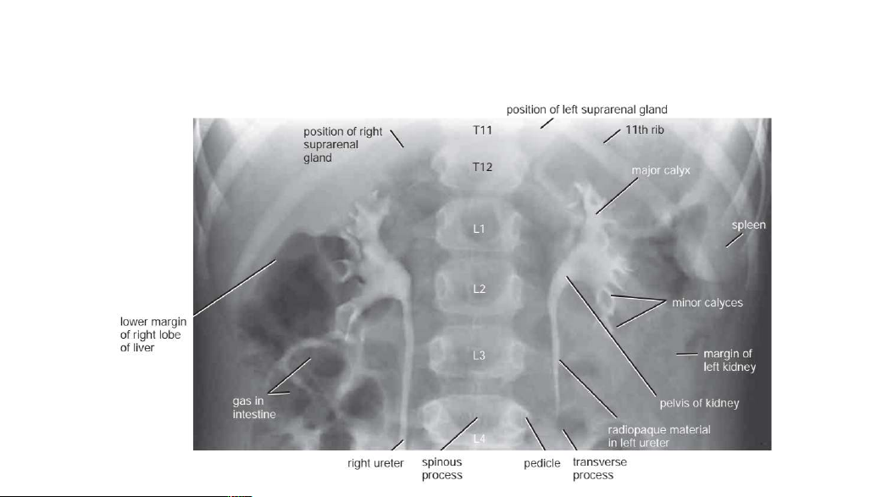
ADRENAL GLAND
Anteroposterior radiograph of both kidneys 15 minutes after intravenous injection of an
iodine-containing compound (5-year-old girl).

Slide 30
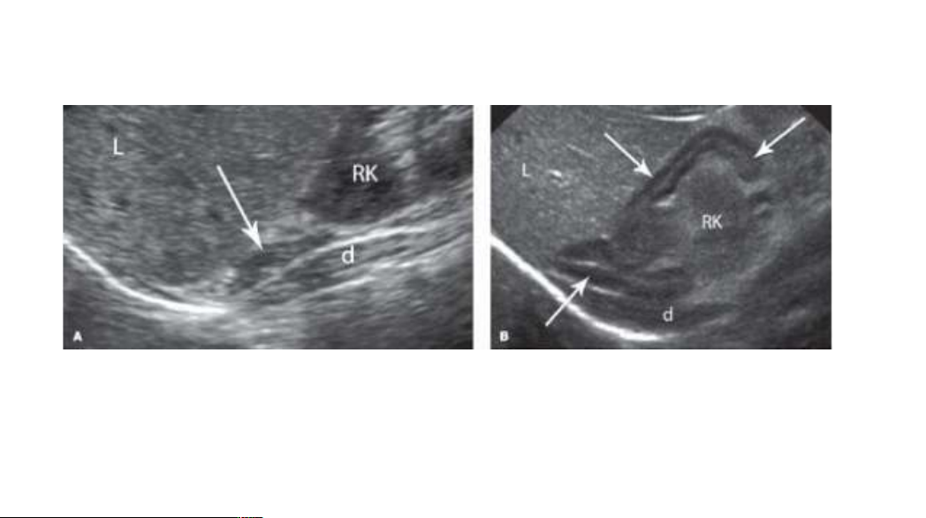
The normal adrenal glands may be difficult to visualize sonographically in the adult, but are usually quite prominent in the newborn.
Normal Adrenal GlandA. Longitudinal image reveals the normal right adrenal gland (arrow) in an adult.B. Longitudinal image reveals the comparatively huge adrenal gland (arrows) of a newborn infant.Sonographic landmarks for the right adrenal gland include the liver (L), the upper pole of the rightkidney (RK), and the right crus of the diaphragm (d).

Slide 31
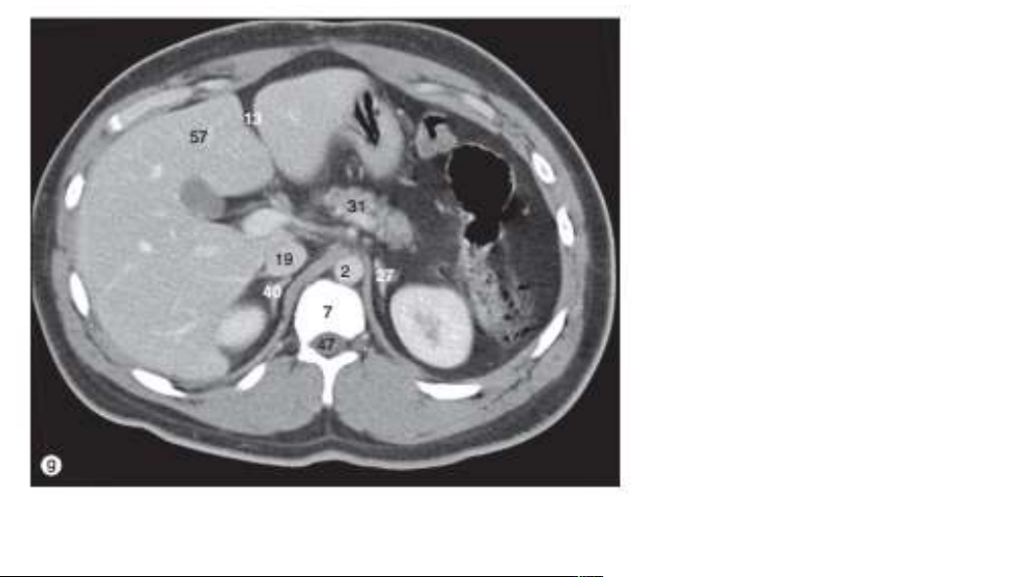
AXIAL CT ADRENAL GLANDS
57. Liver
13. Fissure for falciform ligament
31. Neck of pancreas
2. Aorta
19. IVC
40.Right suprarenal gland
27.Left suprarenal gland
7. Body of vertebra
47.Thecal sac

Slide 32
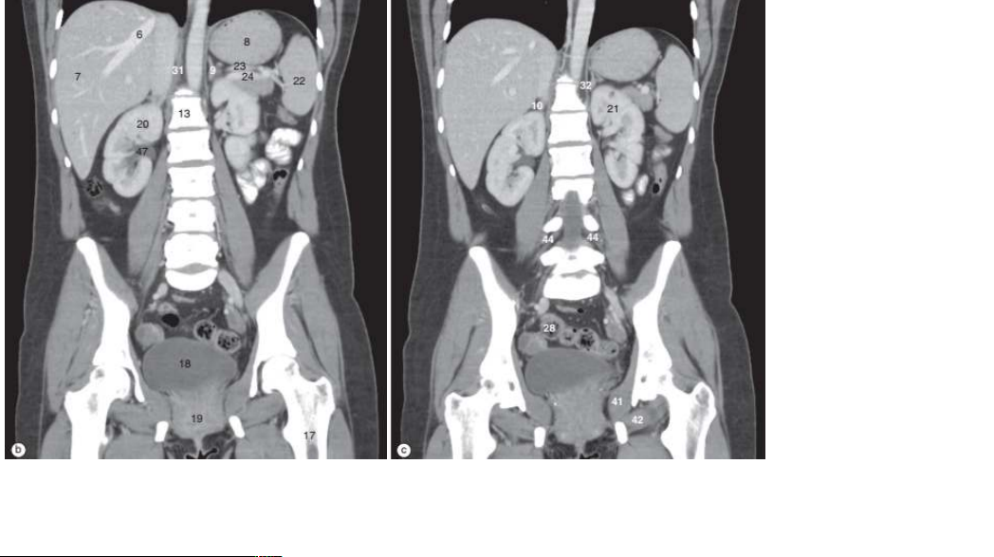
CORONAL CT ADRENAL GLAND
6. Hepatic vein
7. Right lobe of liver
8. Fundus of stomach
9. Left suprarenal gland
10. Right suprarenal gland
13. Vertebral body of L1
17. Femur
18. Urinary bladder
19. Vagina
20. Right kidney
21. Left kidney
22. Spleen
23. Splenic artery
24. Splenic vein
28. Sigmoid colon
31. Right crus of diaphragm
32. Left crus of diaphragm
41. Obturator internus muscle
42. Obturatorexternusmuscle
44. Lumbar nerve roots
47. Renal pelvis

Slide 33
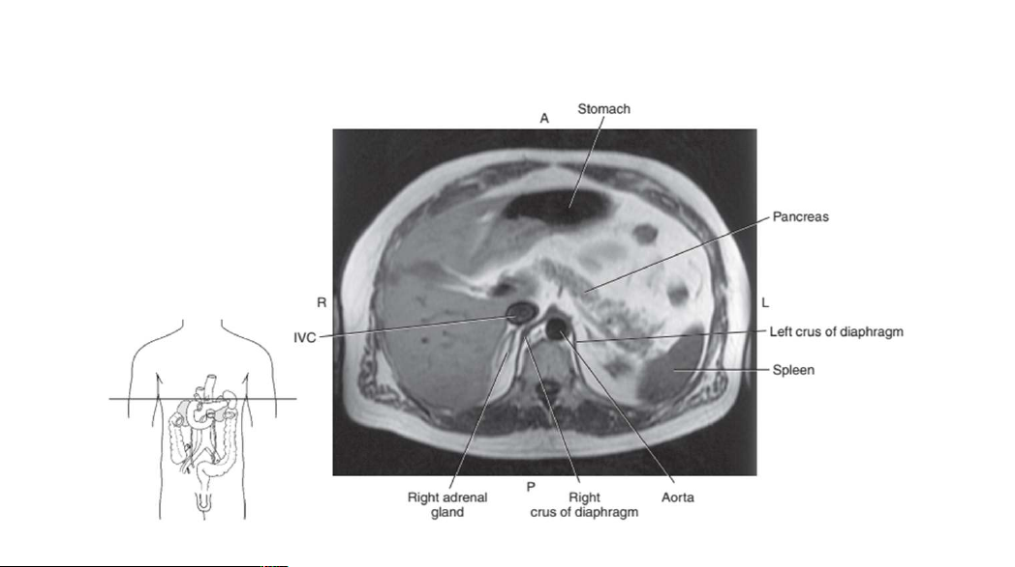

Slide 34
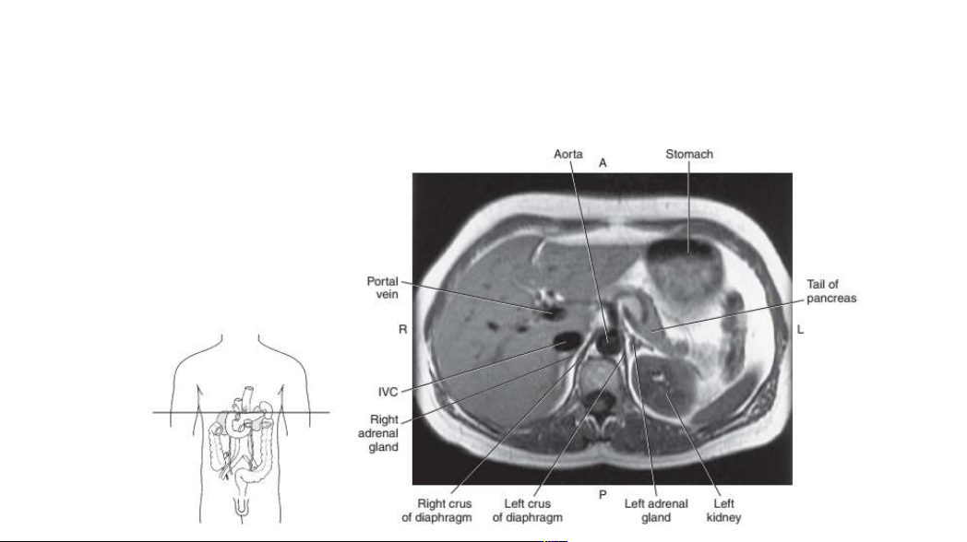

Slide 35
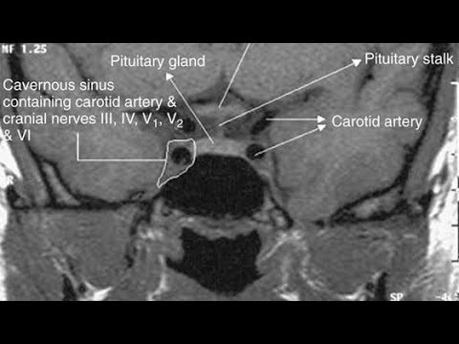
Normal sagittal anatomy. ( A ) Sagittal graphic demonstrates key structures including the sella turcica (ST), the anterior pituitary or adenohypophysis (AH), posterior pituitary or neurohypophysis (NH), the pituitary stalk or infundibulum (INF), diaphragma sella (DS), and optic chiasm (OC). ( B ) Sagittal fat-saturated T1-weighted MR imaging without gadolinium shows hyperintense signal in neurohypophysis, a normal finding referred to as the pituitary bright spot. Note the relationship of the sella turcica to the sphenoid sinus and clivus. ( C ) Sagittal postgadolinium T1-weighted image shows homogeneous enhancement of the infundibulum and anterior pituitary.

Slide 36
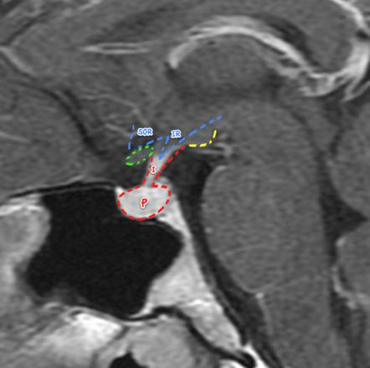

Slide 37
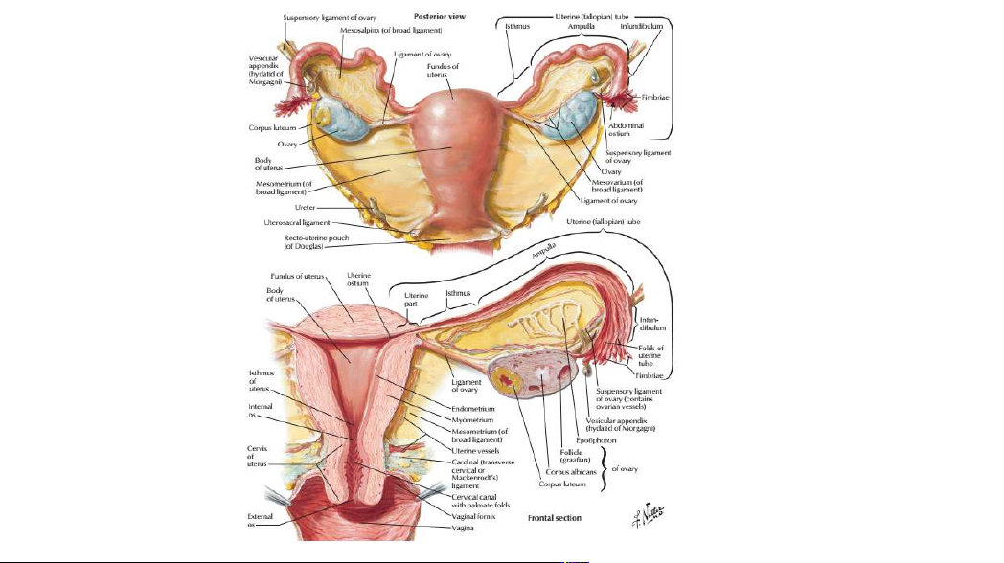

Slide 38
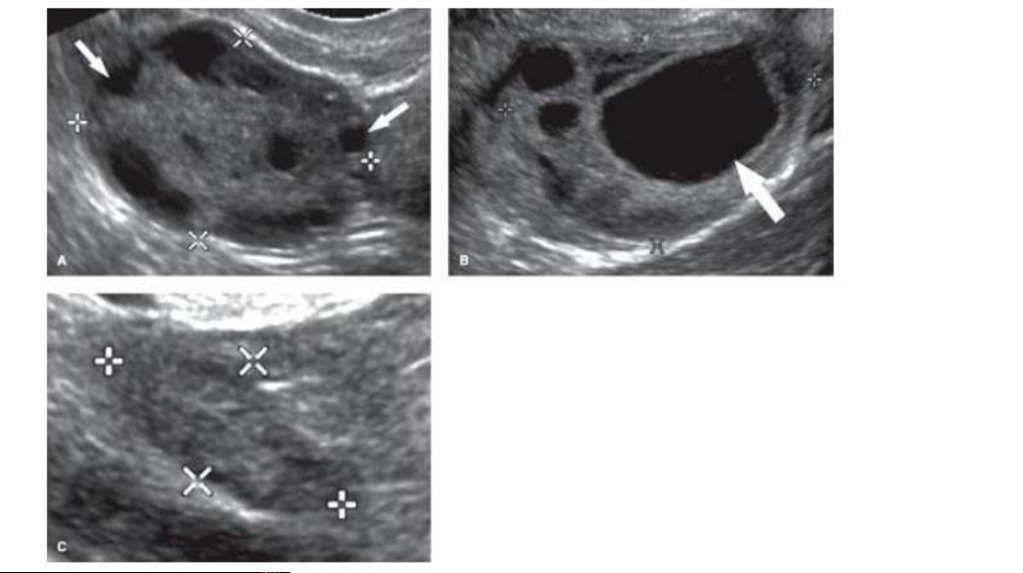
Normal Ovaries.
A. Transvaginal US shows a normal ovary (between cursors, x,
+) with follicles (arrows) in a woman of childbearing age.
Follicles are normal physiological structures that serve as US
landmarks for the identification of the ovary. B. This ovary
(between cursors, x, +) contains an enlarging dominant follicle
(arrow). Dominant follicles may be up to 3 cm size. C. A normal
ovary (between cursors, x, +) in postmenopausal women is
smaller and lack follicles.

Slide 39
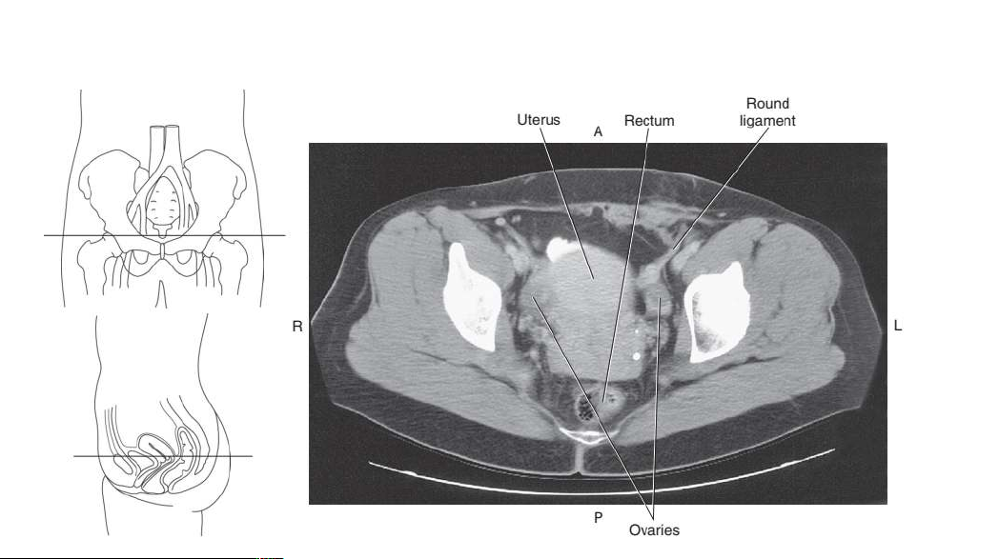

Slide 40
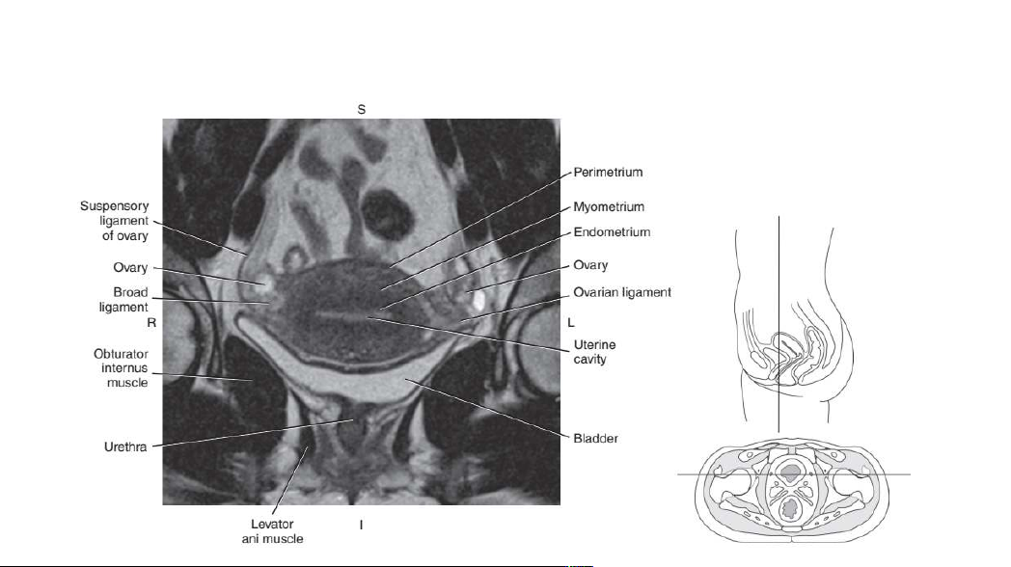

Slide 41
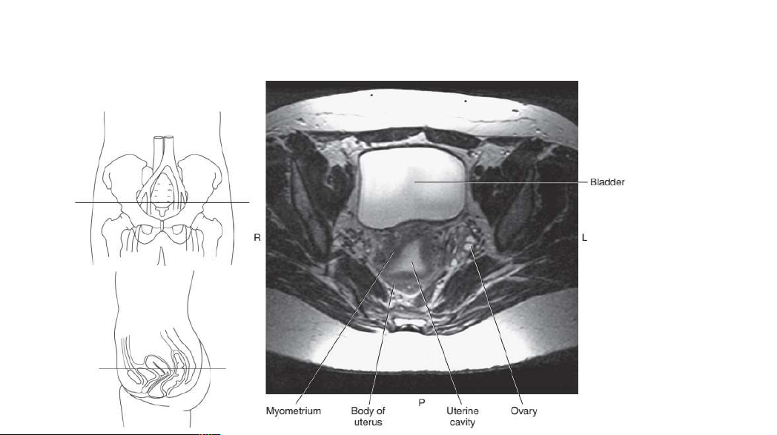

Slide 42
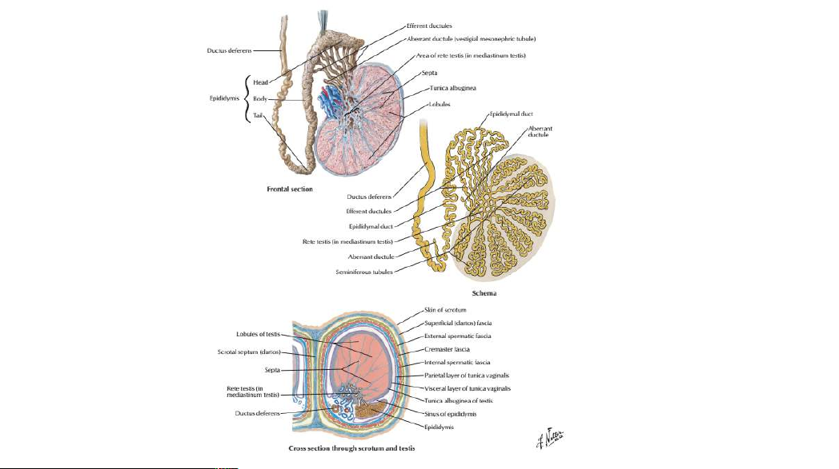

Slide 43
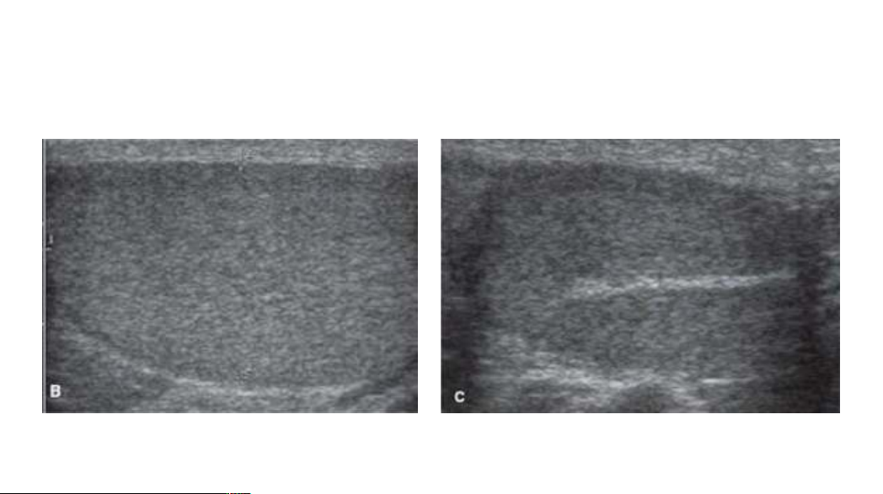
USG TESTIS
B. The normal testis is of uniform midlevel echogenicity.
C. The mediastinum of the testis appears as a brightly echogenic line where the tunica
albuginea infolds to allow the entry and exit of blood vessels and the efferent ductules.

Slide 44
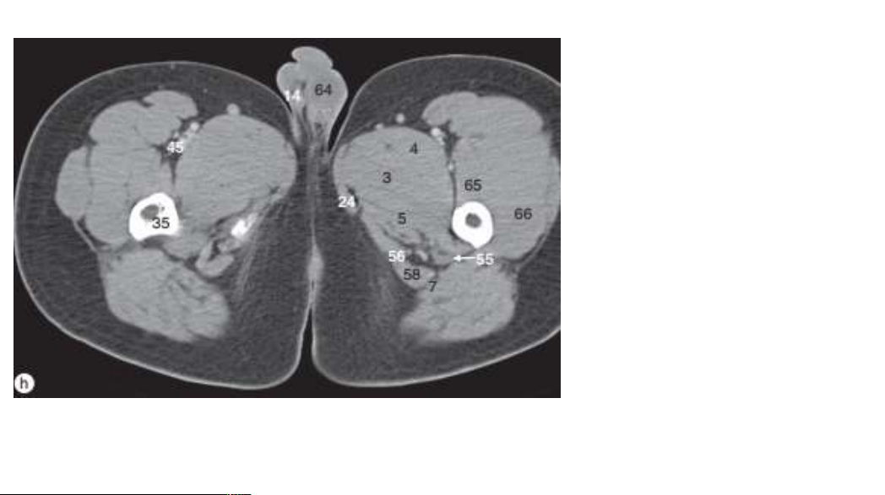
AXIAL CT LEVEL OF TESTIS
3. Adductor brevis muscle
4. Adductor longus muscle
5. Adductor magnus muscle
7. Biceps femoris muscle
14. Epididymis
24. Gracilis muscle
35. Lesser trochanter of femur
45. Profunda femoris artery
55. Sciatic nerve
56. Semimembranosus muscle
58. Semitendinosus muscle
64. Testis
65. Vastus intermedius muscle
66. Vastus lateralis muscle

Slide 45
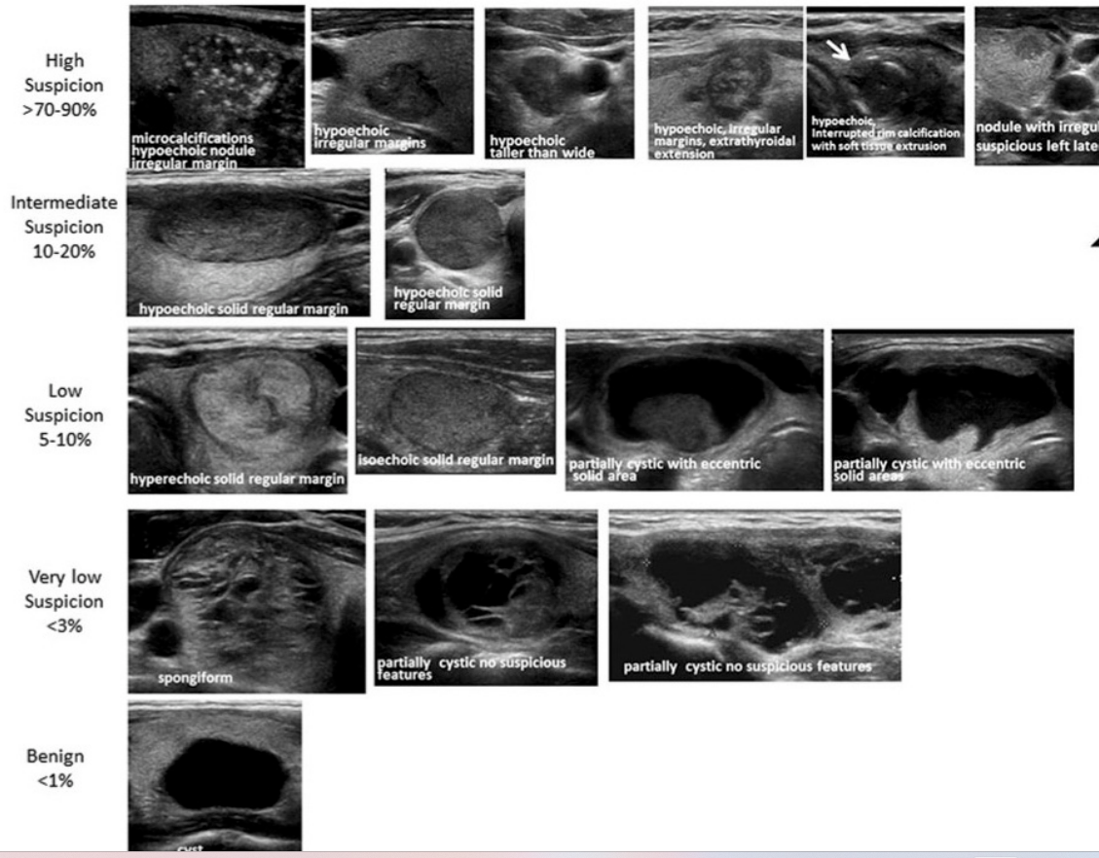
VERTICAL INTEGRATION PATHOLOGIES

Slide 46
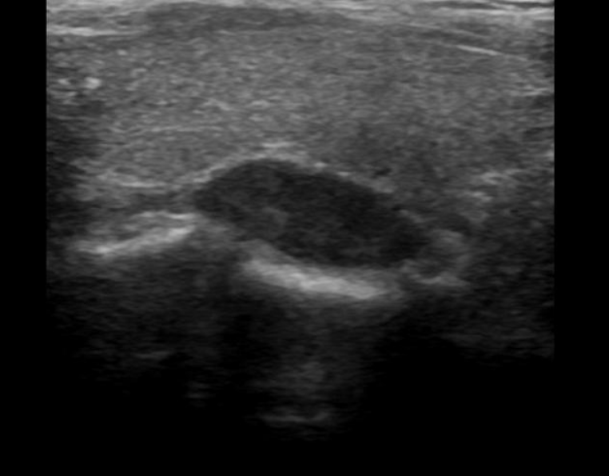
Parathyroid adenoma
There is a well-defined, homogeneous lesion posterior-inferior to the right lobe of the thyroid gland. It is hypoechoic in comparison to the thyroid gland. There is no calcification/ cystic space in it. The lesion elevates the echogenic posterior capsule of the thyroid gland. Few flow signals are present in the lesion.

Slide 47
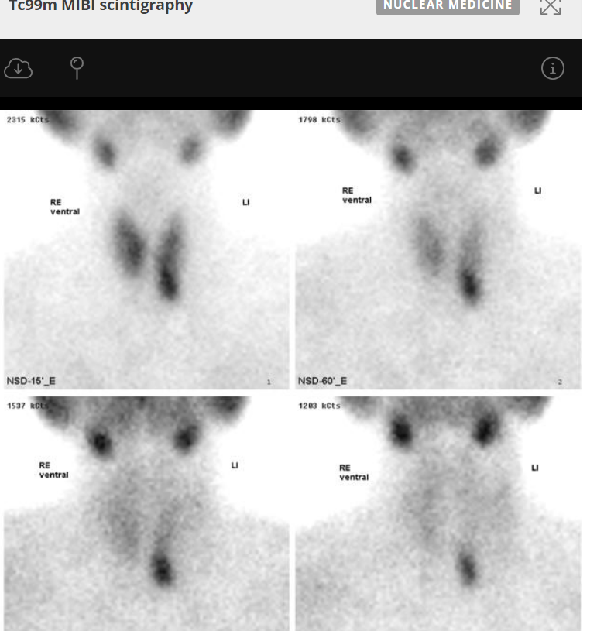
Tc 99m MIBI scintigraphy
Parathyroid adenomas typically retain activity on late scans after wash-out in the thyroid has occurred.

Slide 48
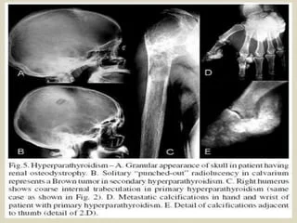
HYPERPARATHYROIDISM –SKELETAL MANIFESTATIONS

Slide 49
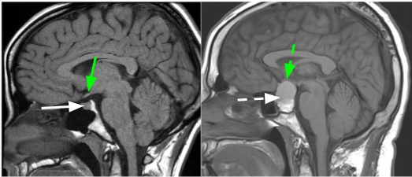
Pitutary adenoma

Slide 50
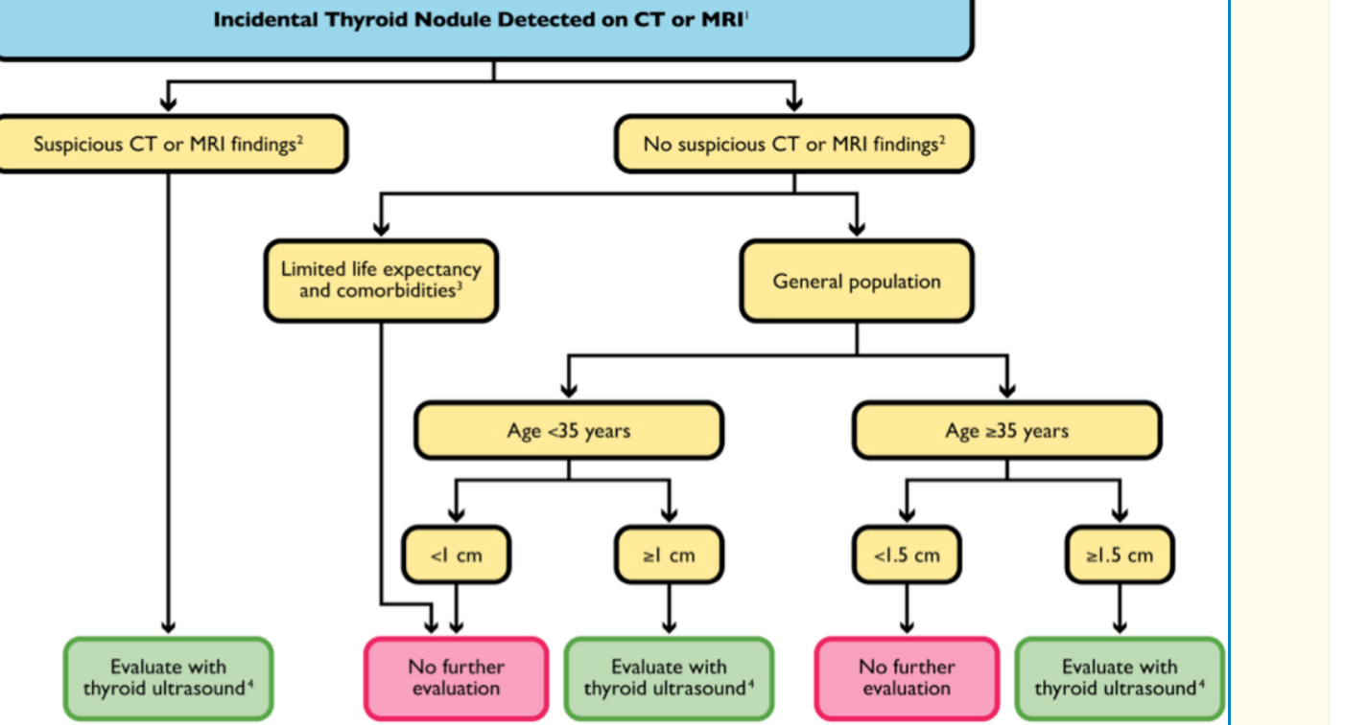
CLINICAL SCENARIO AND MANAGEMENT

Slide 52
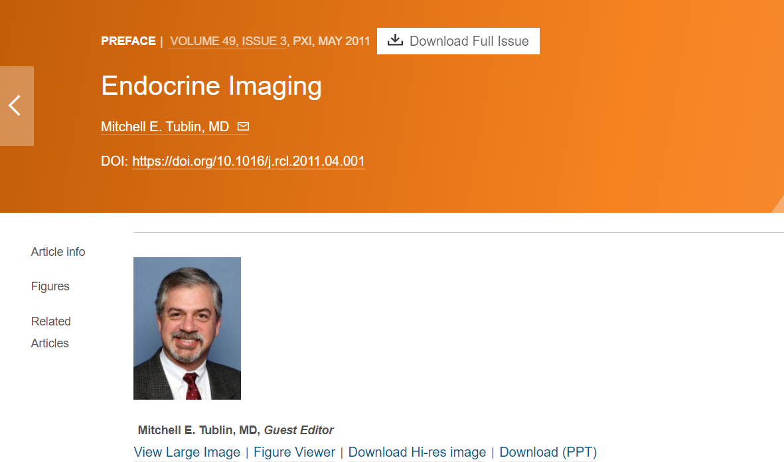

Slide 53
