Slide 1
DIABETES MELLITUS
Dr Saima Ambreen Associate Professor, Internal Medicine, HOD,Medical Unit 1, Holy Family Hospital, Rawalpindi.

Slide 3
Learning Outcomes:
Diagnostic Criteria For DM
Different Types of DM
Pathogenesis Of DM
Symptoms and Signs Of DM
Management Of DM Type 1 & 2
Antidiabetic Drugs ,modes of action and side effects
Insulin and its Types
Gestational DM

Slide 4
Clinical Case Scenario:
A 55-year-old man is evaluated in the emergency department for lethargy, polyuria. He also complaints of fatigue, blurred vision, and increased thirst. On physical examination, we notice a non healing draining chronic ulcer on the left foot. Based on this scenario, what is the most probable cause of this patients symptoms?

Slide 5
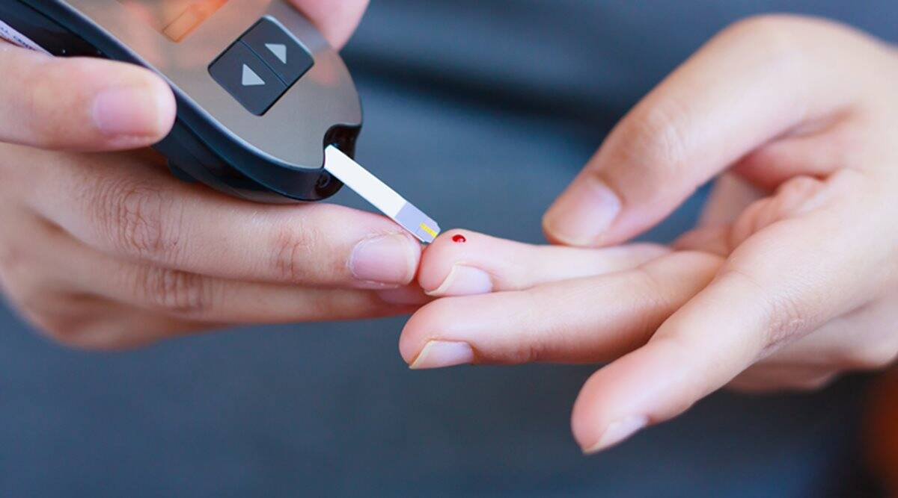
DIABETES MELLITUS:
Core subject
Define: Syndrome with disordered metabolism and inappropriate hyperglycemia
a metabolic disorder of multiple etiology characterized by chronic hyperglycemia with disturbances of carbohydrate, fat and protein metabolism resulting from defects in insulin secretion, insulin action or both
( BSF >/= 126 mg/dl on more than 1 occasion) (BSR>/= 200 mg/dl on more than 1 occasion)

Slide 6
Criteria for Diagnosis of DM:
Core subject
 | Normal Glucose tolerance | Impaired glucose tolerance | Diabetes mellitus
BSF mg/dl or mmol/l | <100 or <5.6 | 100- 125 or 5.6- 6.9 | >/= 126
OGTT mg/dl or mmol/l | <140 or <7.8 | 140- 199 7.8- 11.0 | >/= 200
HbA1c % | <5.7 | 5.7 to 6.4 | >/= 6.5

Slide 7
TYPES:
Core subject
Type 1→ Usually under 30 yrs of age, Autoimmune disorder, islet beta cell destruction. Due to pancreas's failure to produce enough insulin, total lack of insulin in the body Sudden onset of severe symptoms Rapid weight loss Ketones produced Managed by Insulin This form was previously referred to as "insulin dependent diabetes mellitus" (IDDM) or "juvenile diabetes". causes: autoimmune( 95%), idiopathic(5%).

Slide 8
Core subject
Type 2→ Usually over 40 yrs of age though the age of diagnosis is getting younger, due to increase tissue resistance towards insulin, Gradual onset with mild symptoms, Most produce a normal amount of insulin but it is unable to work properly, due to insulin resistance, Many have complications at diagnosis causes: genetic and environmental factors.
Obesity is the most important factor causing insulin resistance. This form was previously referred to as "non insulin dependent diabetes mellitus" (NIDDM) or "adult-onset diabetes".

Slide 9
Vertical Integration

Slide 10
Vertical Integration
Genetic defects of b-cell function : Maturity-onset diabetes of the young (MODY), caused by mutations in: Hepatocyte nuclear factor 4a [HNF-4a] (MODY1)\ Glucokinase (MODY2) Hepatocyte nuclear factor 1a [HNF-1a] (MODY3) Insulin promoter factor [IPF-1] (MODY4) Hepatocyte nuclear factor 1b [HNF-1b] (MODY5) Neurogenic differentiation factor 1 [Neuro D1] (MODY6) Mitochondrial DNA mutations

Slide 11
Vertical Integration
4. Genetic defects in insulin processing or insulin action
Defects in proinsulin conversion
Insulin gene mutations
Insulin receptor mutations
5. Exocrine pancreatic defects Chronic pancreatitis Pancreatectomy Neoplasia Cystic fibrosis Hemachromatosis Fibrocalculous pancreatopathy

Slide 12
Vertical Integration
6. Endocrinopathies Cushing syndrome Hyperthyroidism Pheochromocytoma Glucagonoma Acromegaly
7. Infections Rubella Cytomegalovirus Coxsackie virus B Epstein barr virus
8. Drugs: Glucocorticoids, interferon, Protease inhibitors, b-adrenergic agonists, Thiazides, Nicotinic acid
9. Genetic syndromes associated with diabetes: Down syndrome, Kleinfelter syndrome, Turner syndrome
• 10. Gestational diabetes mellitus

Slide 13
Gestational DM:
Horizontal Integration
occurs in pregnant women without a previous history of diabetes
diagnosed when glucose intolerance occurs beyond 24 to 28 weeks of gestation.
Needs insulin for management of GDM.

Slide 14
Insulin resistance syndrome (syndrome x,metabolic syndrome,REAVEN’S SYNDROME)
Core subject
Metabolic syndrome is a name for a group of risk factors that occur together and increase the risk for CAD, STROKE, and type 2 diabetes
• The two most important risk factors for metabolic syndrome are: • Extra weight around the middle and upper parts of the body (central obesity). The body may be described as "apple-shaped."
Other risk factors include: Aging, Genes that make more likely to develop this condition, Hormonal changes, Lack of exercise

Slide 15
Core subject
Maturity Onset Diabetes of Young (MODY): noninsulin requiring diabetes But age of onset is </=25 years Autosomal dominant inheritance pattern Managed by Sulfonylureas

Slide 16
Core subject
 | Type 1 DM | Type 2 DM
onset | Sudden | gradual
Age of onset | Under 30 | Over 40
Body shape | Thin lean | obese
Ketoacidosis | Common | Rare
Autoantibodies | Usualy present | Absent
Endogenous insulin | Low or Absent | Normal or low
Prevalence | 10% | 90%
Concordance in identical twins | 50% | `90%
Hyperosmolar state | Rare | Common
Weight | Normal or under weight | 80% are over weight

Slide 17
MANAGEMENT:
Core subject
1) Diet Composition: 1. Carbohydrates: 60 – 70% of daily diet – Carbohydrates convert quickly to sugars Advice patient to consume a similar amount of carbs at each meal Medications can work on a consistent glucose response from foods 2. Protein: 15 – 20% of daily diet 3. Fats: No more than 10% of total calories from saturated fats

Slide 18
MANAGEMENT:
Core subject
2) Exercise and weight loss: Benefits of a 10kg weight loss – Fall of 50% in fasting glucose – Fall of 10% total cholesterol – Fall of 15% LDL – Fall of 30% triglycerides – Rise of 8% HDL – Fall of 10 mmHg systolic, 20 mmHg diastolic

Slide 19
MANAGEMENT:
Core subject
3) HbA1c: target is 6.5% or 48 mmol/mol. should be checked every 3-6 months until stable then 6 monthly.
4)BP: 130/80 use ACEI or ARBs for higher BP

Slide 20
MANAGEMENT:
Core subject
5) Oral Hypoglycemics: Biguanides( metformin) Sulfonylureas Thiazolidinediones alpha glucosidase inhibitors GLP-1 receptor agonists DPP4 inhibitors Meglitinides SGLT2 inhibitors

Slide 21
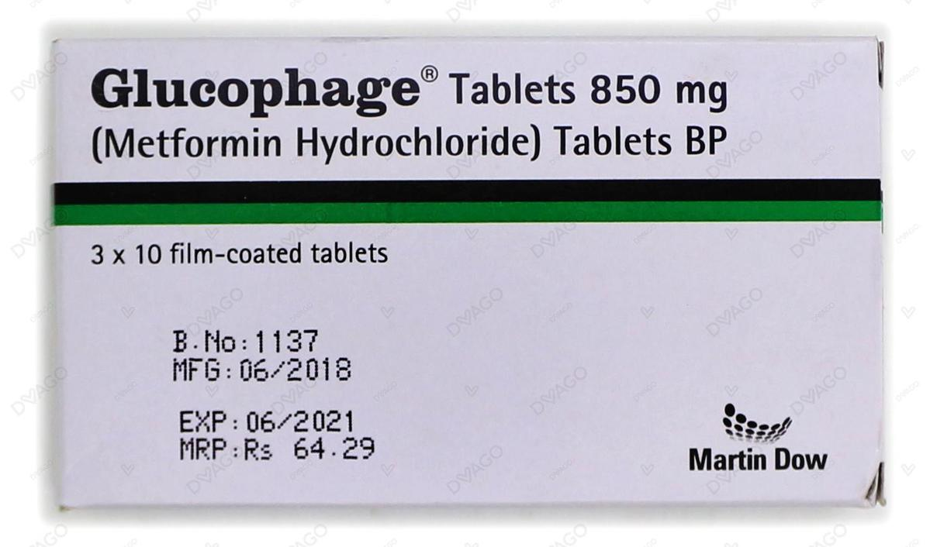
MANAGEMENT:
Vertical Integration
Metformin: improves insulin sensitivity doesn’t cause hypoglycemia doesn’t cause weight gain First line for obese patients in T2DM also used in PCOS (polycystic ovarian syndrome) and NAFLD (non alcoholic fatty liver disease) side effects→ GI upset, lactic acidosis with liver or kidney disease contraindications→ renal failure( stop if Cr >150 umol/L), hepatic failure, heart failure, within 6 weeks of MI, before IV contrast, stop 2 days before general anesthesia

Slide 22
MANAGEMENT:
Vertical Integration
Sulfonylureas: insulin secretagogues- increase insulin secretion hypoglycemic episodes weight gain SIADH BMS avoid in pregnancy and lactating mothers
Thiazolidinediones: PPAR gamma receptor agonist increase peripheral insulin sensitivity No hypoglycemic episodes weight gain side effects: fluid retention, derange LFTs, bone fractures, bladder cancer only continue if reduction in HBA1c is >0.5% in 6 months

Slide 23
MANAGEMENT:
Vertical Integration
GLP1 analogs: Glucagon like peptide-1( exenatide, liraglutide) s/c injection, must be given before morning or evening meals. released by small intestine in response to oral glucose load increase insulin secretion results in weight loss
DPP-4 inhibitors: Dipeptidyl peptidase inhibitors( Vildagliptin, sitagliptin) oral, No hypoglycemia, no weight gain side effects: GI upset

Slide 24
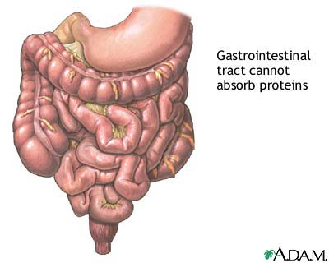
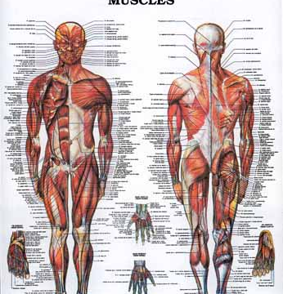
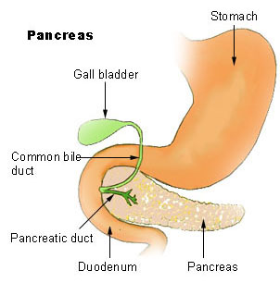
Strategy for Controlling Hyperglycemia
Vertical Integration
Absorption from Diet
Biosynthesis in Liver
α-Glucosidase Inhibitors
Biguanides
Cellular Uptake
Serum Sugar
Biguanides;
thiazolidinediones
Pancreas
Insulin
Sulfonylureas
Meglitinide

Slide 25
NICE treatment algorithm:
Core subject
Usually metformin is first line
if HbA1c remains > 6.5% after 6 months, add sulfonylureas
If patient is at risk of hypoglycemia, then use DPP-4 inhibitor or thiazolidinedione
Meglitinides→ for patients with erratic lifestyle
GLP1 analogs (Exenatide)→ use only when insulin dose is high or patient is obese
If HbA1c > 7.5%, consider insulin

Slide 26
INSULIN:
Core subject
For all patients of T1DM
For those T2DM patients whose HbA1c levels are not within normal range with oral hypoglycemic medications.
Usually commenced if HBA1c >7.5%
Usually start from 0.5-1 units / kg / day with 2/3rd dose given in morning and 1/3rd given in evening.
Eg, for a 72 kg patient, total units would be 36, now 2/3rd of it (24 units) will be given in morning, while 1/3rd of it( 12 units) will be given in evening.
Gradually increment the insulin dose to adjust BSF and BSR at <126 and <200 respectively.

Slide 27
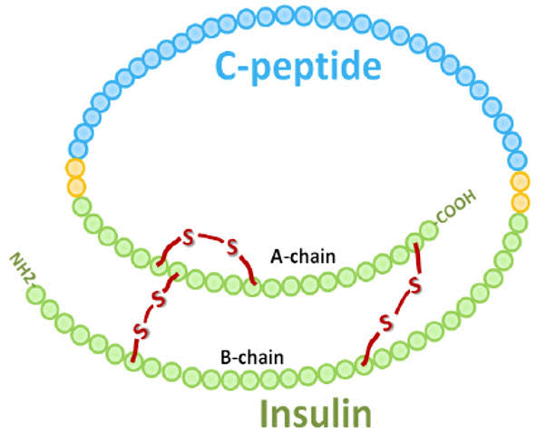
Insulin and Pro-insulin structure:
Spiral integration

Slide 28
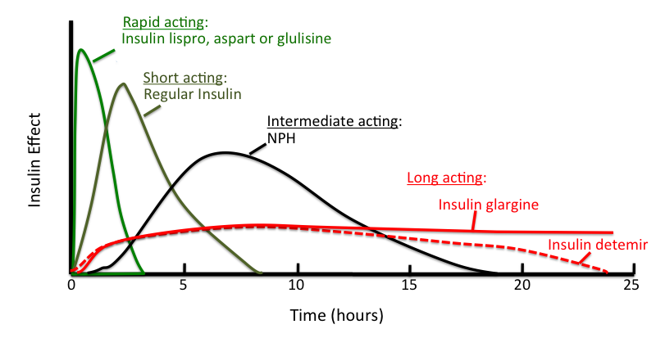
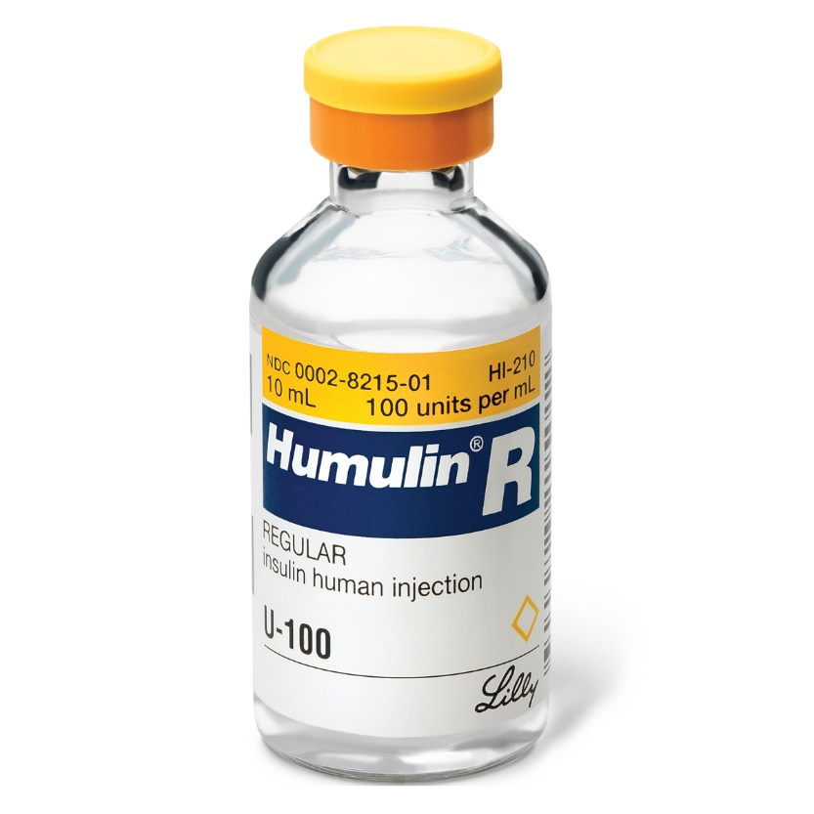
TYPES OF INSULIN:
Vertical Integration
Rapid acting: lispro, aspart, glulycine peak action in 1-1.5 hours
Short acting: regular, semilente peak action 3-4 hours
Intermediate acting: NPH, lente peak action 7-10 hours
Long acting: glargine, detemir, degludec, ultralente peak action 20-22 hours

Slide 29
Core subject
In wards, we generally use insulin regular.
For home management, patients are generally prescribed a combination of short acting with intermediate acting or a combination of short with long acting insulin.
Premixed preparation of insulin are also available like insulin 70/30( 70% NPH, 30% R)

Slide 30
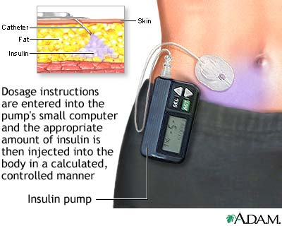
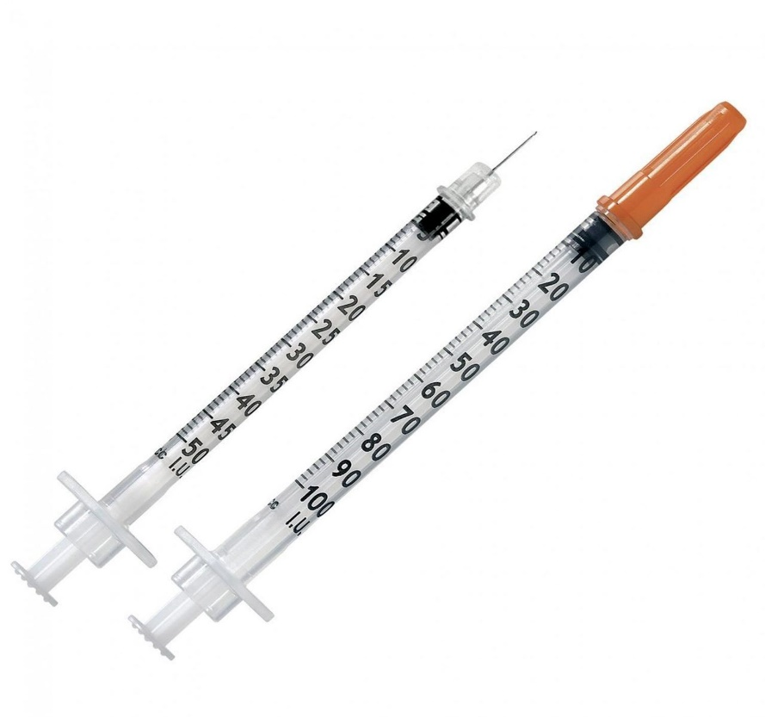
Core subject
Insulin syringe: Available in 1ml, 0.5ml, 0.3ml sizes
Sites of injection: abdomen, thigh, upper arms, flanks, buttock
Recent advancements: insulin pen insulin pumps closed loop systems inhaled insulin
Pancreatic islet transplantation

Slide 31
Core subject

Slide 32
Core subject
Annual eye examination
Annual microalbuminuria
Feet examination
BP monitoring
Lipid profile

Slide 33
Desired outcomes:
Core subject
Relieve symptoms
Reduce mortality
Improve quality of life
Reduce the risk of microvascular and macrovascular disease complications
Macrovascular complications:
Coronary heart disease, stroke and peripheral vascular disease
Microvascular Complications:
Retinopathy, nephropathy and neuropathy

Slide 34
MCQ1
Which of following confirmed values meet diagnostic threshold for Diabetes?
a)Fasting blood glucose <140mg/dl
b)Random glucose > 160mg/dl
c)2 hours post prandial glucose 126mg/dl
d)Fasting blood glucose ≥ 126mg/dl
e)HBA1C > 6

Slide 35
Answer 1
Option d

Slide 36
MCQ 2
What is the first line drug for type 2 diabetes and obesity?
a) Acarbose
b) Metformin
c) Sulphonylureas
d) Insulin
e) Sitagliptin

Slide 37
Answer 2
b

Slide 38
Researchers and References
Vertical integration
https://emedicine.medscape.com/article/117853-overview
https://pubmed.ncbi.nlm.nih.gov/31855345/
https://www.uptodate.com/contents/table-of-contents/endocrinology-and-diabetes/diabetes-mellitus
https://www.nice.org.uk/guidance/ng3
Davidson’s Principles and Practice of Medicine
The Oxford Textbook of Medicine
Medical Diagnosis and Treatment 2022
Harrison’s Principles of Internal Medicine

