Slide 1


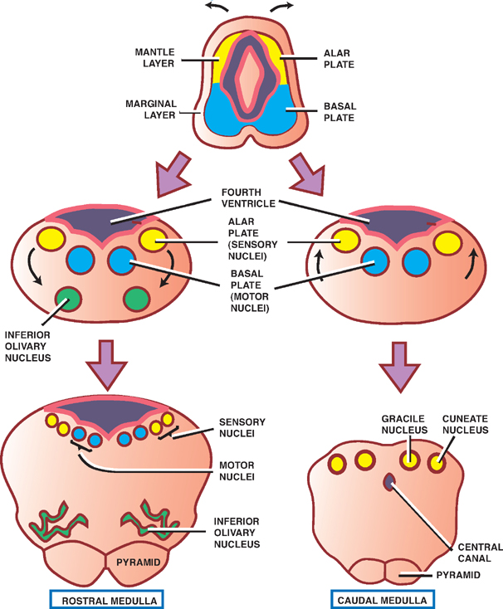
Central Nervous System Module -I
2nd Year MBBS(LGIS)
Development of Spinal Cord
Presenter: Prof.Dr. Ifra Saeed Date: 00-00-25

Slide 2
Prof. Umar’s Model of Teaching Strategy
Self Directed Learning Assessment Program
Objectives :To cultivate critical thinking, analytical reasoning, and problem-solving competencies.
To instill a culture of self-directed learning, fostering lifelong learning habits and autonomy.
First Ten Minutes
How to Assess?
Ten randomly selected students will be evaluated within the first 10 minutes of the lecture through 10 multiple-choice questions (MCQs) based on the PowerPoint presentation shared on Students Official WhatsApp group, one day before the teaching session.
The number of MCQs from the components of the lecture will follow the guidelines outlined in the Prof. Umar model of Integrated Lecture.
Component of LGIS | Core Knowledge | Horizontal Integration | Vertical Integration | Spiral Integration
No of MCQs | 6-7 | 1-2 | 1 | 1

Slide 3
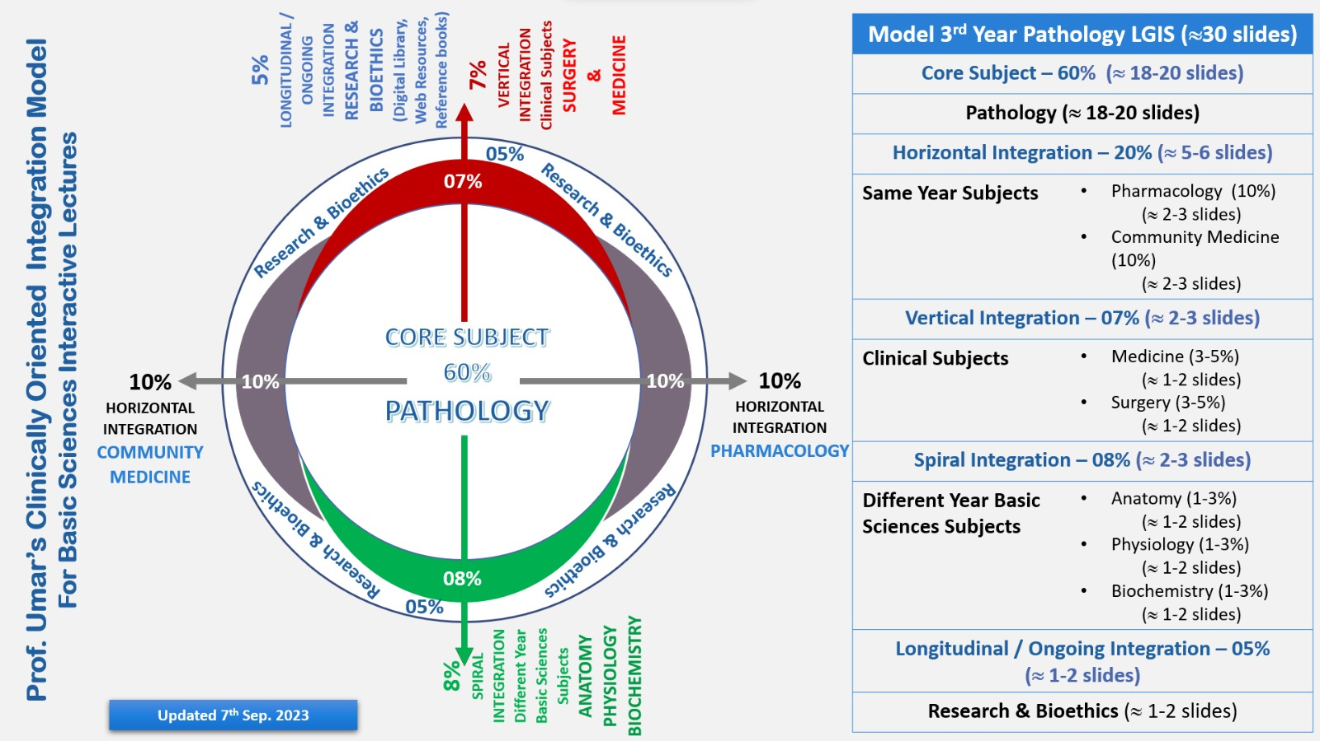
Professor Umar Model of Integrated Lecture

Slide 4
Motto Vision; ThDream/Tomorrow
To impart evidence based research oriented medical education
To provide best possible patient care
To inculcate the values of mutual respect and ethical practice of medicine
Wisdom
Truth
Service

Slide 5
Learning Objectives
At the end of the session, student will be able to
Describe development of Spinal Cord
Discuss process of histogenesis
Discuss congenital abnormalities associated with spinal cord
Integrate physiological and biochemical aspects with development of Spinal Cord
Approach towards patient of spina bifida
Correlate and build core knowledge on the basis of latest research
Bioethics related to spina bifida

Slide 6
Development of Spinal Cord
Core Concept

Slide 7
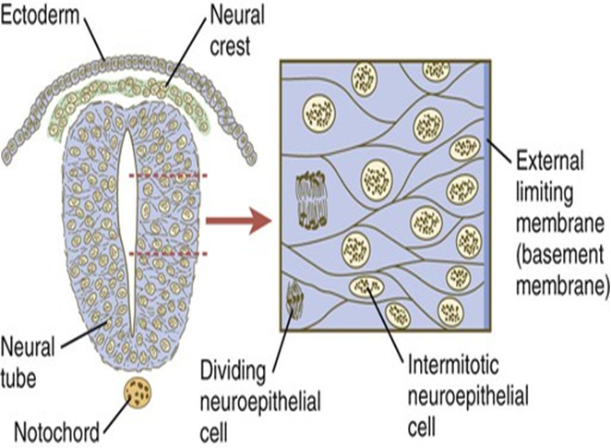

Development on Mantle, Marginal layers
The neural tube caudal to the fourth pair of somites develops into the spinal cord
The lateral walls of the neural tube thicken, gradually reducing the size of the neural canal until only a minute central canal of the spinal cord is present at 9 to 10 weeks
Initially, the wall of the neural tube is composed of a thick, pseudostratified, columnar neuroepithelium.
Core Concept

Slide 8
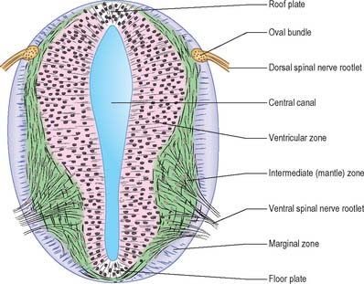
These neuroepithelial cells constitute the ventricular zone (ependymal layer), which gives rise to all neurons and macroglial cells (macroglia) in the spinal cord
Macroglial cells includes astrocytes and oligodendrocytes.
Soon a marginal zone composed of the outer parts of the neuroepithelial cells becomes recognizable
This zone gradually becomes the white matter (substance) of the spinal cord as axons grow into it from nerve cell bodies in the spinal cord, spinal ganglia, and brain.

Slide 9
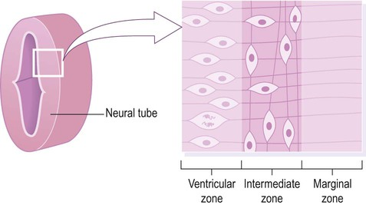

Slide 10

Some dividing neuroepithelial cells in the ventricular zone differentiate into primordial neurons-neuroblasts.
These embryonic cells form an intermediate zone (mantle layer) between the ventricular and marginal zones. Neuroblasts become neurons as they develop cytoplasmic processes

Slide 11
White matter
The outermost layer of the spinal cord, the marginal layer, contains nerve fibers emerging from neuroblasts in the mantle layer.
As a result of myelination of nerve fibers, this layer takes on a white appearance

Slide 12
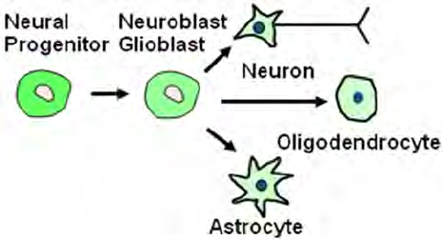
The primordial supporting cells of the central nervous system-glioblasts (spongioblasts)-differentiate from neuroepithelial cells, mainly after neuroblast formation has ceased.
The glioblasts migrate from the ventricular zone into the intermediate and marginal zones.
Some glioblasts become astroblasts and later astrocytes, whereas others become oligodendroblasts and eventually oligodendrocytes

Slide 13
When the neuroepithelial cells cease producing neuroblasts and glioblasts, they differentiate into ependymal cells, which form the ependyma (ependymal epithelium) lining the central canal of the spinal cord. Sonic hedgehog signaling controls the proliferation, survival, and patterning of neuroepithelial progenitor cells by regulating Gli transcription factors.

Slide 14
Layers of the early neural tube wall
Spinal cord
Ventricular zone(neuroepithelial layer)
  Give rise to Ependymal cells, which line the central canal
  Cells migrate into intermediate layer
  Give rise to all neurons and glial cell of spinal cord.(SC)
Intermediate zone (mantle layer)
  Consist of neuron and glial cells of the gray matter of SC
  Contain the developing alar and basal plates
Marginal zone
  Contain nerve fibers of the neuroblasts of the mantle layer and glial cells
  Forms white matter of SC through myelination of axons

Slide 15
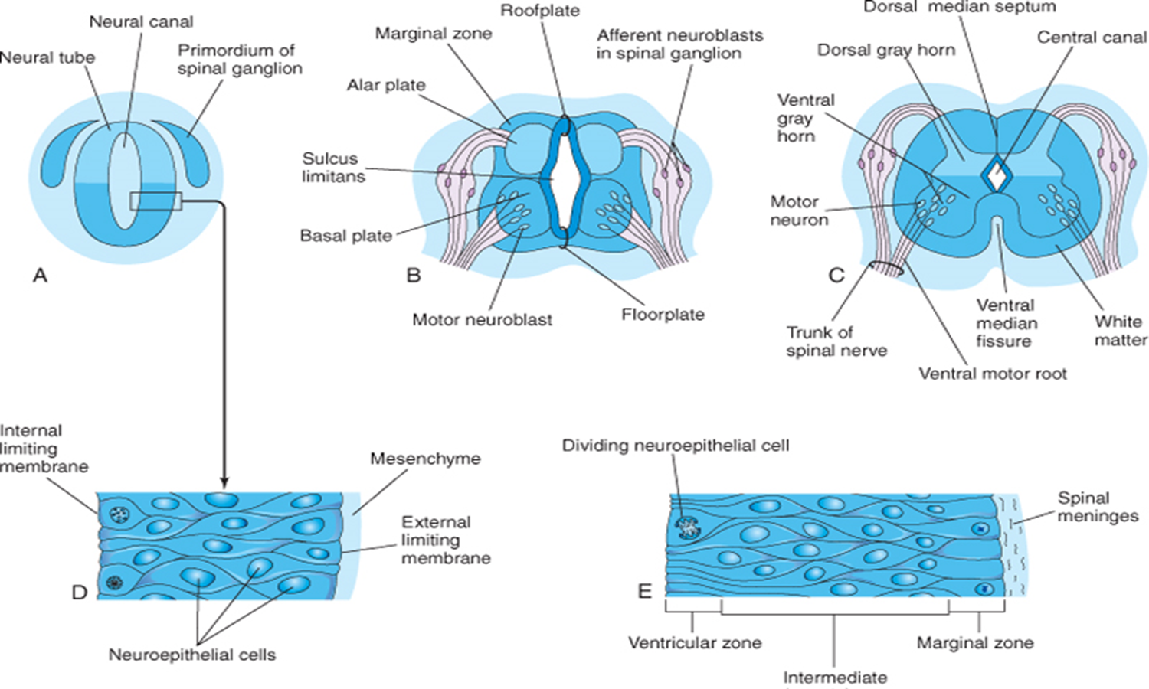
Proliferation and differentiation of neuroepithelial cells in the developing spinal cord produce thick walls and thin roof- and floor-plates
Differential thickening of the lateral walls of the spinal cord soon produces a shallow longitudinal groove on each side-the sulcus limitans
This groove separates the dorsal part, the alar plate (lamina), from the ventral part, the basal plate (lamina).

Slide 16
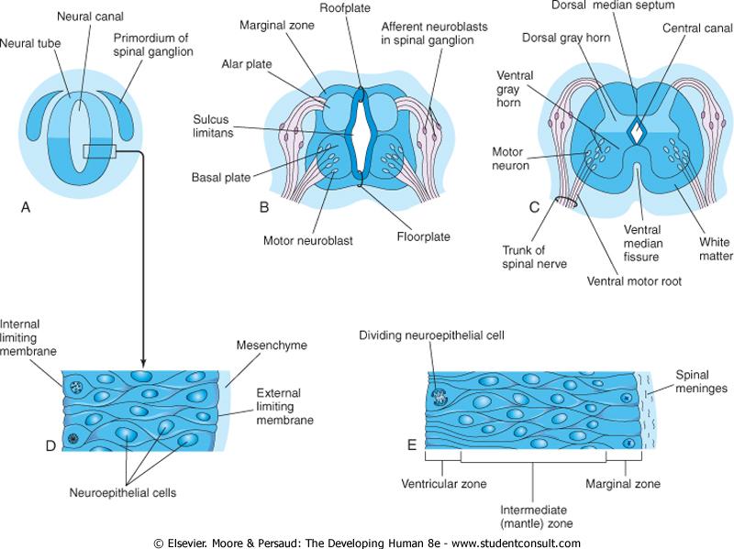
Basal, Alar, Roof and Floor plates

Slide 17
Basal, Alar, Roof and Floor plates
The alar and basal plates produce longitudinal bulges extending through most of the length of the developing spinal cord. This regional separation is of fundamental importance because the alar and basal plates are later associated with afferent and efferent functions, respectively.

Slide 18
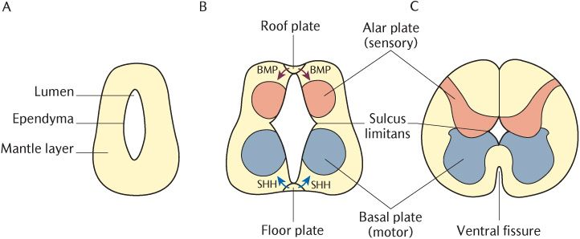
Basal, Alar, Roof and Floor plates

Slide 19
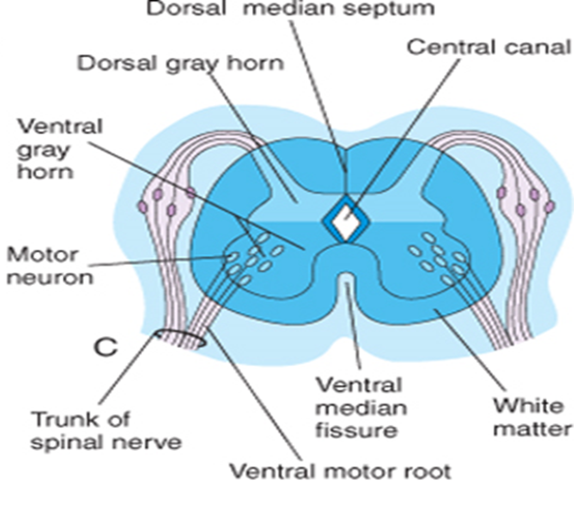
Dorsal and ventral gray column
Cell bodies in the alar plates form the dorsal gray columns that extend the length of the spinal cord.
Neurons in these columns constitute afferent nuclei, and groups of these nuclei form the dorsal gray columns
Cell bodies in the basal plates form the ventral and lateral gray columns.

Slide 20
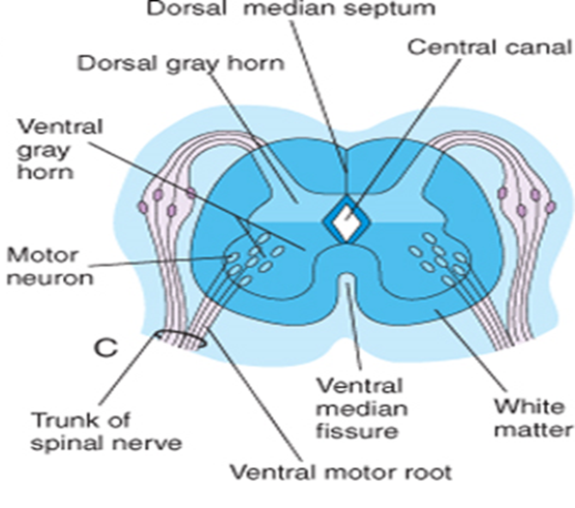
Spinal Nerves
Axons of ventral horn cells grow out of the spinal cord and form the ventral roots of the spinal nerves.
As the basal plates enlarge, they bulge ventrally on each side of the median plane.
As this occurs, the ventral median septum forms, and a deep longitudinal groove-the ventral median fissure-develops on the ventral surface of the spinal cord

Slide 21
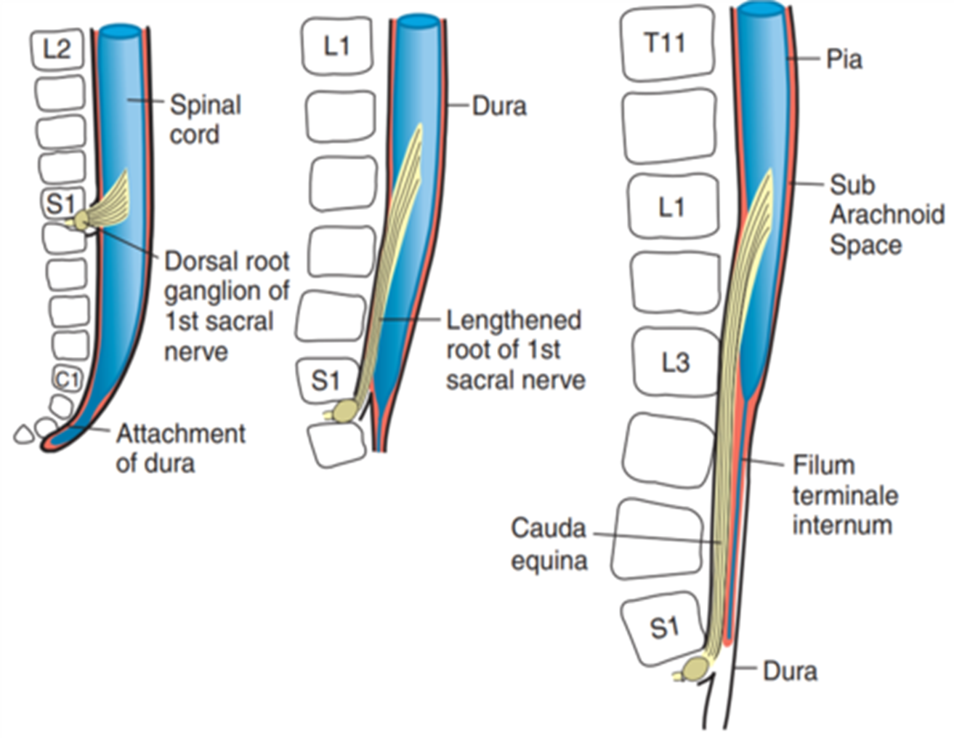
Positional changes
The spinal cord in the embryo extends the entire length of the vertebral canal
The spinal nerves pass through the intervertebral foramina opposite their levels of origin.

Slide 22

Positional Changes
Because the vertebral column and dura mater grow more rapidly than the spinal cord, this positional relationship to the spinal nerves does not persist.
The caudal end of the spinal cord gradually comes to lie at relatively higher levels.
In a 6-month-old fetus, it lies at the level of the first sacral vertebra

Slide 23

The spinal cord in the newborn terminates at the level of the second or third lumbar vertebra

Slide 24
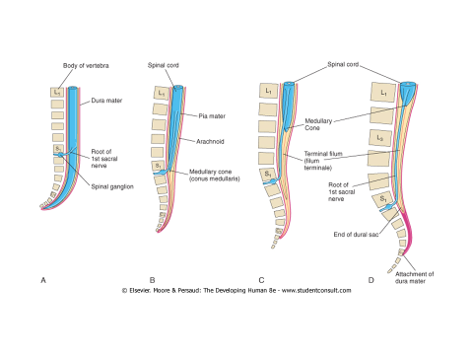
Positional Changes
8 week
24 weeks
Newborn

Slide 25
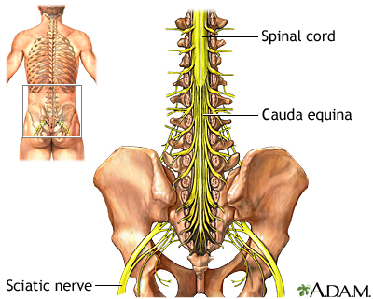
Cauda Equina
The spinal cord in the adult usually terminates at the inferior border of the first lumbar vertebra).
As a result, the spinal nerve roots, especially those of the lumbar and sacral segments, run obliquely from the spinal cord to the corresponding level of the vertebral column.
The nerve roots inferior to the end of the cord-the medullary cone. conus medullaris-form a bundle of spinal nerve roots, the cauda equine

Slide 26
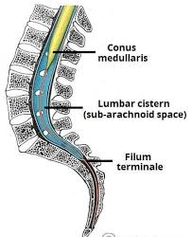
Filum Terminale
Although the dura mater and arachnoid mater usually end at S2 vertebra in adults, the pia mater does not. Distal to the caudal end of the spinal cord, the pia mater forms a long fibrous thread, the terminal filum (L. filum terminale)
This thread extends from the medullary cone and attaches to the periosteum of the first coccygeal vertebra

Slide 27
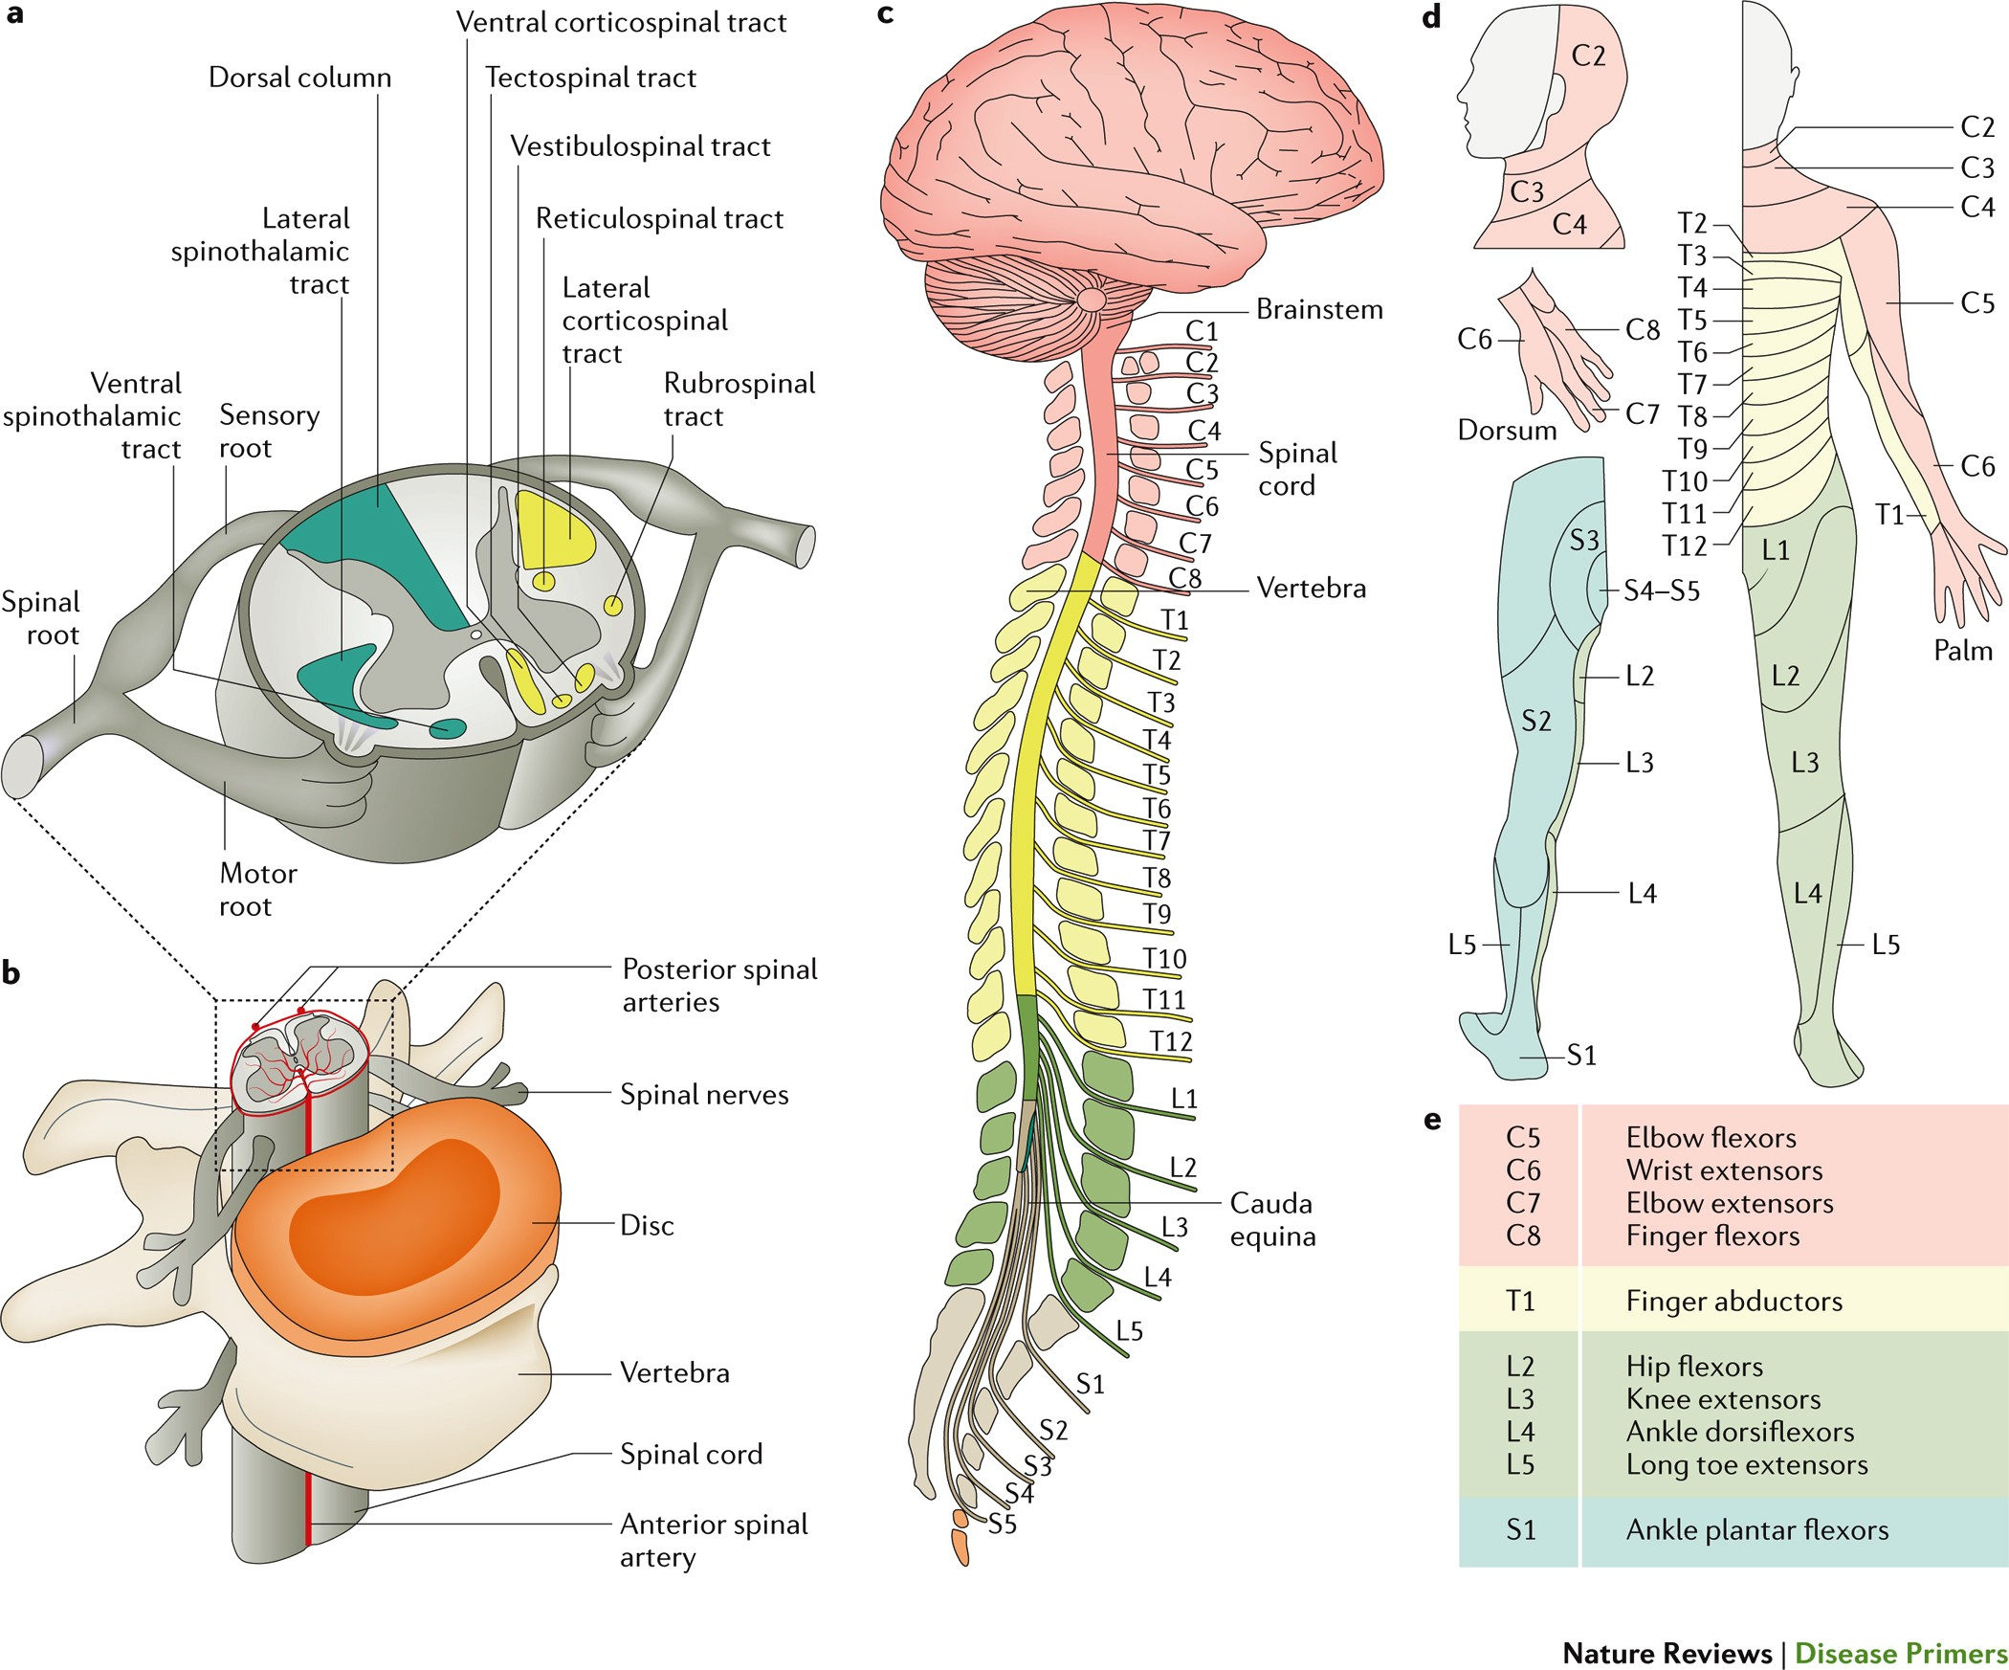
Physiological aspects of spinal cord
Horizontal Integration

Slide 28
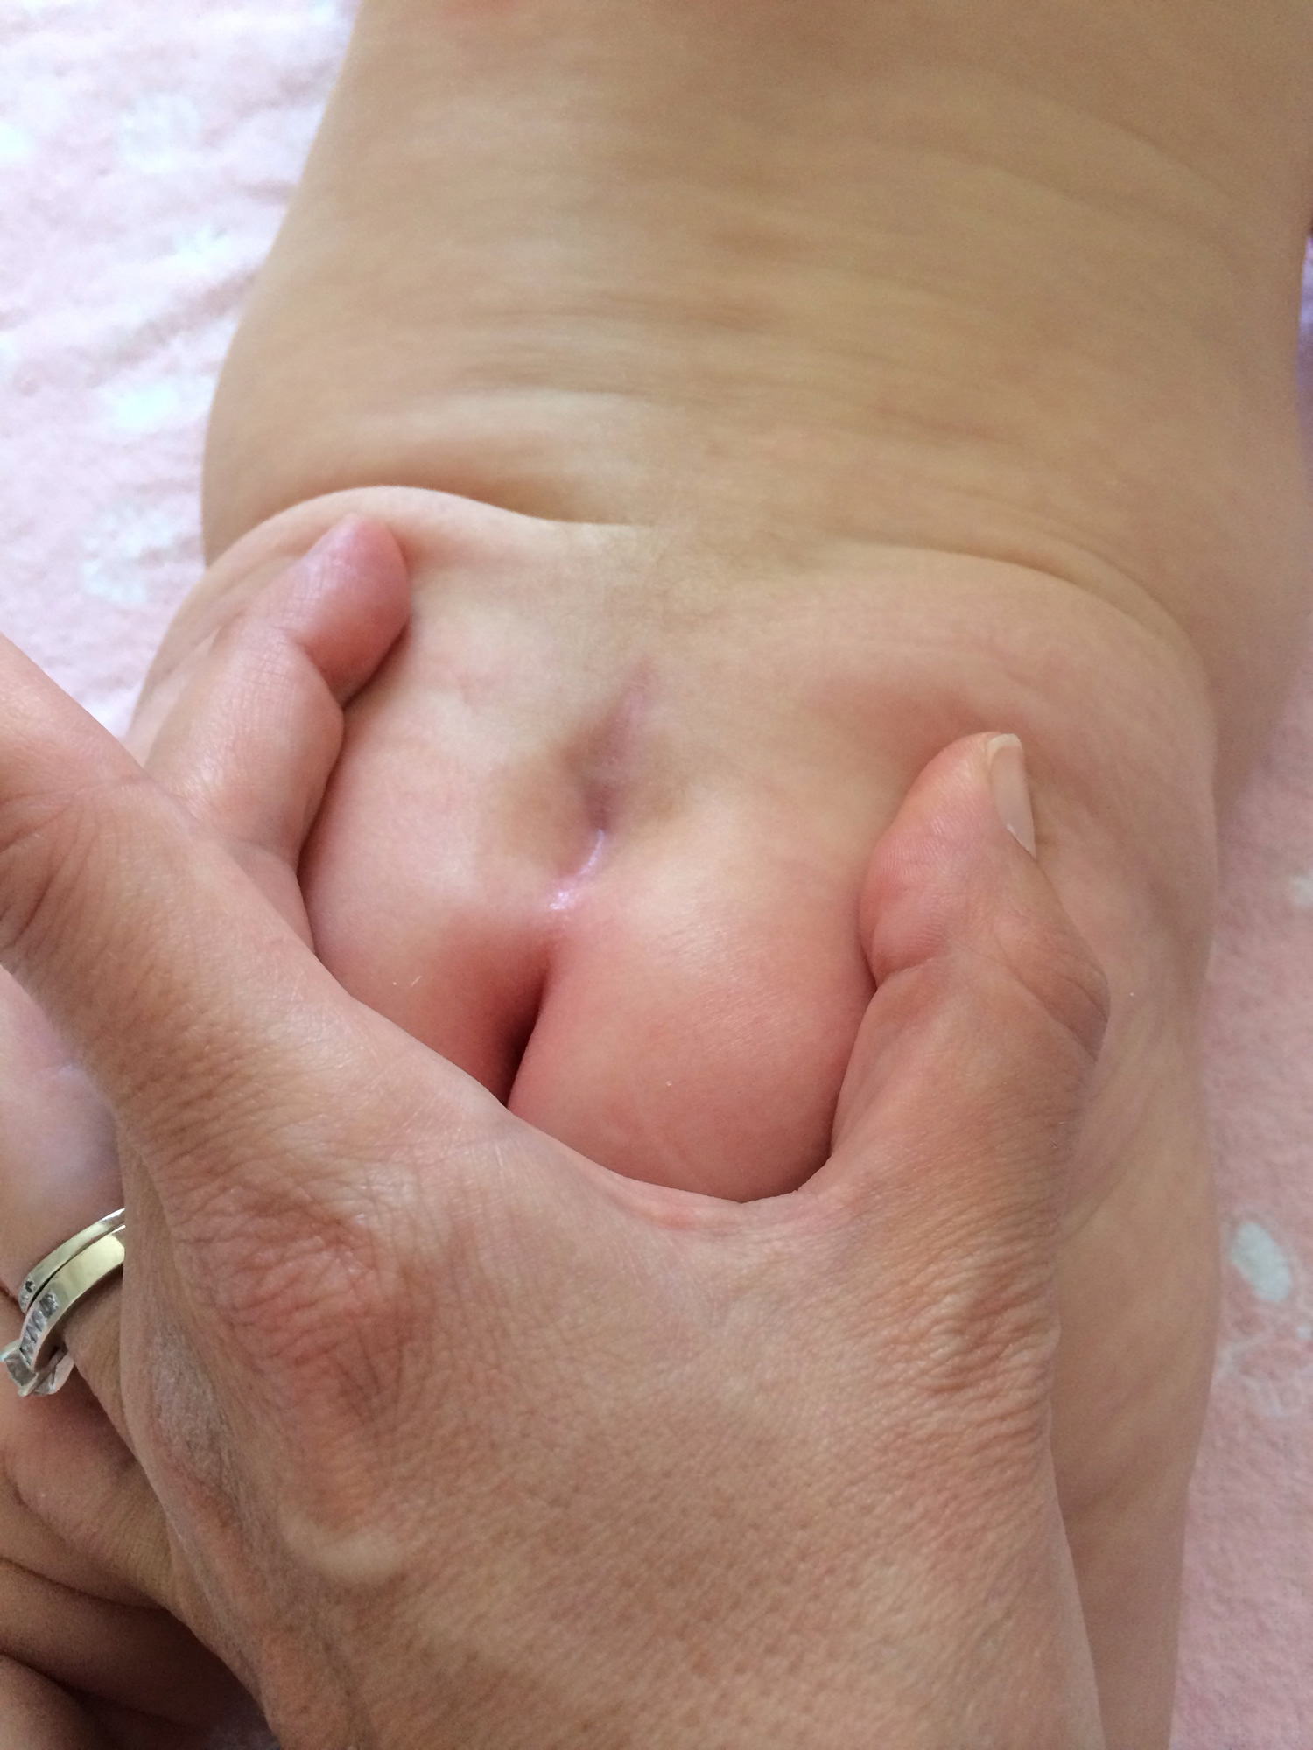
Spinal Dermal Sinus
A posterior skin dimple in the median plane of the sacral region of the back may be associated with a spinal dermal sinus
The dimple indicates the region of closure of the caudal neuropore at the end of the fourth week.
In some cases, the dimple is connected with the dura mater by a fibrous cord
Vertical integration

Slide 29
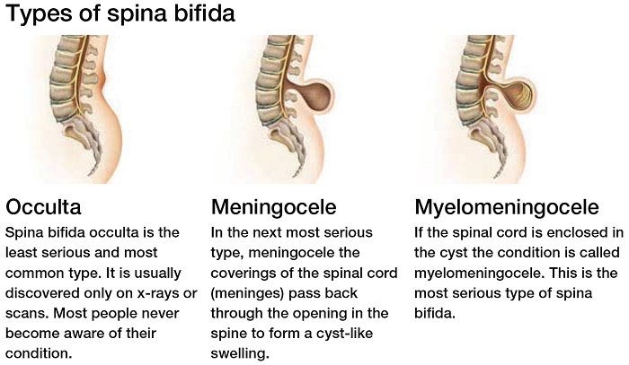


Slide 30
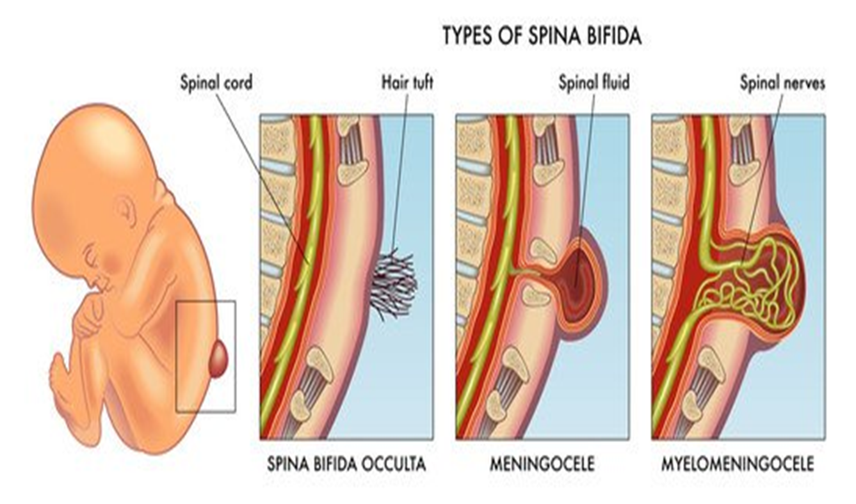


Slide 31
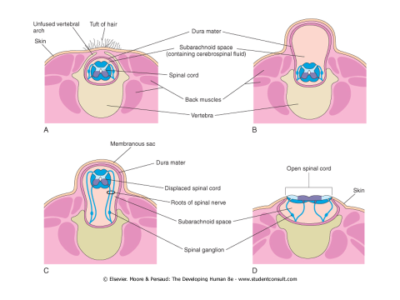
Myeloschisis
This is the most severe type of spina bifida. In these cases, the spinal cord in the affected area is open because the neural folds failed to fuse
As a result, the spinal cord is represented by a flattened mass of nervous tissue.
Spina bifida with myeloschisis may result from an NTD that is caused by a local overgrowth of the neural plate. As a result, the caudal neuropore fails to close at the end of the fourth week.

Slide 32
Disability or death: a focused review of informed consent in pediatric neurosurgery
The “death or disability” paradigm represents a common challenge to informed consent in pediatric neurosurgery. Patient, family, and societal factors vary and sometimes conflict. Pediatric neurosurgeons must use a comprehensive approach to best mitigate the limitations inherent to the informed consent process in the context of this paradigm.
Reference: Shlobin NA, Kolcun JP, Leland BD, Ackerman LL, Lam SK, Raskin JS. Disability or death: a focused review of informed consent in pediatric neurosurgery. InSeminars in pediatric neurology 2023 Apr 1 (Vol. 45, p. 101030). WB Saunders.
Spiral Integration
Bioethics

Slide 33

Access and Utilization of Health Care by Adults with Spina Bifida
Persons with congenital genitourinary conditions (CGC) such as spina bifida (SB) face many obstacles when transitioning from a dependent child to an independent adult.
In addition to the challenge of developing self-management skills, there are systems-based issues inherent in the transition from child-centered, family-based care to independent management of medical issues.
The benefits gained over many years of comprehensive care delivered during childhood may be compromised by the lack of services, lack of expertise among adult health care providers, and lack of experience in navigating the health system outside of the pediatric setting.
Reference:Lai LY, Lopez AD, Copp HL, Baradaran N, Breyer BN, Allen IE, Hampson LA. Access and Utilization of Health Care by Adults with Spina Bifida. Urology. 2023 Nov 1;181:174-81.
Family Medicine

Slide 34
Antibiotic Overtreatment of Presumed Urinary Tract Infection Among Children with Spina Bifida
Among 236 encounters, overtreatment occurred in 80% of cases in which antibiotics were initiated (47% of the entire cohort). Pyuria with <2 urologic symptoms was the most important factor associated with overtreatment.
Overtreatment of presumed UTI among patients with spina bifida was common. Pyuria, which is not specific to UTI in this population, was the main driver of overtreatment.
Symptoms are a cornerstone of UTI diagnosis among children with spina bifida, should be collected in a standardized manner, and considered in a decision to treat.
Reference: Kucherov V, Russell T, Smith J, Zimmermann S, Johnston EK, Rana MS, Hill E, Ho CP, Pohl HG, Varda BK. Antibiotic Overtreatment of Presumed Urinary Tract Infection Among Children with Spina Bifida. The Journal of Pediatrics. 2024 Sep 1;272:114092.
Research

Slide 35
Deep Learning of Videourodynamics to Classify Bladder Dysfunction Severity in Patients With Spina Bifida
Our deep learning models built from the urodynamics volume-pressure relationships and fluoroscopic images were able to automatically classify bladder dysfunction severity. Retrospective and prospective studies performed at other institutions are needed to validate our models, but in the future these models could influence clinical decision-making by extracting informative features from VUDS (video uro dynamics) studies that would not otherwise be available to clinicians.
Reference: Weaver JK, Martin-Olenski M, Logan J, Broms R, Antony M, Van Batavia J, Weiss DA, Long CJ, Smith AL, Zderic SA, Huang J. Deep learning of videourodynamics to classify bladder dysfunction severity in patients with spina bifida. The Journal of Urology. 2023 May;209(5):994-1003.
Artificial Intelligence

