Slide 1


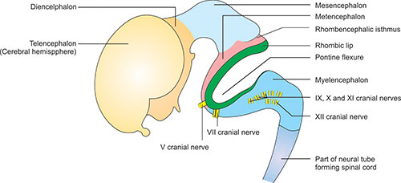
Central Nervous System Module - I
2nd Year MBBS(LGIS)
Development of Rhombencephalon
Presenter: Prof.Dr. Ifra Saeed Date: 00-00-25

Slide 2
Prof. Umar’s Model of Teaching Strategy
Self Directed Learning Assessment Program
Objectives :To cultivate critical thinking, analytical reasoning, and problem-solving competencies.
To instill a culture of self-directed learning, fostering lifelong learning habits and autonomy.
First Ten Minutes
How to Assess?
Ten randomly selected students will be evaluated within the first 10 minutes of the lecture through 10 multiple-choice questions (MCQs) based on the PowerPoint presentation shared on Students Official WhatsApp group, one day before the teaching session.
The number of MCQs from the components of the lecture will follow the guidelines outlined in the Prof. Umar model of Integrated Lecture.
Component of LGIS | Core Knowledge | Horizontal Integration | Vertical Integration | Spiral Integration
No of MCQs | 6-7 | 1-2 | 1 | 1

Slide 3
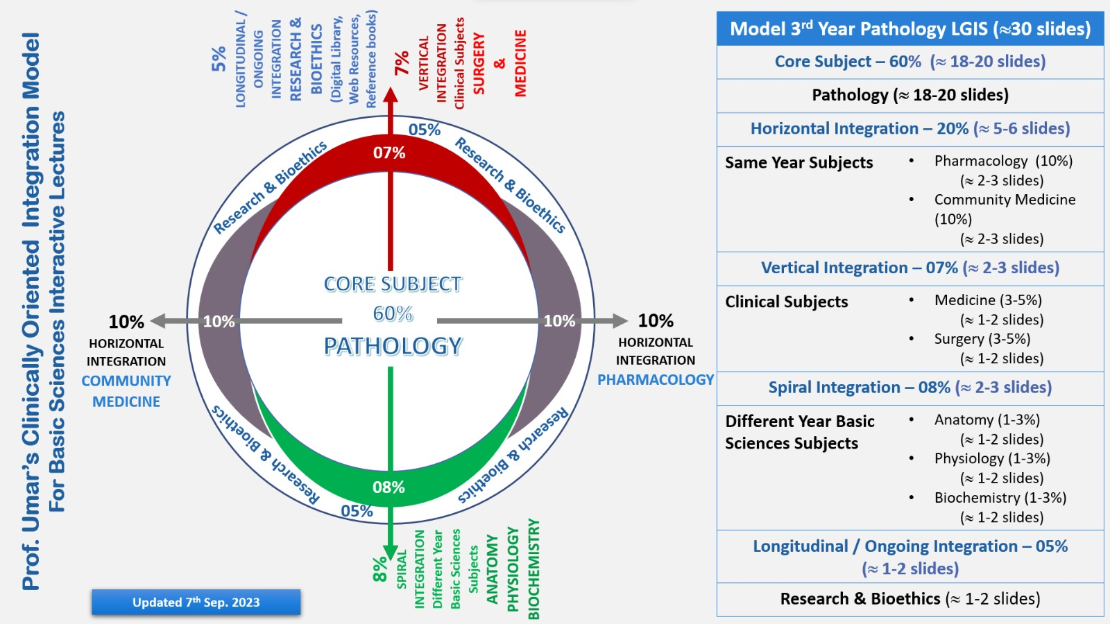
Professor Umar Model of Integrated Lecture

Slide 4
Motto Vision; ThDream/Tomorrow
To impart evidence based research oriented medical education
To provide best possible patient care
To inculcate the values of mutual respect and ethical practice of medicine
Wisdom
Truth
Service

Slide 5
Learning Objectives
At the end of the session, student will be able to
Describe development of Rhombencephalon
Discuss congenital abnormalities associated with hind brain
Integrate physiological and biochemical aspects with development of hind brain
Approach towards patient of Early Onset Parkinsonosm
Correlate and build core knowledge on the basis of latest research
Bioethics related to Parkinsonism

Slide 6
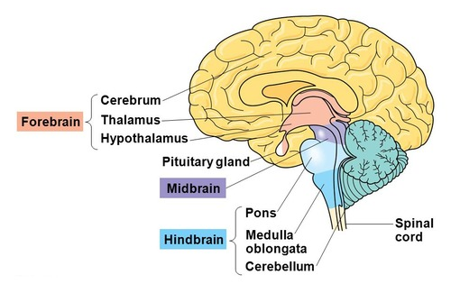
Parts of Brain
Core Concept

Slide 7

Development of Neural Tube

Slide 8
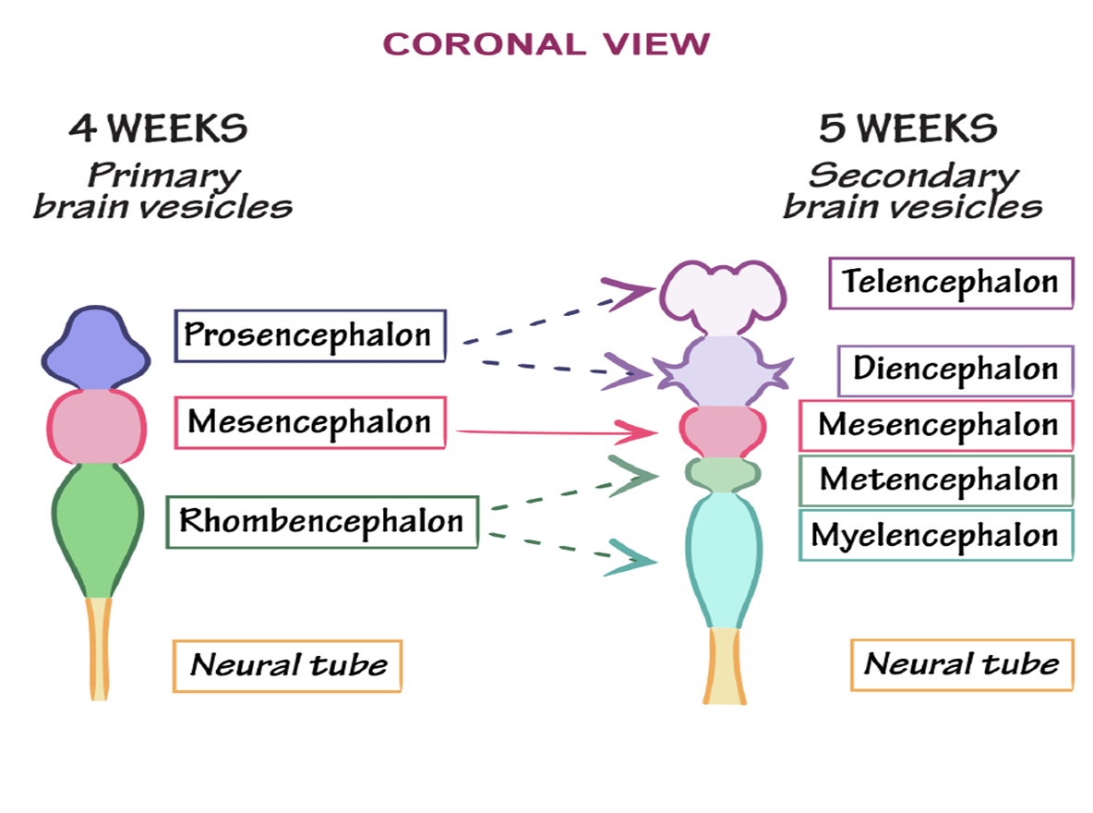
Stages of neural tube development
  3 Primary brain during the fourth week
  Prosencephalon ( forebrain)
      Telencephalon
      Diencephalon
    Mesencephalon (midbrain) )
    Rhombencephalon (hindbrain )
      Metencephalon (pones & cerebellum)
      Myelencephalon (medulla oblongata )

Slide 9


Slide 10
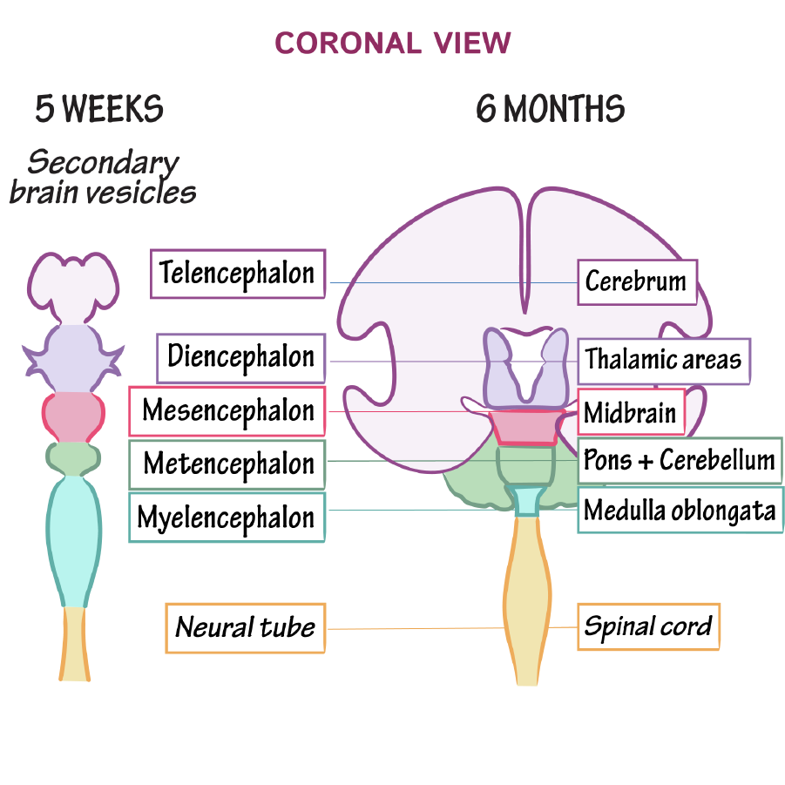

Slide 11
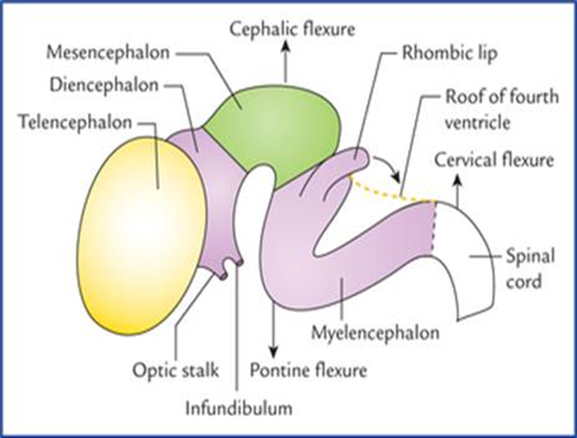
Flexures
Cervical flexure
  b/w rhombencephalon & spinal cord
Cephalic flexure (midbrain flexure )
  b/w the prosencephalon & rhombencephalon
Rhombencephalic isthmus
  Separates the mesencephalon from rhombencephalon
Pontine flexure (b/w Metencephalon and Myelencephalon

Slide 12
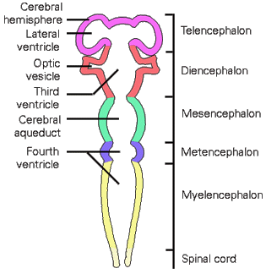

Slide 13
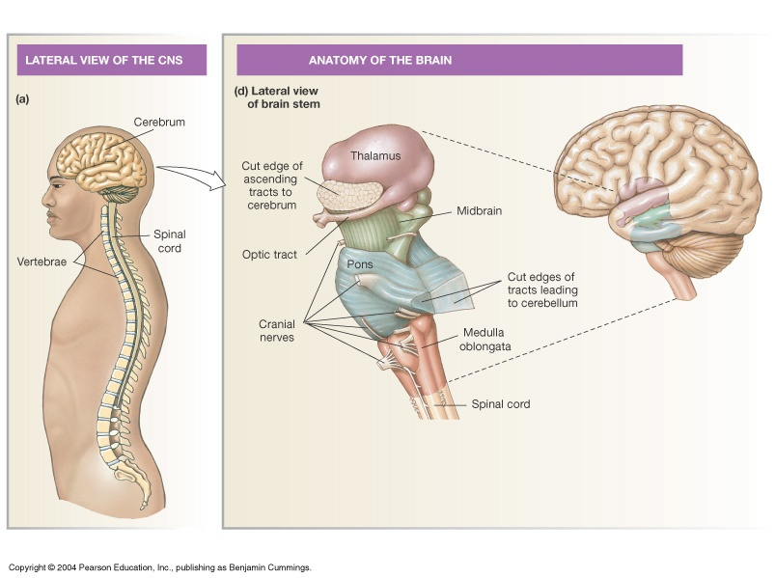
Brain Stem Overview: Midbrain, Pons & Medulla

Slide 14
RHOMBENCEPHALON
HIND BRAIN
MYELENCEPHALON
METENCEPHALON

Slide 15
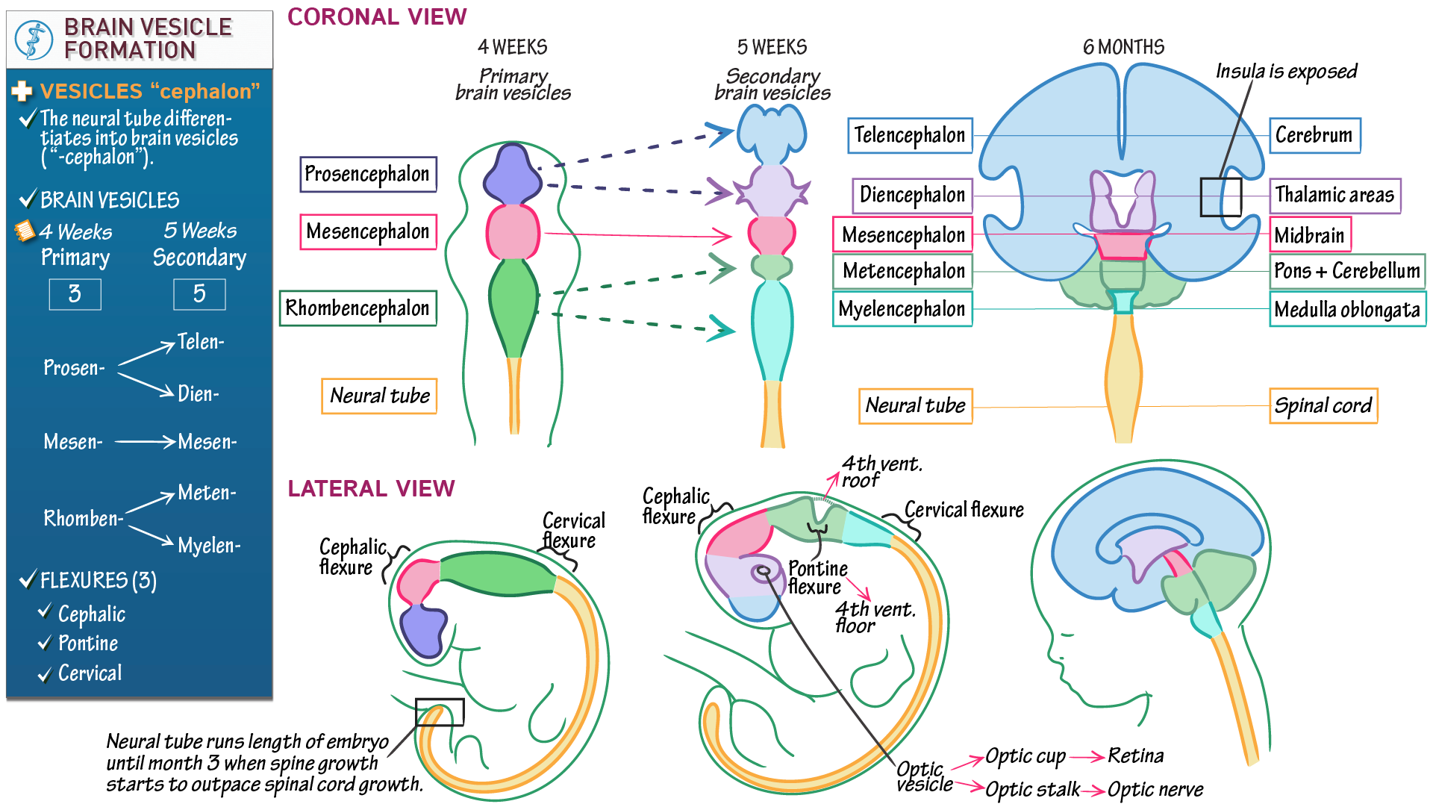
Myelencephalon
During the fifth week, the forebrain partly divides into two secondary brain vesicles,
the midbrain does not divide
the hindbrain partly divides into the metencephalon and myelencephalon

Slide 16
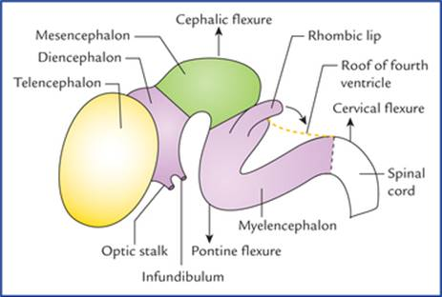
Cephalic and Cervical Flexures
Unequal growth of the brain produces the pontine flexure in the opposite direction. This flexure results in thinning of the roof of the hindbrain.

Slide 17
Initially, the primordial brain has the same basic structure as the developing spinal cord
the brain flexures produce considerable variation in the outline of transverse sections at different levels of the brain and in the position of the gray and white matter (substance).
The sulcus limitans extends cranially to the junction of the midbrain and forebrain
The alar and basal plates are recognizable only in the midbrain and hindbrain

Slide 18
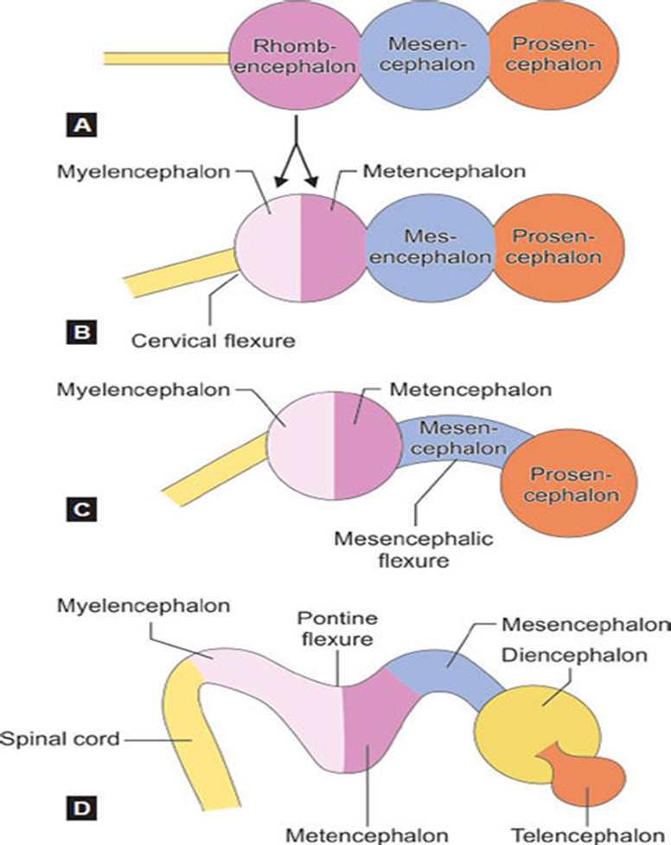
Hindbrain
The pontine flexure, located in the future pontine region, divides the hindbrain into caudal (myelencephalon) and rostral (metencephalon) parts.
The cavity of the hindbrain becomes the fourth ventricle and the central canal in the medulla.

Slide 19
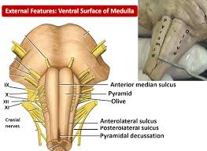
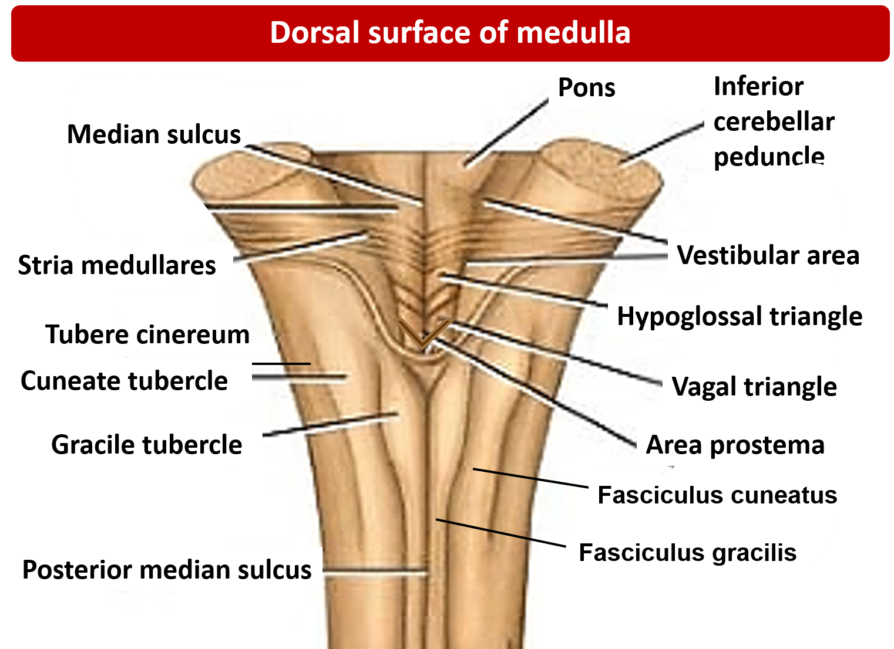
Myelencephalon (Medulla Oblongata)
The caudal part of the myelencephalon (closed part of medulla) resembles the spinal cord, both developmentally and structurally .
The neural canal of the neural tube forms the small central canal of the myelencephalon.

Slide 20
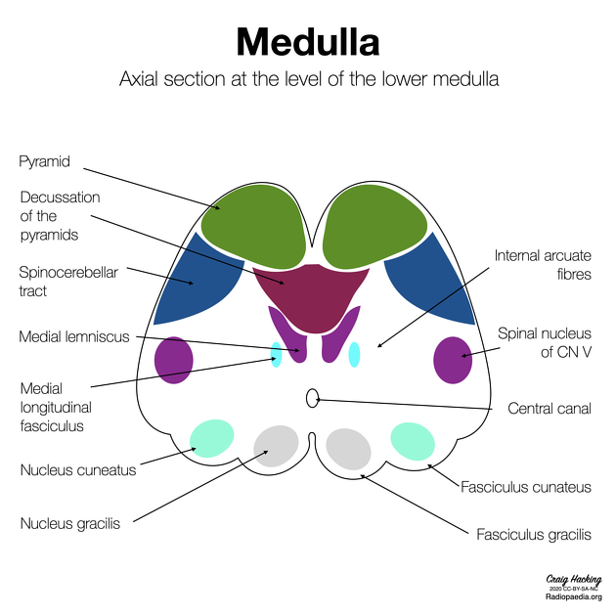
Development of Medulla Oblongata
Neuroblasts from the alar plates in the myelencephalon migrate into the marginal zone and form isolated areas of gray matter-the gracile nuclei medially and the cuneate nuclei laterally.
These nuclei are associated with correspondingly named tracts
The ventral area of the medulla contains a pair of fiber bundles-the pyramids

Slide 21
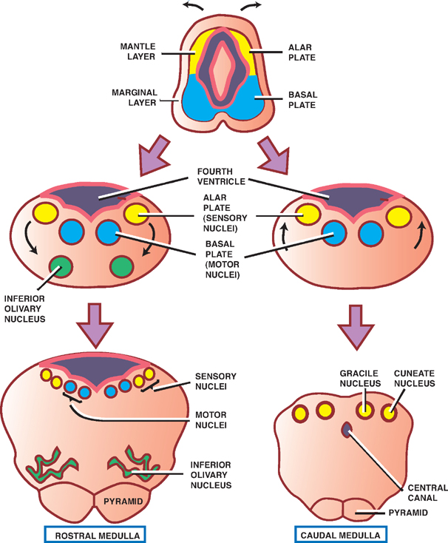

Development of Medulla Oblongata

Slide 22

Rostral Part of Medulla Oblongata
The rostral part of the myelencephalon ("open" part of medulla) is wide and rather flat,
The pontine flexure causes the lateral walls of the medulla to move laterally like the pages of an open book. As a result, its roof plate is stretched and greatly thinned.

Slide 23

Rostral Part of Medulla Oblongata
In addition, the cavity of this part of the myelencephalon (part of future fourth ventricle) becomes somewhat rhomboidal (diamond shaped).
As the walls of the medulla move laterally, the alar plates come to lie lateral to the basal plates.
As the positions of the plates change, the motor nuclei generally develop medial to the sensory nuclei

Slide 24
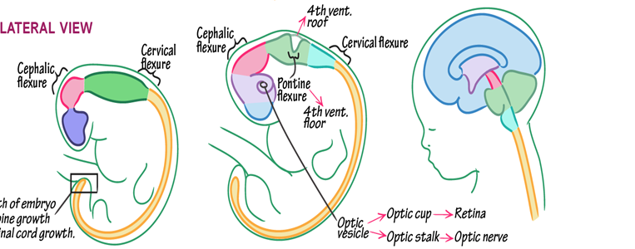
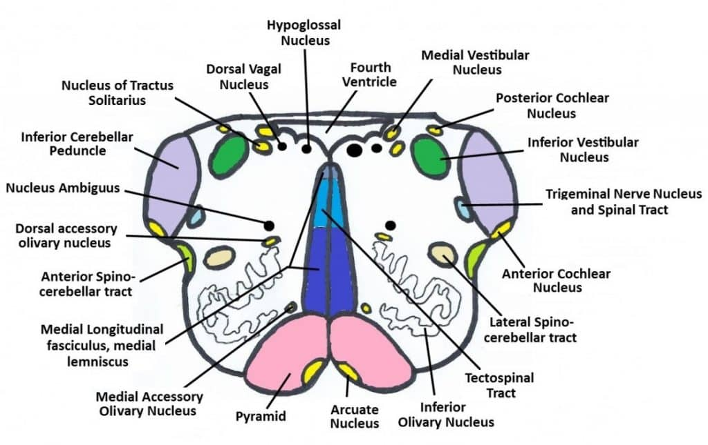
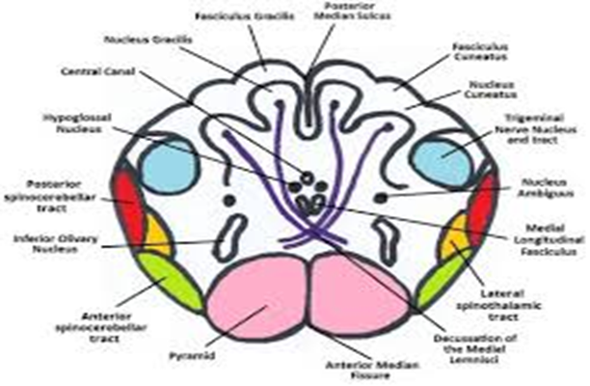

Slide 25
Physiological Aspects of Medulla Oblongata
Neuroblasts in the basal plates of the medulla, form nuclei (groups of nerve cells) and organize into three cell columns on each side
Medial to lateral, they are:
The general somatic efferent, represented by neurons of the hypoglossal nerve
The special visceral efferent, represented by neurons innervating muscles derived from the pharyngeal arches
The general visceral efferent, represented by some neurons of the vagus and glossopharyngeal nerves
Horizontal Integration

Slide 26

Neuroblasts in the alar plates of the medulla form neurons that are arranged in four columns on each side. From medial to lateral, they are:
The general visceral afferent receiving impulses from the viscera
The special visceral afferent receiving taste fibers
The general somatic afferent receiving impulses from the surface of the head
The special somatic afferent receiving impulses from the ear

Slide 27
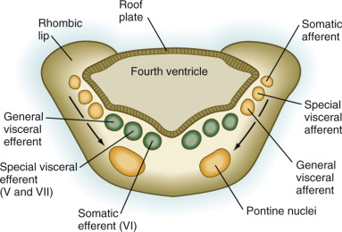

Metencephalon (Pons and Cerebellum)
The walls of the metencephalon form the pons and cerebellum, and the cavity of the metencephalon forms the superior part of the fourth ventricle
The pontine flexure causes divergence of the lateral walls of the pons, which spreads the gray matter in the floor of the fourth ventricle).
Neuroblasts in each basal plate develop into motor nuclei and organize into three columns on each side.

Slide 28
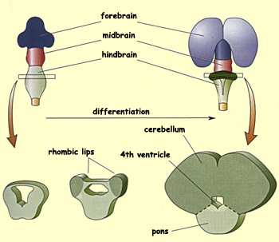
Development of Cerebellum
The cerebellum develops from thickenings of dorsal parts of the alar plates. Initially, the cerebellar swellings project into the fourth ventricle
As the swellings enlarge and fuse in the median plane, they overgrow the rostral half of the fourth ventricle and overlap the pons and medulla .

Slide 29
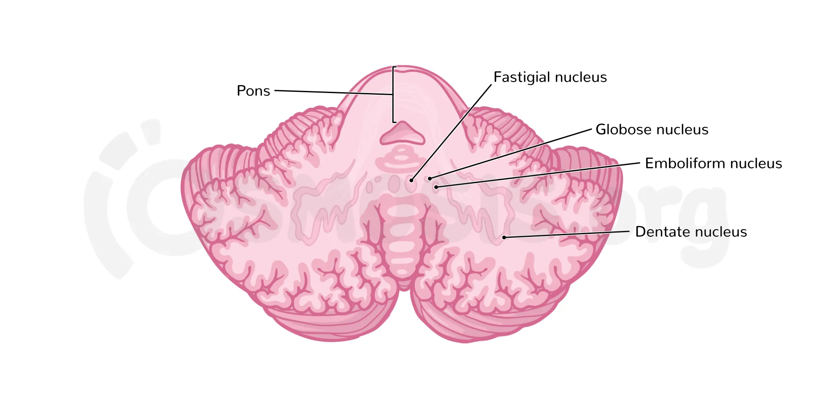
Development of Cerebellum
Some neuroblasts in the intermediate zone of the alar plates migrate to the marginal zone and differentiate into the neurons of the cerebellar cortex.
Other neuroblasts from these plates give rise to the central nuclei, the largest of which is the dentate nucleus.
Cells from the alar plates also give rise to the pontine nuclei, the cochlear and vestibular nuclei, and the sensory nuclei of the trigeminal nerve.

Slide 30
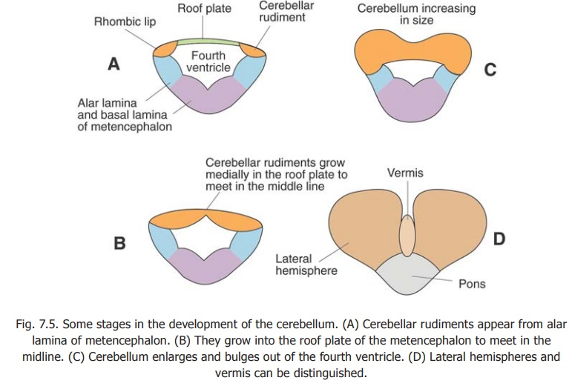

Stages in Development of Cerebellum

Slide 31
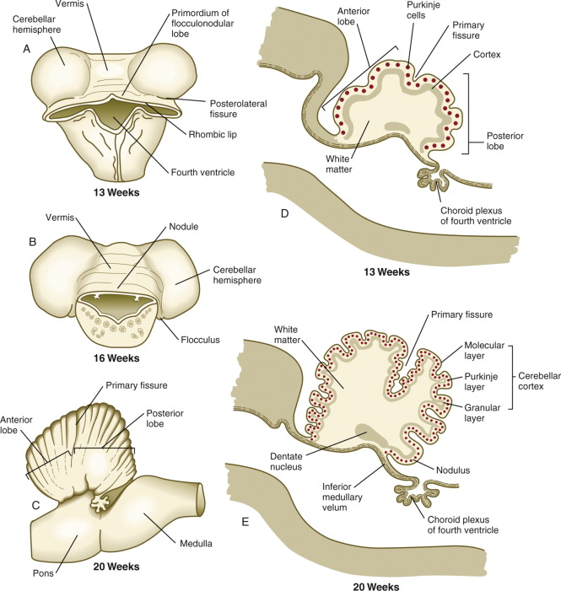

Slide 32
The structure of the cerebellum reflects its phylogenetic (evolutionary) development
The archicerebellum (flocculonodular lobe), the oldest part phylogenetically, has connections with the vestibular apparatus.
The paleocerebellum (vermis and anterior lobe), of more recent development, is associated with sensory data from the limbs.
The neocerebellum (posterior lobe), the newest part phylogenetically, is concerned with selective control of limb movements

Slide 33

Choroid Plexus and CSF
The thin ependymal roof of the fourth ventricle is covered externally by pia mater, derived from mesenchyme associated with the hindbrain .
This vascular membrane, together with the ependymal roof, forms the tela choroidea of the fourth ventricle. Because of the active proliferation of the pia mater, the tela choroidea invaginates the fourth ventricle, where it differentiates into the choroid plexus (infoldings of choroidal arteries of the pia mater). Similar plexuses develop in the roof of the third ventricle and in the medial walls of the lateral ventricles.

Slide 34
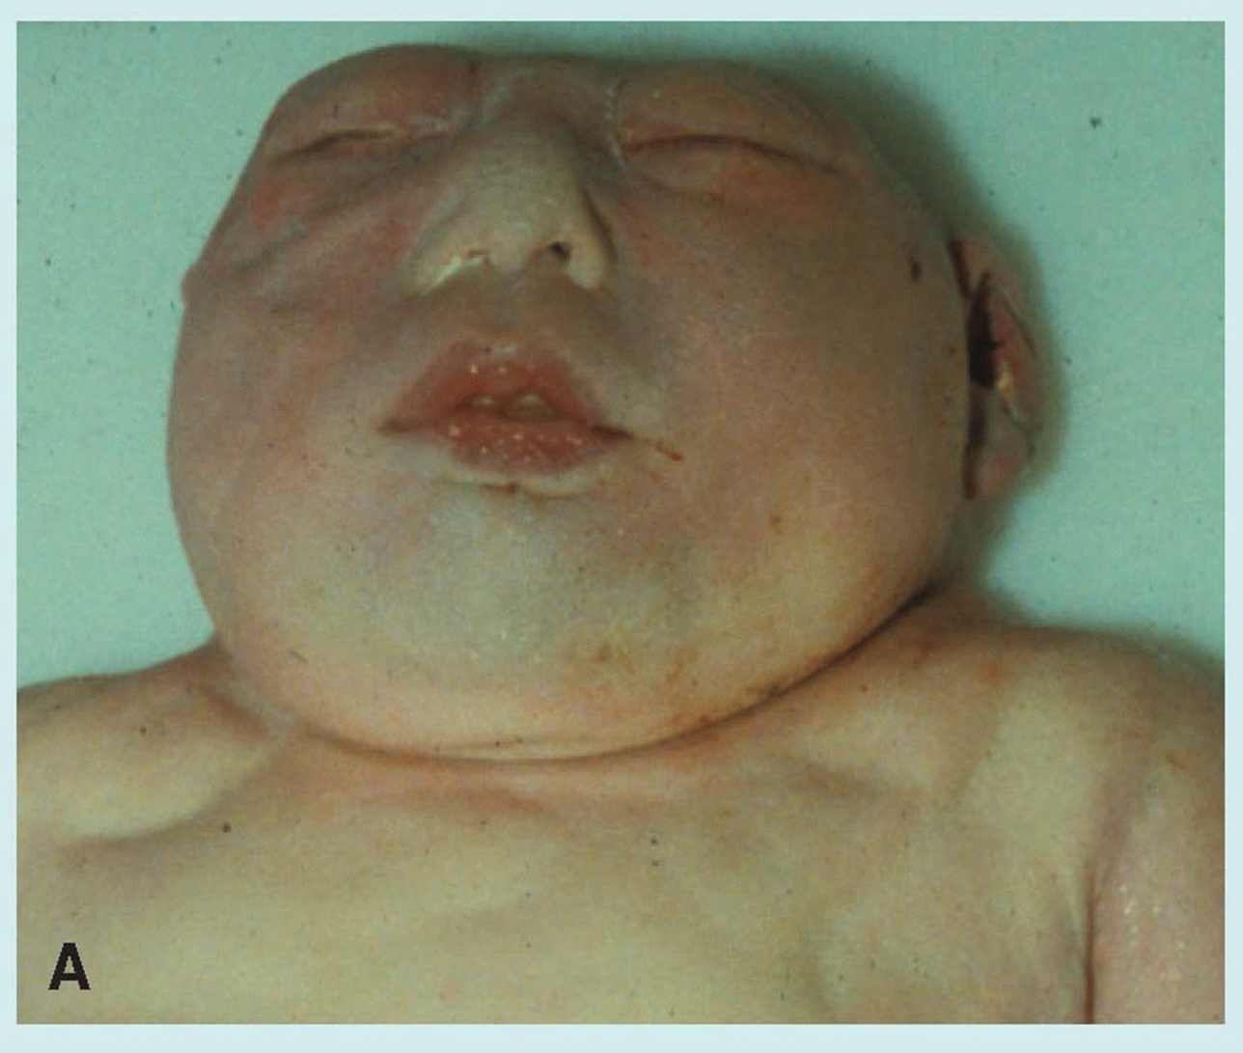
Anencephaly
is a neural tube defect that occurs when the head end of the neural tube fails to close, usually during the 23rd and 26th days of pregnancy, resulting in an absence of a major portion of the brain and skull.
without the main part of the forebrain—the largest part of the cerebrum—and are usually blind, deaf and unconscious.
infant will never gain consciousness. Infants are either stillborn or usually die within a few hours or days after birth.
Vertical Integration

Slide 35
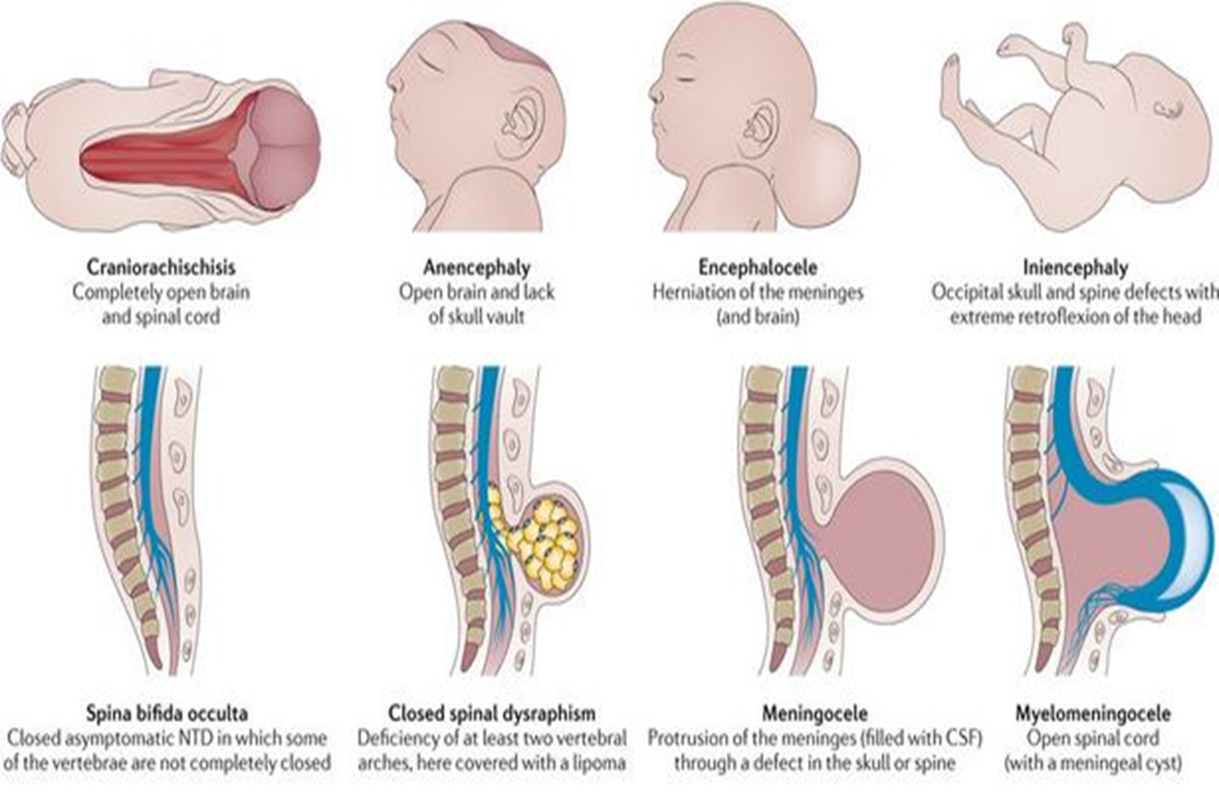

Encephaloceles
are characterized by protrusions of the brain through the skull that are sac-like and covered with membrane. They can be a groove down the middle of the upper part of the skull, between the forehead and nose, or the back of the skull. Encephaloceles are often obvious and diagnosed immediately. Sometimes small encephaloceles in the nasal and forehead are undetected.

Slide 36

Gene therapy for Parkinson's Disease and Ethical Challenges: A Systematic Review
Parkinson’s disease (PD) is a complex, multifactorial neurodegenerative disorder with a pathophysiology deriving from the synergy of abnormal aggregation of neuroinflammation, synuclein and dysfunction of lysosomes, mitochondria and synaptic transport difficulties influenced by genetic and idiopathic factors. Worldwide, PD has a prevalence of 2-3% in people over the age of 65. To date, there is no certified, effective treatment for PD.
Aim: The aims of this research were: (i) to present, on the basis of recent advances in molecular genetics and epigenetics, the genomic aspects and challenges of gene therapy trials for PD; (ii) to outline the ethical principles applicable to therapeutic trials
Reference: Zohoncon TM, Sawadogo J, Zoure AA, Ouattara AK, Ouedraogo MN, Zongo L, Ouedraogo P, Djigma FW, Nadembèga CW, Kabore R, Ouermi D. Gene therapy for Parkinson’s Disease and Ethical Challenges: A Systematic Review. Advances in Parkinson's Disease. 2023 May 31;12(2):9-28.
Bioethics

Slide 37
A Practical Approach to Early-Onset Parkinsonism
Article summarize the most important conditions associated with primary and secondary EO parkinsonism. It also proposed a practical approach based on the current literature and expert opinion to help movement disorders specialists and neurologists navigate this complex and challenging landscape.
Reference: Riboldi GM, Frattini E, Monfrini E, Frucht SJ, Di Fonzo A. A practical approach to early-onset Parkinsonism. Journal of Parkinson's disease. 2022 Jan 1;12(1):1-26.
Family Medicine

Slide 38
Linking the cerebellum to Parkinson disease: an update.
Over the past decade, an accumulating body of research has provided clinical, pathological, neurophysiological, structural and functional neuroimaging findings that clearly establish a link between the cerebellum and PD.
This Review presents an overview and update on the involvement of the cerebellum in the clinical features and pathogenesis of PD, which could provide a novel framework for a better understanding the heterogeneity of the disease.
Reference : Li T, Le W, Jankovic J. Linking the cerebellum to Parkinson disease: an update. Nature Reviews Neurology. 2023 Nov;19(11):645-54.:
Research

Slide 39
Artificial Intelligence Applications for Assessment, Monitoring, and Management of Parkinson Disease Symptoms: Protocol for a Systematic Review
Parkinson disease (PD) is the second most prevalent neurodegenerative disease, with around 10 million people with PD worldwide.
To address, digital technologies including wearable sensors, smartphone apps, and artificial intelligence (AI) methods have been implemented for this population. Many reviews have explored the use of AI in the diagnosis of PD and management of specific symptoms; however, there is limited research on the application of AI to the monitoring and management of the range of PD symptoms. A comprehensive review of the application of AI methods is necessary to address the gap of high-quality reviews and highlight the developments of the use of AI within PD care.
Reference: Bounsall K, Milne-Ives M, Hall A, Carroll C, Meinert E. Artificial intelligence applications for assessment, monitoring, and management of Parkinson disease symptoms: protocol for a systematic review. JMIR Research Protocols. 2023 Jun 14;12(1):e46581.
Artificial Intelligence
Spiral Integration

