Slide 1

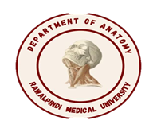
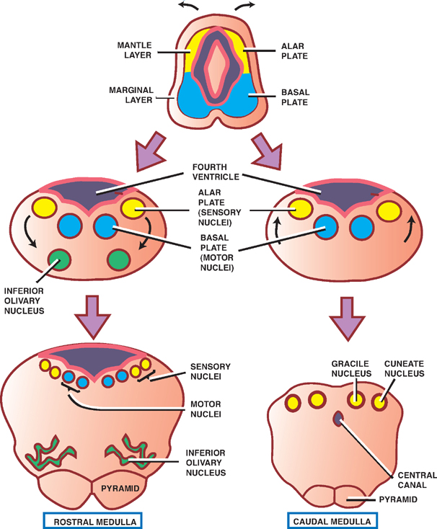
Central Nervous System Module -I
2nd Year MBBS(LGIS)
Development of Spinal Cord
Presenter: Prof.Dr. Ifra Saeed Date: 00-00-25

Slide 2
Prof. Umar’s Model of Teaching Strategy
Self Directed Learning Assessment Program
Objectives :To cultivate critical thinking, analytical reasoning, and problem-solving competencies.
To instill a culture of self-directed learning, fostering lifelong learning habits and autonomy.
First Ten Minutes
How to Assess?
Ten randomly selected students will be evaluated within the first 10 minutes of the lecture through 10 multiple-choice questions (MCQs) based on the PowerPoint presentation shared on Students Official WhatsApp group, one day before the teaching session.
The number of MCQs from the components of the lecture will follow the guidelines outlined in the Prof. Umar model of Integrated Lecture.
Component of LGIS | Core Knowledge | Horizontal Integration | Vertical Integration | Spiral Integration
No of MCQs | 6-7 | 1-2 | 1 | 1

Slide 3
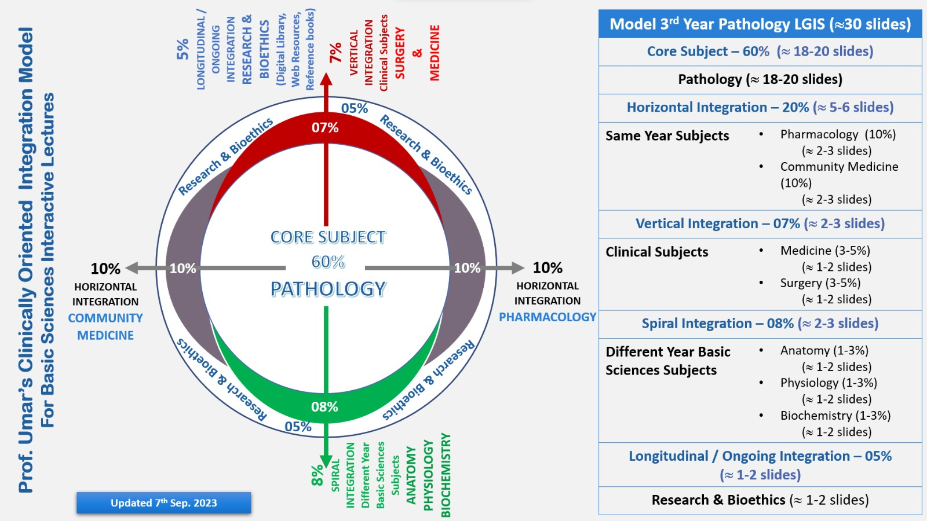
Professor Umar Model of Integrated Lecture

Slide 4
Motto Vision; ThDream/Tomorrow
To impart evidence based research oriented medical education
To provide best possible patient care
To inculcate the values of mutual respect and ethical practice of medicine
Wisdom
Truth
Service

Slide 5
Learning Objectives
At the end of the session, student will be able to
Describe development of Prosencephalon and Mesencephalon
Discuss congenital abnormalities associated with forebrain and Mid brain
Integrate physiological and biochemical aspects with development
Approach towards patient of Neural tube defects
Correlate and build core knowledge on the basis of latest research
Bioethics related to patients of neural tube defects

Slide 6
Development of Neural Tube
Core Knowledge

Slide 7
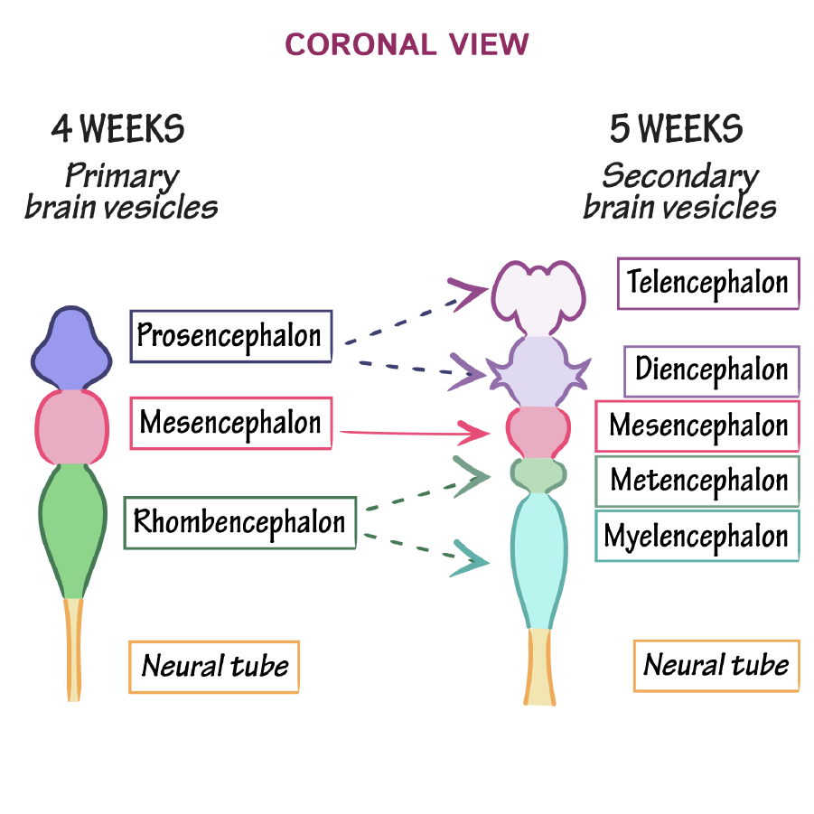


Slide 8
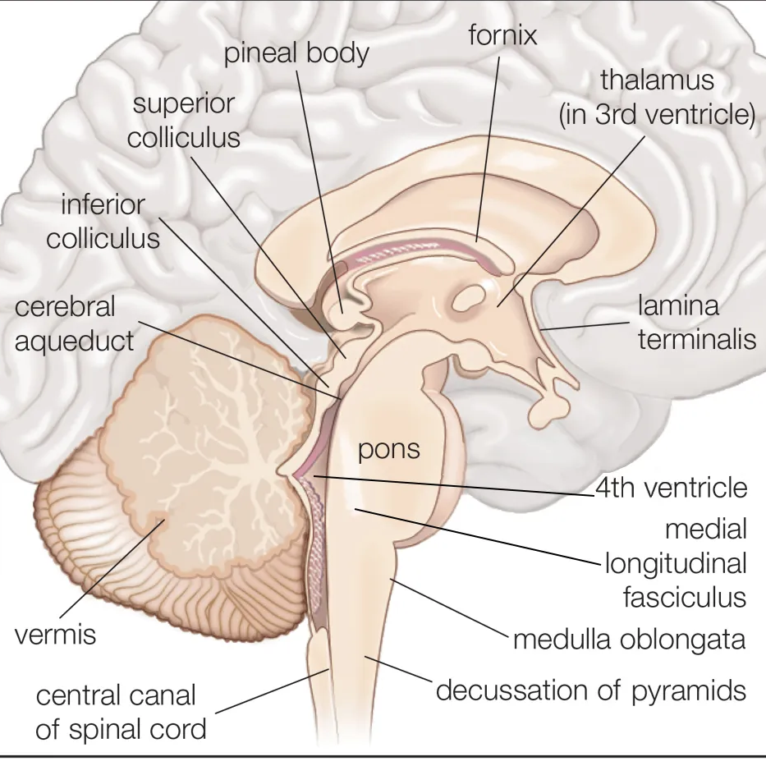
Midbrain
The midbrain, or mesencephalon (plural: mesencephala or mesencephalons), is the most rostral part of the brainstem and sits above the pons and is adjoined rostrally to the thalamus.
During development, the midbrain forms from the middle of three vesicles that arise from the neural tube.

Slide 9
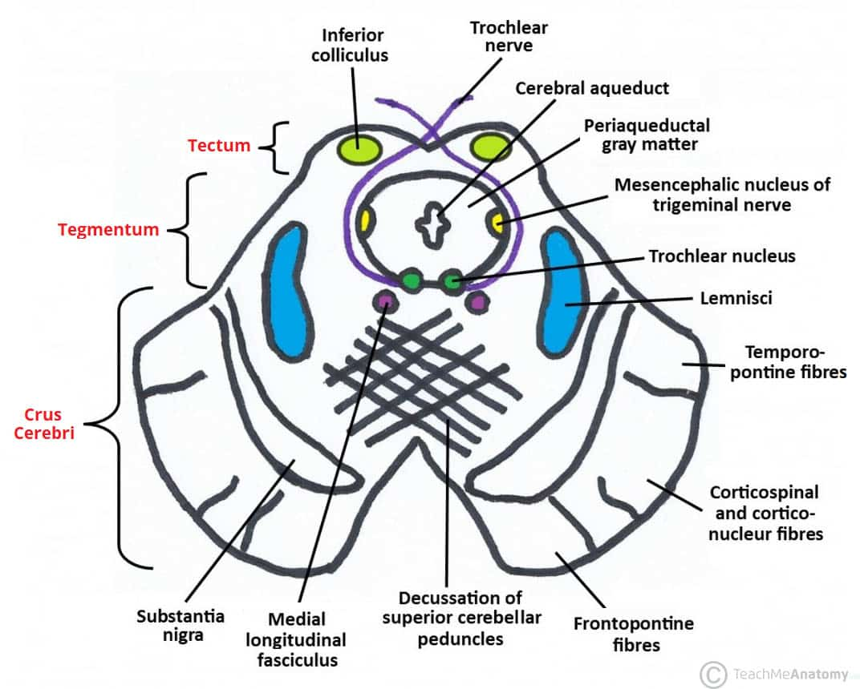
Midbrain
When viewed in cross-section, the midbrain can be divided into three portions:
tectum (posterior)
tegmentum
cerebral peduncles (anterior)

Slide 10
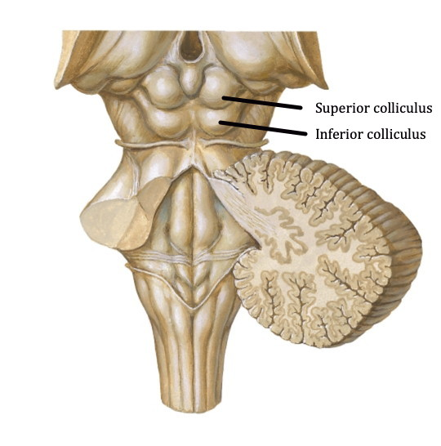

Tectum
Sitting posteriorly, the tectum (Latin for "roof" or "covering") is composed of the tectal (quadrigeminal) plate and superior and inferior colliculi. The tectum is unique to the midbrain and does not have a counterpart in the rest of the brainstem.

Slide 11
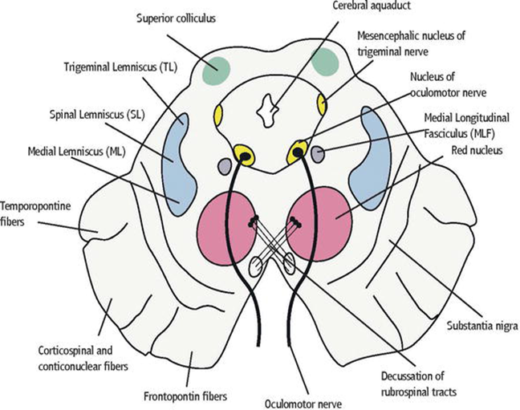
Tegmentum
The tegmentum is the phylogenetically-old part of the brainstem and runs through the pons and medulla oblongata. In the adult brain, it contains all the brainstem nuclei
Anterior to the tegmentum are the cerebral peduncles which are composed of the large ascending and descending tracts that run to and from the cerebrum.

Slide 12
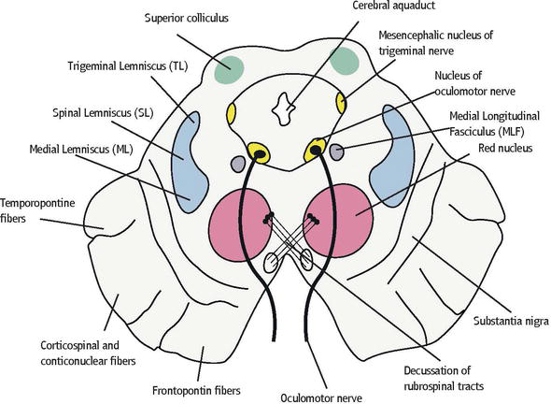
Development of Mesencephalon(Midbrain)
The midbrain (mesencephalon) undergoes less change than any other part of the developing brain), except for the caudal part of the hindbrain. The neural canal narrows and becomes the cerebral aqueduct, a channel that connects the third and fourth ventricles.

Slide 13

Histogenesis
Neuroblasts migrate from the alar plates of the midbrain into the tectum (roof) and aggregate to form four large groups of neurons, the paired superior and inferior colliculi, which are concerned with visual and auditory reflexes, respectively.

Slide 14
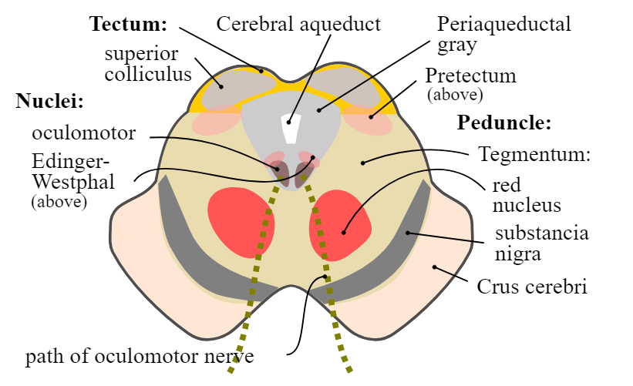
Histogenesis
Neuroblasts from the basal plates may give rise to groups of neurons in the tegmentum of midbrain (red nuclei, nuclei of third and fourth cranial nerves (CNs), and the reticular nuclei).

Slide 15
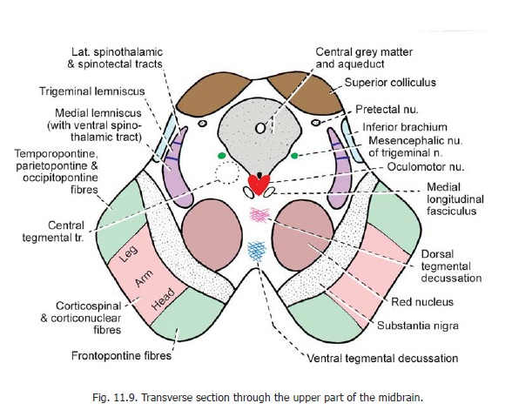
The Substantia Nigra
a broad layer of gray matter adjacent to the cerebral peduncle may also differentiate from the basal plate, but some authorities believe that it is derived from cells in the alar plate that migrate ventrally.
Fibers growing from the cerebrum form the stemlike cerebral peduncles anteriorly.

Slide 16
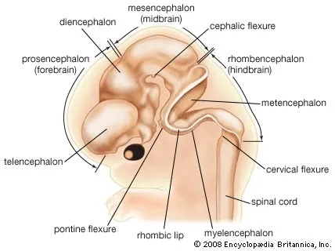
Development of forebrain
Prosencephalon

Slide 17
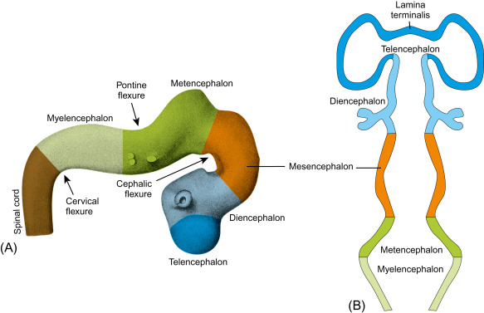
Flexures
Cephalic flexure (midbrain flexure )
  b/w the prosencephalon & rhombencephalon
Cervical flexure
  b/w rhombencephalon & spinal cord
Rhombencephalic isthmus
  Separates the mesencephalon from rhombencephalon
Pontine flexure (b/w Metencephalon and Myelencephalon

Slide 18
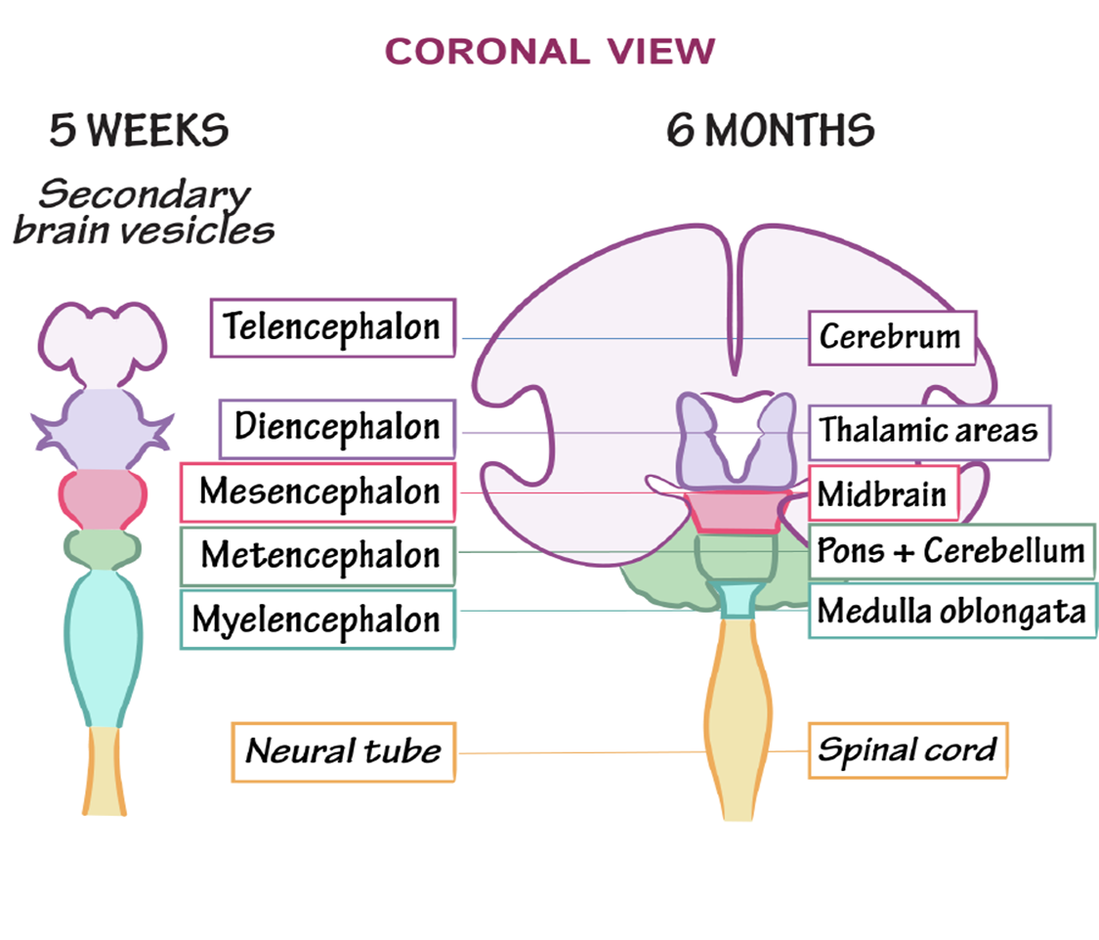
As closure of the rostral neuropore occurs, two lateral outgrowths-optic vesicles-appear one on each side of the forebrain. The optic vesicles are the primordia of the retinae and optic nerves.
A second pair of diverticula, the telencephalic vesicles, soon arise more dorsally and rostrally. They are the primordia of the cerebral hemispheres, and their cavities become the lateral ventricles

Slide 19
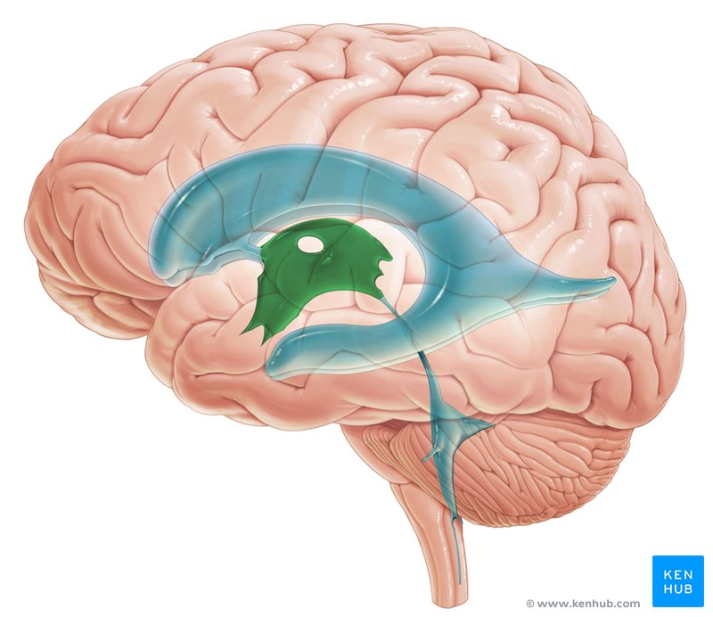
Cavities of the telencephalon
The cavities of the telencephalon and diencephalon contribute to the formation of the third ventricle, although the cavity of the diencephalon contributes more

Slide 20
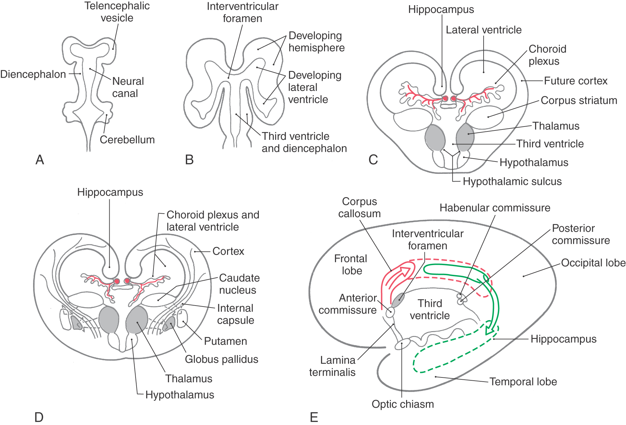
Telencephalon
The telencephalon consists of a median part and two lateral diverticula, the cerebral vesicles
These vesicles are the primordia of the cerebral hemispheres. The cavity of the median portion of the telencephalon forms the extreme anterior part of the third ventricle
At first, the cerebral hemispheres are in wide communication with the cavity of the third ventricle through the interventricular foramina

Slide 21
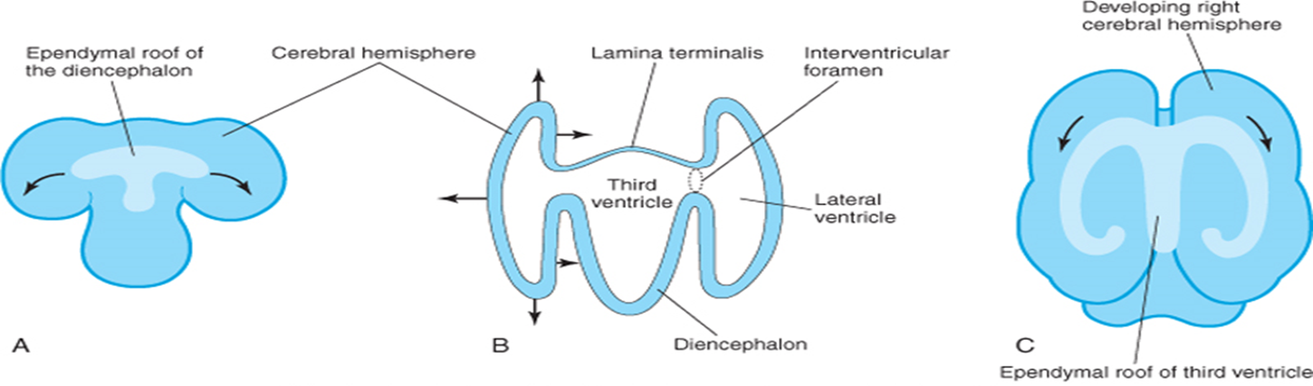
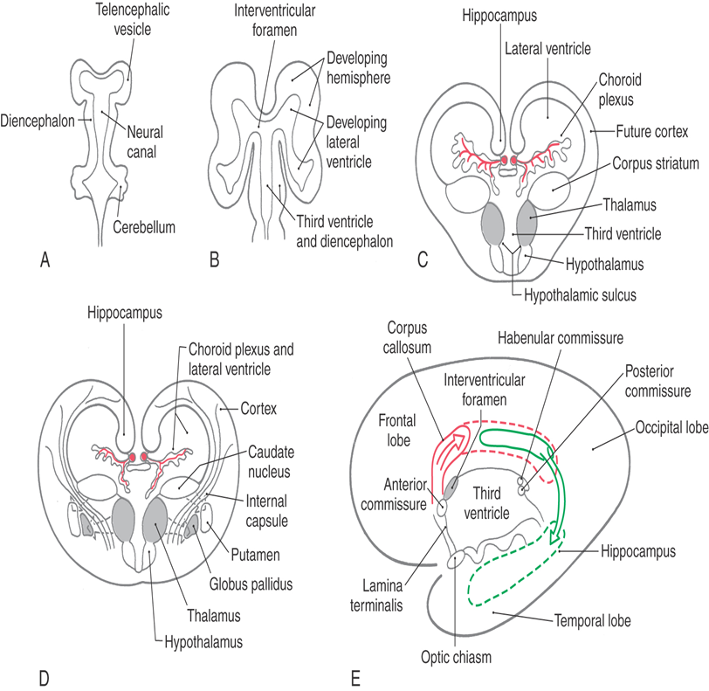

Slide 22

Choroid Plexus
Along the choroid fissure, part of the medial wall of the developing cerebral hemisphere becomes very thin. Initially, this thin ependymal portion lies in the roof of the hemisphere and is continuous with the ependymal roof of the third ventricle The choroid plexus of the lateral ventricle later forms at this site

Slide 23
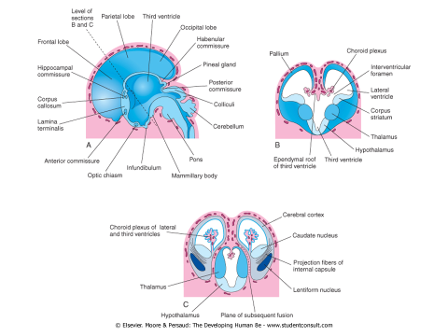
Falx Cerebri
As the cerebral hemispheres expand, they cover successively the diencephalon, midbrain, and hindbrain.
The hemispheres eventually meet each other in the midline, flattening their medial surfaces.
The mesenchyme trapped in the longitudinal fissure between them gives rise to the cerebral falx, a median fold of dura mater.

Slide 24

Corpus Striatum
The corpus striatum appears during the sixth week as a prominent swelling in the floor of each cerebral hemisphere
The floor of each hemisphere expands more slowly than its thin cortical walls because it contains the rather large corpus striatum; consequently, the cerebral hemispheres become C shaped

Slide 25
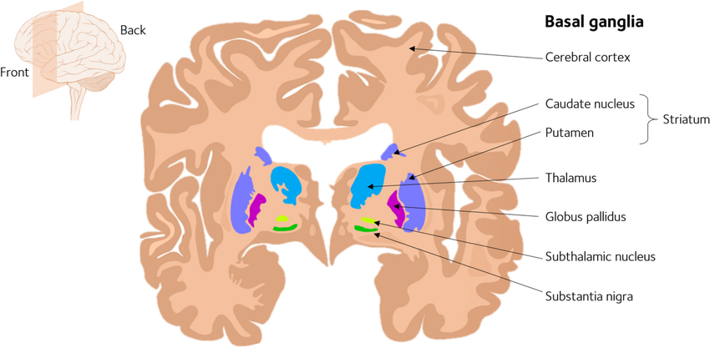
Cerebral Cortex
As the cerebral cortex differentiates, fibers passing to and from it pass through the corpus striatum and divide it into the caudate and lentiform nuclei.
This fiber pathway-the internal capsule becomes C shaped as the hemisphere assumes this form.

Slide 26
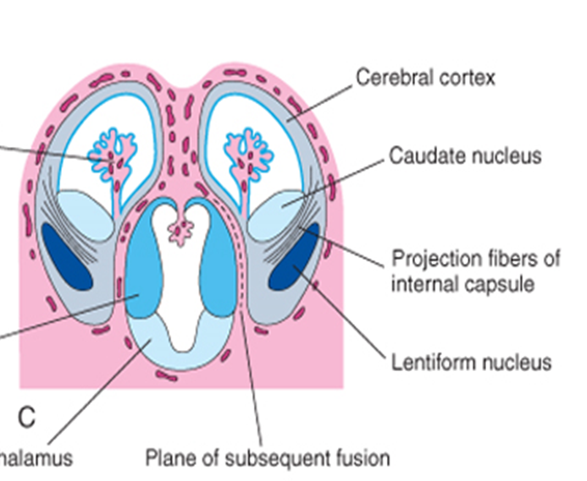
Lateral Ventricles
The growth and curvature of the hemispheres also affect the shape of the lateral ventricles. They become roughly C-shaped cavities filled with CSF.
The caudal end of each cerebral hemisphere turns ventrally and then rostrally, forming the temporal lobe; in so doing, it carries the lateral ventricle (forming its temporal horn) and choroid fissure with it.

Slide 27
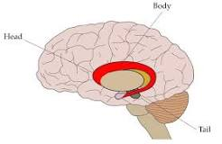
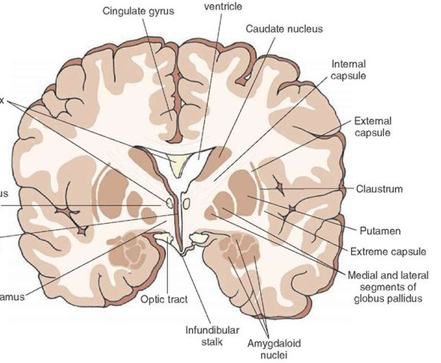
The Caudate nucleus
becomes elongated and C shaped, conforming to the outline of the lateral ventricle.
Its pear-shaped head and elongated body lie in the floor of the frontal horn and body of the lateral ventricle.
Tail makes a U-shaped turn to gain the roof of the temporal or inferior horn.

Slide 28
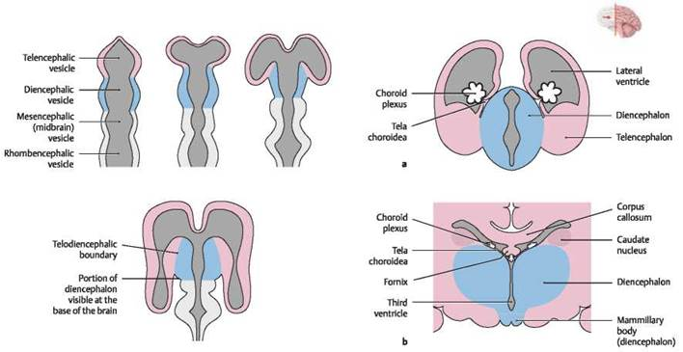
Diencephalon Thalamus
The thalamus develops rapidly on each side and bulges into the cavity of the third ventricle, reducing it to a narrow cleft. The thalami meet and fuse in the midline in approximately 70% of brains, forming a bridge of gray matter across the third ventricle-the interthalamic adhesion.

Slide 29
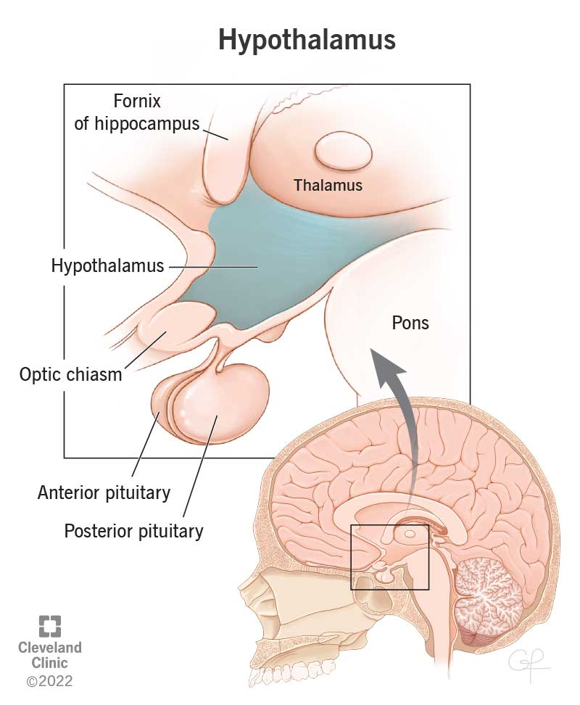
Hypothalamus
The hypothalamus arises by proliferation of neuroblasts in the intermediate zone of the diencephalic walls, ventral to the hypothalamic sulci.
Later, a number of nuclei concerned with endocrine activities and homeostasis develop.

Slide 30
Commissures
As the cerebral cortex develops, groups of nerve fibers-commissures-connect corresponding areas of the cerebral hemispheres with one another.
The most important of these commissures cross in the lamina terminalis, the rostral (anterior) end of the forebrain. This lamina extends from the roof plate of the diencephalon to the optic chiasm
Horizontal Integration

Slide 31
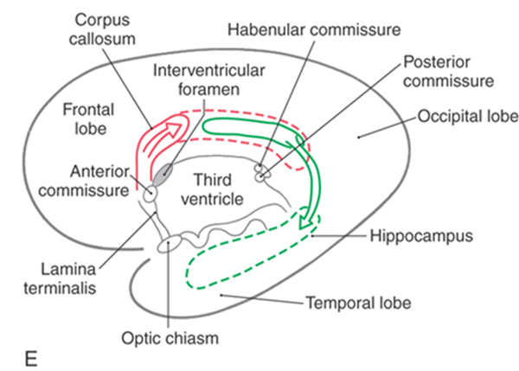

The lamina is the natural pathway from one hemisphere to the other.
The first commissures to form, the anterior commissure and hippocampal commissure, are small fiber bundles that connect phylogenetically older parts of the brain.
The anterior commissure connects the olfactory bulb and related areas of one hemisphere with those of the opposite side.
The hippocampal commissure connects the hippocampal formations.

Slide 32
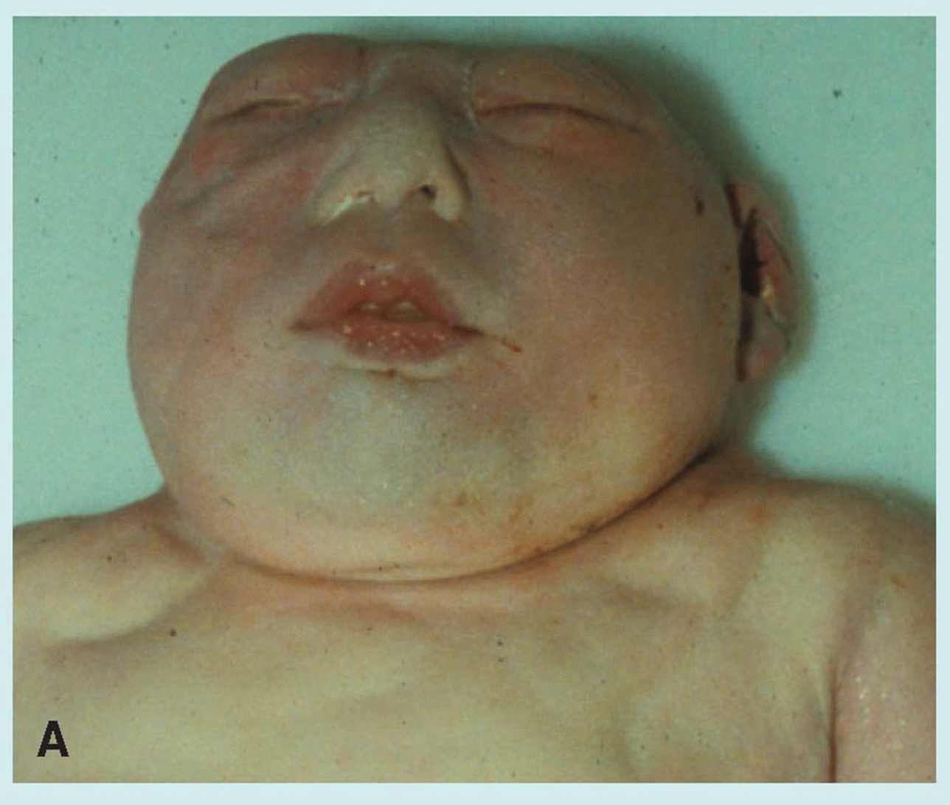

Anencephaly
is a neural tube defect that occurs when the head end of the neural tube fails to close, usually during the 23rd and 26th days of pregnancy, resulting in an absence of a major portion of the brain and skull.
without the main part of the forebrain—the largest part of the cerebrum—and are usually blind, deaf and unconscious.
infant will never gain consciousness. Infants are either stillborn or usually die within a few hours or days after birth.

Slide 33
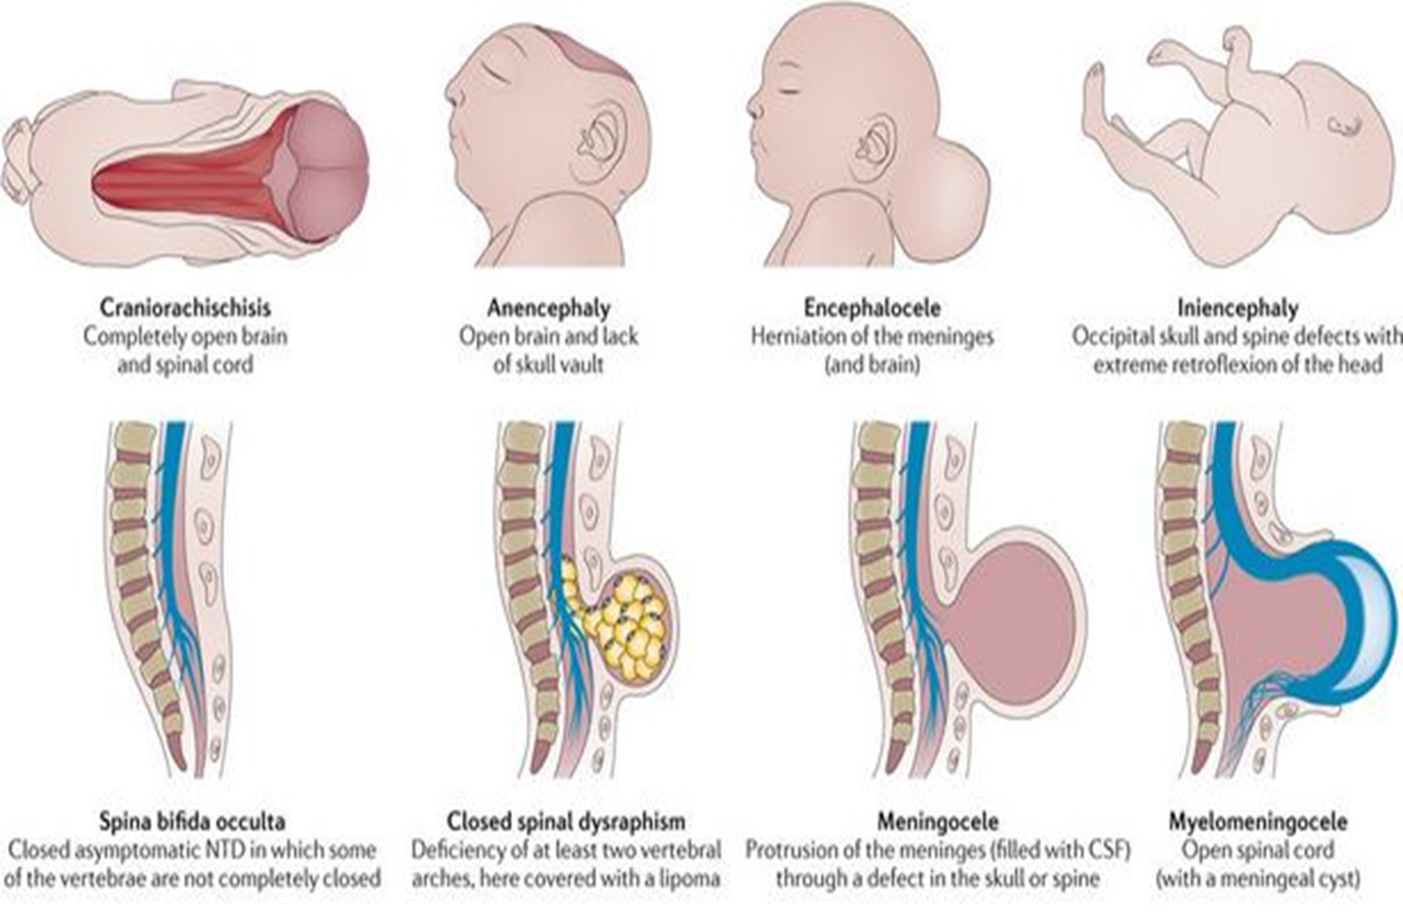
Encephaloceles
are characterized by protrusions of the brain through the skull that are sac-like and covered with membrane. They can be a groove down the middle of the upper part of the skull, between the forehead and nose, or the back of the skull.
Small encephaloceles in the nasal and forehead are undetected.
Vertical Integration

Slide 34

Foetal neurosurgery and neural tube defects: A critical review of the ethical considerations
A congenital neurological anomaly connected to the growing
central nervous system is myelomeningocoeles. The Management of Myelomeningocoele (MOMS) study (2011) demonstrated that prenatal surgery improved motor results, albeit at the expense of maternal-foetal hazards, when compared to the postnatal surgical protocol. It is paramount to continue the conversation on the ethical implications of the MOMS trial not withstanding its comprehensive bioethical requirements to ensure that participants could make an informed decision.
Reference: Fang S, Patel D, Wellington J, Sohawon H, Ibrahim A, Beg S. Foetal neurosurgery and neural tube defects: A critical review of the ethical considerations. Brain and Spine. 2023 Sep 26;3.
Bioethics

Slide 35
Folic acid supplementation to prevent neural tube defects: US Preventive Services Task Force reaffirmation recommendation statement
Abstract
Importance Neural tube defects are among the most common congenital malformations in the US, with an estimated 3000 pregnancies affected each year. Many of these neural tube defects are caused by low folate levels in the body.
Objective The US Preventive Services Task Force (USPSTF) commissioned a reaffirmation evidence update on the benefits and harms of folic acid supplementation.
Population Persons who are planning to or could become pregnant.
Evidence Assessment The USPSTF concludes that, for persons who are planning to or could become pregnant, there is high certainty that folic acid supplementation has a substantial net benefit to prevent neural tube defects in their offspring.
Recommendation The USPSTF recommends that all persons planning to or who could become pregnant take a daily supplement containing 0.4 to 0.8 mg (400 to 800 μg) of folic acid. (A recommendation)
References US Preventive Services Task Force. Folic Acid Supplementation to Prevent Neural Tube Defects: US Preventive Services Task Force Reaffirmation Recommendation Statement. JAMA. 2023;330(5):454–459. doi:10.1001/jama.2023.12876
Family Medicine

Slide 36
Neural tube defects: a review of global prevalence, causes, and primary prevention
Neural tube defects (NTDs) are common birth defects and contribute to life-long disabilities, high medical care costs, and perinatal and child mortality. This review is a primer on prevalence, causes, and evidence-based prevention strategies for NTDs. The estimated average global prevalence of NTDs is two cases per 1000 births, amounting to approximately 214,000–322,000 affected pregnancies worldwide annually.
Prevalence and associated adverse outcomes are disproportionately high in developing countries. NTDs have multiple risk factors including genetic and non-genetic (i.e., maternal nutritional status, pre-pregnancy diabetes, early pregnancy exposure to valproic acid (anti-epileptic medication), and a previous pregnancy affected by a NTD) factors.
Reference: Kancherla V. Neural tube defects: a review of global prevalence, causes, and primary prevention. Child's Nervous System. 2023 Jul;39(7):1703-10.
Research

Slide 37
Using Artificial Intelligence to Assess the Teratogenic Risk of Vitamin A Supplements
Vitamin A in high doses has been found to be highly teratogenic, leading to severe fetal abnormalities. Hence, prescription vitamin A acne medications like isotretinoin are highly regulated via programs such as iPledge, which intend to avert fetal exposure to isotretinoin
However, over-the-counter (OTC) vitamin A supplements are not subject to these requirements, and calculating the vitamin A content of these supplements can be difficult due to the lack of Food and Drug Administration (FDA) regulations and inconsistencies in labeling.
If the necessary information is provided, ChatGPT, a generative artificial intelligence (AI) tool, can help the general public calculate the vitamin A content of supplements. Nonetheless, supplement manufacturers do not always provide the data necessary for these calculations.
References Holla S, Zamil DH, Paidisetty PS, Wang LK, Katta R. Using Artificial Intelligence to Assess the Teratogenic Risk of Vitamin A Supplements. Cureus. 2023 Sep;15(9).
Spiral Integration
Artificial Intelligence

