Slide 1
Dengue Fever
Dr. Muhammad Mujeeb Khan
FCPS (Medicine)
Dip. DM (UK), Dip. Nutrition (Pak),
MSc. Infectious Diseases (UK)
Associate Professor
Rawalpindi Medical University, Rawalpindi

Slide 2
UNIVERSITY MOTTO, VISION, VALUES & GOALS
Mission Statement
To impart evidence-based research-oriented health professional education
Best possible patient care
Mutual respect, ethical practice of healthcare and social accountability.
Vision and Values
Highly recognized and accredited centre of excellence in medical education, using evidence-based training techniques for development of highly competent health professionals, who are lifelong experiential learner and are socially accountable.
Goals
The Undergraduate Integrated Learning Program is geared to provide you with quality medical education in an environment designed.

Slide 3
PROF UMER MODEL OF INTEGRATED LECTURE

Slide 4
SEQUENCE OF LGIS
Learning objectives
What is Dengue and how to diagnose it?(core concept = 70%)
Related pathology and pharmacology (horizontal integration 15%)
Recent advances and developments. (vertical integration – 10%)
Research article related to topic (3%) Ethics (2%)

Slide 5
LEARNING OBJECTIVES
At the end of the lecture, students will have learnt about
➢ What is dengue? ➢ Transmission and risk factors of dengue ➢ Pathophysiology of dengue ➢ Approach and management of dengue ➢ Complications and prevention ➢ Recent advances

Slide 6
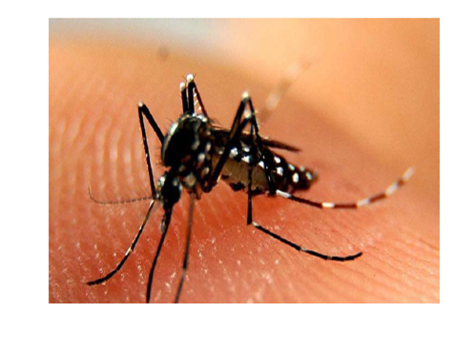
WHAT IS DENGUE FEVER?
Dengue Fever is a viral infection caused by the dengue virus.
There are 4 kinds of dengue viruses.

Slide 7
CHAIN OF INFECTION

Slide 8
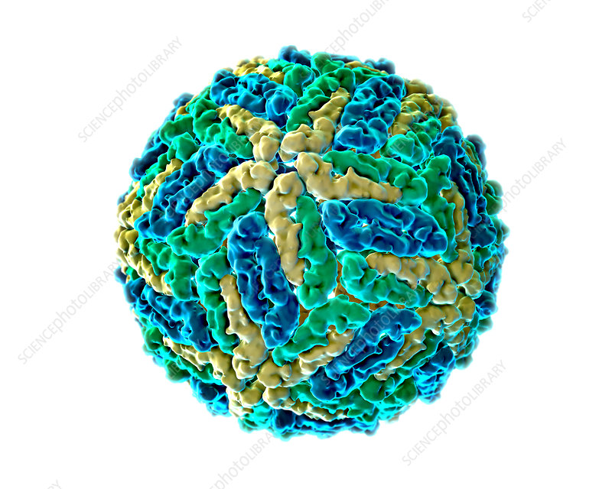
DENGUE VIRUS
Family : Flaviviridae
Genus : Flavivirus
Serotypes : DV1, DV2, DV3, DV4
Enveloped virus
3 major proteins
SS positive sense RNA

Slide 9
AEDES MOSQUITO
AEDES AEGYPTI
AEDES ALBOPITICUS

Slide 11
PATHOGENESIS OF DENGUE FEVER
Virus enters blood-reticuloendothelial system and bone marrow-blood
Incubation period 3-10 days
Viremia for 7 days after the entry
Immune response ONLY for the infecting serotype

Slide 12
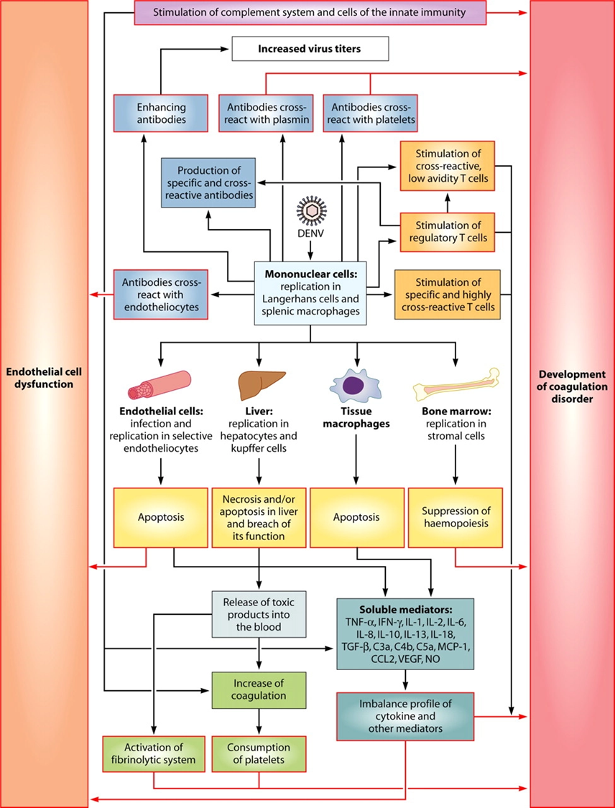

Slide 13
“Breakbone” symptoms due to adventitial and dendritic cell involvement of the marrow
Cytopenia due to direct marrow involvement

Slide 14
CLINICAL FEATURES OF DENGUE FEVER
Fever > 2 and < 10 days (essential criterion)
Headache
Retro orbital pain
Myalgia
Arthralgia/ severe backache/ bone pains
Rash
Bleeding manifestations (epistaxis, hematemesis, bloody stools, menorrhagia, hemoptysis)
Abdominal pain
Decreased urinary output despite adequate fluid intake
Irritability in infants

Slide 15
DENGUE FEVER
Dengue Suspect
Dengue Probable
Dengue Confirmed

Slide 17
WARNING SIGNS WARRANTS ADMISSION
No clinical improvement / worsening clinical parameters
Persistent vomiting
Severe abdominal pain
Lethargy and or restlessness
Bleeding: severe epistaxis, black stools, hematemesis, extensive menstrual bleeding, hematuria
Giddiness
Pale cold clammy extremities
Less / no urine output for 4 – 6 hours

Slide 18
LABORATORY DIAGNOSIS
Detection of Dengue viral antigen
Detection of Dengue specific IgM, IgG
Detection of the Dengue viral genome
Isolation of the Dengue virus

Slide 19
NATURAL COURSE OF DENGUE FEVER
Febrile phase
High grade fever for 2-7 days
No critical phase
Convalescent phase
2-5 days, longer in adults

Slide 20
DENGUE HEMORRHAGIC FEVER

Slide 21
FEATURES OF DENGUE HEMORRHAGIC FEVER
Highly Suggestive | Confirmed**
Disproportionate tachycardia Narrowing of pulse pressure < 20 mm CRFT > 2 secs Tender hepatomegaly (DHF likely) Haemoconcentration HCT 20% rise from baseline or rise approaching 20% if patient already on IV fluids Biochemistry Serum albumin < 3.5 g/dl or 0.5 gm/dl fall during illness Non fasting serum cholesterol < 100 mg/dl or 20mg/dl fall during illness Oedematose gall bladder wall on U/S | Ascites on U/S Pleural effusions (CXR Right lateral decubitus or chest U/S to detect minimal effusion) ** Definitive evidence of plasma leakage

Slide 22
NATURAL COURSE OF DENGUE HEMORRHAGIC FEVER
Febrile phase
High grade fever for 2-7 days
Critical phase
Plasma leakage 24- 48 h, usually on D5/D6, but earliest on D3
Recovery phase
2-5 days, longer in adults

Slide 23
DENGUE HEMORRHAGIC FEVER
Febrile Phase
Critical phase characterized by plasma leak
Convalescent Phase

Slide 24
DENGUE “LEAK” FEVER
Plasma leak during critical phase is the hall mark
Leading to 3rd space losses : Peritoneal cavity, Pleural cavity
Variable in magnitude and exact timing

Slide 25
PULSE PRESSURE
WARNING IF 20 OR BELOW!
BP 120/60 Pulse Pressure = 60
BP 80/60 Pulse Pressure = 20

Slide 26
THROMBOCYTOPENIA
Low production due to temporary bone marrow suppression (DV infection, effect of cytokines)
Increased consumption (activation of coagulation system, DIC)
Direct infection of platelets with the virus: kills platelets
Increased destruction of platelets by activated macrophages

Slide 27
BLEEDING
Thrombocytopenia
Activation of the coagulation system due to endothelial dysfunction, cytokines
Disseminated intravascular coagulation
Poor perfusion of GIT: can lead to mucosal bleeding
Drugs: Steroids, NSAIDS

Slide 28
ORGAN INVOLVEMENT IN DENGUE
Direct involvement - infection of hepatocytes or brain with the dengue virus
Circulatory failure - poor organ perfusion
Drugs – Paracetamol

Slide 29
ORGAN INVOLVEMENT
Like other viruses many organ involvement has been reported (myositis, pancreatitis, myocarditis etc.)
GB syndrome
Stevens Johnsons
Features may vary from one year to another and one epidemic to another

Slide 30
MANAGEMENT OF DENGUE FEVER
Symptomatic
Monitoring

Slide 31
SYMPTOMATIC MANAGEMENT
Reassurance of the patient
Rest as much as possible.
Take acetaminophen (paracetamol) to control fever and relieve pain. Avoid aspirin or ibuprofen.
Stay hydrated

Slide 32
DOCUMENTATION AND MONITORING OF DENGUE PATIENTS
Dengue Expert Advisory Group

Slide 33
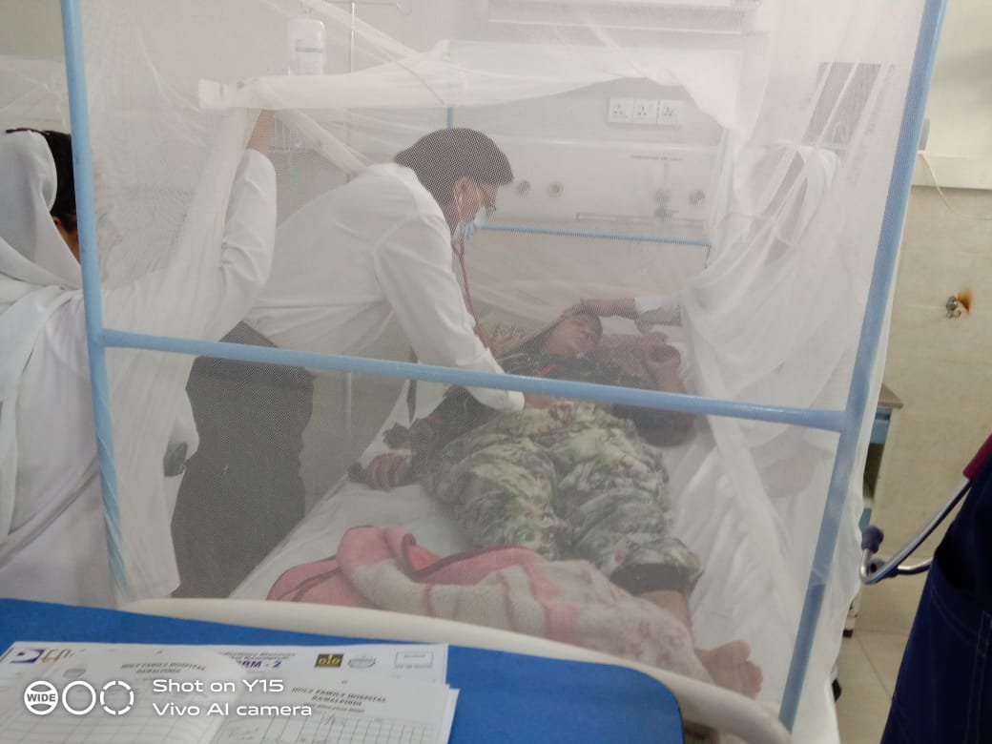
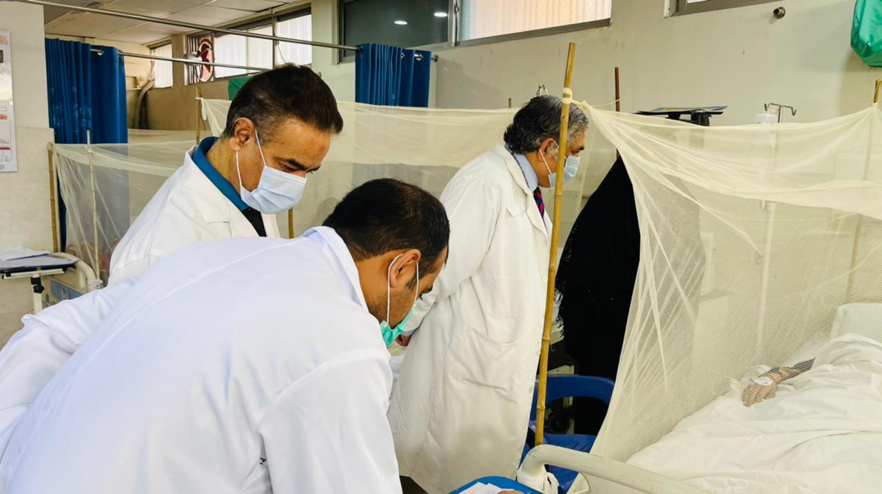
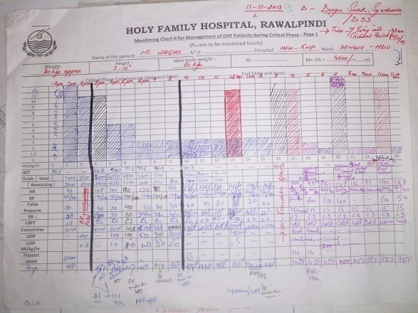
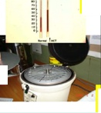
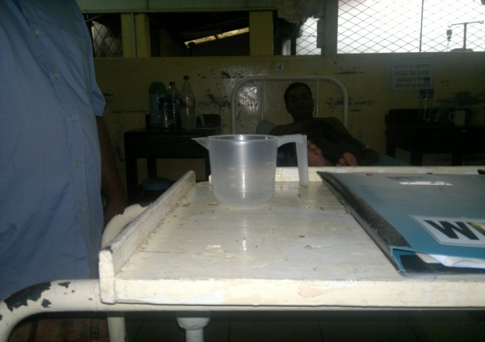
MONITORING PARAMETERS

Slide 37
Fluid Management in Dengue Hemorrhagic Fever

Slide 38
AMOUNT OF FLUID?
Based on weight
Adults
– If less than 50kg use actual weight
– If more take weight as 50 kg
Paediatrics
– Current OR Ideal body weight whichever is lower

Slide 39
IDEAL BODY WEIGHT
50kg

Slide 40
TYPES OF FLUID
Crystalloids
0.9% Saline
5%Dextrose 0.9% Saline
5% Dextrose ½ saline
Colloids
Dextran 40

Slide 41
FLUID QUOTA
M + 5% = Maintenance + 5% of body weight
Over 48 hours if patient presents in the beginning of critical phase (without shock)
Over 24 hours for patients coming in shock

Slide 42
MAINTENANCE + 5% DEFICIT - Adults
Maintenance
– 1st 10 kg – 1000 mls
– 2nd 10 kg – 500 mls
– Remaining 30kgs – 600 mls
– Sum = 2100 mls
5% deficit – 50 x 50 = 2500 mls
Total = 4600 mls

Slide 44
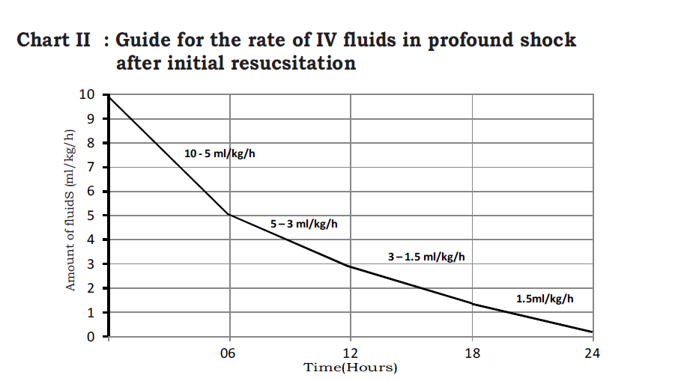

Slide 45
DENGUE SHOCK SYNDROME

Slide 46
IS IT CRITICAL PHASE ?
Day 3-7 of illness, lasts for 24-48 hours
Clinical
Fever settled
Tachycardia
CRFT >2seconds
Pulse pressure ≤ 20 mm Hg
Urinary output <0.5-1 ml/hour
Tender hepatomegaly
Notes:
<

Slide 47
DENGUE SHOCK SYNDROME
Profound Shock (No BP, No Pulse)
Decompensated Shock (feeble pulse, pulse pressure <20)
Compensated Shock (pulse pressure 20-30)

Slide 48
FLUID MANAGEMENT IN DENGUE SHOCK SYNDROME

Slide 49
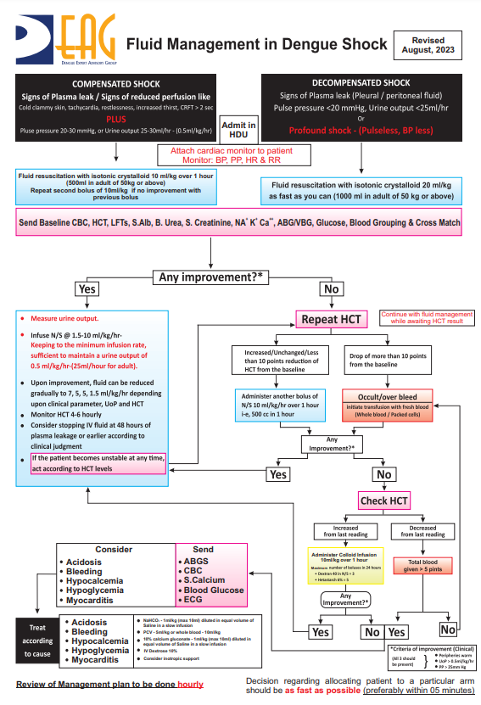

Slide 50
REFRACTORY SHOCK - ABCS
Blood
packed cells
whole blood
Bicarbonate
Glucose
Calcium

Slide 51
RECOVERY PHASE

Slide 52
CONVALESCENT PHASE
Lasts 5 – 7 days.
Good appetite
Convalescent rash
Pruritus
Hemodynamic stability
Bradycardia
Diuresis
Stabilization of HCT
Rise in WBC
Rise in platelet count.
Management:
Maintain oral intake, antihistamines, rest, discharge

Slide 53
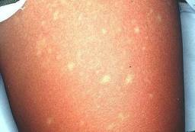
RECOVERY

Slide 54
MISCONCEPTIONS
Platelet Transfusions
Steroids
Misinterpretation of low WBC/TLC
Antibiotics
Growth Factors
Empiric Anti Malarials

Slide 55
Thank You

