Slide 1
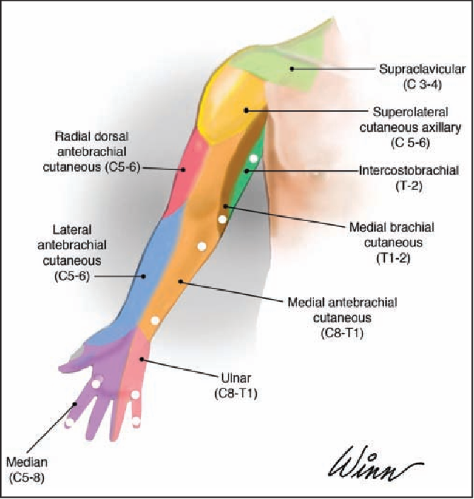
1st Year MBBS Cutaneous Innervation & Dermatomes of upper limb,
MSK-1 Module SGD/Dissection
10th May 2025
Dr. Sumyyia Bashir Assistant Professor

Slide 2
Vision; The Dream/Tomorrow
Motto
To impart evidence based research oriented medical education
To provide best possible patient care
To inculcate the values of mutual respect and ethical practice of medicine
Wisdom
Truth
Service

Slide 3
Prof. Umar’s Model of Teaching Strategy Self Directed Learning Assessment Program
Objectives :To cultivate critical thinking, analytical reasoning, and problem-solving competencies.
To instill a culture of self-directed learning, fostering lifelong learning habits and autonomy.
How to Assess?
➢Ten randomly selected students will be evaluated within the first 10
minutes of the lecture through 10 multiple-choice questions (MCQs)
based on the PowerPoint presentation shared on Students Official
WhatsApp group, one day before the teaching session.
➢The number of MCQs from the components of the lecture will follow
the guidelines outlined in the Prof. Umar model of Integrated Lecture.
Component of LGIS | Core Knowledge | Horizontal Integration | Vertical Integration | Spiral Integration
No. of MCQs | 6-7 | 1-2 | 1 | 1

Slide 4
Professor Umar Model of Integrated Lecture

Slide 5
Learning Objectives
Discuss the cutaneous nerve supply of upper limb
Draw the dermatoms of upper limb
Understand the curative and preventive healthcare measures.
Apply the strategic use of artificial intelligence in healthcare.
Practice principles of bioethics.
Use the HEC digital library.
Read a relevant research article.

Slide 6
Cutaneous Nerve Supply Of The Upper Limb
Core Knowledge
Sensory nerve supply of the back
Posterior rami of the spinal nerve. 1st and 8th cervical nerve do not supply the skin.
Cutaneous nerve supply of the pectoral region
Medial, intermediate and lateral supraclavicular nerves supply the skin of upper half of deltoid and form the clavicle to the 2nd rib.
Anterior and lateral cutaneous branches of 2nd to 6th intercostal nerves supply the skin below 2nd rib.
Cutaneous nerve of the upper arm
Intercostobrachial nerve and medial cutaneous nerve of arm
Upper lateral cutaneous nerve of arm(branch of axilliary)
Lower lateral cutaneous nerve of arm(branch of radial nerve)
Posterior Cutaneous nerve of arm(branch of radial nerve)

Slide 7
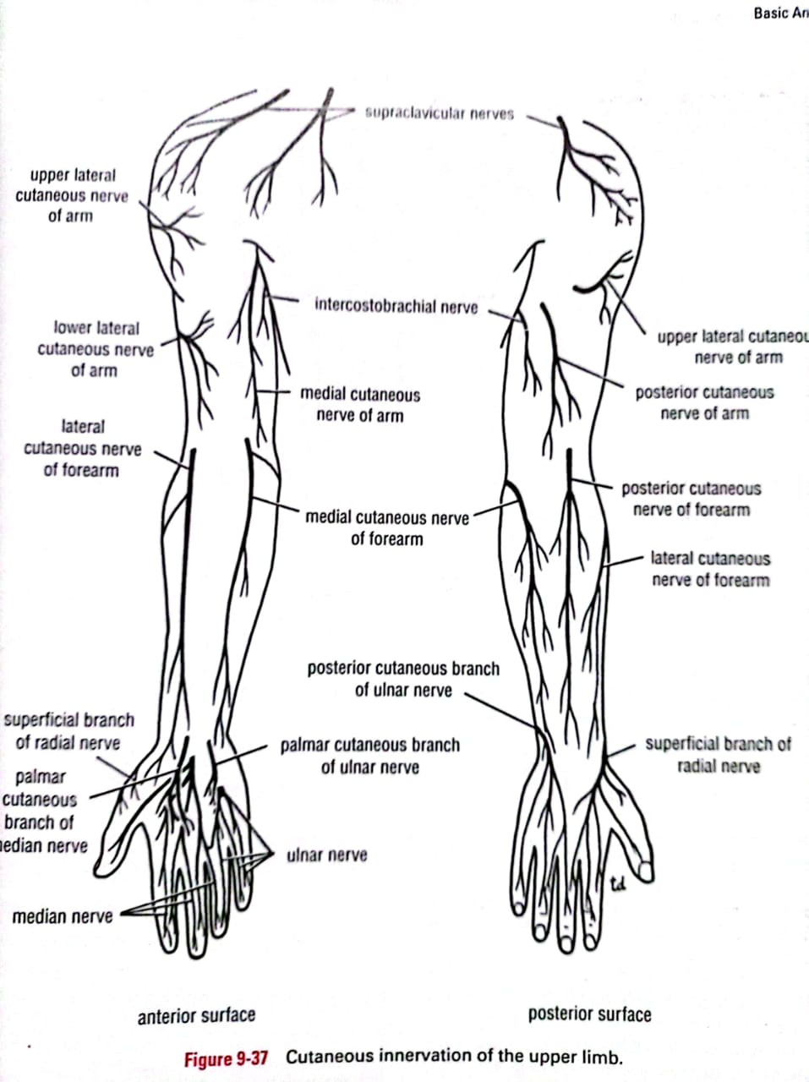
Cutaneous Nerve Supply Of The Upper Limb
Core Knowledge
Cutaneous nerves of forearm
Median cutaneous nerve of forearm(brachial plexus)
Lateral cutaneous nerve of forearm (continuation of musculocutaneous nerve)
Posterior cutaneous nerve of forearm (branch of radial nerve)

Slide 8
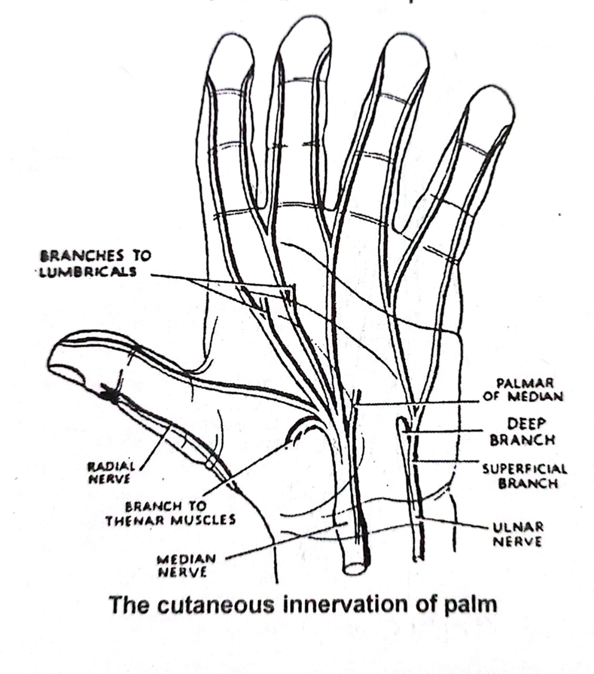
Cutaneous Nerve Supply Of The Upper Limb
Core Knowledge
Cutaneous nerves of palm
Palmar cutaneous branch of the ulnar nerve
Palmar cutaneous branch of the median nerve

Slide 9
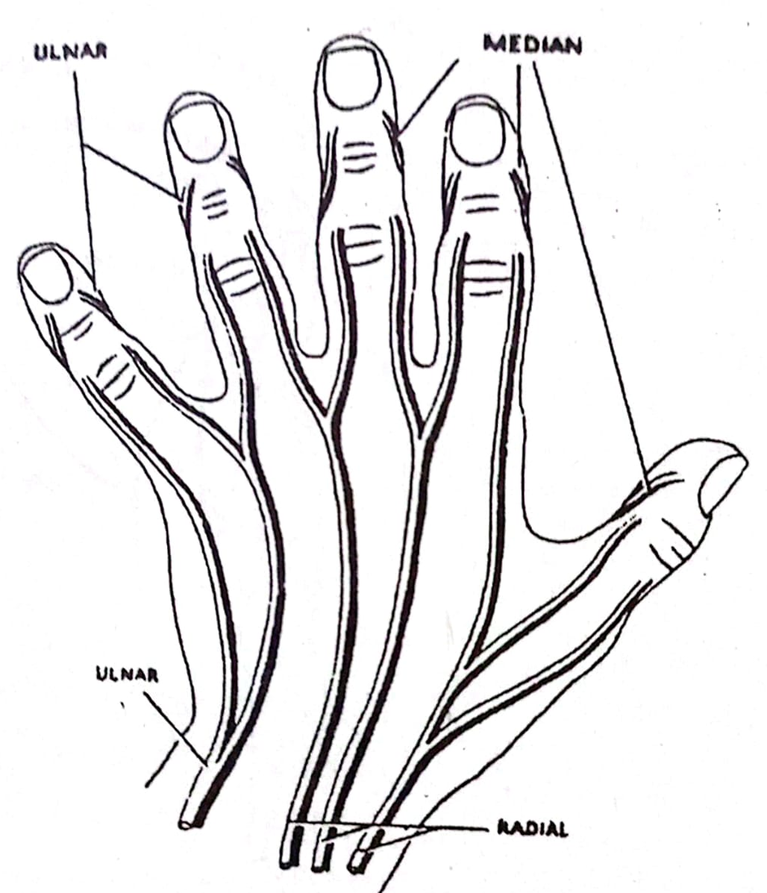
Cutaneous Nerve Supply Of The Upper Limb
Core Knowledge
Cutaneous nerves of dorsum of hand
Dorsal cutaneous branch of ulnar nerve
Superficial branch of the radial nerve

Slide 10
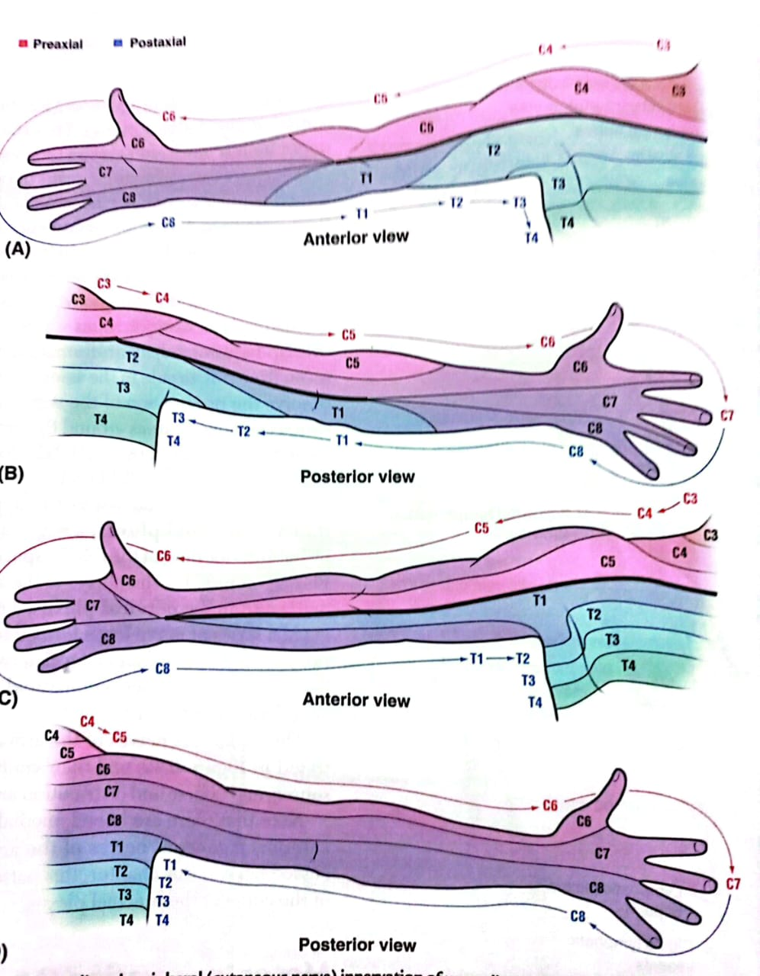
Dermatomes of Upper Limb
Core Knowledge
Dermatome
The area of the skin supplied by a single spinal segment is called a dermatome.

Slide 11
Core Knowledge

Slide 12
Core Knowledge

Slide 13
Sensory Loss in Nerve Injuries
Vertical Integration
Sensory Loss in the Axillary Nerve Damage
Injury can lead to sensory loss over the lower half of the deltoid. (Badge area).
Radial Nerve Damage in Axilla
Sensory loss in the posterior aspect of the arm.
Radial Nerve Damage in Spiral Groove
Sensory loss in the antero-lateral aspect of the arm.
Sensory loss in the posterior aspect of the forearm.

Slide 14
Sensory Loss in Nerve Injuries
Vertical Integration
Median Nerve Damage in Arm
Sensory loss in the lateral aspect of the palm of the hand and lateral three and a half fingers.
Median Nerve Damage in Carpal Tunnel
Sensory loss in lateral three and a half fingers
Ulnar Nerve Damage in Forearm
Sensory loss in dorsal aspect of medial one and a half fingers

Slide 15
Vertical Integration

Slide 16
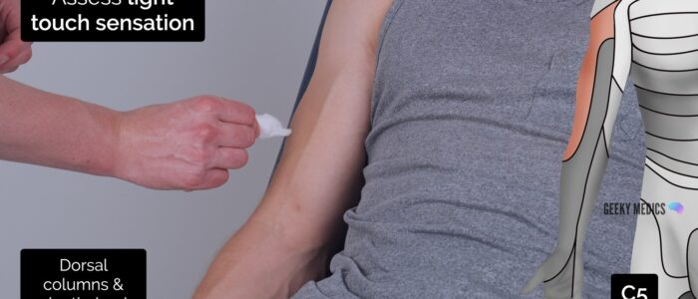
Managing Patient with Sensory Loss
Spiral Integration
Family Medicine
Diagnostic Assessment: Family physicians diagnose sensory nerve loss in the upper limb through history-taking, physical examination, and neurological assessments.
Initial Management and Referral: They provide initial treatment and decide on specialist referral, such as to neurologists or surgeons, for further evaluation and management.
Long-term Monitoring: Family physicians offer ongoing care, monitoring symptoms, and adjusting treatment plans to optimize the patient's quality of life.

Slide 17
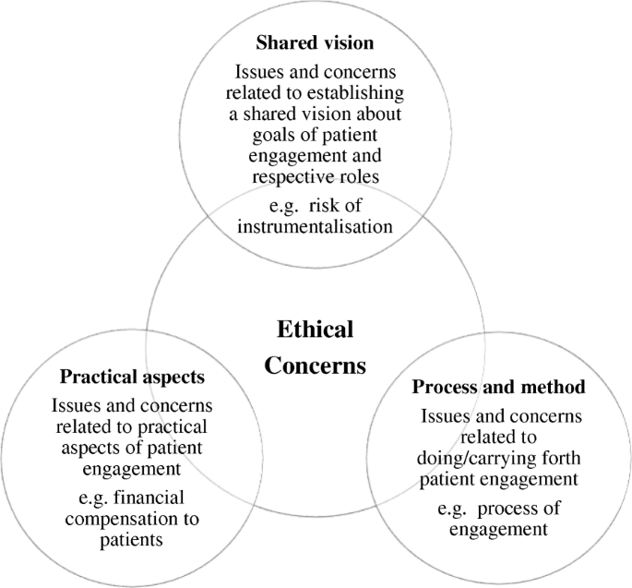
Ethical Considerations
Spiral Integration
Bioethics

Slide 18
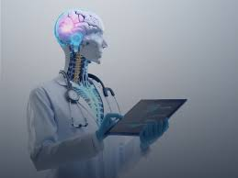
Role of AI in Managing Upper Limb Sensory Loss
Spiral Integration
Artificial Intelligence
1. Data Analysis and Pattern Recognition: AI analyzes patient data to identify patterns associated with upper limb sensory loss, aiding in early detection and accurate diagnosis.
2. Diagnostic Support: AI assists healthcare professionals by providing decision support in interpreting sensory tests, guiding prioritization of investigations and interventions.
3. Personalized Treatment: AI contributes to personalized treatment planning by analyzing individual patient characteristics, recommending tailored therapies based on predicted outcomes.

Slide 19
Experiences of SENSory Relearning of the UPPer Limb (SENSUPP) after Stroke and Perceived Effects: A Qualitative Study
Spiral Integration
Research Article
Authors: Hakan Carlsson, et al.
Date: 2022
https://www.ncbi.nlm.nih.gov/pmc/articles/PMC8955037/
Recently, it was shown that sensory relearning of the upper limb (SENSUPP) is a promising intervention to improve sensorimotor function after stroke.
The SENSUPP protocol is meaningful and beneficial in improving the functioning of the UL in chronic stroke. Improving compliance to the home training, regular follow-ups, and an exercise diary are recommended.

Slide 20
Learning Resources
1.Clinically Oriented Anatomy by Keith Moore 9th edition.
2. Snell’s Clinical Anatomy 7th edition.
3. Google Scholar
4. NCBI (National Center fro Biotechnology Information)

Slide 21
Take Home Message
Understanding the anatomy of the upper limb is crucial in diagnosing sensory loss effectively. Identifying the distribution of cutaneous nerves helps localize the site of injury and determine its potential causes. Mastery of upper limb anatomy enhances clinical assessment, guiding targeted interventions to alleviate sensory deficits and improve patient outcomes.

Slide 22
Thank You!

