Slide 1
Craniosynostosis

Slide 2
Introduction
Craniosynostosis : premature fusion of cranial sutures
Calvarial or facial deformities
Neurocognitive impairment
Otto was the first to explain pathogenesis in 1830
Virchow observation: premature suture fusion results in compensatory growth in other areas of skull
Recent studies: genetic regulation
Broadly: 1) single vs multiple suture
2) syndromic vs non syndromic

Slide 3
Moss and Salentjin (mid 20th cent) described “functional matrix theory”
Theory explains normal cranial vault development depends on normal neural mass and subsequent expansion
Suture itself may not be primary source of deformity
Complex interplay between cranial base and expanding brain may be real culprit
Management involves early diagnosis with interventions aimed at minimizing constricted brain growth and craniofacial deformities

Slide 4
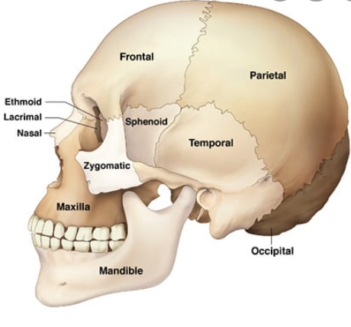
Anatomy & Embryology
Skull consists of neurocranium (cranial vault and base) and viscerocranium (facial bones)
Mammalian cranial vault has mainly 5 bones
Paired frontal and parietal bones and inter parietal bone with contributions from parts of temporal and sphenoid

Slide 5
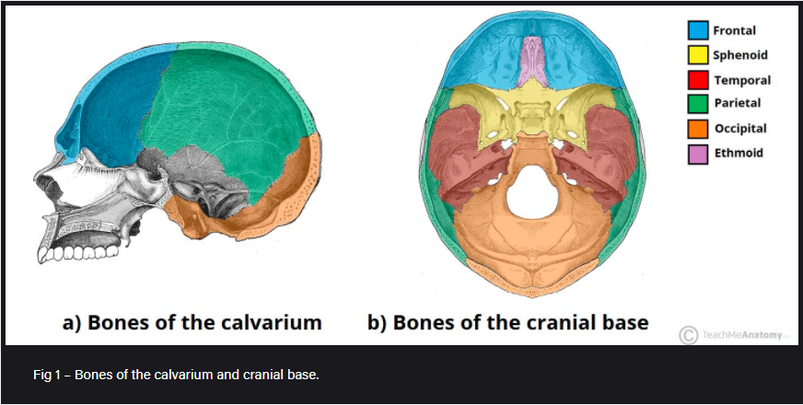

Slide 6
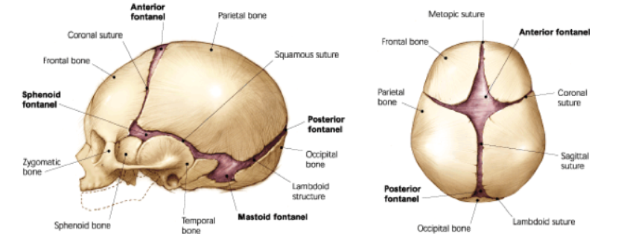
These bones derive from neural crest cells via intramembranous ossification
Boundaries between these bones form sutures
All sutures except metopic suture are initiated at a point where neural crest cells and mesoderm are in close approximation

Slide 7
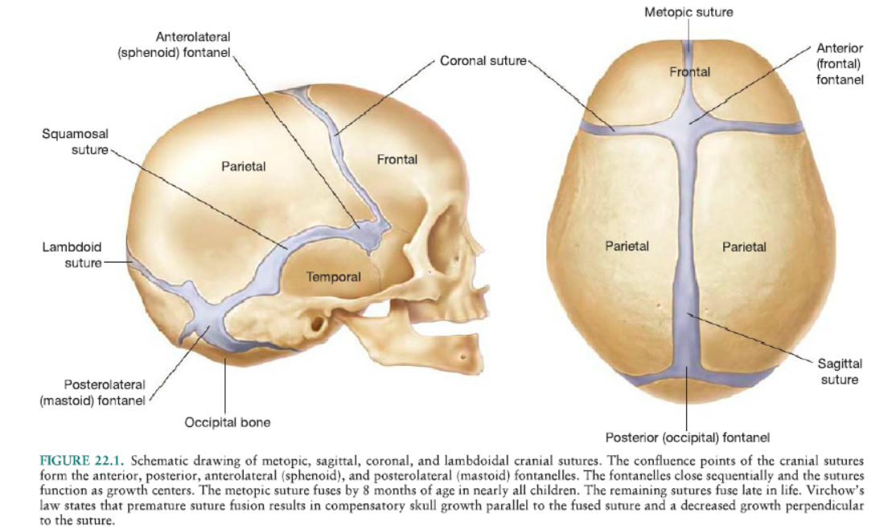

Slide 8
Growth occurs perpendicular to orientation of sutures
Driven by rapidly expanding brain during infancy
When a suture closes prematurely, normal perpendicular growth doesn’t occur
Compensatory growth occurs parallel to affected suture
Importance of cranial sutures:
Allows head to deform during parturition
Sutures couple rapid brain expansion early in life to growth of cranium
Craniosynostosis can impair brain growth and development

Slide 9
Epidemiology
Incidence is estimated to be between 1 in 2000 – 2500 live births
In Pakistan, it has been found as 2 per 2,360 live births
(Craniosynostosis, Craniofacial reconstruction, TC, FOAR. (JPMA 66: 1611; 2016)
Non syndromic 0.4 to 1 in 1000 births
Most common suture involved is sagittal (45%), male : female 4:1
Unilateral coronal F:M 3:2
Bilateral coronal, metopic & lambdoid, no gender predilection

Slide 10
Pathogenesis
Numerous theories and explanations have been set forth for development of premature sutural fusion
1. genetic processes
2. external environmental causes

Slide 11
Genetics:
Genetic mutations: FGFR3, FGFR2, TWIST1
Causing abnormal signaling of growth factors and stem cells at dura mater-cranial suture interface
Genetic counseling recommended in all cases, of particular importance in coronal craniosynostosis or with multiple suture involvement
Gene expression in both dura and cranium, with timing of expression, targeted gene therapy for prevention of early suture fusion

Slide 12
Other potential causes:
Plural births
Fetal constraint upregulates FGFR2 causing change in cranial base
Lambdoid type – preterm labor
Maternal smoking
Nitrosatable drugs in utero
Paternal- mechanic, agriculture, forestry sector
In a nutshell-multifactorial

Slide 13
Types & various clinical presentations

Slide 14
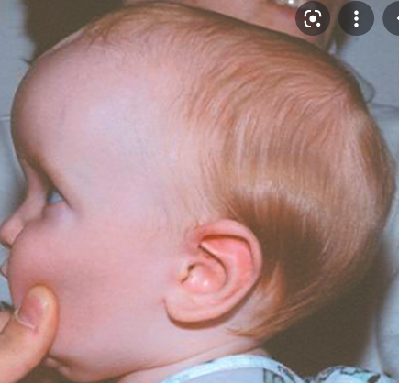
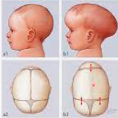
Sagittal (scaphocephaly)
Means boat shaped
premature fusion of the sagittal suture
premature infants
head is typically elongated in the anterior-posterior direction and shortened in the bilateral direction
frontal bossing & occipital coning
Boys are more frequently affected than girls, with a ratio of 3.5:1

Slide 15
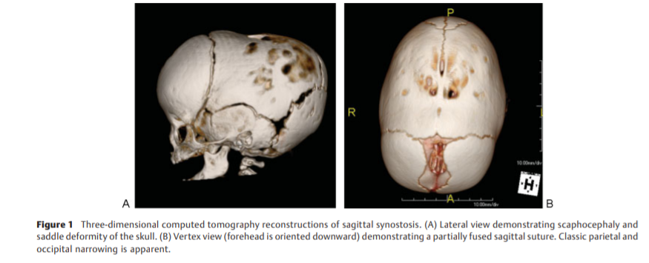
Sagittal synostosis

Slide 16
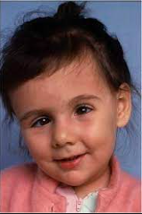
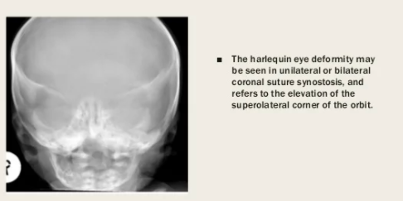
Anterior plagiocephaly
premature fusion of the unilateral coronal suture
On affected side, forehead is flattened because of arrested growth
On the opposite side, the forehead is pushed forward.
flat cheeks on the side of synostosis and nasal septum deviation towards normal side
F:M 2:1

Slide 17
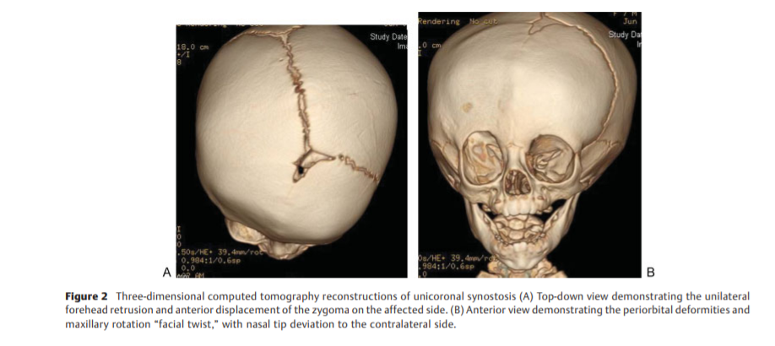
Anterior plagiocephaly

Slide 18
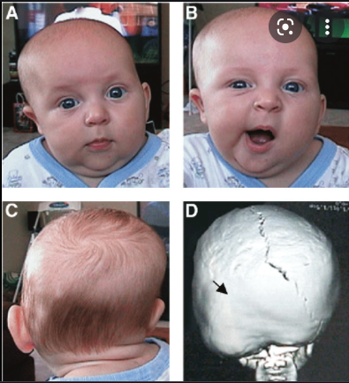
Posterior plagiocephaly
unilateral lambdoid synostosis.
Frontal and occipital bossing can develop contralateral to the affected side.
ipsilateral ear and mastoid can be displaced downward.
In majority of cases, the ear is also displaced in the anteroposterior direction.
Clinically, the shape of the head from above can resemble a trapezoid

Slide 19
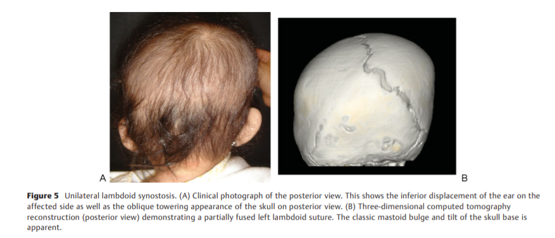
Posterior plagiocephaly

Slide 20
Positional plagiocephaly
difficult to distinguish between synostotic and positional plagiocephaly
caused by repeated pressure to the same area before or after birth
ipsilateral ear and forehead are usually displaced anteriorly, giving the head a parallelogram shape.
The ipsilateral occipital flattening can be accompanied by a contralateral occipital bossing.
The male-to-female ratio is 3:1.
effects of positional plagiocephaly are primarily cosmetic and do not require surgical intervention

Slide 21
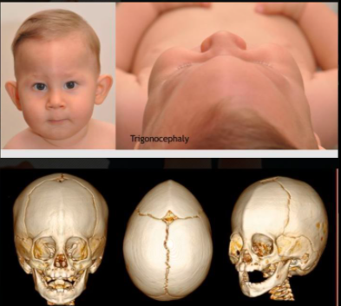
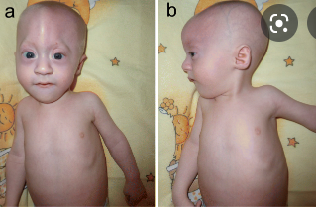
Trigonocephaly
premature fusion of the metopic suture
back of the head is broad
forehead is narrow and pointed.
Parietal and occipital prominence
When viewed from above, the forehead has a triangular shape.
The orbits are abnormally close together (hypotelorism)
Low dorsum with epicanthal folds

Slide 22
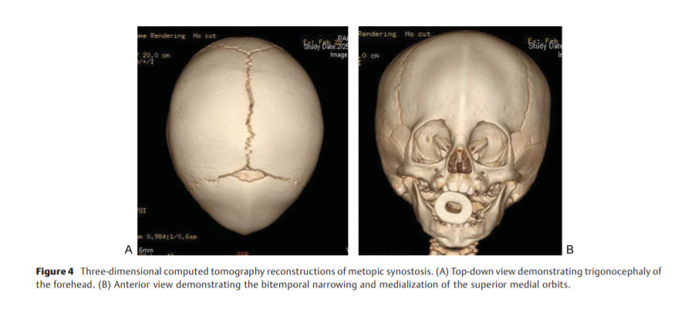
Trigonocephaly

Slide 23
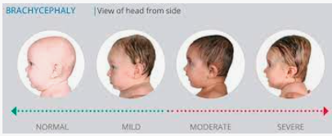
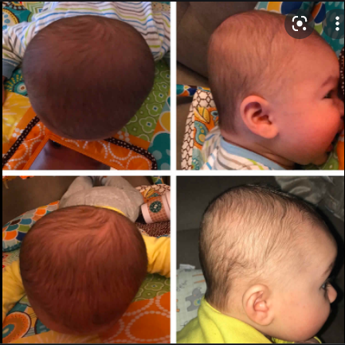
Brachycephaly
bilateral coronal synostosis.
fused coronal suture, the skull is short.
forehead and occipital part are flattened and the frontal bone is prominent and elongated in a vertical direction.
The orbits are abnormally separated (hypertelorism)

Slide 24
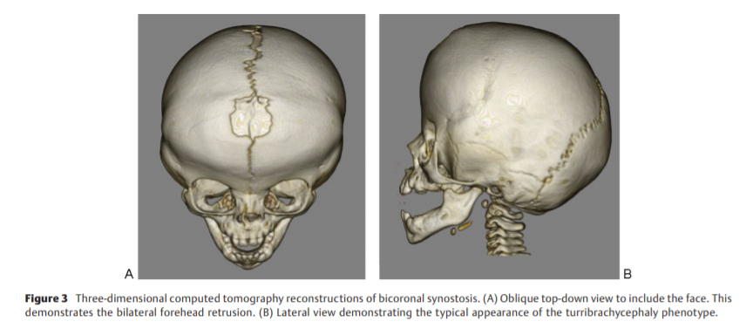
Brachycephaly

Slide 25
Anatomic & Neurodevelopment consequences
Raised Intra cranial pressure (ICP)
Hydrocephalus (syndromic:Apert)
Mental impairment
Altered morphology of brain
Affected brain growth and development

Slide 26
Raised ICP
Cranio cerebral disproportion
venous hypertension resulting from stenosis or complete closure of the sigmoid/jugular sinus complex.
The gold standard for detecting elevated ICP is direct monitoring
Intraparenchymal and intraventricular monitoring is
more accurate than epidural measurements
Radiographic signs: loss of subdural space, often with effacement of the basal cisterns and vertex sulci, ventricular compression, and scalloping of the cranial endocortex. This finding has been termed the "copper-beaten" skull and can be visualized on both conventional radiography and CT

Slide 27
Neurodeveloment
Both cortical and subcortical structures of the central nervous system are dysmorphic in craniosynostosis
despite surgical correction of skull shape, brain tends to follow growth pattern similar to pts in untreated craniosynostosis
Multiple factors affect neurocognitive development
Study revealed a developmental abnormality in 47% of patients age 5 or older following corrective surgery for craniosynostosis in infancy. (Becker et al)
problems with attention, language, information processing, and visual spatial skills

Slide 28
Kapp-Simon et al pose several hypotheses explaining how suture fusion leads to observed cognitive outcomes
sagittal synostosis → speech and language impairment
scaphocephaly associated with alterations in occipital and parietal brain and dorsolateral prefrontal cortex, areas known to be involved in language development, processing, and production
behavioral problems observed in children affected by metopic synostosis may be due to dysmorphism of the frontal lobes

Slide 29
Indications & considerations for surgery
Craniofacial team + informed consent
Cosmetic deformity or functional impairment
Most surgeons delay till child is 3 months
Debate early vs late (>1 yr )
Early→ minimized cerebral constriction
Improved morphologic result and better mental level
possible benefit of later intervention is a lower rate of revision due to decreased incidence of restenosis
between 3 - 6 months of age to take advantage of this period of rapid brain and skull growth, to provide an optimal chance for reossification of the surgical cranial defects, and to ensure ease of bone remodeling

Slide 30
timing of surgical intervention is influenced by surgeon preference, timing of referral to a specialist, and preferred surgical technique
Endoscopic < 3 mths → requires several months of molding helmet therapy postoperatively to optimize results
Open method:
do not require postoperative helmet molding and can be done later, as the bones are surgically placed in, not molded to, the desired position
Minimally invasive : 3-6 mths
Open cranial vault remodelling: 8-11 mths

Slide 31
Pre-operative evaluation
Thorough medical history
Physical examination (98% diagnostic accuracy in single suture)
Opthalmic screening
Imaging techniques
Plain radiographs in children → limited by low mineralization of cranium and low sensitivity to check for raised ICP
CT scan: thin slice CT high fidelity view of bony & sutural architecture and associated brain pathology (IR , cost)
Imaging indicated when surgeon must evaluate for changes in brain parenchyma, signs of hydrocephalus and ventriculomegaly, presence of tonsillar herniation, or in preoperative planning for cases in which calvarial bone graft will be needed

Slide 32
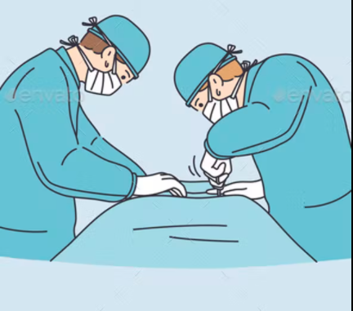
Surgical management
no consensus on the optimal surgical techniques for skull reconstruction
many techniques and modifications described
dependent on surgeon preference and experience alone, without comparative trials or agreed-upon aesthetic outcomes.

Slide 33
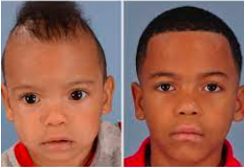
Sagittal craniosynostosis
Features
Goals
Elongated skull
Bitemp/biparietal narrowing
Frontal bossing
Occipital bulleting
Ridge over sagital suture
Affect ant or post skull
Reduce AP dimension
Increase skull height, width
Decrease frontal bossing
Decreasing occipital bulleting

Slide 34
Procedures
STRIP CRANIECTOMY (endoscopic vs open)
Near-total cranial vault reconstruction for children
3) Pi procedure:
involves more extensive strip craniectomy for anteroposterior shortening
+ modifications
Generally, greater degrees of deformity and scaphocephaly require lateral wedge, radial/frontal, and occipital osteotomies and subtotal calvarial reconstruction + post op helmet therapy

Slide 35
