Slide 2
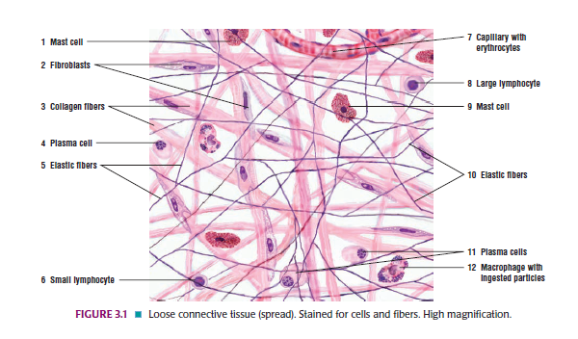
Muscloskeletal (MSK 1) Module 1st Year MBBS(LGIS) Connective Tissue II
Presenter: Dr. Kashif Date: 21-04-25
(APMO)

Slide 4
Motto, Vision, Dream
To impart evidence based research oriented medical education
To provide best possible patient care
To inculcate the values of mutual respect and ethical practice of medicine
Wisdom
Truth
Service

Slide 5
Professor Umar Model of Integrated Lecture

Slide 6
Learning Objectives
Identify dense regular and irregular connective tissue under microscope.
Illustrate histological structure of dense regular and irregular connective tissue.
Write two points of identification.
Differentiate between dense regular and irregular connective tissue
Microscopically.
Focus the slide.

Slide 7
Core Knowledge

Slide 8
Core Knowledge Classification Of Connective Tissue

Slide 9
Core Knowledge Classification Of Connective Tissue

Slide 10
Core Knowledge

Slide 11
Core Knowledge Dense Irregular Connective Tissue
Consists primarily of fibroblasts, and thick and densely packed collagen fibers
• Fewer other cell types and minimal ground substance
• Collagen fibers exhibit random orientation and provide
strong tissue support
• Concentrated in areas where resistance to forces from different
directions is needed

Slide 12
Dense Irregular Connective Tissue

Slide 13
Core Knowledge

Slide 14
Core Knowledge

Slide 15
Core Knowledge Dense Regular Connective Tissue

Slide 16
Vertical Integration

Slide 17
Vertical Integration Keloid

Slide 18
Family Medicine
Laser Keloid Scar Removal
Referral to specialized field of medicine is a part of family medicine.

Slide 19
How To Access Digital Library
Go to the website of HEC National Digital Library.
On Home Page, click on the INSTITUTES.
A page will appear showing the universities from Public and Private Sector and other Institutes which have access to HEC National Digital Library HNDL.
Select your desired Institute.
A page will appear showing the resources of the institution
Journals and Researches will appear
You can find a Journal by clicking on JOURNALS AND DATABASE and enter a keyword to search for your desired journal.

Slide 20
Research Article

Slide 21
Research Articles
https://www.ncbi.nlm.nih.gov/books/NBK507906/
Lipoma (CME activity)
https://www.statpearls.com/account/trialuserreg/?articleid=24318&utm_source=pubmed&utm_campaign=reviews&utm_content=24318

Slide 22
Abstract
Lipomas are benign tumors of fat cells (adipocytes) that present as soft, painless masses most commonly seen on the trunk, but can be located anywhere on the body. Lipomas usually range from 1- >10 cm. They are mesenchymal tumors and are found anywhere in the body where normal fat cells are present. They are benign and have many histologic subtypes.

Slide 23
Assessment

Slide 24
1. Location in the human body where dense irregular connective tissue is present
tendon
ligament
skin
d. Liver
e. pancreas
2. Location in human body where dense regular connective tissue predominate
Skin
Perichondrium
Periosteum
Tendon
Ligaments
Both d and e

Slide 25
3.Which type of fibers are abundant in dense regular connective tissue
a. Collagen
b. Elastic
c. Reticular
d. None of above
e. Argyrophilic fibers
4.Which of the following is example of connective tissue proper
a. Mucoid
b. Mesenchymal
c. reticular
d. Dense regular
e. elastic

Slide 26
Key
C
F
A
d

Slide 27
Learning Resources
1.Clinically Oriented Anatomy by Keith Moore 9th edition.
2.Cunningham’s Manual of Practical Anatomy by G.J. Romanes, 16th edition, Vol-I, II and III
3.http://www.anatomyzone.com 3D anatomy
https://teachmeanatomy.info

Slide 28
Take Home Message

Slide 31
Thank You

