Slide 1
.

Slide 2
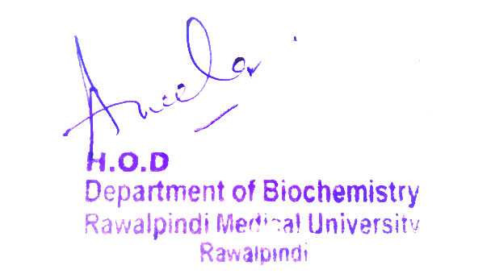
Classification And Mechanism of Action of Endocrine Hormones Endocrinology Module LGIS
Presentor: Dr. Rahat
Date:00-00-2025

Slide 3
Motto, Vision, Dream
Wisdom
Truth
Service
To impart evidence based research oriented medical education
To provide best possible patient care
To inculcate the values of mutual respect and ethical practice of medicine

Slide 4
Professor Umar Model of Integrated Lecture

Slide 5
Learning Objectives
Students will learn about endocrine hormones.
They will get to know about classification of hormones on the basis of:
their chemical structure
mechanism of action

Slide 6
HORIZONTAL INTEGRATION

Slide 7
Anatomical Aspect
HORIZONTAL INTEGRATION

Slide 8
Physiological Aspect

Slide 9
CORE KNOWLEDGE

Slide 10
What is endocrine hormone?
CORE KNOWLEDGE
It is a chemical messenger secreted by glands and specialized cells into circulating blood and acts on target cells on another location in the body.
Example:
Prolactin
ACTH
Oxytocin
Melanin
Thyroid hormones

Slide 11
3 General Classes Of Hormones
CORE KNOWLEDGE
.
Steroids:
Adrenal Cortex(Cortisol and Aldosterone)
Ovaries(Estrogen and Progesterone)
Testes (Testosterone)
Placenta (Estrogen and Progesterone)
Tyrosine Derivatives:
1.Adrenal Medulla(Catecholamines)
2.Thyroid(Thyroxine and Triiodothyronine)
Proteins And Polypeptides:
Pituitary hormones
Pancreas(Insulin+ Glucagon)
Parathyroid Gland(Parathormone)

Slide 12
Polypeptide And Protein Hormones
CORE KNOWLEDGE
Are stored in secretory vesicles until required
Exocytosis of vesicles by increased cytosolic Ca+2 or Camp
Peptide hormones are Water soluble, allowing them to enter circulatory system easily, where they act on target tissues
PreProHormone
ProHormone
Hormone
m

Slide 13
Steroid Hormones
CORE KNOWLEDGE
Are Not Stored
Stimulus
Rapid synthesis of steroid hormones from cholestrol
After synthesis, lipophilic nature allows them to diffuse across cell membrane

Slide 14
Amine Hormones 1.Thyroid Hormones
CORE KNOWLEDGE
Synthesized and stored in the thyroid gland
Most of the hormones bind with thyroxine binding globulin
Slow release of hormones to the target tissues
Enter the blood

Slide 15
2. Epinephrine and Norepinephrine
CORE KNOWLEDGE
Formed in the Adrenal Medulla
Released by exocytosis
Enter the circulation
Can exist in plasma in free form or in conjugation with other substances
Taken up into preformed vesicles and stored until secreted

Slide 16
.
CORE KNOWLEDGE

Slide 17
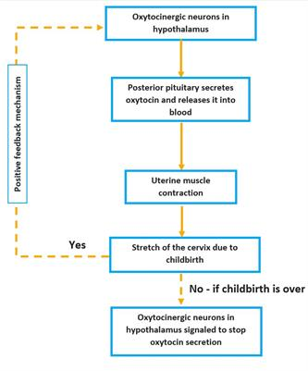
Feedback Control
CORE KNOWLEDGE

Slide 18
Hormone Transport
CORE KNOWLEDGE
1. Hydrophilic Hormone(lipophobic)
Water Soluble
(Peptides and catecholamines)
Dissolved in plasma
2.Hydrophobic(lipophilic):
Steroid and thyroid hormones
Circulate in blood
Bound to plasma proteins

Slide 19
.
Hormone receptors
In or on the cell surface
Protein
Peptides
Catecholamines
Nuclear
Thyroid hormones
Cytosolic
Steroid hormones
Retinoid
CORE KNOWLEDGE

Slide 20
Regulation Of Receptors
CORE KNOWLEDGE

Slide 21
Intracellular Signalling
CORE KNOWLEDGE

Slide 22
Ionotropic Receptors
CORE KNOWLEDGE

Slide 23
G protein cell receptor
CORE KNOWLEDGE

Slide 24
Enzyme Linked Receptors
CORE KNOWLEDGE
Hormones via Tyrosine Kinase:
Fibroblast growth factor
Leptin
Insulin
Prolactin
Growth Hormone
Insulin Like Growth Factor 1
Vascular endothelial growth factor

Slide 25
Intracellular Hormone Receptors and their signalling
CORE KNOWLEDGE
Adrenal and gonadal steroid hormones
Thyroid hormones
Vitamin D
Retinoid receptors

Slide 26
Second Messenger System: cAMP Pathway
CORE KNOWLEDGE
ACTH
AngiotensinII(epithelial cells)
Calcitonin
FSH
CRF
LH
PTH
Secretin
Somatostatin
TSH

Slide 27
Phospholipase C System
CORE KNOWLEDGE
Oxytocin
GnRH
Catecholamines(a receptors)
GHRH
TRH
PTH
Vasopressin(V1receptor)

Slide 28
Calcium Calmodulin System
CORE KNOWLEDGE

Slide 29
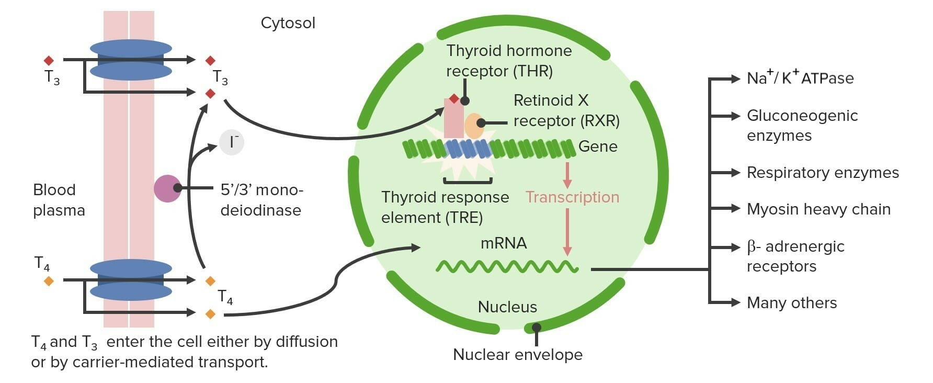
Hormones that act mainly on the genetic machinery of cell
CORE KNOWLEDGE

Slide 30
VERTICAL INTEGRATION

Slide 31
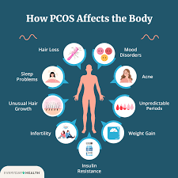
Hormonal Imbalance
VERTICAL INTEGRATION
Under secretion or over secretion of hormones can disturb homeostasis.
Example: Polycystic Ovary Syndrome
Due to overproduction of androgens

Slide 32
SPIRAL INTEGRATION

Slide 33
Spiral Integration Family Medicine
Family Medicine plays important role in following manner:
Diagnosis: Family physician plays a crucial role in recognizing the signs and symptoms such as developmental delays, muscle weakness, and neurological abnormalities.
Education: Family physicians educate patients and their families about Leigh syndrome, including its underlying genetic cause, clinical manifestations, prognosis, and available treatment options.
Multidisciplinary Care Coordination: Family physicians collaborate with a multidisciplinary team of health care professionals, including neurologists, genetic counselors, physical therapists, occupational therapists, and social workers, to provide comprehensive care for individuals with Leigh syndrome.
Community Support: Family physicians advocate for individuals with Leigh syndrome and their families within the healthcare system and the broader community.
Refer to Specialists: Family physicians refer to patient to the specialist for further treatment

Slide 34
Spiral Integration Artificial Intelligence
Artificial Intelligence plays role in following aspects:
AI algorithms can assist in the early detection of Leigh syndrome by analyzing medical imaging data such as MRI scans, aiding clinicians in making a timely diagnosis.
AI can help analyze genetic data to identify mutations associated with Leigh syndrome
AI-driven drug discovery platforms can identify potential therapies for Leigh syndrome. By analyzing vast amounts of biological data, including molecular pathways involved in the disease

Slide 35
Spiral Integration
Bioethics
Genetic Testing and Counseling
Prenatal Diagnosis and Reproductive Choices
Treatment Decision-Making
Research Ethics
Access to Healthcare and Support Services

Slide 36
Suggested Research Article
Spiral Integration
https://www.ncbi.nlm.nih.gov/books/NBK459251/
Topic: Polycystic Ovarian Disease
Introduction:
Polycystic ovarian syndrome (PCOS) is the most common endocrine pathology in females of reproductive worldwide. Stein and Leventhal initially described it in 1935. The prevalence ranges between 5% and 15%, depending on the diagnostic criteria applied. It is widely accepted among specialty society guidelines that the diagnosis of PCOS must be based on the presence of at least 2 of the following 3 criteria: chronic anovulation, hyperandrogenism (clinical or biological), and polycystic ovaries. It is a diagnosis of exclusion, and disorders that mimic clinical features of PCOS must be excluded. These include thyroid disease, hyperprolactinemia, and non-classical congenital adrenal hyperplasia. Selected patients may need more extensive workup if clinical features suggest other causes. Despite its high prevalence, PCOS is underdiagnosed and frequently takes more than 1 visit or different physicians to get identified, and these usually occur in more than a 1-year timeframe. It is a very frustrating process for the patient. Delays in diagnosis can lead to the progression of comorbidities, making it more difficult to implement lifestyle intervention, which is critical for the improvement of features of PCOS and quality of life

Slide 37
How To Access Digital Library
Spiral Integration
Go to the website of HEC National Digital Library.
On Home Page, click on the INSTITUTES.
A page will appear showing the universities from Public and Private Sector and other Institutes which have access to HEC National Digital Library HNDL.
Select your desired Institute.
5. A page will appear showing the resources of the institution
6. Journals and Researches will appear
7. You can find a Journal by clicking on JOURNALS AND DATABASE and enter a keyword to search for your desired journal.

Slide 38
Learning Resources
Guyton and Hall
Google Images

Slide 39
.

