Slide 1
CORROSIVE INJURY
BY DR FARYAL AZHAR

Slide 2


Slide 3
"Hadith of the Holy Prophet, peace be upon him warned of the double penalty for the one who commits suicide. Here are the words of the Prophet S.A.W: Abu Hurayrah narrated that the Holy Prophet (S.A.W) said: Whoever kills himself down from the mountain, so they will be in the Fire, to abide therein, and will continue to fall remain there. Poison you and the person who removed the poison will be in his hands at the fire of hell he does and always will be there. Whoever kills himself with an iron weapon, and then the weapon will be in his hands which he hit in the belly of hell fire will always and forever will always remain there (Bukhari, Hadith: 5442).

Slide 4
Caustic injury
Accidental: Children
Suicidal: Adults
Alkalis swallowed accidently more commonly.

Slide 5
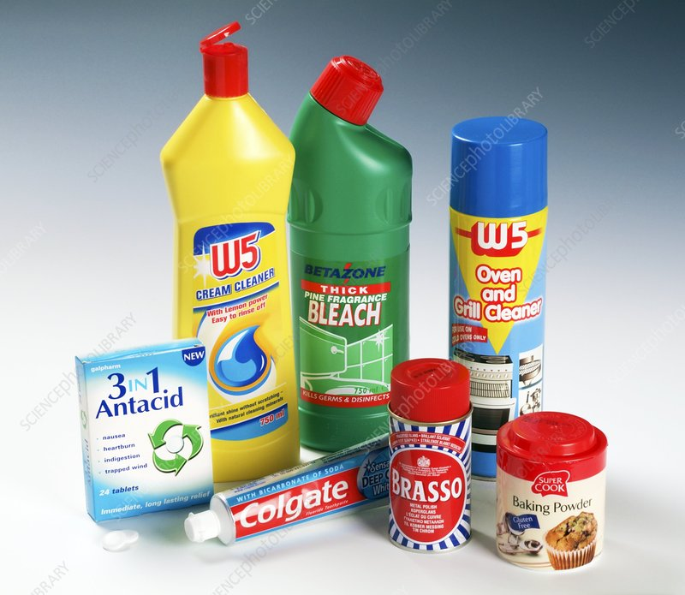

Slide 6
Pathology
Acute injury: Potential for perforation
Chronic injury: Strictures

Slide 7
Pathology
Factors affecting acute injury
Nature of caustic substance
Concentration
Quantity swallowed
Time of contact

Slide 8
Pathology
Alkalis dissolve tissues leading to perforation
Acids cause coagulative necrosis.

Slide 9
Most affected area of esophagus is striated smooth muscle interface.
Time of contact if prolong then more damage.

Slide 10
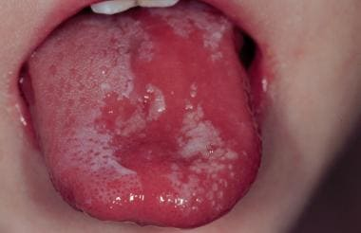

Slide 11
Phases
First phase : acute necrotic phase – 1-4 days, coagulation of intracellular proteins.
Second phase : granulation tissue formation – 3 – 5 days, granulation tissue fill the defect and it lasts for 10 to 12 days.

Slide 12
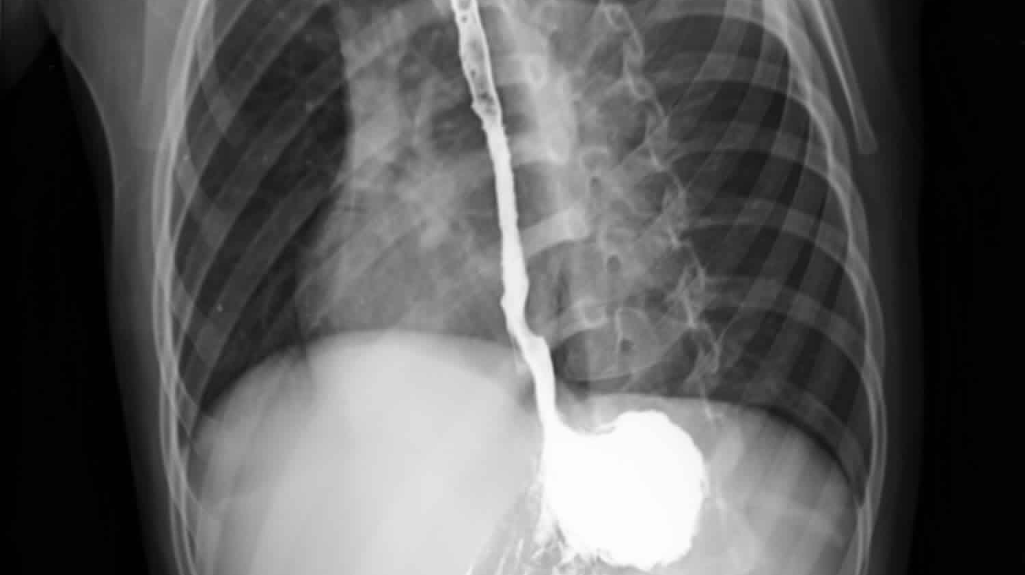

Slide 13
Third phase is of cicatrization. Contraction of connective tissue leads to stricture formation.
This phase needs attention to stop stricture formation.

Slide 14
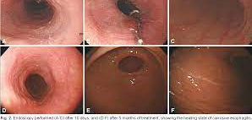

Slide 15
Clinical manifestations:
Initial phase: pain in mouth, hyper salivation, odynophagia and dysphagia. Bleeding , Vomit.
Quiescent period symptoms disappears.
Third phase : again dysphagia.

Slide 16
Clinical findings
Respiratory complications: laryngeal spasm, edema, pulmonary edema.
Oral cavity examination reveals evidence of burn

Slide 17
Endoscopic grading
First degree: Mucosal hyperemia and edema
Second degree: Limited hemorrhage, ulceration and pseudo membrane formation
Third degree: Sloughing of mucosa, charring, blockage of lumen by edema and perforation.

Slide 18
Location of caustic injury
Pharynx 10%
Esophagus 70%
Stomach 20 %

Slide 20
Treatment
Immediate treatment: Limiting burn by administering neutralizing agent
Lye or alkali neutralized with half strength vinegar, lemon juice or orange juice.

Slide 21
Treatment
Acid neutralized with milk, egg white and antacids.
Broad spectrum antibiotics
Feeding jejunostomy

Slide 22
Treatment
Early dilatations with Bougies
Perforations needs emergency gastrectomy or esophagectomy

Slide 23
Treatment
Bougies used are maloneys and Tucker for dilatations of esophagus.
Surgery indicated where too much stenosis.
Fistula
Medistinitis

Slide 24
Surgical options
Esophagectomy
Jejunal transposition
Colonic transposition.

Slide 25
Take home message
Prevention is better then cure
For children keep these article out of their reach.
For adults, this method is very painful for committing suicide.

Slide 26

This Photo by Unknown Author is licensed under CC BY-SA

