Slide 2
2nd Year MBBS Gastrointestinal Tract Module Large Group Interactive Session (LGIS) Cancer
Presenter: Dr. Almas Ajaz

Slide 3
Motto, Vision, Dream
To impart evidence based research oriented medical education
To provide best possible patient care
To inculcate the values of mutual respect and ethical practice of medicine
Wisdom
Truth
Service

Slide 4
Professor Umar Model of Integrated Lecture

Slide 5
Learning Objectives
At the end of this session students should be able to
Understand the Molecular and Genetic Basis of Cancer
2. Explore the Biochemical Pathways Altered in Cancer
3. Examine the Role of the Tumor Microenvironment and Immune Evasion in Cancer

Slide 6
Interactive Session
A 57-year-old woman, named Jane, presents to her primary care physician with complaints of progressive abdominal discomfort, bloating, early satiety, and unintentional weight loss over the past few months. She has a past medical history of hypertension, controlled with medication, and osteoarthritis. On physical examination, she has tenderness in the right lower quadrant of her abdomen

Slide 7
Tissue Specificity: How different cancers target specific body tissues, altering the anatomy and function of organs like the breast, lung, or colon.
Metastasis Mechanism: The process by which cancer cells spread from their original site to other parts of the body, affecting various organs and tissues.
Structural Alterations: Changes at the cellular and tissue levels, such as tumor growth disrupting normal anatomical structures and causing physical symptoms.

Slide 8
Physiology of Cancer
Impact on Organ Function: Cancer's metabolic reprogramming can affect organ functions by altering energy use, potentially leading to organ dysfunction or failure.
Systemic Effects: The release of cancer cell-derived factors and the body's response can lead to systemic effects, such as cachexia, impacting overall physiology.
Immune System Interaction: Cancer alters immune system function, leading to a complex interaction between tumor growth and immune response, affecting the body's ability to fight other diseases.

Slide 10
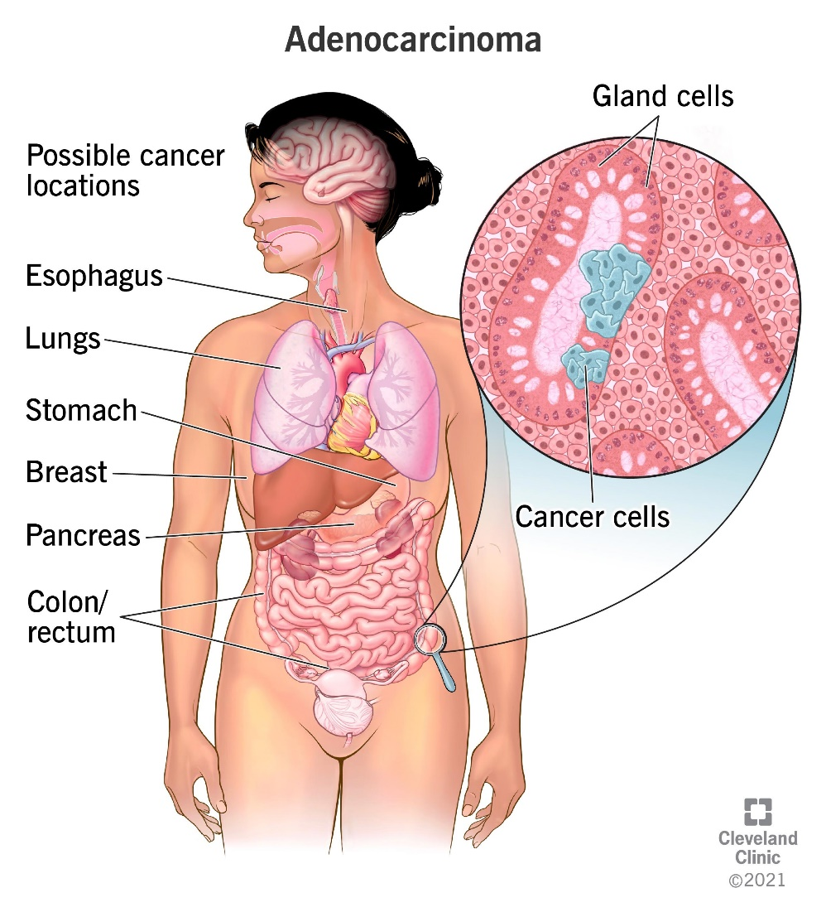
HORIZONTAL INTEGRATION (ANATOMY AND PHISOLOGY )

Slide 11
CANCER
Cancer is a complex group of diseases characterized by the uncontrolled growth and spread of abnormal cells in the body. It can affect virtually any tissue or organ, leading to a range of health problems and potentially life-threatening conditions. The development of cancer is often associated with genetic mutations that disrupt the normal regulatory mechanisms of cell growth and division

Slide 12
Normal cells in the body undergo a tightly regulated process of growth, division, and death, known as the cell cycle.
When this regulatory system malfunctions due to genetic alterations, cells may begin to proliferate uncontrollably, forming a mass of tissue known as a tumor.
Not all tumors are cancerous; benign tumors do not spread to other parts of the body and are generally less harmful. However, malignant tumors, or cancers, have the ability to invade nearby tissues and can metastasize, spreading to distant organs through the bloodstream or lymphatic system.

Slide 13
Pathophysiology
Cancer is, ultimately, a disease of genes. In order for cells to start dividing uncontrollably, genes which regulate cell growth must be damaged.
Proto-oncogenes are genes which promote cell growth and mitosis, and tumor suppressor genes discourage cell growth, or temporarily halt cell division to carry out DNA repair. Typically, a series of several mutations to these genes are required before a normal cell transforms into a cancer cell.
When normal cells are damaged beyond repair, they are eliminated by apoptosis (A). Cancer cells avoid apoptosis and continue to multiply in an unregulated manner (B).

Slide 14
Carcinogenesis
Is the process during which normal genes are damaged so that cells lose normal control mechanisms of growth and proliferate out of control.
When the genes of a single cell are altered by a carcinogenic event, the offspring of the single cell continue to mutate and divide, producing even more virulent mutant clones

Slide 15
Phases of carcinogenesis
Initiation - is the conversion of normal cell to tumor cell. It has an initiator, which is an agent that permanently and irreversibly alters DNA structure within a cell. This can occur after á single exposure to an agent, such as chemical compounds, radiation and viruses. These are examples that can initiate carcinogenesis.
Promotion - is the process of altering the genetic expression of a cell, by increasing DNA synthesis, increasing the number of copies of a particular gene and altering intercellular communication. A promote is an agent that favors this activity. The effects of promoting agents are transitory and potentially reversible. It is the repeated, frequent application of or exposure to a promoter that is necessary to stimulate latent tumor cells to form tumors and complete the neoplastic transformation. Examples of promoters are hormonal preparations, alcohol, tobacco, dietary fat and certain lifestyles.

Slide 16
Progression – is an irreversible phase in which the cells are led to morphologic changes and malignant behavior. Both initiation and promotion are necessary for the complete transformation of the cell. A cell must be transformed by an initiating agent before further neoplastic changes can occur. Then the promoting agent further leads the cells towards progression up to the point when malignancy occurs.

Slide 17
Core Knowledge

Slide 18
Core Knowledge
Benign growth vs. Malignant Tumors

Slide 19
Core Knowledge
Metastasis
Cancer cells move from their original location to other sites.
Routes of Metastasis
Local Seeding: Distribution of shed cancer cells occurs in the local area of the primary tumor.
Blood-borne Metastasis: Tumor cells enter the blood, which is the most common cause of cancer spread.
Lymphatic Spread: Primary sites rich in lymphatics are more susceptible to early metastatic spread.

Slide 20
Metastasis
Core Knowledge
Cells in an invasive tumour can separate off, digest a pathway through the extracellular matrix and enter the bloodstream. When they reach a permissible site, they can exit (extravasation) the blood stream and set up shop as secondary tumours (metastases).

Slide 21
Common Sites of Metastasis for Different Cancer Types Breast Cancer – bone, lung, liver, brain 2. Lung Cancer – brain, bone, liver, lymph nodes, adjacent structures 3. Colorectal Cancer – liver, lymph nodes, adjacent structures 4. Prostate Cancer – Bone(esp. spine and legs), pelvic nodes 5. Melanoma -– GIT, lymph nodes, lung, brain 6. Primary Brain Cancer – CNS
Core Knowledge

Slide 22
Cancer Classification
Core Knowledge
1.Solid Tumors: Associated with the organs from which they developed, such as breast or lung cancer
2.Hematological Cancers: Originate from blood-cell forming tissues, such as the leukemias and the lymphomas

Slide 23
Grading and Staging - Are methods used to describe the tumor, these methods describe the extent of the tumor, the extent to which malignancy has increased in size, the involvement of regional nodes, and metastatic development. Grading a tumor classifies the cellular aspects of the cancer. Staging classifies the clinical aspects of the cancer.
Core Knowledge

Slide 24
Core Knowledge
GRADING
Grade X: Grade cannot be determined
Grade 1: Cells differ slightly from normal cells and are well differentiated (Mild Dysplasia)
Grade II : Cells are abnormal and are moderately differentiated (Moderate Dysplasia)
Grade III: Cells are very abnormal and are poorly differentiated (Severe Dysplasia)
Grade IV: Cells are immature (anaplasia) and undifferentiated, cell of origin is difficult to determine.

Slide 25
STAGING
Stage 0: Carcinoma in Situ"cancer in place“
Stage 1: Tumor limited to the tissue of origin; localized tumor growth
Stage II : Limited local spread
Stage III: Extensive local and regional spread
Stage IV: Metastasis

Slide 26
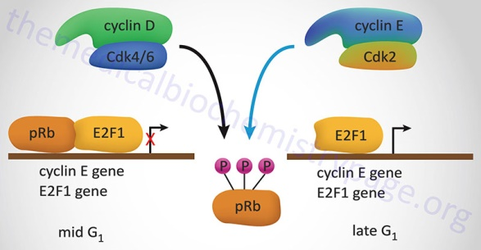
Mutations and Cancer Biochemistry:
Mutations cause abnormal protein functions, altering cell growth pathways.
Oncogenes produce proteins that can accelerate cell division uncontrollably.
Tumor suppressor genes, when mutated, fail to inhibit cell division, leading to tumor growth.

Slide 27
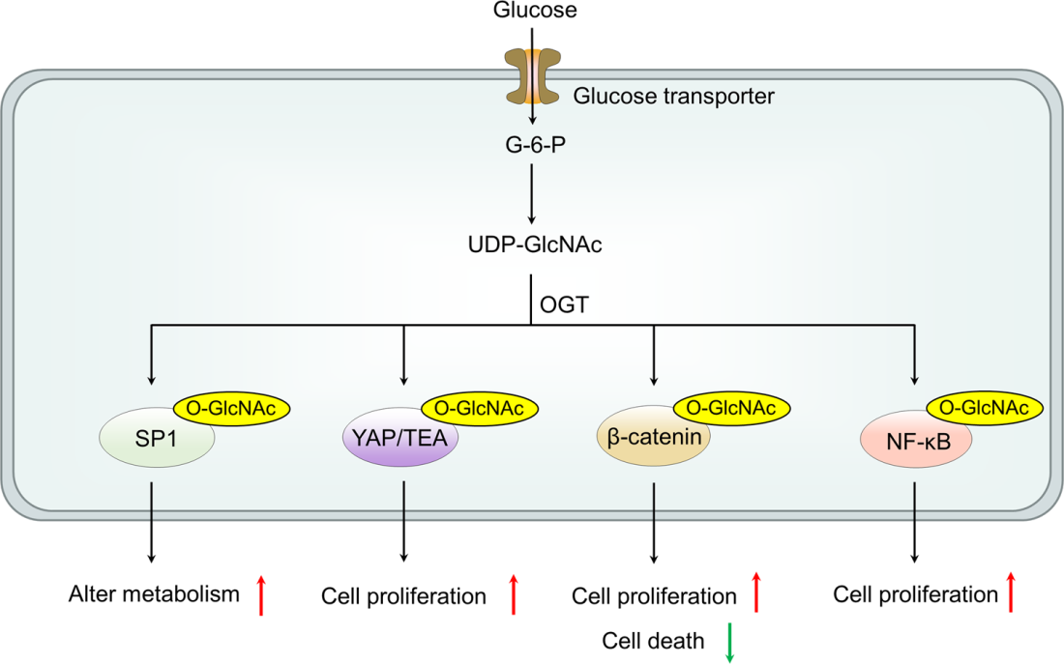
Signal Transduction Pathways in Cancer:
Altered signaling pathways promote cancer cell proliferation and survival.
EGFR mutations activate downstream signaling cascades, bypassing normal growth controls.
Disruption of the PI3K/AKT pathway leads to increased cell growth and survival, contributing to cancer progression.

Slide 28
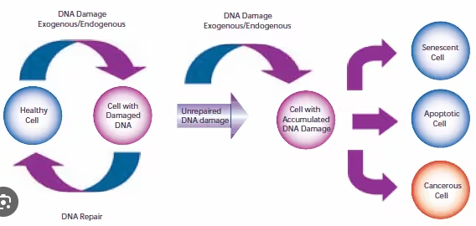
DNA Repair Mechanisms and Cancer:
Defective DNA repair systems lead to genomic instability and mutation accumulation.
BRCA1 and BRCA2 mutations impair repair of double-strand breaks, increasing breast and ovarian cancer risk.
Mismatch repair system failures result in microsatellite instability, seen in colorectal cancers.

Slide 29
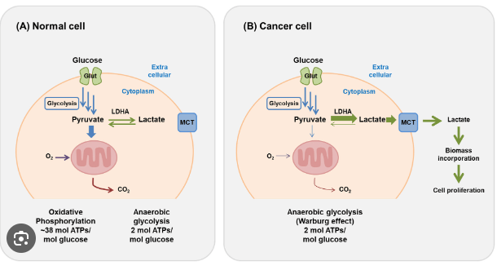
Cancer Metabolism: The Warburg Effect:
Cancer cells prefer glycolysis over oxidative phosphorylation for energy production, even in the presence of oxygen.
This metabolic reprogramming supports rapid proliferation by supplying building blocks for biomolecules.
Lactic acid production from glycolysis promotes a microenvironment conducive to cancer progression.

Slide 30
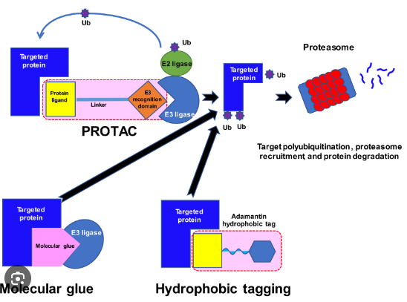
Protein Synthesis and Degradation in Cancer:
Dysregulated protein synthesis in cancer cells supports uncontrolled growth and proliferation.
The overexpression of eukaryotic initiation factors (eIFs) enhances general and specific protein synthesis, driving tumorigenesis.
Proteasome-mediated degradation of tumor suppressors, such as p53, diminishes cellular checkpoints.

Slide 31
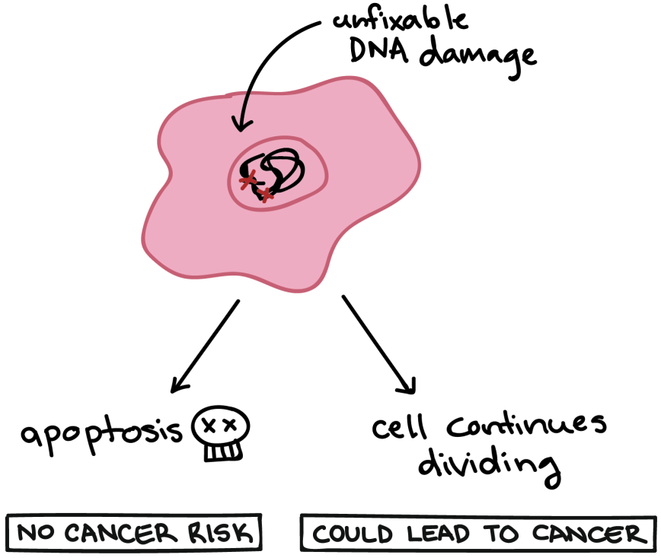
Apoptosis and Cancer:
Apoptosis, or programmed cell death, is often inhibited in cancer cells, allowing them to evade death.
Mutations in the Bcl-2 family proteins can prevent apoptosis, promoting cell survival.
The caspase cascade, crucial for apoptosis execution, is often disrupted in cancer cells.

Slide 32
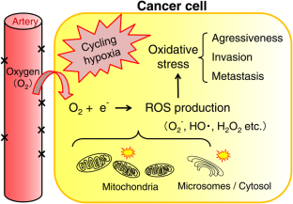
Oxidative Stress and Cancer:
Oxidative stress results from an imbalance between reactive oxygen species (ROS) production and antioxidant defenses.
High levels of ROS can damage DNA, proteins, and lipids, contributing to cancer development.
Cancer cells adapt to oxidative stress by upregulating antioxidant pathways, promoting survival and growth.

Slide 33
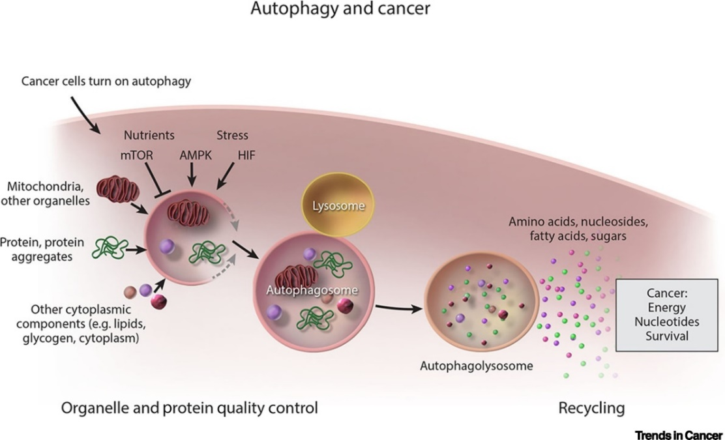
Autophagy and Cancer:
Autophagy can both suppress and promote cancer at different stages of tumor development.
In early stages, autophagy removes damaged organelles and proteins, preventing tumorigenesis.
In established tumors, autophagy supports cancer cell survival under metabolic stress and therapeutic challenge.

Slide 34
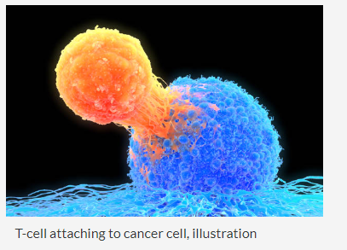
Immune Evasion by Cancer Cells:
Cancer cells modify surface antigens to escape recognition by the immune system.
The expression of immune checkpoint proteins, like PD-L1, inhibits T-cell mediated killing of cancer cells.
Secretion of immunosuppressive molecules creates a microenvironment that hampers immune response.

Slide 35
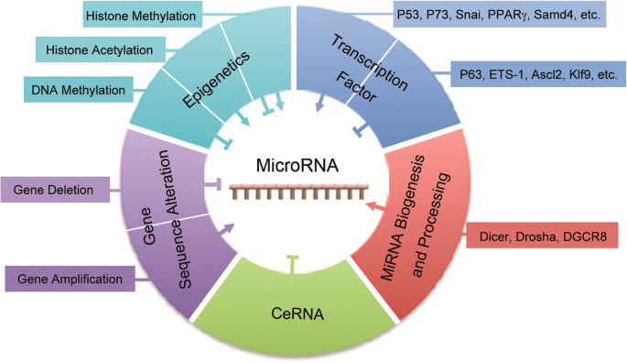
MicroRNAs and Cancer:
MicroRNAs (miRNAs) regulate gene expression post-transcriptionally, with roles in cancer initiation and progression.
Overexpression of oncogenic miRNAs (oncomiRs) can downregulate tumor suppressor genes.
Loss of tumor-suppressive miRNAs enhances oncogene expression.

Slide 36
Family Medicine
Preventive Care: Understanding genetic predispositions and biochemical markers for early detection and preventive strategies in at-risk families.
Personalized Treatment: Tailoring treatments based on the patient's genetic profile, considering familial patterns of cancer to optimize outcomes.
Holistic Management: Addressing not just the biological aspects of cancer but also the psychological, social, and lifestyle impacts on patients and their families, providing comprehensive car

Slide 37
Artificial Intelligence
Predictive Analytics: AI models predict cancer progression and patient outcomes by analyzing genetic mutations and biochemical markers, enhancing personalized medicine approaches.
Diagnostic Support: AI algorithms improve the accuracy of diagnosing cancers through pattern recognition in genetic data and imaging, facilitating early detection.
Treatment Optimization: AI helps in developing targeted therapies by analyzing vast biochemical datasets, identifying potential drug targets, and predicting treatment responses, improving efficacy and reducing side effects.

Slide 38
Bioethics
Consent and Confidentiality: Addressing ethical concerns in genetic testing for hereditary cancers, ensuring patient consent, and maintaining confidentiality of genetic information.
Equity in Access: Ensuring equitable access to cancer diagnostic tools, treatments, and new technologies across different populations to prevent disparities in cancer care.
Ethical Implications of Research: Considering the ethical implications of cancer research, including the use of human subjects, and balancing the potential benefits against the risks and ethical concerns.

Slide 39
Assessment
What is the primary cause of cancer?
a) Bacterial infection
b) Genetic mutations
c) Viral infection
d) Environmental pollution
2. Which of the following is a viral infection that can lead to cervical cancer in women?
a) Hepatitis B
b) Human Immunodeficiency Virus (HIV)
c) Human Papillomavirus (HPV)
d) Epstein-Barr Virus

Slide 40
What is the purpose of cancer staging?
a) Determine the type of cancer
b) Assess the response to treatment
c) Identify the genetic mutations
d) Evaluate the spread and severity of cancer
4. Which type of skin cancer is often associated with excessive sun exposure?
a) Melanoma
b) Leukemia
c) Lymphoma
d) Sarcoma
5-What is the role of oncogenes in cancer development?
a) Suppress the growth of cancer cells b) Trigger the growth of normal cells c) Repair damaged DNA d) Inhibit the spread of cancer

Slide 41
1- b) Genetic mutations
2-c) Human Papillomavirus (HPV)
3-d) Evaluate the spread and severity of cancer
4-a) Melanoma
5-b) Trigger the growth of normal cells

Slide 42
Suggested Research Article
Link:
https://link.springer.com/article/10.1134/S0006297923140018
Journal Name: Biochemistry (Moscow)
Title: Warburg Effect Revisited: Embodiment of Classical Biochemistry and Organic Chemistry. Current State and Prospects
Author Name: Leonid G. Menchikov, Alexander A. Shestov & Anatoliy V. Popov
Abstract:
The Nobel Prize Winner (1931) Dr. Otto H. Warburg had established that the primary energy source of the cancer cell is aerobic glycolysis (the Warburg effect). He also postulated the hypothesis about “the prime cause of cancer”, which is a matter of debate nowadays. Contrary to the hypothesis, his discovery was recognized entirely. However, the discovery had almost vanished in the heat of battle about the hypothesis. The prime cause of cancer is essential for the prevention and diagnosis, yet the effects that influence tumor growth are more important for cancer treatment. Due to the Warburg effect, a large amount of data has been accumulated on biochemical changes in the cell and the organism as a whole. Due to the Warburg effect, the recovery of normal biochemistry and oxygen respiration and the restoration of the work of mitochondria of cancer cells can inhibit tumor growth and lead to remission. Here, we review the current knowledge on the inhibition of abnormal glycolysis, neutralization of its consequences, and normalization of biochemical parameters, as well as recovery of oxygen respiration of a cancer cell and mitochondrial function from the point of view of classical biochemistry and organic chemistry.

Slide 43
Learning Resources
Textbook of Biochemistry, Lippincott 8th edition
Google scholar
Google images

Slide 44
How to access Digital Library
Open PC.
Open Internet.
Search HEC library.
Access public universities
Click on RMU
Read your desired article.

