Slide 1
COVID-19 & Influenza
Dr. Muhammad Mujeeb Khan
FCPS (Medicine)
Dip. DM (UK), Dip. Nutrition (Pak),
MSc. Infectious Diseases (UK)
Associate Professor
Rawalpindi Medical University, Rawalpindi

Slide 2
UNIVERSITY MOTTO, VISION, VALUES & GOALS
Mission Statement
To impart evidence-based research-oriented health professional education
Best possible patient care
Mutual respect, ethical practice of healthcare and social accountability.
Vision and Values
Highly recognized and accredited center of excellence in medical education, using evidence-based training techniques for development of highly competent health professionals, who are lifelong experiential learner and are socially accountable.
Goals
The Undergraduate Integrated Learning Program is geared to provide you with quality medical education in an environment designed.

Slide 3
SEQUENCE OF LGIS
Learning objectives
What is Covid-19 & influenza. How to diagnose it?(core concept = 70%)
Related pathology and pharmacology (horizontal integration 15%)
Recent advances and developments. (vertical integration – 10%)
Research article related to topic (3%) Ethics (2%)

Slide 4
LEARNING OBJECTIVES
At the end of the lecture, students will have learnt about
What are Covid-19 & influenza?
Transmission and risk factors
Pathophysiology
Approach and management
Complications and prevention
Recent advances

Slide 5
PROF UMER MODEL OF INTEGRATED LECTURE

Slide 6
INTRODUCTION OF COVID-19 & INFLUENZA
Both of the diseases primarily causes respiratory symptoms and has overlaping clinical features
Spread by respiratory droplets
May progress to pneumonia, ARDS and MOF
PCR is the gold standard, Rapid antigen test also available with lower senstivity

Slide 7
PANDEMICS OF COVID-19 AND INFLUENZA
ASPECT | COVID-19 | INFLUENZA H1N1
Pandemic year | 2019 | 2009
Origin | Wuhan, China | Mexico (Swine flue)
Cases | > 700 million | Estimated 1.4 billion cases
Deaths | 6.9 million | 284000
Case fatality rate | ~1-3% | ~0.02%
High risk group | Elderly, immunocompromised | Young adults, children, pregnant women

Slide 8
SARS-COV2 & INFLUENZA VIRUSES TYPES
Influenza viruses are of 4 types: A, B, C, D
Influenza A and B are clinically significant in human.
C and D are less relevant. Does not infect humans
SARS-cov2 has different variants like omicron, alpha, beta

Slide 9
INFLUENZA A & B VIRUSES
 | INFLUENZA A | INFLUENZA B
 | Most common & impactful | Less severe
Hosts | Humans, Birds (avian flue), Pigs (Swine flue) | Primarily humans
Subtypes | Based on 2 surface proteins Hemagglutinin (H): 18 subtypes (H1- H18) Neuraminidase (N): 11 Subtypes (N1-N11) | 2 main lineages Victoria lineage Yamagata lineage
Pandemic potential | Can undergo antigenic shift leading to new strains that causes pandemics | Do not cause pandemics

Slide 10
AVIAN INFLUENZA (BIRD FLU)
Causative Agent:
Influenza A viruses that primarily infect birds (e.g., H5N1, H7N9).
Transmission:
Spread from birds to humans through direct contact with infected birds or contaminated environments.
Rare human-to-human transmission.
Clinical Features:
Severe respiratory illness, pneumonia, and multi-organ failure.
High case fatality rate (up to 60%).
Prevention:
Avoid contact with infected birds or contaminated environments.
No widely available vaccine for humans

Slide 11
SWINE FLU (H1N1)
Causative Agent:
Influenza A virus subtype H1N1, which originated in pigs.
Transmission:
Spread from pigs to humans; human-to-human transmission is common.
Caused the 2009 H1N1 pandemic.
Clinical Features:
Similar to seasonal flu (fever, cough, sore throat, body aches).
Severe cases can lead to pneumonia and ARDS.
Prevention:
Annual flu vaccine includes H1N1 protection.
Antivirals (e.g., oseltamivir) for treatment and prophylaxis.

Slide 12
SEASONAL INFLUENZA
Causative Agents:
Influenza A (e.g., H1N1, H3N2) and Influenza B (Victoria, Yamagata).
Transmission:
Human-to-human transmission via respiratory droplets.
Clinical Features:
Fever, cough, sore throat, body aches, and fatigue.
Severe cases can lead to pneumonia and hospitalization.
Prevention:
Annual flu vaccine.
Antivirals (e.g., oseltamivir) for treatment and prophylaxis.

Slide 13
PATHOGENESIS
Covid-19
Influenza
Virus enters through respiratory tract
Virus enters through respiratory tract
Virus Hemaggltunin protein binds with respiratory epithelium (sialic acid receptor)
Virus Spike (S) protein binds with respiratory epithelium (ACE 2 receptors)
replicates inside cell
replicates inside cell
Release of proinflammatory cytokines
Release of proinflammatory cytokines
Respiratory + systemic symptoms
Cytokine storm may cause MOF
Respiratory + systemic symptoms
Cytokine storm may cause MOF
Thromboembolism in Covid-19

Slide 14
CLINICAL FEATURES
FEATURES | COVID 19 | INFLUENZA
Incubation period | 2-14 days | 1-4 days
Common Symptoms | Fever, cough, SOB, Sore throat, Fatigue, myalgias, headache | Fever, cough, sore throat, Nasal congestion, fatigue, myalgias, headache
Severe symptoms | Pneumonia, ARDS, MOF | Pneumonia, ARDS, Exacerbation of chronic condition (Astham, COPD)
Long term effects | Long Covid syndrome | Less common
Unique symptoms | Anosmia, dysguesia, Gastrointestinal symptoms | Abrupt onet, More nasal symptoms

Slide 15
RE-INFECTION
Reinfection in Covid 19 occurs due to
Waning immunity (antibodies decline over the period of time
Viral variants: like omicron can evade prior infection or vaccination
Reinfection in influenza: is Common due to
Antigenic drift: Small mutations in virus
Antigenic shift: Major changes in the virus
Vaccination is most effective way to reduce reinfection risk and severe outcome

Slide 16
CO-INFECTION
COVID-19 and influenza co-infections are possible, especially during flu season.
Co-infections may increase disease severity and complicate management.

Slide 17
INVESTIGATIONS
PCR: Gold standard test for both Covid and influenza. (1-4 hours)
Rapid antigen test: It has lower senstivity, but used for rapid screening (15-30 minutes)
Imaging: CXR & CT scan
Covid: Bilateral ground glass opacities/consolidation in covid 19
Chest X-ray: patchy infiltrates

Slide 18
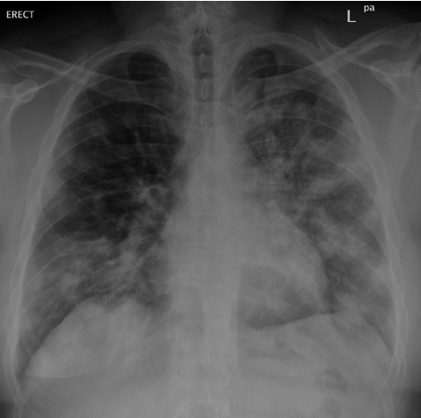
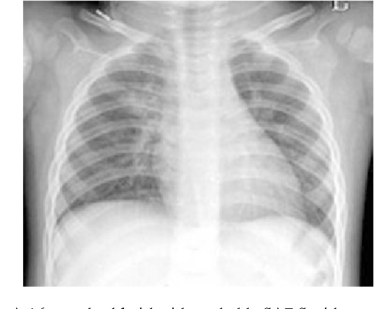
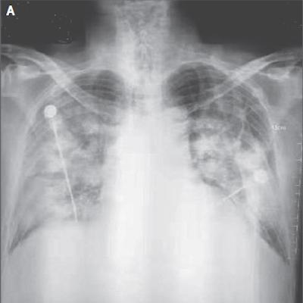
DIAGNOSTIC FINDINGS
CBC | Lymphopenia, Leukopenia, Leukocytosis
Inflammatory Markers | Raised CRP, ESR & Interleukin-6
CT Scan Chest | Ground Glass Opacities, Subsegmental Consolidation, Multilobular Consolidation

Slide 19
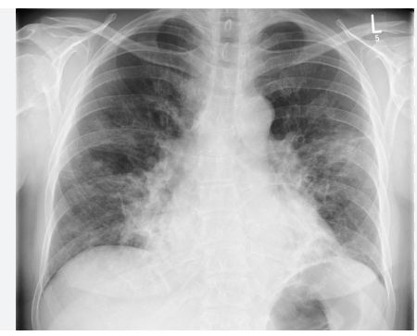
INFLUENZA A PNEUMONIA

Slide 20
RADIOLOGICAL DIAGNOSIS

Slide 21
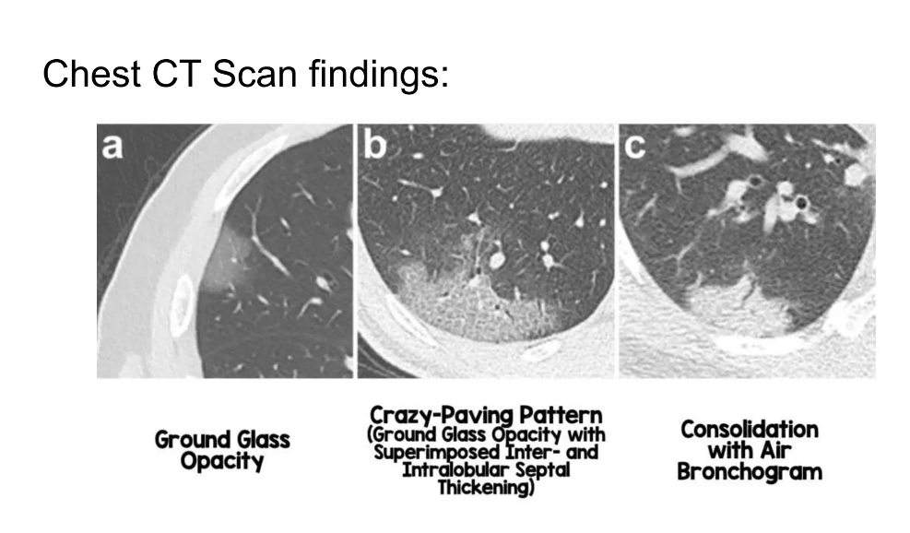
RADIOLOGICAL DIAGNOSIS

Slide 22
APPLYING STANDARD PRECAUTIONS FOR ALL PATIENTS
Respiratory Hygiene:
Encourage patients to cover their nose and mouth with a tissue or elbow when coughing or sneezing.
Mask Usage:
Provide medical masks to patients with suspected COVID-19 while they are in waiting areas or cohorting rooms.
Hand Hygiene: Perform hand hygiene after contact with respiratory secretions. Use alcohol-based hand rubs if hands are not visibly soiled; wash with soap and water when visibly soiled.

Slide 23
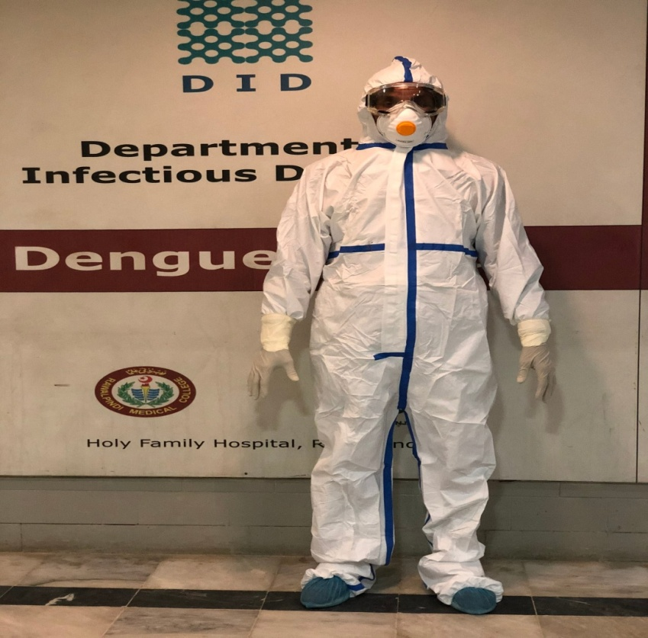
IMPLEMENTING EMPIRIC ADDITIONAL PRECAUTIONS
1. | Goggles
2. | Face Mask
3. | Gown
4. | Gloves
5. | Shoe Covers

Slide 24
TREATMENT OF MILD COVID AND INFLUENZA
Covid-19
Influenza
Symptomatic Treatment:
Antipyretics (e.g., paracetamol) for fever.
Hydration and rest.
Antiviral therapy: With in 5 days of symptom onset
Age > 75 years
Immunocompromised
Multiple comorbidities
Nirmatrelvir/ritonavir (Paxlovid)
Remdesivir for patients with hepatic impairment
Symptomatic Treatment:
Antipyretics (e.g., paracetamol) for fever.
Hydration and rest
Antiviral therapy: Start as soon as possible
Patient at increased risk of complication
Patients with progressive illness who do not require hospitalization
Oseltamivir

Slide 25
PREVENTION
Covid-19
Influenza
Public health measures:
Wear masks
Hand hygeine
Stay home when sick
Vaccinations:
mRNA vaccines: Pfizer, Moderna
Viral vector Vaccines: Pfizer, astrazeneca
Bivalent Boosters: For omicron variants
Antiviral prophylaxis:
Paxlovid for post exposre prohylaxis in high risk group
Public health measures:
Wear masks
Hand hygeine
Stay home when sick
Vaccinations:
mRNA vaccines: Pfizer, Moderna
Viral vector Vaccines: Pfizer, astrazeneca
Bivalent Boosters: For omicron variants
Antiviral prophylaxis:
Paxlovid for post exposre prohylaxis in high risk group

Slide 26
TREATMENT OF MODERATE - SEVERE COVID AND INFLUENZA
Covid-19
Influenza
Oxygen Support
Dexamethasone
Antiviral:
Remdesivir (For all patients without mechnaical ventilation)
Tocilizumab
Thromboprophylaxis
Oxygen Support
Antiviral therapy: Start irrespective of symptom onset
Oseltemavir
Peramivir
Zanamivir

Slide 27
COMPLICATIONS
Covid-19
Influenza
Respiratory:
Pneumonia, ARDS, Respiratory Failure
Higher risk of pulmonary embolism
Cardiac:
Myocarditis, Arrhythmia, Thromboembolism
Neurological:
Encephalitis, Stroke, GBS
Long term effects:
Long covid is common
Hyperinflammatory syndrome:
Cytokine storm is a hallmark of severe covid
Respiratory:
Pneumonia, ARDS, Respiratory Failure
High Risk of secondary bacterial infection
Cardiac:
Myocarditis and pericarditis are more common
Neurological:
Encephalitis, Stroke, Seizure
Long term effects:
Long covid is not common
Hyperinflammatory syndrome:
less common

Slide 28
ADVANCEMENTS:
Covid-19
Influenza
Drugs:
Immunomodulator: Tocilizumab/Baricitinib
Vaccines:
mRNA vaccines: Pfizer/moderna
Viral vector vaccines: Astrazeneca, J&J
Bivalent Boosters
Drugs:
Baloxavir Marboxil: Single dose oral antiviral
Vaccines:
Universal flue vaccines
Cell based and recombinant vaccines
Quadrivalent vaccines

Slide 29
REFERENCES
World Health Organization (WHO). Coronavirus disease (COVID-19): How is it transmitted? Geneva: World Health Organization; 2023.
Centers for Disease Control and Prevention (CDC). Influenza (Flu): Key facts about influenza (flu). CDC. 2023.
Zhu N, Zhang D, Wang W, Li X, Yang B, Song J, et al. A novel coronavirus from patients with pneumonia in China, 2019. N Engl J Med. 2020;382(8):727-33.
Krammer F, Smith GJD, Fouchier RAM, Peiris M, Kedzierska K, Doherty PC, et al. Influenza. Nat Rev Dis Primers. 2018;4:3.
Huang C, Wang Y, Li X, Ren L, Zhao J, Hu Y, et al. Clinical features of patients infected with 2019 novel coronavirus in Wuhan, China. Lancet. 2020;395(10223):497-506.
Uyeki TM, Bernstein HH, Bradley JS, Englund JA, File TM, Fry AM, et al. Clinical practice guidelines by the Infectious Diseases Society of America: 2018 update on diagnosis, treatment, chemoprophylaxis, and institutional outbreak management of seasonal influenza. Clin Infect Dis. 2019;68(6):e1-e47.
Berlin DA, Gulick RM, Martinez FJ. Severe COVID-19. N Engl J Med. 2020;383(25):2451-60.
World Health Organization (WHO). COVID-19 clinical management: living guidance. Geneva: World Health Organization; 2023.
Beigel JH, Tomashek KM, Dodd LE, Mehta AK, Zingman BS, Kalil AC, et al. Remdesivir for the treatment of COVID-19 — final report. N Engl J Med. 2020;383(19):1813-26.
Paules CI, Marston HD, Fauci AS. Influenza vaccines: good, but we can do better. J Infect Dis. 2019;219(Suppl_1):S1-S4.

Slide 30
Thank You

