Slide 2
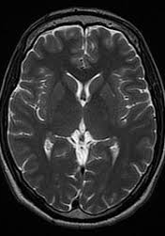
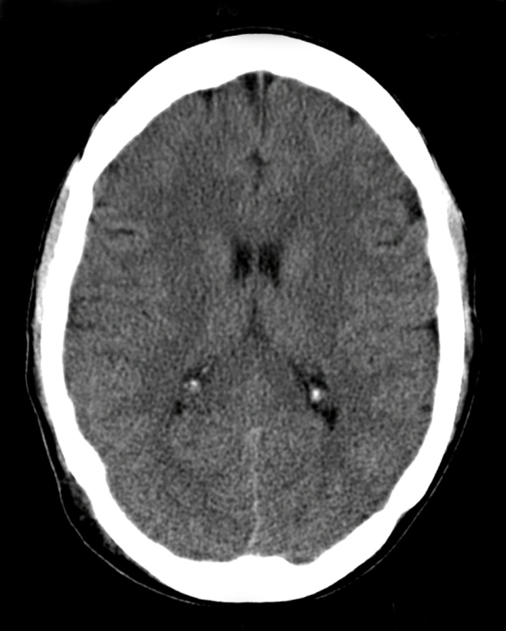
Foundations module (LGIS) CNS MODULE (RADIOLOGY) BASIC CNS ANATOMY & PATHOLOGY ON CT AND MRI
Professor Dr.UMAR
Vice chancellor Rawalpindi medical University

Slide 7
LEARNING OBJECTIVES
At the end of the LGIS. Students should be able to:
Describe …. Radiological techniques i.e CT and MRI
Identify…Radiological anatomy and pathology like Hydrocephalus, Cerebrovascular accidents
Classify…Cerebrovascular disease and hemorrhages
Explain…CNS trauma and clinical implications and management

Slide 8
Sequence of LGIS
Introduction To CT
Radiological anatomy on CT brain
Radiological pathology on CT brain
Introduction To MRI
Radiological anatomy on MRI brain and spine
Radiological pathology on MRI brain and spine
Clinical scenario and management
Research article
Biomedical ethics

Slide 9
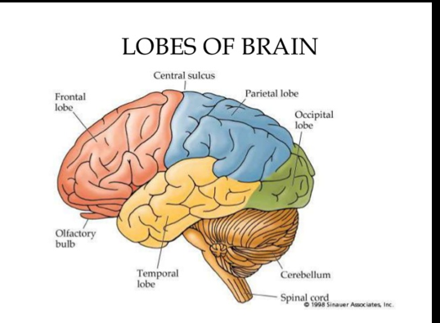
Horizontal integration

Slide 10
INTRODUCTION TO COMPUTED TOMOGRAPHY
CT (computed tomography)
Or CAT (computer assissted tomography)
Tomography refers to a process for generating 2D image slice of an examined organ of three dimensions 3D
Based on differential absorption of x ray by various tissues

Slide 12
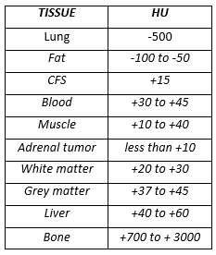
In CT, shades of gray correspond to a number on an arbitrary linear scale, expressed as HOUNSEFIELD UNITS (HU). (-1000 to +3000)
Human eye has limitations in number of different shades it can perceive. Monitors can display 256 gray scales & human eye can perceive 64 shades of gray
CT WINDOWING is done by setting the display to the HU of tissues of interest

Slide 16
SYSTEMIC APPROACH TO CT INTERPRETATION
Symmetry: Compare left & right side
Midline: Look for midline shift
Cross sectional anatomy:
Brain matter (gray matter, white matter, any lesions
CSF & ventricles
Skull & soft tissues
Subdural windows: Blood & collections adjacent to bone
Bone windows: Skull, orbit, sinuses, air

Slide 17
Interhemispheric fissure
Horizontal integration
Frontal Lobe
Lateral Ventricle
Splenium corpus callosum
Postcentral gyrus Parietal lobe
Occipital Lobe
Superior Sagittal Sinus

Slide 18
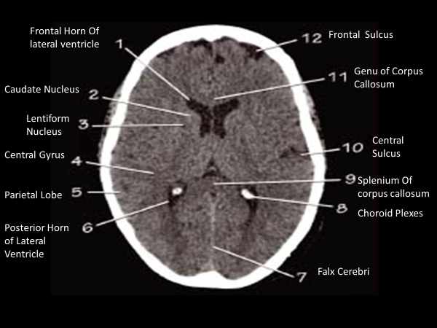

Slide 21
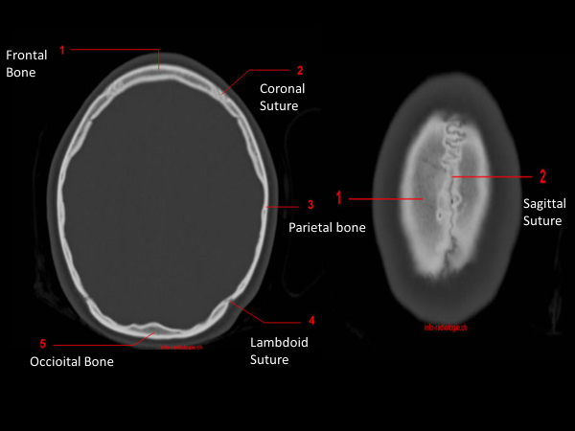

Slide 23
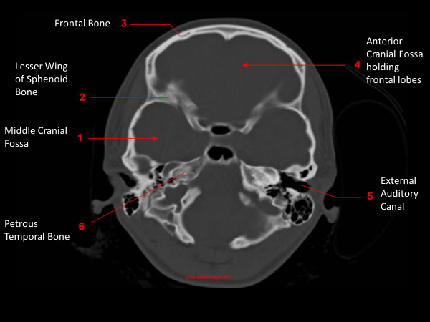

Slide 25
AXIAL IMAGES

Slide 26
Different Pathologies on CT
Vertical integration

Slide 27
Hydrocephalus

Slide 29
As a rule for ischemic infarcts best modality of choice is MRI (DWI)
First and best modality of choice for hemorrhagic stroke is CT

Slide 30
Epidural /subdural hemorrhage
Usually traumatic in origin
Subdural (concavoconvex)
Venous bleed
Low pressure
Slow growth
Epidural (biconvex)
Arterial bleed
High pressure
Rapid growth
Both may be life-threatening from mass effect and herniation

Slide 31
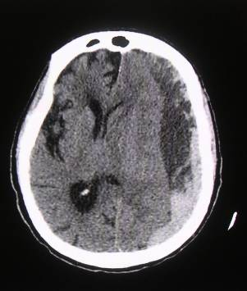

Slide 32
Subarachnoid bleed

Slide 33
BRAIN SPACE OCCUPYING LESION

Slide 34
BRAIN ABCESS

Slide 36
MRI BRAIN

Slide 37
INTRODUCTION TO MRI BRAIN
MRI (Magnetic Resonance Imaging)
An MRI scanner is actually a large, powerful magnet in which the patient lies. This powerful magnet is used to send signals to the body which interact with body protons. Then these protons in the body send magnetic signals according to their properties back to the scanner which receives these signals and forms and image with the help of computer attached to the scanner
MRI sensitization Body sensitized & magnetized body sends magnetic signals Received by MRI scanner Computer image formed from proton map

Slide 38
FAT -------------------high T1, high T2
Water / fluid-------low T1, high T2
Pathology may it be ischemia, inflammation or tumor has more fluid so they will show high T2 signal
Next we have special sequences
FLAIR: CSF fluid signal is suppressed so pathology gets prominent
DWI (diffusion weighted): detects movement free diffusion of protons. Restricted diffusion is high on DWI. Restricted diffusion seen in ischemia
Contrast enhancement: Gadolinium is given intravenously & T1W images are acquired. T1 pre & post contrast images are then assessed. Fluid in Pathology is usually low on T1 & hence if there is contrast enhancement it is better picked on T1 images.

Slide 39
FEW IMPORTANT SEQUENCES FOR BRAIN MR IMAGING

Slide 40
ADVANTAGES OF MRI
No radiations
Multiplanar imaging (axial, sagittal , coronal or oblique) without repositioning the patient. CT can only take axial cuts and planar images are reconstructed.
MRI has superior soft tissue contrast
Advanced techniques like diffusion, perfusion & spectroscopy allow precise tissue characterization
Some angiographic imaging technique s can be performed without intravenous contrast

Slide 41
DISADVANTAGES OF MRI
Expensive
Longer acquisition time
Noise & claustrophobia
MRI not safe with some metallic implants and foreign bodies

Slide 42
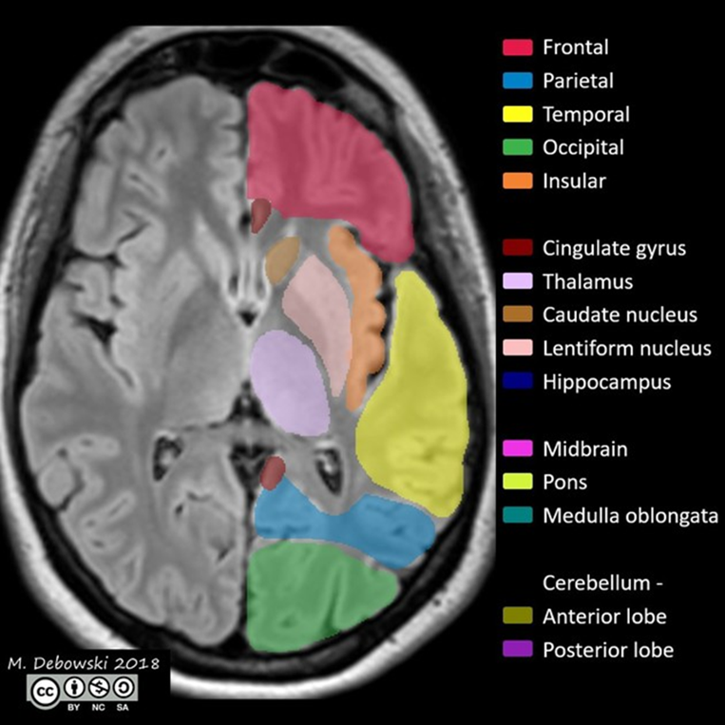
NORMAL ANATOMY
Horizontal integration

Slide 43
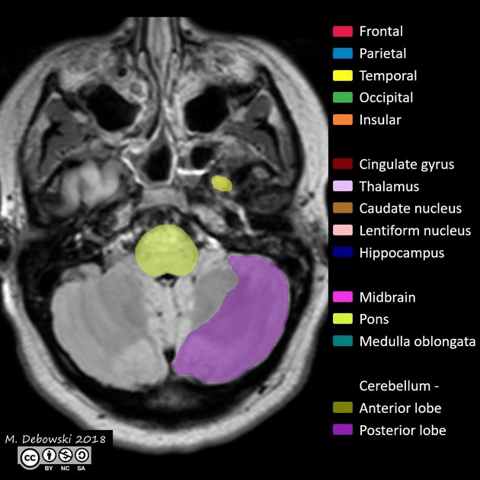

Slide 48
Sagittal view

Slide 52
Stroke
Headache
Many others

Slide 53
Indications
CT
MRI

Slide 54
Pathologies on MRI
Vertical integration

Slide 56
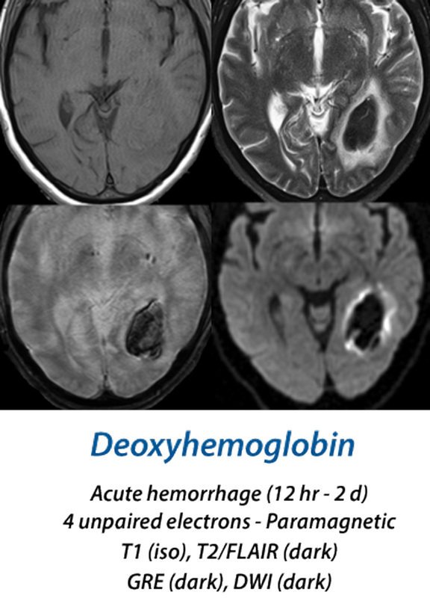

Slide 57
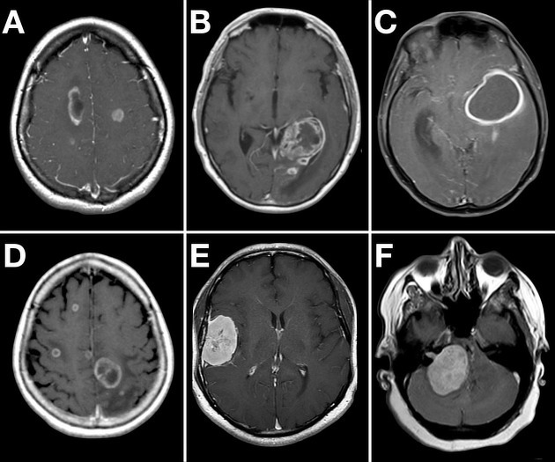

Slide 58
VERTEBRAL FRACRURE

Slide 59
SPINA BIFIDA CT &MRI

Slide 60
DEMYELINATING DISEASES

Slide 61
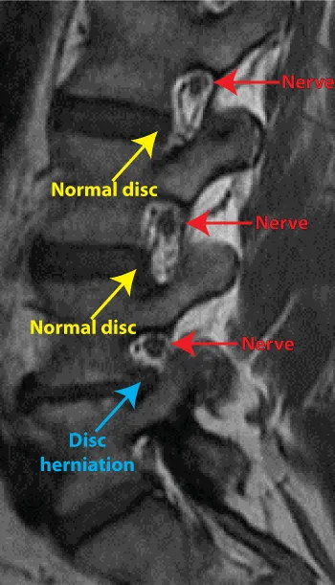
DEGENERATIVE DISEASE

Slide 62
Clinical scenario and management (vertical intregration)

Slide 63
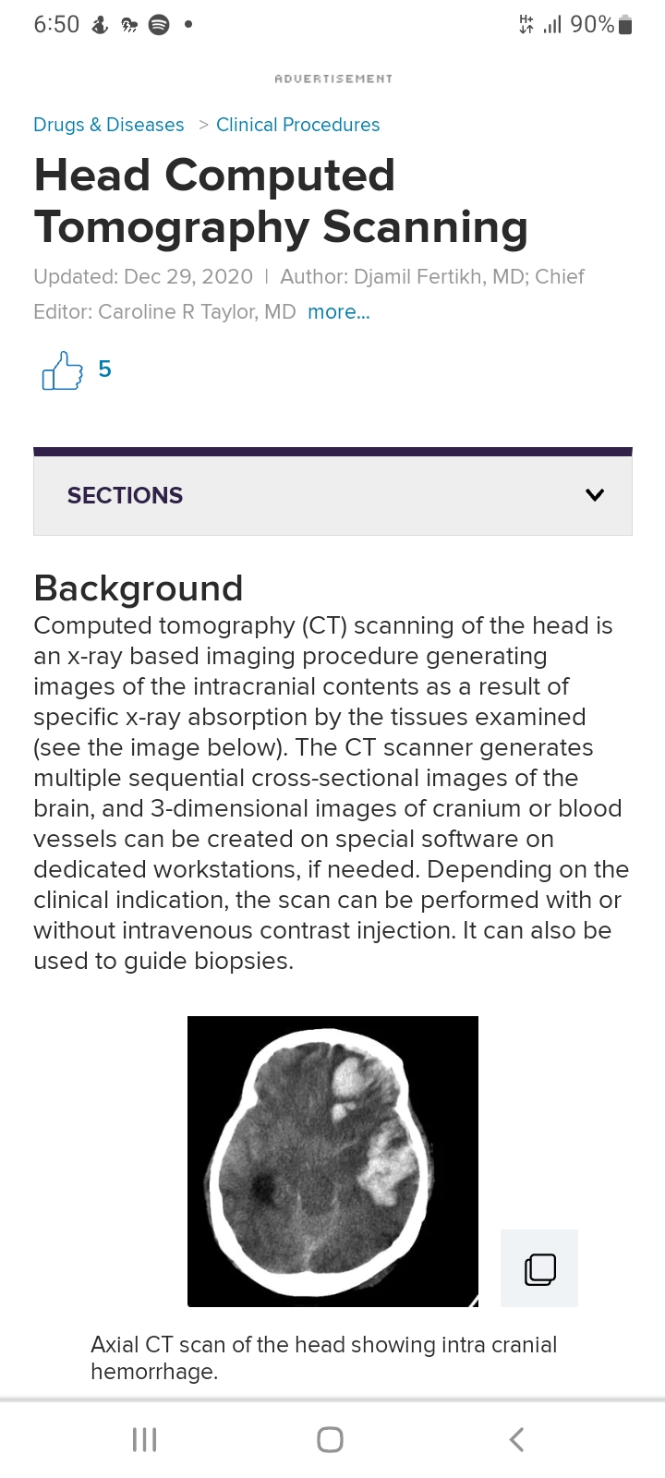
Research articals

Slide 64
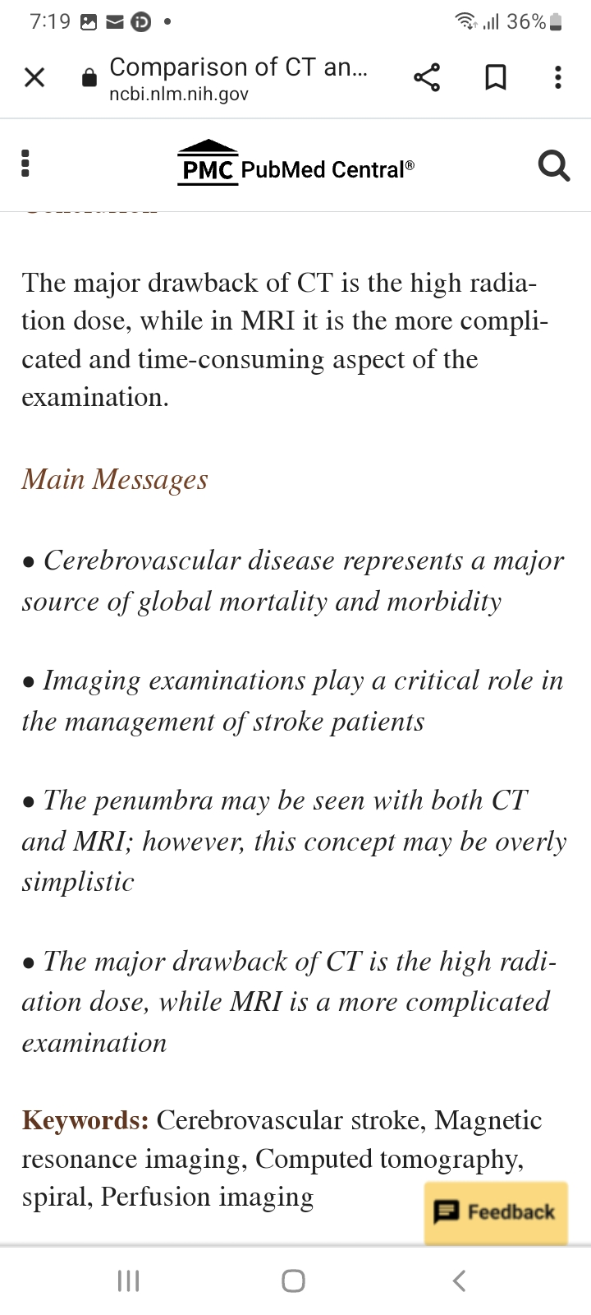

Slide 66
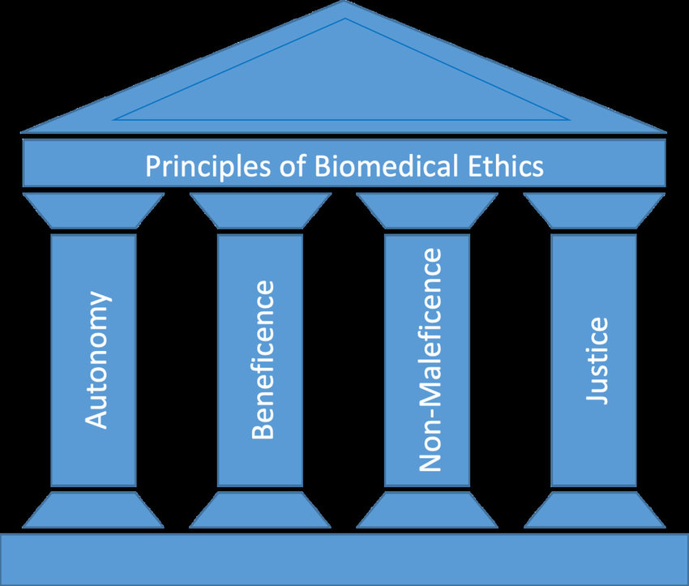

Slide 67
THANKYOU

