Slide 1
Brain Infections

Slide 2
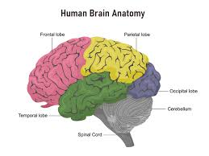
Basic Brain Anatomy
Cerebrum, Cerebellum, Brainstem
Lobes: Frontal, Parietal, Temporal, Occipital

Slide 3
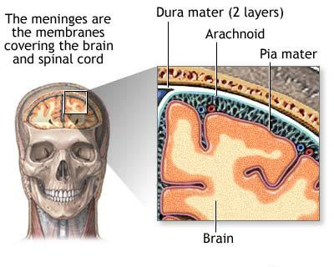
Protective Structures
Skull
Meninges: dura mater, arachnoid mater, pia mater
Blood-brain barrier

Slide 4
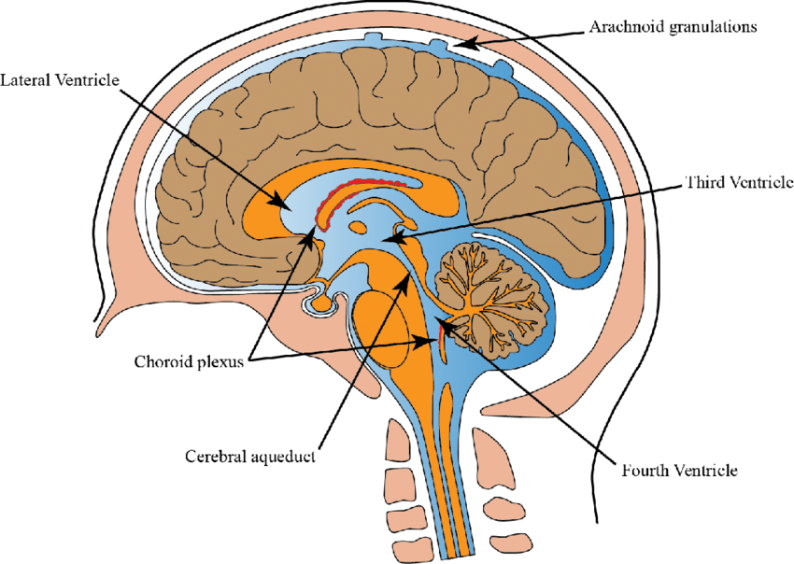
Ventricular System
Lateral ventricles
Third and Fourth ventricles
CSF circulation

Slide 5
CNS Immune Privilege
Microglia
Limited lymphatic drainage
Role in infections

Slide 6
Classification of Infections
Meningitis
Encephalitis
Brain abscess
Subdural/Epidural empyema
Tuberculosis of Brain

Slide 7
Meningitis
Bacterial, viral, fungal, parasitic
Inflammation of meninges
Chemical meningitis

Slide 8
Encephalitis
Viral origin common (e.g., HSV)
Affects brain parenchyma

Slide 9
Brain Abscess
Localized collection of pus
Secondary to infection, trauma, or surgery
Hematogenous spread most common(congenital heart diseae,infective endocarditis,pulmonary Av fitula)
Dental source
From sinusitis contigous spread

Slide 10
Empyema
Subdural and epidural
Often sinus or ear-related infections
Post surgical

Slide 11
Global Burden
High morbidity and mortality
Developing vs. developed countries

Slide 12
Age Distribution
Neonates: Group B Streptococcus
Adults: S. pneumoniae, N. meningitidis

Slide 13
Seasonal Variations
Enteroviruses in summer
Arboviruses in monsoon/rainy season

Slide 14
Risk Factors
Immunosuppression
Travel
Neurosurgical interventions
Congenital heart diseae
Penetrating trauma
Chronic sinusitis
Otitis Media

Slide 15
Bacterial Pathogens
S. pneumoniae, most common group
Strep milleri,Strep.Anginosus (frontoethmoidal sinusitis)
Stayphalococcus aureus,Enterobacteriacea(post traumatic)
Actinomycosis (Dental)

Slide 16
Viral Pathogens
HSV, VZV, CMV, Enteroviruses, Arboviruses

Slide 17
Fungal and Parasitic Pathogens
Cryptococcus, Candida, Toxoplasma, Naegleria

Slide 18
Nosocomial Infections
Shunt infections, post-neurosurgical infections

Slide 19
Entry to CNS
Hematogenous spread
Direct extension
Peripheral nerves

Slide 20
Host Response
Inflammation
BBB disruption
Cerebral edema

Slide 21
Complicatios of Brain infection
Hydrcephaus
Ventriculitis
cognitive impairment
Seizures
Permanant hearing and visual damage
Hemiparesis
Death if untreated

Slide 22
General Symptoms
Fever, headache, vomiting
Photophobia, neck stiffness

Slide 23
Meningitis signs
Kernig’s and Brudzinski’s signs
Irritability, altered sensorium
Neck rigidity

Slide 24
Encephalitis Symptoms
Confusion, seizures, focal deficits

Slide 25
Abscess/Empyema Symptoms
Localized signs
ICP increase, neurological deficits
Seizures
Hemiparesis

Slide 26
Clinical Evaluation
History and physical exam
pyrexia,alteres sensorium,headach,confusion.
nausea ,vomiting,hemiparesis

Slide 27
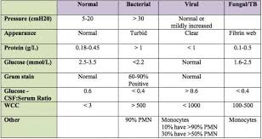
Lumbar Puncture
CSF analysis: WBC count, protein, glucose, culture

Slide 28
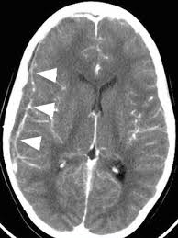
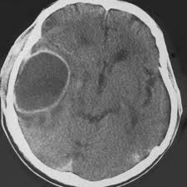
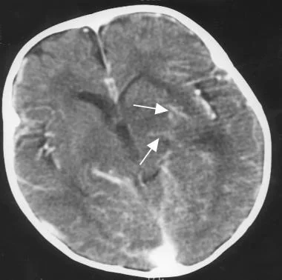
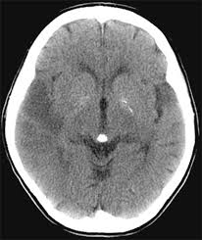
Imaging Studies
CT/MRI to assess swelling, abscess, empyema

Slide 30
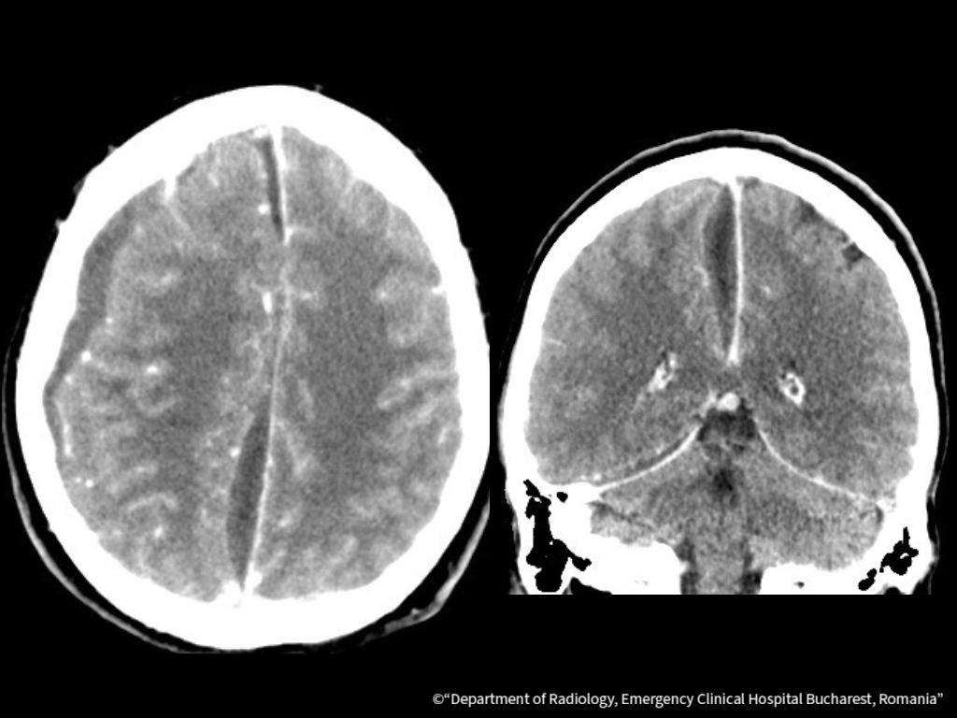

Slide 31
Ct scn features in Brain infection
Brain Abscess (Ring enhancement surrounding the lesion)
Subdural empyema (hypodense area over the hemisphere or along the falx)
Meningitis( mild ventricular dilatation, sulcal effacement, or contrast enhancement of the meninges.
Encephalitis(areas of low density (hypodense lesions) in the temporal lobes, basal ganglia, or other brain regions)

Slide 32
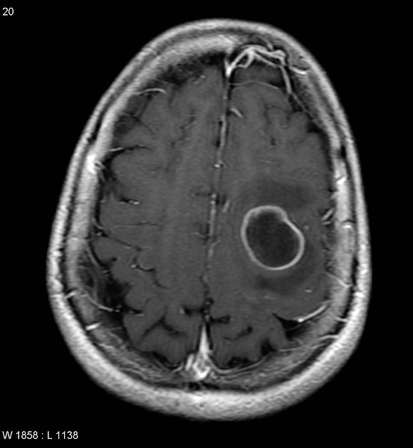
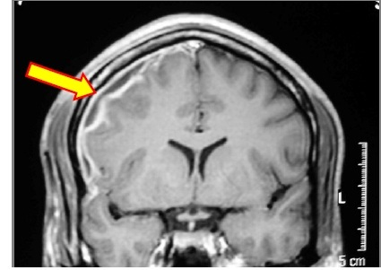
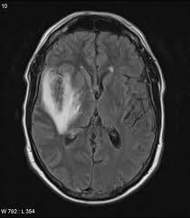
MRI in Brain infections

Slide 35
MRI features
Subdural empyema (crescent-shaped lesion of hyperintensity on T2-weighted sequences)
Meningitis (leptomeningeal enhancement (thin, linear enhancement of the meninges)
Brain abscess (contrast-enhanced rim surrounding a necrotic core)
Encephalitis (hyperintensity on T2-weighted and FLAIR sequences, often affecting the temporal lobes, deep gray matter, and meninges)

Slide 36
OtherTesting
PCR, culture, antigen detection
Leukoyte scan with Tc 99
CBC,ESR,CRP
Chest x rays,Echocardiography

Slide 37
Additional Tests
EEG for encephalitis
Serologies
Brain biopsy (rare)

Slide 38
Initial Stabilization
Airway, breathing, circulation

Slide 39
Empirical Antimicrobial Therapy in Brain abscess
Start immediately
Adjust per culture
Vancomycin 15mg/kg intravenous 8-12 hrs
3rd generation cephalosporin
Metronidazole 500mg adult dose iv 8 hourly
Antibiotics given for 6 ---8 weeks.

Slide 40
Medical treatment other than bacterial source
Acyclovir for HSV
Amphotericin B, fluconazole in fungal infection
Pyrimethamine and Sulphdiazine+leucovorin in toxoplasmosis
HRZE ati tuberculous therapy

Slide 41
Adjunctive Therapy
Steroids in bacterial meningitis
Anticonvulsants

Slide 42
Surgical Intervention
Signficant mass effect
difficult diagnosis
proximity to vntricles
Significant increase ICP
Traumatic abscess associated with foriegn material
Subdural empyema mostly surgically drained followed by antibiotics

Slide 43
Surgical Options
Craniotomy and excision of abscess/Empyema
Burr Hole Aspiration of abscess via brain cannula
Sterotactic Aspiration of brain abscess

Slide 50
Supportive Care
ICU management
External ventricular drain for lowering ICP and intrathecal anibiotics
Rehabilitation

Slide 51
Prevention
Vaccines (Hib, meningococcal, pneumococcal)
Prophylaxis for contacts
BCG vaccine

Slide 52
Artificial intelligence
Artificial Intelligence (AI) is playing an increasingly important role in the early detection, diagnosis, and management of brain infections such as meningitis, encephalitis, and brain abscesses. Here's how AI contributes:
Early diagnosis
Predictive Anlytics
Treatment decision support
Monitoring anf follow up
Research and Data analysis

Slide 53
EOLA( END OF LECTURE ASSESSMENT)
A 28-year-old man presents to the emergency department with a 5-day history of worsening headache, fever, and confusion. He has a past medical history of chronic otitis media. On examination, his temperature is 38.8°C, pulse is 102 bpm, and blood pressure is 130/85 mmHg. He is disoriented to time and place. Neurological examination shows mild right-sided weakness and papilledema on fundoscopy.
A CT scan with contrast shows a ring-enhancing lesion in the left frontal lobe with surrounding edema.

Slide 54
Summary and Key Takeaways
Recap major points
Early diagnosis = better outcome
Initiation of atimicrobial therapy
Promot surgical intervention in case of surgical indications

Slide 55
References and Resources
Greenberg Handbook of Surgery 10th Edition
Principles of Neurological Surgery 4th Edition
Youman's Neurological Surgery 6th Edition

Slide 56
Thank you

