Slide 2
2nd Year MBBS Gastrointestinal Tract Module Large Group Interactive Session (LGIS) Bile, Pancreatic Juice
Presenter: Dr. Almas Ajaz

Slide 3
Motto, Vision, Dream
To impart evidence based research oriented medical education
To provide best possible patient care
To inculcate the values of mutual respect and ethical practice of medicine
Wisdom
Truth
Service

Slide 4
Professor Umar Model of Integrated Lecture

Slide 5
Learning Objectives
At the end of this session students should be able to
What is bile ,Understanding Composition of bile , Importance of bile in digestion and absorption , Overview of the biliary system (liver, gallbladder, bile ducts)
What is pancreatic juice ,Understanding Composition of pancreatic juice , Importance and function of pancreatic enzymes , diseases and clinical …

Slide 6
Interactive Session
A 55-year-old male presents to the emergency department with severe, sudden-onset epigastric pain radiating to his back, accompanied by nausea and vomiting. He has a history of alcohol use and occasional abdominal discomfort. On examination, the patient is in distress, with a heart rate of 110 bpm, blood pressure of 140/90 mmHg, and a temperature of 37.8°C. His abdomen is tender, especially in the epigastric region, and there is guarding but no rebound tenderness. The patient is diagnosed with acute biliary pancreatitis due to gallstone-induced obstruction at the ampulla of Vater, leading to biliopancreatic reflux.

Slide 7
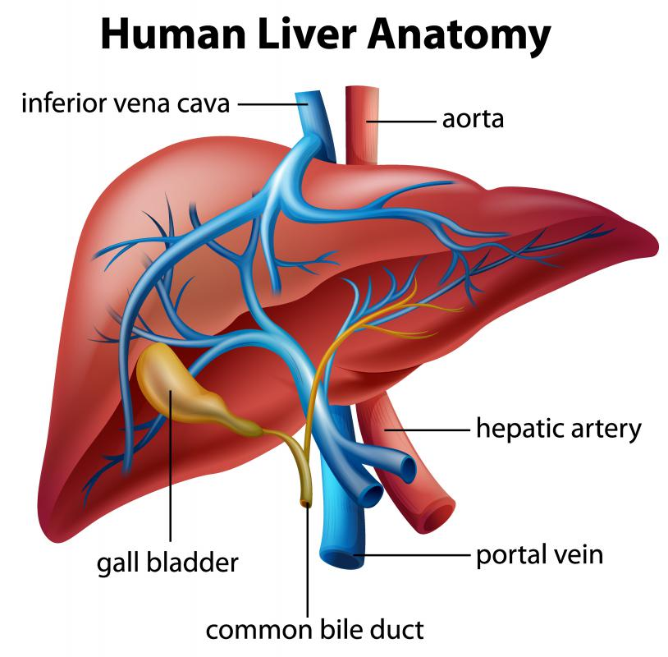

Slide 9
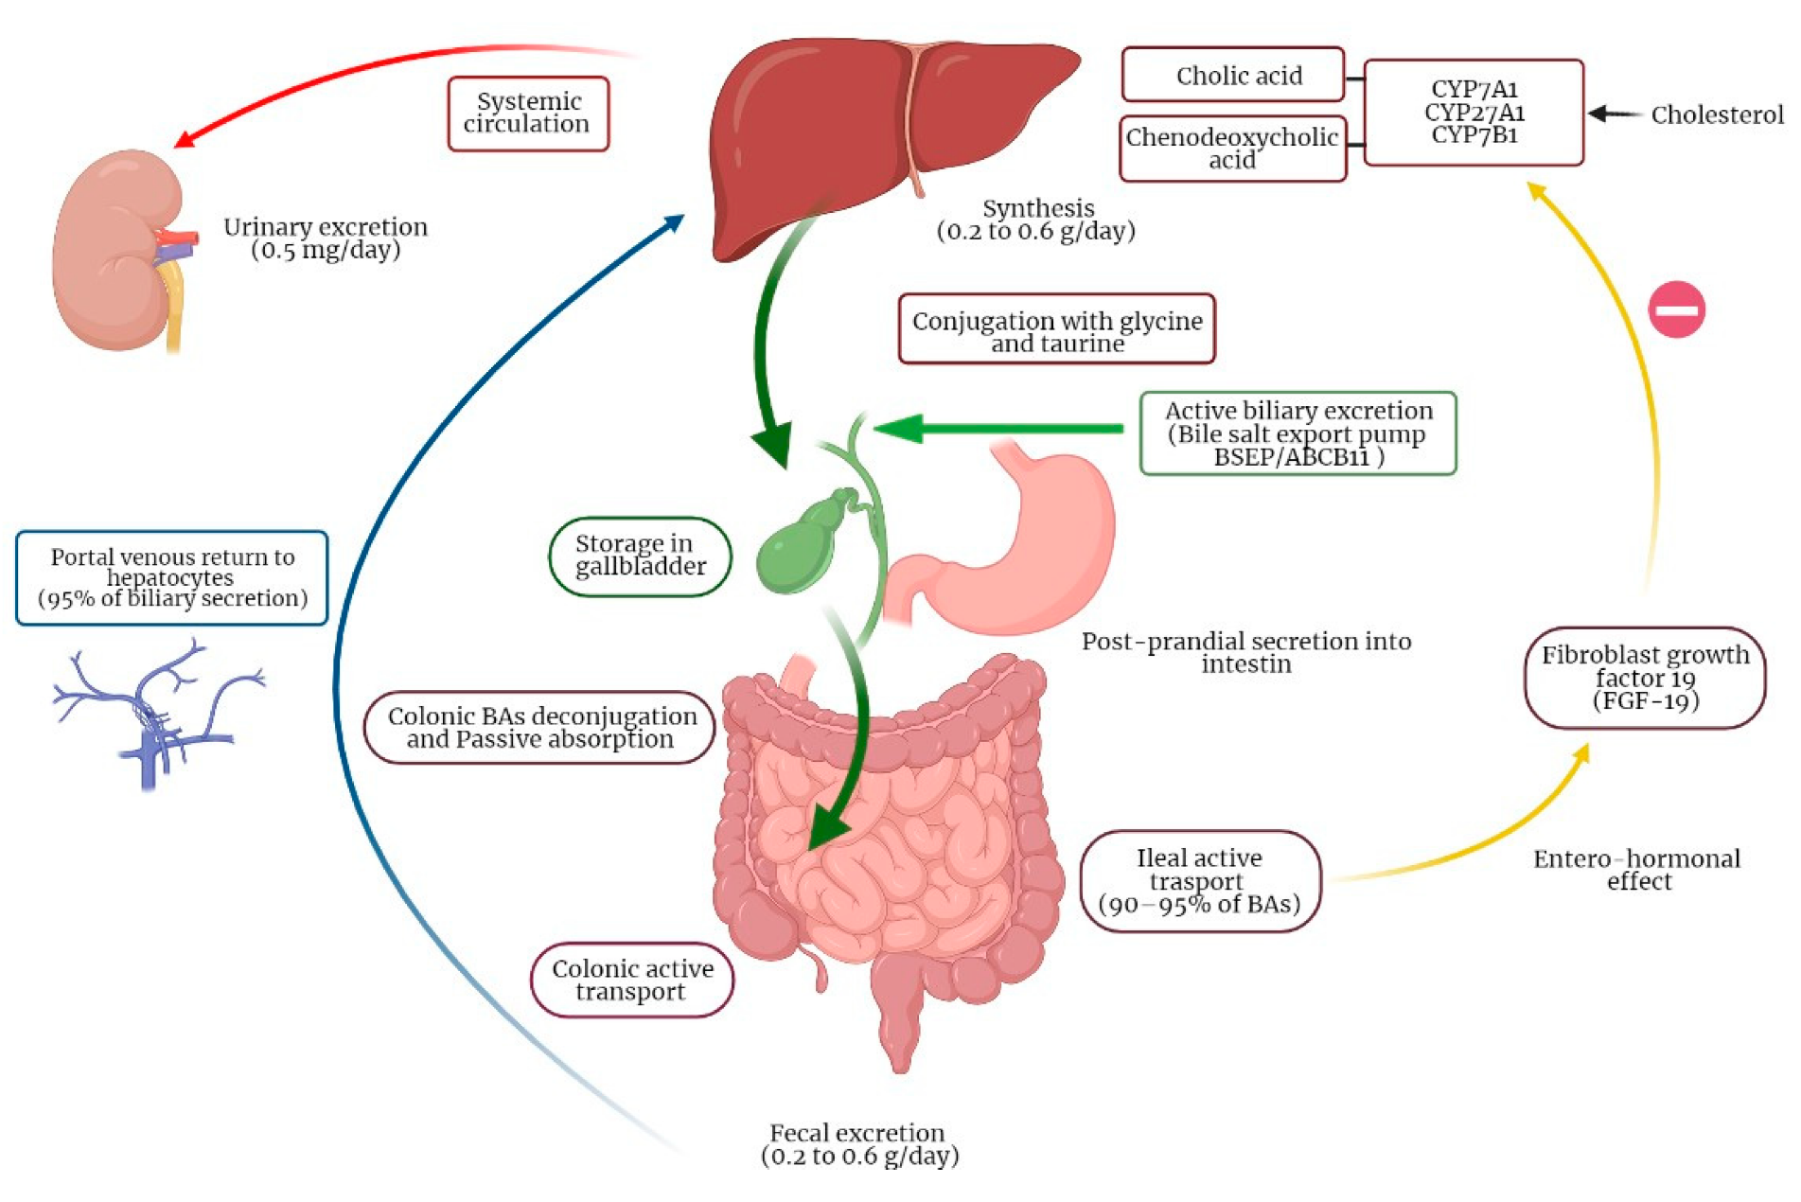
Physiology of bile

Slide 10
Core Concept
Bile is a digestive fluid produced by the liver and stored in the gallbladder.
It plays a crucial role in the digestion and absorption of fats in the small intestine.
Bile contains various substances, including bile salts, cholesterol, bilirubin, and electrolytes.
Its primary function is to emulsify fats, breaking them down into smaller droplets that can be more easily digested by enzymes.
Bile also helps in the absorption of fat-soluble vitamins, such as vitamins A, D, E, and K.

Slide 11
Liver as primary site of bile synthesis
Hepatocytes and Bile Synthesis:
Hepatocytes, the main functional cells of the liver, are responsible for bile synthesis.
Bile formation occurs in a series of interconnected hepatocytes termed bile canaliculi.
Within hepatocytes, various enzymes and transporters facilitate the synthesis and secretion of bile components.
Cholesterol Metabolism:
Bile synthesis begins with the conversion of cholesterol to primary bile acids, such as cholic acid and chenodeoxycholic acid.
This process involves several enzymatic steps, including cholesterol 7-alpha hydroxylase, which catalyzes the rate-limiting step in bile acid synthesis.

Slide 12
Liver as primary site for bile synthesis
Bile Acid Conjugation:
Once synthesized, primary bile acids undergo conjugation with either glycine or taurine, enhancing their solubility and excretion properties.
Conjugated bile acids are more efficiently transported across cell membranes and are less susceptible to passive reabsorption in the intestines.
Transport of Bile Components:
Hepatocytes actively transport bile acids, cholesterol, phospholipids, and bilirubin into bile canaliculi using specific transporters such as ABC transporters and bile salt export pump (BSEP).
This coordinated transport ensures the proper composition of bile and prevents the accumulation of toxic bile constituents within hepatocytes.

Slide 13
Composition of Bile
Bile Components:
Bile is a complex fluid composed of water, electrolytes, bile acids, cholesterol, phospholipids, bilirubin, and various proteins.
Water and electrolytes constitute the majority of bile volume and provide the fluid medium for bile solutes.
Bile acids, cholesterol, and phospholipids are essential for the emulsification and digestion of dietary fats.
Bilirubin Metabolism:
Bilirubin, a waste product derived from the breakdown of heme in aged red blood cells, is conjugated with glucuronic acid in hepatocytes to form water-soluble bilirubin glucuronides.
Conjugated bilirubin is actively secreted into bile and represents the major pigment responsible for the color of bile and stool

Slide 14
Bile is a complex fluid comprising various components
Water (around 97%)
Electrolytes (sodium, potassium, bicarbonate)
Bile acids (primary and secondary)
Cholesterol
Phospholipids (e.g., lecithin)
Bilirubin (a breakdown product of hemoglobin)
Various proteins (albumin, immunoglobulins)

Slide 15
Bile acid metabolism

Slide 16
1- Synthesis of primary bile acids:
Cholesterol is converted into primary bile acids (cholic acid and chenodeoxycholic acid) within hepatocytes through enzymatic processes involving several key enzymes such as cholesterol 7-alpha hydroxylase.

Slide 17
2-Conversion to secondary bile acids
Upon entering the intestine, primary bile acids are further metabolized by gut bacteria into secondary bile acids (deoxycholic acid and lithocholic acid) through processes like dehydroxylation and epimerization.

Slide 18
Core Knowledge
3-Enterohepatic circulation
Secondary bile acids are reabsorbed in the terminal ileum and returned to the liver via the portal circulation, completing the enterohepatic circulation. This recycling mechanism allows for efficient use of bile acids.

Slide 19
Bile Flow and Regulation

Slide 20
Storage and concentration in the gallbladder:
Bile produced by the liver is stored and concentrated in the gallbladder between meals. Concentration occurs through the absorption of water and electrolytes, leading to a more viscous bile.
Regulation of bile secretion:
Bile secretion is tightly regulated by hormonal and neural mechanisms. Cholecystokinin (CCK), released in response to the presence of fatty acids and amino acids in the duodenum, stimulates gallbladder contraction and sphincter of Oddi relaxation, facilitating bile release into the duodenum.

Slide 21
Release of bile:
Upon ingestion of a meal, especially one rich in fats, the gallbladder contracts under the influence of CCK, releasing stored bile into the duodenum through the common bile duct. This bile aids in the emulsification and digestion of dietary fats.

Slide 22
Pancreatic Juice
Pancreatic juice is a fluid secreted by the pancreas, an organ located behind the stomach in the abdominal cavity.
This clear alkaline fluid plays a crucial role in digestion, particularly in the breakdown of carbohydrates, proteins, and fats in the small intestine.

Slide 23
Structure of the Pancreas
Exocrine and endocrine functions: The pancreas has both exocrine (digestive enzyme secretion) and endocrine (hormone secretion) functions.
Acinar cells and pancreatic ducts: Acinar cells produce and secrete digestive enzymes into pancreatic ducts, which ultimately empty into the duodenum.
Islets of Langerhans: These clusters of endocrine cells within the pancreas secrete hormones such as insulin and glucagon.

Slide 24
Pancreatic juice production
The exocrine function of the pancreas involves the production and secretion of pancreatic juice, which is essential for the digestion of food in the small intestine.
Pancreatic juice is produced by specialized clusters of cells called acinar cells located within the pancreas.
These acinar cells synthesize and secrete various digestive enzymes and bicarbonate ions into small ducts that eventually merge to form the main pancreatic duct.

Slide 25
Digestive enzymes present in pancreatic juice
Amylase: Responsible for breaking down complex carbohydrates (such as starches and glycogen) into simpler sugars like maltose and glucose.
Lipase: Catalyzes the hydrolysis of triglycerides into fatty acids and monoglycerides, facilitating the digestion and absorption of fats.
Proteases: Include enzymes like trypsin, chymotrypsin, and carboxypeptidase, which work together to break down proteins into smaller peptides and amino acids

Slide 26
Bicarbonate ions
The pancreas secretes bicarbonate ions to neutralize the acidic chyme that enters the small intestine from the stomach.
Bicarbonate ions raise the pH of the acidic chyme, creating an optimal alkaline environment for the activity of pancreatic enzymes.
This neutralization process also protects the lining of the small intestine from damage by acidic contents, ensuring efficient digestion and absorption of nutrients

Slide 27
Functions of Pancreatic Enzymes
1- Amylase: Amylase is responsible for initiating the breakdown of complex carbohydrates into simpler sugars. It catalyzes the hydrolysis of glyosidic bonds in polysaccharides like starch and glycogen, breaking them down into disaccharides (such as maltose) and ultimately into monosaccharides (such as glucose).
2- Lipase: Lipase plays a crucial role in the digestion of dietary fats.It catalyzes the hydrolysis of triglycerides, the primary form of dietary fats, into fatty acids and glycerol.
3- Proteases (including Trypsin, Chymotrypsin, and Carboxypeptidase): Proteases are enzymes that specialize in breaking down proteins into smaller peptides and individual amino acids.

Slide 28
Activation of Pancreatic Enzymes
Zymogen activation: Enzymes are secreted in inactive forms (zymogens) to prevent self-digestion.
Role of enteropeptidase (enterokinase) in activating trypsinogen: Enteropeptidase converts trypsinogen to its active form trypsin.
Cascade of enzyme activation: Once trypsin is activated, it activates other pancreatic zymogens, initiating a cascade of enzyme activation.

Slide 29
Regulation of Pancreatic Secretion
Neural regulation: Nervous signals trigger pancreatic secretion in response to the presence of food in the digestive tract.
Hormonal regulation: Hormones such as secretin and cholecystokinin stimulate pancreatic enzyme secretion in response to specific nutrients in the small intestine.
Feedback mechanisms: Pancreatic secretion is regulated by feedback mechanisms to maintain digestive balance.

Slide 30
Vertical Integration

Slide 31
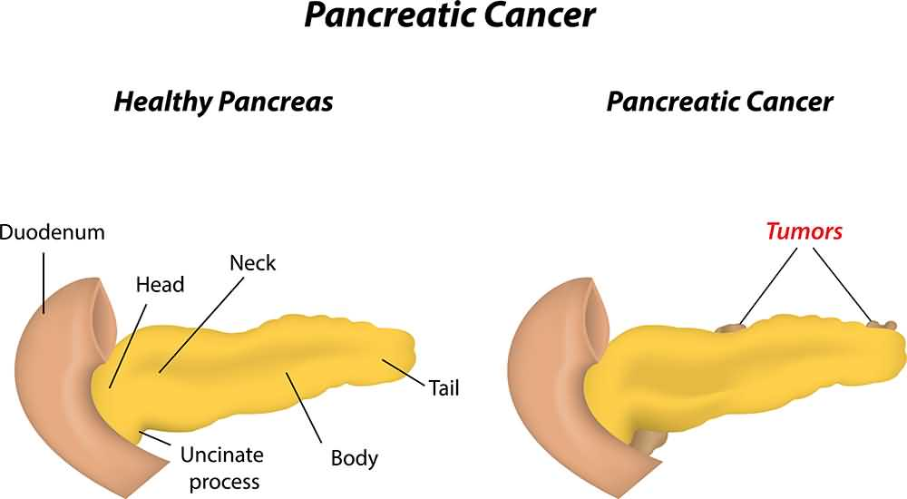
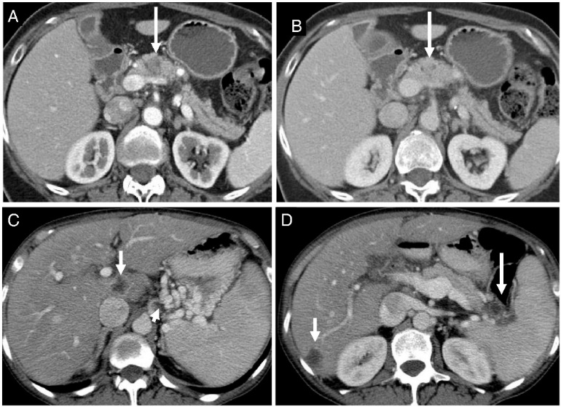
Pancreatic Cancer
Pancreatic cancer is a highly aggressive form of cancer originating in the pancreas. Symptoms often emerge in later stages and may include jaundice, abdominal pain, weight loss, and digestive issues.

Slide 32
Family Medicine(pancreatic cancer)
Family Medicine plays important role in following manner:
Diagnosis - Prompt and accurate diagnosis of pancreatic cancer involves a range of tests such as imaging scans (CT scan, MRI, ultrasound), blood tests (including tumor markers), and sometimes biopsy.
Education- :Providing comprehensive education to patients and their families about pancreatic cancer, its symptoms, treatment options, and prognosis is essential.
Dietary Guidance- Patients may require dietary adjustments to manage symptoms like poor appetite, weight loss, and digestive issues.
Monitoring - Regular monitoring of patients with pancreatic cancer is vital to track disease progression, assess treatment effectiveness, and manage any side effects or complications .
Refer to Specialists - Pancreatic cancer treatment often involves a multidisciplinary approach.

Slide 33
Family Medicine (Jaundice)
Family Medicine plays important role in following manner:
Diagnosis -Identifying jaundice involves physical examination, evaluating symptoms like yellowing of the skin and eyes knowing by conducting blood tests to measure bilirubin levels and assess liver function.
Education- : Educating patients and their families about jaundice is crucial to understanding its causes, symptoms, and potential complications.
Dietary Guidance- Recommend a diet low in fat , processed foods while emphasizing hydration and consumption of nutrient-rich foods like fruits, vegetables, and lean proteins.
Monitoring - Regular monitoring is essential to track bilirubin levels, liver function, and overall health by periodic blood tests.

Slide 34
Artificial Intelligence (pancreatic cancer)
Artificial Intelligence plays role in following aspects:
Personalized Nutrition - AI can analyze an individual's health data, including their liver function tests and dietary habits, to provide personalized nutrition recommendations. For jaundice patients, tailored dietary plans can be created to support liver health and manage symptoms effectively.
Diagnostic Tools- AI-powered diagnostic tools can assist healthcare professionals in the early detection and monitoring of jaundice.
Food Recommendations- AI can analyze vast amounts of data on food composition, nutritional content, and their effects on liver health to provide personalized food recommendations for individuals with jaundice.
Drug Development -AI accelerates the drug development process by facilitating the discovery of novel therapies for jaundice and related liver disorders.

Slide 35
Artificial Intelligence (Jaundice)
Artificial Intelligence plays role in following aspects:
Personalized Nutrition – AI algorithms can analyze vast amounts of patient data, including genetic information, medical history, and dietary habits, to tailor personalized nutrition plans for individuals with pancreatic cancer.
Diagnostic Tools- AI-based diagnostic tools utilize advanced image analysis techniques, such as deep learning algorithms, to assist in the early detection and diagnosis of pancreatic cancer.
Food Recommendations- AI recommendations may take into account factors such as nutrient requirements, digestive capabilities, and potential side effects of cancer treatments, aiming to optimize nutritional intake and support overall well-being during treatment and recovery.

Slide 36
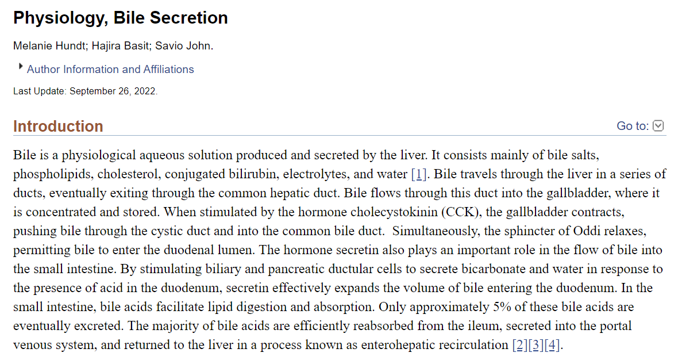
Suggested Research Article
Link: https://www.ncbi.nlm.nih.gov/books/NBK470209/

Slide 37
Learning Resources
Textbook of Biochemistry, Lippincott 8th edition
Google scholar
Google images

Slide 38
ASSESSMENT
What role do bile salts play in digestion?
a) Breaking down carbohydrates
b) Neutralizing stomach acid
c) Emulsifying fats
d) Activating lipase
e) Inhibiting pepsin
Which organ primarily produces and releases pancreatic juice?
a) Liver
b) Stomach
c) Pancreas
d) Gallbladder
e) Small intestine

Slide 39
ASSESSMENT
What is the primary function of bile in digestion?
a) Emulsification of fats
b) Activation of pepsin
c) Neutralization of stomach acid
d) Production of bicarbonate ions
e) Absorption of water
Which enzyme is responsible for breaking down proteins in pancreatic juice?
a) Lipase
b) Maltase
c) Trypsin
d) Sucrase
e) Amylase

Slide 40
ASSESSMENT
Which of the following components is NOT typically found in pancreatic juice?
a) Lipase
b) Trypsin
c) Amylase
d) Bile salts
e) Ribonuclease

Slide 41
ANSWERS
c) Pancreas
c) Emulsifying fats
c) Trypsin
a) Emulsification of fats
d) Bile salts

