Slide 1
BASIC DRUG MONITORING
Dr. Ayesha Saleem
Senior Registrar( Anaesthesia)
MBBS, FCPS, FIPM, Member ANZCA
dr.ashi_sa86@hotmail.com

Slide 2
Sequence of LGIS
Inhaled anesthetic agents
Intravenous anesthetic agents
Neuromuscular blocking drugs
Local anesthetics
Pain management

Slide 3
Learning Objectives
Correlate pharmacodynamics and pharmacokinetics of drugs used in anesthesia
Understand mechanism of action of local anesthetics
Monitoring of neuromuscular blockade during anesthesia and recovery from them
Understand step ladder approach to pain relief

Slide 4
Inhaled Anesthetic agents
Can be volatile or gaseous
Volatile agents
  Have low vapor pressure with high boiling points and so are liquid at room temp
  Include halothane, enflurane, isoflurane, desflurane, sevoflurane
  Administered through precision vaporizers
Gaseous agents
  High vapor pressures and low boiling points so are in gas form at room temp
  Include nitrous oxide and xenon

Slide 5
Pharmacokinetics
Factors affecting uptake and distribution
  Inspired concentration and ventilation – easily controlled and most important factor as partial pressure is easily adjusted according to need
  Solubility – It affects transfer of agent from alveoli to blood and blood gas partition coefficient is a useful index of solubility
  Cardiac output – Increase in cardiac output will increase uptake and slow induction of anesthesia by increasing distribution to areas that are not involved in site of action of the anesthetic agent
  Arterial-venous partial pressure difference – depends on uptake of agent by tissues and influenced by similar factors as those that affect transfer from lungs to blood including tissue-blood partition coefficients

Slide 6
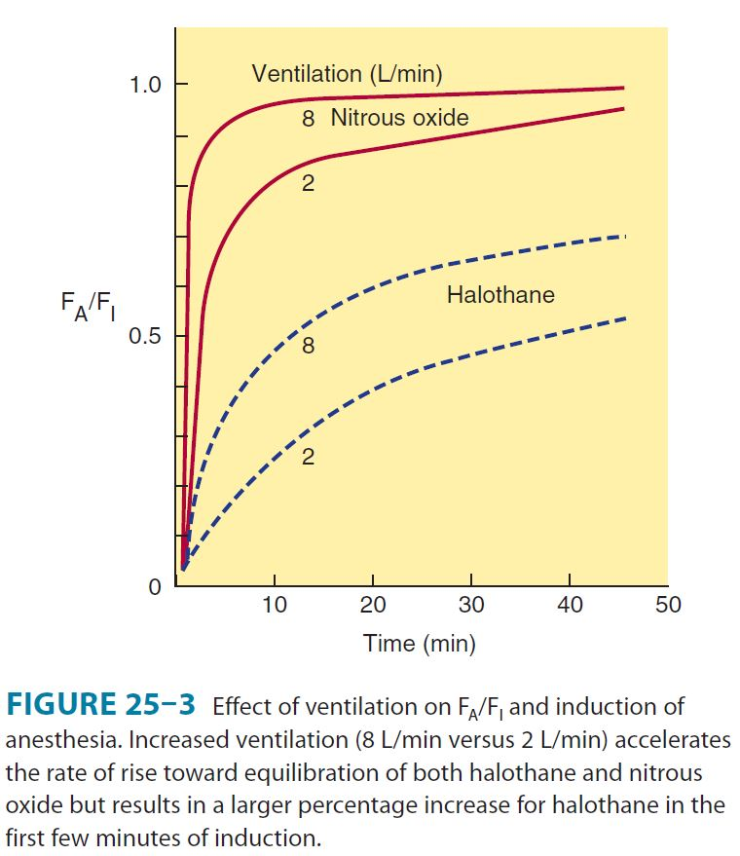

Slide 7
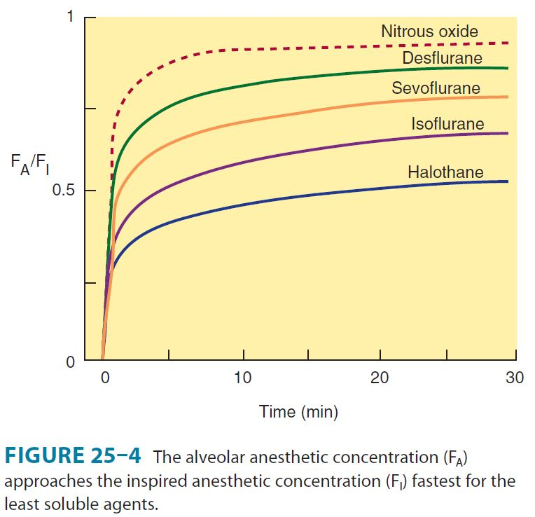

Slide 8
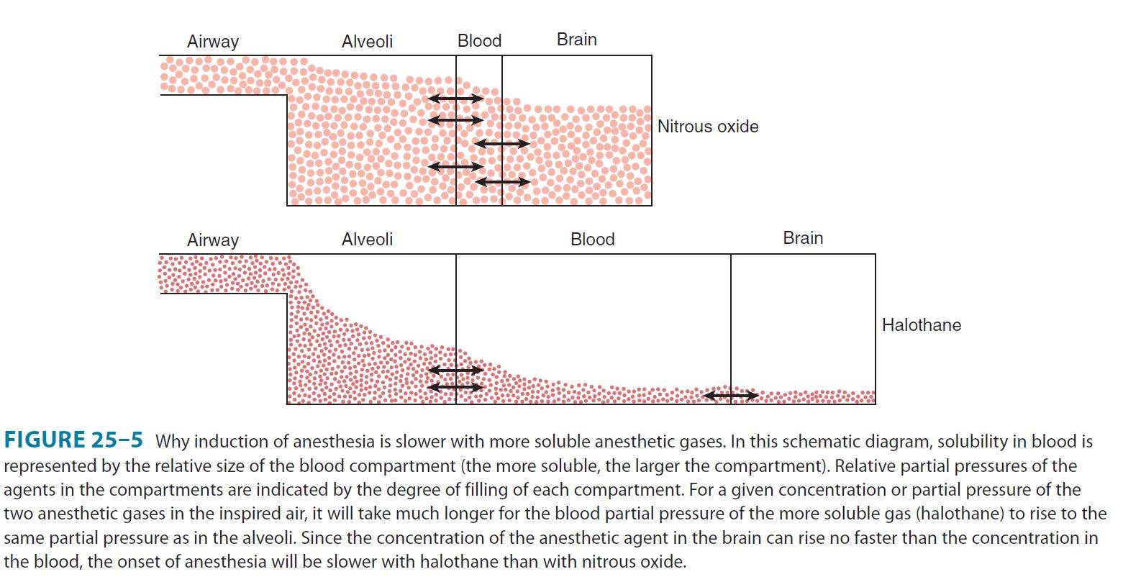

Slide 9
Elimination
Metabolized only to a small extent so most elimination is through lungs
Factors affecting it include
  Blood-gas partition coefficient
  Tissue solubility
  Pulmonary blood flow
Two parameters manipulated to increase elimination include
  Concentration in inspired gas
  Alveolar ventilation
Metabolism has important implications for toxicity but not elimination

Slide 10
Pharmacodynamics
CNS effects:
  Decreases cerebral metabolic rate (CMR)
  Cause cerebral vasodilation
  Net effect of change in cerebral blood flow depend on concentration of agent delivered
  Produces 4 stages of increasing depth of CNS depression
CVS effects:
  Depress cardiac contractility and hence MAP in a concentration-dependent manner
  Reduce myocardial oxygen consumption and produce coronary vasodilation

Slide 11
Respiratory effects:
  Cause varying degrees of bronchodilation where pungent agents produce less dilation due to airway irritation while nonpungent agents produce more
  All inhaled anesthetics in current use cause a dose-dependent decrease in tidal volume and an increase in respiratory rate, resulting in a rapid, shallow breathing pattern except nitrous oxide
  All volatile anesthetics are respiratory depressants and increase resting PaCO2 levels while also increasing apneic threshold
  Depress mucociliary function in airway
Renal effects:
  Decrease GFR and urine flow
  Filtration fraction increases due to autoregulation
Hepatic effects
  Concentration dependent decrease in portal vein blood flow
Effect on uterine smooth muscles:
  Halogenated agents cause concentration dependent relaxation while N2O has little effect

Slide 12
Toxicity
Neprhotoxicity
Hematotoxicity
Malignant Hyperthermia
Hepatotoxicity (Halothane Hepatitis)
Carcinogenicity

Slide 13
Intravenous Anesthetics
These include
  Propofol
  Barbiturates
  Benzodiazepines
  Etomidate
  Ketamine
  Dexmedetomidine

Slide 14
Propofol
Very commonly used as drug for induction of anesthesia
Also used for short sedation and TIVA or short-duration general anesthesia
MOA – potentiation of CL current through GABA_{A} receptor complex
Pharmacokinetics – Rapidly metabolized by liver and excreted through kidney with extrahepatic metabolism occurring in lungs
Context-sensitive half life is very brief therefore recovery occurs promptly

Slide 15
Barbiturates
Mostly replaced by propofol
Thiopental and methohexital previously used for induction
Anesthetic effect presumably involves a combination of enhancement of inhibitory transmission and inhibition of excitatory neurotransmission
The effects on inhibitory transmission probably result from activation of the GABA_{A} receptor complex, the effects on excitatory transmission are less well understood
Undergo hepatic metabolism

Slide 16
Benzodiazepines
Commonly used peri-operatively
Include midazolam, lorazepam and less frequently diazepam
Unique among IV anesthetics as action can be terminated with administration of antagonist, Flumazenil
Desired effects are anxiolysis and anterograde amnesia
Useful for premedication
Lipid soluble and rapidly enter CNS followed by redistribution to inactive tissue
Midazolam has shortest context-specific half-time and the only one of the three benzodiazepine drugs to be suitable for continuous infusion

Slide 17
Etomidate
Hypnotic but no analgesic effects
Minimal hemodynamic effects
Endocrine side effects limit usage for infusions
Poorly water soluble
Has GABA-like effects
Acts through potentiation of GABA_{A}-mediated CL current

Slide 18
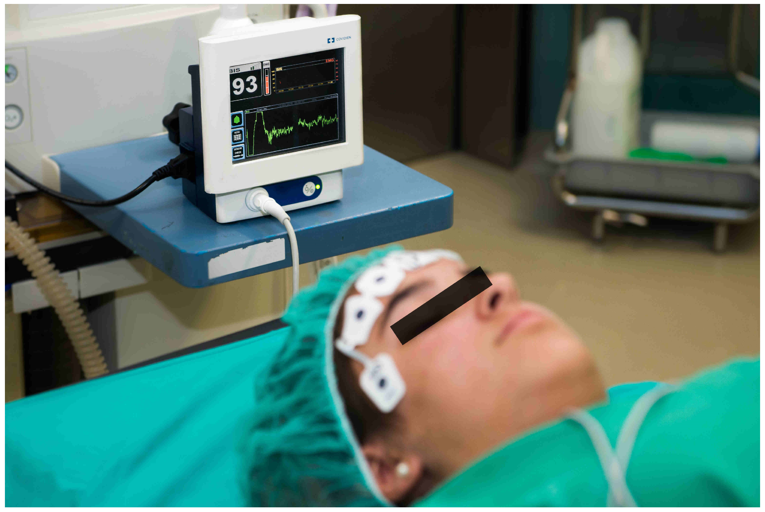
Monitoring Depth of Anesthesia with BIS Monitor
BIS monitors provide real-time feedback on anesthesia depth using EEG analysis.
BIS Score Ranges:
40-60: Ideal range for general anesthesia
<40: Deep anesthesia (risk of over-sedation)
>60: Light anesthesia (risk of awareness)
Advantages:
Reduces anesthetic dosing
Minimizes intraoperative awareness
Shortens recovery time
Limitations:
Affected by muscle artifacts
Complements clinical judgment (not a standalone tool

Slide 19
Ketamine
Partially water-soluble and highly lipid soluble
Produces significant analgesia
Causes dissociative anesthesia
Major effect is through inhibition of NMDA receptor complex
Rapid onset with metabolism primarily by liver by cyp-450 system
Excreted through urine
If used alone then amnesia is not as complete as with benzodiazepines and reflexes often preserved

Slide 20
Dexmedetomidine
Highly selective α₂-adrenergic agonist
Used in veterinary medicine
Water soluble
Undergoes rapid hepatic metabolism and excreted in urine and bile
Elimination half-time is short
Mainly used for short term sedation of intubated and ventilated patients in ICU
Can be used as an adjunct

Slide 21
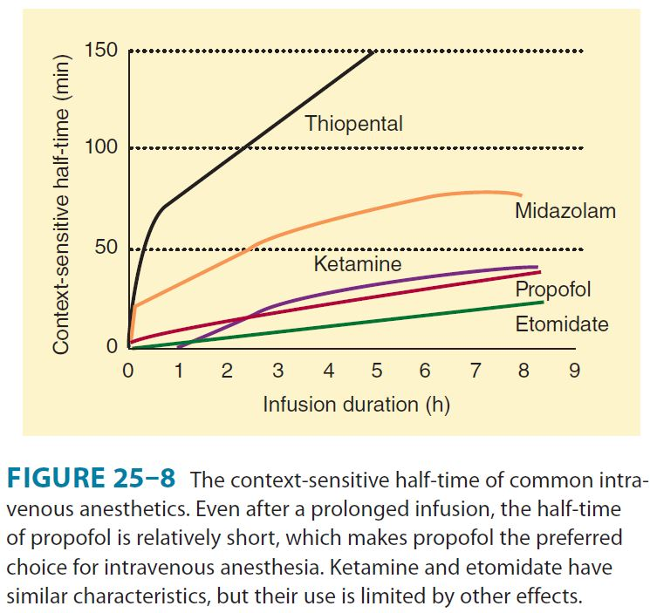

Slide 22
Neuromuscular Blocking Drugs
Main function is to cause skeletal muscle relaxation
Can be of two types based on MOA
  Depolarizing neuromuscular blocking drugs
  Nondepolarizing neuromuscular blocking drugs

Slide 23
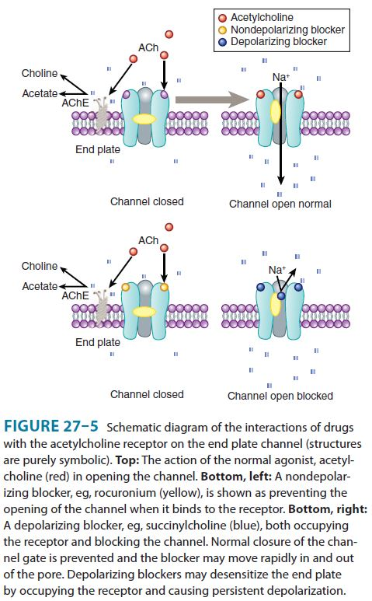

Slide 24
Assessment of neuromuscular transmission
Monitoring the effects of muscle relaxants can be done by checking motor responses to different patterns of peripheral nerve stimulation
Neuromuscular monitoring is done by nerve stimulator
It can be visually observed and common patterns include
  Single-twitch stimulation
  Train-of-four (TOF) stimulation
  Tetanic stimulation
Two other modalities include double-burst stimulation and posttetanic count

Slide 25
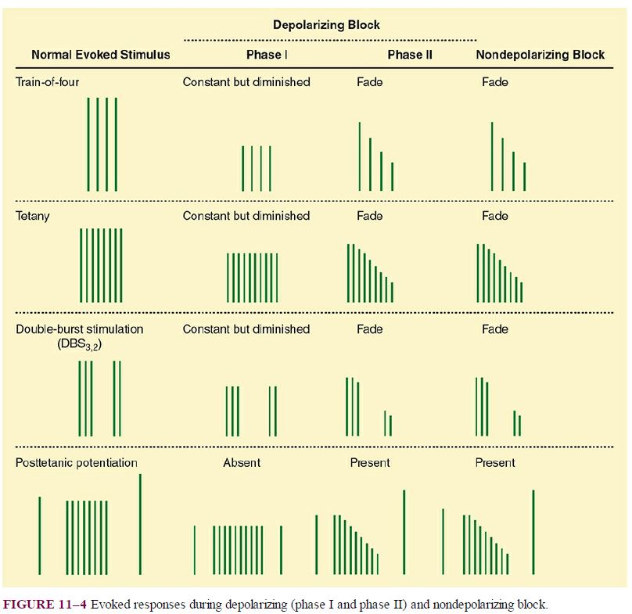

Slide 26
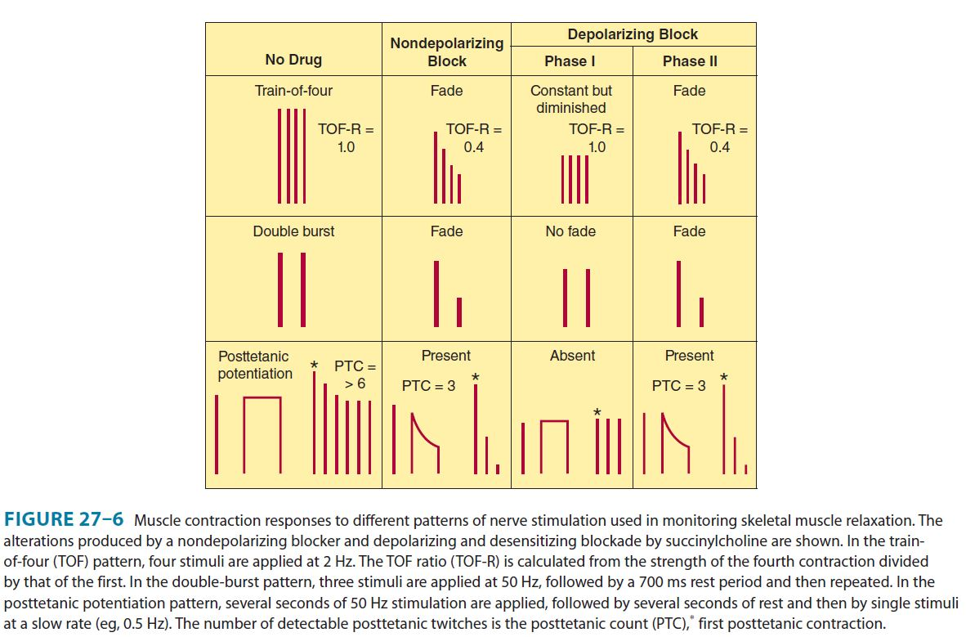

Slide 27
Local Anesthetics
These transiently inhibit sensory, motor or autonomic nerve function when applied near neural tissue
Examples include Bupivacaine, lidocaine, lignocaine, mepivacaine, cocaine, procaine, tetracaine e.t.c

Slide 28
Mechanism of action
Action potential in neurons is caused by voltage-gated Na channels
Local Anesthetics (LA) bind to specific region in α subunit of these receptors
Prevent channel activation and Na influx
As conc of LA increases, more channels are blocked and the threshold for excitation and nerve conduction is increased
Rate of rise and magnitude of action potential decreases and conduction velocity slows
At great enough conc. Impulse generation is abolished as no more action potentials are generated

Slide 29
Local Anesthetics
LA have higher affinity for open and inactivated Na channels caused by depolarizations
Depolarizations lead to more LA binding
So Fraction of Na channels bound to LA increases with frequent depolarizations
This is called use-dependent block
LA binding is greater when nerve fibers are frequently depolarizing than with infrequent depolarizations

Slide 30
Neuromuscular Blocking Drugs
Main function is to cause skeletal muscle relaxation
Can be of two types based on MOA
  Depolarizing neuromuscular blocking drugs
  Nondepolarizing neuromuscular blocking drugs

Slide 31
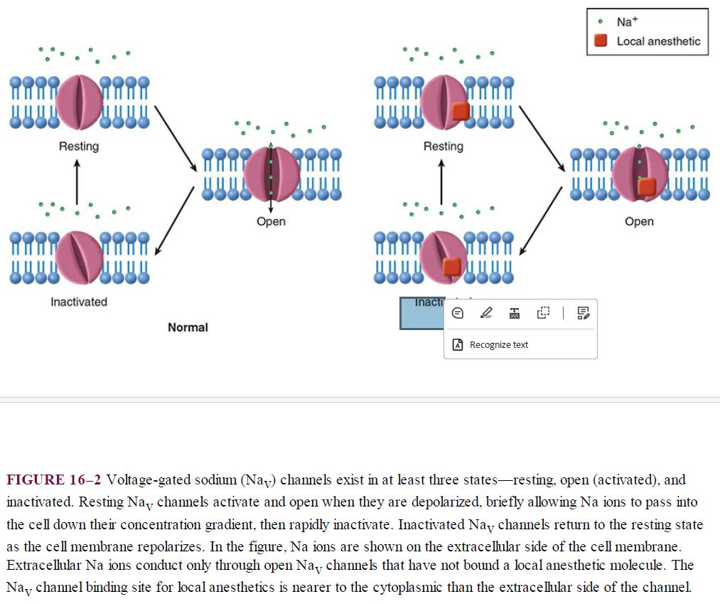

Slide 32
Depolarizing Muscle Relaxant
Succinylcholine
  The only depolarizing muscle relaxant in clinical use today. Primarily used for rapid-sequence intubation because of its quick onset (30–60 seconds) and short duration of action (4–6 minutes).
  Succinylcholine binds to acetylcholine receptors at the neuromuscular junction, causing continuous depolarization of the muscle membrane. This sustained depolarization leads to initial muscle fasciculations (small, involuntary contractions), followed by paralysis.

Slide 33
Depolarizing Muscle Relaxant
Side Effects of Succinylcholine
  1. Hyperkalemia
  2. Malignant Hyperthermia (MH)
  3. Increased Intraocular Pressure (IOP)
  4. Increased Intracranial Pressure (ICP)
  5. Bradycardia
  6. Myalgia (Muscle Pain)
  7. Prolonged Paralysis in Pseudocholinesterase Deficiency
  8. Rhabdomyolysis (Rare)

Slide 34
Non-depolarizing muscle relaxants
Aminosteroidal Compounds
  Rocuronium
    Side Effects: Anaphylaxis (rare), mild tachycardia, pain at the injection site, minimal histamine release.
  Vecuronium
    Side Effects: Prolonged muscle weakness, bradycardia, minimal histamine release, prolonged effect in patients with liver or kidney impairment.
  Pancuronium
    Side Effects: Significant vagolytic effects causing tachycardia and hypertension, increased salivation, prolonged paralysis (especially in renal impairment).

Slide 35
Non-depolarizing muscle relaxants
Benzylisoquinolinium Compounds
  Atracurium
    Side Effects: Significant histamine release, leading to flushing, hypotension, bronchospasm, and CNS excitement (risk of seizures due to laudanosine, a breakdown product).
  Cisatracurium
    Side Effects: Minimal histamine release, rare cases of bradycardia and hypotension, generally safe for organ-compromised patients due to Hofmann elimination.
  Mivacurium
    Side Effects: Histamine release leading to hypotension, skin flushing, and bronchospasm. Prolonged effect in patients with pseudocholinesterase deficiency due to its metabolism by plasma cholinesterase.

Slide 36
Parameters for assessment of pain during anaesthesia
  Heart rate
  Blood pressure
  Sweating

Slide 37
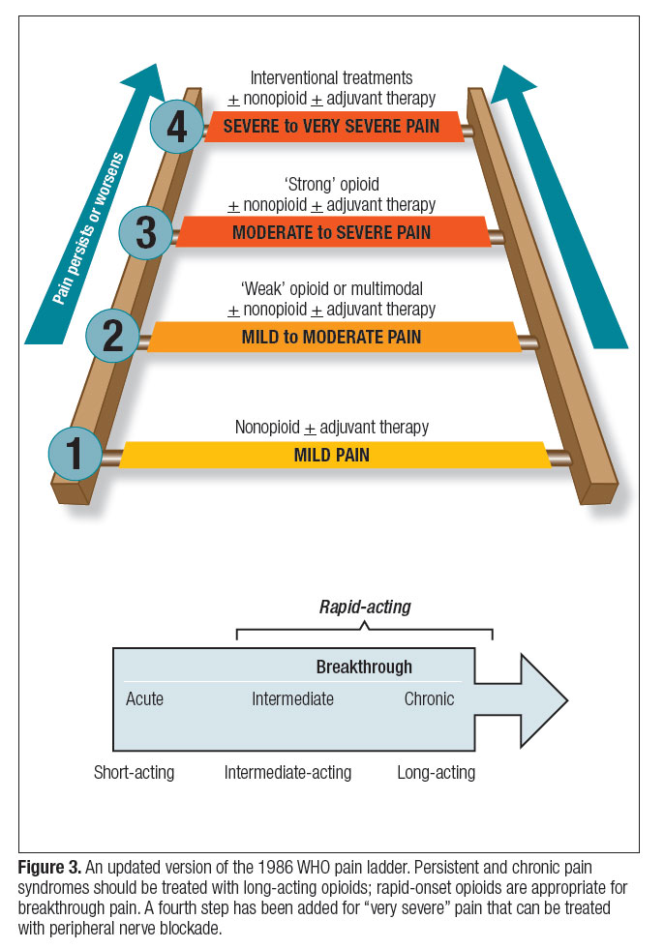
Pain Management

Slide 38
Questions

Slide 39
Mini Assessment
Which monitor is commonly used to assess the depth of anesthesia by analyzing brain activity?
What is the ideal range for the Bispectral Index (BIS) score to maintain adequate depth of anesthesia?
Which of the following is a potential risk if the anesthesia depth is too light during surgery?
How do you measure pain?

Slide 40
Question 1 of 5
Succinylcholine is metabolized by which enzyme?
A) Acetylcholinesterase
B) Monoamine oxidase
C) Plasma pseudocholinesterase (butyrylcholinesterase)
D) Cytochrome P450

Slide 41
Question 2 of 5
Which electrolyte abnormality can be caused by succinylcholine administration?
A) Hyperkalemia
B) Hypokalemia
C) Hypercalcemia
D) Hypocalcemia

Slide 42
Question 3 of 5
Which one the following is most commonly used drug used in TIVA?
Propofol
Methohexital
Etomidate
Kehta mine
Sevoflurane

Slide 43
Question 4 of 5
Which of the following inhalational anesthetic agents is most associated with hepatotoxicity?
A) Sevoflurane
B) Isoflurane
C) Halothane
D) Desflurane

Slide 44
Question 5 of 5
Dexmedetomidine is classified as which type of drug?
A) Alpha-1 adrenergic agonist
B) Alpha-2 adrenergic agonist
C) Beta-blocker
D) Benzodiazepine

Slide 45
Thanks

