Slide 2
MOTTO AND VISION VI
To impart evidence based research oriented medical education
To provide best possible patient care
To inculcate the values of mutual respect and ethical practice of medicine

Slide 3
Alcohols and drug of abuse
CNS MODULE 4thYEAR MBBS 2024
Dr Saba Sarfraz
Sources: BERTRAM G. KATZUNG BASIC & CLINICAL PHARMACOLOGY 15TH EDITION

Slide 4
Prof Umar’s Clinically Oriented Integrated Model For Basic Sciences And Interactive Lectures
6%
Vertical INTEGRATION RESEARCH
BIOETHICS
(Digital Library, Reference books)
15%
VERTICAL INTEGRATION
Clinical Subject
MEDICINE
4th Year Pharmacology LGIS
Core Subject – 64%
Pharmacology
Horizontal Integration – 3%
Same Year Subjects | Pathology (2)
Vertical Integration – 6%
Clinical Subjects | Medicine (3)
Spiral Integration – 10%
Different Year Basic Sciences Subjects | Physiology Biochemistry
Research & Bioethics,Digital library 9%
05%
3.55
15%
Research & Bioethics
Research & Bioethics
CORE SUBJECT
64%
PHARMACOLOY
3%
03%
HORIZONTAL
INTEGRATION
Pathology
Research & Bioethics
Research & Bioethics
08%
10%
05%
10%
SPIRAL INTEGRATION
Different Year
Basic Sciences Subjects
PHYSIOLOGY
BIOCHEMISTRY

Slide 5
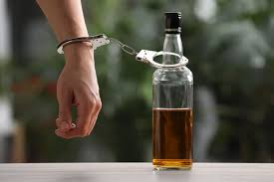
LEARNING OBJECTIVES
Understand the pharmacokinetic properties and metabolism of alcohol
Discuss different organ effects of Alcohol.
Manage acute and chronic alcoholism
Brief discussion on the toxicity, withdrawal and management of other drugs of abuse

Slide 6
PHARMACOKINETICS OF ALCOHOLS
Small water soluble molecule
Rapidly absorbed from GIT
Peak blood concentration is acheived within 30 mins
Ethanol with food delays gastric emptying
Rapidly distributed to tissues including CNS
V_{d} = total body water
Women have a higher peak plasma conc than men
Elimination follows zero order kinetics

Slide 7
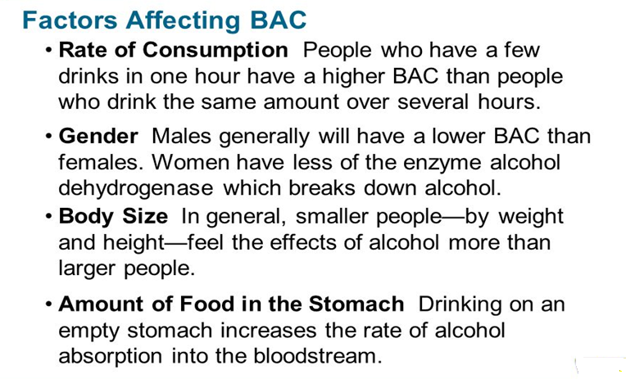

Slide 8
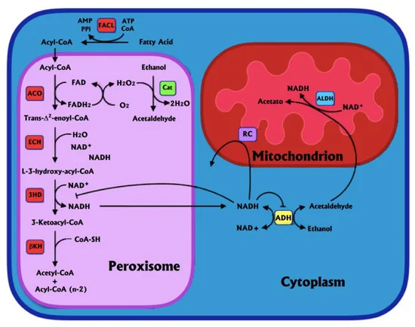
Metabolism of Alcohol
Acetaldehyde formed from the oxidation of ethanol by either ADH or MEOS
For low to moderate doses of ethanol, cytosolic NAD+ dependent enzymes will metabolize the ethanol.
SPIRAL INTEGRATION

Slide 9
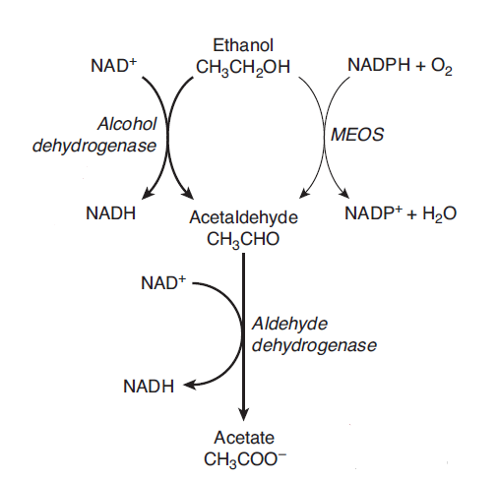
Metabolism of Alcohol
Chronic ethanol consumption induce cytP450 enzyme synthesis and MEOS system
Fomepizole
Aldehyde dehydrogenase is inhibited by disulfiram and other drugs, like metronidazole, oral hypo glycemic and cephalosporin. Genetic variation in ADH enzymes ADH1B*2 confers protection against alcohol dependence in east Asians
Disulfiram
SPIRAL INTEGRATION

Slide 10
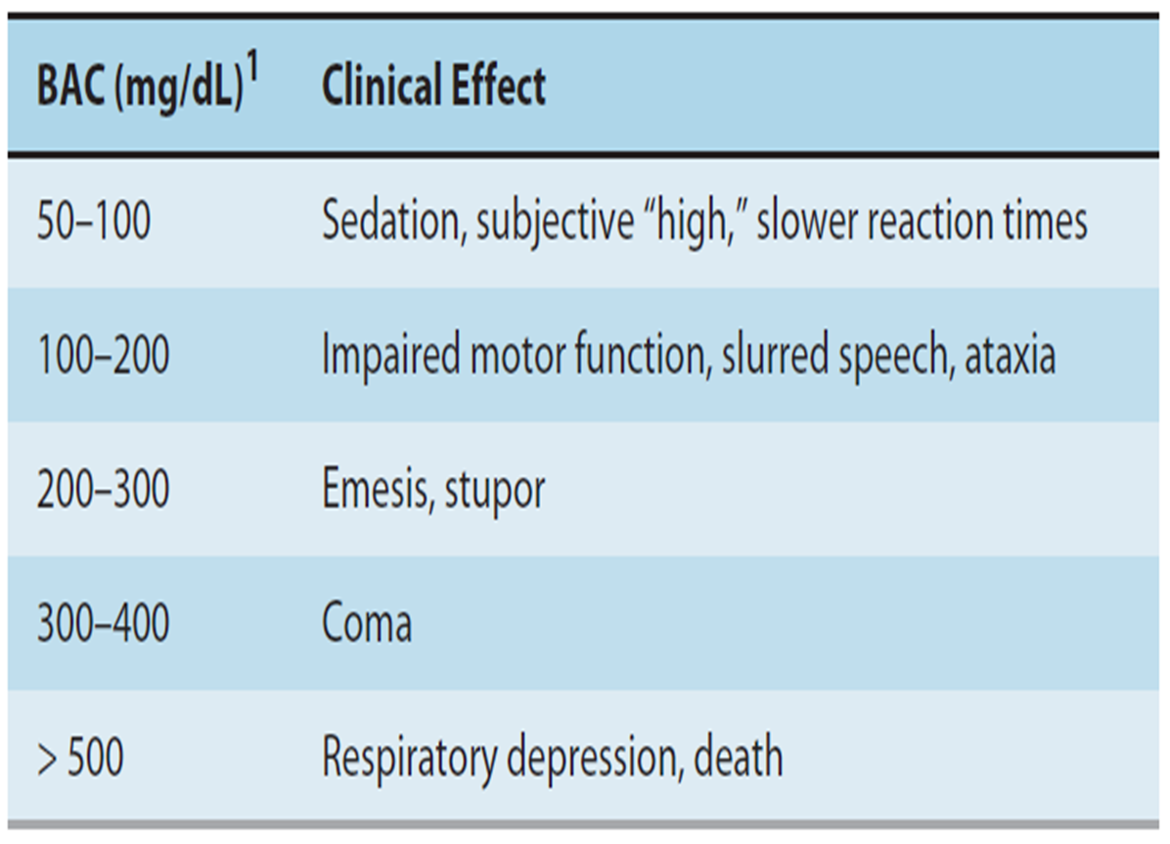
ACUTE EFFECTS OF ALCOHOL
CENTRAL NERVOUS SYSTEM:
Affects several membrane proteins that participate in signaling pathway
Enhances effect of GABA at GABA_{A} receptor
Inhibits Glutamate at N-methyl-D-aspartate NMDA receptor
HEART:
Suppression of myocardial activity at blood conc above 100mg/dl
SMOOTH MUSCLE:
Causes vasodilation
Overdose → hypothermia
Uterine relaxant

Slide 11
CHRONIC EFFECTS OF ALCOHOLISM
TOLERANANCE AND DEPENDENCE system:
Tolerance
occurs due to CNS adaptation and ethanol metabolism. There is cross tolerance to sedatives.
Psychological dependence (addiction)
Compulsive desire to take alcohol in order to experience the rewarding effects &/or to avoid consequences of withdrawal
Triggered by environmental cues, familiar places, people or events etc.
Physical dependence (dependence)
Withdrawal symptoms: hyperexcitability, seizures, toxic psychosis, delirium tremens
LIVER & GIT:
Liver disease is the commonest complication of alcohol abuse
Disease Risk depends on duration of use, avg consumption, co existing diseases
Fatty liver → alcoholic hepatitis → cirrhosis →liver failure
Liver disease is multifactorial
Chronic pancreatitis
Gastritis → anemia & protein malnutrition
Intestinal damage → vitamin deficiencies

Slide 12
PERIPHERAL NEUROPATHY: (Parasthesias, gait disturbances, ataxia, dememtia & demyelinating disease)
Wernicke-Korsakoff syndrome:(Paralysis of external eye muscles, ataxia, confusion, coma , death)
Associated with thiamine deficiency
Treatment includes administration of thiamine
Korsakoff’s psychosis is a Permanent memory disorder occurs, occurs in thiamine deficiency.

Slide 13
CHRONIC EFFECTS OF ALCOHOLISM
CARDIOVASCULAR SYSTEM:
Cardiomyopathy & heart failure:
Dilated cardiomyopathy with fibrosis
Membrane disruption, dec function of mitchondria and SR, accumulation of phospholipids and fatty acids.
Can be partially reversed after cessation
Arrhythmias:
Binge drinking atrial & ventricular arrhythmias
Alcohol withdrawal related arrhythmias
Hypertension
Coronary heart disease:
Moderate alcohol confers protection against CHD, ischemic stroke & peripheral arterial disease
Raises HDL levels Prevent atherosclerosis – inhibit inflammation, increase tPA
“J shaped relationship”

Slide 14
CHRONIC EFFECTS OF ALCOHOLISM
Blood: mild anemia
Endocrine system & electrolyte imbalance:
Gynecomastia, testicular atrophy -derangement of steroid hormone balance
Altered K levels, sec hyperaldosteronism
Hypoglycemia
Fetal Alcohol syndrome:
teratogenic
Intrauterine growth retardation, microcephaly, poor coordination, underdevelopment of mid facial features, minorjoint anomalies
fetus can not metabolize alcohol
Alcohol causes neurodegeneration

Slide 15
CHRONIC EFFECTS OF ALCOHOLISM
IMMUNE SYSTEM
Lungs: heavy use can cause infectious pneumonia
Liver: chronic alcohol abuse can enhance inflammation in liver and pancrease
INCREASED RISK OF CANCER:
Mouth, pharynx, larynx, esophagus, liver
ALCOHOL DRUG INTERACTION
Chronic use leads to induction of cyt P450
Increased metabolism of acetaminophen
Increased chances of hepatotoxicity
Acute ingestion leads to inhibition of metabolism of Phenothiazines, TCA’s &Sedative-hypnotics

Slide 16
Treatment of acute and chronic alcoholism
Excessive CNS depression
Maintain vital signs
Alcohol withdrawal syndrome
Correction of electrolyte imbalance
Alcohol use disorder (chronic alcoholism)
Naltrexone
Alcohol dependence
Disulfiram
Prevent aspiration
IV dextrose
Thiamine administration
Correction of electrolyte imbalance
Administration of thiamine
Administration of sedatives-hypnotics…BENZODIAZEPINES
Acamprosate
Several anti depressants
VERTICAL INTEGRATION

Slide 17
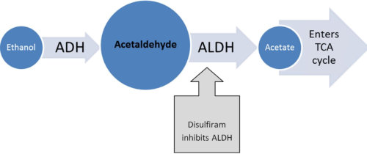
Disulfiram Like Reaction?
Accumulation of Acetaldehyde leads to following symptoms
Nausea,
headache
flushing
hypotension
Metronidazole
Oral hypoglycemic
cephalosporin
CORE SUBJECT

Slide 18
Drugs of abuse
Use of elicit drug or chemicals, that are not considered as drugs, for, motivation or feeling of pleasure derived from CNS effects of a substance. It has its physical or psychological dependence.
Dopamine is the neurotransmitter of reward center in brain, i.e mesolimbic system.
Drugs of abuse will facilitate the effects of dopamine in the brain.
Drugs include:
Sedatives-hypnotics
Opioid analgesics
Stimulants
Hallucinogens
Marijuana
Inhalants
steroids

Slide 19
Schedule of controlled drugs

Slide 20
CLASSIFICATION OF BENZODIAZEPINES
Benzodiazepines
Short acting
Intermediate acting
Lorazepam
Alprazolam
Long acting
Clonazepam
Midazolam
Triazolam
Oxazepam
Diazepam
CORE SUBJECT

Slide 21
Sedative-hypnotics-Schedule IV
Commonly abused drugs
Short acting benzodiazepine (secobarbital) highest abuse potential
Anxiolytic
Acute over dose
Death d/t resp depression or cardiovascular arrest
Management by Flumazenil
withdrawal
Tremors, anxiety, delirium, hallucination
Treated by replacement with long acting benzodiazepines and gradual onset dose reduction
Clonidine and propanol may suppress sympathetic over activity

Slide 22
Opioid analgesics-schedule III
Commonly abused drugs
Heroin, morphine, codeine, oxycodone, meperidine, fentanyl
IV administration has rapid development of tolerance, dependence and addiction
Drug overdose
Causes Respiratory depression, coma and death
Managed by parenteral naloxone, nalmefene and ventilator support
withdrawal
Causes, lacrimation, rhinorrhea, yawning, sweating, weakness, tremors, muscle jerks and hyper apnea
Treatment includes replacement with equivalent agent methadone followed by dose reduction
Buprenorphine, substitution therapy

Slide 23
Stimulants-schedule II
Caffeine Nicotine
Withdrawal,anxiety and mental discomfort,Rx, varenicline-partial agonist at N receptors,Rimonabant, agonist at cannabinoid receptors
Amphetamines
Dextroamphetamin and methamphetamine
High dose abuse leads to psychotic state like schizopherenia.
cocain
It is an inhibitor of CNS transporters of dopamine, norepinephrine and serotonin.causes self confidence, mental alertness andeuphoria
Toxicity, CNS stimulation, tremers, arrhythmia,insomnia
Antidepressants are used in the treatment o withdrawal indused depression.
Overdose causes arrhythmia, seizers and resp depression, cardiatoxiity
No specific antidote is available.
Fetal morbidity mortality

Slide 24
Hallucinogens-schedule-IV
Common drugs of abuse
PCP, phencyclidine-an angel dust and ketamine, special K are antagonist at glutamate NMDA receptors
overdose
Horizontal and vertical nystagmus, hypertension and seizers
Rx
Parentral benzodiazepines are used to Curb CNS excitation.

Slide 25
Inhalants
Anesthetics
Euphoria and disinhibition
Industrial solvents
Rubber cement, shoe polish, glues
Childern and early adults
Organic Nitrates
Amyl nitrite, isobutyl nitrite
Dizziness, tachycardia, hypotension and flushing, methhemoglobinurea
NO, chloroform, diethylether
Effects judgement and loss of consciousness NO causes aphyxia and death
Active ingredient benzene, hexane,methyl ethyl ketone,trichloroethylene
Toxic to liver, kidney, peripheral nerves, brain, bonemarrow

Slide 26
Steroids
Schedule -III
Anabolic steroids
Improve muscle mass and strength
Adverse effects
Acne, premature closure of epiphyses,
Masculinization in females, hepatic dysfunction, MI
withdrawal
Fatigue and depression of mood
Treatment, tapper off steroids with multidisciplinary approach

Slide 27
BIOETHICS
Minimize the risk of dependence
Minimize the risk of harm by monitoring closely
Ethical prescribing
Maintain confidentiality
Provide comprehensive care to patient
SPIRAL INTEGRATION

Slide 28
ROLE OF AI IN USE OF SEDATIVES HYPNOTICS
Personalized medicine
Dosing optimization
Symptoms tracking
Adherence monitoring
Side effect prediction, drug interactions alerts
Patient education
Behavioral interventions
Clinical trials
New drug development
SPIRAL INTEGRATION

Slide 29
HOW TO ACCESS DIGITAL LIBRARY
Go to the website of HEC National Digital Library.
On Home Page, click on the INSTITUTES.
A page will appear showing the universities from Public and Private Sector and other Institutes which have access to HEC National Digital Library HNDL.
Select your desired Institute.
A page will appear showing the resources of the institution
Journals and Researches will appear
You can find a Journal by clicking on JOURNALS AND DATABASE and enter a keyword to search for your desired journal.
SPIRAL INTEGRATION

Slide 30
FURTHER READING
Cho J, Spence MM, Niu F, Hui RL, Gray P, Steinberg S. Risk of overdose with exposure to prescription opioids, benzodiazepines, and non-benzodiazepine sedative-hypnotics in adults: a retrospective cohort study. Journal of general internal medicine. 2020 Mar;35:696-703.
Sweetman A, Putland S, Lack L, McEvoy RD, Adams R, Grunstein R, Stocks N, Kaambwa B, Van Ryswyk E, Gordon C, Vakulin A. The effect of cognitive behavioural therapy for insomnia on sedative-hypnotic use: A narrative review. Sleep medicine reviews. 2021 Apr 1;56:101404.
SPIRAL INTEGRATION

