Slide 1
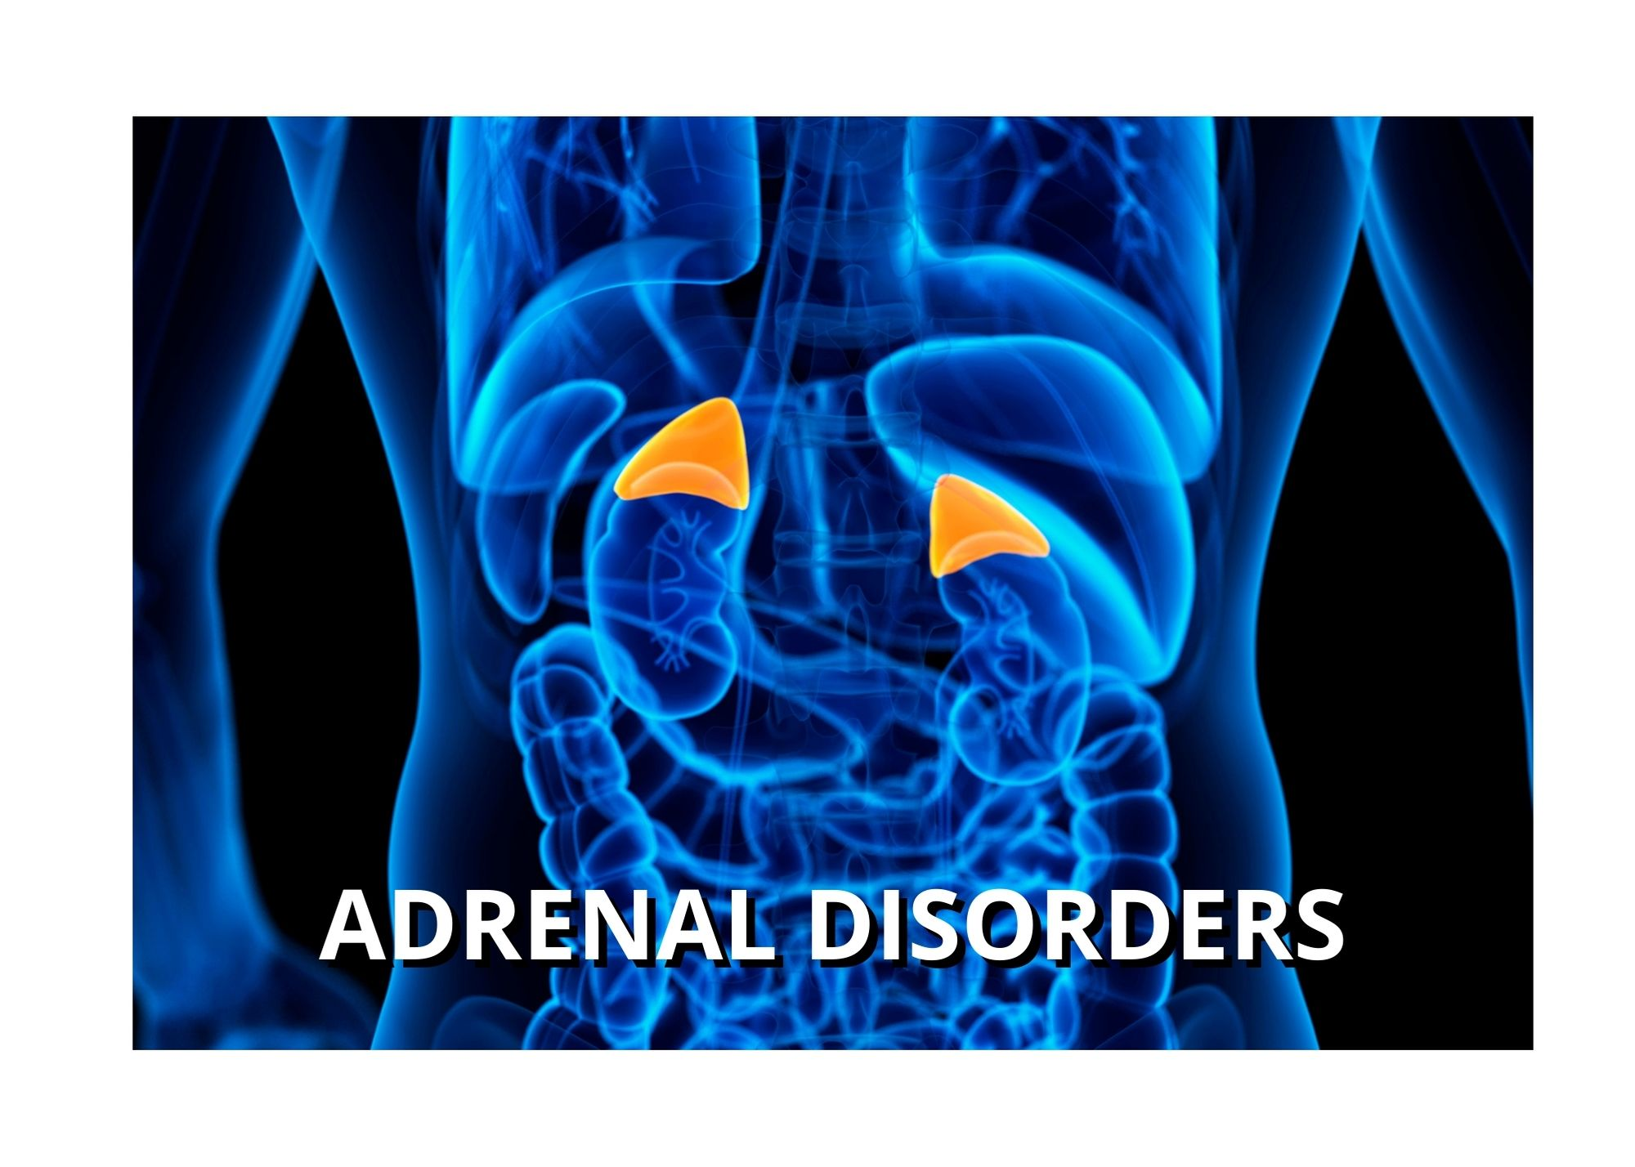

Slide 2
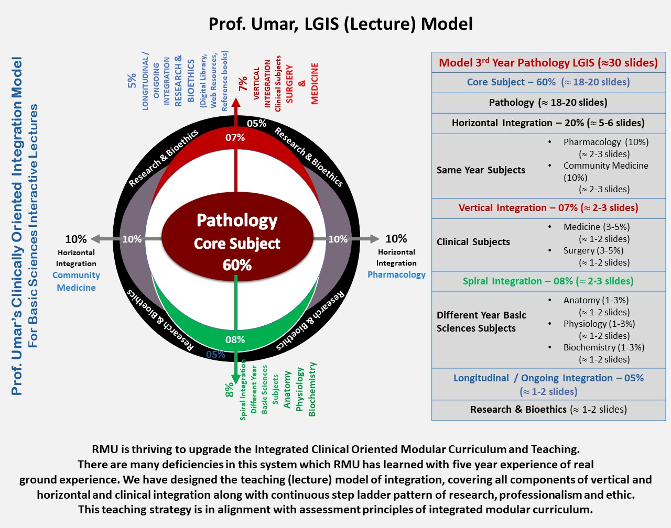

Slide 3
Objectives of today’s Presentation
Anatomy of Adrenal glands
Pathophysiology of adrenal disorders
Clinical Manifestations of Adrenal disorders
Investigations to confirm diagnosis
Principles of management
Research and references

Slide 4

Epidemiology
Males-3 times greater incidence of the ectopic ACTH syndrome due to cigarette smoking.
Females-3 to 8 times more likely to develop Cushing's disease and Cushing's syndrome associated with an adrenal tumor.
The age at presentation varies depending upon the cause of hypercortisolism:
Ectopic ACTH syndrome develops parallels to the development of lung carcinoma.
Cushing's disease-mainly in women aged 25 to 45 years.
Adrenal tumors-bimodal age distribution

Slide 5

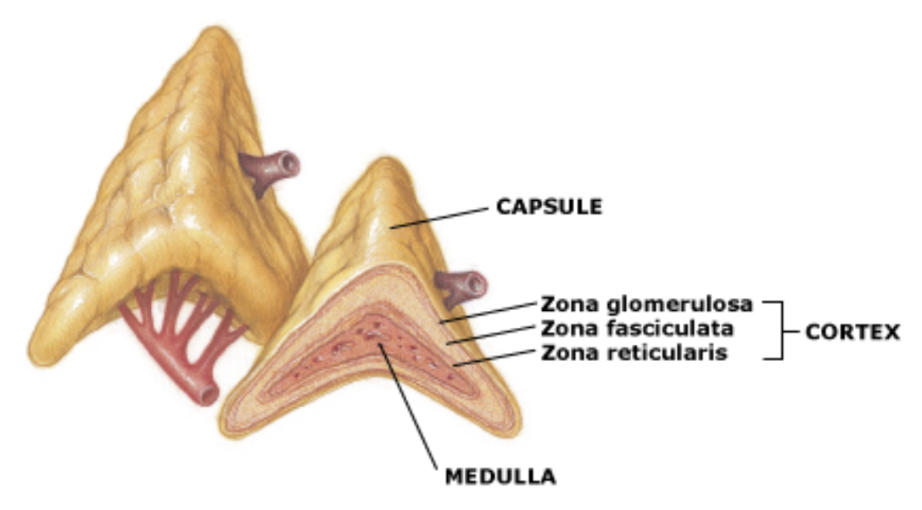
Anatomy of Adrenal gland
The adrenal glands are retroperitoneal and are located on the superior medial aspect of the upper pole of each kidney.
The adrenal glands have a rich, multiple arterial supply from three main groups of vessels: the superior suprarenal arteries, the middle suprarenal artery, and the inferior suprarenal renal arteries.

Slide 6
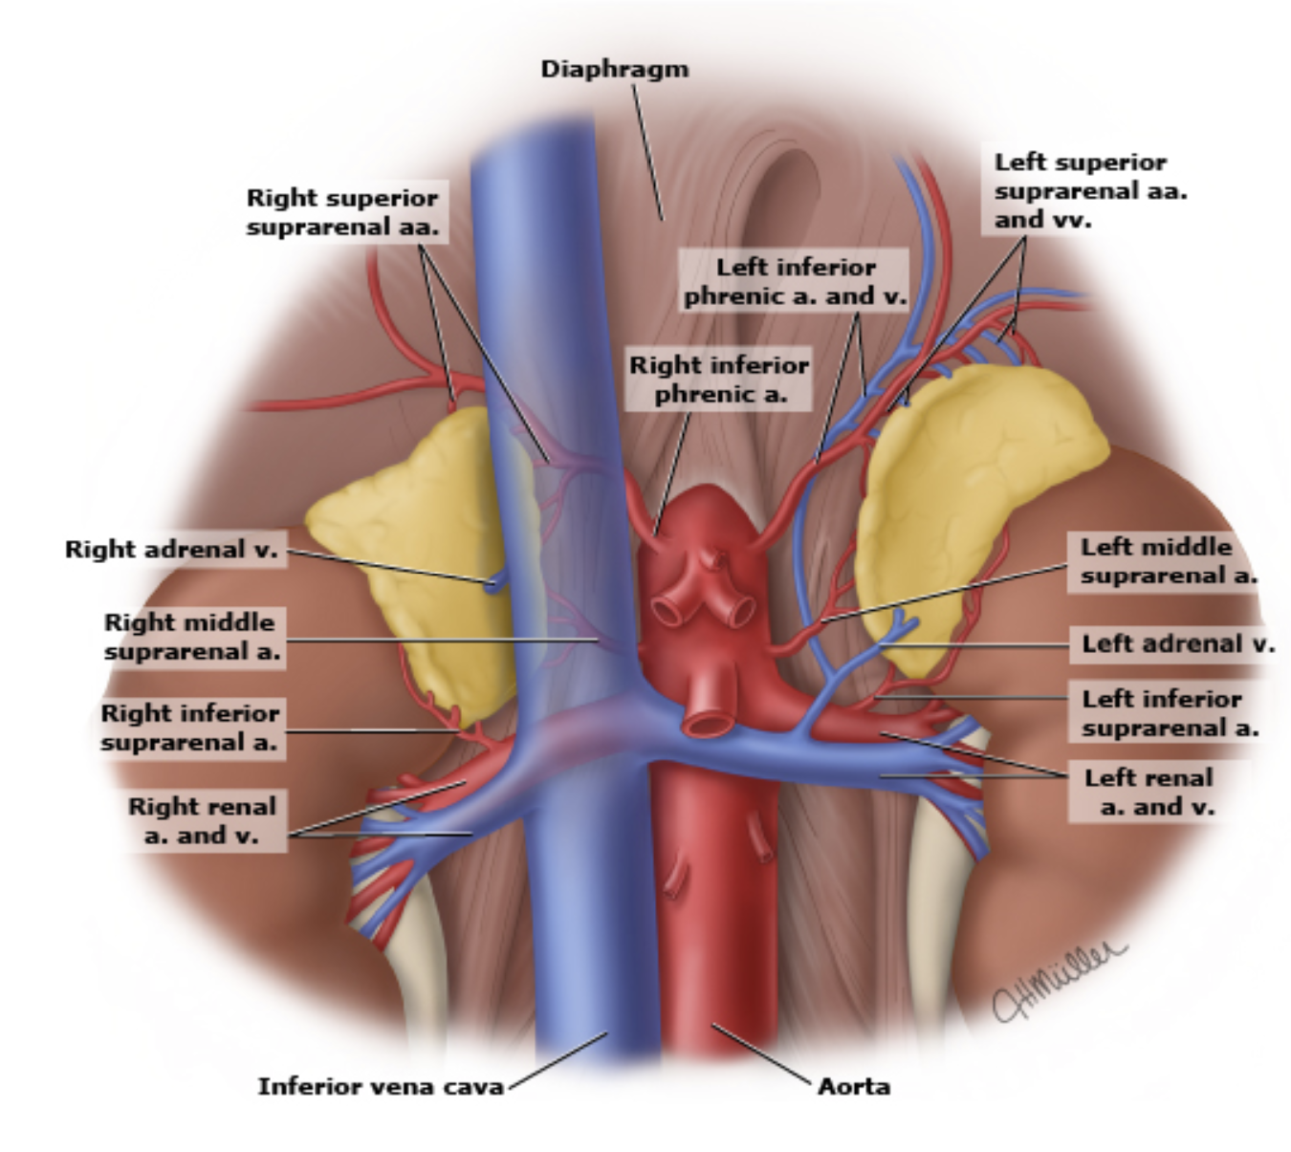
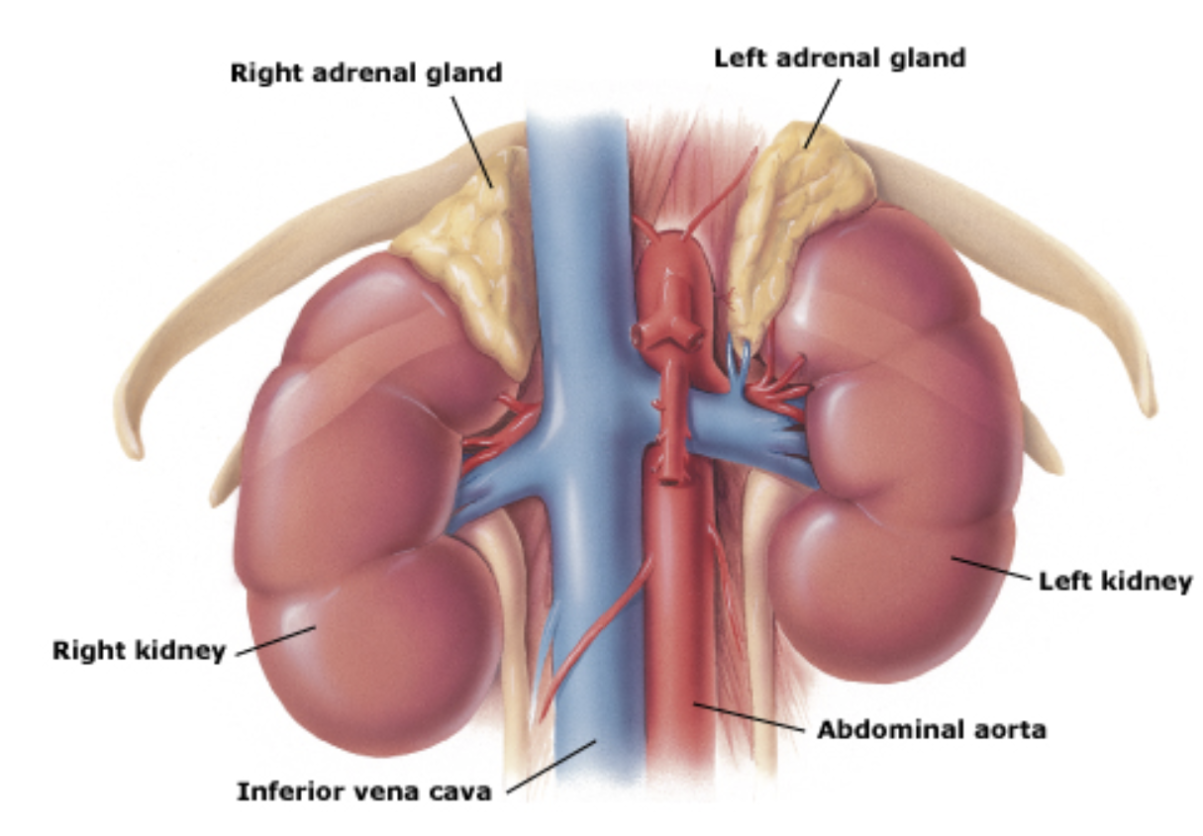
Anatomy of Adrenal gland

Slide 7
Addison’s Disease

Slide 8
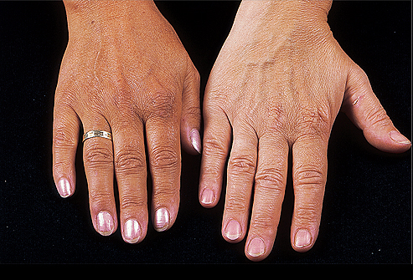
Addison’s Disease
Develops when the level of adrenal cortex hormone is low due to hypo-secretion

Slide 9
Pathophysiology
Anterior pituitary produces excessive but ineffective amounts of ACTH→decrease in production of Glucocorticoids and Mineralocorticoids.
Since there is no ACTH to stimulate the adrenal cortex to release its hormones, the adrenal cortex can not release hormones to regulate processes in the body.

Slide 10
Pathophysiology
Anterior Pituitary
ACTH to Adrenal Cortex
Release of Glucocorticoids or Mineralocortcoids
When their Functions are Completed
Target tissue release feedback hormones towards hypothalamus

Slide 11
Negative Feedback Loop in Addison’s Disease
Anterior Pituitary
Excessive but ineffective ACTH to adrenal cortex
No release of Glucocorticoids or Mineralocorticoids
Bronzing of skin
ACTH is linked to melanin production
Lack of glucose , Na & Water
Dehydration, unable to manage stressful
situations

Slide 12
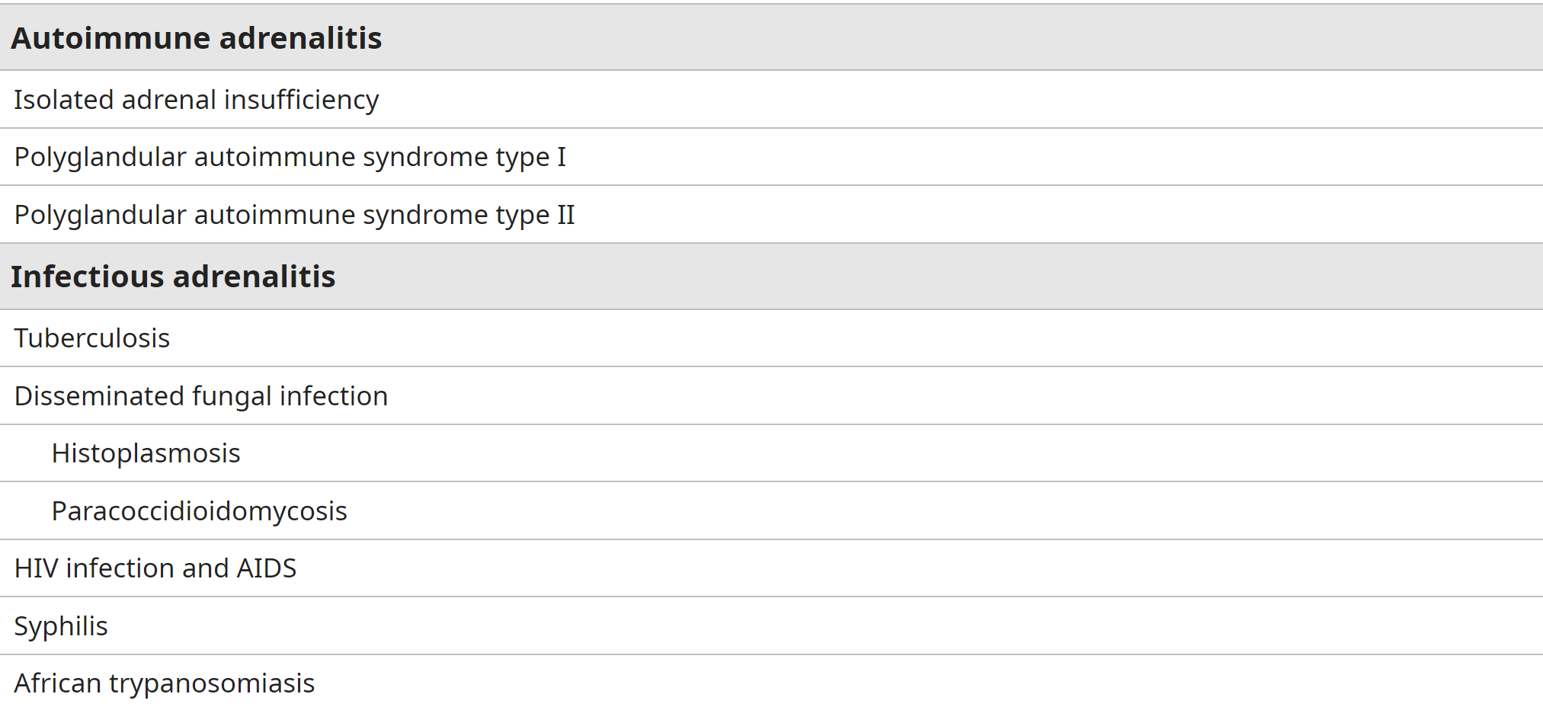
Causes of Primary Adrenal Insufficiency

Slide 13
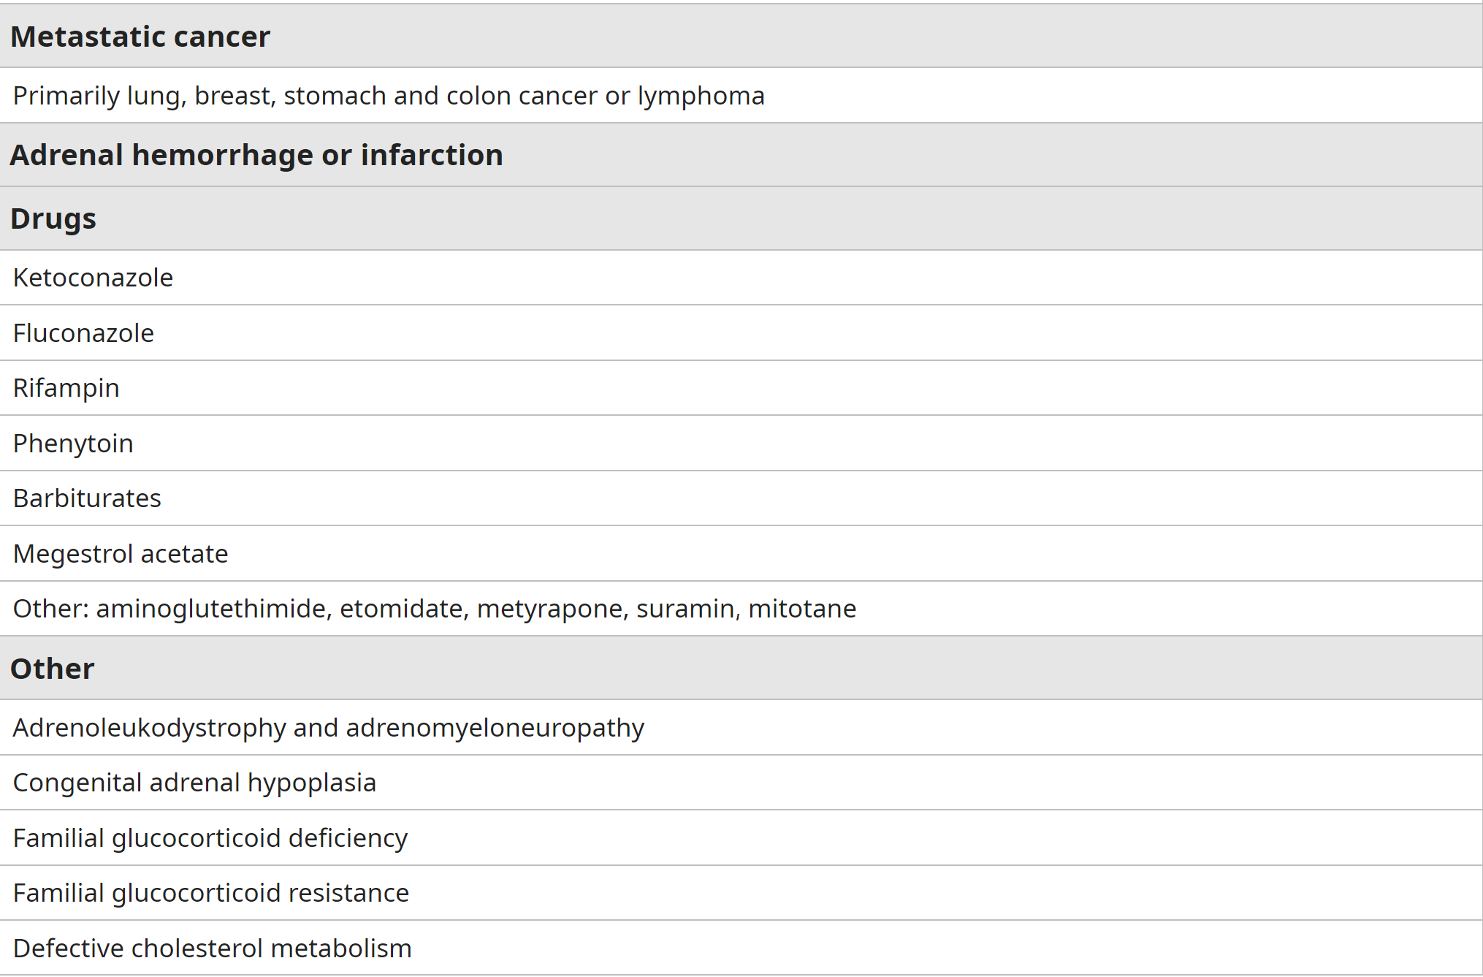
Causes of Primary Adrenal Insufficiency

Slide 14
Secondary and Tertiary Adrenal Insufficiency
Secondary: Any process that involves the pituitary and interferes with ACTH secretion can cause secondary adrenal insufficiency.
For example: Panhypopituitarism, Isolated ACTH deficiency and Autoimmune
Tertiary: Tertiary adrenal insufficiency refers to causes that relate to hypothalamic abnormalities that reduce corticotropin-releasing hormone (CRH) secretion. Most common causes are as follows:
Abrupt cessation of high-dose glucocorticoid therapy
Correction (cure) of hypercortisolism (Cushing's syndrome)

Slide 15

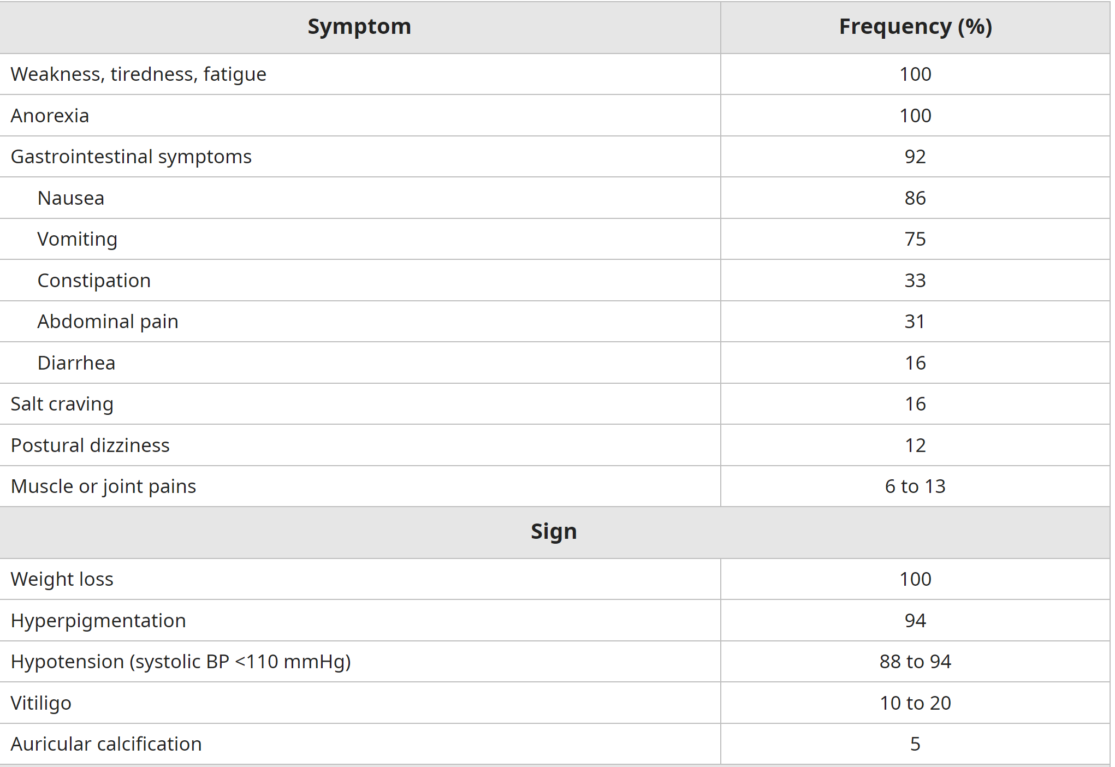
Clinical Signs and Symptoms

Slide 16
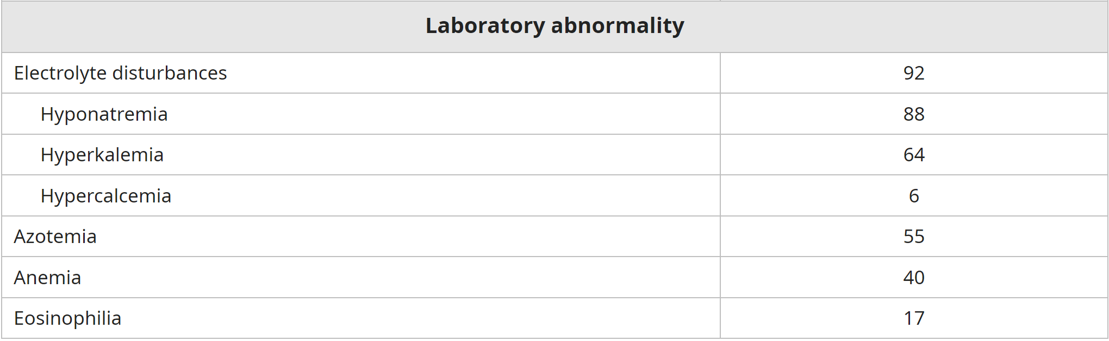
Clinical Signs and Symptoms

Slide 17
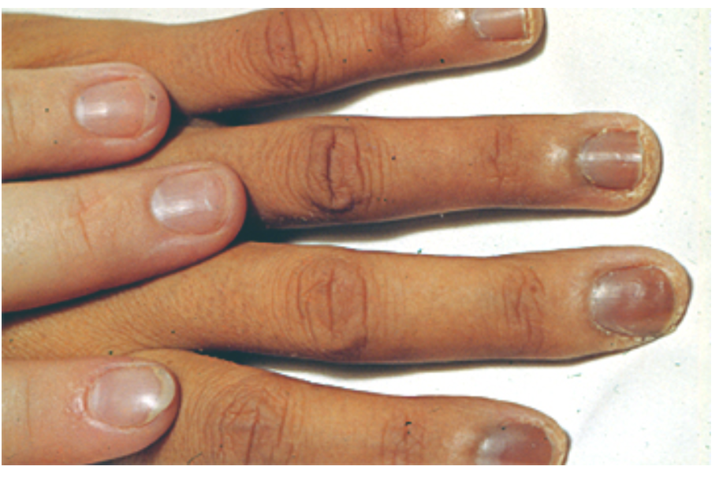
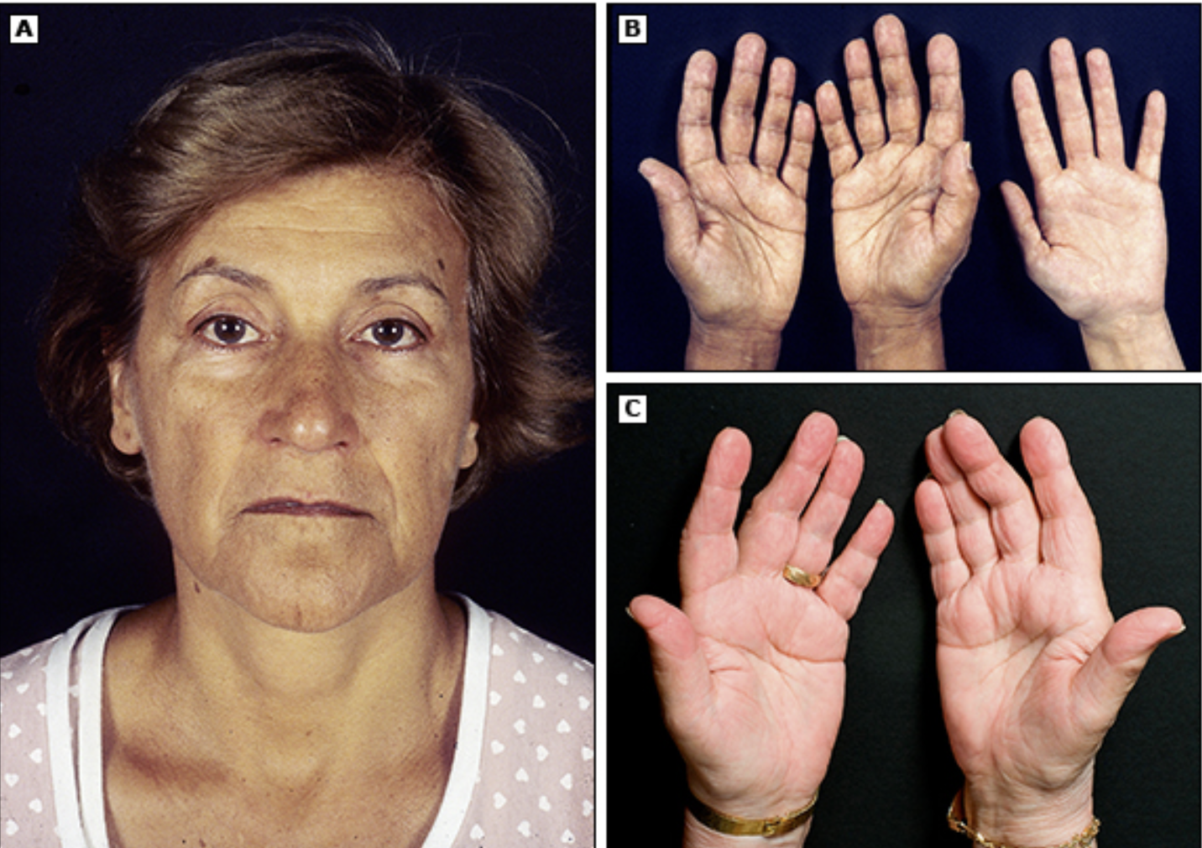
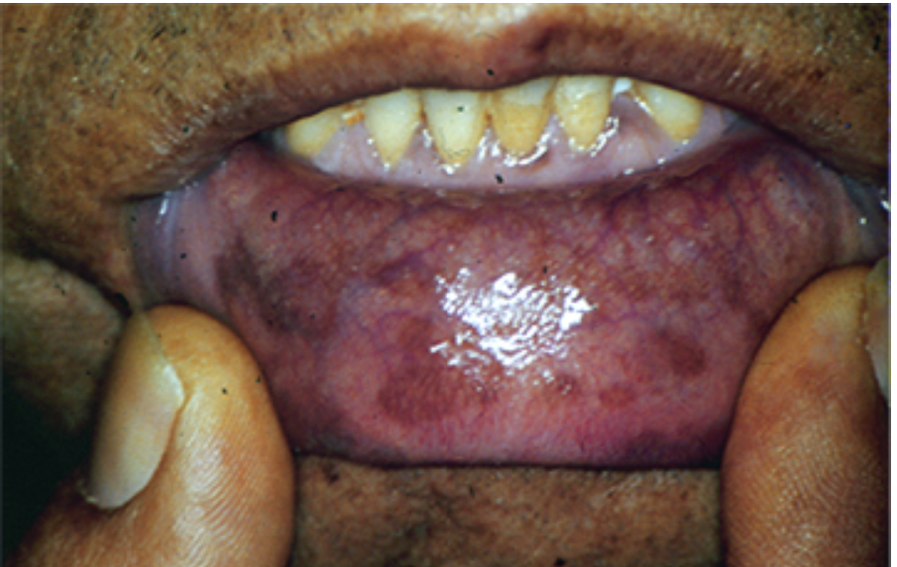
Clinical Signs and Symptoms

Slide 18
Physical Examination
Examine the following:
Hyperpigmentation, typically localized to palmar creases and knuckles
Hand: Compare the creases with your own hand
Mouth and Lips for pigmentation
Areas usually cowered by clothing: Nipples, Areas irritated by belts, straps, collar or rings
Look for vitiligo
Tell the examiner that you would like to investigate
BP: for postural hypotension
Looking for sparse axillary and pubic hair

Slide 19
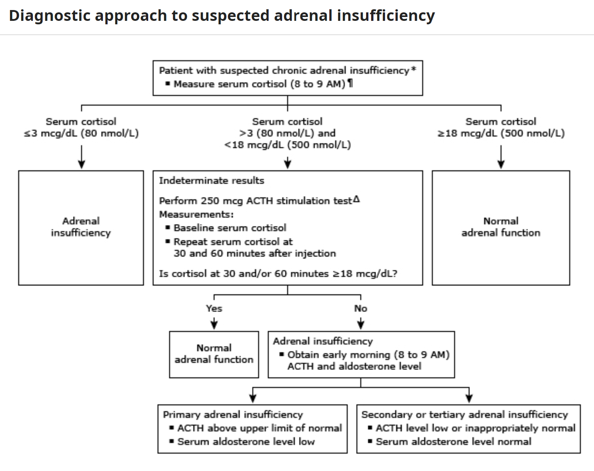
Diagnosis

Slide 20
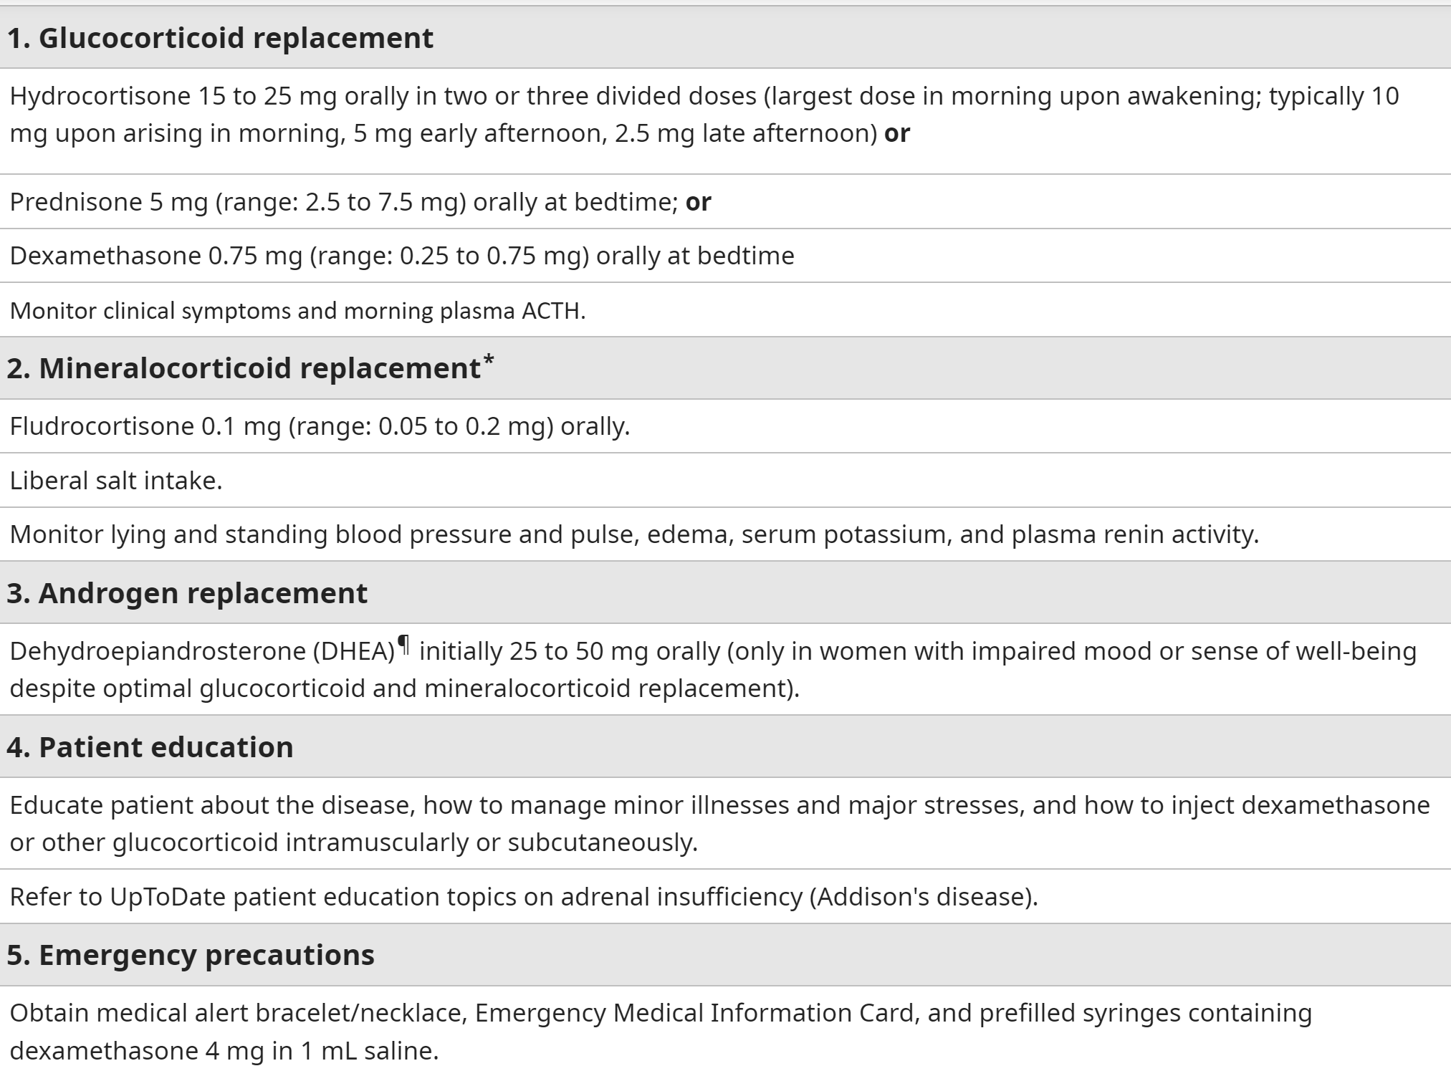
Treatment

Slide 21
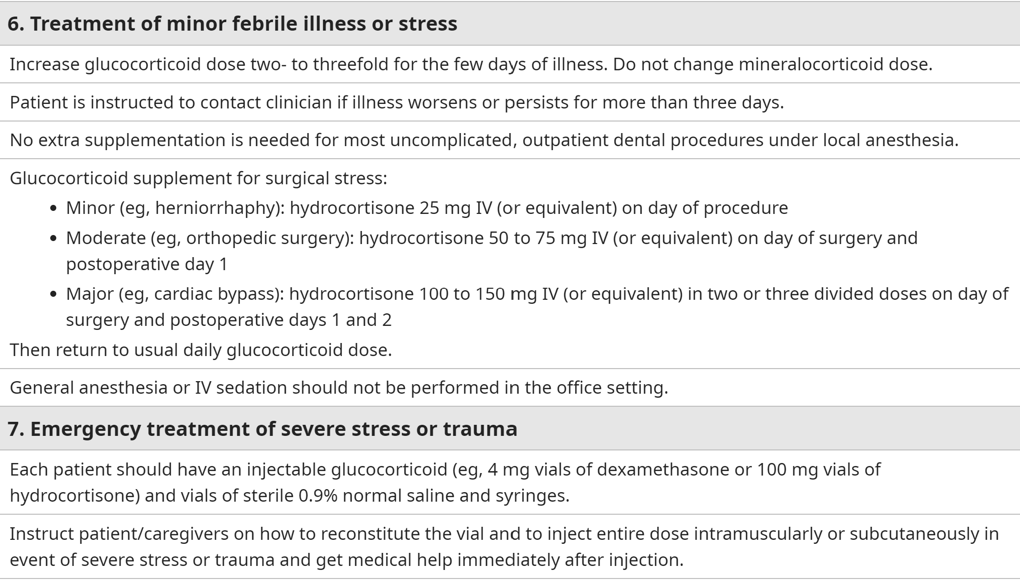
Treatment

Slide 22
Cushing’s Syndrome

Slide 23
Cushing Syndrome
Cushing “syndrome” refers to the manifestations of excessive corticosteroids.
It is caused:
mostly supraphysiologic doses of corticosteroid drugs.
rarely due to spontaneous production of excessive cortisol by the adrenal cortex.

Slide 24
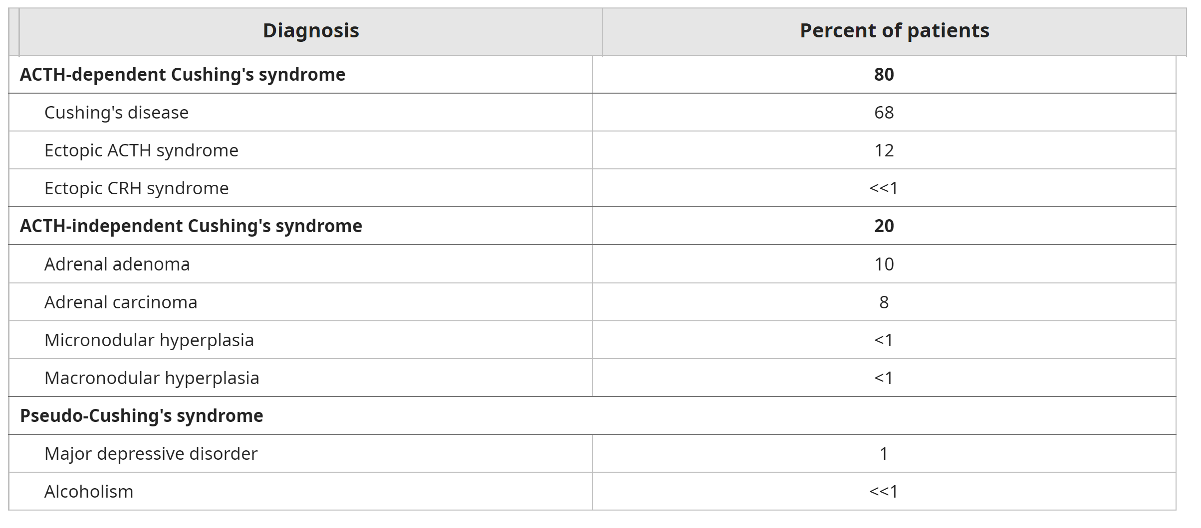
Causes of Cushing Syndrome

Slide 25
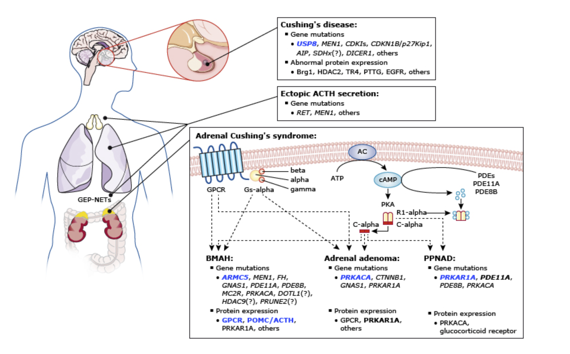
Mechanisms in Cushing’s Syndrome

Slide 26
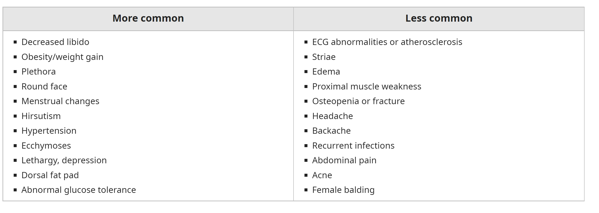
Clinical Manifestations

Slide 27
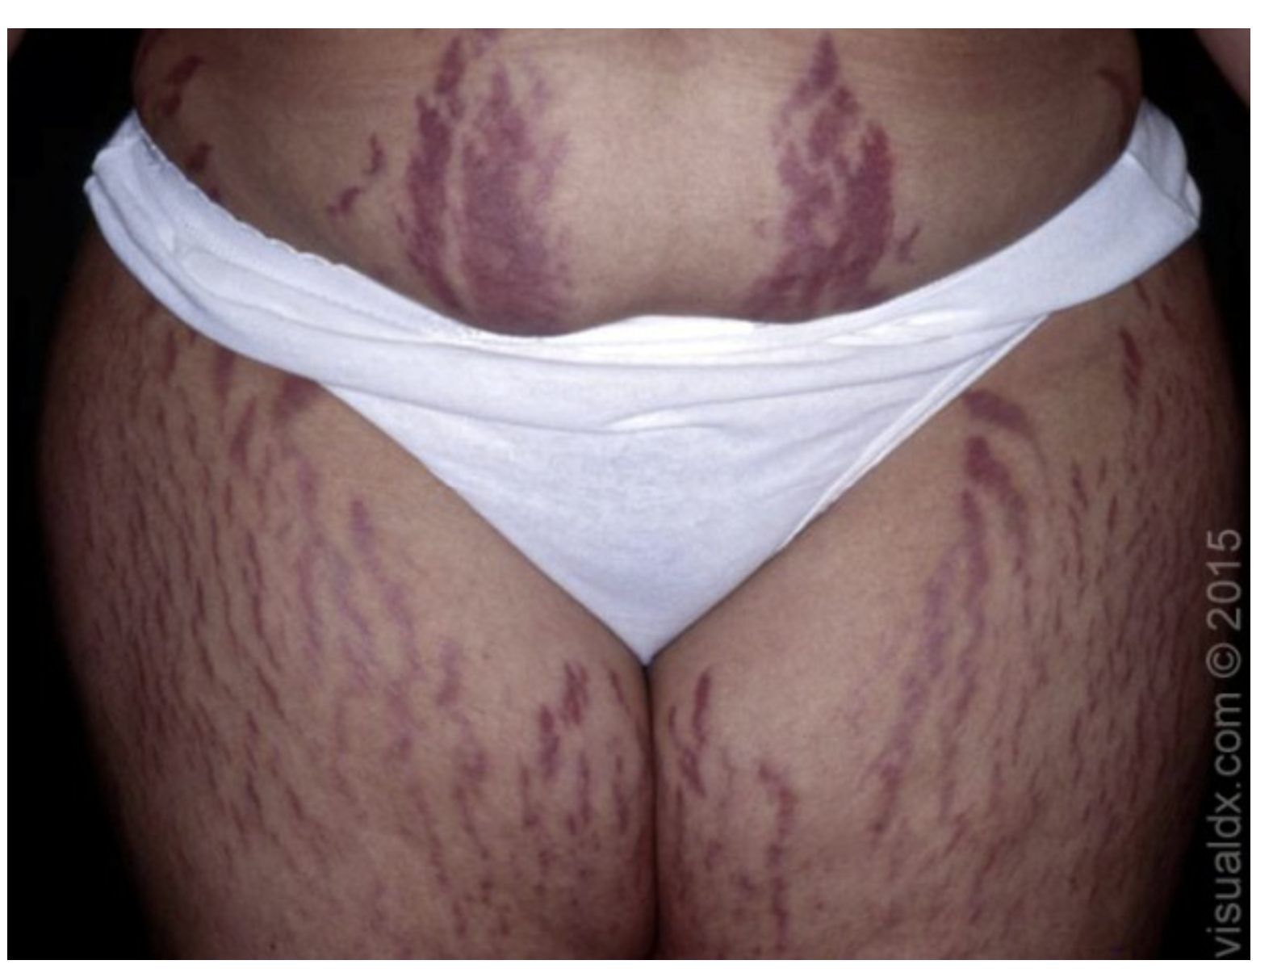
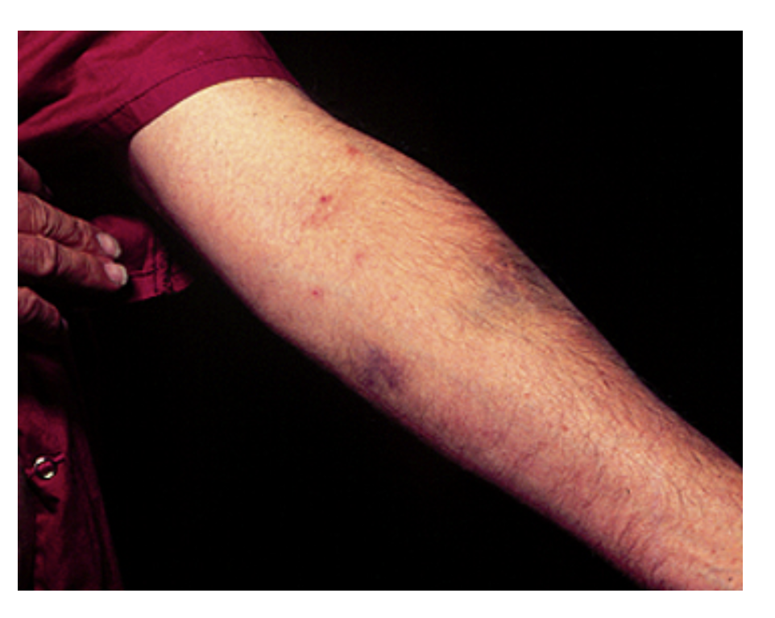
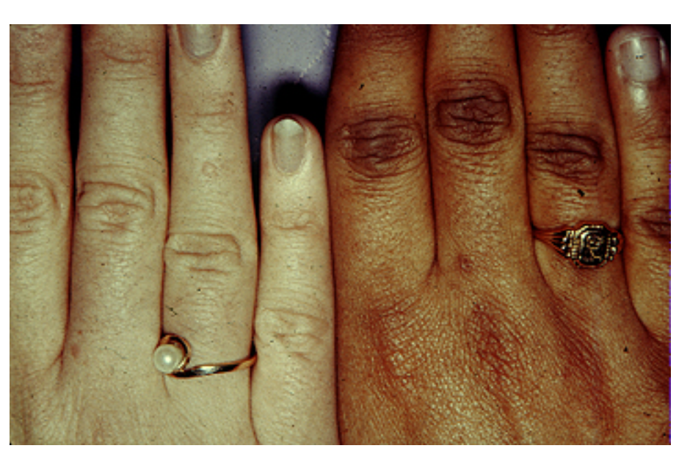

Slide 28
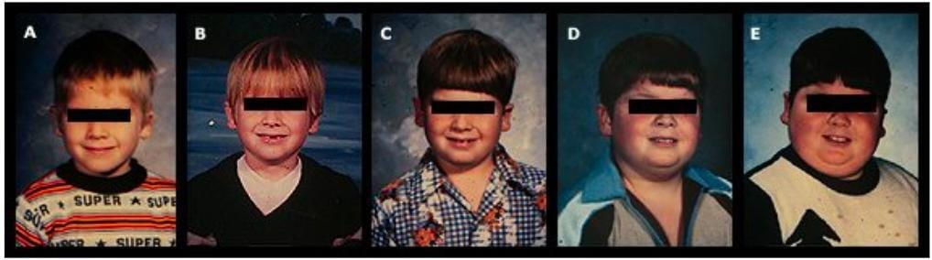
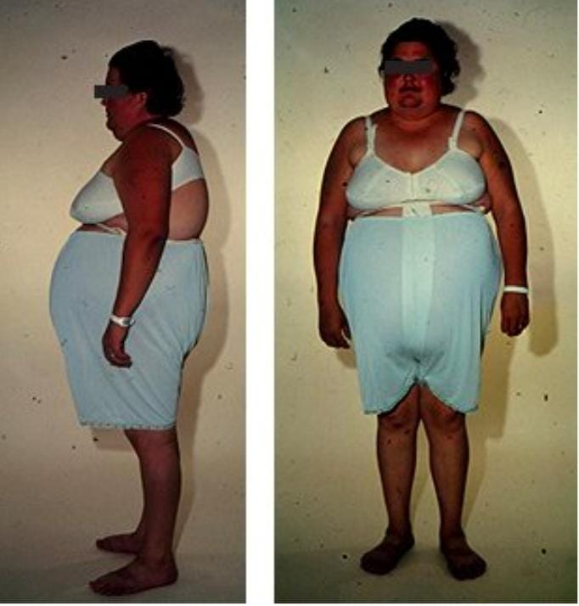
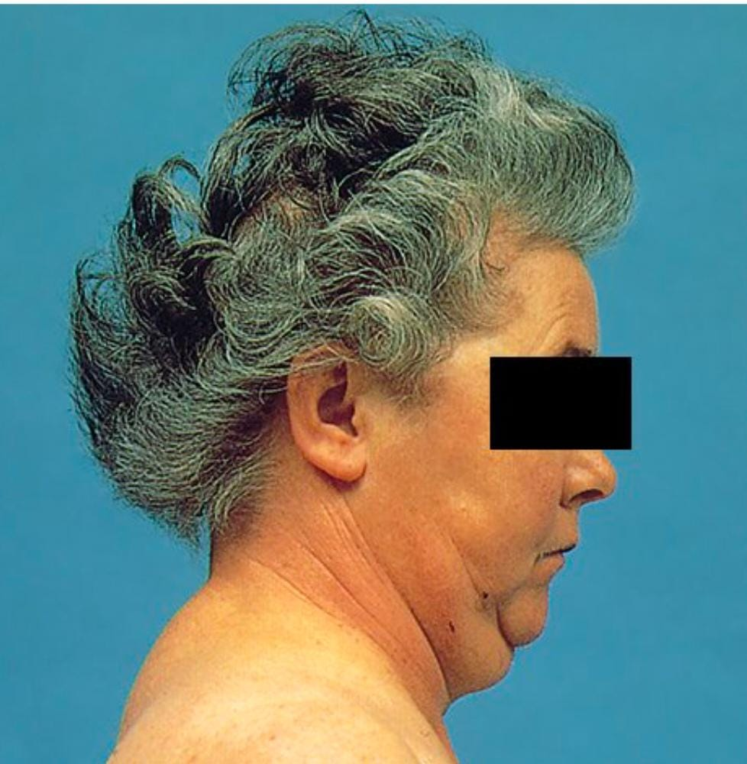
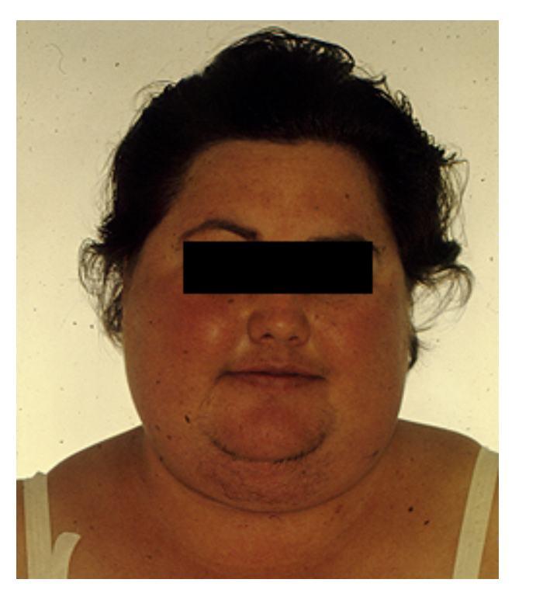

Slide 29
Physical Examination
Examine the following:
The mouth for superimposed thrush
The interscapular area for 'buffalo hump
Increased fat pads and bulge above supraclavicular fossae
The abdomen for thinning of skin and purple striae
The limbs for bruising, wasting of the limbs, weakness of the muscles of the shoulders and hips: get the patient to squat (proximal myopathy).

Slide 30
Physical Examination
Ask the patient whether he or she has back pain and then examine the spine, looking for evidence of osteoporosis and collapse of vertebra, kyphoscoliosis.
Measure the BP
Tell the examiner you would like to
Test the urine for glucose
check visual fields (for pituitary tumour)
Examine the fundus for optic atrophy, papilloedema, signs of hyper tensive or diabetic retinopathy.
Comment on signs of asthma, rheumatoid arthritis, SLE, fibrosing alveolitis (as these are conditions that are treated with long-term steroids).

Slide 31
Establishing the Diagnosis of Cushing’s Syndrome
First-line tests
Late-night salivary cortisol (2 measurements)
24-hour urinary free cortisol (UFC) excretion (2 measurements)
Overnight 1 mg dexamethasone suppression test.
For patients with a low index of suspicion: one of the first line test
For patients with a high index of suspicion: two or three first-line tests.

Slide 32
Confirmatory Tests
low-dose DST (most sensitive) The overnight test consists of administration of 1 mg of dexamethasone at 11 PM to 12 AM (midnight), and measurement of serum cortisol at 8 AM the next morning. Failure to suppress cortisol below 50nmol/L is highly suggestive of Cushing’s.
24 hours urniary free cortisol. An ideal initial testThe patient can be assumed to have CS if basal urinary cortisol excretion is more than three times the upper limit of normal and one other test is abnormal.

Slide 33
Localization Tests
ACTH levels
If ACTH levels are low- origin is in the adrenal gland-scan the gland with a CT or MRI
If ACTH levels are high- origin is either in Pituitary gland or ectopic ACTH
High dose DST
If ACTH is suppressed- origin is the pituitary- scan
If ACTH is not suppressed- origin is ectopic- scan the chest for lung cancer or Carcinoid.

Slide 34
Management (Surgical)

Slide 35
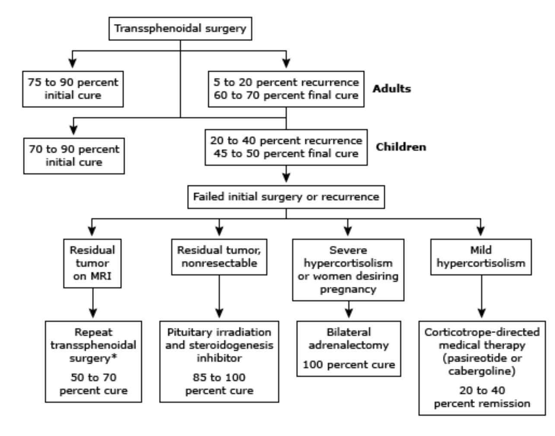


Slide 36
Management (Medical)

Slide 37
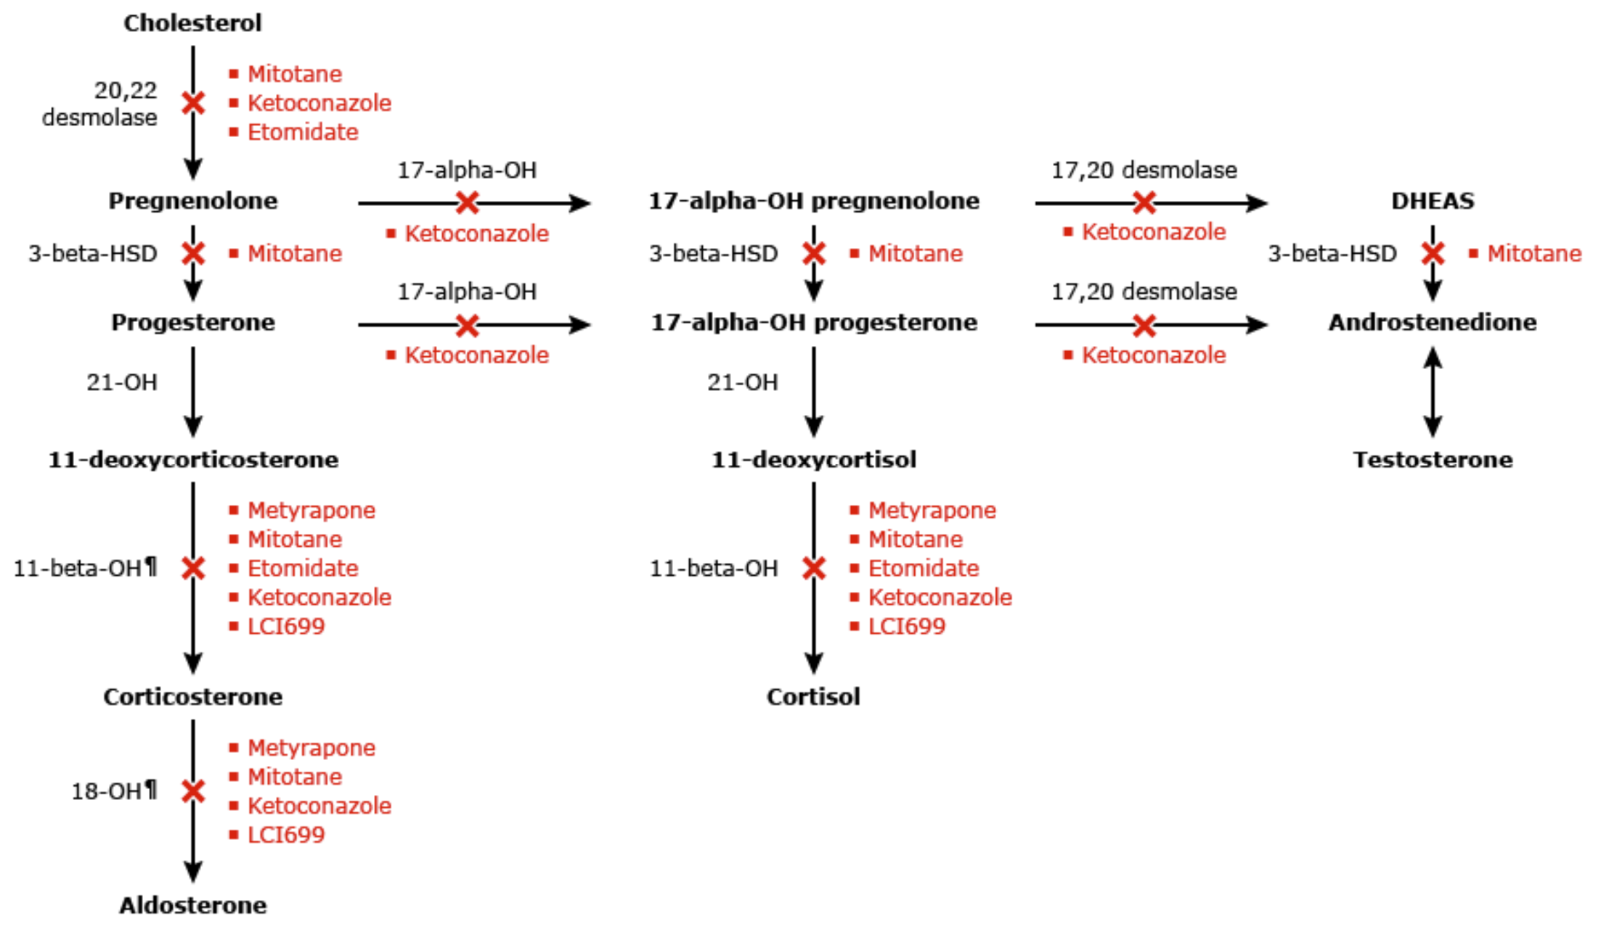

Slide 38
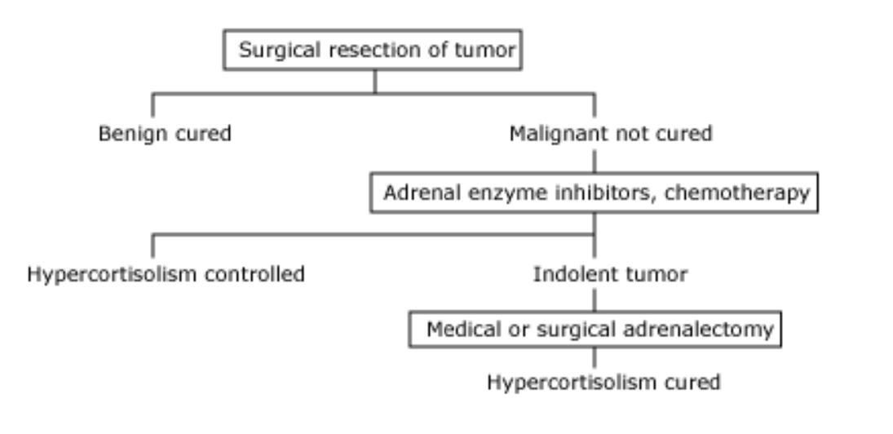
Treatment of ectopic ACTH Syndrome

Slide 39
Pheochromocytoma

Slide 40
Pheochromocytoma
PHEOCHROMOCYTOMA are rare neuroendocrine tumor of the medulla of the adrenal glands 85-95% cases(originating in the chromaffin cells), or extra-adrenal chromaffin tissue that secretes excessive amounts of catecholamines (epinephrine and norepinephrine) -- hormones that regulate heart rate and blood pressure.

Slide 41
Pathophysiology
Adrenal medulla secretes Adrenaline (epinephrine) which Boosts the supply of oxygen and glucose to the brain and muscles by:
increasing heart rate and stroke volume.
vasodilation
increasing catalysis of glycogen in liver
breakdown of lipids in fat cells
suppress non-emergency bodily processes
suppress immune system.

Slide 42
Pathophysiology
Noradrenaline (norepinephrine): Boosts the supply of oxygen and glucose to the brain and muscles by:
increasing heart rate and stroke volume
vasoconstriction and increased blood pressure
breakdown of lipids in fat cells
increasing skeletal muscle readiness.

Slide 43
Clinical Manifestations
Elevated blood glucose and glucosuria( glycogen is converted into glucose in liver by catecholamines).
Hypertension : principal manifestation , can be persistent, fluctuating, intermittent or paroxysmal.
Headache.
Increased metabolic rate, diaphoresis, agitation, rapid pulse, palpitation, emotional outbursts.
Emotional instability.
Nausea, vomiting.
Acute attacks (profuse diaphoresis, dilated pupils, cold extremities, severe hypertension which can precipitate stroke or sudden blindness)

Slide 44
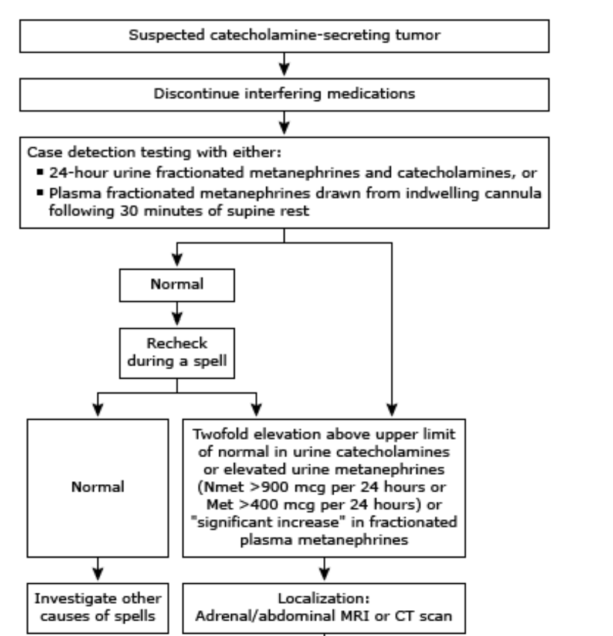
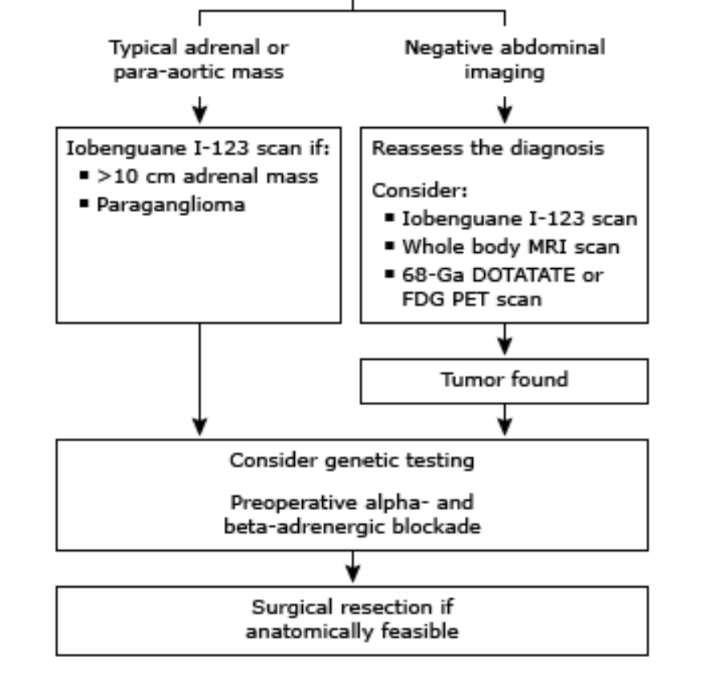
Diagnosis and Management

Slide 45
Adrenocortical Carcinoma
Adrenocortical carcinomas (ACCs) are rare and frequently aggressive tumors that may be functional (hormone-secreting) and cause Cushing's syndrome and/or virilization, or nonfunctional and present as an abdominal mass or as an incidental finding.
Complete surgical resection is the only potentially curative treatment for adrenocortical carcinoma (ACC). For patients with potentially respectable stage I to III disease who are surgical candidates, complete surgical resection as initial therapy is recommended.

Slide 46
MCQ 1
A woman, aged 55, presents with symptoms consistent with Cushing's syndrome. She is taking no medication. Her basal cortisol and serum ACTH levels are significantly raised. ACTH levels have failed to suppress in response to a low dose DST, although they do suppress to less than 50% of baseline after the high dose of dexamethasone. What is the most likely Diagnosis?
Adrenal Tumor
Conn syndrome
Cushing's disease
Ectopic ACTH- secreting syndrome
Depression

Slide 47
Correct option
c

Slide 48
MCQ 2
A 55-year-old woman has a 6-month history of weight gain. She is otherwise well and takes no medication. On examination her body mass index (BMI) is 28 kg./m^2, her blood pressure is 170/100 mmHg and she has a round, red face and slight atrophy of her arm muscles. Renal function tests and urinalysis are normal. What is the next step of obtaining the diagnosis?
A low-dose overnight dexamethasone suppression test
Urinary catecholamine collection
Urinary 5 hydroxy indoleacetic acid (5 –HIAA) collection
Abdominal ultrasound
CT of the abdomen

Slide 49
Correct option
A

Slide 50
MCQ 3
A 45-year-old obese woman on long term treatment for Rheumatoid arthritis, attends the clinic with the history of hirsutism and weakness over past 4 months. Red/purple patches are seen over her elbows and legs. A Full blood count and clotting screens are within normal range.Which drug treatment is most likely to give rise to these symptoms?
Azathioprine
Diclofenac
Gold
Prednisolone
Hydroxychloroquine

Slide 51
D

Slide 52

Research and References
https://www.nature.com/articles/nrendo.2016.185.pdf
https://www.endocrine.org/clinical-practice-guidelines/treatment-of-cushing-syndrome
https://sccm.org/Clinical-Resources/Guidelines/Guidelines/Guidelines-for-the-Diagnosis-and-Management-of-(1)

Slide 53
References
Pearce, JMS. Thomas Addison. J R Soc Med. 2004 June; 97(6): 297–300.
Ontjes, DA. Disorders of the Adrenal Cortex. Netter’s Internal Medicine, 2nd ed. 2009; 321-4.
Adrenal Insufficiency. Little: Dental Management of the Medically Compromised Patient, 7th ed. 2007.
Oelkers, W. Adrenal Insufficiency. N Engl J Med. 1996 Oct 17;335(16):1206-12.

Slide 54
