Slide 2
ANAEMIA
DR. MUHAMMAD UMER
MBBS,FCPS (MED) SENIOR REGISTRAR MEDICINE MU-1 HOLY FAMILY HOSPITAL RWP

Slide 4
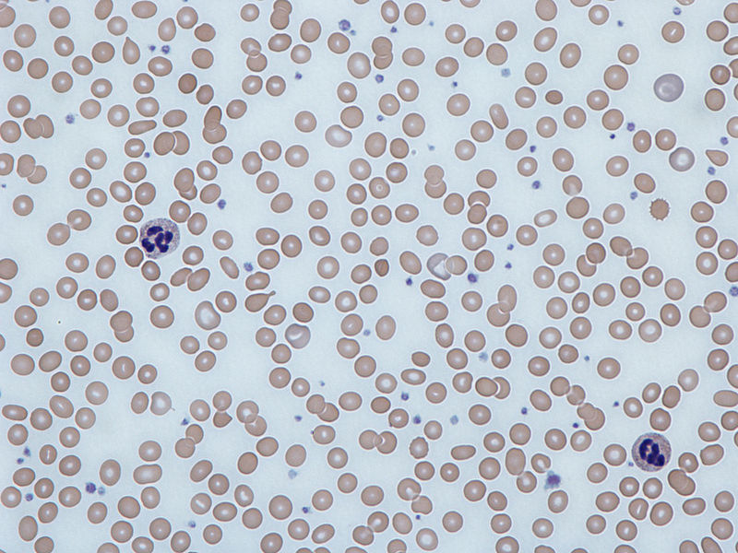
LEARNING OBJECTIVES
Definition of anaemia
Signs and symptoms related to anaemia
Classification of anaemia
Diagnostic approach

Slide 5
DEFINITION
CORE CONCEPT
An (without) -aemia (blood)
Anemia is defined as a hemoglobin concentration below a specified cut-off point; that cut-off point depends on the age, gender, physiological status, smoking habits and altitude at which the population being assessed lives
Anaemia is not a diagnosis itself
Work-up for the cause of anaemia can lead to a diagnosis of the underlying disease

Slide 6
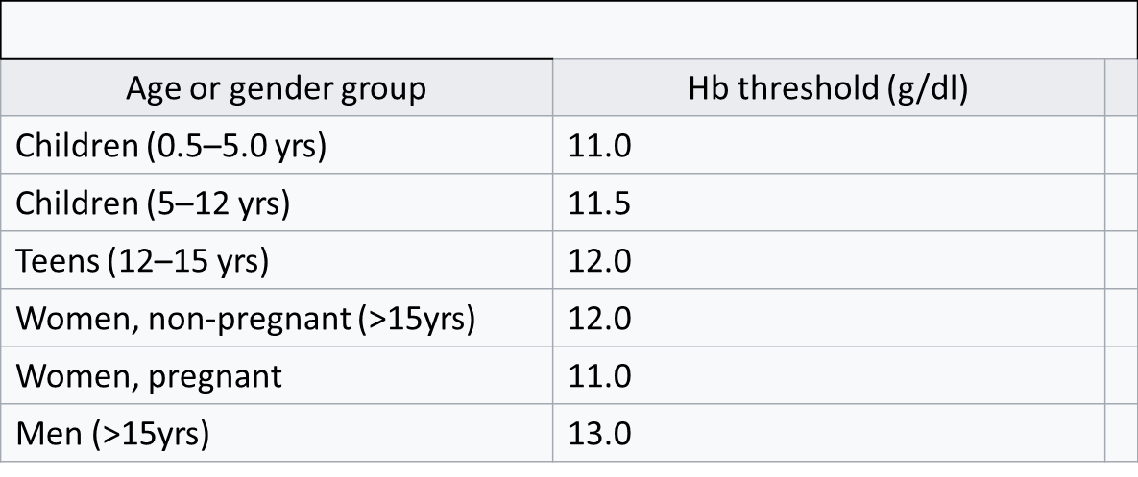
DEFINITION
CORE CONCEPT
Can be defined as anemia in children aged under 5 years and pregnant women as a haemoglobin concentration <110 g/L at sea level, and
Non-pregnant women as a haemoglobin concentration <120 g/L or haemoglobin concentration <130 g/L in males.
Reduction in oxygen-transporting capacity of blood, which usually stems from a decrease in red cell mass to subnormal levels.

Slide 7
CORE CONCEPT
Anemia is a serious global public health problem that particularly affects young children and pregnant women.
WHO estimates that 42% of children less than 5 years of age and 40% of pregnant women worldwide are anemic.

Slide 8
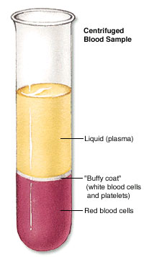
CORE CONCEPT
Normal Ranges
HCT
Female | Male | Indices
12-15.5 | 13-17.5 | Hemoglobin(g/dL)
36-48 | 40-52 | Hematocrit (PCV) (%)
3.9-5.6 | 4.5-6.5 | Red Cell Count (×10¹²)
80-95 |  | Mean Cell Volume (MCV) (fL)
30-35 |  | Mean Cell Hemoglobin (MCH) (pg)
Hb
MCV
MCH
Microcytic
Hypochromic
Normocytic
Macrocytic
Normochromic

Slide 9
PATHOPHYSIOLOGY
HORIZONTAL INTEGRATION
Basically, three causes of anemia exist:
Blood loss
Increased destruction of RBCs (hemolysis)
Decreased production of RBCs
Each of these causes includes several disorders that require specific and appropriate therapy.

Slide 10
PATHOPHYSIOLOGY
HORIZONTAL INTEGRATION
Genetic causes include the following:
Hemoglobinopathies
Thalassemia
Enzyme abnormalities of the glycolytic pathways
Defects of the RBC cytoskeleton
Congenital dys-erythropoietic anemia
Rh null disease
Hereditary xerocytosis
Abetalipoproteinemia
Fanconi anemia

Slide 11
PATHOPHYSIOLOGY
HORIZONTAL INTEGRATION
Nutritional etiologies
Iron deficiency
Vitamin B12 deficiency
Folate deficiency
Starvation and generalized malnutrition
Physical etiologies
Trauma
Burns
Frostbite
Prosthetic valves and surfaces

Slide 12
PATHOPHYSIOLOGY
HORIZONTAL INTEGRATION
Chronic disease and malignant etiologies:
Kidney disease
Liver disease
Chronic infections
Neoplasia
Collagen vascular diseases
Infectious etiologies :
Viral - Hepatitis, infectious mononucleosis, cytomegalovirus
Bacterial - Clostridia, gram-negative sepsis
Protozoal - Malaria, leishmaniasis, toxoplasmosis

Slide 13
Risk factors
HORIZONTAL INTEGRATION
Intestinal disorders. malabsorption of nutrients in small intestine — such as Crohn's disease and celiac disease
Menstruation. a greater risk of iron deficiency anemia
Pregnancy. Being pregnant and not taking folic acid and iron
Chronic blood loss from an ulcer or other source can deplete body's store of iron
Other factors. exposure to toxic chemicals and the use of some medications
Age. People over age 65.

Slide 14
HORIZONTAL INTEGRATION
Fluid overload
Fluid overload causes decreased hemoglobin concentration and apparent anemia
General causes of hypervolemia include excessive sodium or fluid intake, sodium or water retention and fluid shift into the intravascular space.
From the 6th week of pregnancy, hormonal changes cause an increase in the mother's blood volume due to an increase in plasma

Slide 15
HORIZONTAL INTEGRATION
Clinical Features
Presence or absence of clinical feature depends on:
1-Speed of onset :
Rapidly progressive anemia causes more symptoms than slow onset anemia due to lack of compensatory mechanisms:
Decreased oxygen delivery to tissues
Exertional dyspnea, dyspnea at rest, fatigue, lethargy, confusion and life-threatening complications such as congestive failure, angina, arrhythmia, and/or myocardial infarction.
Hypovolemia (acute bleeding)
Postural dizziness, lethargy, syncope, hypotension, shock, and death.
2-Severity:
Mild anemia :no symptoms usually
Symptoms appear if Hb less than 9g/dL
3- Age:
Elderly tolerate anemia less than young patients

Slide 16
HORIZONTAL INTEGRATION
Clinical Features
1-General features of anemia
Weakness
Headache
Pallor
Lethargy
Dizziness
Palpitation (tachycardia)
Angina
Cardiac failure
Related to anemia
Related to compensatory mechanism
2-Specific features
Specific signs are associated with particular types of anemia :
Spoon nail with iron deficiency,
Leg ulcers with sickle cell anemia
Jaundice with hemolytic anemia
bone deformities in thalassemia major

Slide 17
HORIZONTAL INTEGRATION
Hemoglobin structure
β
α
Globin chain
O2
O2
Fe⁺⁺
Fe⁺⁺
Haem
α
β
Iron atom
Fe⁺⁺
Prophyrin ring
Fe⁺⁺
O2
O2

Slide 18
Hemoglobin
DNA
RBC count
Prophyrin
DNA synthesis
Blood loss
Iron
Hemolysis
Globin chain
RBC production
Acute bleeding
Thalassemia
Megaloblastic anemia:
-B12 def.
-Folate def.
MDS
Autoimmune
Enzymopathy
Membranopathy
Mechanical
Sickle cell anemia
BM failure:
-Chemotherapy
-Aplastic anemia
-Malignancy
Anemia of chronic disease
Iron def. anemia
Sidroblastic anemia
Hypochromic microcytic anemia
Macrocytic anemia
Normocytic normochromic anemia
HORIZONTAL INTEGRATION

Slide 19
Causes of Anemia: Kinetic Approach
HORIZONTAL INTEGRATION
Decreased RBC production | Increased RBC destruction | Blood loss
Nutritional deficiency: iron, B12, folate | Hemolysis Inherited Membrane defects: hereditary spherocytosis, hereditary elliptocytosis Enzymopathy: G-6-PD deficiency, pyruvate kinase deficiency Thalassemias Acquired Immune: AIHA, alloimmune hemolysis Non-immune: PNH, drugs, chemical, infection, MAHA, mechanical hemolysis | Obvious bleeding
Bone marrow disorders: aplastic anemia, PRCA, MDS, tumor infiltration) |  | Occult bleeding
Bone marrow suppression: drugs,chemotherapy, radiation, alcohol, toxin) |  | Induced bleeding
Low levels of hormones: EPO (CKD),thyroidhormone (hypothyroidism),and androgens (hypogonadism)
Anemia of chronic disease/inflammation

Slide 20
Causes of anemia: Morphologic Approach
HORIZONTAL INTEGRATION
Microcytic anemia (MCV< 80 fL) | Normocytic anemia (MCV 80-100 fL) | Macrocytic anemia (MCV > 100 fL)
Iron deficiency anemia | Acute blood loss | Megaloblastic anemia (vitamin B12 deficiency , folate deficiency, drugs)
Thalassemias | Hemolytic anemia: Hereditary spherocytosis. G-6PD deficiency, PNH | Non-megaloblastic anemia (alcohol, liver disease, hypothyroidism)
Anemia of chronic disease/ inflammation | -Anemia of chronic disease/ inflammation -Anemia of CKD | Other bone marrow disorders: MDS
Sideroblastic anemia (congenital, lead poisoning, alcohol, drugs) | Hypersplenism | Reticulocytosis (eg. hemolytic anemia)
Copper deficiency, zinc poisoning | Bone marrow suppression/invasion: AA, PRCA, acute leukemia, MDS, myelophthisis

Slide 21
Classification according to severity
HORIZONTAL INTEGRATION
DEGREE | LEVEL OF Hb | PRESENTATION
Mild | 10-11 | Mild dyspnea on exertion, palpitations
Moderate | 7-10 | As with mild anemia, may also have excessive fatigue.
Severe | <7 | Dyspnea at rest, tachycardia, weakness, dizziness, syncope, headache, insomnia.

Slide 22
APPROACH TO PATIENT:
VERTICAL INTEGRATION
HISTORY
Examination
Investigation
Management

Slide 23
Diagnostic Approach
VERTICAL INTEGRATION
History Taking: Initial Evaluation
Acute vs. sub-acute to chronic onset?
Any bleeding?
Evidence of haemolysis, urine colour? If so, acute or chronic
Is the patient iron deficient? If so, why?
Has the patient systemic/chronic/inflammatory disease?
Is the bone marrow affected (other cytopenia, myelophthisis)
Is the patient taking medication, alcohol?
Is the patient deficient in folate or vitamin B12? If so, why?
Family history, and history of transfusion

Slide 24
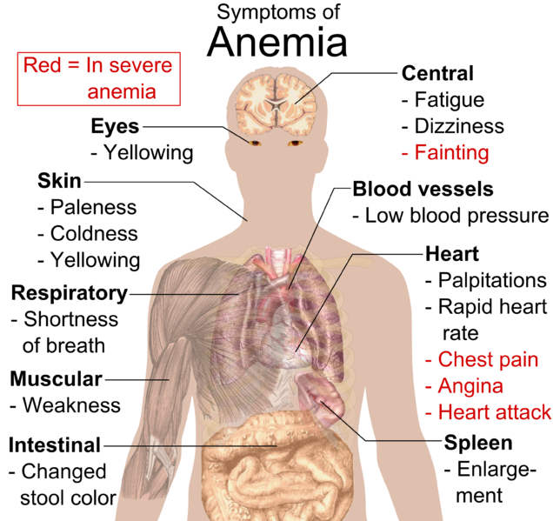
Bleeding
Melena
Hemoptysis
Hematuria
menorrhagia
Dietary hx
SOB, Dyspnea
Easy fatigability
Fever
Chronic illness
Past medical/ surgical: gastrectomy, chronic illness, CA
Family Hx: hemolytic , pernicious
Drug Hx; NSAIDS Blood loss
PPIs reduction in absorption of vit B12
Chloramphenicol aplasia
VERTICAL INTEGRATION

Slide 25
Physical Examination
VERTICAL INTEGRATION
Vital signs: tachycardia, hypotension, fever
Pallor
Jaundice
Lymphadenopathy, hepatosplenomegaly, and bone tenderness
Petechiae, ecchymosis, and other signs of bleeding disorder
Signs of organ or multisystem involvement (e.g. heart failure, CNS)
Signs of nutritional deficiency

Slide 26
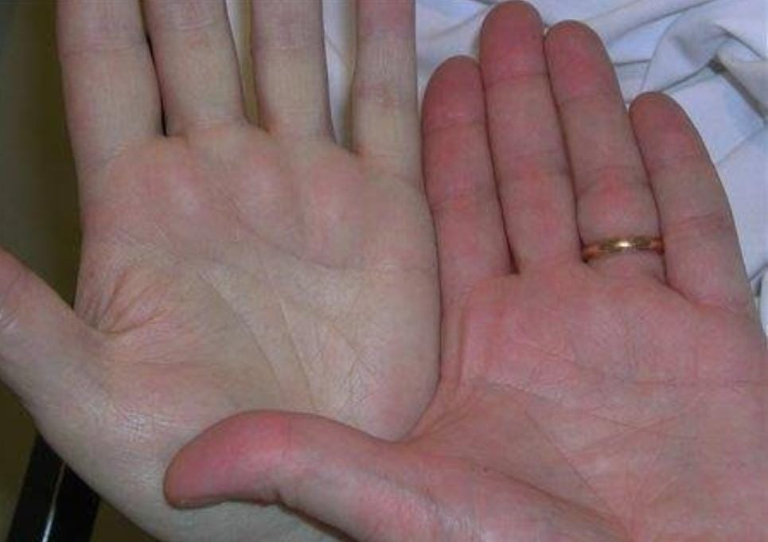
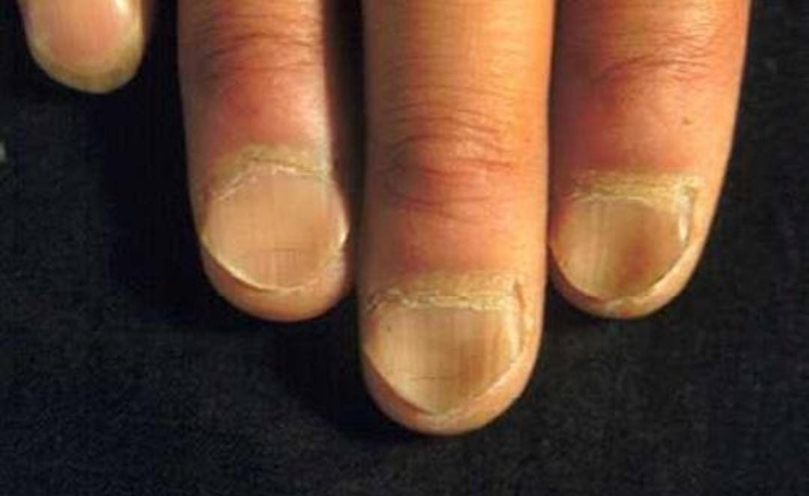
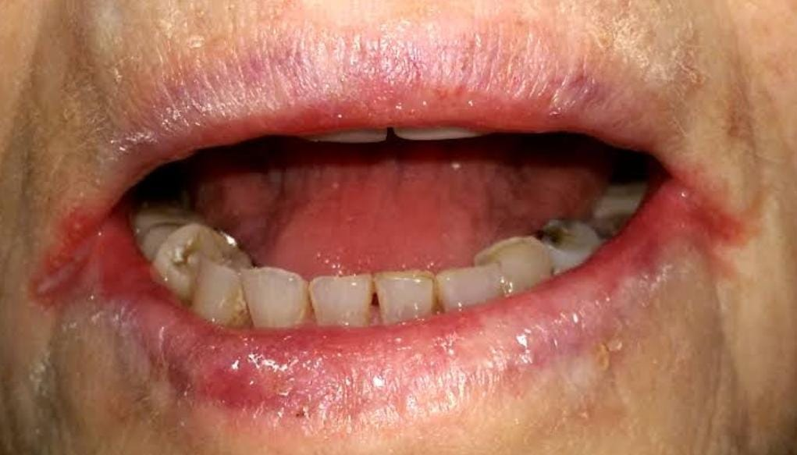
VERTICAL INTEGRATION
Mouth: gum swelling, stomatitis, ulcers, bald tongue
Neck : lymph nodes, thyroid, ↑JVP
Skin : pallor, jaundice, petechiae, bruise
Hands : bone deformities, koilonychia, pulse tachycardia, high vol. pulse
CVS: flow murmurs
Abdomen : splenomegaly, hepatomegaly
Legs : ulcers sickle cell anemia, bone deformities thalassemia, ankle edema

Slide 27
Laboratory Investigation: Initial Tests
VERTICAL INTEGRATION
Complete blood count
-- > Limitation:
Increased plasma volume: pregnancy, heart failure
Decreased plasma volume: dehydration, burn
--> Discrepancy: HbH disease, cold type AIHA
Reticulocyte count
Peripheral blood smear

Slide 28
VERTICAL INTEGRATION
Complete blood count
Red cell parameters
Absolute reticulocyte count
WBC count and differential
Platelet count
*Comparison to previous CBC*
Red cell parameters
Direct measurement
Erythrocyte concentration (RBC) x10⁶/L
Mean corpuscular volume (MCV) fL
Hemoglobin g/dL
Indirect measurement
Hematocrit (Hct) %
Mean corpuscular hemoglobin pg
Mean corpuscular hemoglobin conc. (MCHC) g/dL
Red cell distribution width (RDW) %

Slide 29
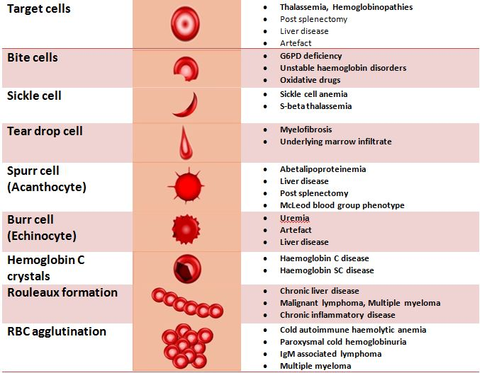
Peripheral blood smear
VERTICAL INTEGRATION

Slide 30
VERTICAL INTEGRATION
Reticulocyte count
Non-nucleated RBC with polyribosome RNA as stained by supravital stain
Polychromasia underestimate reticulocytes
Corrected reticulocyte %
= % reticulocyte x patient’s Hct
45
The reticulocyte production index is a calculation of the ratio between the level of anemia and the extent to which the reticulocyte count has risen in response. If the degree of anemia is significant, even a "normal" reticulocyte count actually may reflect an inadequate response

Slide 31
Special investigations:
VERTICAL INTEGRATION
Serum ferritin This protein helps store iron in the body, a low levels of ferritin usually indicates a low levels of stored iron.
Bone marrow aspiration from the sternum or posterior iliac crest is performed to:
Confirm a diagnostic made from peripheral blood count
Determine the cellularity of the marrow
Determine the type of erythropoiesis
Determine the proportion of the various lines
See whether the marrow is infiltrated
Determine the size of the iron stores

Slide 33
Complications
VERTICAL INTEGRATION
Left untreated, anemia can cause many health problems
Extreme fatigue.
Pregnancy complications. such as premature birth.
Heart problems. tachycardia or arrhythmia.
(When you're anemic your heart pumps more blood to make up for the lack of oxygen in the blood. This can lead to an enlarged heart or heart failure.)
Death. Some inherited anemia's, such as sickle cell anemia, can lead to life-threatening complications.
Among older people, anemia is associated with an increased risk of death.

Slide 34
Prevention
VERTICAL INTEGRATION
Many types of anemia can't be prevented.
Can avoid iron deficiency anemia and vitamin deficiency anemias by eating a diet that includes a variety of vitamins and minerals, including:
Iron. beef and other meats, beans, lentils, iron-fortified cereals, dark green leafy vegetables and dried fruit.
Folate. fruits and fruit juices, dark green leafy vegetables, green peas, kidney beans, peanuts.
Vitamin B-12. meat, dairy products, and fortified cereal and soy products.
Vitamin C. citrus fruits and juices, peppers, broccoli, tomatoes, melons and strawberries. These also help increase iron absorption.

Slide 35
CORE CONCEPT
Anaemia is not a diagnosis itself
Initial approach to the diagnosis
Perform complete history and physical examination
Review of the complete blood count with white blood cell differential, platelet count, reticulocyte count
Examination of the peripheral blood smear
There may be more than one causes of anaemia, including blood loss, effects of current medications, etc.

Slide 36
LONGITUDINAL INTEGRATION

Slide 37
LONGITUDINAL INTEGRATION

Slide 39
