Slide 2
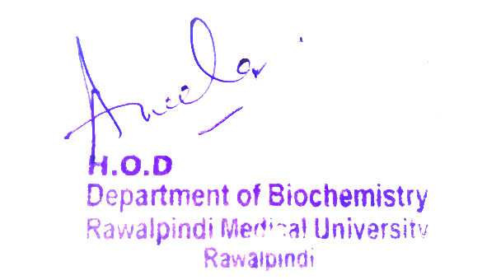
2nd Year MBBS Gastrointestinal Tract Module Large Group Interactive Session (LGIS) AIDS
Presenter: Dr. Almas Ajaz

Slide 3
Motto, Vision, Dream
To impart evidence based research oriented medical education
To provide best possible patient care
To inculcate the values of mutual respect and ethical practice of medicine
Wisdom
Truth
Service

Slide 4
Professor Umar Model of Integrated Lecture

Slide 5
Learning Objectives
At the end of this session students should be able to
What is AIDs ?
Mode of transmission
Signs and symptoms of disease
Precautions of disease
Treatment of aids

Slide 6
Interactive Session
A 32-year-old male, named John, presents to the clinic with a history of fatigue, weight loss, and recurrent fevers over the past few months. He has a past medical history of intravenous drug use and unprotected sexual encounters. On examination, he is found to have oral thrush and generalized lymphadenopathy. Laboratory tests reveal a CD4 count of 200 cells/mm³ and a positive HIV antibody test.

Slide 7
Vitamins are essential organic compounds required in small amounts for normal metabolism and good health.
They are not a source of energy
They are classified into Water-Soluble (Example; vitC and vitB) and Fat-Soluble (Example; A,D,E,K)

Slide 8
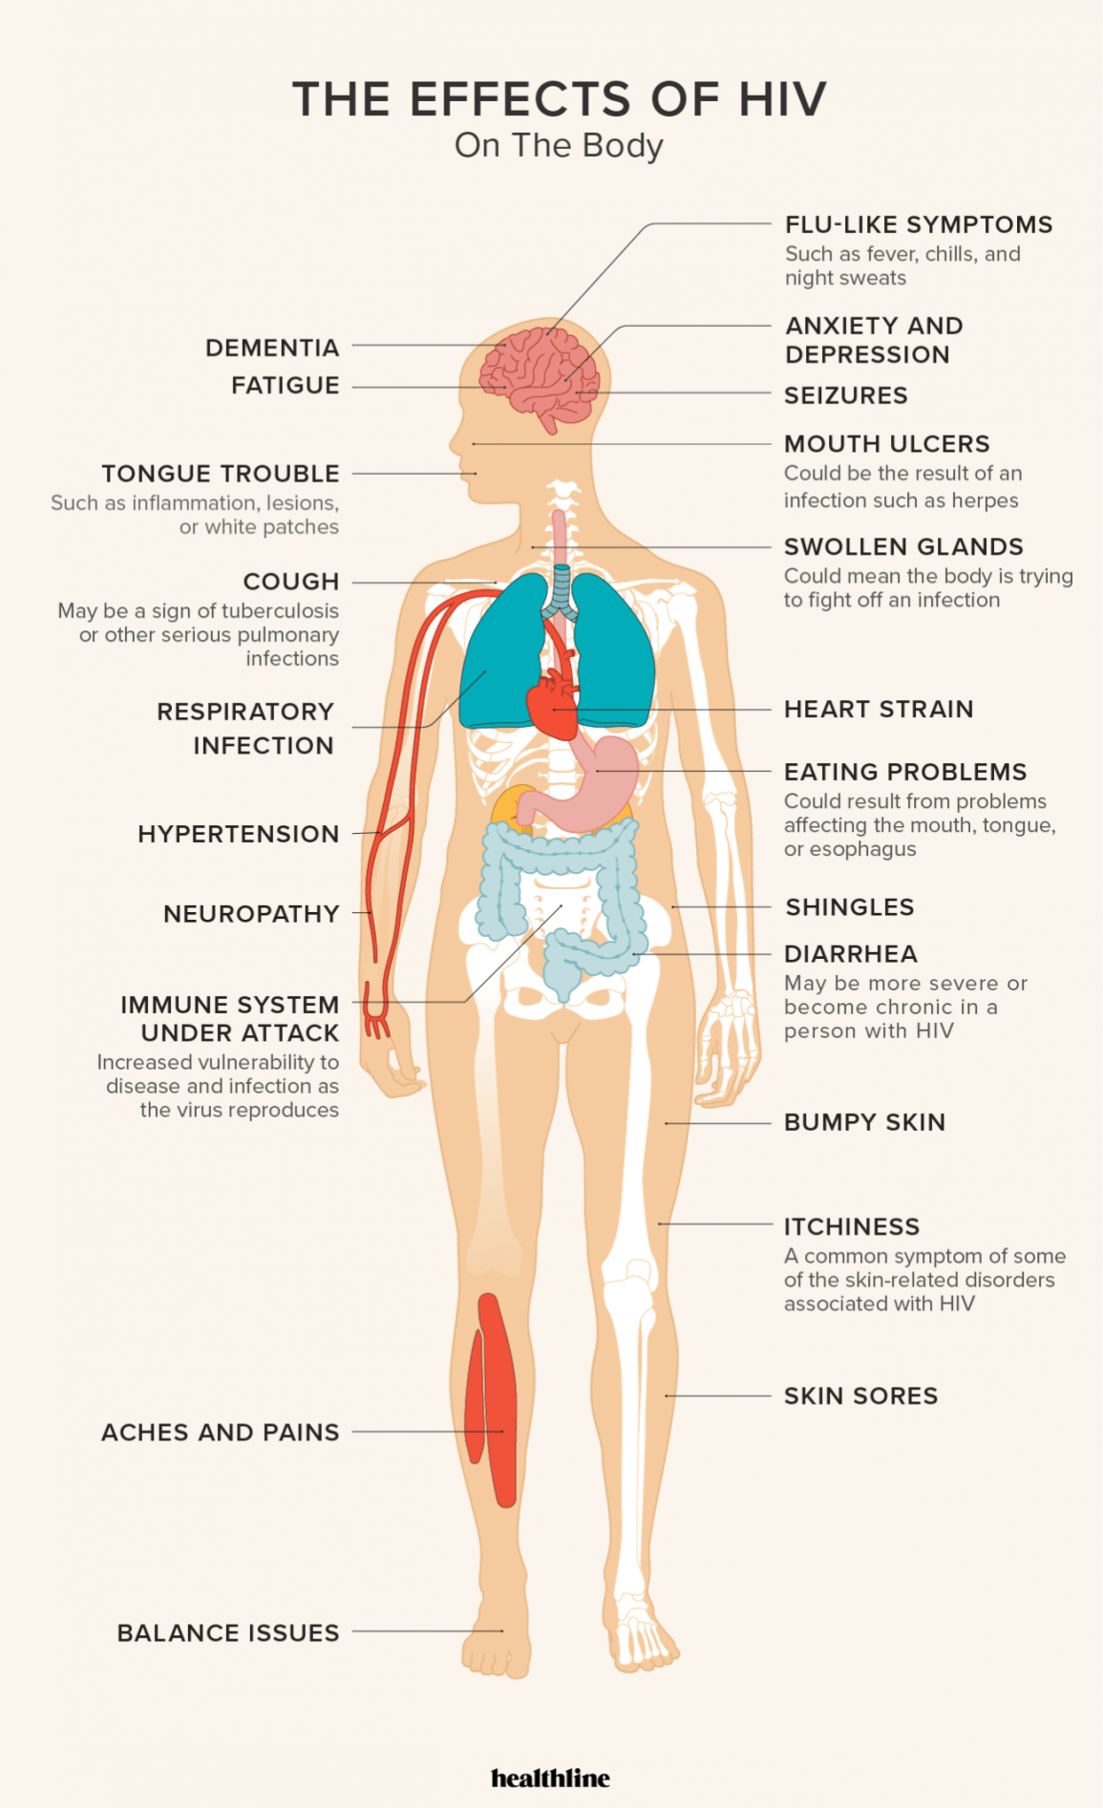

Slide 9
CORE CONCEPT

Slide 17
Core Knowledge

Slide 18
ROLE OF ENZYMES
REVERSE TRANSCIPTASE(RT)
Multifunctional enzyme having RNA dependent DNA polymerase activity
Also having RNAase H (helical) activity
Catalyses the activity of double standed pre viral DNA from single standed RNA genome.
Due to its central role in viral replication RT is prime target for anti aids therapy .

Slide 19
Inhibitors of RT can be classified as
Nuecloside RT inhibitor
Non nucleotide RT inhibitor
NRTI are competitive in nature While NNRTI are non competitive
2.PROTEASE
Protease is essential for production of mature, infectious viriods.
HIV protease is responsible for post transcriptional processing of Poly protein and protolytic activity.

Slide 20
Inhibition of these protease enzyme is also attractive target for anti aids therapy.
3. INTEGRASE
Catalyses the integration of double standed DNA copy of their RNA genome into chromosome of the host cell.
Inhibition of integrase enzyme is prime target of anti aids

Slide 30
STAGES OF HIV

Slide 33
HIV INFECTION AND ANTIBODY RESPONSE

Slide 52
Suggested Research Article
https://r.search.yahoo.com/_ylt=AwrFFcTXPslk0qoKKiFXNyoA;_ylu=Y29sbwNiZjEEcG9zAzEEdnRpZANMT0NVSTEwMkJfMQRzZWMDc3I-/RV=2/RE=1690939223/RO=10/RU=https%3a%2f%2fwww.nih.gov%2fresearch-training%2fadvances-hiv%2faids-research/RK=2/RS=3o_C8g7UuXTgDon216kvXq22S.M-
https://r.search.yahoo.com/_ylt=AwrFFcTXPslk0qoKLCFXNyoA;_ylu=Y29sbwNiZjEEcG9zAzIEdnRpZANMT0NVSTEwMkJfMQRzZWMDc3I-/RV=2/RE=1690939223/RO=10/RU=https%3a%2f%2fwww.nejm.org%2fmedical-research%2fhiv-aids/RK=2/RS=4PAutYjQcCEF6CLS2UEhazimtzI-

