Slide 1
ACID PEPTIC DISEASE
DR. ANUM ABBAS
MBBS,FCPS GASTROENTEROLOGY,MRCP UK
SENIOR REGISTRAR GASTROENTEROLOGY HOLY FAMILY HOSPITAL

Slide 4
LEARNING OBJECTIVES
Understand the pathophysiology of acid peptic disease.
Recognize the clinical features and diagnostic approaches.
Outline the pharmacological and non-pharmacological management.
Discuss complications and preventive strategies

Slide 5
APD
Acid Peptic Disease (APD) encompasses conditions related to excessive acid production or impaired mucosal defense mechanisms, leading to mucosal injury.
Includes:
Gastric ulcers
Duodenal ulcers
Gastro esophageal reflux disease (GERD)

Slide 6
EPIDEMIOLOGY
Affects millions worldwide; high prevalence in regions with H. pylori infection.

Slide 7
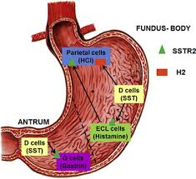
PHYSIOLOGY OF THE ACID SECRETION

Slide 8
Physiology Of Gastric Acid Secretion & Digestion
SPIRAL INTEGRATION
3 phases
Sight, smell, taste or thought of food activate enteric neurons via vagus. Major effect of Gastrin is indirect via histamine from ECL cells not through direct parietal cell stimulation.
Food stretches stomach walls activating neural reflex to stimulate acid secretion. Peptides & amino acids stimulate G cells to release Gastrin. Food acts as a buffer, raising pH & thus removing the stimulus for somatostatin secretion.
Cephalic Phase
Intestinal phase
Gastric Phase
Once Chyme enters the duodenum, it activates negative feedback mechanisms to reduce acid secretion
Notes:
Gagné’s event 4: Present the content

Slide 9
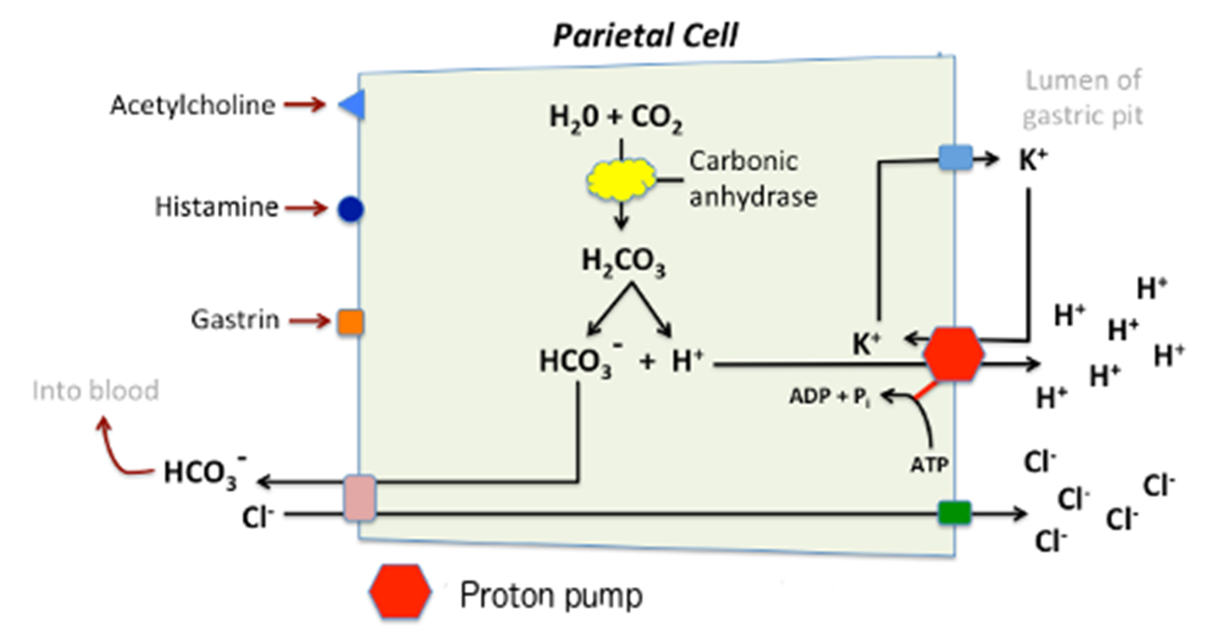
PHYSIOLOGY OF THE ACID SECRETION

Slide 10
The stomach contains parietal cells that produce hydrochloric acid under stimulation from:
Acetylcholine (vagus nerve)
Gastrin
Histamine (H2 receptors).
Protective mechanisms:
Mucus and bicarbonate secretion.
Rich mucosal blood flow prevents injury.

Slide 11
PATHOPHYSIOLOGY
Imbalance between aggressive factors and protective mechanisms

Slide 13
CLINICAL FEATURES
Epigastric pain: Burning or gnawing, may vary with meals.
Nausea, vomiting, bloating, and dyspepsia.
Alarm Symptoms
Hematemesis, melena, weight loss, anemia (suggest complications).
Many patients, especially elderly are asymptomatic.

Slide 15
DIAGNOSIS
Laboratory Tests:
H. pylori detection: Urease breath test, stool antigen test, serology.
Endoscopy:
Diagnostic and therapeutic tool.
Indicated in alarm symptoms or treatment failure.

Slide 18
MANAGEMENT
Non-pharmacological:
Lifestyle changes: Smoking cessation, avoid alcohol and NSAIDs.

Slide 19
Pharmacological treatment
Pharmacological:
Acid suppression: Proton pump inhibitors (PPIs), H2 blockers.
H. pylori eradication: Triple therapy (PPI + 2 antibiotics) or quadruple therapy.
Cytoprotective agents: Sucralfate, misoprostol.
Surgical treatment: for perforation or obstruction.

Slide 20
Medical Treatment
VERTICAL INTEGRATION

Slide 21
Acid Suppression
VERTICAL INTEGRATION
H₂ Receptor Blockers
PPIs
Cannot provides 24 Hours pH control with once daily dose.
Delayed onset of action. (As long as 3 Hours)
Cimetidine, Ranitidine, Famotidine
Temoprazole 1970
Omeprazole 1980
Lansoprazole 1984
Pantoprazole 1988
Rabeprazole 1989
Esomeprazole 1999
Dexlensoprazole 2009
Notes:
Gagné’s event 4: Present the content -- Provide examples

Slide 22
Acid Suppression
VERTICAL INTEGRATION
PPIs
P-CAB
Notes:
Gagné’s event 6: Elicit recall strategies – ask students to revisit, or reiterate information they have learned , Help students integrate new knowledge – provide content in a context-rich way
Gagné’s event 5: Provide learning guidance – provide analogies for knowledge construction and visual images to make visual associations

Slide 23
Acid Suppression
VERTICAL INTEGRATION
P-CAB
Potent potassium competitive acid blocker
Binds & inhibits H+,K+-ATPase at the final step in the acid secretory pathway in gastric parietal cells.
Vonoprazan 2015 (Japan)
Notes:
Gagné’s event 4: Present the content -- Provide examples

Slide 24
LONGITUDINAL INTEGRATION
CONCLUSION: Efficacy of vonoprazan-based triple therapy is superior to that of PPI-based triple therapy
for first-line H. pylori eradication

Slide 25
LONGITUDINAL INTEGRATION
First-ever National study on the role of Vonoprazan in Gastric conditions
CONNECT-VPN
Real wOrld evideNce to evaluatE the effiCacy & safeTy of VonoPrazaN in Gastrointestinal disorders in Pakistani population
Submitted for Publication

Slide 26
LONGITUDINAL INTEGRATION
Key Findings:
n= 1642
Gerd Q Score at Baseline
Gerd Q Score at 4th week
20.37±15.87
3.70±6.31
H. Pylori positive at Baseline
H. Pylori Negative at 4th week After Therapy
735
667
H. Pylori eradication achieved
Patient’s condition improved
Acid regurgitation and heartburn-free days
Treatment compliance
90.74%
96.9%
>70%
78.13%
Submitted for Publication

Slide 27
COMPLICATIONS
Bleeding: Most common; presents as hematemesis or melena.
Perforation: Leads to acute peritonitis; requires urgent surgical intervention.
Gastric outlet obstruction: Presents as persistent vomiting and weight loss.
Malignancy: Chronic H. pylori infection increases the risk of gastric adenocarcinoma.

Slide 28
PREVENTION
Primary Prevention:
H. pylori eradication in high-risk populations.
Use of PPIs with NSAIDs in at-risk individuals.
Secondary Prevention:
Regular follow-up for patients with previous ulcers.
Lifestyle modifications to reduce recurrence risk.

Slide 29
SUMMARY
Acid Peptic Disease results from an imbalance between acid production and mucosal protection.
H. pylori and NSAIDs are key risk factors.
Diagnosis involves endoscopy and tests for H. pylori.
Management includes acid suppression, eradication therapy, and preventive strategies.

Slide 30
REFERENCES
Davidson's Principles and Practice of Medicine.
Kumar and Clark's Clinical Medicine.
Open-access medical resources for figures and diagrams.

