Slide 1
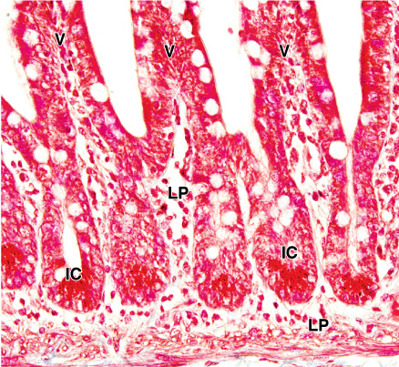
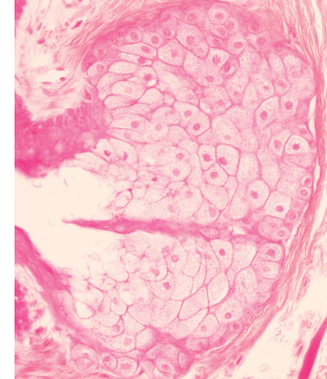
Classification
Architectural classification
Unicellular
Multicellular

Slide 2
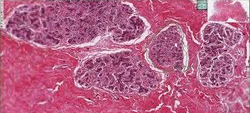
FOUNDATION MODULE(LGIS) Epithelial Tissue
Mammary Gland
Presenter:
Dr. Mohtasham Hina

Slide 3
Vision; The Dream/Tomorrow
Motto
To impart evidence based research oriented medical education
To provide best possible patient care
To inculcate the values of mutual respect and ethical practice of medicine
Wisdom
Truth
Service

Slide 4
Learning Objectives
Core Knowledge
At the end of the session students should be able to
Explain the development of mammary gland
Describe the histological features seen in different phases of the gland
Discuss the biophysiological aspects
Clinically correlate the abnormality of mammary gland

Slide 5
Development
Core Knowledge

Slide 6
Ddevelopment
Core Knowledge

Slide 7
Anomalies
Core Knowledge
Athelia
Polythelia
Amastia
Polymastia
Gynaecomastia
Inverted nipples

Slide 8
Parts of Gland
Core Knowledge

Slide 9
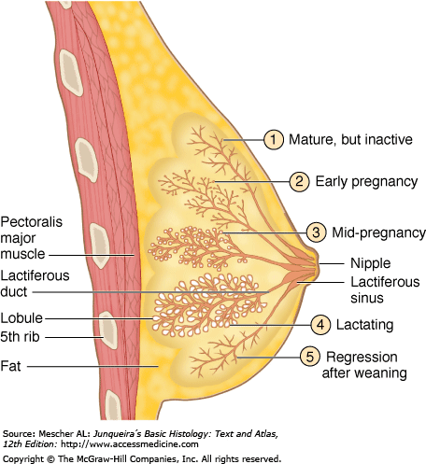
Mammary Gland
Core Knowledge

Slide 10
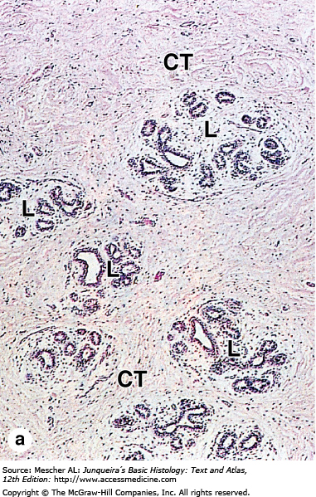
Inactive
Core Knowledge

Slide 11
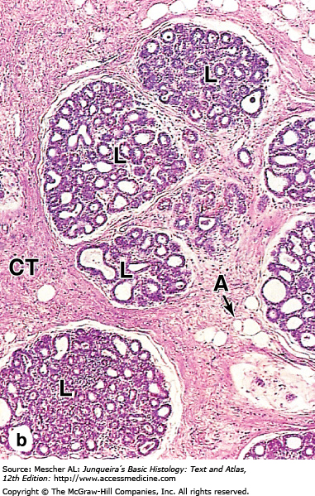
Mid Pregnancy
Core Knowledge

Slide 12
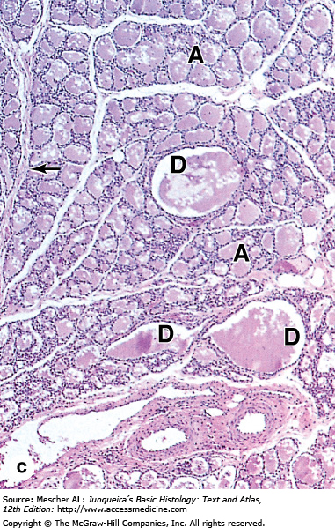
Lactating State
Core Knowledge

Slide 13
Bio-Physiological Aspects
Horizontal integretation
Colostrum rich in antibodies
The composition of human milk is
1.5% protein
Casine
Alpha lactoalbumin
Beta lactoglobulin
4% lipids
7-8% lactose

Slide 14
Clinical Correlation
Vertical integretation
Most of mammary carcinomas arise from epithelial cells of lactiferous ducts and metastasize through blood and lymphatics to the brain and lungs

Slide 15
Vertical intergradation
Gynecomastia
Gynecomastia (Gr. gyne, woman + mastos, breast) refers to developing the rudimentary lactiferous ducts in the male mammary tissue. During mid-puberty, approximately two-thirds of boys develop varying degrees of hyperplasia of the breasts. This subareolar hyperplasia may persist for a few months to 2 years. A decreased ratio of testosterone to estradiol is found in boys with gynecomastia. Approximately 80% of males with Klinefelter syndrome have gynecomastia. It is typically associated with an XXY chromosome complement

Slide 16
Breaking bad news of CA breast
Spiral Integration
Bioethics
Review the Details
Choose the Setting
Establish a Supportive Environment
Encourage a Support Person
Offer Empathy
Deliver the News
Be Direct but Compassionate
Pause to Allow Processing
Provide Information and Support
Plan Follow-Up

Slide 17
Management Of CA Breast
Surgery
lumpectomy
mastectomy
Radiation Therapy
Chemotherapy
Hormone Therapy
Immunotherapy
Supportive Care

Slide 18
Learning Resources
Junqueira’s Basic Histology 12th Edition, Chapter 22
DiFiore's Atlas of Histology with Functional Correlations 11th Edition
Google scholar

