Slide 1
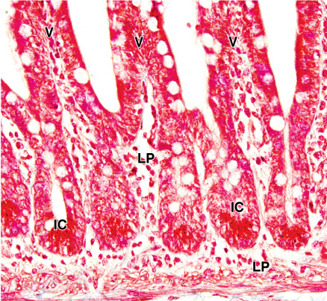
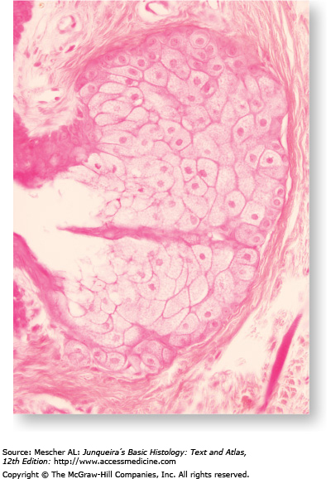
Classification
Architectural classification
Unicellular
Multicellular

Slide 2
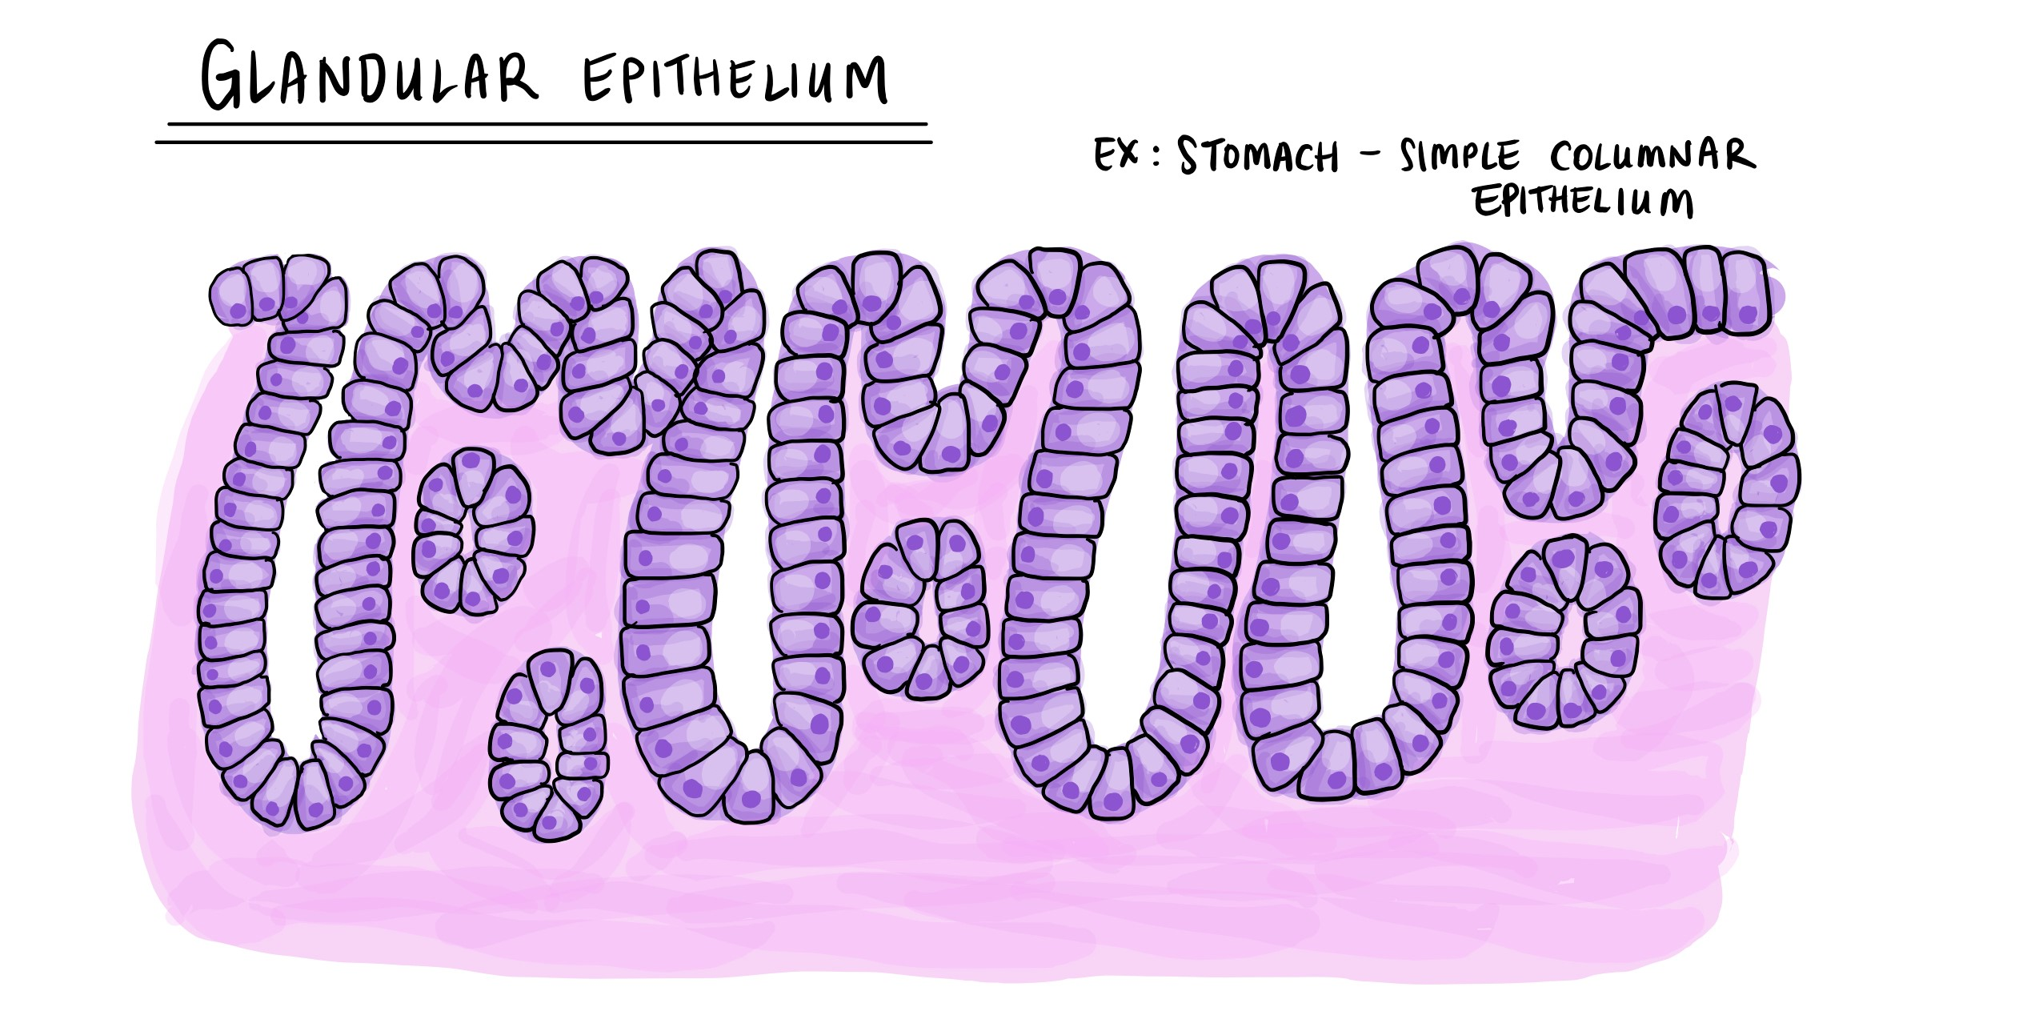
FOUNDATION MODULE(LGIS)
Glandular Epithelium
Presenter:
Dr. Mohtasham Hina 14-3-2025

Slide 3
Vision; The Dream/Tomorrow
Motto
To impart evidence based research oriented medical education
To provide best possible patient care
To inculcate the values of mutual respect and ethical practice of medicine
Wisdom
Truth
Service

Slide 4
Learning Objectives
At the end of lecture 1st year students should be able to
Compare between exocrine and endocrine glands with examples
Classify glands based on morphology, secretory product, and mode of secretion
To understand the bio-physiological aspect of different types of glands
Apply the strategic use of artificial intelligence in healthcare
Read a research article
Use digital library

Slide 5
A patient presented to the medical OPD with weight loss and loss of appetite (anorexia) for the past one month. He complained of pain in the abdomen with nausea and vomiting.

Slide 6
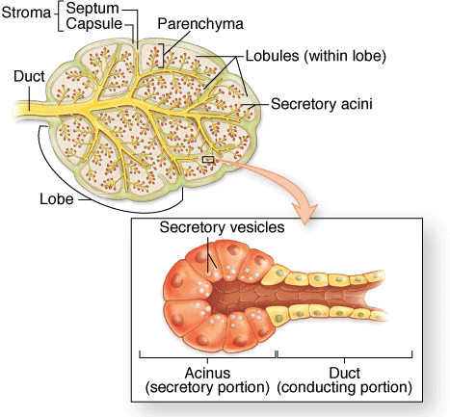
General structure of gland

Slide 7
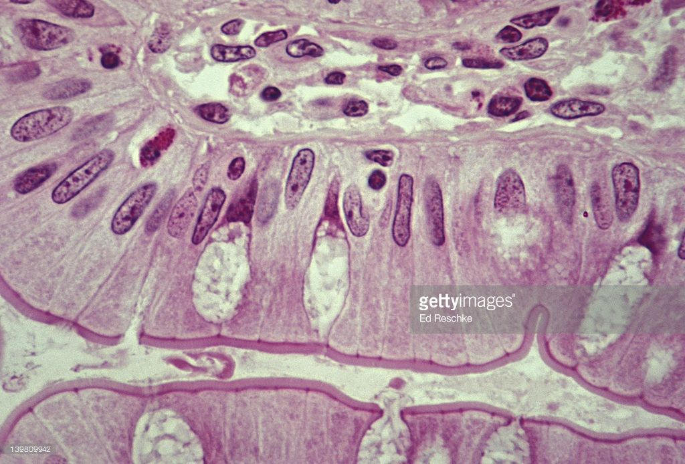
Classification
Number of cells
Unicellular
Multicellular

Slide 8
Classification
Developmental classification
Exocrine
Endocrine
Autocrine
Paracrine

Slide 9
Classification ….

Slide 10
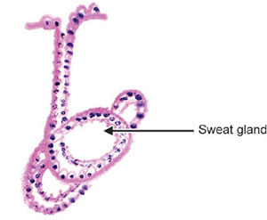
Exocrine glands
Secretory portion
Tubular
Straight
Branched
Coiled
Acinar
Single
Branched
Tubuloacinar
Duct
Simple
Compund

Slide 11
Structural Classification Of Exocrine Glands
Simple (unbranched)
Compound (branched)

Slide 12
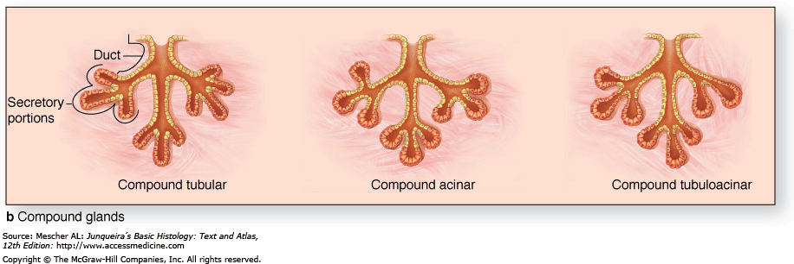
Stomach , uterus
Sweat glands
sebaceous
Small intestine
Urethra:
Bruner’s, testis, kidney
pancreas
Submandibular, lacramal,
mammary

Slide 14
Classification according to mode of secretion
Merocrine (eccrine)
Holocrine
Apocrine

Slide 15
Holocrine

Slide 16
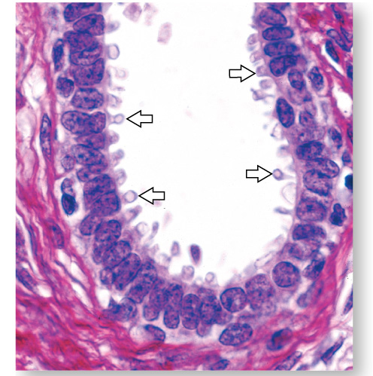
Apocrine

Slide 17
Merocrine glands can be further classified
Serous
Mucous

Slide 18
Serous and mucous

Slide 19
Serous demilune

Slide 20
Myoepithelial cell

Slide 21
Bio-Physiological Aspects
Cellular Structure and Function:
Secretory Mechanisms

Slide 22
Adenocarcinoma
Vertical Integration
A patient presented to medical OPD with weight loss and loss of appetite (anorexia) for past one month. He complaint of pain in abdomen with nausea and vomiting.

Slide 23
Spiral integration
Family medicine
Spiral Integration
Multidisciplinary approach
Recognition and Initial Assessment
Diagnostic Investigations
Laboratory Tests
Imaging Studies:
Biopsy and Histological Confirmation
Referral to Specialists
Oncology Referral
Ssurgery/multidisciplinary

Slide 24
Bioethics
Spiral Integration
Informed Consent
Beneficence and Non-maleficence
Balancing Risks and Benefits
Palliative Care
Justice and Equity
Access to Care:
Resource Allocation
End-of-Life Care
Research Ethics
Informed Consent in Research
Protection of Vulnerable Populations

Slide 25
Role Of AI
Family medicine
Spiral Integration
3D Visualization and Virtual Dissection
Customized Learning
Automated Identification and Analysis
Simulation of Physiological Processes

Slide 26
Pancreatic Ductal Adenocarcinoma: Current and Evolving Therapies
Spiral Integration
Research
Pancreatic ductal adenocarcinoma (PDAC), which constitutes 90% of pancreatic cancers, is the fourth leading cause of cancer-related deaths in the world. Due to the broad heterogeneity of genetic mutations and dense stromal environment, PDAC belongs to one of the most chemo resistant cancers. Most available treatments are palliative, aiming to relieve disease-related symptoms and prolong survival.

Slide 27
Learning Resources
Junqueira’s Basic Histology 12th Edition, Chapter 22
DiFiore's Atlas of Histology with Functional Correlations 11th Edition,
Google scholar

