Slide 2
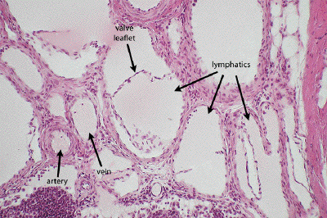
CVS Module (LGIS) Histology Of Heart And Lymphatics
Presenter:
Dr. Mohtasham Hina

Slide 3
Vision; The Dream/Tomorrow
Motto
To impart evidence based research oriented medical education
To provide best possible patient care
To inculcate the values of mutual respect and ethical practice of medicine
Wisdom
Truth
Service

Slide 4
Professor Umar Model of Integrated Lecture

Slide 5
Learning Objectives
At the end of one hour lecture 1st year students should be able to:
Describe the general histological structure of heart
Tabulate histological differences between veins and lymphatics
Correlate clinical aspects
Read a research article
Use digital library
Describe the general histological structure of lymphatics

Slide 6
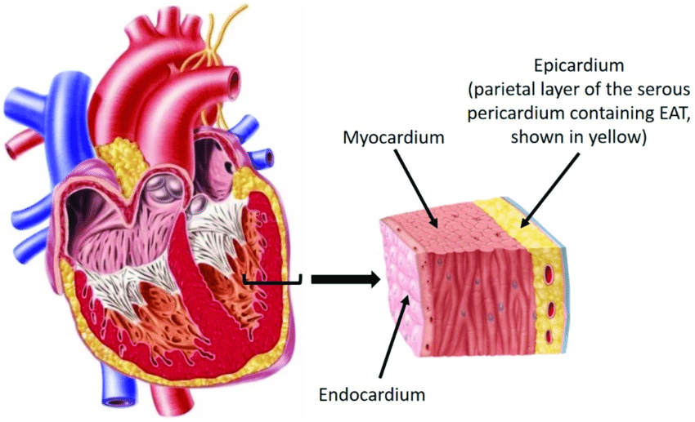
Tunics Of Heart
Core Concept
Epicardium

Slide 7
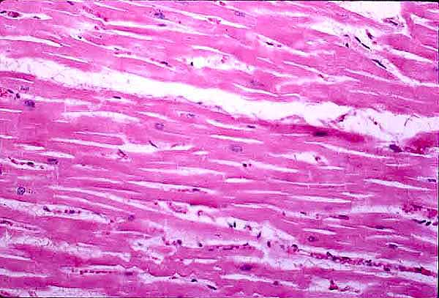
Myocardium
Core Concept
Epicardium

Slide 8
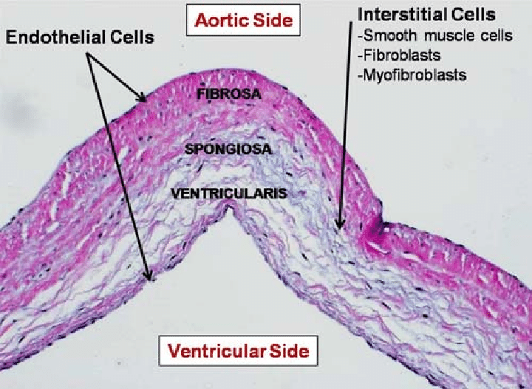
Core Concept
Epicardium

Slide 9
Purkinje Fibres
Core Concept

Slide 10
Lymphatic Capillaries
Core Concept

Slide 11
Core Concept

Slide 12
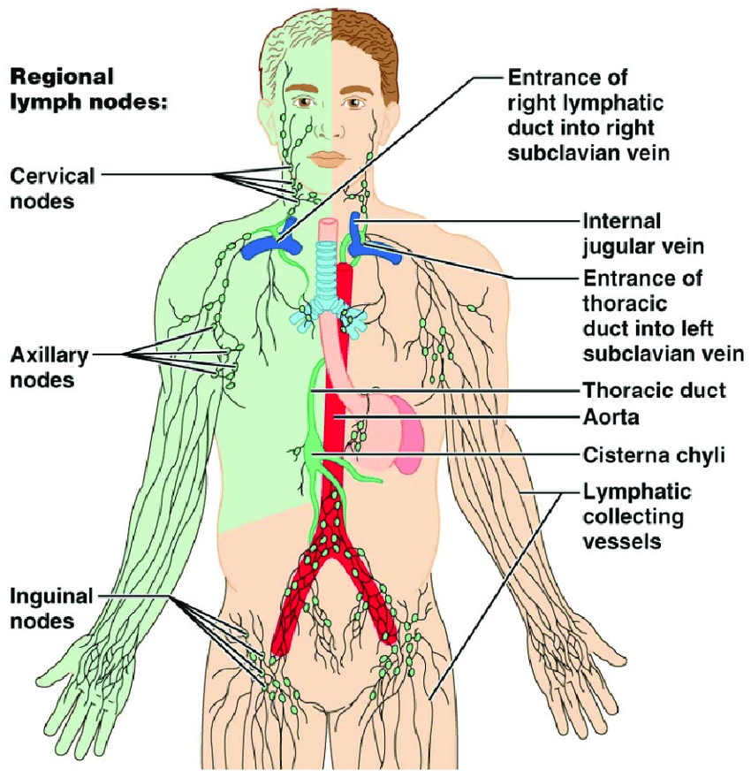
Core Concept

Slide 13
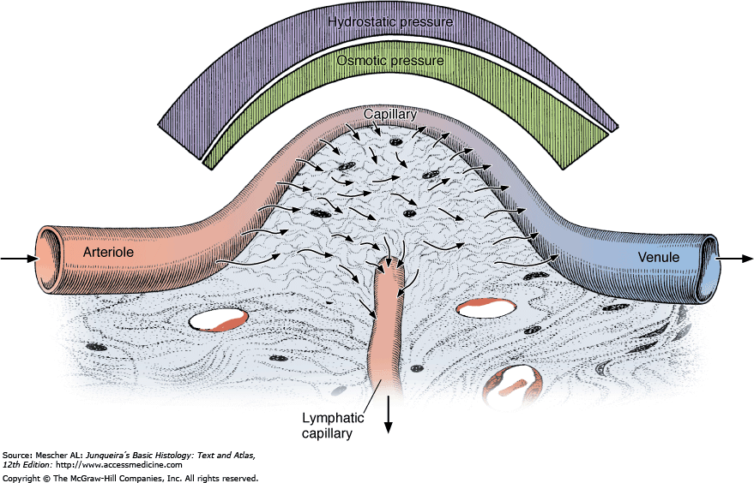
Horizontal Integration
Physiological Anatomy

Slide 14
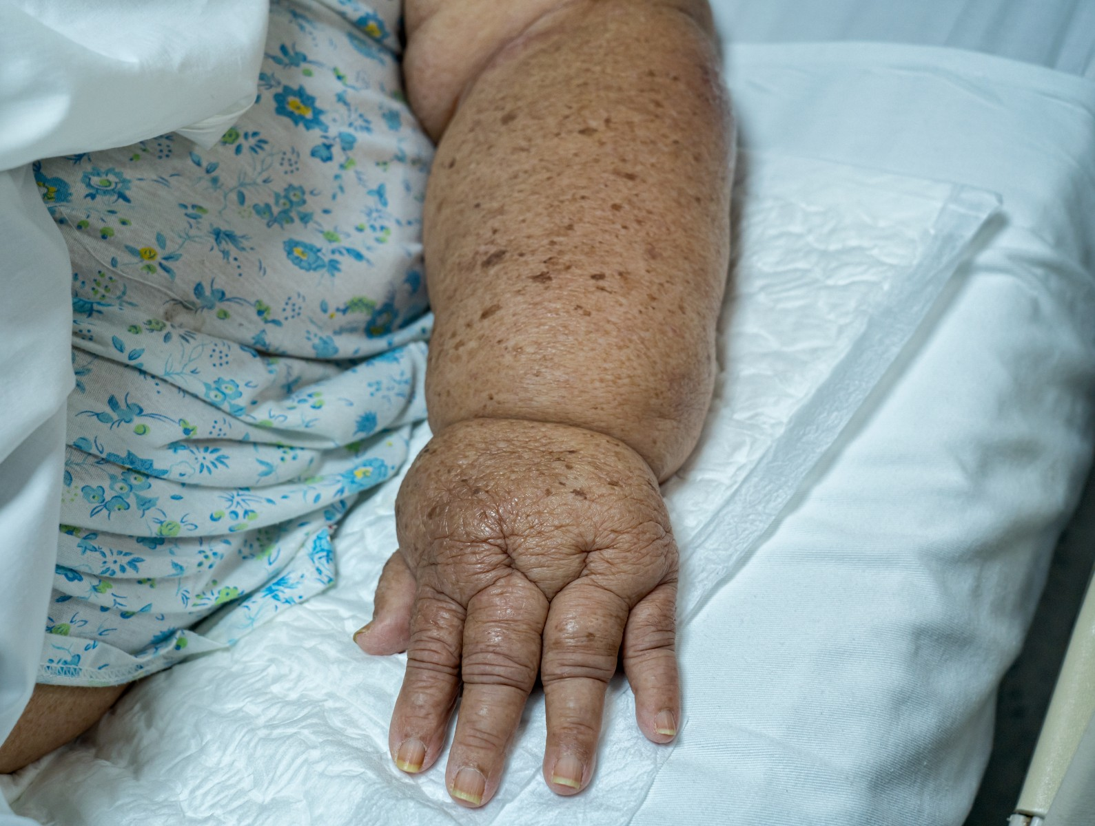
Lymphedema
Vertical Integration
Swelling when there is blockage of the lymphatic system
Treatment
Compression garments
Physical therapy
Elevation
Exercise

Slide 15
Cardiomyopathy
Vertical Integration
Cardiomyopathy causes the heart muscle to become enlarged, thick or rigid
Treatment
Lifestyle changes
Medications
Blood pressure lowering drugs
Heart rate decreasing drugs
Diuretics to remove excess fluid

Slide 16
Cardiomyopathy
Spirall Integration
Bioethics
How are you feeling right now (comfortable environment, empathy)
What have you already been told about your illness (how much pt. knows)
Discuss the condition, lab reports etc.
Answering the patient’s questions
Discussion about the plans and
treatments

Slide 17
Reference: Hall CN, Reynell C, Gesslein B, Hamilton NB, Mishra A, Sutherland BA, O’Farrell FM, Buchan AM, Lauritzen M, Attwell D. Capillary pericytes regulate cerebral blood flow in health and disease. Nature. 2014 Apr 3;508(7494):55-60.
Spiral Integration
Research
Capillary Pericytes Regulate Cerebral Blood Flow In Health And Disease
https://www.nature.com/articles/nature13165
Pericytes are major regulators of cerebral blood flow
Pericytes cause contraction of cerebral blood vessels prior the contraction of arteriolar smooth muscles in response to impulse
Cerebral Ischemia causes death of pericytes
This may irreversibly constrict capillaries and damage the blood-brain barrier.

Slide 18
Question?
.Give the role of pericyte and arteriolar smooth muscles in the regulation of cerebral blood flow.

Slide 19
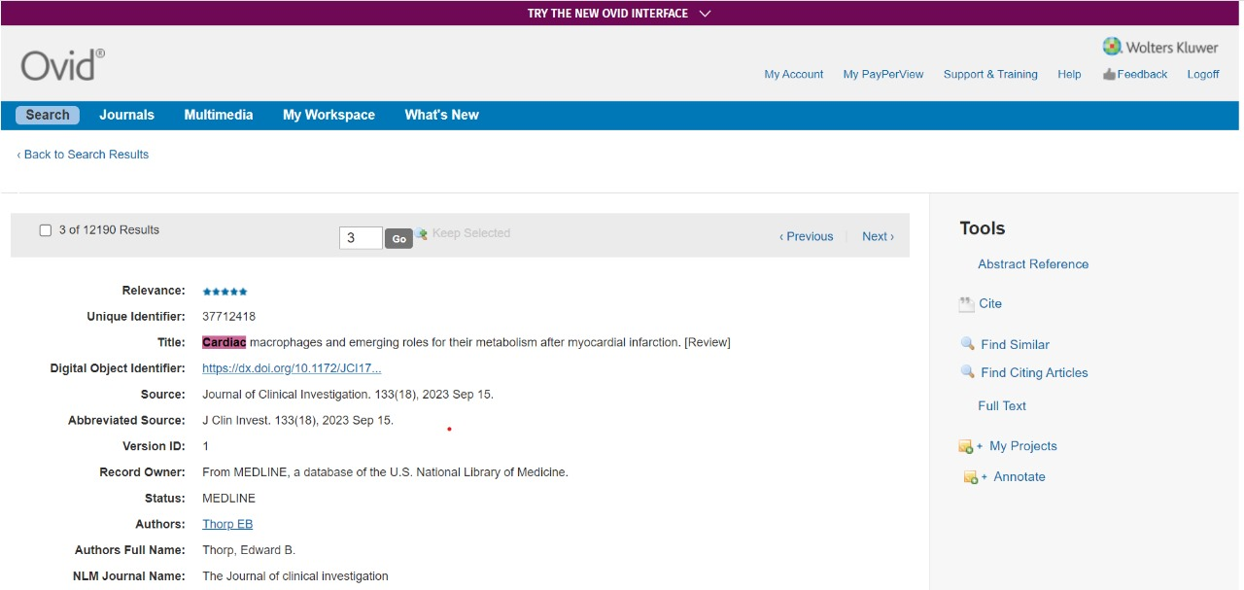
How To Access Digital Library
Go to the website of HEC National Digital Library.
On Home Page, click on the INSTITUTES.
A page will appear showing the universities from Public and Private Sector and other Institutes which have access to HEC National Digital Library HNDL.
Select your desired Institute.
5. A page will appear showing the resources of the institution
6. Journals and Researches will appear
7. You can find a Journal by clicking on JOURNALS AND DATABASE and enter a keyword to search for your desired journal.

Slide 20
Learning Resources
Junqueira’s Basic Histology 12th Edition, Chapter 11, p.no. 228-232
Histology , A text and Atlas by Michael H.Ross 6th Edition, Chapter 13, p.no.403-406
Google scholar

